Slide 1

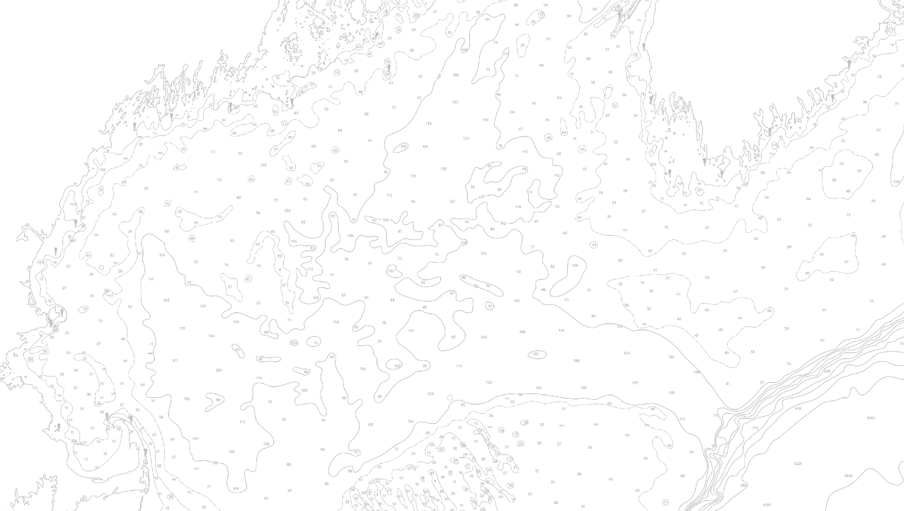

Casco Bay Ecological Monitoring Update
Fisheries Ecology Lab: Katie, Graham, Zach, Sam, Aaron

Slide 2



Patterns through space and time
Local reflects and drives global
Patterns at local scales are often similar to what would be observed at regional or global scales
Global does not necessarily reflect local
Regional or global studies are conducted at scales too large to characterize patterns at local scales

Slide 3


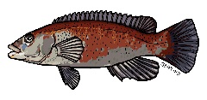


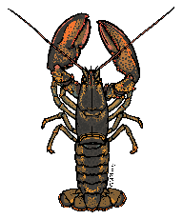
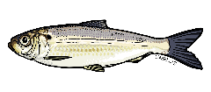

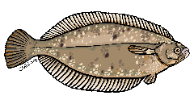
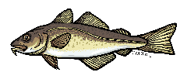


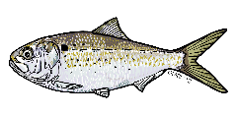
Casco Bay and nearshore environments
Nearshore environments are important for many species
Year-round residents
Spawning
Nursery area
Seasonal food availability and temperature refuge
Ecosystem-level consequences and economic consequences for changes in the utility of nearshore environments

Slide 4
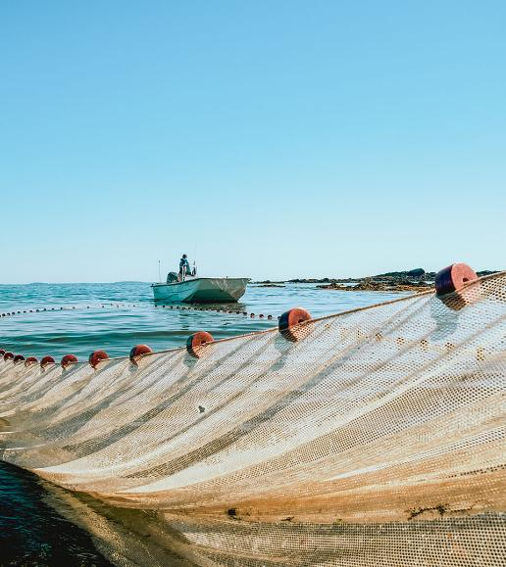
REALLY locally focused, still globally relevant
We can be the source of information on coastal Maine ecosystems with a well-designed monitoring program

Slide 5

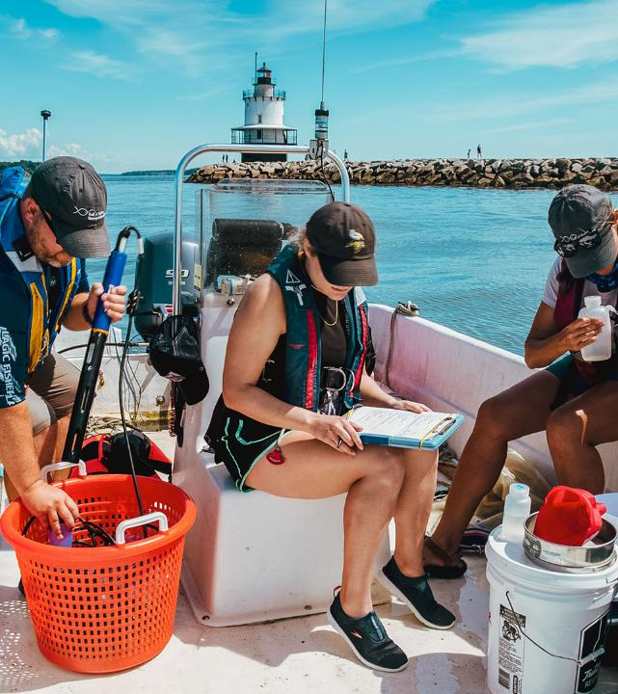

CBASS⁺
Casco Bay Aquatic Systems Survey and associated projects

Slide 6
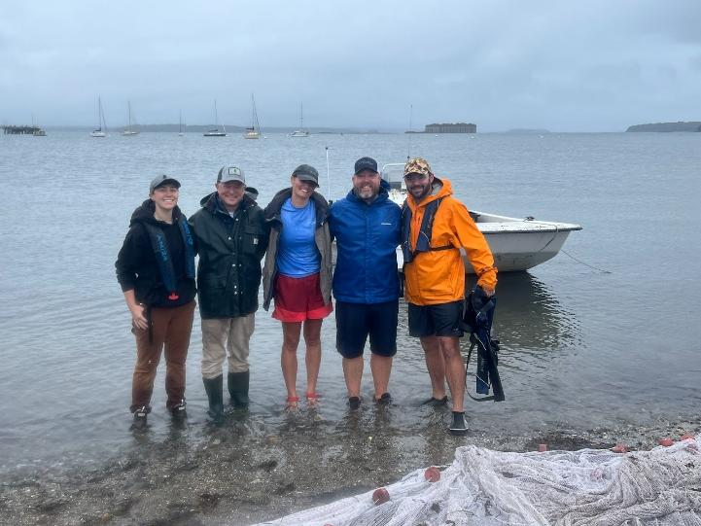


Scientists
Fisheries Ecology Lab
GMRI Staff (come join us!)
REU students
Quahog Bay Conservancy Interns

Slide 7
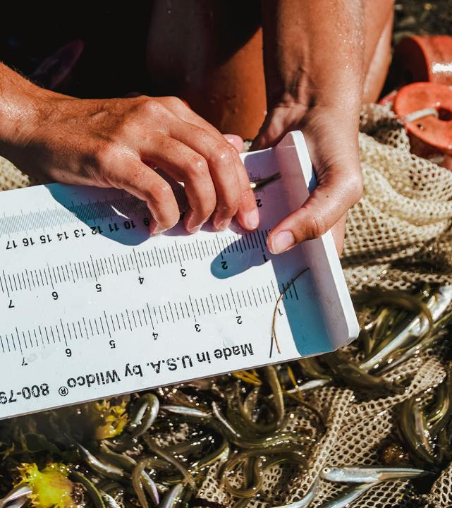
Findings

Slide 8

Mussel bed mapping / Acoustics
Mussel acoustics
Herring acoustics

Slide 9
Acoustic echosounders (Fancy depth sounders!)

Slide 10

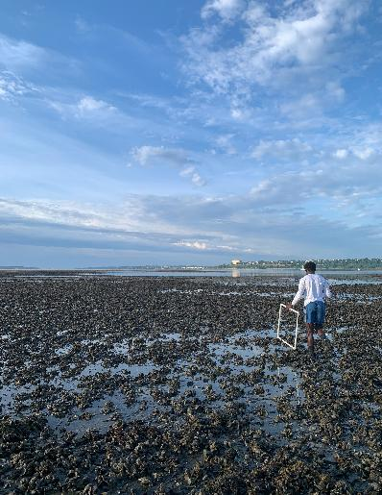
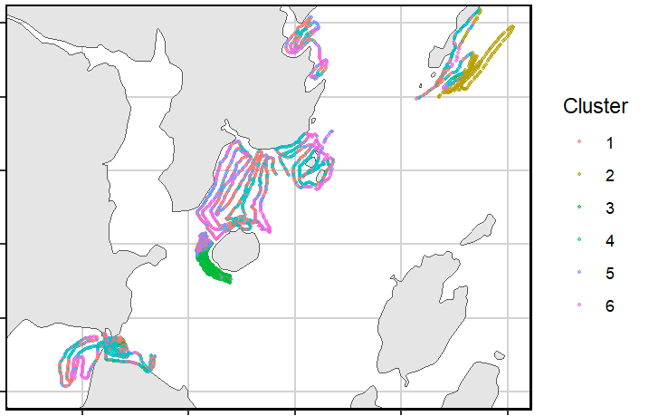

Mussel bed mapping

Slide 11
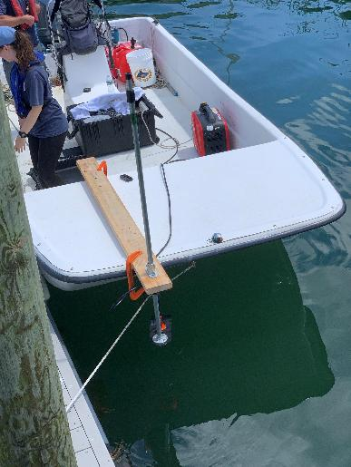
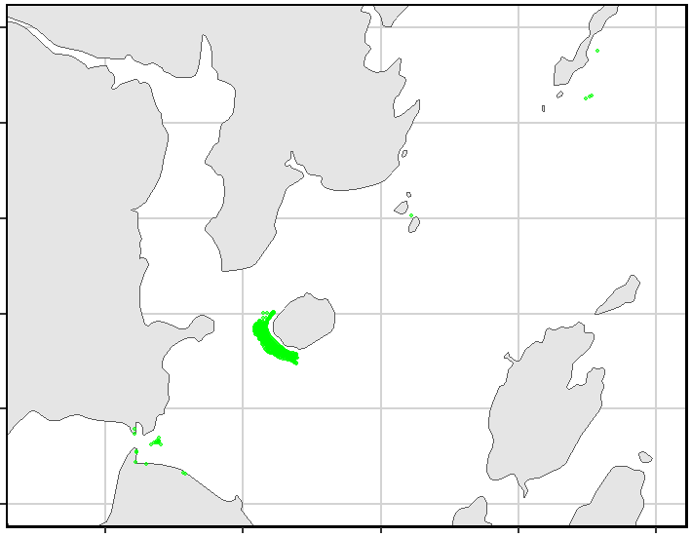
Mussel bed mapping

Slide 12
Jigging
Mussel acoustics
Herring acoustics
Jigging

Slide 13




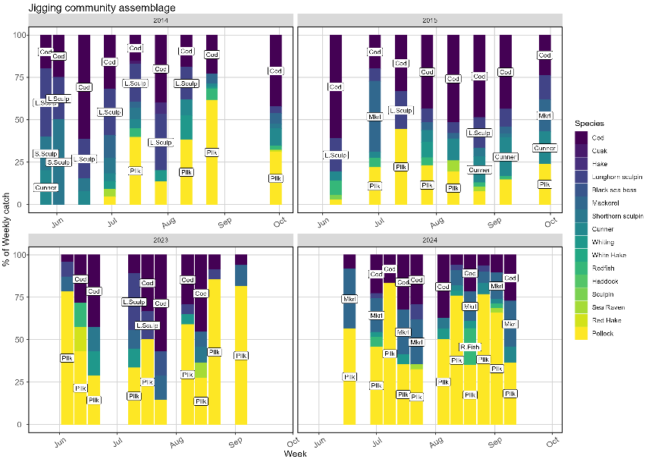
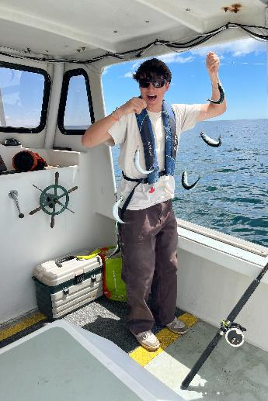

Community Ecology

Slide 14
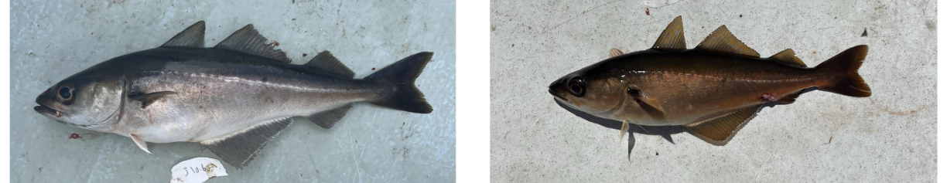
Juvenile Pollock coloration
Is different coloration an indicator of different habitat or diet preferences?

Slide 15
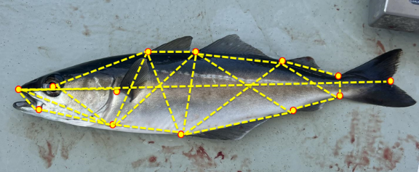
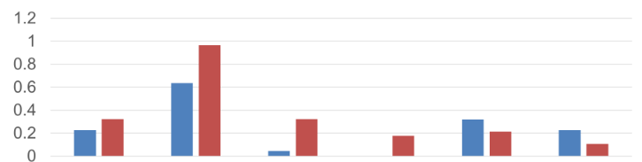

Juvenile Pollock coloration
Ecotype Diet Occurrence (%)
Algae
Crab
Inorganic (Rock / Shell)
Other Invertebrate
Fish
Amphipod
Is different coloration an indicator of different habitat or diet preferences?

Slide 16
Seining / Environmental DNA
Mussel acoustics
Herring acoustics
Jigging
Seine/ eDNA
River sampling

Slide 17



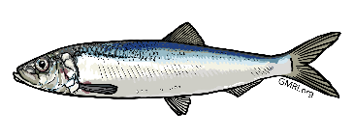
Environmental DNA

Slide 18
Environmental DNA

Slide 19
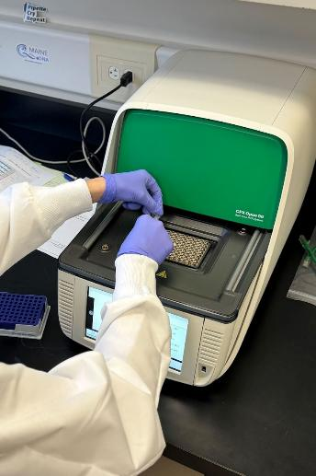
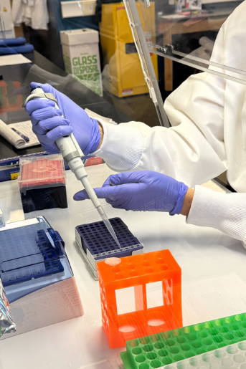
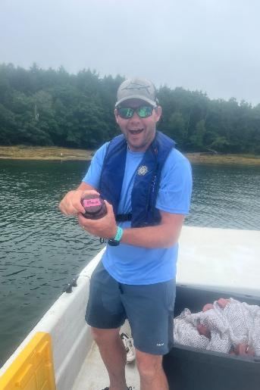
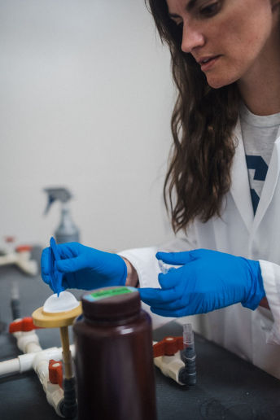
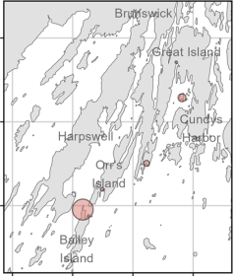
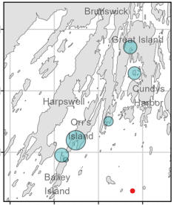
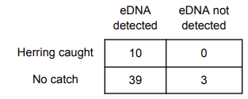

Environmental DNA
Mean 2023 seine catch
Mean 2023 eDNA concentration

Slide 20


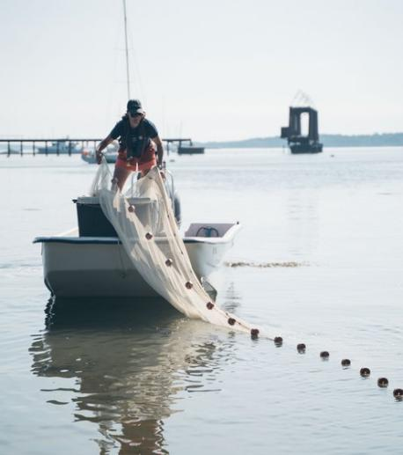
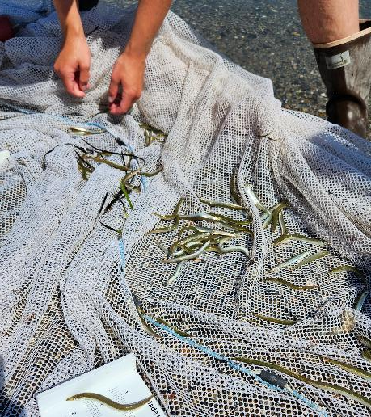
Seining

Slide 21
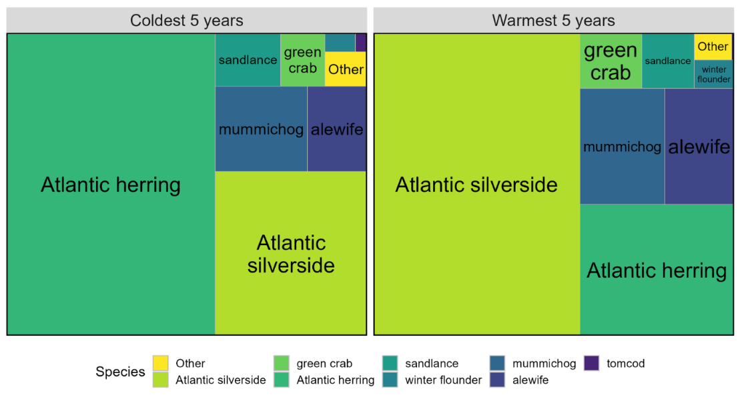





Community Ecology

Slide 22
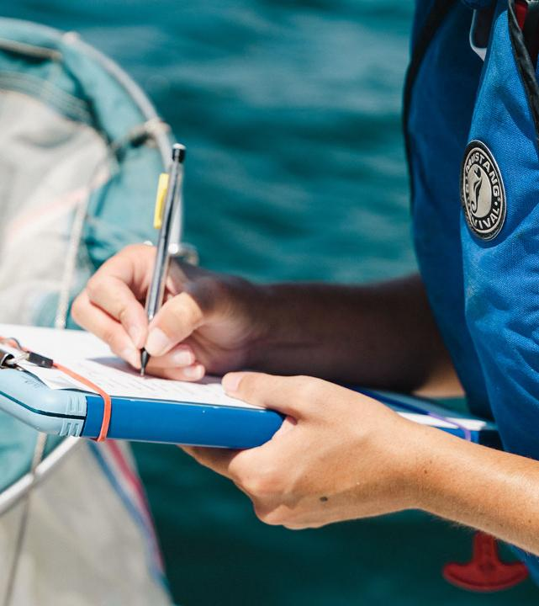
Then what?

Slide 23
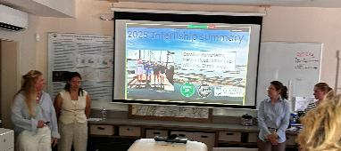

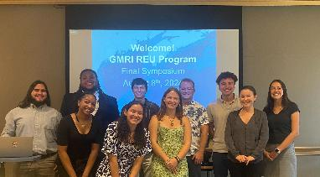




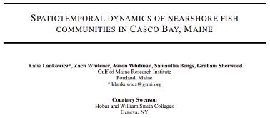

Where our work goes

Slide 24



Thanks!

