Slide 1
Ecosystem Indicator Report Analyses

Slide 2
Section: Species of note
Southern orphans – Atlantic saury*, Atlantic moonfish*, crevalle jack, permit, white mullet
* New this year, both captured late summer
White mullet presence noted earlier in summer, extended later into fall
Persistent in sheltered, vegetated coves

Slide 3
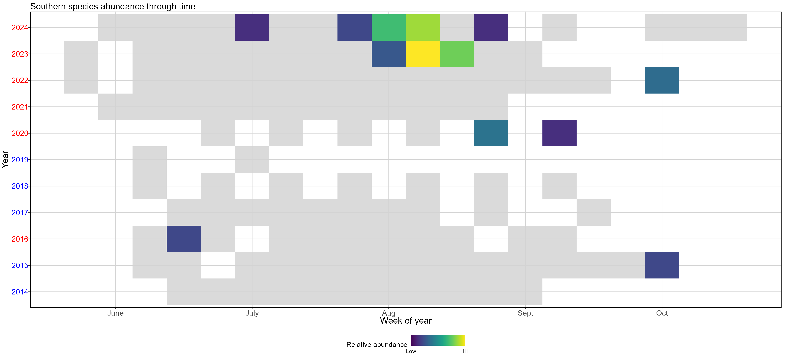
Section: Species of note

Slide 4
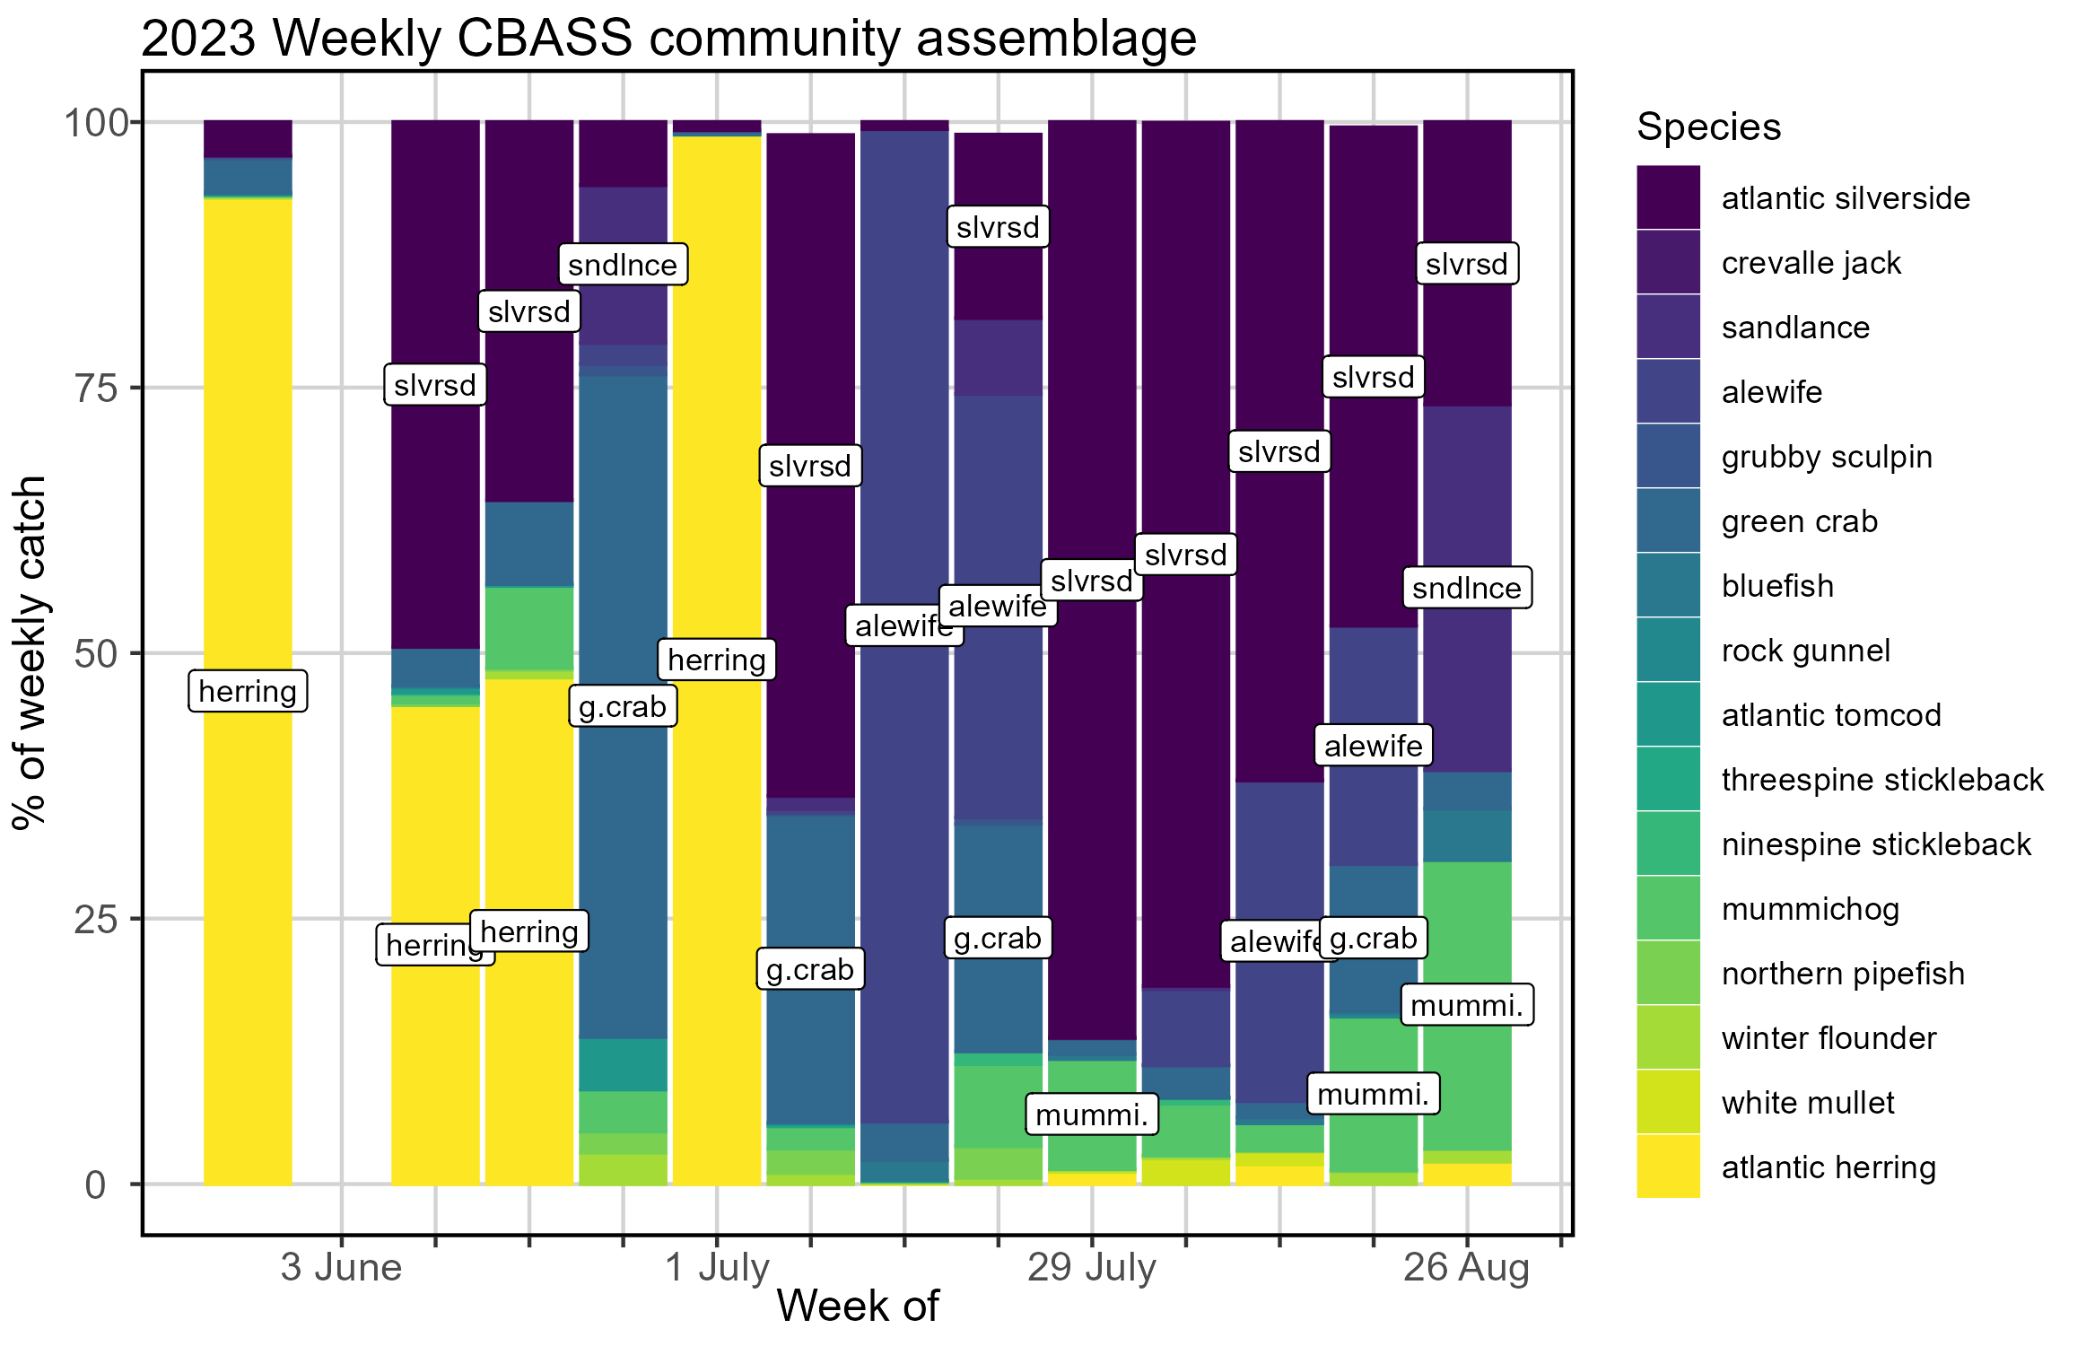
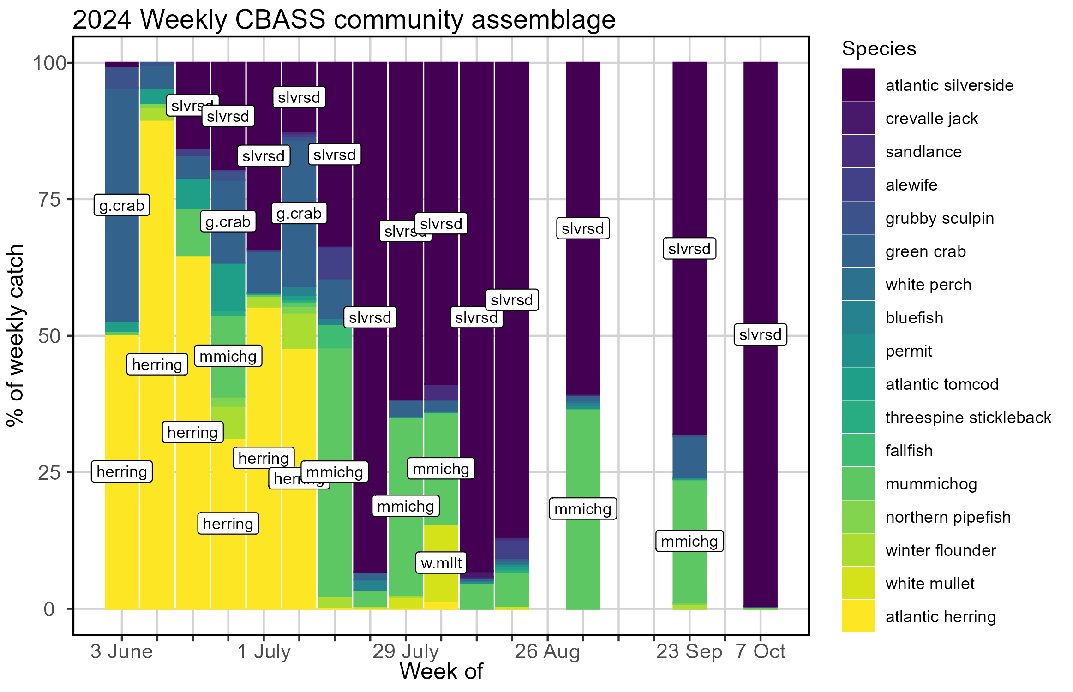
Section: Species of note

Slide 5
Section: Ecosystem Change
Evidence that we are at the beginning of a “cold wave” in the Gulf of Maine (Record et al. 2024, Oceanography)
Average annual surface temp at Portland Harbor tide gauge coldest it’s been since 2020
Anecdotal evidence from fishermen that ecosystem processes were delayed as compared to what they’ve seen in the recent past
For us: Seine results indicate later spawning times for estuarine residents

Slide 6
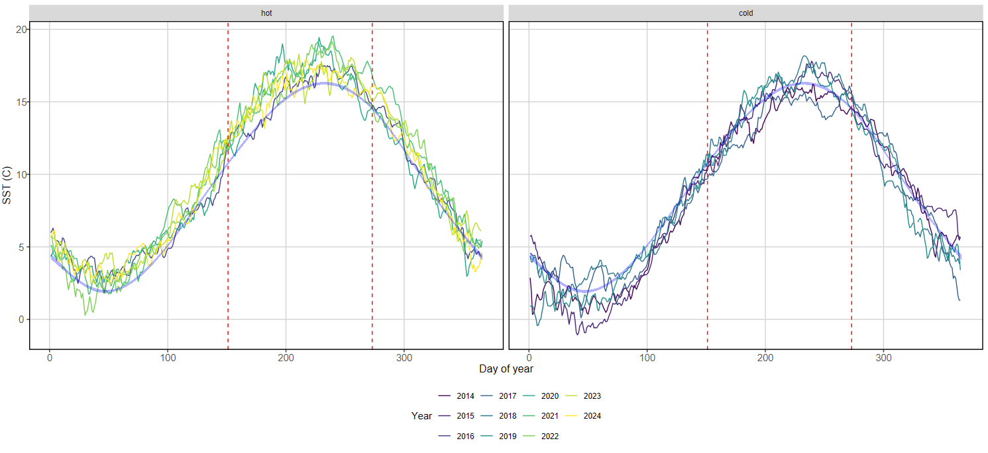
Section: Ecosystem Change

Slide 7
Section: Emergent Trends
Increased Atlantic tomcod abundance as compared to previous years, related to temperature

Slide 8
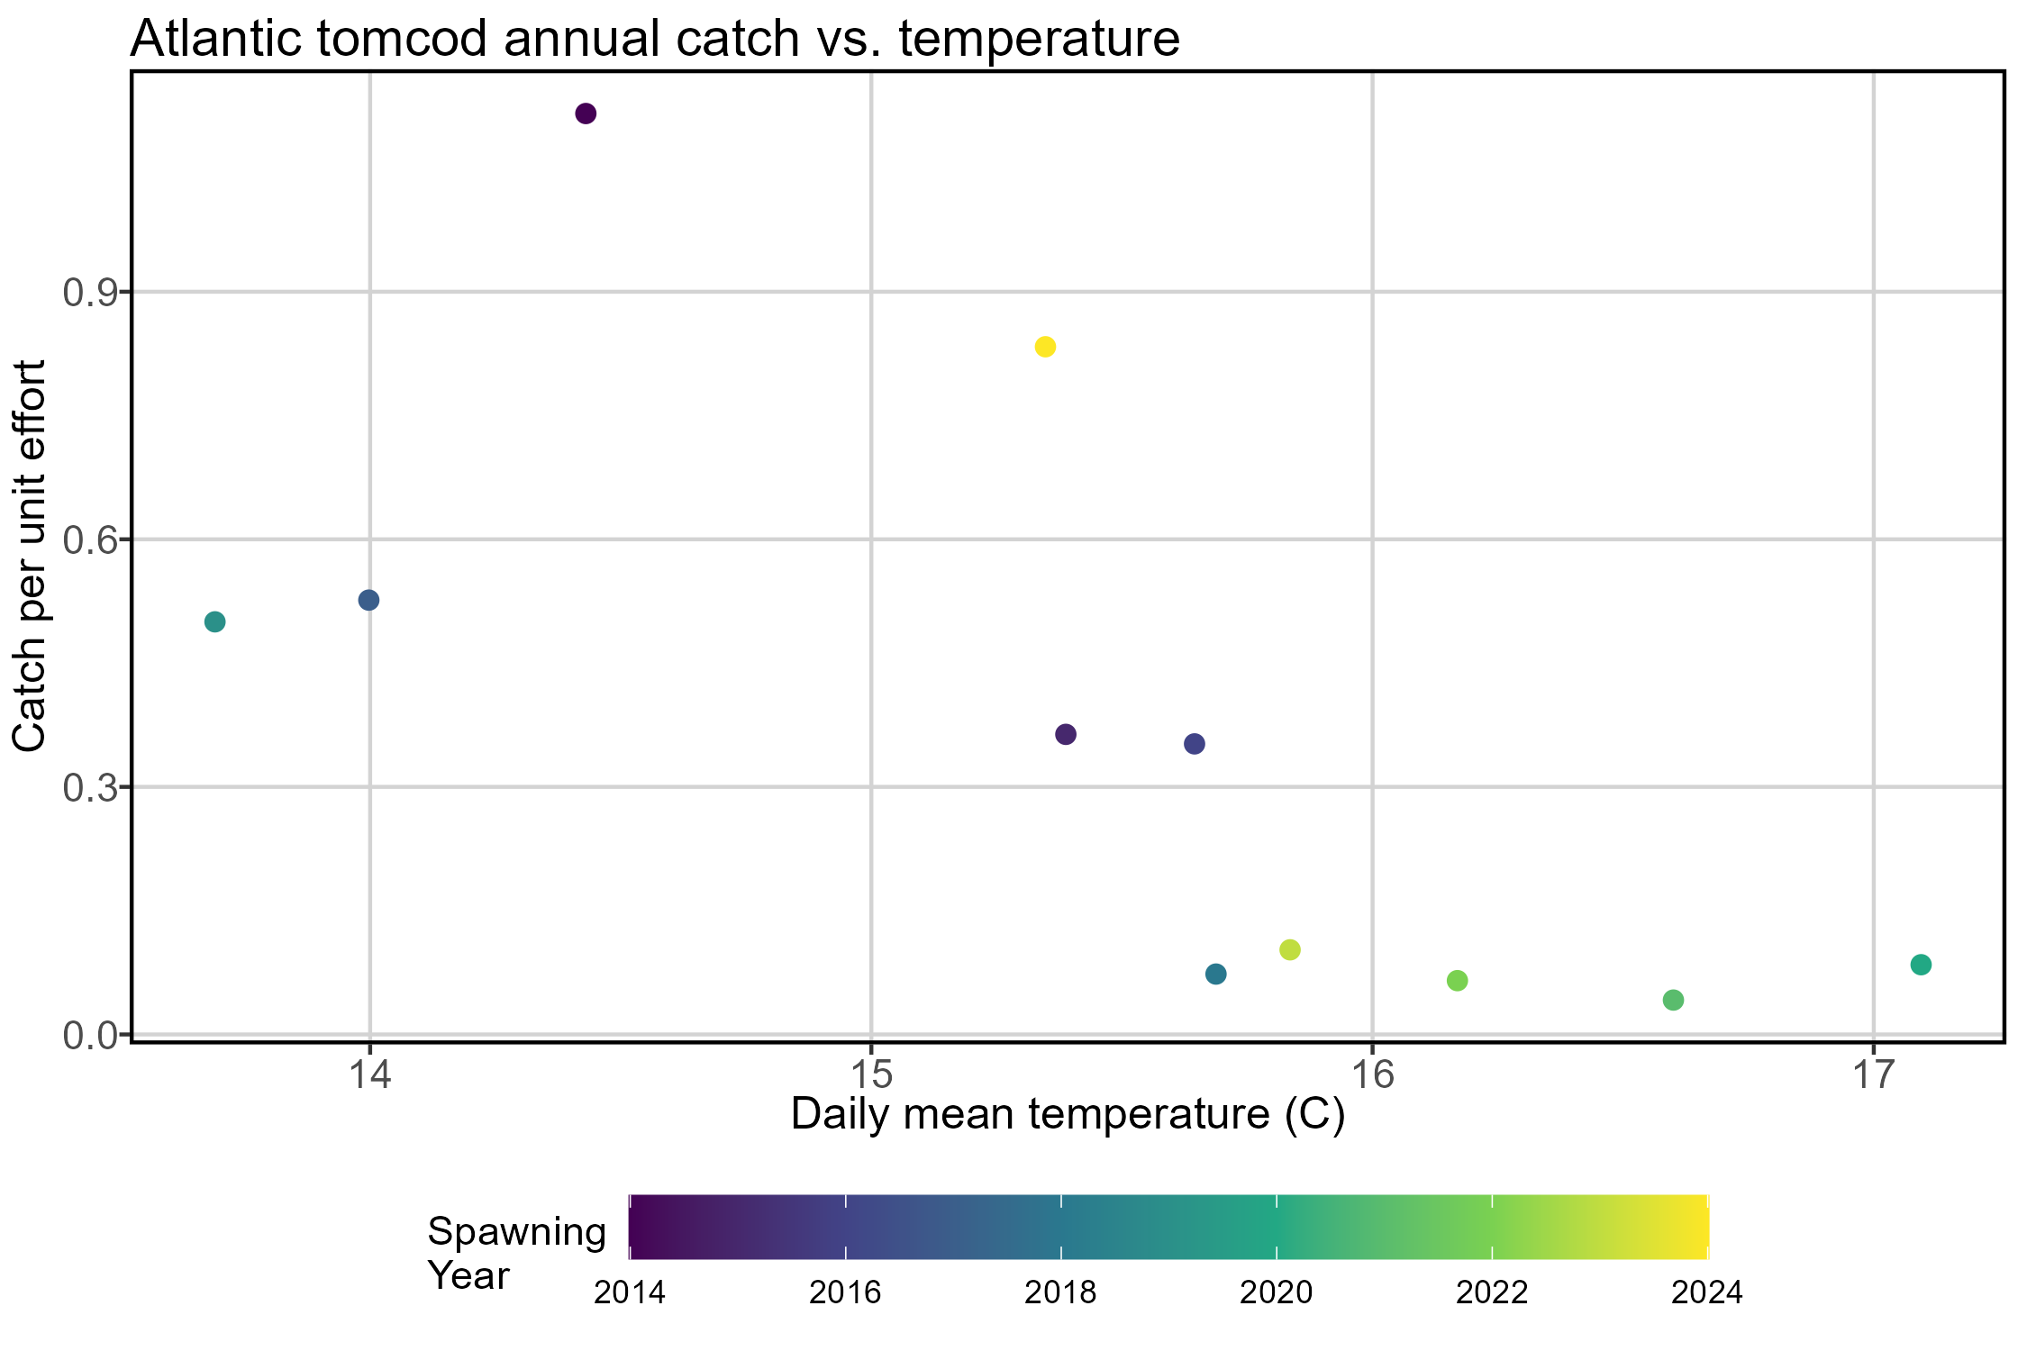
Section: Emergent Trends
Notes:
GMRI tomcod only
Used spawning year (Nov-October)
Other stuff I tried: winter/ early spring precipitation, winter/ early spring Presumpscot river height (proxy for flow), seasonal temperatures, instantaneous temperature (sonde, data missing and/or uncalibrated)

Slide 9
Section: Emergent Trends
Delayed spawning for estuarine residents (Atlantic silverside, mummichog)

Slide 10
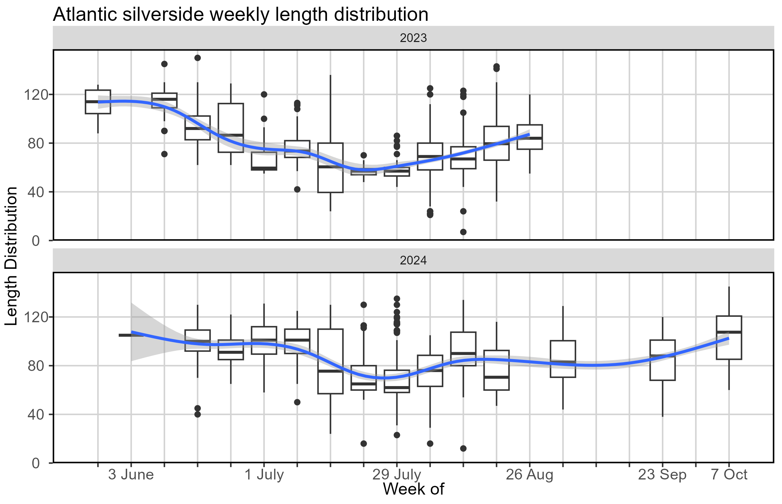
Section: Emergent Trends

Slide 11
Section: Emergent Trends
Increased Atlantic silverside growth and decreased Atlantic herring growth in warmer conditions
QBC student involvement on this project

Slide 12
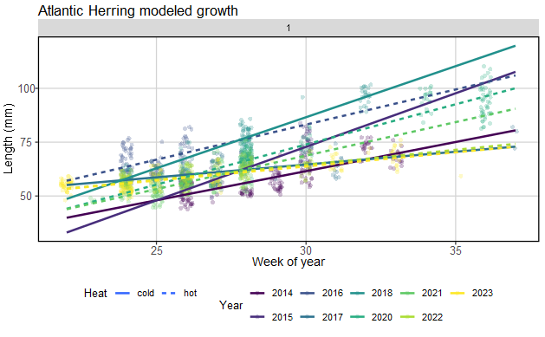
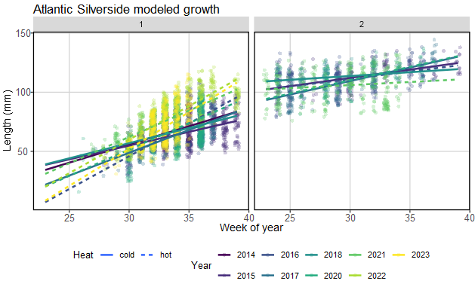
Section: Emergent Trends

Slide 13
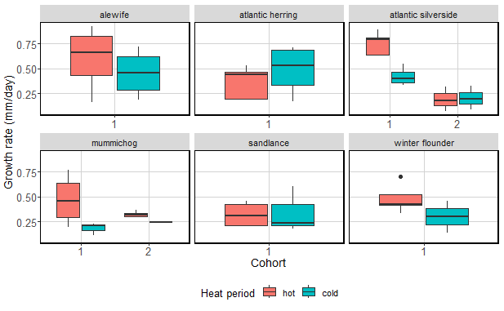
Section: Emergent Trends

