Slide 1
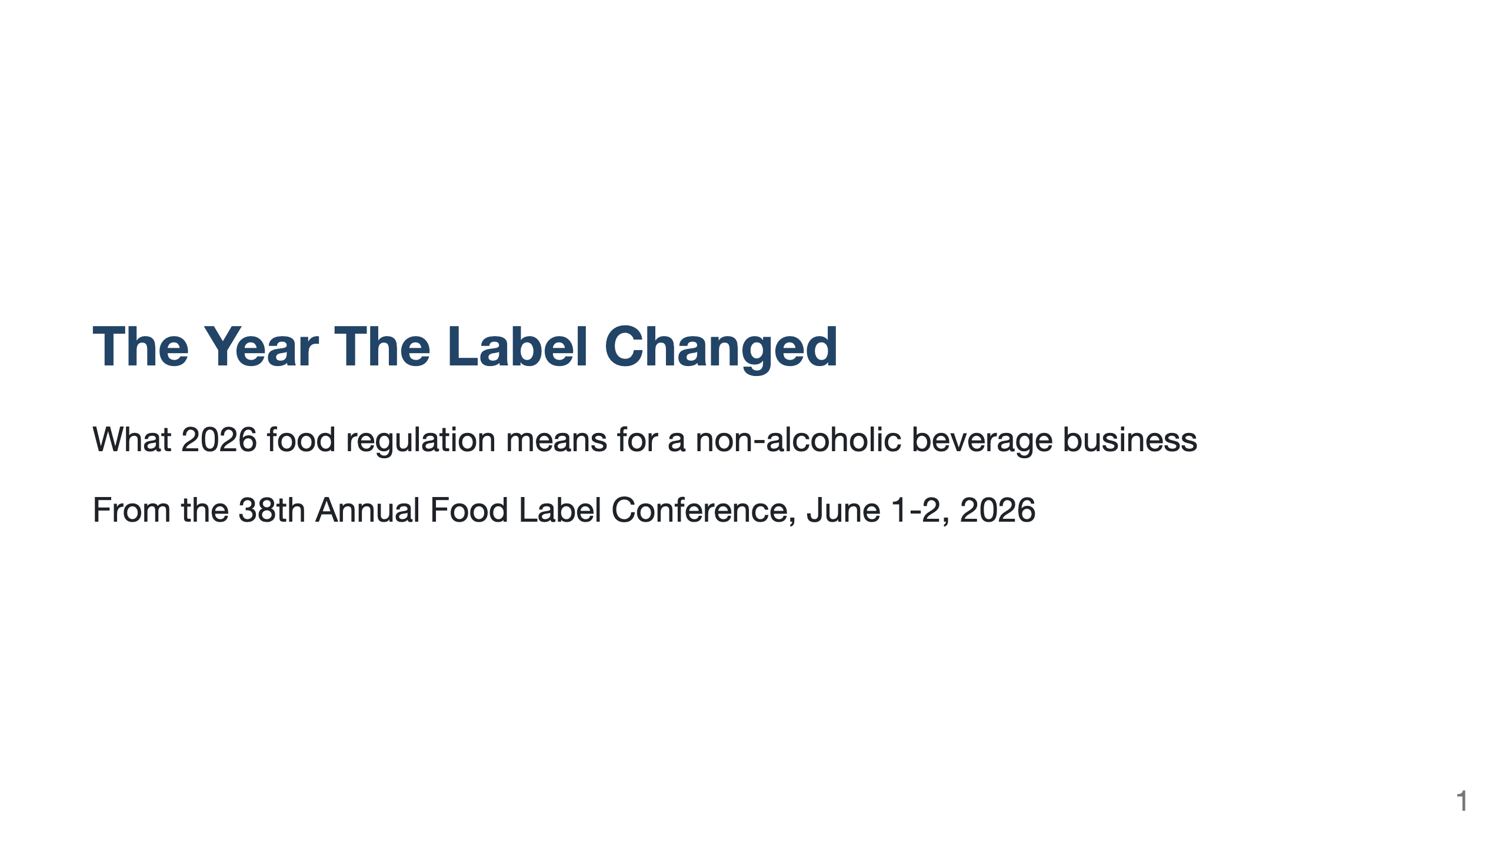
Notes:
Clean, minimal Marp deck. No custom colors, no per-slide styling, no italics.
The content is plain markdown so it copies cleanly into any theme or tool
(Google Slides, PowerPoint, Keynote). One idea per slide.
Render to PDF: npx @marp-team/marp-cli docs/reports/food-label-conference-2026-beverage-deck.md -o food-label-conference-2026-beverage-deck.pdf
Render to PPTX: npx @marp-team/marp-cli docs/reports/food-label-conference-2026-beverage-deck.md -o food-label-conference-2026-beverage-deck.pptx
Run the two commands separately; combining --pdf and --pptx is rejected.
Audience: non-regulatory beverage team. Source: 38th Annual Food Label
Conference, June 1-2, 2026. Full briefing:
docs/reports/food-label-conference-2026-beverage-briefing.md

Slide 2
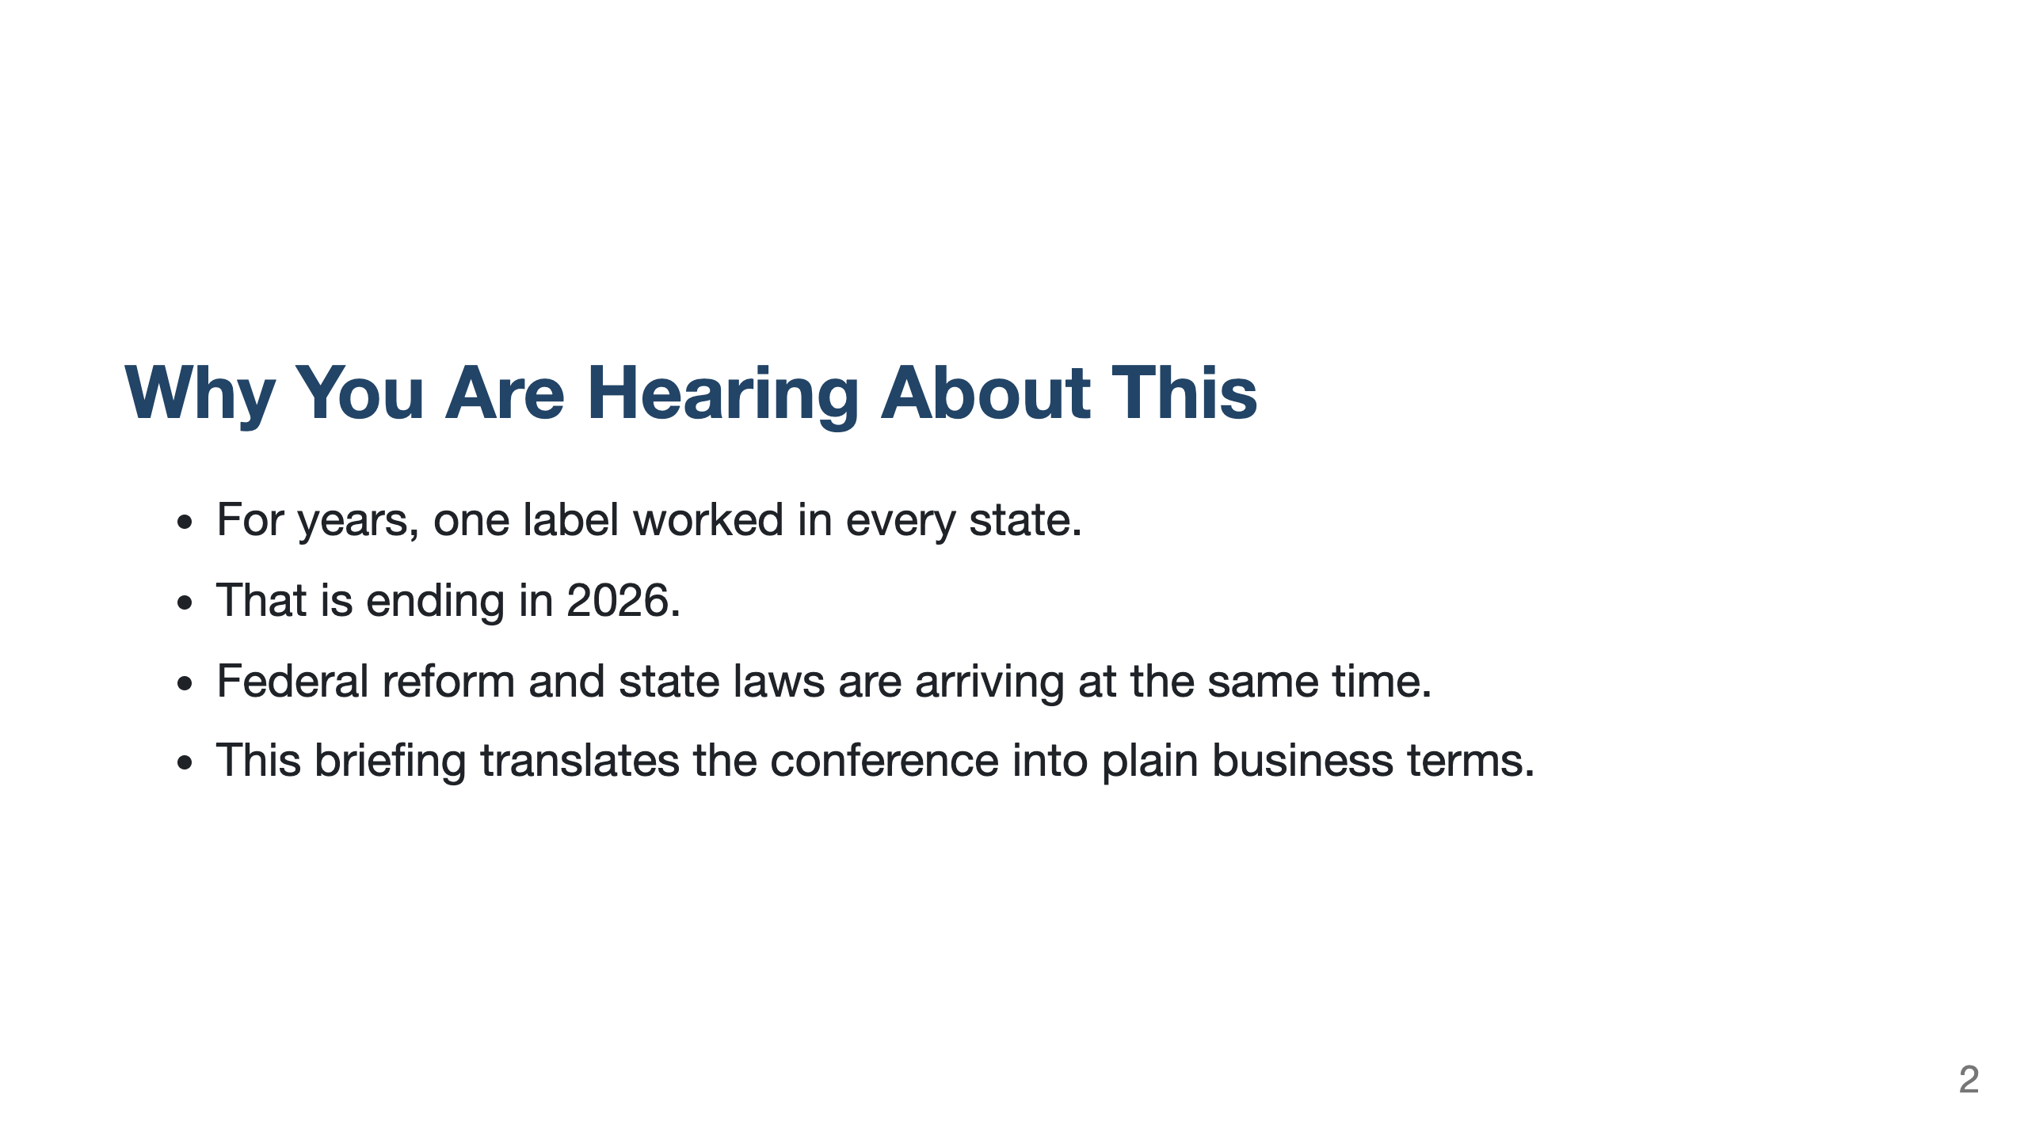

Slide 3
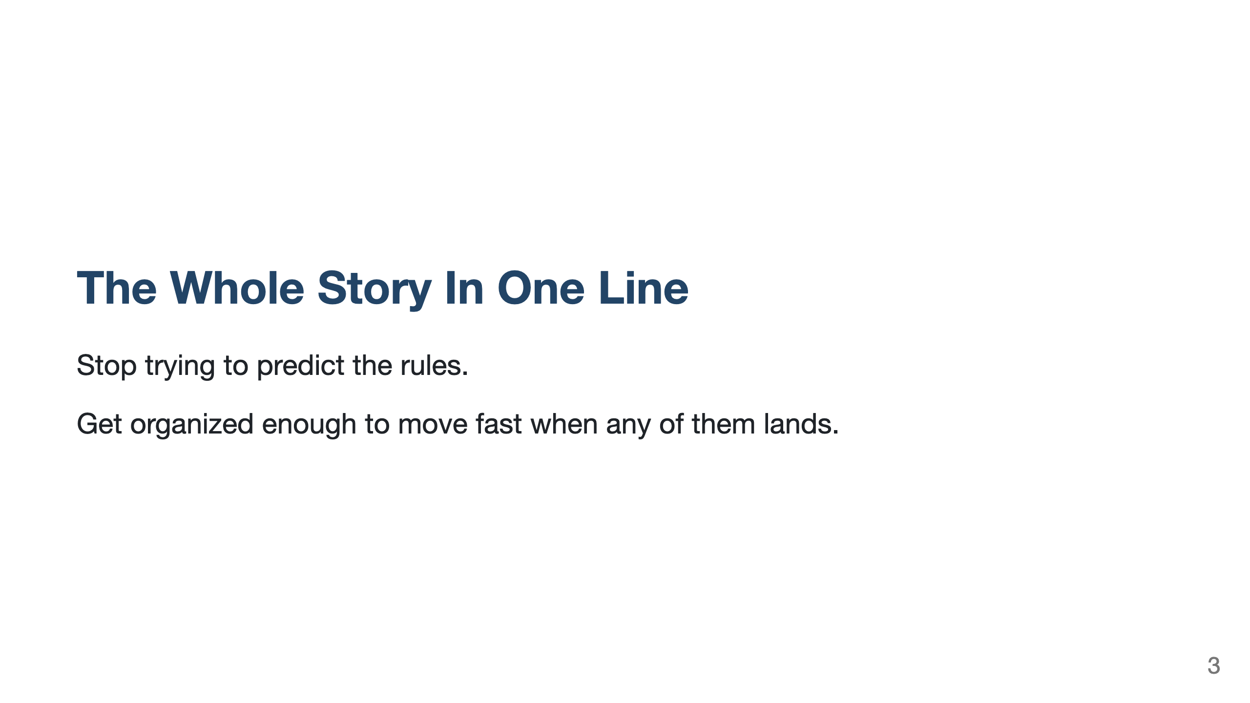

Slide 4
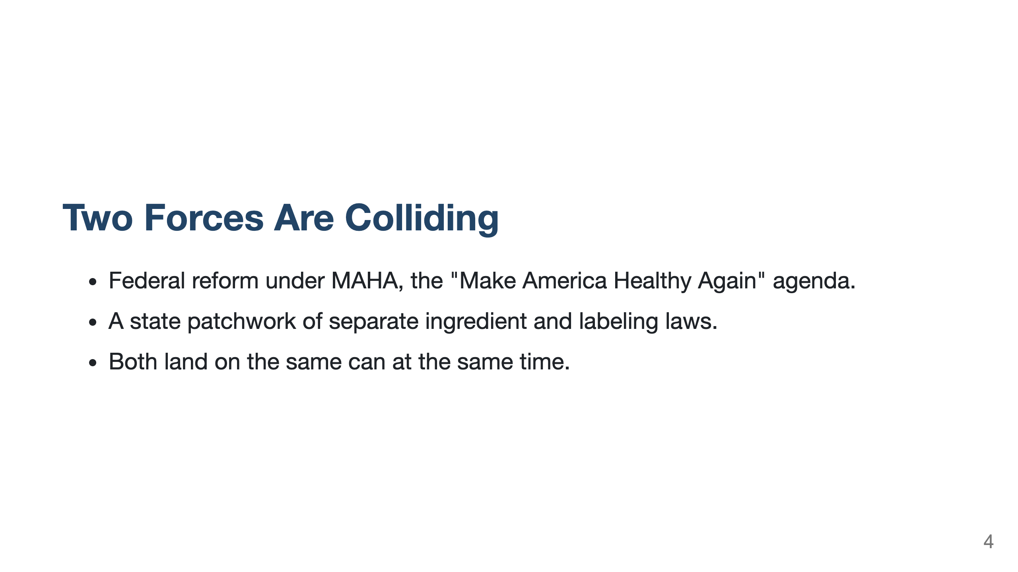

Slide 5
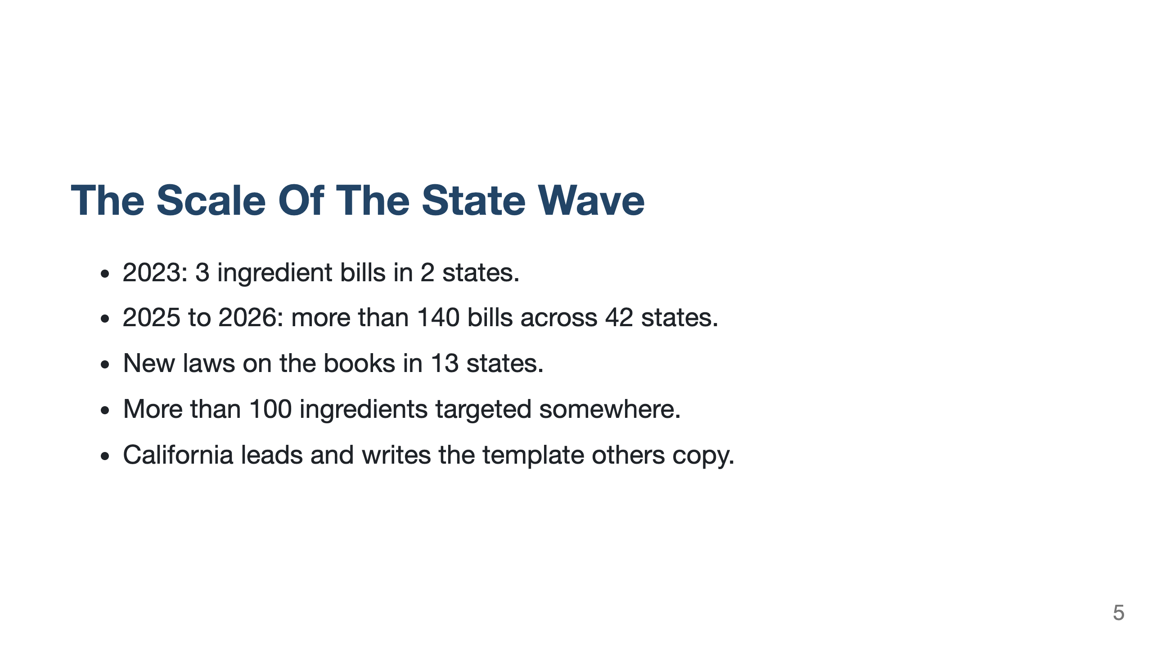

Slide 6
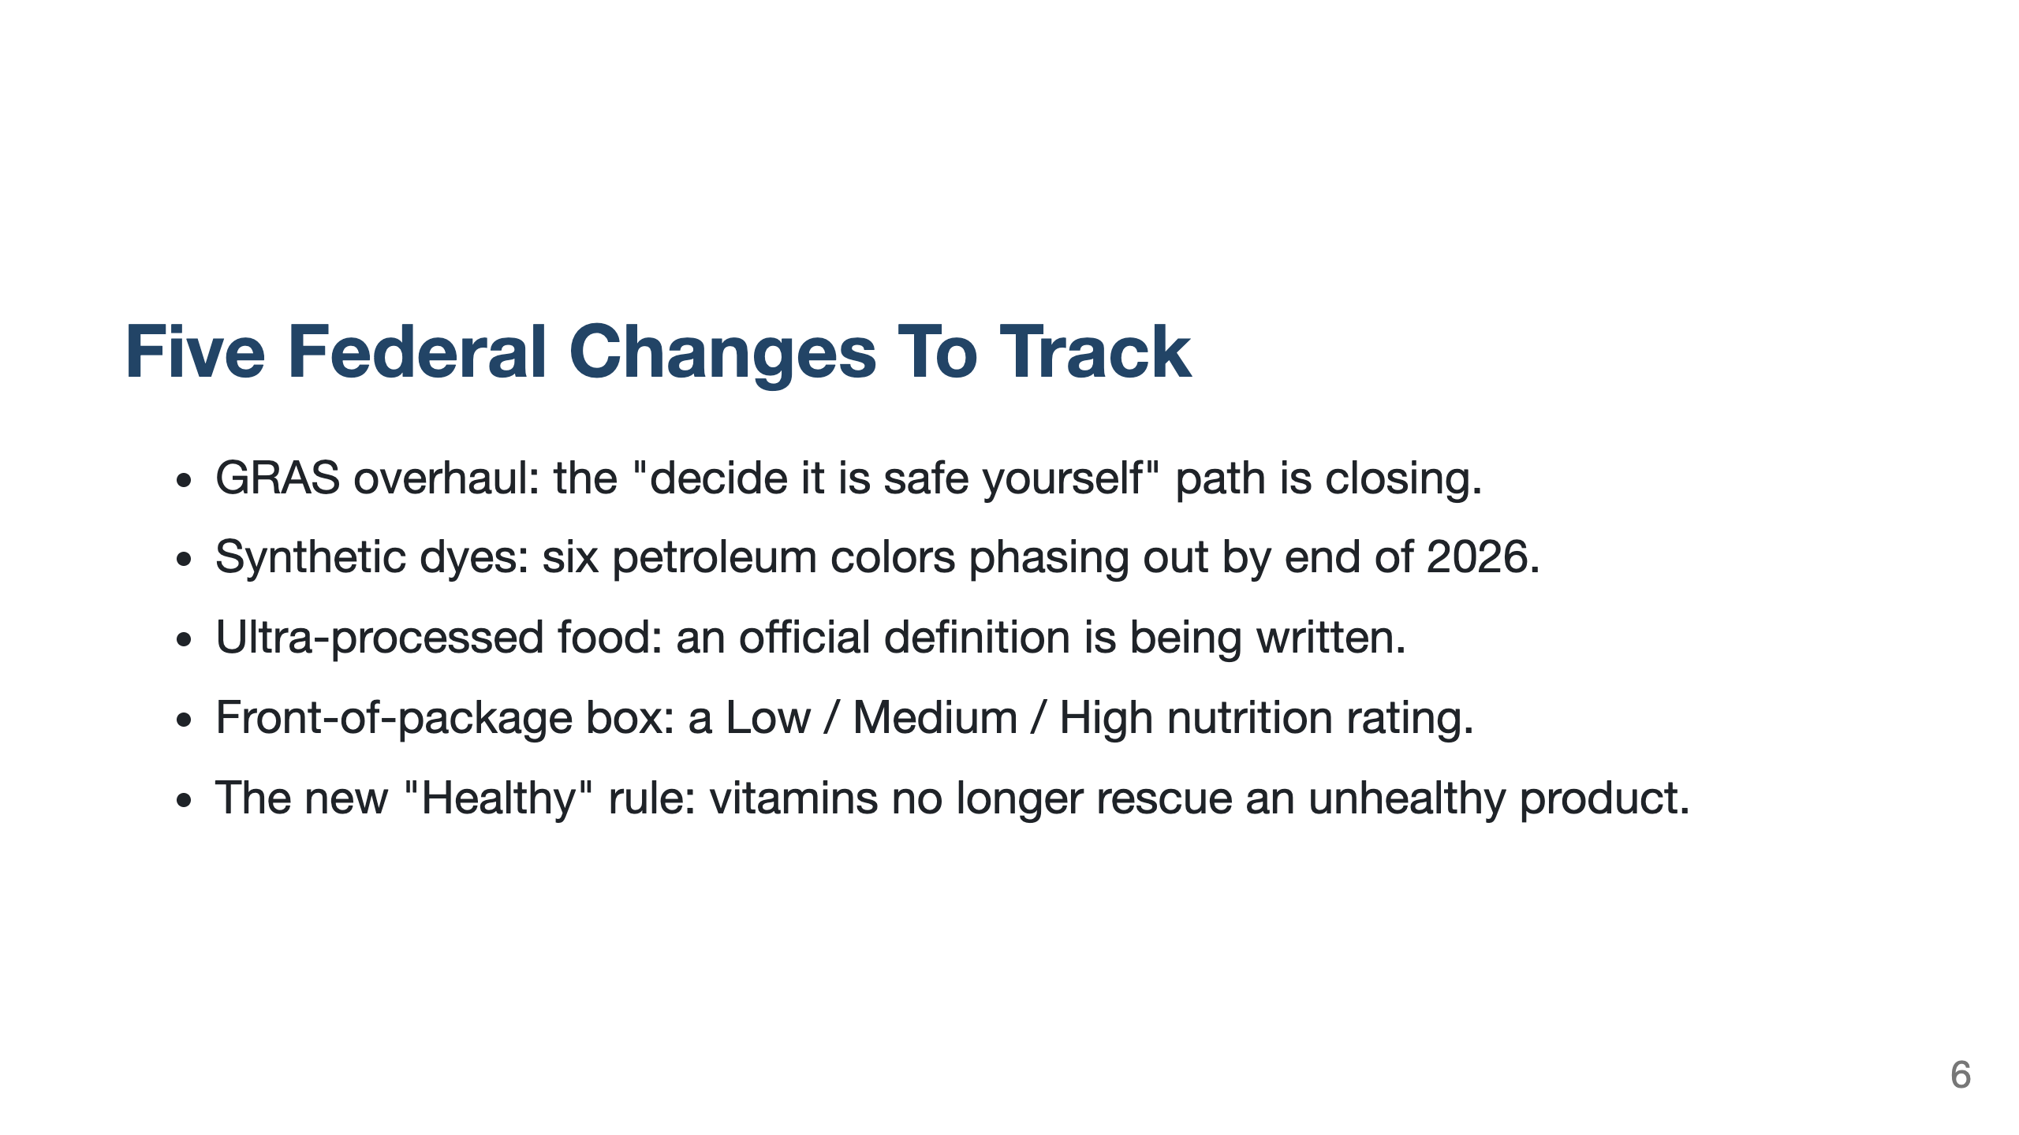

Slide 7
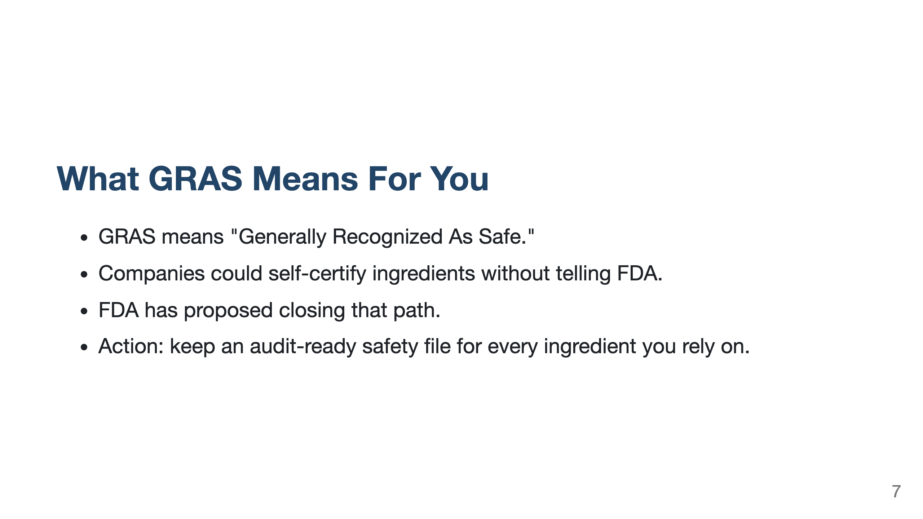

Slide 8
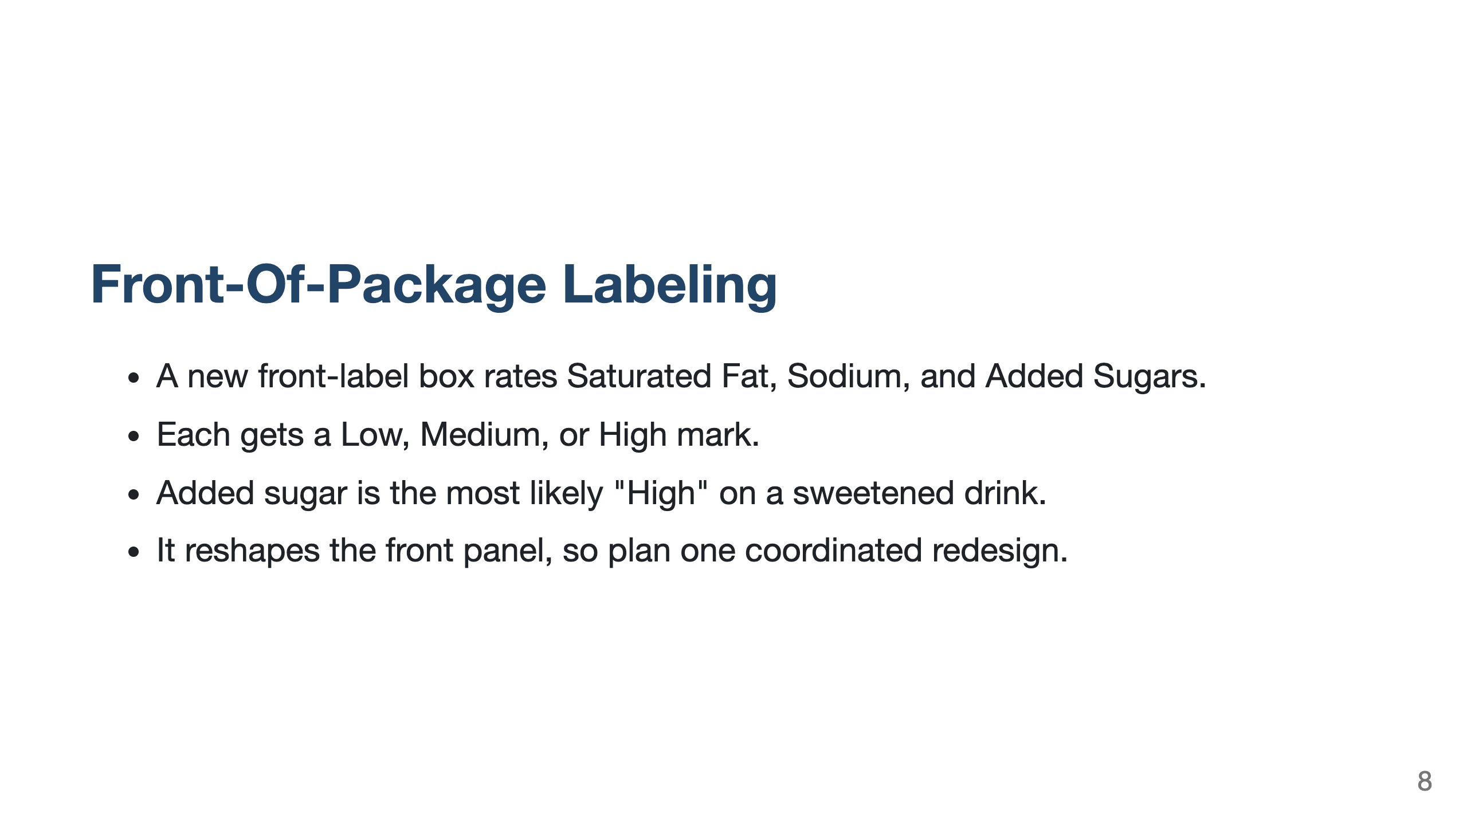

Slide 9
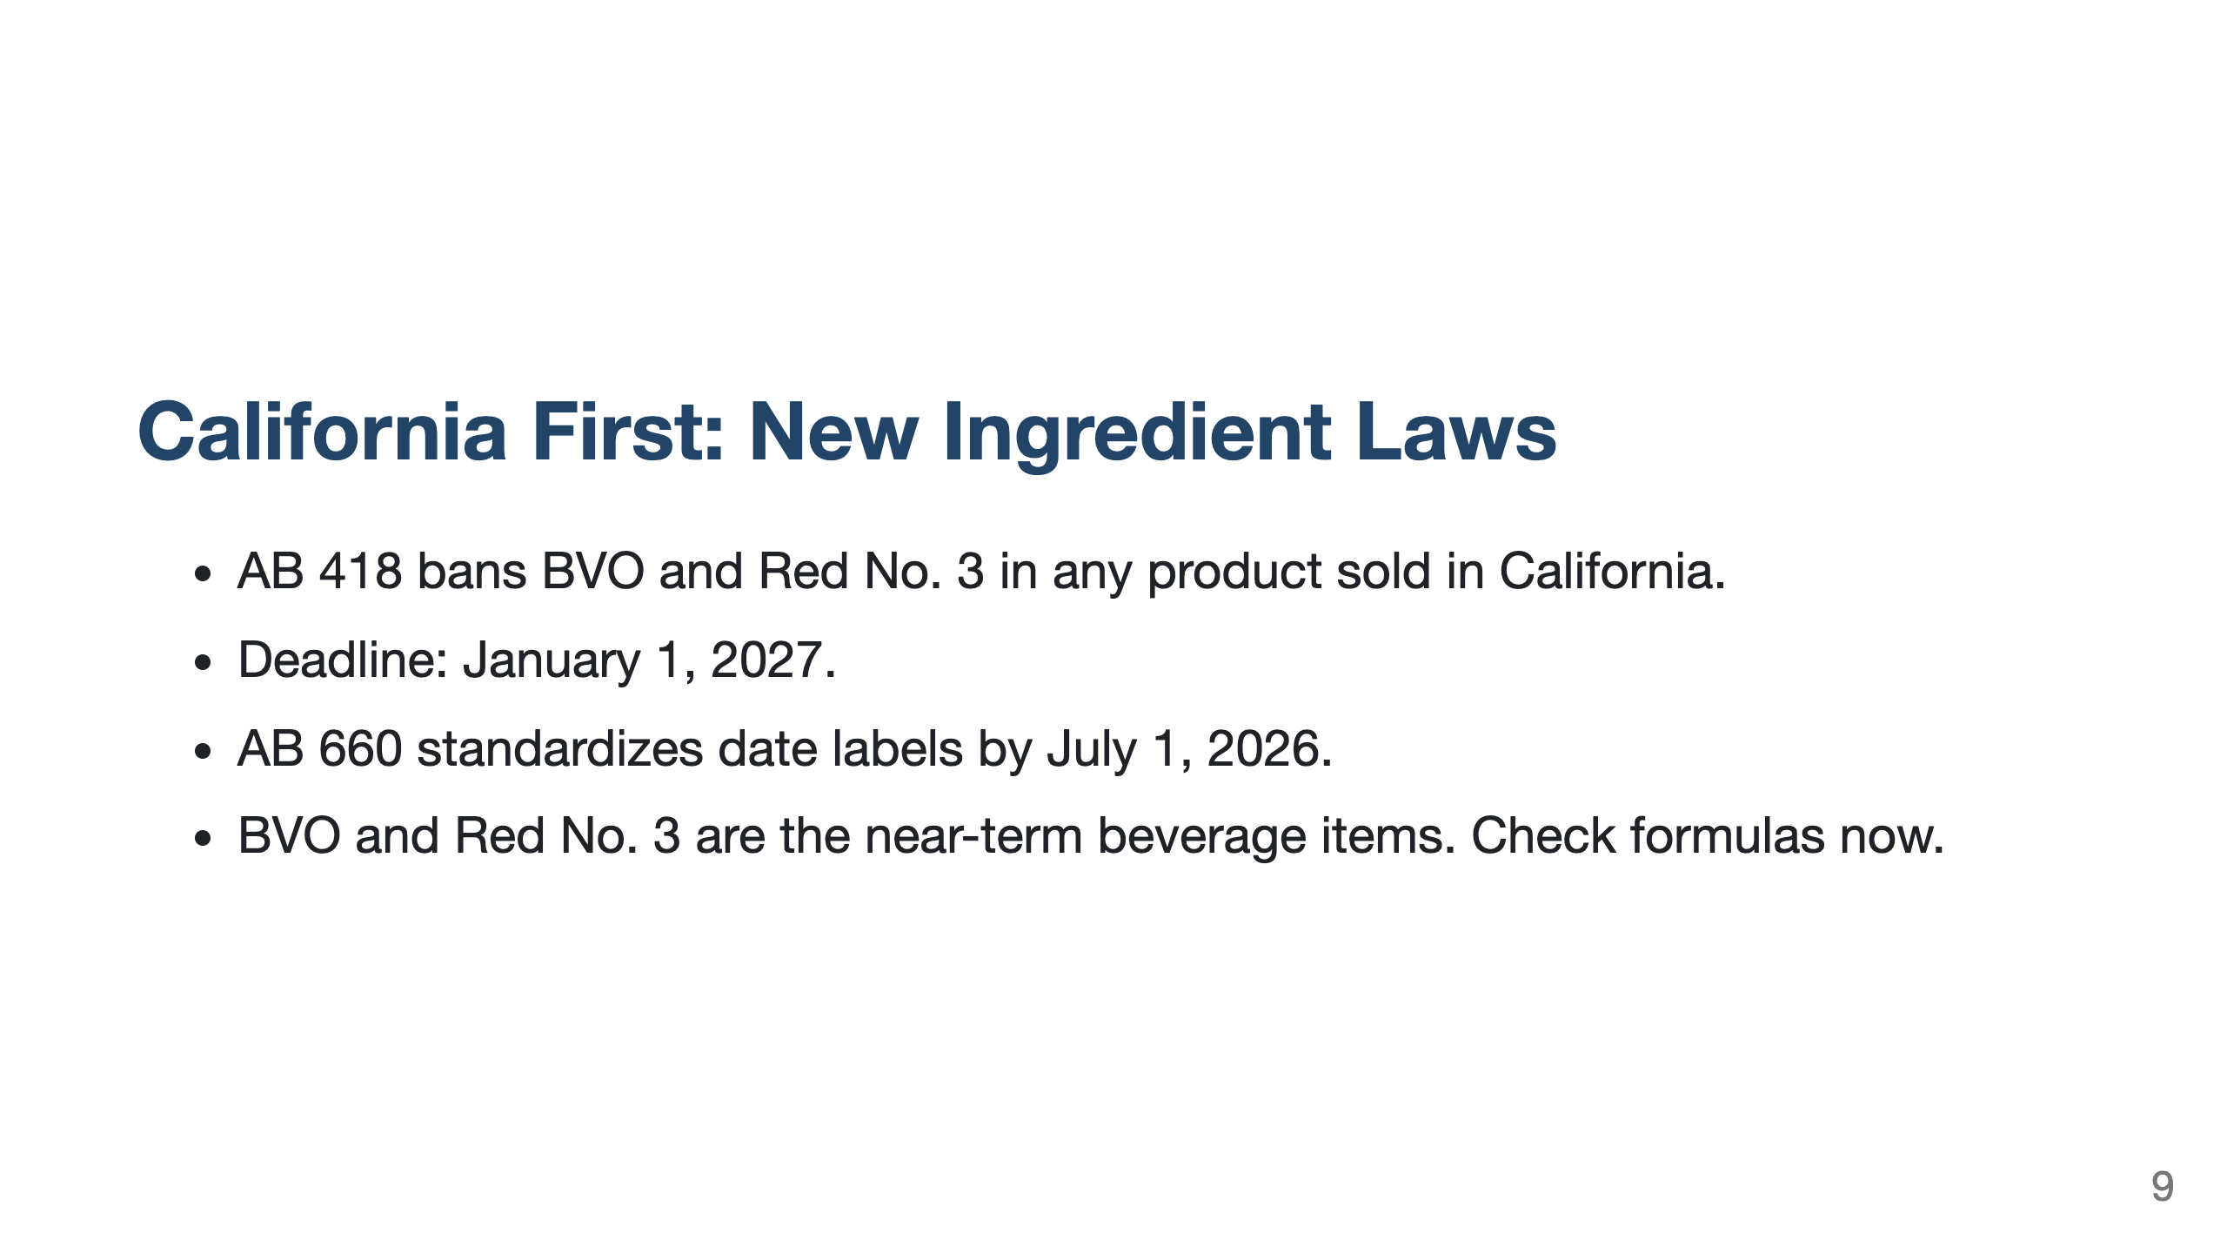

Slide 10
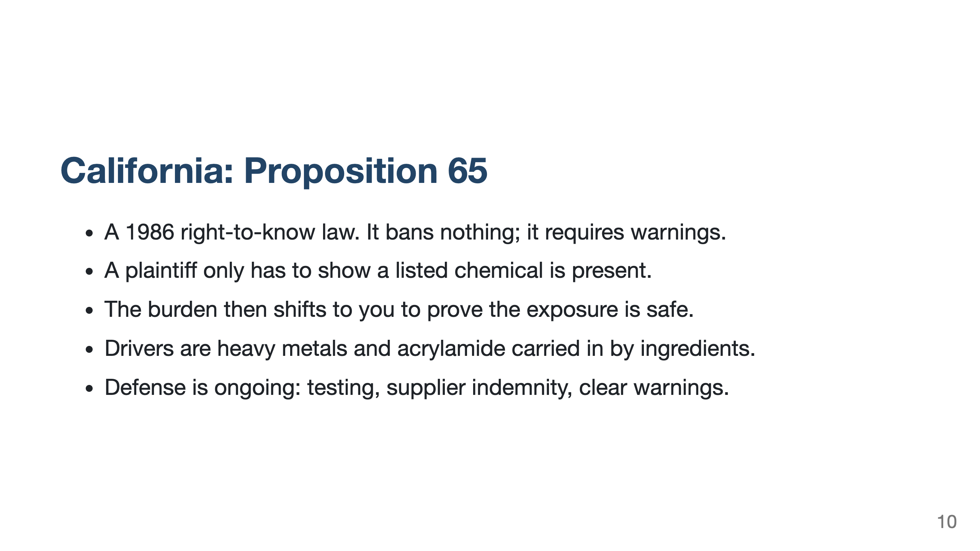

Slide 11
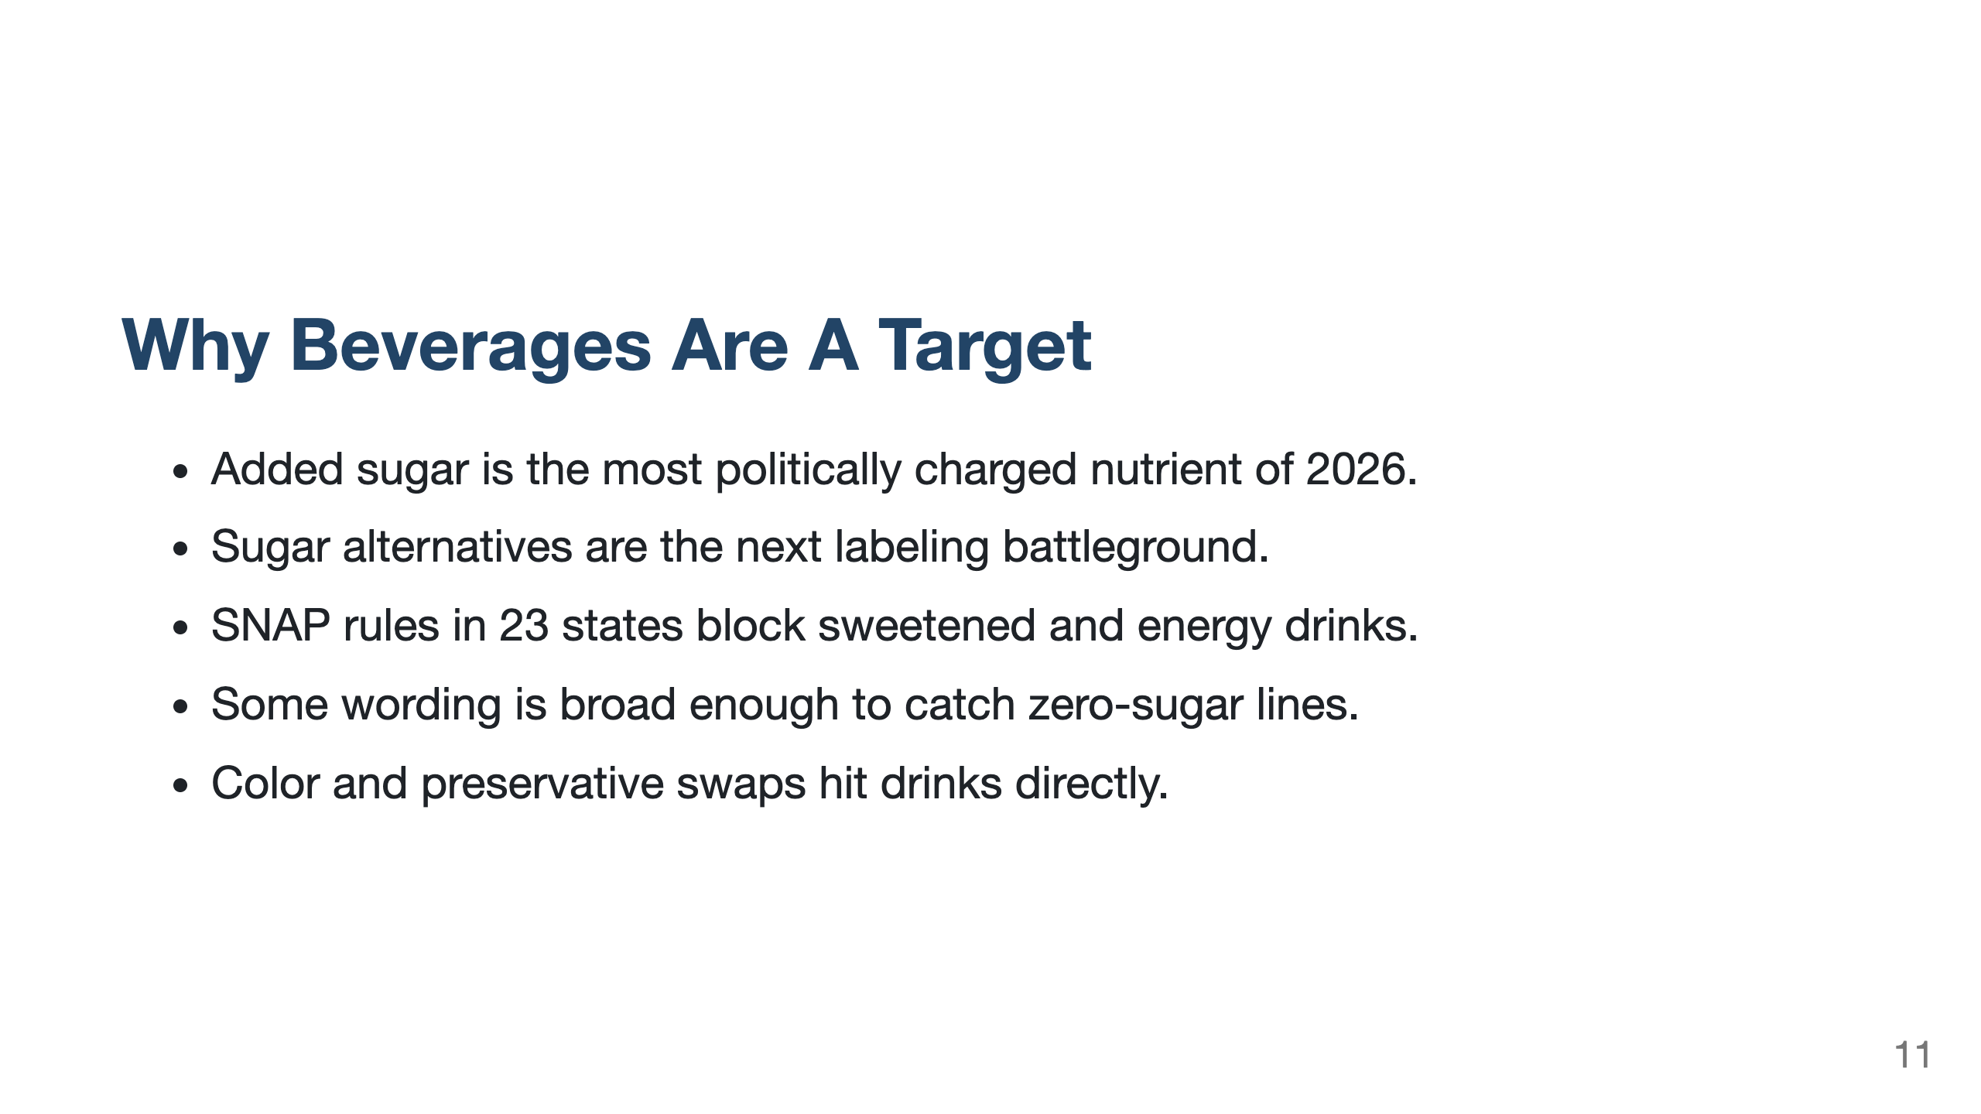

Slide 12
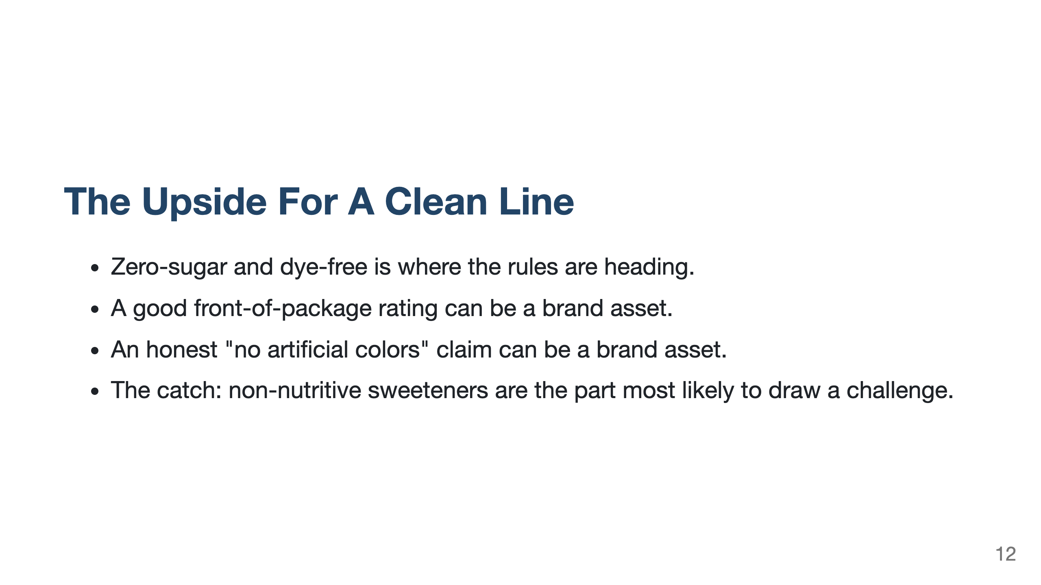

Slide 13
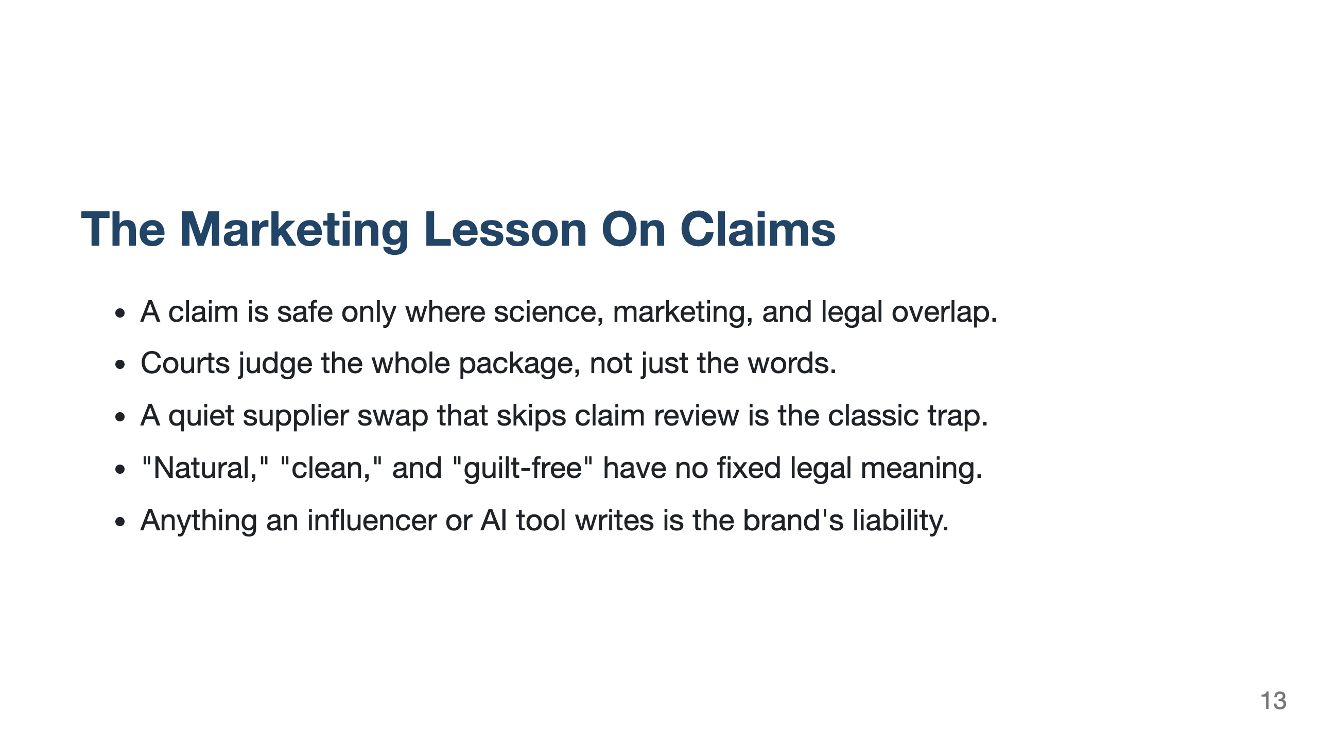

Slide 14
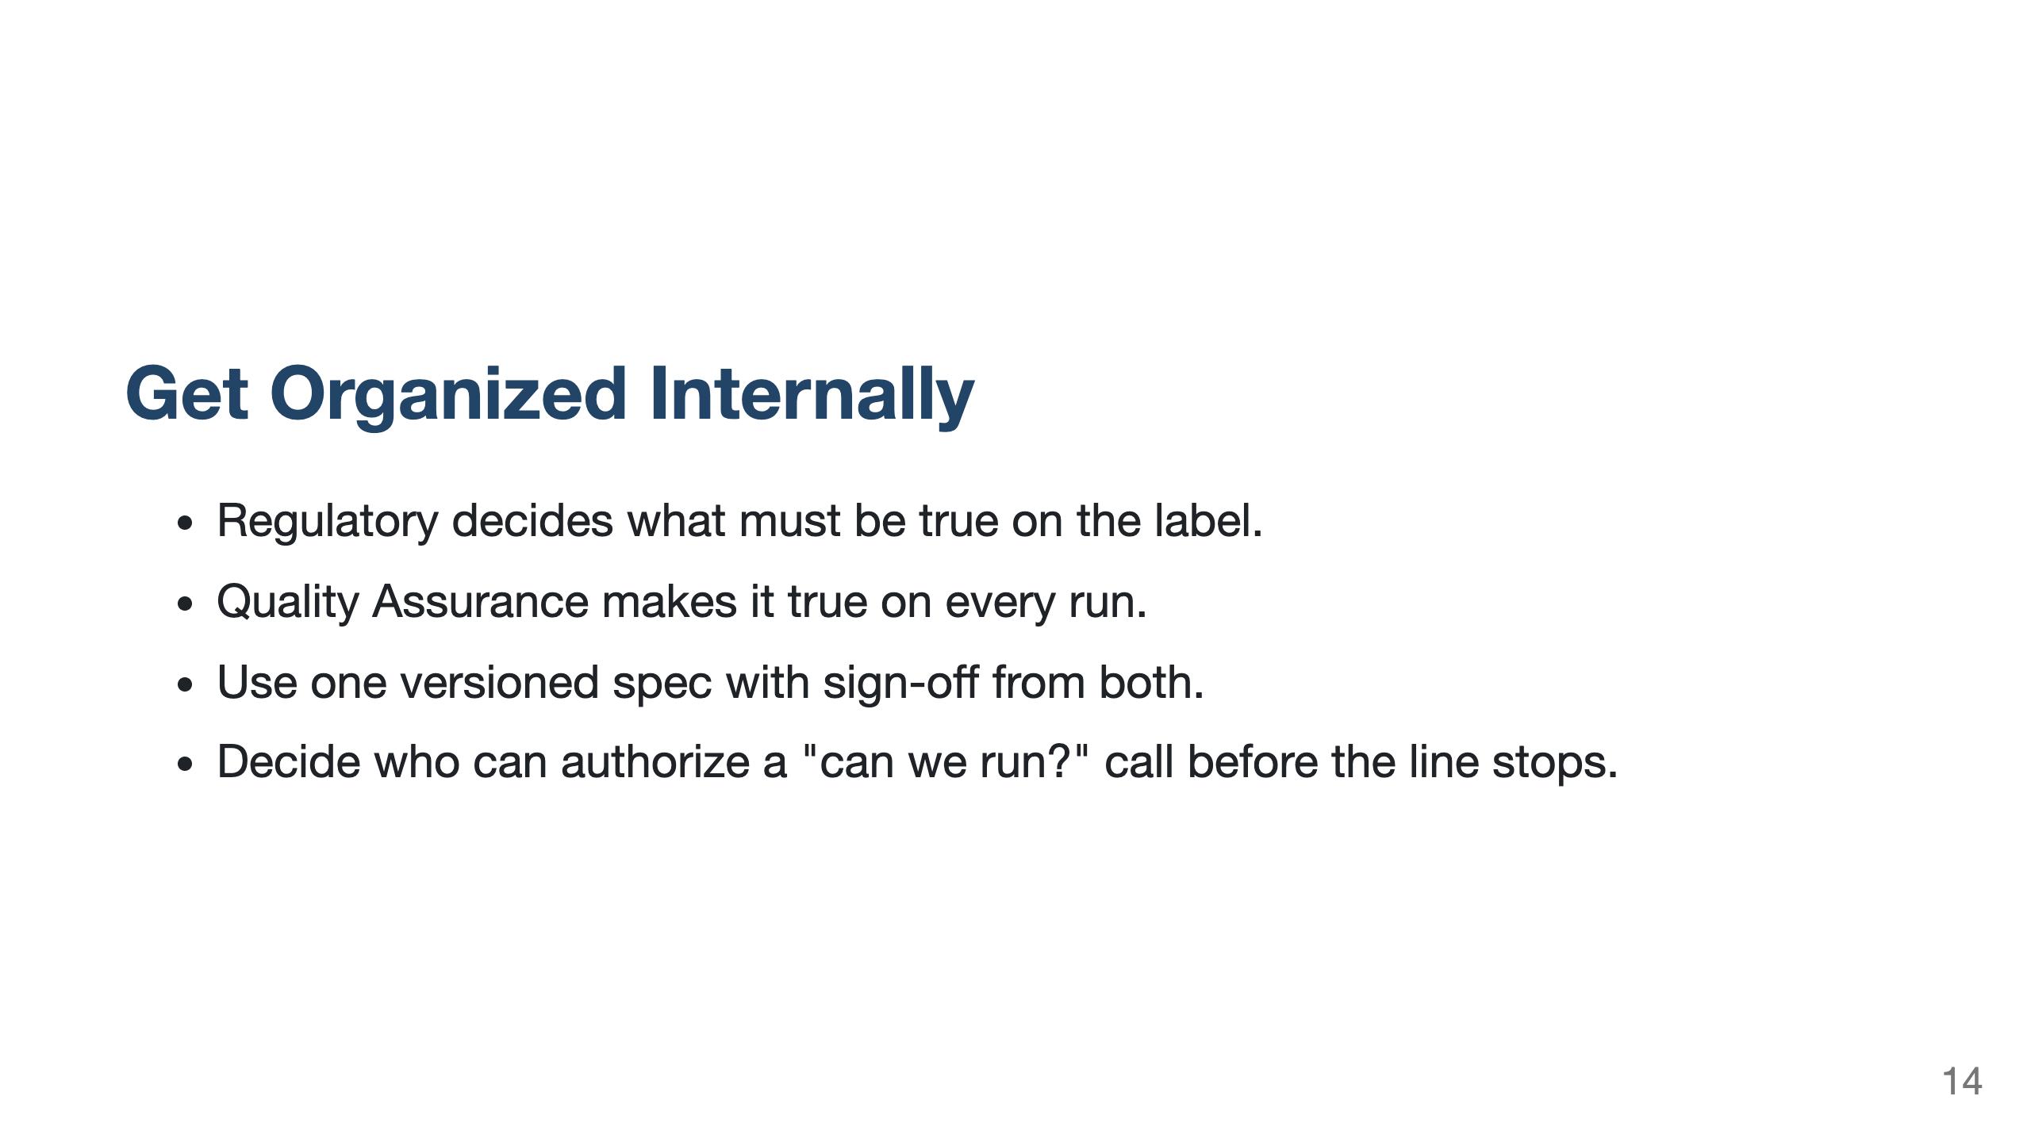

Slide 15
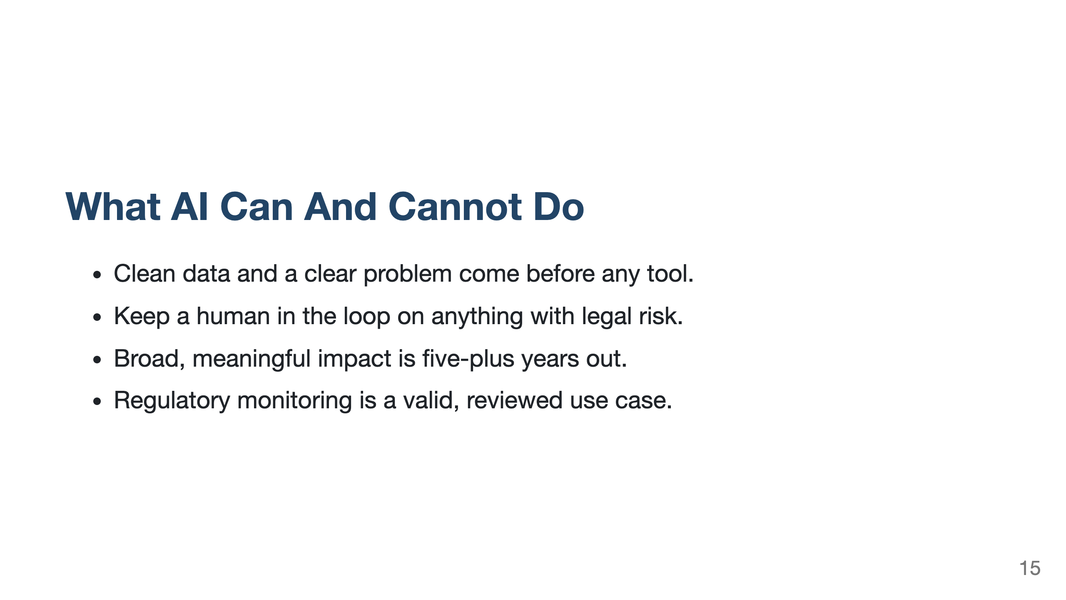

Slide 16
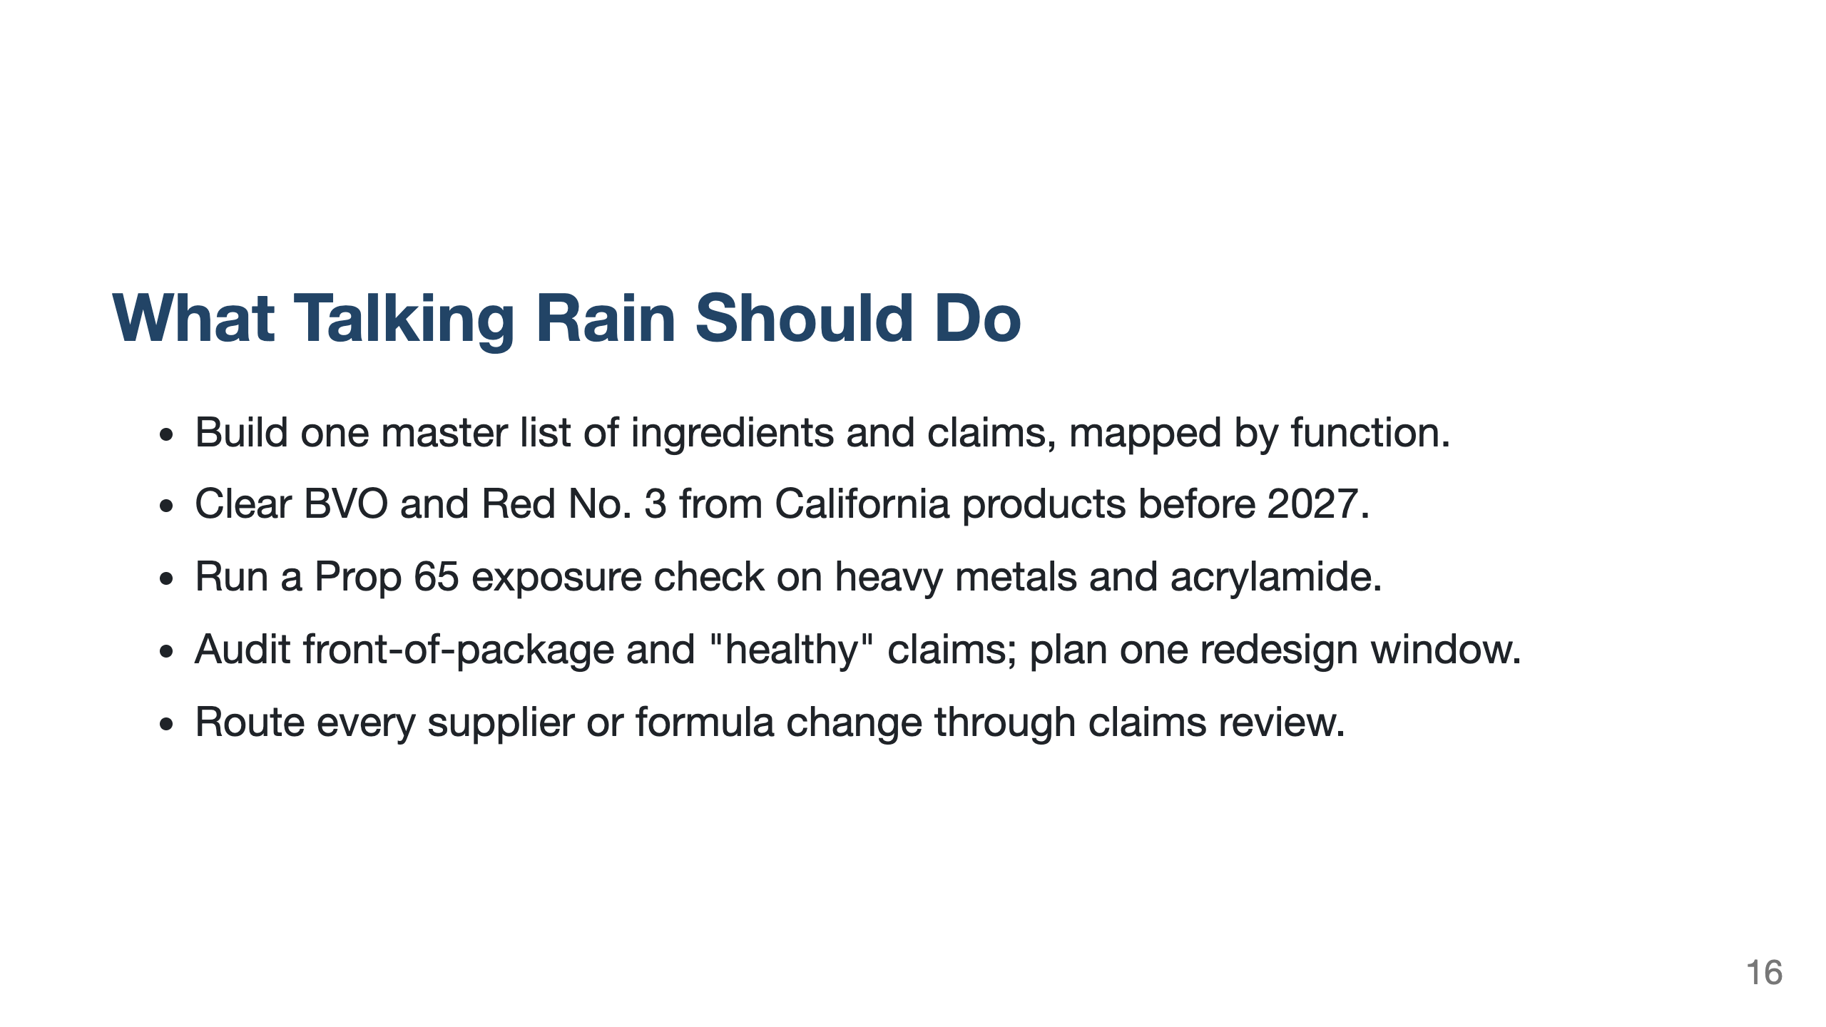

Slide 17
