Slide 1
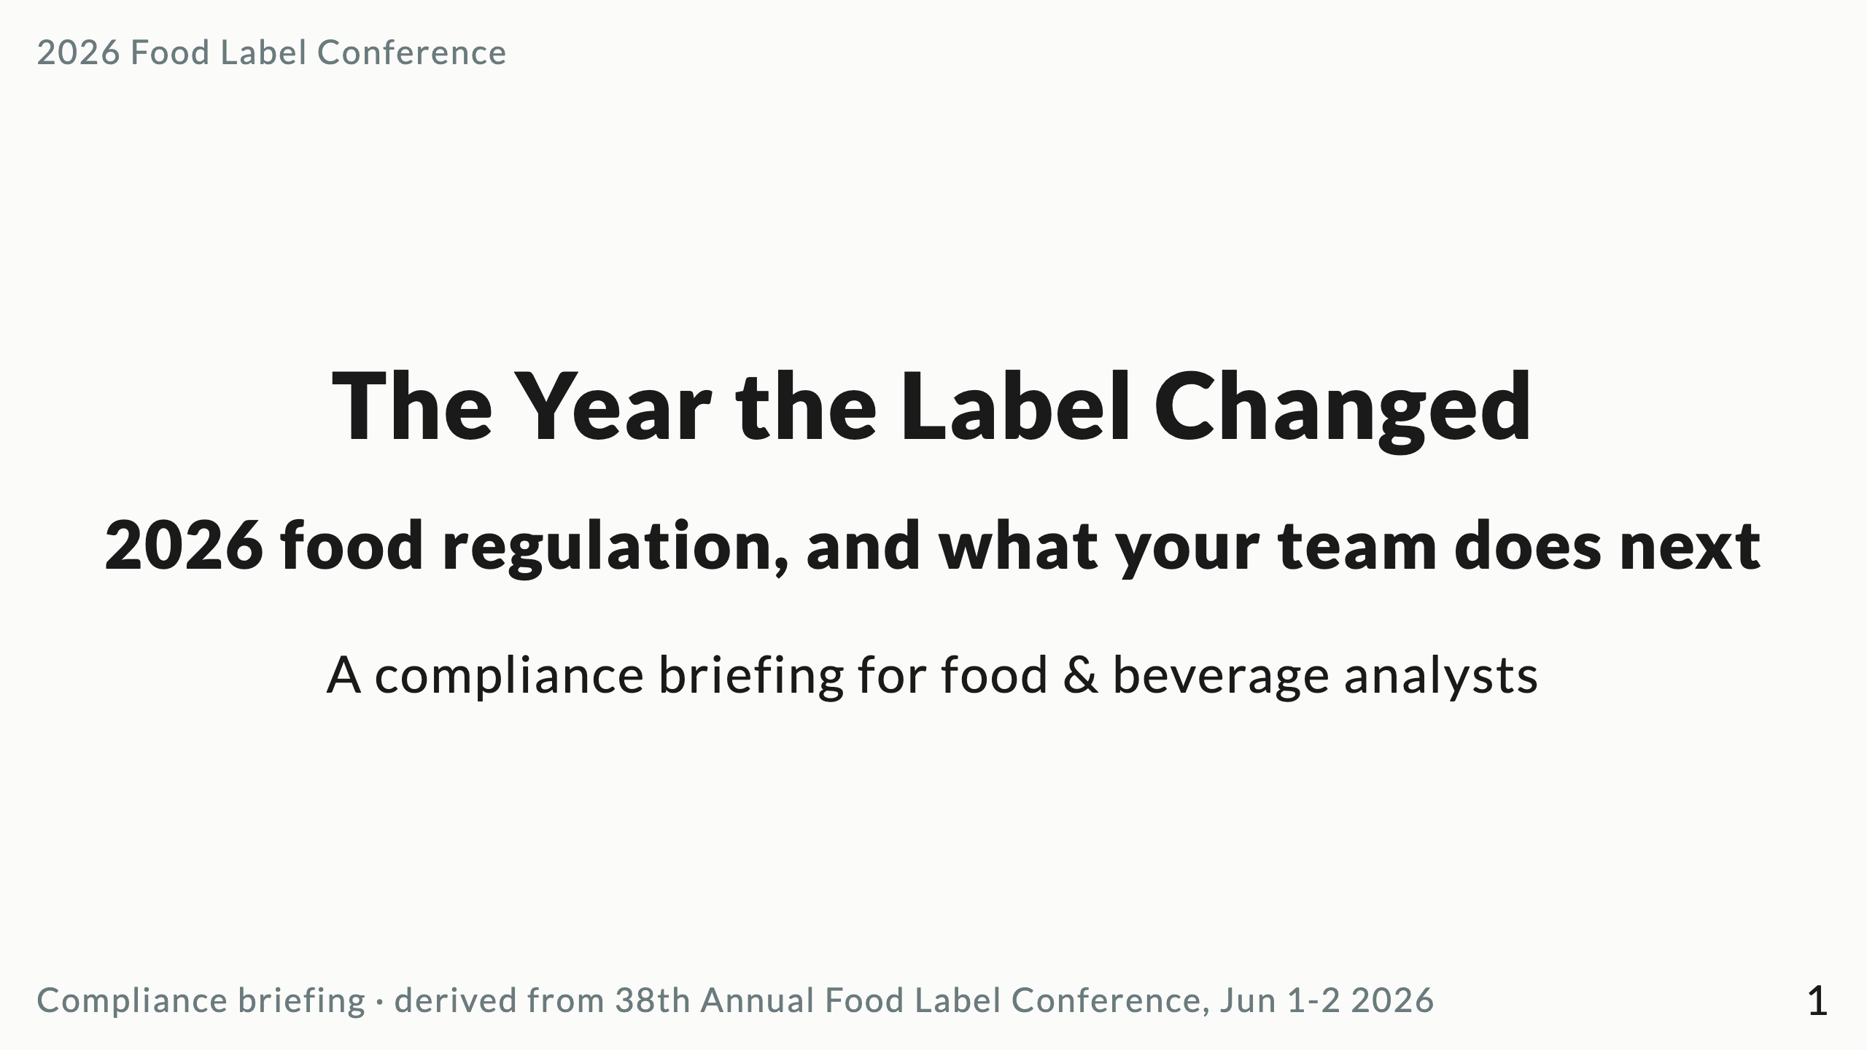
Notes:
Marp deck. Render with: npx @marp-team/marp-cli docs/reports/food-label-conference-2026-deck.md -o deck.pdf
(or --pptx for PowerPoint, --html for web). Speaker notes are in HTML comments per slide.
Source content: docs/reports/food-label-conference-2026-summary.md
Design: one idea per slide, title states the takeaway, glance-test ~3s.
Open on the shift, not credentials. ~20 min, 22 slides. Don't read slides; talk to the room.

Slide 2
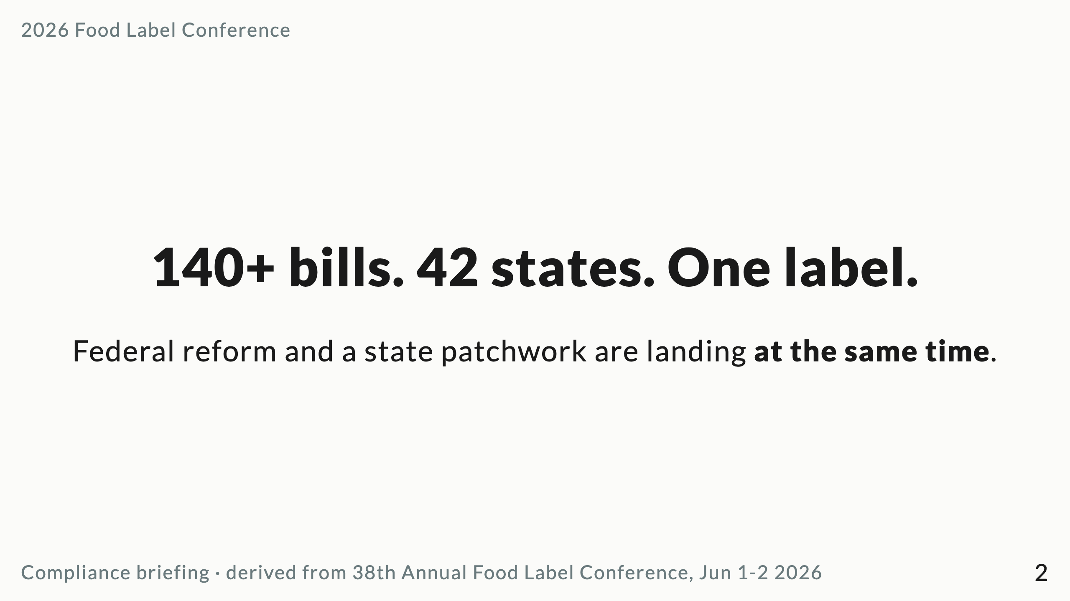
Notes:
The hook. In 2023 it was 3 bills in 2 states. Two years later, 140+ across 42, with new laws in 13. The volume is the story.

Slide 3
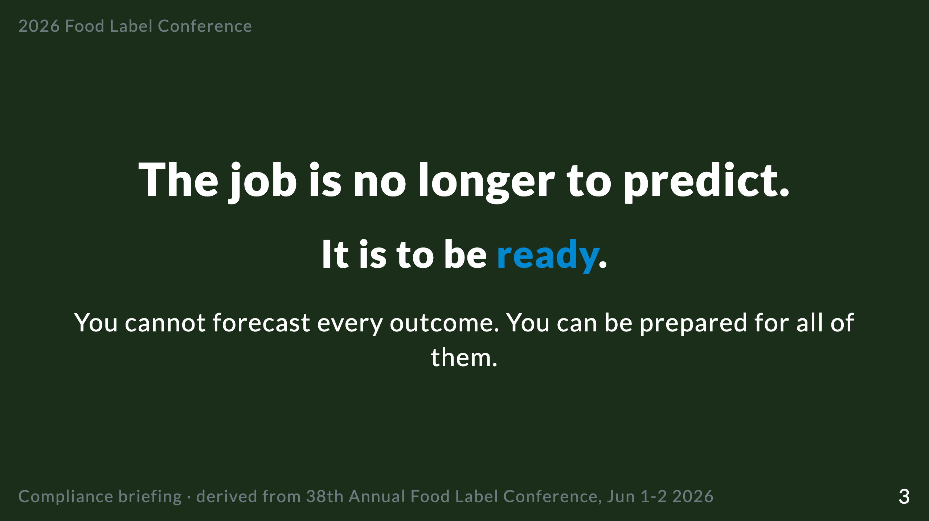
Notes:
This is the Big Idea / spine. "Readiness, not prediction." Everything after this supports it.

Slide 4
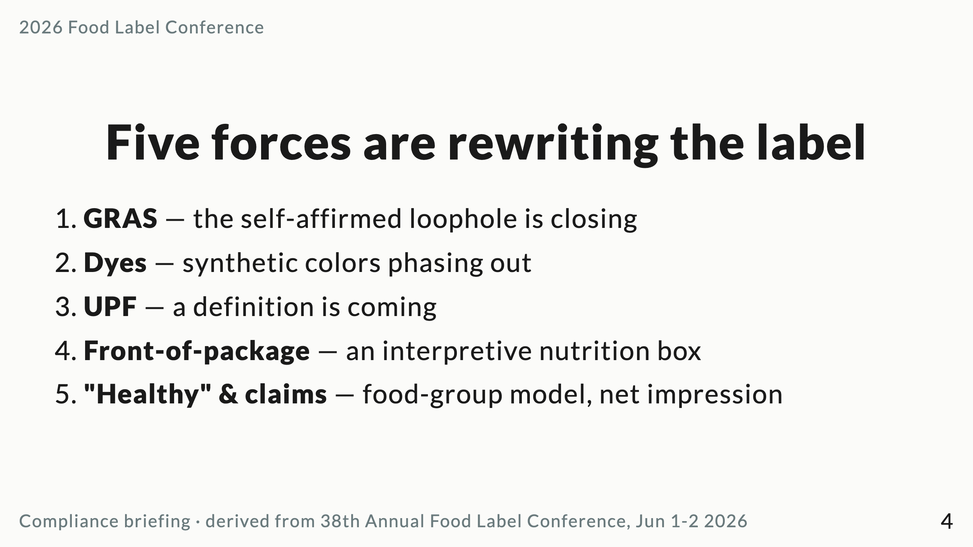
Notes:
Preview the journey without spoiling. Each gets its own slide next.

Slide 5
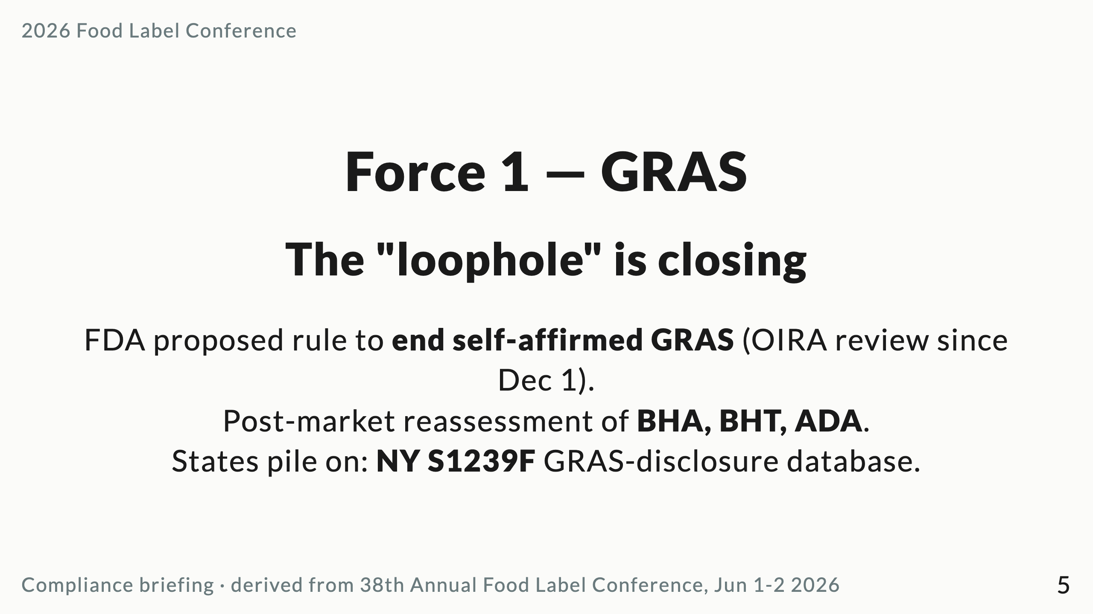
Notes:
Self-GRAS has let companies self-certify ingredients. That pathway is narrowing federally AND states are building disclosure registries. Inventory every self-GRAS ingredient now.

Slide 6
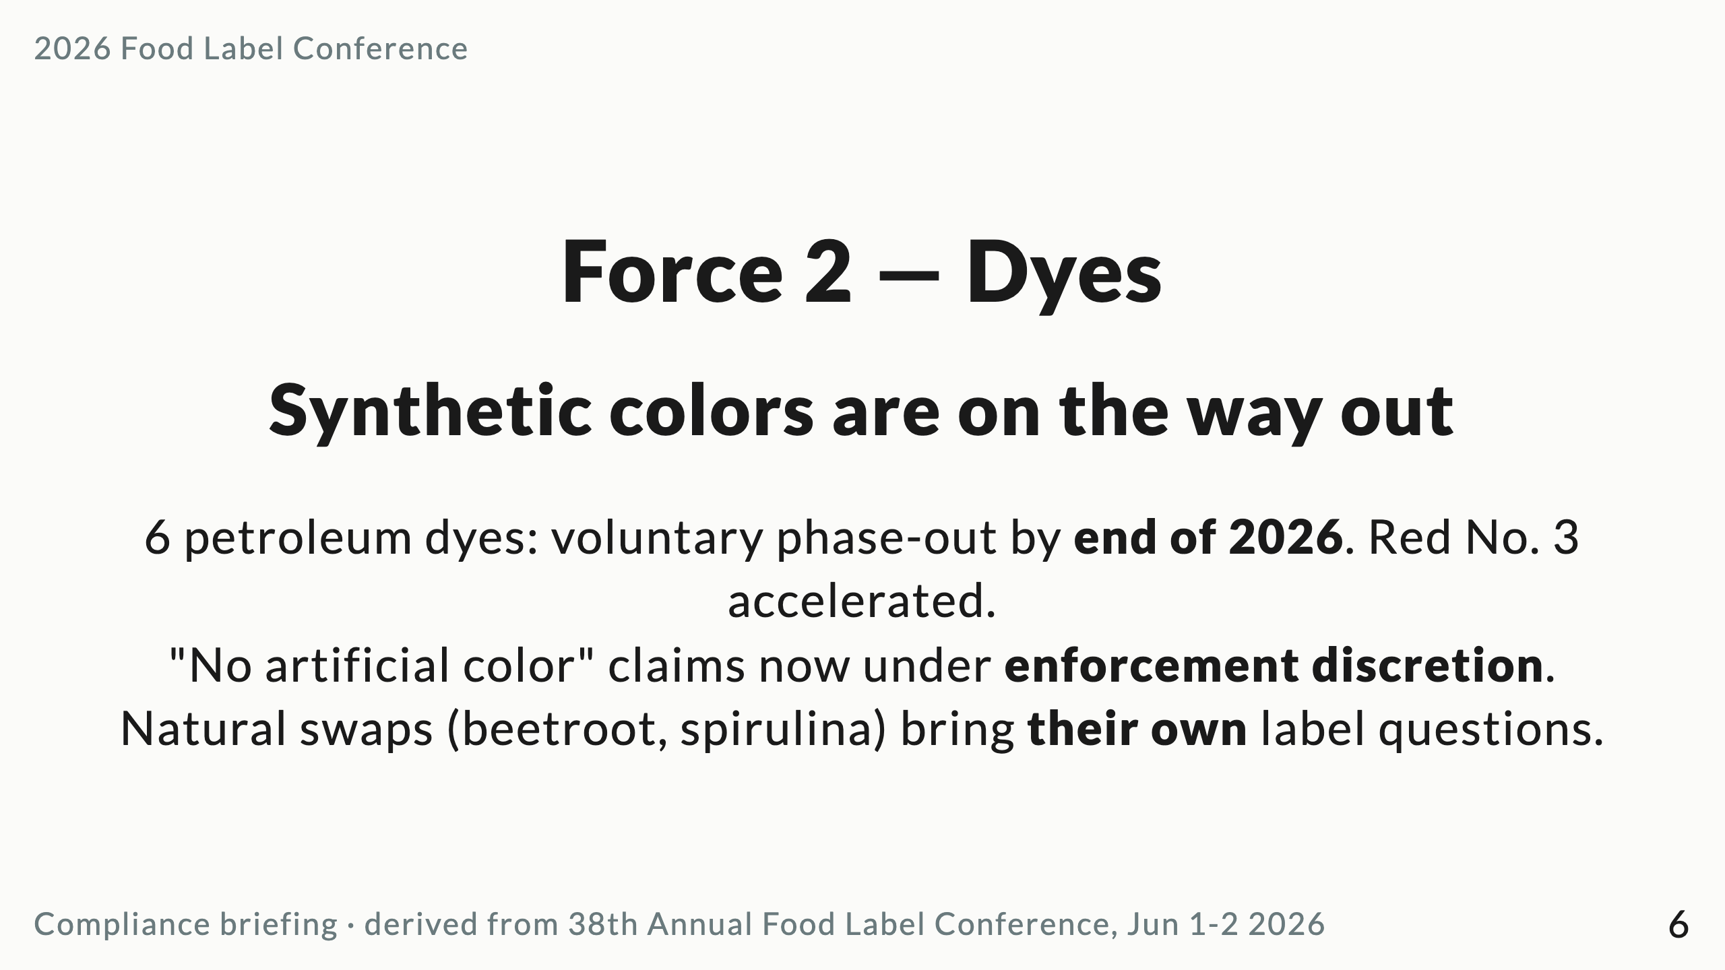
Notes:
Federal is mostly voluntary + "understanding," not formal rule. The teeth are at the state level — see CA AB 418 / AB 2316 and TX SB 25.

Slide 7
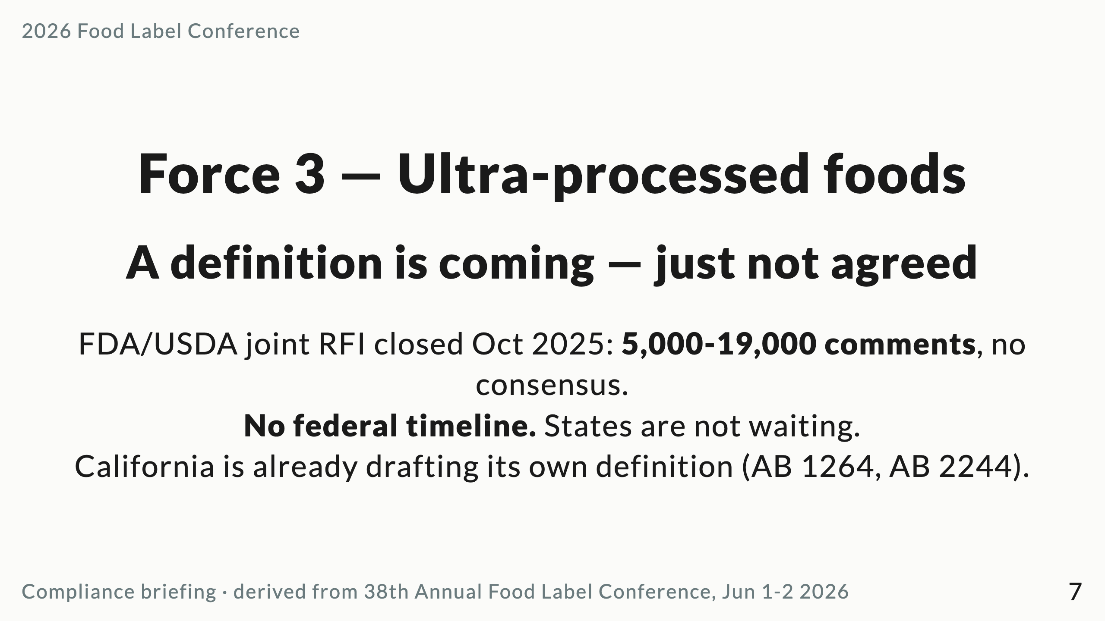
Notes:
The risk: divergent state definitions before a federal one exists. Watch whether NOVA or nutrient criteria win.

Slide 8
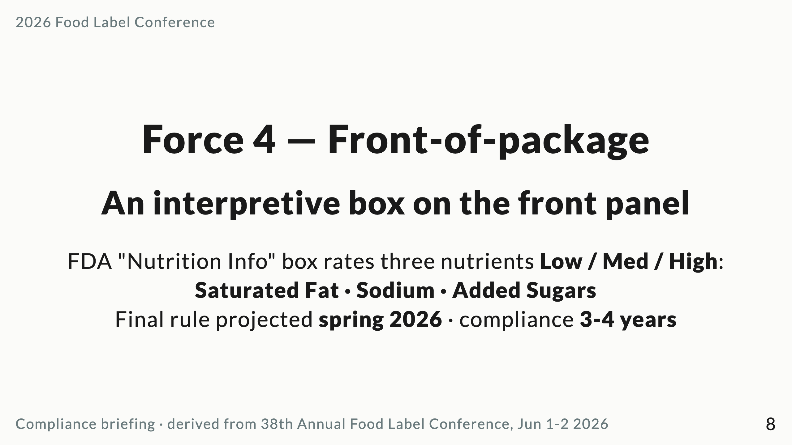
Notes:
Docket FDA-2024-N-2910. Kennedy has floated a green/yellow/red traffic light, which could mean a new NPRM — don't lock packaging to the Biden-era design.

Slide 9
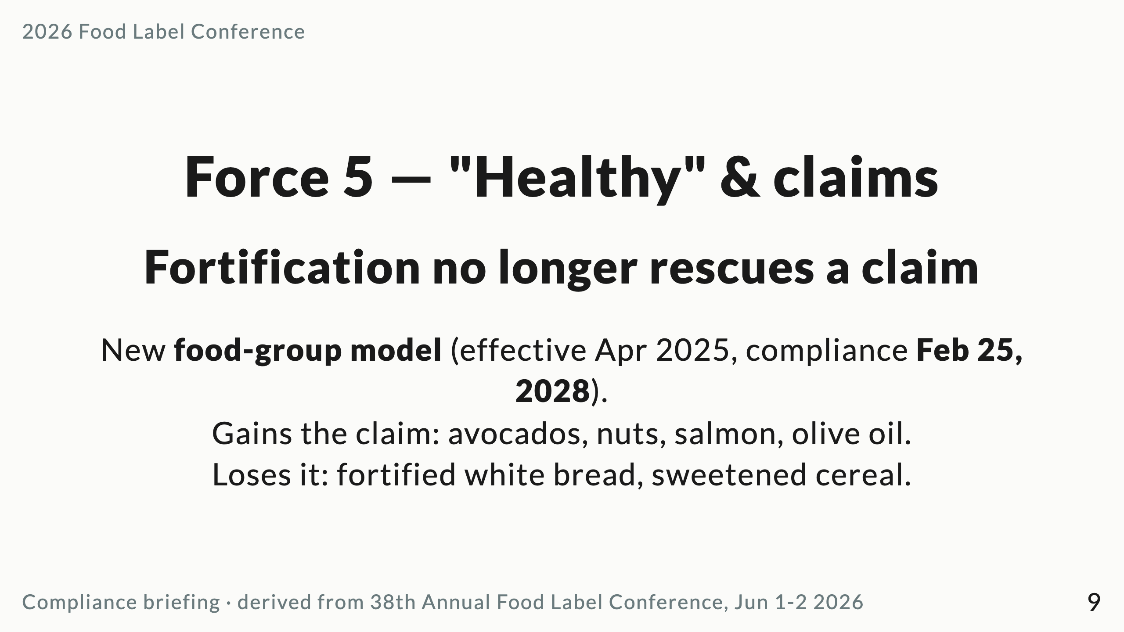
Notes:
The "fortification trap." Audit the healthy-claimed portfolio before the 2028 deadline and align it with the FOP relabel into ONE redesign window.

Slide 10
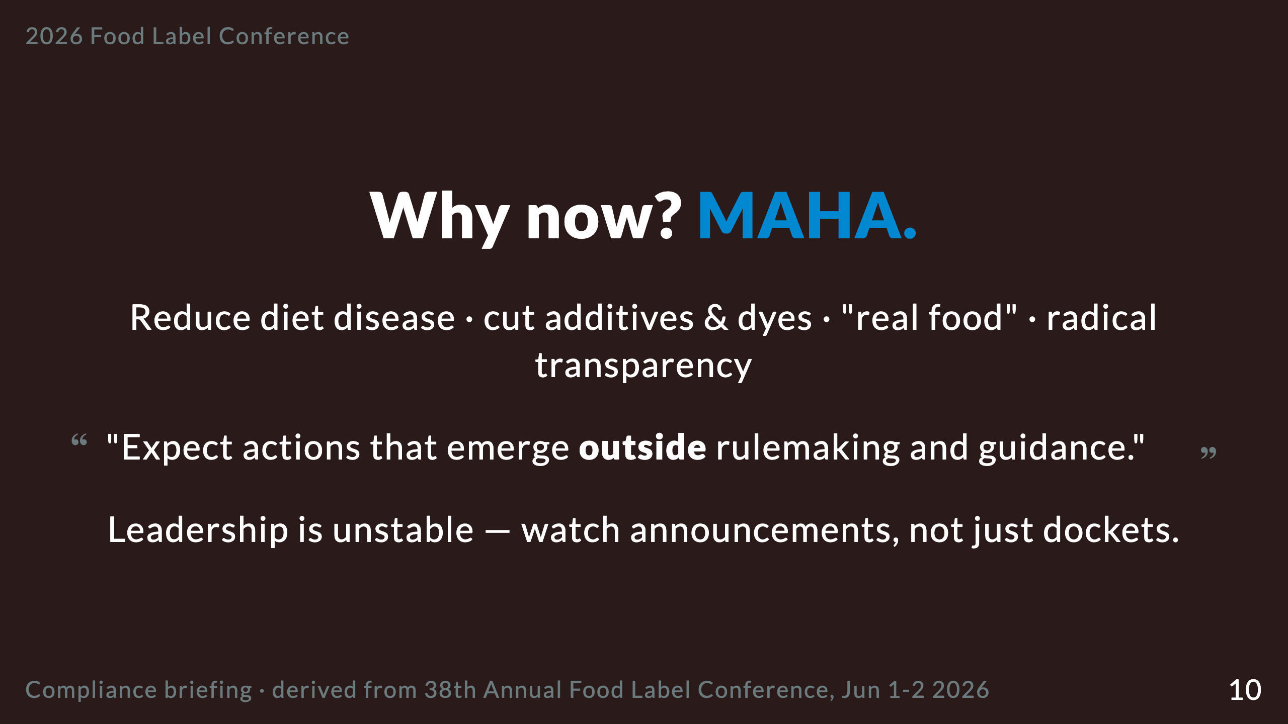
Notes:
Makary out, Diamantas in (acting), Prater steady at the Human Foods Program. Big changes are being announced via press, not the Federal Register.

Slide 11
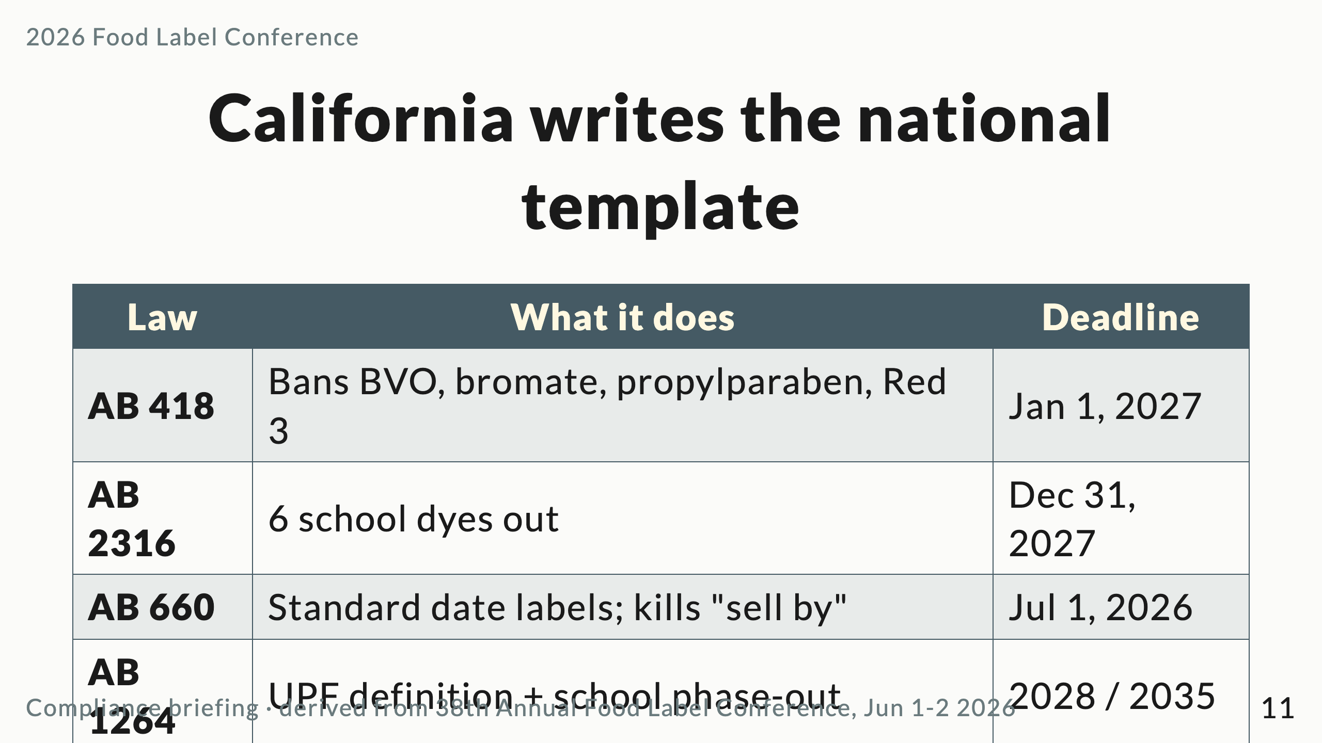
Notes:
If you comply with California, you are most of the way to compliant everywhere. That is the planning shortcut.

Slide 12
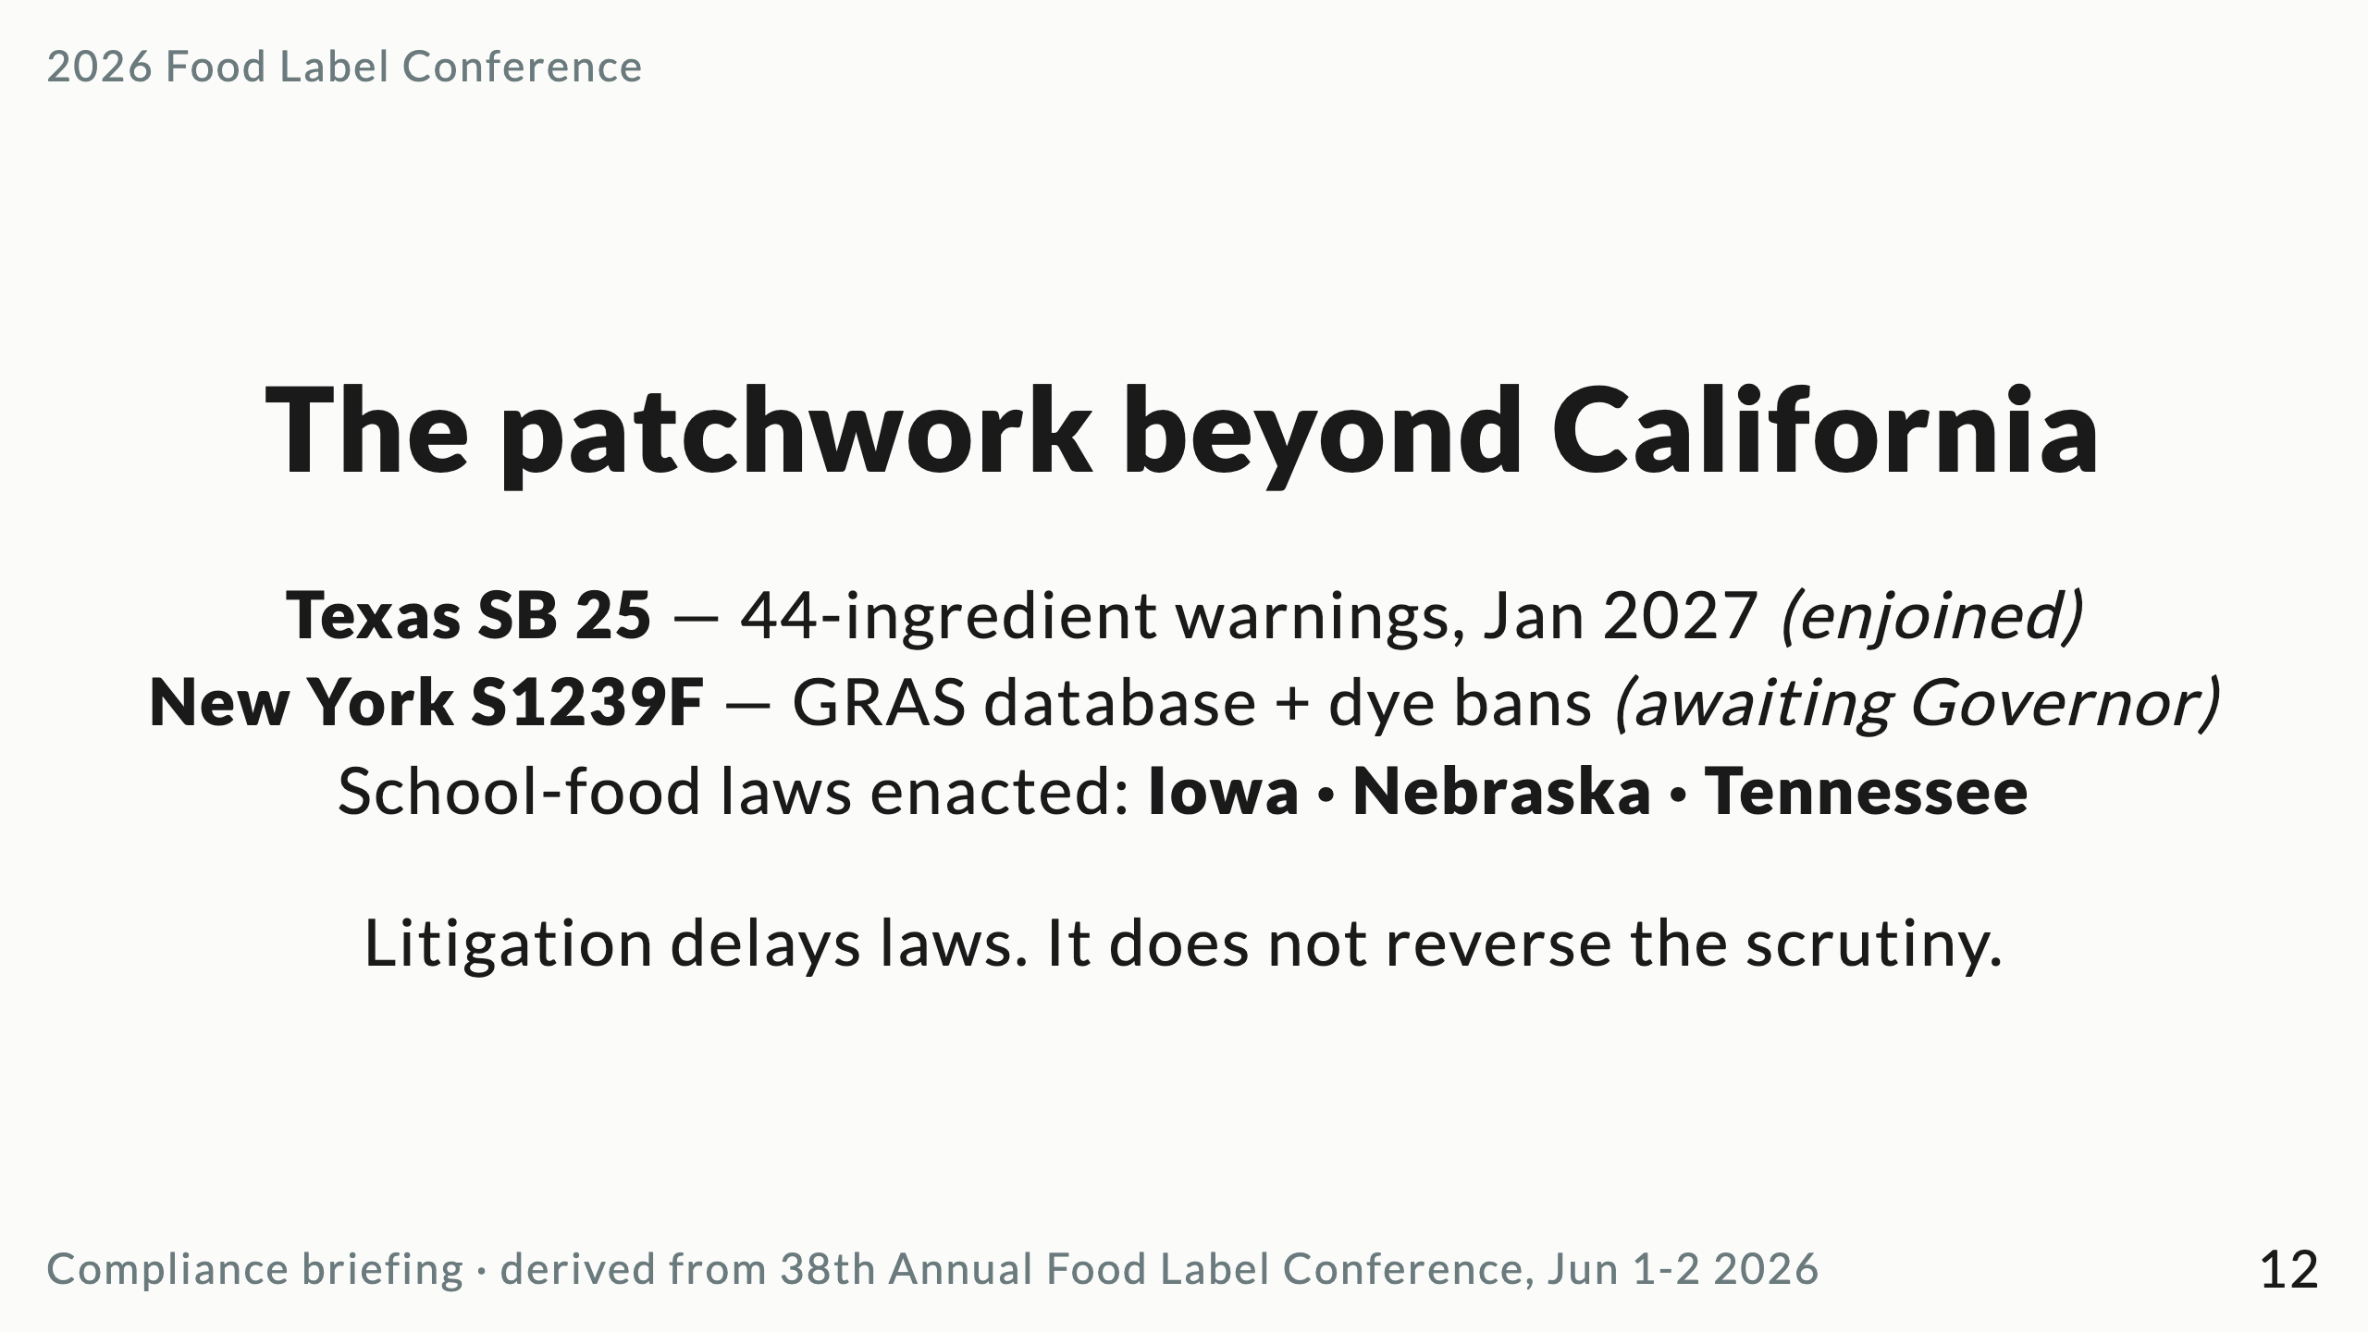
Notes:
Injunctions are a pacing signal, not an off-switch. Plan for a 2027 resurgence after the election cycle.

Slide 13
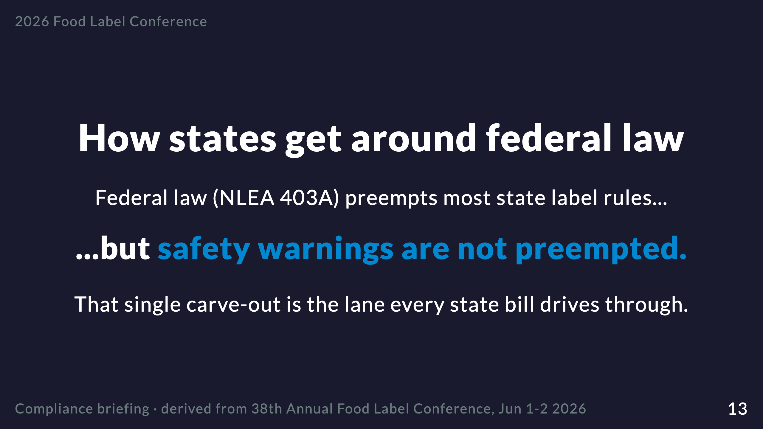
Notes:
This is the legal mechanic that explains the whole patchwork. Warning labels and disclosure mandates survive preemption; nutrition-content rules do not.

Slide 14
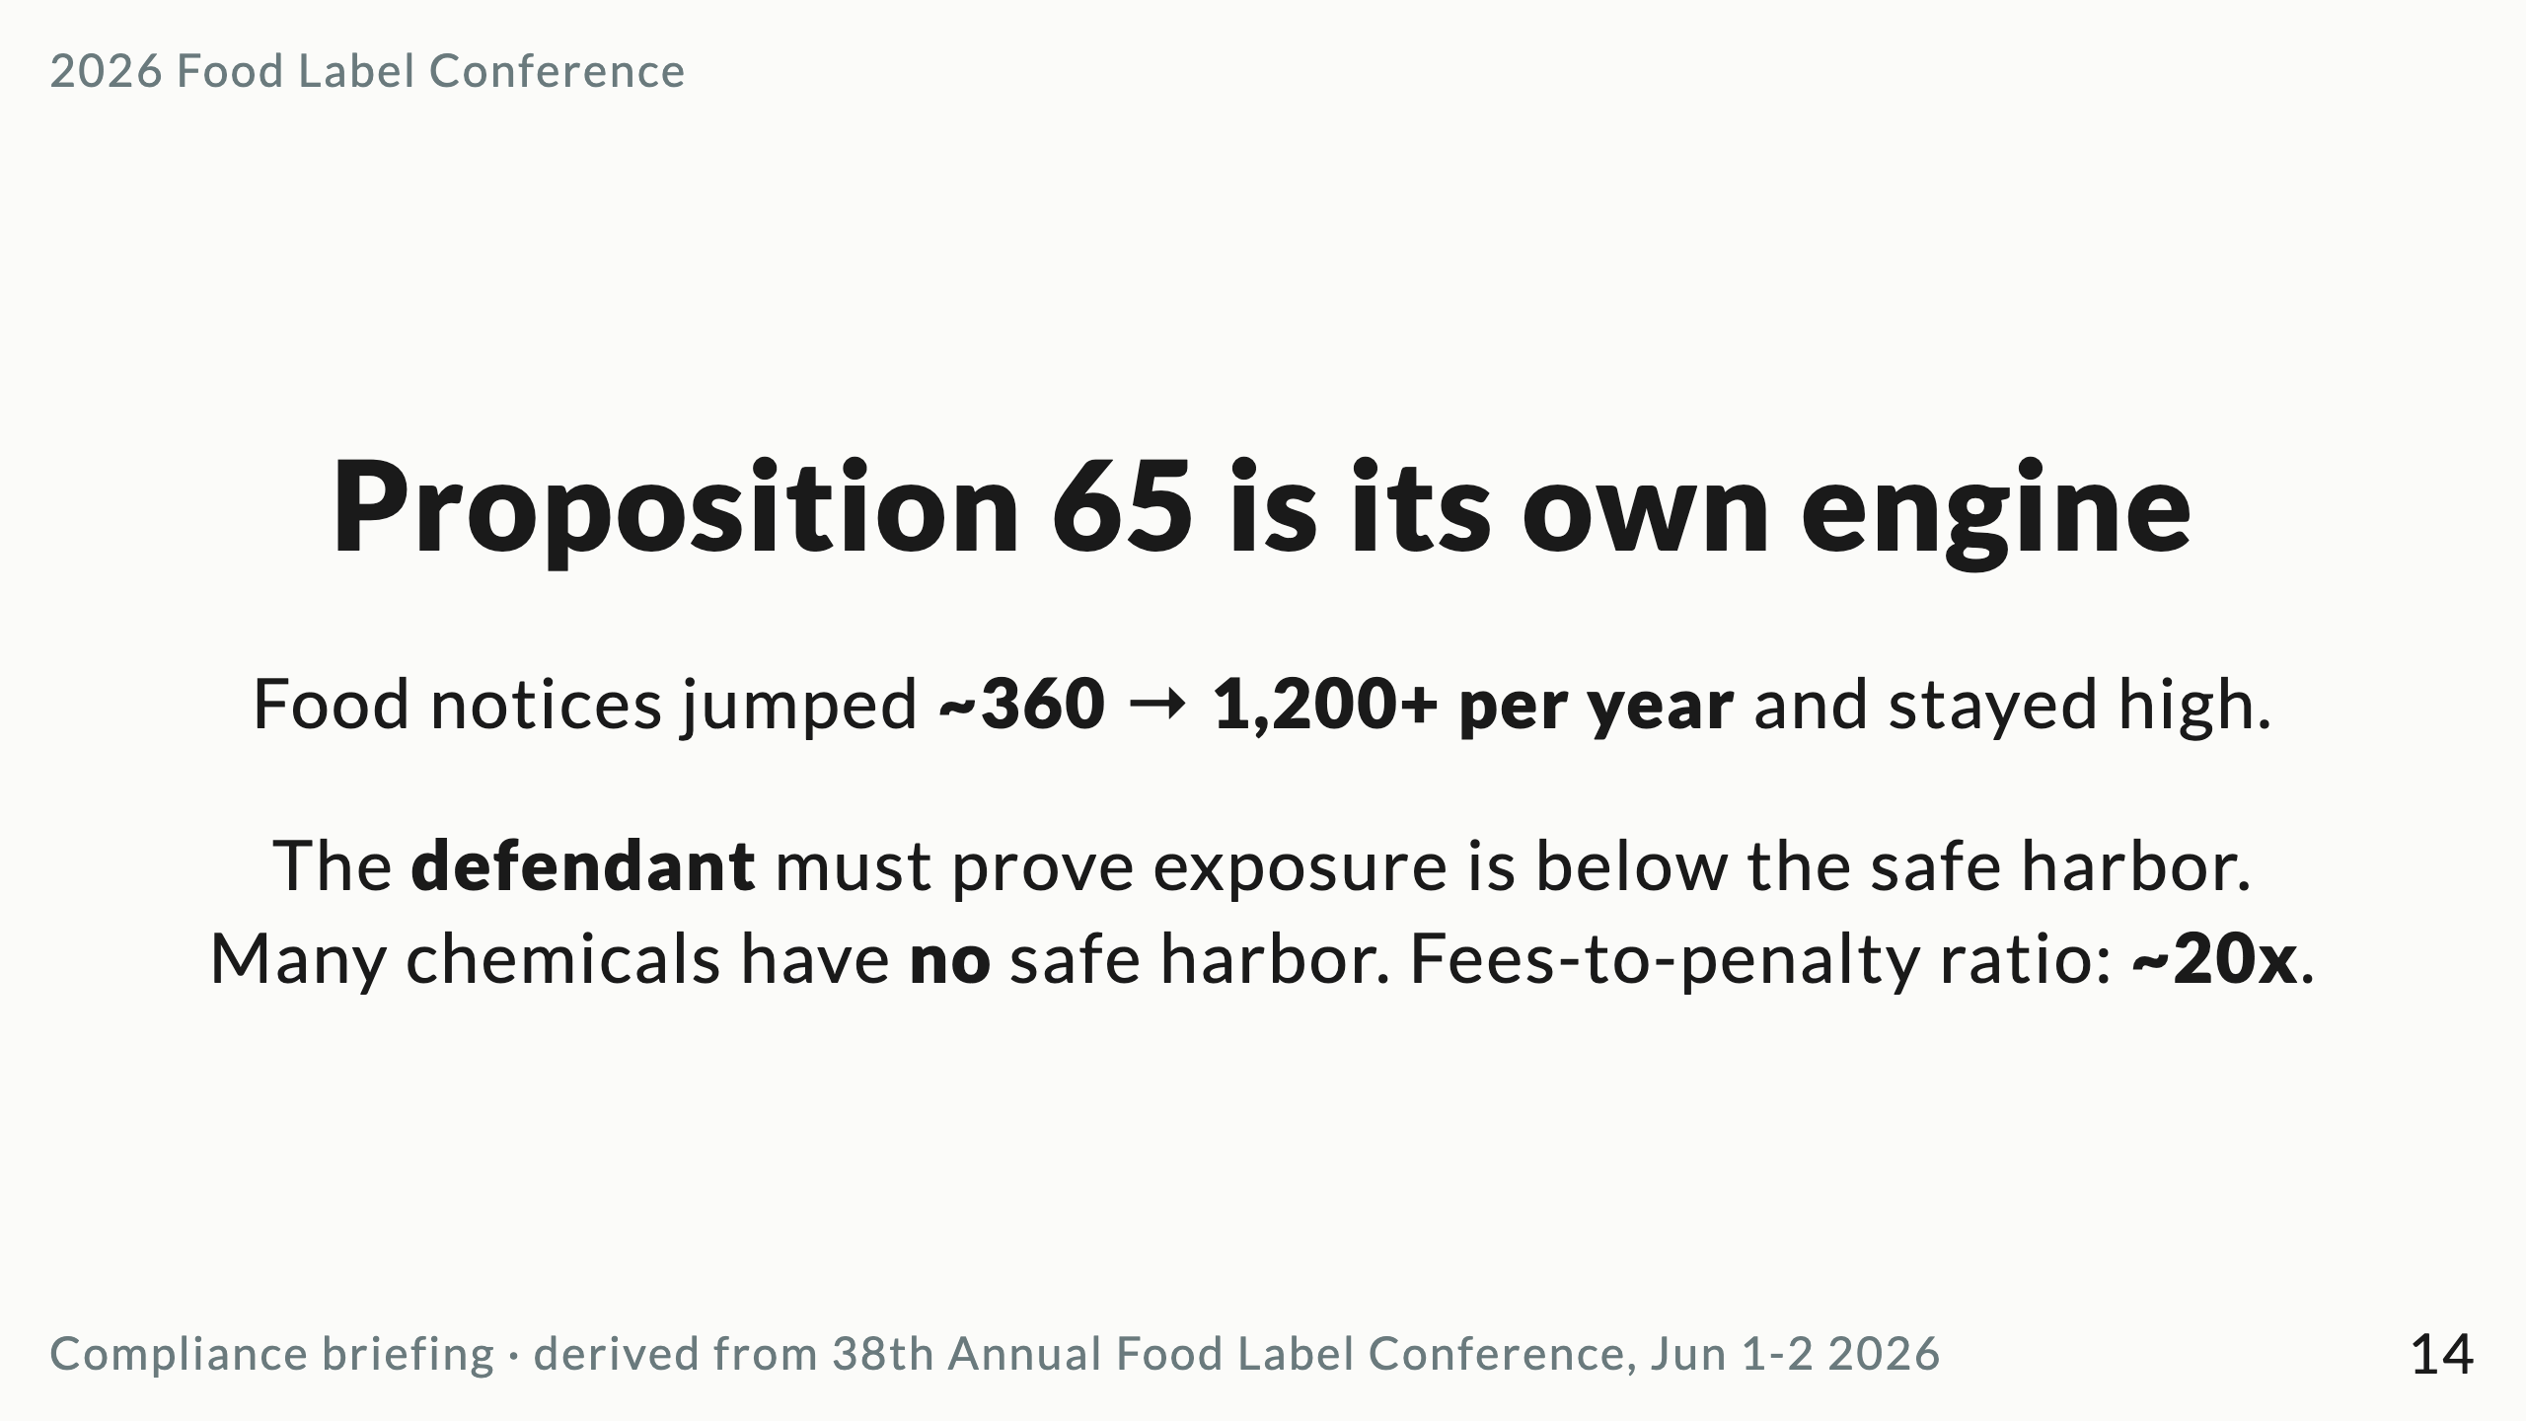
Notes:
Highest risk: heavy metals (lead, cadmium, arsenic) in roots, fish, rice, spices; acrylamide in cooked carbs. Build the defense file BEFORE the 60-day notice arrives.

Slide 15
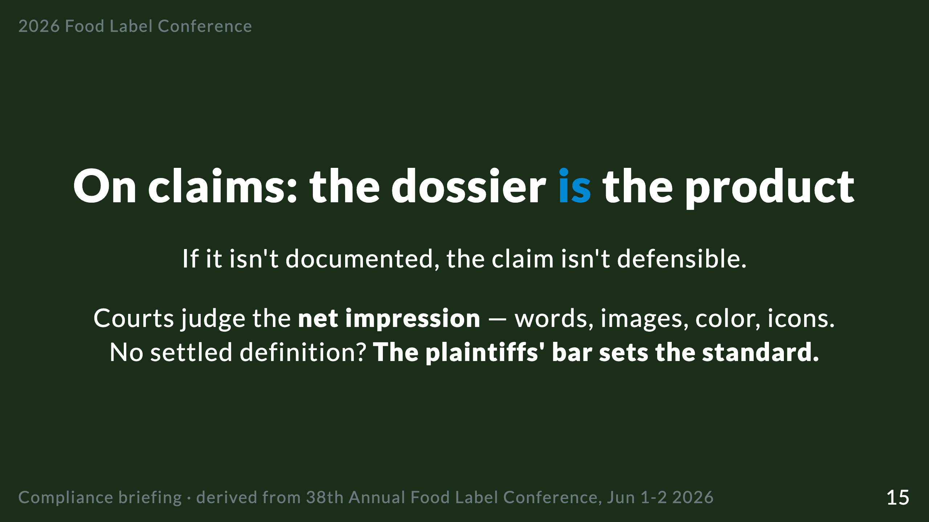
Notes:
"Natural," "clean," "guilt-free," "GLP-1 friendly" have no federal definition. Default to specific, measurable nutrient claims. Every spec-sheet change — and every influencer post — is a claims-register event.

Slide 16
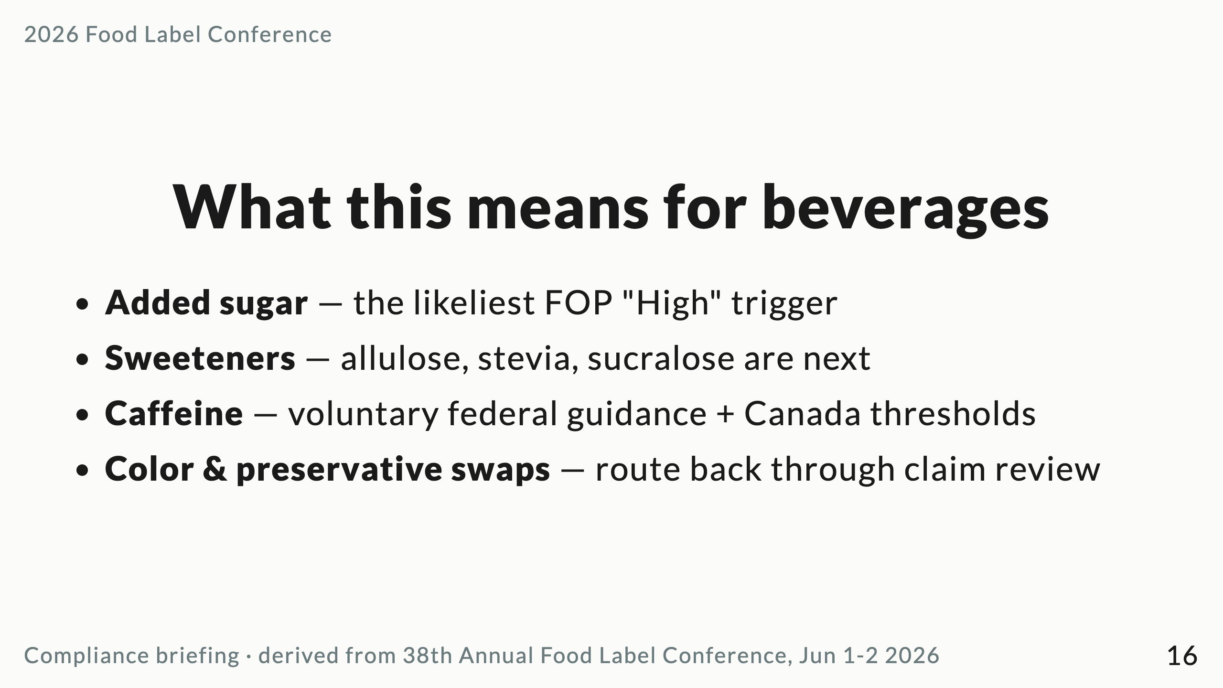
Notes:
Sugar is the most politically charged nutrient of 2026. The DGA line — "no amount of added sugars... is recommended" — will be quoted in litigation.

Slide 17
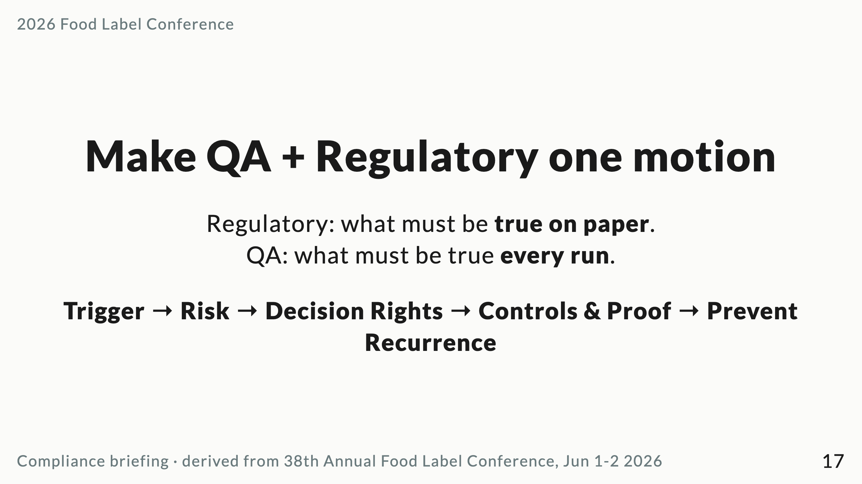
Notes:
Pre-define "who can authorize running with a non-conforming ingredient" before the line stops to ask. Documentation is protection, not bureaucracy.

Slide 18
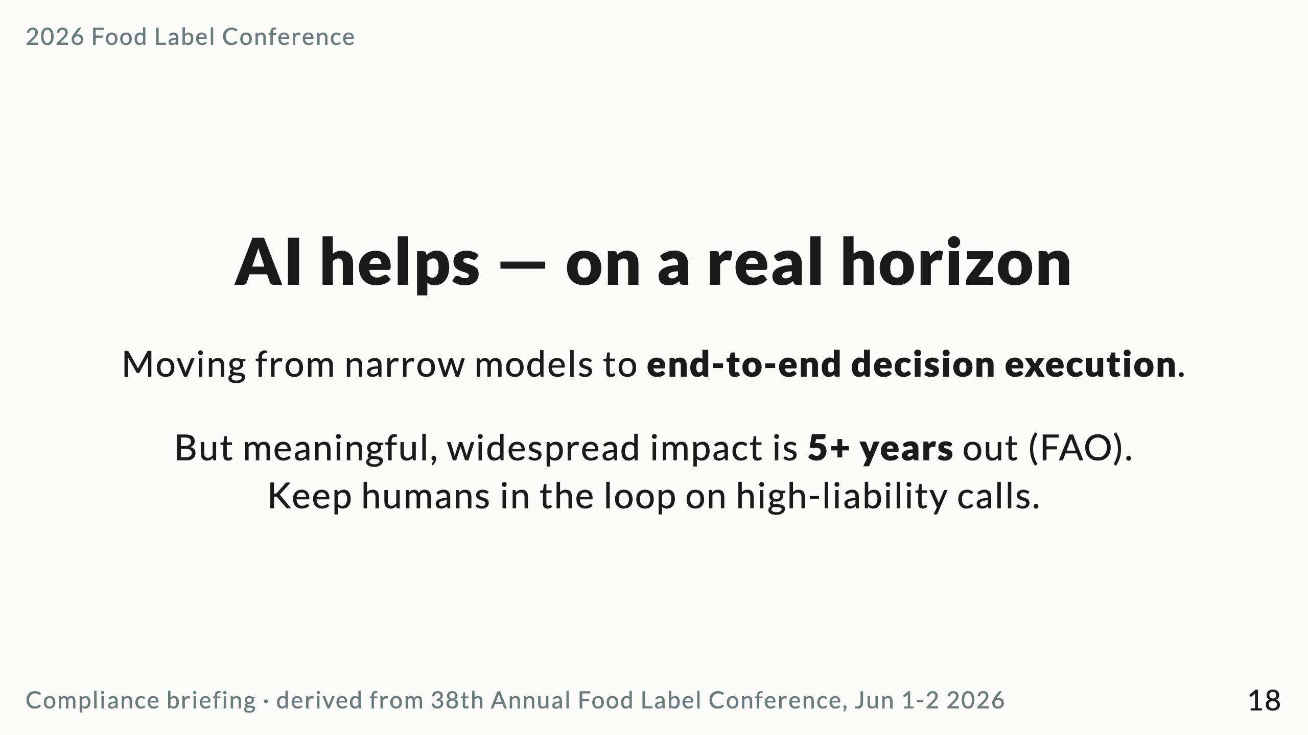
Notes:
This is the bridge to our own project: automating regulatory updates. Highest value where AI is paired with domain context. Biggest failure mode: over-complexification — innovation by subtraction.

Slide 19
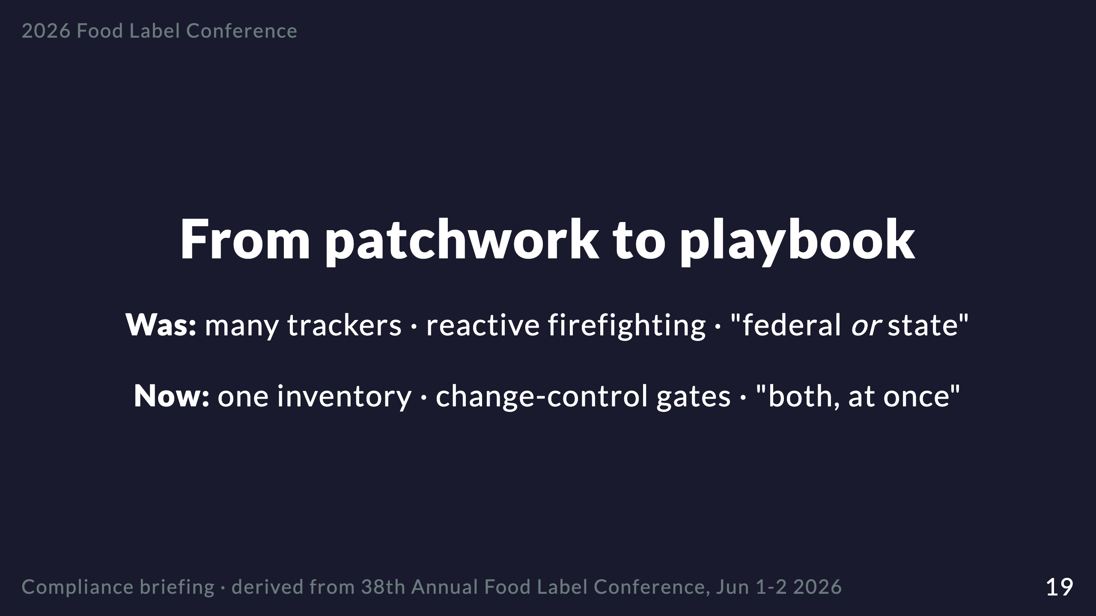
Notes:
The Sparkline turn: current reality vs. the better future. This is where the audience becomes the hero.

Slide 20
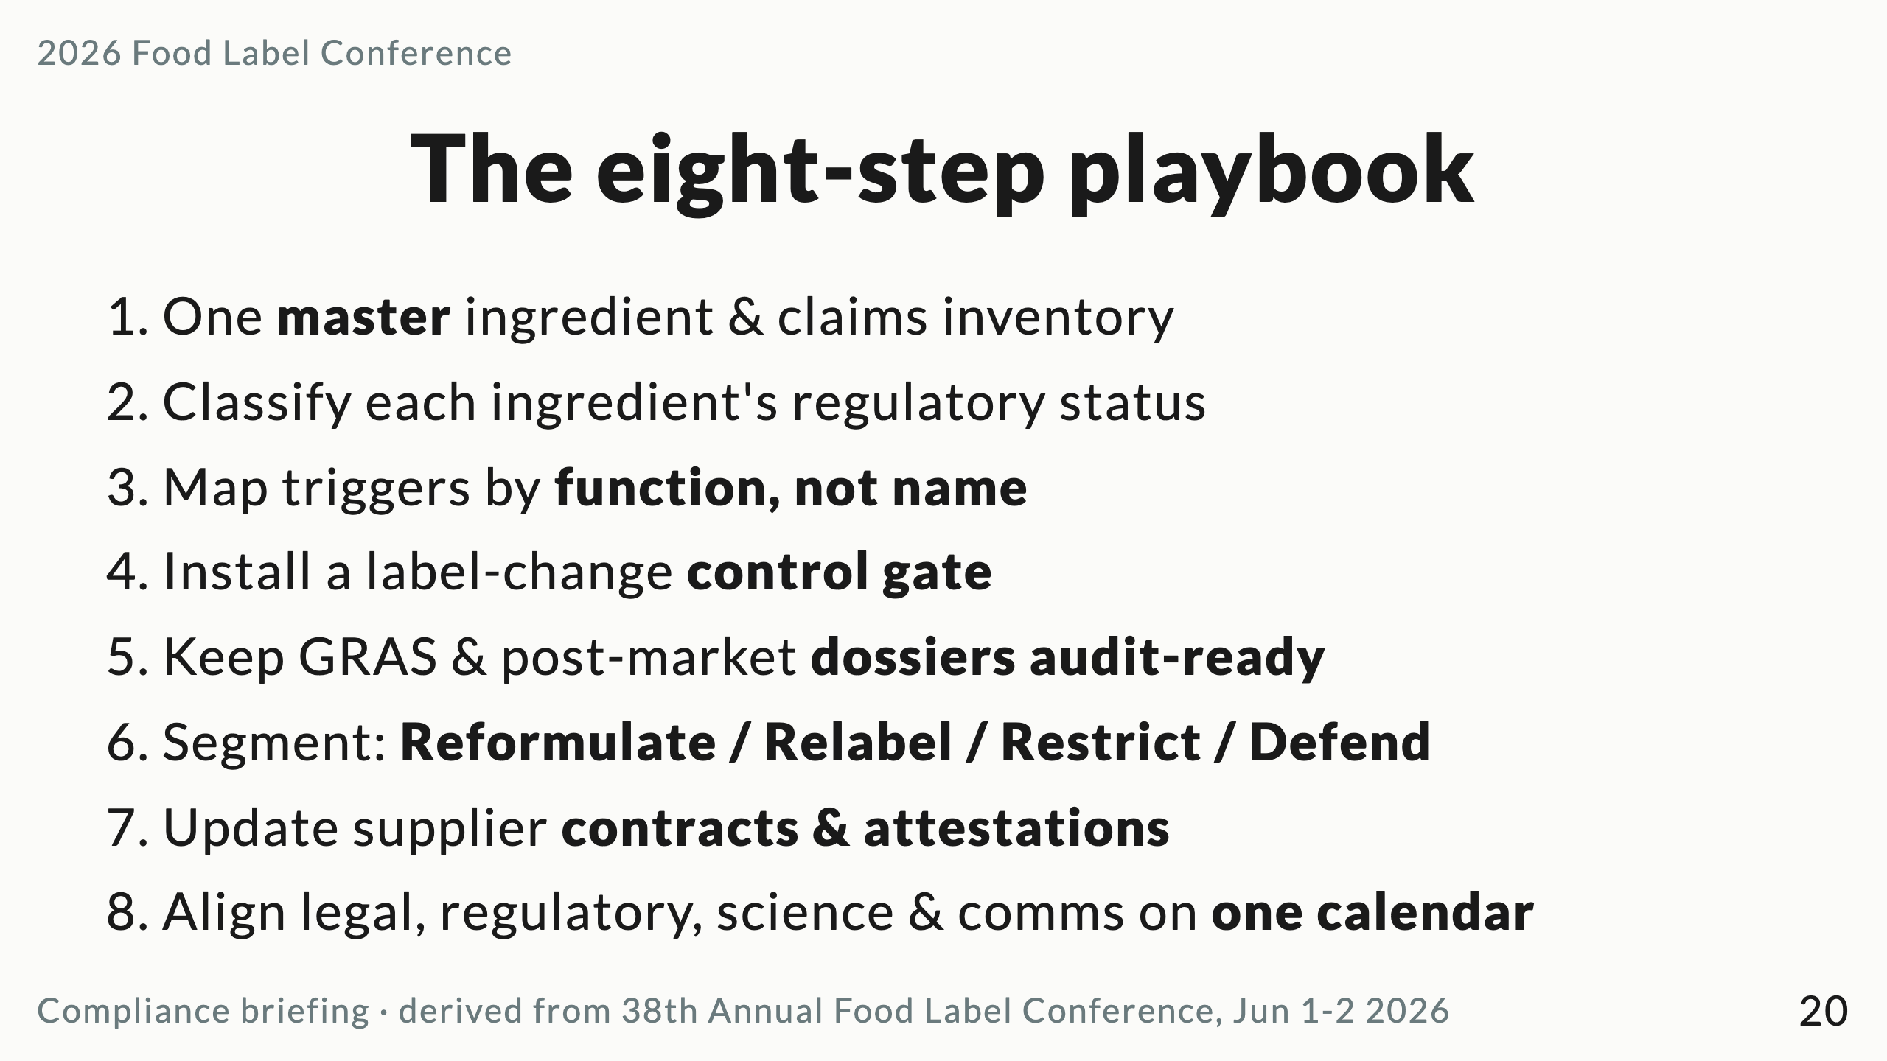
Notes:
This is the deliverable they take home. Don't dwell — point to the printed playbook and move to the ask.

Slide 21
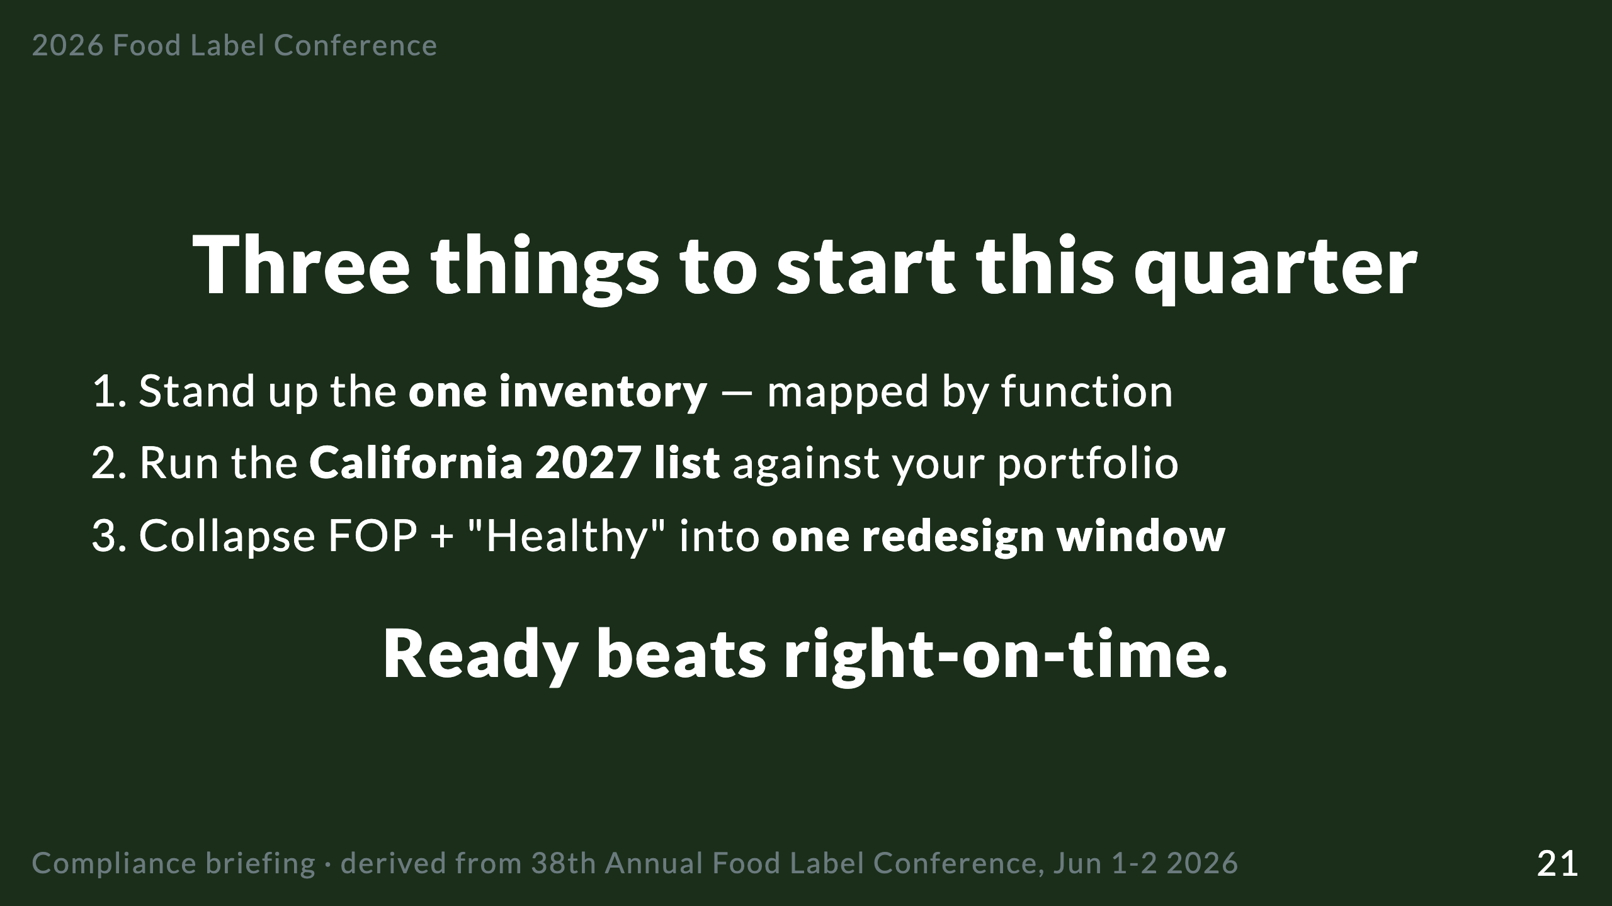
Notes:
Close on the call to action, not "questions?". Return to the Big Idea: readiness, not prediction. Then open the floor.

Slide 22
