Slide 1
Help

Slide 2
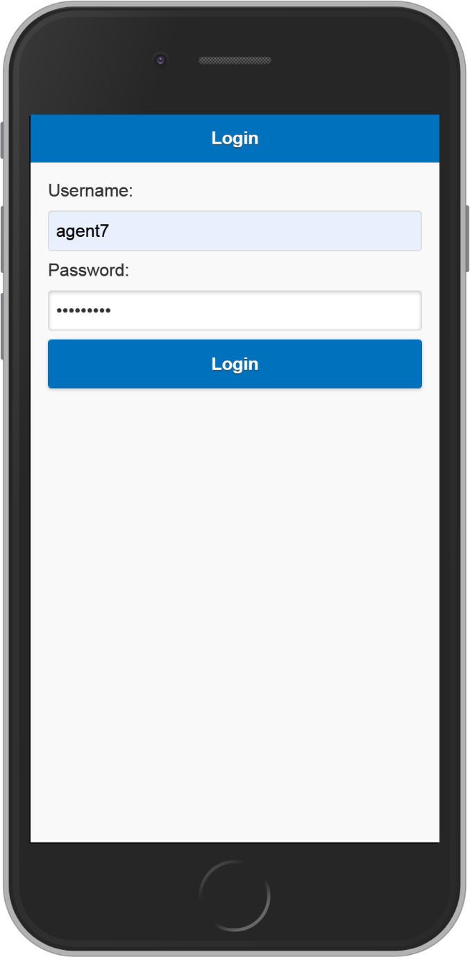
Login
Agents can login with username and password
Username and password details will be given by developer

Slide 3
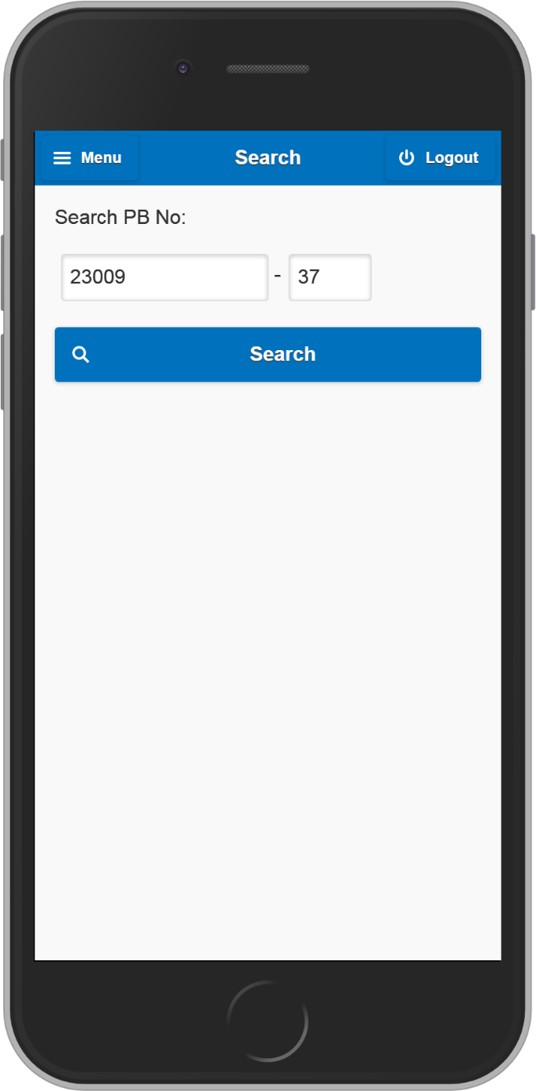
Search PB No.
Search with PB No. with check the status of voter
Enter PB No.
Press ‘Search’ button

Slide 4
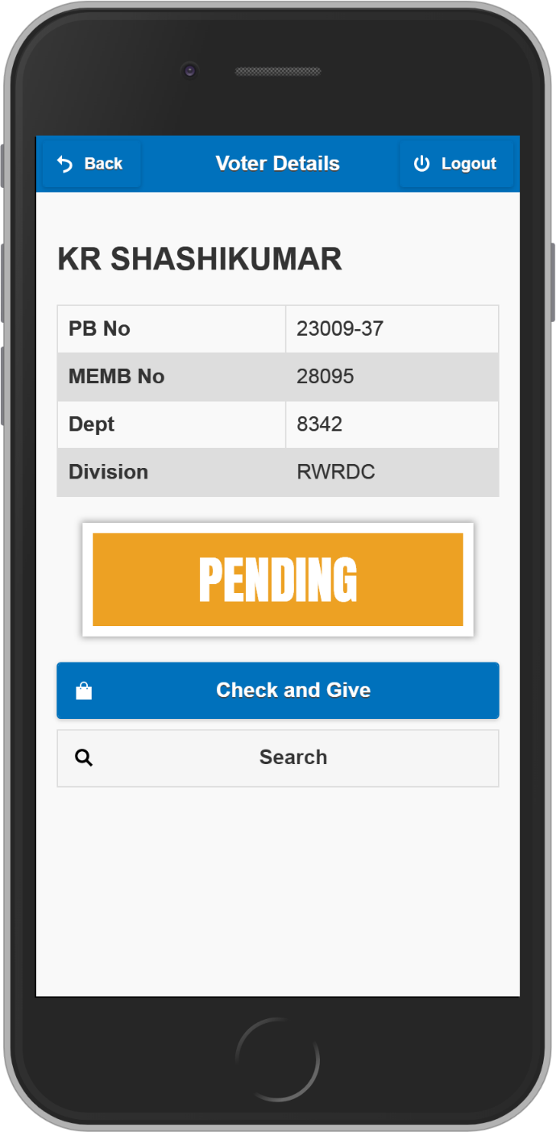
Voter details
Search employee’s PB No. to know the status of the employee
PENDING :- Gift not given yet
Press “Check and Give” button BEFORE giving gift

Slide 5
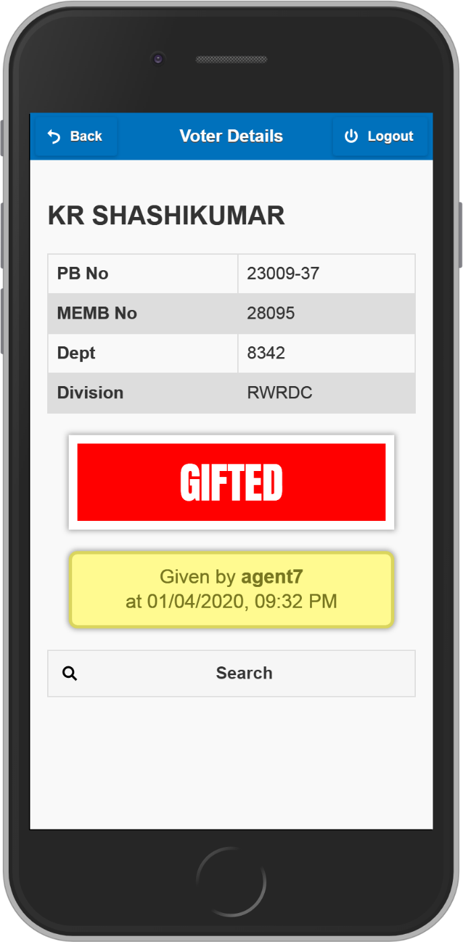
Voter details
Search employee’s PB No. to know the status of the employee
GIFTED:- Gift already given by some agent

Slide 6
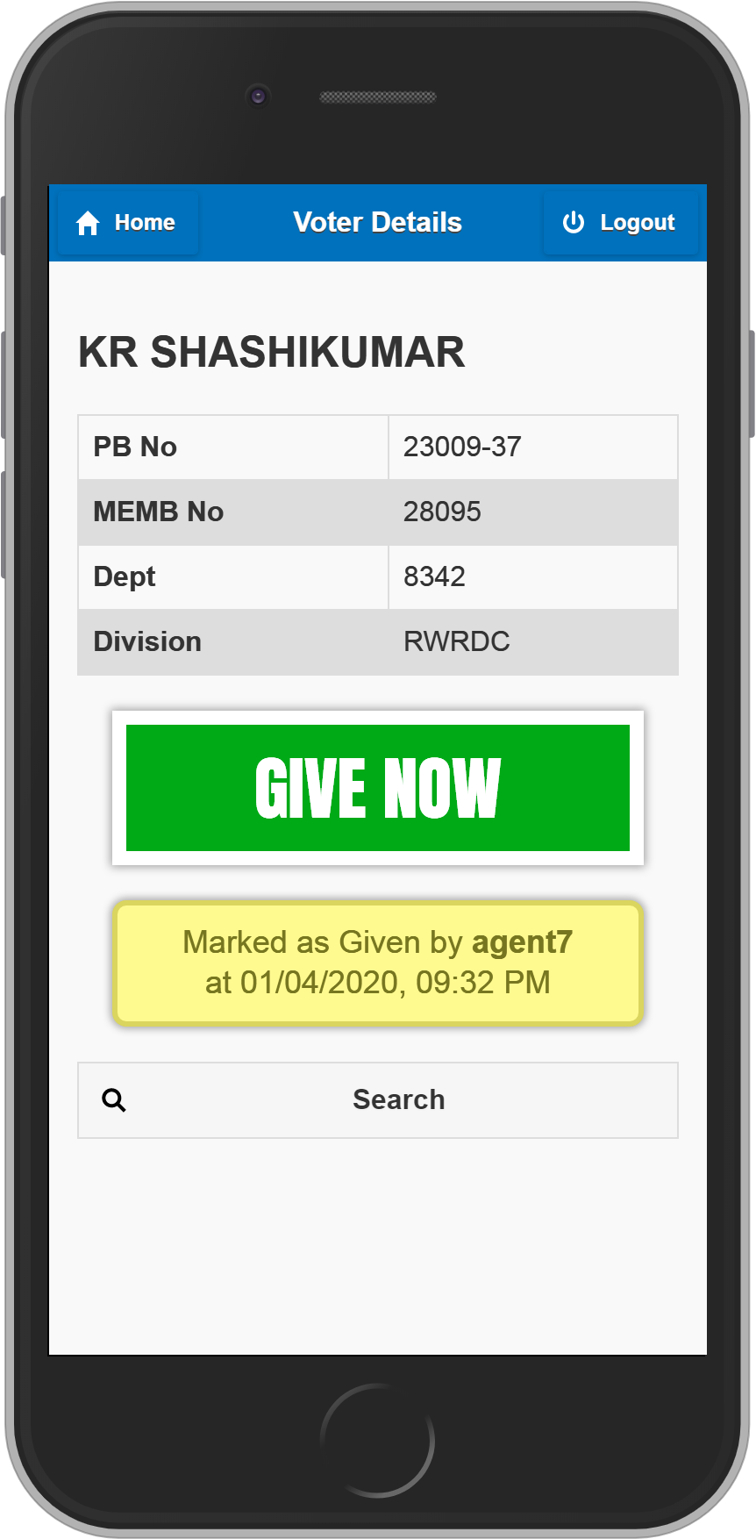
Check and Give gift
Press “Check and Give” before gifting.
GIVE NOW:- Give gift to employee
Employee will be marked as “GIFTED” by current logged-in agent

Slide 7
Check and Give gift
Press “Check and Give” before gifting.
DON’T GIVE:- Don’t Give gift to employee. Already some other agent gave gift to employee.
DON’T GIVE

Slide 8
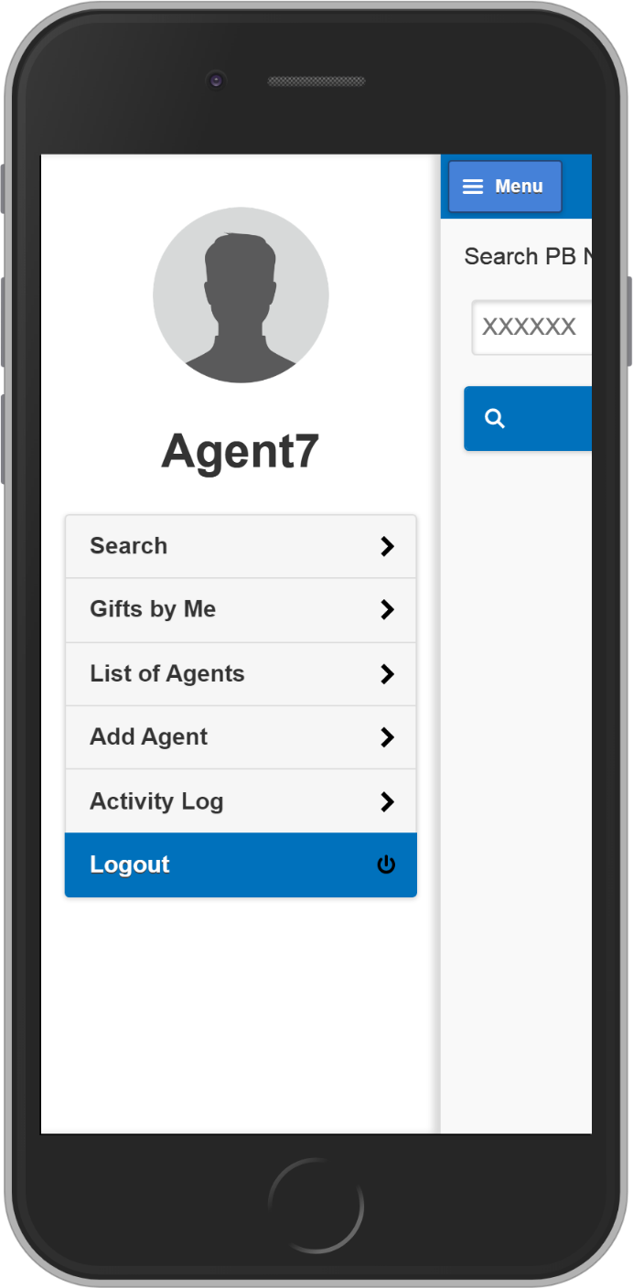
Menu
Goto any pages from Menu

Slide 9
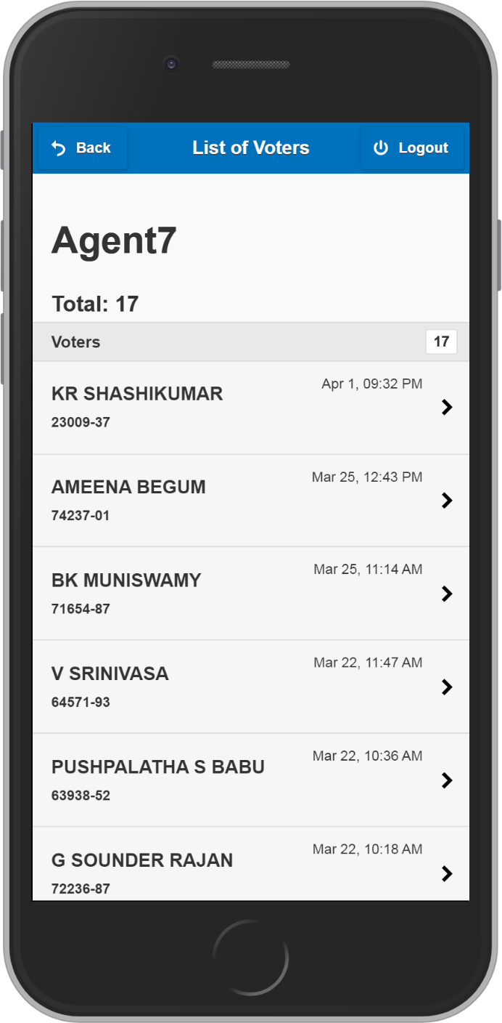
Gifts by Me
List of gifts given by currently logged-in agent

Slide 10

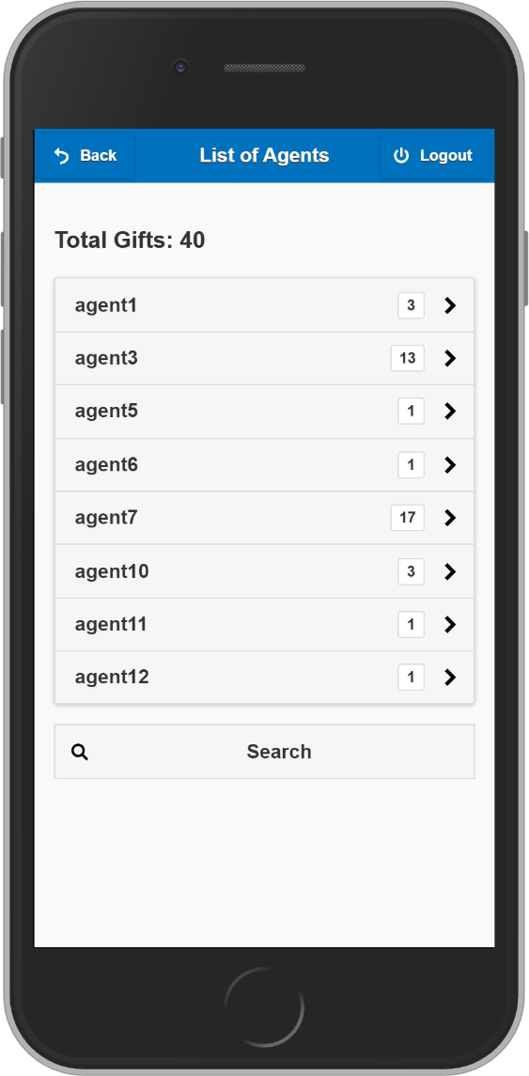
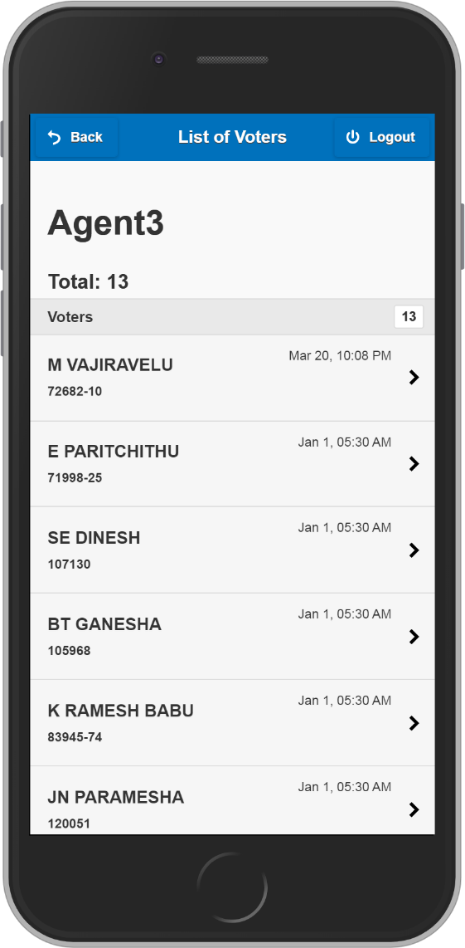
List of Agents
Tap on any agent name to get list of gift given

Slide 11
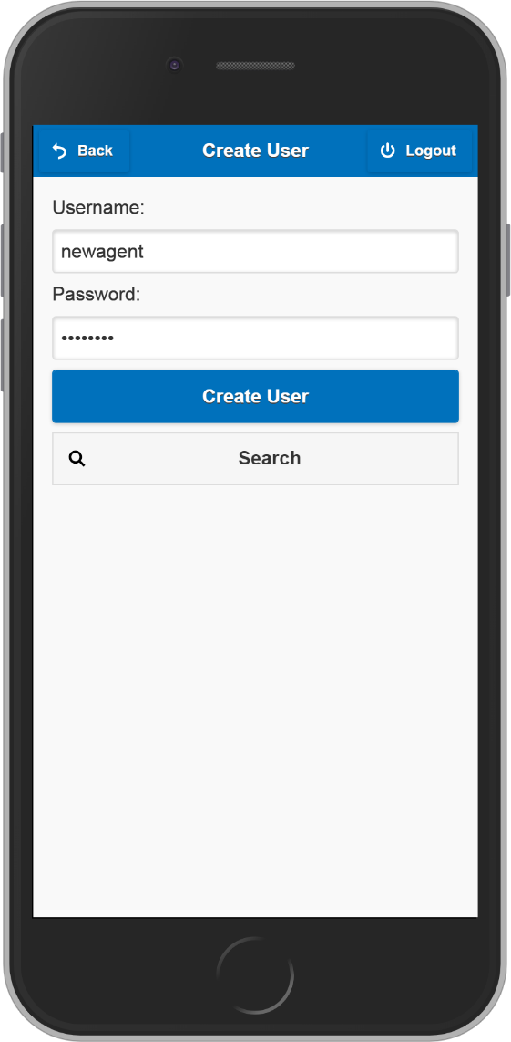
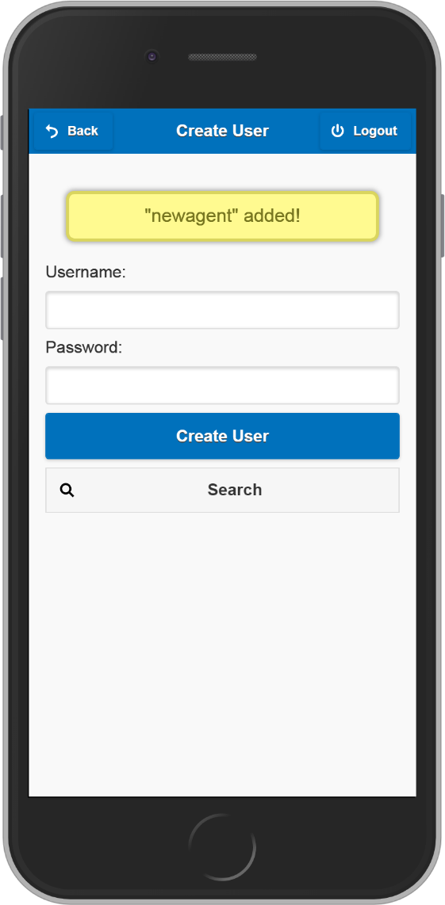
Add New Agent
Create new Agent account

Slide 12
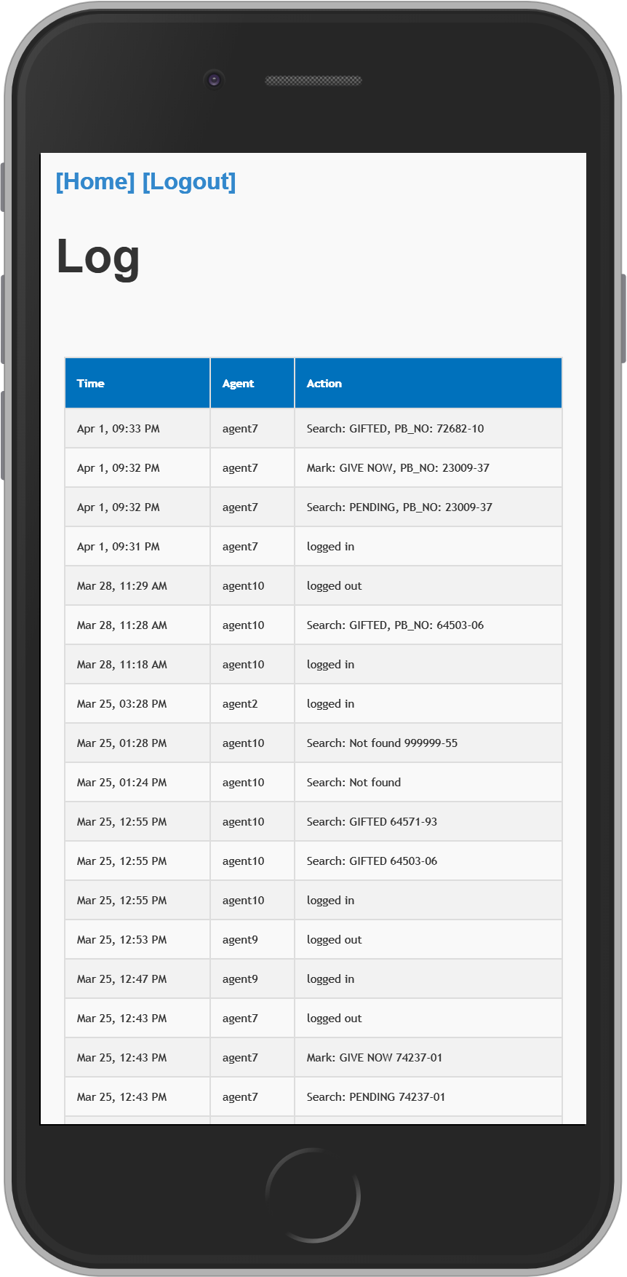
Activity Log
Live list of activities happened

Slide 13
Thank You

