Slide 1

Domain-driven design With Clean Architecture
Code It Up Workshop Vol. 2

Slide 2
For questions During The Live Event
https://sli.do #clean
The YouTube Live Chat Is Also Monitored
Join The Other Live Communication Channels

Slide 3
For questions if you watch the recording
Just Send Me A Message
wewritesoftware@gmail.com or Messenger
https://www.facebook.com/groups/codeitup/

Slide 4
RESOURCES
https://bit.ly/ddd-clean

Slide 5
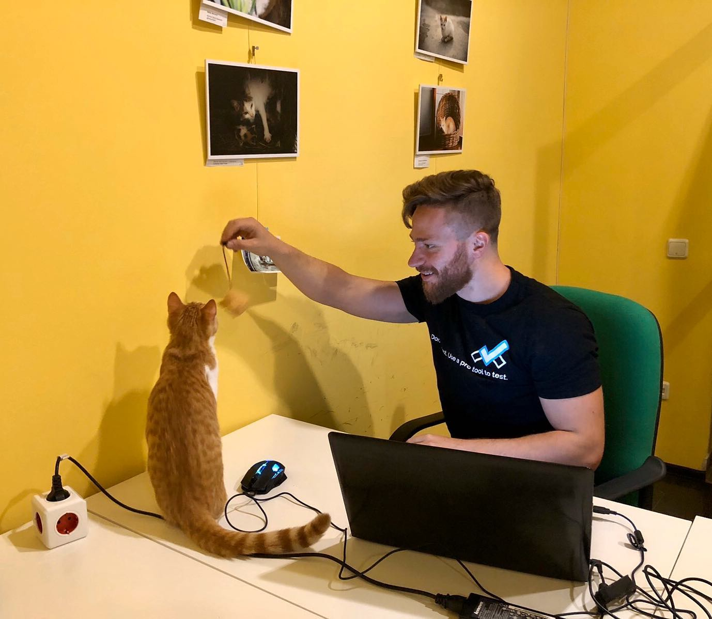
The Presenter
Ivaylo Kenov – Quality Code Advocate
Various job titles at the same time:
Organizer & Speaker @ Code It Up
CTO @ SoftUni
Full Stack Technical Trainer @ Everywhere
Code General @ https://MyTestedASP.NET
Meme Copy Machine @ Daily Programming Fun
{Insert Job Title Here}
Contacts
https://github.com/ivaylokenov
https://facebook.com/ivaylo.kenov
https://linkedin.com/in/kenov
https://www.instagram.com/ivaylokenov/
YouTube
https://youtube.com/MyTestedASPNETTV

Slide 6
What Are We Going To COVER
The Problem & Why This Topic
The Principles We Search For In An Architecture
Few Words About Database-Centric Architecture
The Domain-Driven Design Concepts
Domain Model, objects, Aggregates, Events
Factories, Repositories, Bounded Context
Clean Architecture Principles
Domain, Application, Infrastructure, Presentation

Slide 7
ABOUT CODE IT UP

Slide 8
Code it up
The Code It Up initiative:
Aims to provide detailed knowledge on advanced .NET topics
Aimed at people with at least 1 year of C# experience
Code It Up Online
Free live-streamed online events
Code It Up Networking
Free on-sight events with live streaming
Guest speakers from the industry
Networking part (with pizza and beer)
Code It Up Workshop
Paid events containing theory & practical exercises for the attendees

Slide 9
Upcoming Code it up Events
Events with set dates:
June 25 – ??? Microservices Communication / Docker ???
Events with no specific order or dates:
Automate Your Process with CI/CD
The Limits of the C# Runtime
API Scenarios - REST, GraphQL & gRPC
Serverless Real-Time C# Applications On AWS? Yes, It’s Possible & Easy!
C# On Rocket Fuel – Writing High Performance .NET
Software Engineering – Patterns & Anti-Patterns
Plus many more!
The SoftUni course for microservices is now published!

Slide 10
About this workshop

Slide 11
About this workshop
The theory behind Domain-Driven Design
The theory behind Clean Architecture
A practical guidebook for building applications
More than 60 pages!
12 sections, partial solutions, and more!
Please report in the group, if you find any “bugs” in the book!
Live coding with best practices in mind
And I have a lot more to add in the future!
You receive free updates of all resources!
MOST IMPORTANTLY – HUGE THANK YOU! <3

Slide 12
About this workshop
Requirements:
.NET Core 3.1
Visual Studio 2019 Community
SQL Server Developer Edition
A smile ☺
If you do not have any of these - install them now while the theory is on focus!

Slide 13
About this workshop
HUGE DISCLAIMER!
Domain-Driven Design is an abstract concept
More of a philosophy than an engineering guide!
There are basic rules to follow but that’s it!
Implementation is subjective and strongly opinionated
There are multiple way to design a solution
And all of them may be correct
There are multiple terminologies which describe the same concept
And all of them are correct
The source code provided here is based on my experience and research
Use it as a guide, and not as a set-in stone solution!

Slide 14
The Problem & WHY THIS TOPIC

Slide 15
The Classic Patterns Are great but
Server-side technologies are providing us only a simple “front-end” pattern
So we decide to abstract the business logic
By extracting business logic to services
However, solutions with lots of business logic will get “spaghetti” in no time
Controllers/Components/Services with thousands lines of code
No concepts and strong separation
We often separate the HTTP logic from the business logic, but that’s it
We need to concentrate on the business logic
And do not care about infrastructure & presentation details
We need scalable solutions
Scalable in terms of development teams, not in terms of throughput

Slide 16
The Principles We Search For

Slide 17
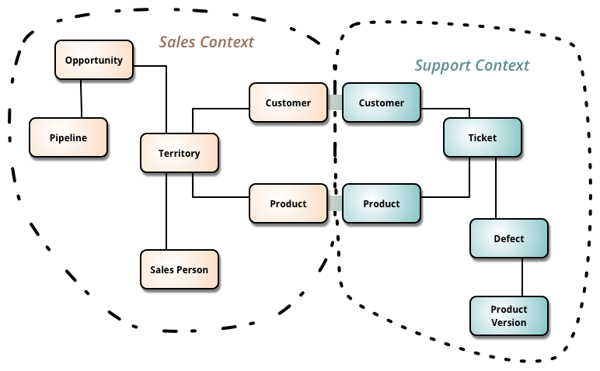
Our architecture needs
Separation of Concerns
Encapsulation
Dependency Inversion
Explicit Components
Single Responsibility
Don’t Repeat Yourself
Persistence & Infrastructure Ignorance
Presentation Ignorance
Bounded Contexts
Testability

Slide 18
Architecture abstraction
Layers:
System, Sub-systems, Layers, Components, Classes, Data and Methods
Bad Architecture:
Complex, Incoherent, Brittle, Untestable, Unmaintainable
Good Architecture:
Simple, Understandable, Flexible, Testable, Maintainable

Slide 19
A few words about the Classic Database-centric Architecture

Slide 20
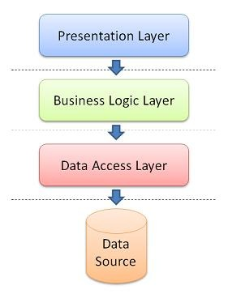
Database-centric Architecture
Database is the center of the application
The business domain and services are built around the database
It usually has the following layers
Presentation – Views or API
Business logic – external services or data-oriented
Data access layer – database-specific logic
The database is designed first
Application code comes secondary

Slide 21
Database-centric Architecture IS NOT BAD
Pros
Easy to learn
Most people understand it well
It covers most of our architecture needs
Cons
It is not flexible
It was designed for single presentation application (before smartphones)
It does not scale well – extracting microservices is a difficult task
All dependencies are towards the database

Slide 22
Domain-Driven Design Concepts

Slide 23
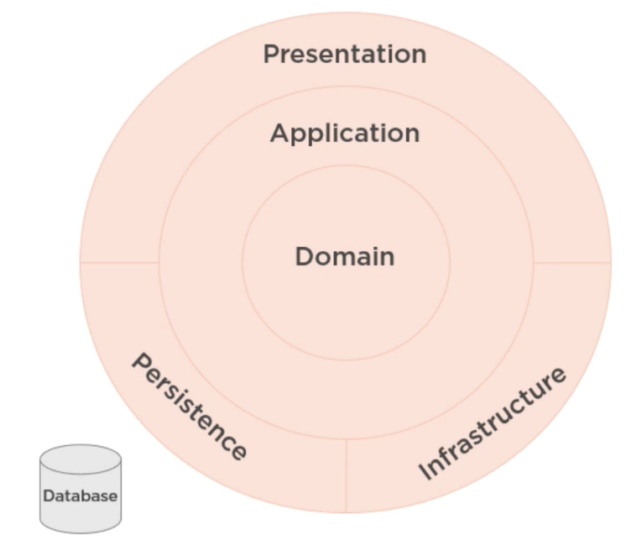
Domain-Driven Design
Business domain comes first
You do not care about the database
It is just a detail
You do not care about the presentation
We communicate with domain experts to design
A history of success with complex projects
Steps are:
Solve problems, understand client needs, and then write the code!

Slide 24
Benefits
Very flexible
Customer’s vision/perspective of the problem
Path through a very complex problem
Well-organized and easily tested code
Business logic lives in one place
Many great patterns to leverage

Slide 25
Drawbacks
Time and Effort
Discuss & model the problem with domain experts
Isolate domain logic from other parts of application
Learning curve (why this workshop was a success)
New principles
New patterns
New processes
Only makes sense when there is complexity in the problem
Not just CRUD or data-driven applications
Not just technical complexity without business domain complexity

Slide 26
DOMAIN-DRIVEN design IS SUPERIOR
Pros
Scalable in terms of development
Code has even better separation
It covers all our architecture needs
Improved patterns and flexibility
Cons
Usable when the business logic is complex
Time-consuming as it needs more classes and relationships between them

Slide 27
Domain-driven design is about code
Writing code is only part of the solution
We need to speak to domain experts
And use the same language in our code
Our domain model should “scream” the business requirements
Our classes and methods should describe the actual process

Slide 28
The domain model

Slide 29
The domain model
Problem Domain
The problem your software is trying to solve
Core Domain
The part of the business that must be perfect, and cannot be outsourced
Sub-Domains
Separate business problems which can work isolated in theory
Bounded Context
A specific responsibility, with specific boundaries that separate it from other parts of the solution
Shared Kernel
Part of the model, which is shared by two or more teams

Slide 30
Domain Model e-commerce Example
Problem Domain
We need a system for an online store
Core Domain
Obviously, the business cannot exist without products and billing
Sub-Domains
Reporting, customer data, support, etc.
Bounded Context
Shopping cart needs a Product, catalog too, but these models are different
Shared Kernel
Clients are part of all domains

Slide 31
Domain Model Pet clinic Example
Problem Domain
We need a system for a pet clinic
Core Domain
Obviously, the business cannot exist without examinations and surgeries
Sub-Domains
Appointments, billing, visit records, medical records, etc.
Bounded Context
Appointments will need a Patient model, medical records too, but they are different
Shared Kernel
Clients are part of all domains

Slide 32
Let’s dive further into the appointments
We need to talk with the client to understand the business needs
Clients (people) schedule appointments for patients (pets)
Appointments may be either office visits or surgeries
Office visits may be an exam requiring a doctor, or a tech visit
Office visits depend on exam room availability
Surgeries depend on operational and recovery space availability, and can involve different kinds of procedures
Different appointment types and procedures require different staff

Slide 33
The appointments Model
Main models:
Client can schedule a Patient (pet)
Schedule is for Appointment or Surgery
Appointment requires a Doctor and Exam Room
Surgery requires a Doctor, an Operational Room and a Recovery Room
The above models define the appointments bounded context
The medical records bounded context will also require a Patient model
But with different properties and operations

Slide 34
The domain model in the code
The domain models are the heart of the software
They are not bound by technology
Pure classes with logic, following the SOLID principles
Contain the business logic and business rules
Behaviors should follow the ubiquitous language
Create behaviors that business domain experts will understand
Anemic vs Rich domain models:
Anemic domain objects are dull – they lack business logic, and contain only data
Good for CRUD only
Rich domain models – different kinds of objects, the classes have behaviors
Our models should be persistence ignorant!

Slide 35
Domain objects

Slide 36
Types of equality
Identifier equality
Objects are equal, if their ID is equal
Structural equality
Objects are equal, if all their properties are equal
Reference equality
Objects are equal, if they use the same memory address

Slide 37
Identifier strategies
Database Identity
Usually integers, autoincremented
Works great, but you cannot have the value before saving the entity
GUIDs
Slower than Identities
Use them if the code is problematic and you need the values before saving the entities
You should have a separate indexed column
Hi/Lo
Sequences
Works like identities, but the database is called less frequently
You know the values before saving the entity

Slide 38
entities
Entities are all objects which have and ID
Entities are considered equal, if their ID is equal
These objects are mutable
Keep entities encapsulated with private setters
Mutability is done through methods and behaviors
Public constructors should create objects in valid state
Collections should be read only and immutable
NOTE: Do not confuse DDD Entity with Entity Framework Entity

Slide 39
Entities relationship
Do not use two-way relationships except in cases where it makes business sense
A bidirectional relationship means that the objects can live only together
Use one-way relationships and avoid using foreign keys, if you can
This simplifies the design, and makes sure associations make business sense
Think which way of the relationship has a better meaning
For example:
Appointment has a Doctor, Patient, and Client
Client has a Patient

Slide 40
Value objects
Measures, quantifies, or describes a thing in the domain
Identity is based on composition of values
Immutable
Compared using all values
No side effects
For example:
.NET String
Appointment – start and end date (range)
Products has price and currency (worth)

Slide 41
enumeration
Create a base class for your enumeration types
Provide common enumeration logic
Gives you more flexibility
It is more OOP-oriented than the built-int enum
It allows you to stop using enumerations for control flow
Please note that this is not a critical topic and it does not matter that much

Slide 42
Domain objects anti-patterns
Plain POCO classes
Missing validation or encapsulation
Unnatural responsibilities
Too much logic in entities
Looking for information in external sources
Communicate with external layers
Throwing generic exceptions

Slide 43
Domain services
Domain logic, which cannot be put in the domain classes directly
Don’t communicate with the outside world
They should be stateless
They should have interfaces
Do not use DTOs, use only the domain models
For example:
Transfer money from one account to another
Process shopping cart and save it as an order
No Database, Files, Mails, or other infrastructure logic
No JSON/HTTP or other presentation logic

Slide 44
Aggregates

Slide 45
Aggregates
An aggregate is cluster objects which have different types
An aggregate is treated as a single unit
Aggregates have a root – the only object with which communication is done
The root is the only one, who has a connection to the outer world
The design should consider invariants
Conditions which must be true for the application state to be valid

Slide 46
Aggregates
Aggregate Roots:
Saved & retrieved a single unit
Should maintain self-integrity & validity
Responsible for sub entities/objects
Works as a transactional boundary
Should be serializable
Two approaches:
Reference only by IDs – easier to decouple in the future
Reference by full object – more business-oriented

Slide 47
Aggregates
Consider the following design:
Appointment is the aggregate root
Client, ExamRoom, Patient, and Doctor are aggregates below it
But there is this invariant in our business rules:
Two appointments should not overlap one another
So we change the design:
The aggregate root becomes a new entity called Schedule
It contains a collection of appointments
Every appointment logic goes through the Schedule root
It validates the state of the application is valid

Slide 48
Aggregates
Some rules to follow when designing aggregates
Try to use value objects as much as possible
Do not make huge aggregates
Separate them
Entities in an aggregate root should be very cohesive
Change boundaries when you have more information

Slide 49
FACTORIES & REPOSITORIES

Slide 50
Factories
Business domain objects often become too complex
Remember that domain objects cannot be in an invalid state
So constructors tend to become quite large and difficult to use
In some cases a static factory method may be good enough
But for bigger solutions – builder factories are better
Mark constructors as internal
Mark all aggregate roots with an interface
Create a factory for each aggregate root

Slide 51
repositories
Repositories serve as an anti-corruption layer
Repositories should work only with aggregate roots
You may separate repositories to domain only repositories and query repositories which map domain models to DTOs
Prefer using specific repositories instead of generic repositories
Specific repositories communicate with the business language
Never return partially instantiated entities!
NOTE: Do not use repositories to abstract Entity Framework Core because it already acts as a repository

Slide 52
The BOUNDED CONTEXT

Slide 53
The bounded context
Central pattern in DDD and Microservices
Its focus is dealing with large models by dividing them into logical groups – Bounded Contexts
The logical groups should be very explicit about their relationships
Each Bounded Context has
Unrelated concepts – such as support ticket in a customer support context
Related concepts – products and customers
Different context may have completely different models of common concepts
But may share the same data identity
One bounded context should not be developed by more than 1 team!

Slide 54
The bounded context

Slide 55
The bounded context
Each bounded context should have:
Its own domain model
Its own factories
Its own repositories
Its own application layer
Its own persistence layer
And why not its own presentation layer?
It should not use classes meant for another bounded context
For example appointments repository should not use a billing domain model
In a perfect scenario bounded contexts will not be linked with a relationship
The bounded context span across all layers of the architecture!

Slide 56
Database design with bounded contexts
Different databases for every context
This allow you to scale easily to microservices, but it may be an overengineering at the beginning
Foreign keys are fictional without any relationship (like in a microservice approach)
One database, different interfaces for each context
This way you will have the architecture, and just need to migrate the data
Just make sure to not mix the interfaces
Foreign keys are real, but you are not allowed to use domain classes from another context
One database for the whole application
This approach is easier, but the code complexity and business logic may become so mixed up that it will be difficult to extract later
Foreign keys are real, and you are allowed to use domain classes from another context

Slide 57
How to update data in multiple contexts
A lot of times the business logic requires to update objects from multiple contexts
For example:
A client makes an appointment, and must pay in the next 3 days
If a payment is not processed, the appointment should be deleted
Domain events to the rescue
Instead of mixing business logic from both contexts, you can just fire and forget an event
Then a handler will catch the event and update the other entity
Decoupling, better communication between entities or contexts
If you wire the event logic with your ORM – it will be atomic and transactional
Only in monolithic applications
For microservices – you need to implement eventual consistency patterns

Slide 58
Domain events guidelines
Use past tense – AppointedScheduledEvent
Include as little data as possible
Do not use domain models
Use as many primitive types as possible
Use IDs when possible
Include full information, if completely necessary
Domain events should be created by the domain layer
But the infrastructure layer should know how to dispatch them

Slide 59
Types of Physical isolation
Same assemblies
You define different contexts in different folders
Separate assemblies
You define different contexts in different assemblies
Separate processes
With separate deployments
The more you separate – the more maintenance overhead!
Be pragmatic and start with the easiest one!

Slide 60
Domain-driven design summary

Slide 61
Domain-driven design summary
Focus on the business logic
Talk to domain experts
The domain model is the first-class citizen in the application
Every other layer communicates with it
Classes are encapsulated and validated
Communication with outer layers is done through gateways like factories and repositories
Bounded contexts define the boundaries of different business “units”
Communication between contexts is done through events
Break the DDD rules only for performance reasons!

Slide 62
CLEAN ARCHITECTURE

Slide 63
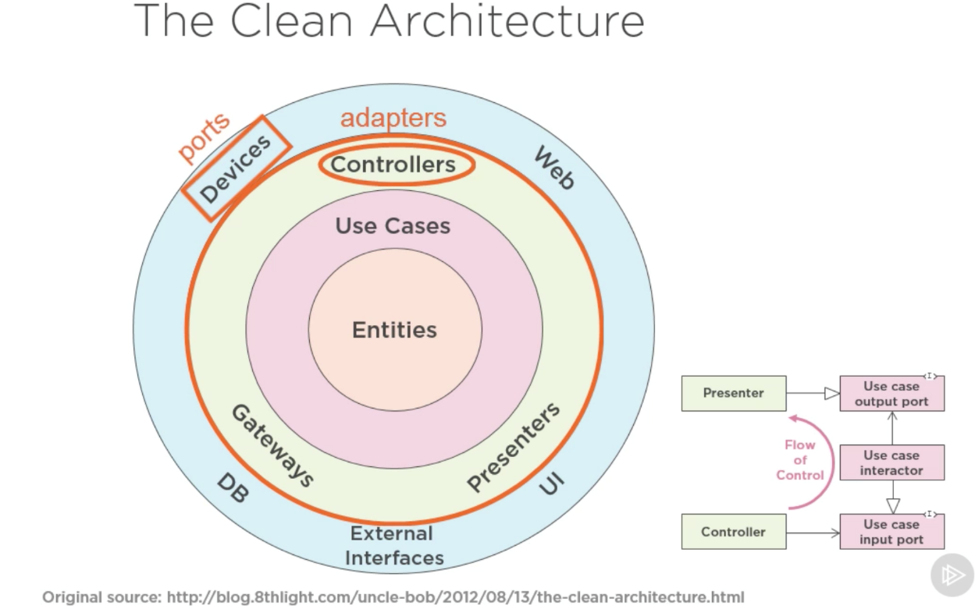
History Lesson
Domain-Driven Architecture is also known as
Hexagonal Architecture
Ports & Adapters
Onion Architecture
Everything Points Toward The Domain
Clean Architecture
The “Latest” Installment

Slide 64
TERMINOLOGY Disclaimer
Interactors
Represent use cases
The business logic which interacts with the entities
Uses interfaces and no implementation details
In other words – factories, repositories, gateways
Boundary
Responsible for translating data from one layer to another
Uses ports, models or results

Slide 65
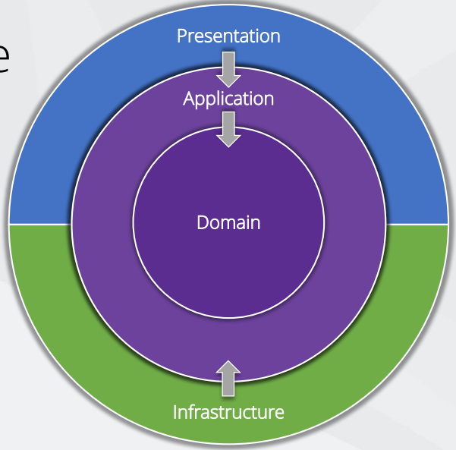
CLEAN ARCHITECTURE
Domain and use cases are important
Infrastructure and presentation are details
Independent of frameworks
Independent of UI
Independent of database
Independent of anything external
Testable

Slide 66
CLEAN ARCHITECTURE
Pros
Focus on business logic
Less coupling
Allows DDD
Cons
Requires more though
Initial higher cost

Slide 67
KEY CONCEPTS
Domain contains enterprise-wide logic and types
Application contains business-logic and types, uses interfaces
Infrastructure contains all external concerns, uses implementations
Presentation and Infrastructure depend only on Application
Infrastructure and Presentation components can be replaced with minimal effort
We pass data between layers with input/output models

Slide 68
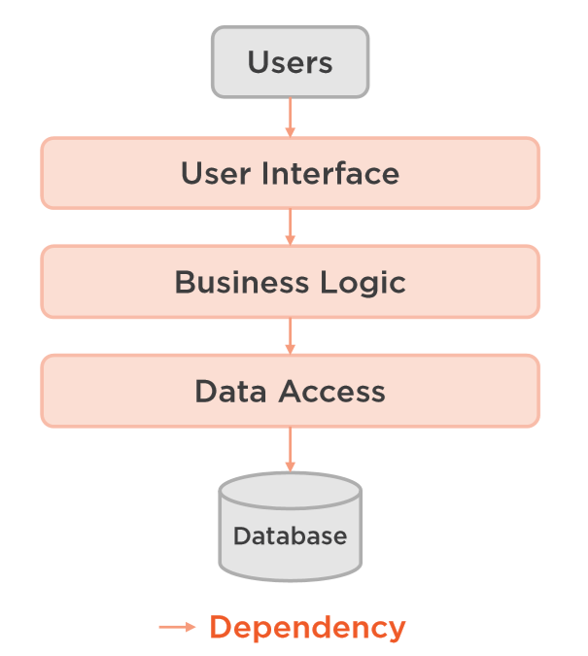
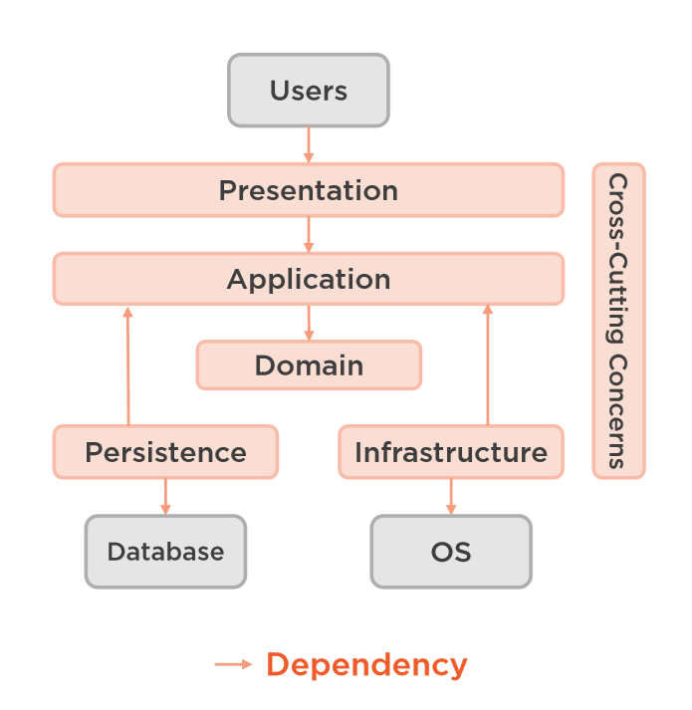
design

Slide 69
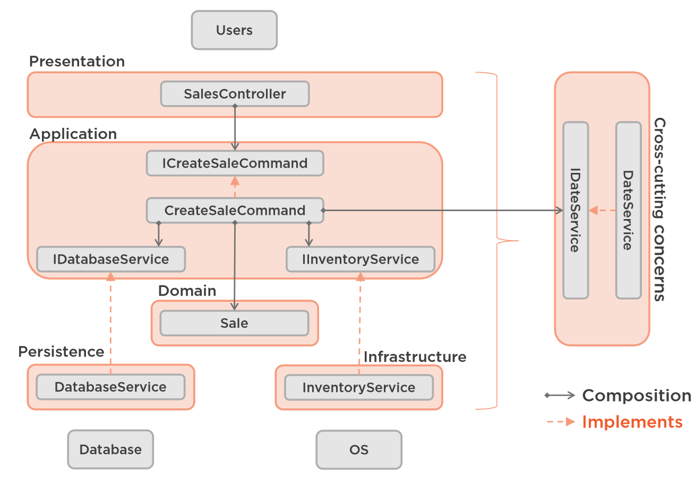
design

Slide 70
DOMAIN
Entities, Value Objects, Enumerations, Exceptions, Domain Logic, Events
Don’t use data annotations
Create custom domain exceptions
Initialise all collections & use private setters
Consideration: internal constructors
Consideration: public factories only for the aggregate roots

Slide 71
Application
Interfaces, Models, Logic, Commands & Queries, Validators
Use CQRS – commands & queries – simple and scalable
Easy to add new features
Easy to maintains, one change effect one query
Add MetiatR and save yourself from too much classes
Application layer becomes just input/output objects
Easy to add additional behaviour before or after each request caching, logging, validation

Slide 72
Application
Using CQRS + MediatR simplifies your overall design
MediatR simplifies cross cutting concerns
Fluent Validation is useful for all validation scenarios
AutoMapper simplifies mapping and projections
Independent of infrastructure concerns

Slide 73
Input/output models
Application layer should always use input/output models to communicate with the outer world
Do not inherit or reference domain models
Do not reuse the same input model for multiple use cases
Use base classes where appropriate
Try to reuse the output models as much as possible
Define only properties, which are needed for the use case
Add only formal validation, do not include complex domain-specific logic
Never auto-map input models to domain entities, use factories & domain methods

Slide 74
Infrastructure
Persistence, Identity, File System, System Clock, API Clients, Payments, E-mails, Etc.
Independent of the database
Use Fluent API configuration over data annotations
Prefer conventions over configuration
Automatically apply all entity type configurations
No layers depend on Infrastructure layer, e.g. Presentation layer

Slide 75
Infrastructure
What About Repository Pattern?
It depends, but keep in mind:
EF Core insulates your code from database changes
DbContext acts as a unit of work
DbSet acts as a repository
EF Core has features for unit testing without repositories
Personally, I do not use it anymore, except when I want to protect aggregate roots from the other layers
Considerations: the Specification pattern

Slide 76
Presentation
Angular, React, Vue, Web API, Razor Pages, MVC, Web Forms
Controllers should not contain any application logic
Create and consume well defined models
Bonus
Open API bridges the gap between the front end and back end
NSwag automates generation of Open API specification and clients

Slide 77
tests
Domain layer – unit tests – domain logic
Application layer – unit tests – commands & queries logic
Infrastructure layer – integration tests – each testable component
Web layer – integration tests – every request
Prefer using the same project for tests, development is easier

Slide 78
FINAL Lecture WORDS

Slide 79
Lecture summary
The Problem & Why This Topic
The Principles We Search For In An Architecture
Few Words About Database-Centric Architecture
The Domain-Driven Design Concepts
Domain Model, objects, Aggregates, Events
Factories, Repositories, Bounded Context
Clean Architecture Principles
Domain, Application, Infrastructure, Presentation

Slide 80
Any Questions?

Slide 81
Your Turn Now!
Download the resources from here: https://bit.ly/ddd-clean
Ask questions on sli.do:
https://sli.do #clean
Join the virtual classroom if you need to share your screen!
Use the Facebook group for questions after the event:
https://www.facebook.com/groups/codeitup/

