Slide 1
Encrypted ESP Ping
draft-antony-ipsecme-encrypted-esp-ping
Antony Antony <antony.antony@secunet.com>

Slide 2
IPsec Background
IKE is control plane (UDP 500 or UDP 4500)
ESP is Data plane (ESP or ESP-in-UDP 4500)

Slide 3
Problem Statement
Diagnose after IKE is established
ESP packets do not share fate with IKE
IKE might succeed but ESP packets are dropped
Hard to detect and recover
Data traffic is blackholed
Why Not Use Existing IP Tools?

Slide 4
Why not ping over IPsec?
eth0: 192.0.2.126/25
eth1: 192.0.2.252/25
eth0: 192.0.1.254/25
eth1: 192.1.2.23/24
pacifica
sunset
west
east
eth0
eth0
ESP
eth1
eth1
ESP
eth0
eth1
eth0: 192.0.2.125/25
eth0: 192.0.2.254/25
eth1: 192.1.2.45/24
xfrm policy 192.0.2.125/25 <-> 192.0.2.125/25
Xfrm state 192.1.2.23 <=> 192.1.2.23
espping -I 192.1.2.45 192.1.2.34 <data>

Slide 5
Use cases
Diagnose ESP Blocked or Filtered
Probing Multiple ESP Paths to same end point
Probe Return Path
  ESP is two unidirectional Security Associations

Slide 6
Example
espping -s <size> -I <src ip> [--spi <spi>] <dst ip>
espping -I 192.1.2.23 –spi 0xAABBCCDD 192.1.2.45

Slide 7
Packet format : Request
IP Header
ESP
Protocol 50
Next Header 144
AGGFRAG_PAYLOAD
Sub-type (3) ESP-ECHO-REQUEST
Echo Payload
R Flag
Data Length
Return Path SPI
Identifier
Sequence #
Optional Data

Slide 8
Packet format : Response
IP Header
ESP
Protocol 50
Next Header 144
AGGFRAG_PAYLOAD
Sub-type (4) ESP-ECHO-RESPONSE
Echo Payload
R Flag
Data Length
Return Path SPI
Identifier
Sequence #
Optional Data

Slide 9
RFC 9347 CC Payloads
0 1 2 3 4 5 6 7 8 9 0 1 2 3 4 5 6 7 8 9 0 1 2 3 4 5 6 7 8 9 0 1
Sub-type (1)
Reserved |P|E|
BlockOffset
BlockOffset
LossEventRate
RTT(22)
Echo Delay(21)
Transmit Delay (21)
TVal
TEcho
DataBlocks ...

Slide 10
IP-TFC Congestion Control Payload
CC payload helps to discover path properties:
  One way delays,
- loss rate.
- estimate bandwidth
Useful to probe manually even when IP-TFS is not negotiated

Slide 11
IKEv2 Notify to announce support?
Add IKEv2 Notification in -03 I.D.
ENCRYPTED_PING_SUPPORTED

Slide 12
SADB Implementation on receiver
How to validate Return Path requested?
  SADB is unidirectional
  Especially when there are multiple SAs
  Only IKEd knows the return path in its peer DB

Slide 13
Questions / Feedback?
Adoption?

Slide 14
Similar ideas
MPLS LSP ping with return path : RFC 7110
Bidirectional Forwarding Detection (BFD)
  IP only (Not suitable for Encrypted ESP Ping)
  https://www.rfc-editor.org/rfc/rfc8562

Slide 15
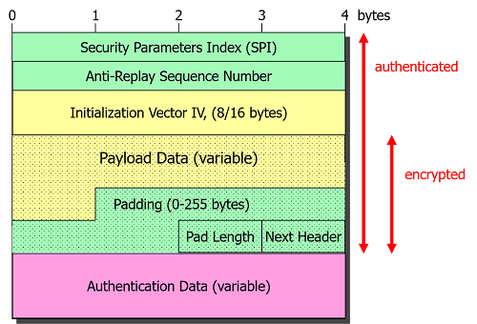
ESP Message

