Slide 1
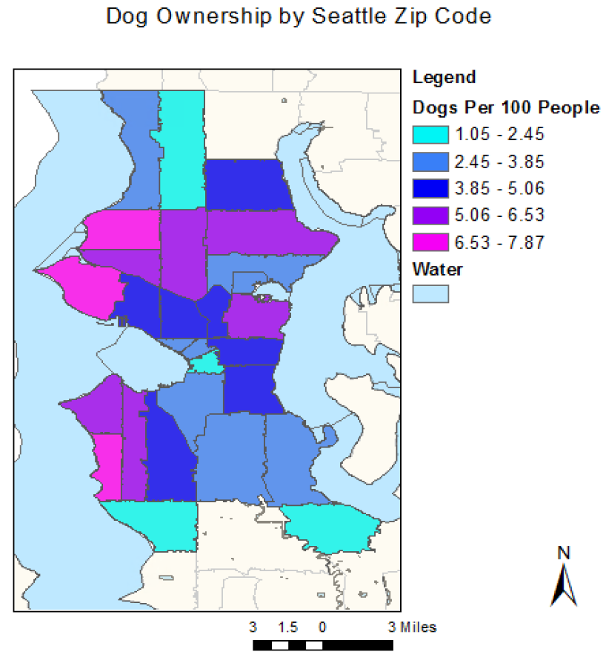
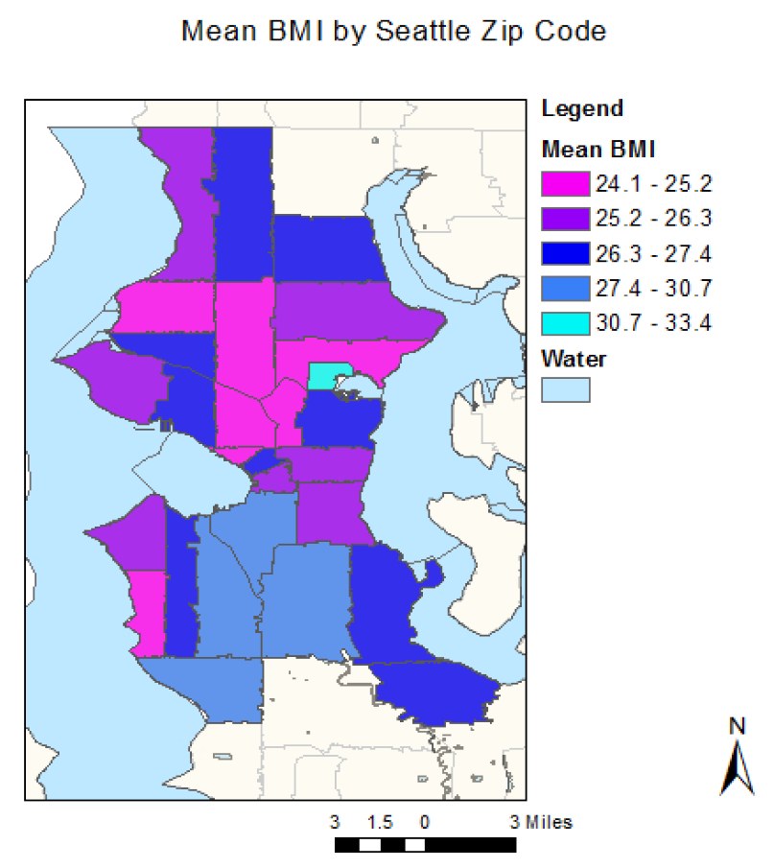
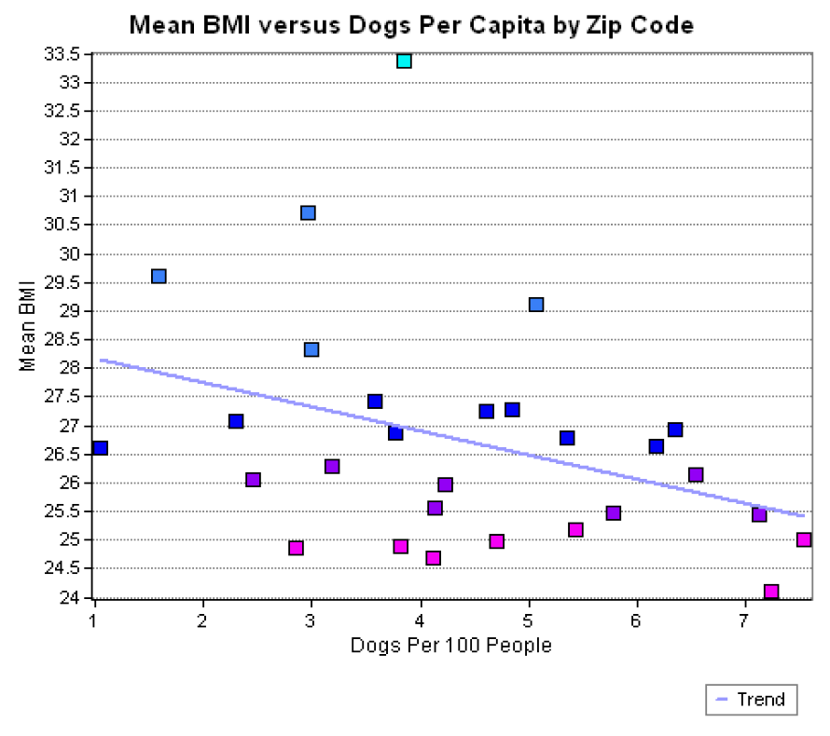
Associations Between Dog Ownership and Health
Physical activity: “During the past month, other than your regular job, did you participate in any physical activities or exercises such as running, calisthenics, golf, gardening, or walking for exercise?”
Body mass index: Calculated from self-reported height and weight
Mental health: “Thinking about your mental health, which includes stress, depression, and problems with emotions, for how many days during the past 30 days was your mental health not good?”

