Slide 1

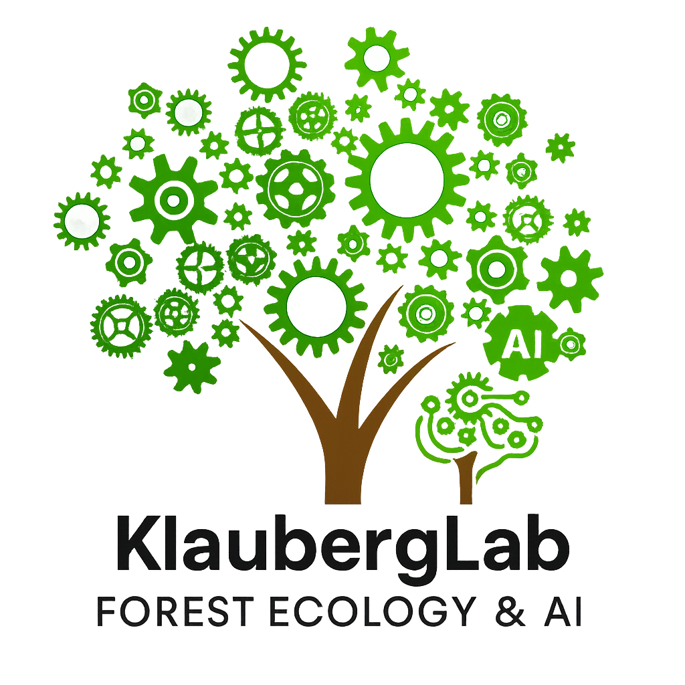
KlaubergLab
Forest Ecology and AI Lab

Slide 2
KlaubergLab
Forest Ecology, GIS and Artificial Intelligence Lab

Slide 3
KlaubergLab

Slide 4
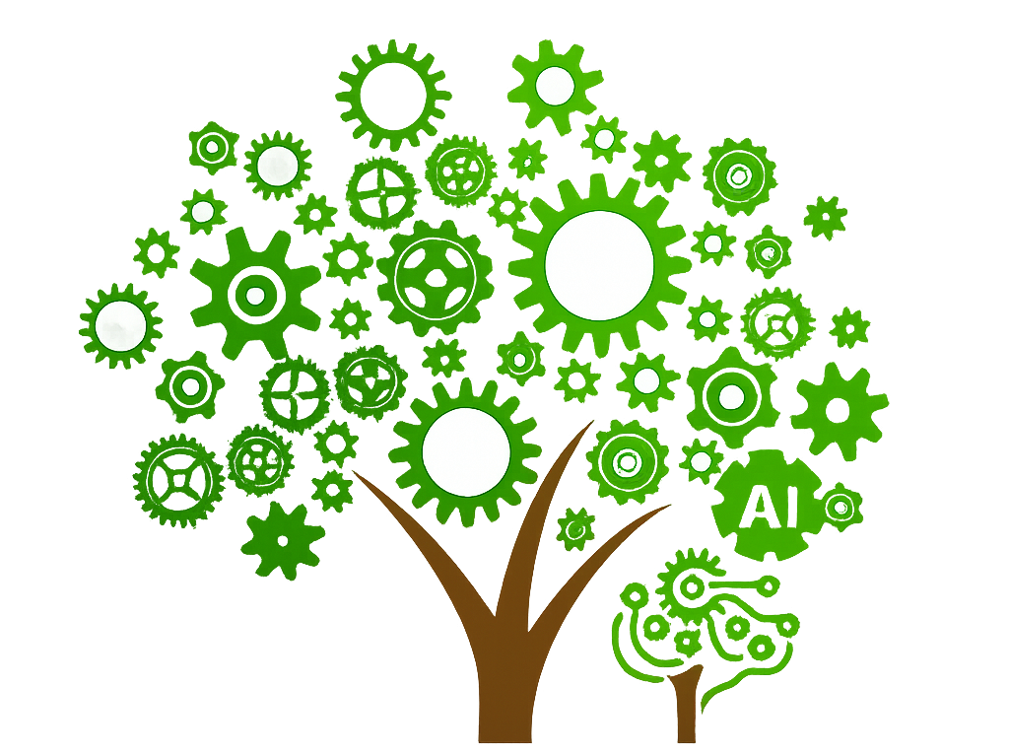
KlaubergLab

