Slide 1
802.11 Physical layer

Slide 2
PHY functionalities
Wireless transmission mechanism for the MAC
Assessing the state of the wireless medium and reporting it to the MAC
Independence between MAC and PHY → enhancements
802.11b, 802.11a, 802.11g PHYs use the same MAC

Slide 3
PHY layer
Two sublayers
  Physical Layer Convergence Procedure (PLCP)
  Physical Medium Dependant (PMD)
The PLCP is essentially a handshaking layer that enables MAC prtocol data units (MPDUs) to be transferred between MAC stations over the PMD
PMD is the method of transmitting and receiving data through the wireless medium.

Slide 4
PLCP
It provides the interface, regardless of the PHY, for the transfer of data octets between MAC and the PMD
  PLCP TX MAC to PHY: “start a transmission”
  PLCP TX PHY to MAC: “transmission completed”
  Similar at the receiver side

Slide 5
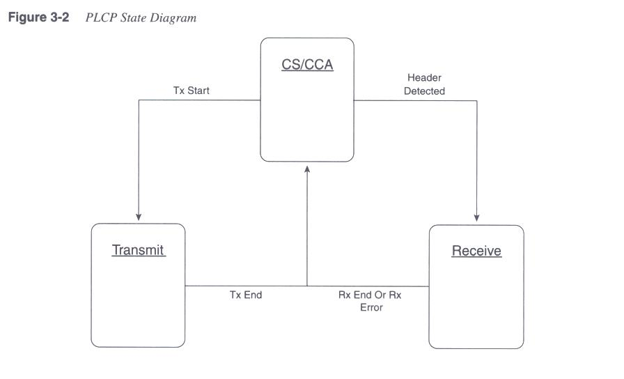
PLCP diagram
Carrier sense/clear assessment

Slide 6
PHY building blocks
Scrambling
Coding
Interleaving
Symbol mapping and modulation

Slide 7
Scrambling
One of the assumption of modern transmitter design is the assumption that the data you provide appears to be random.
It allows higher spectral efficiency.
Scrambling is a method for making the data you receive look more random by performing a mapping between bit sequences, from structured to seemingly random sequences.

Slide 8
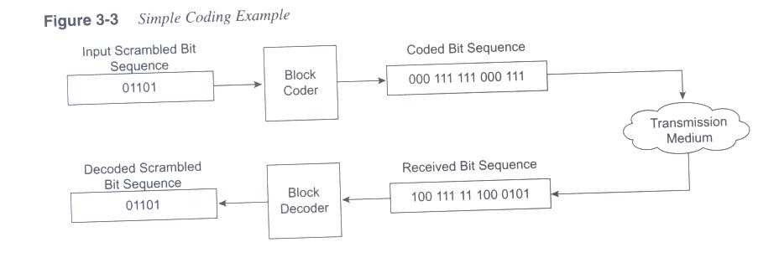
Coding
High speed transmission over noisy channels

Slide 9
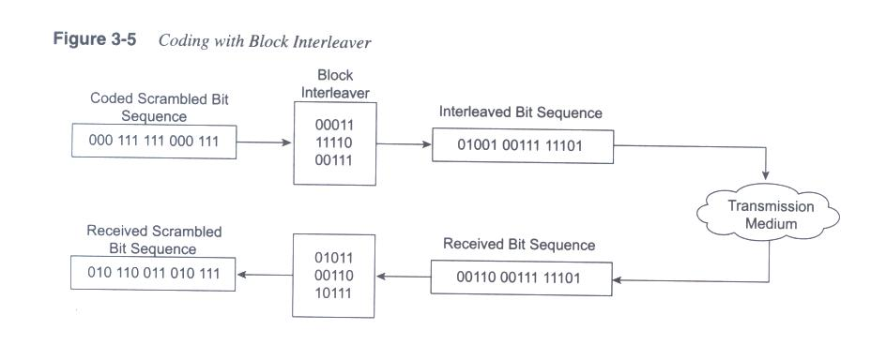
Interleaving
Assumption of codes: errors are independent events
You might often find that bit errors are not independent
Interleavers → errors look more independent

Slide 10
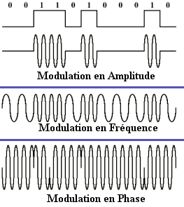
Symbol mapping and modulation

Slide 11
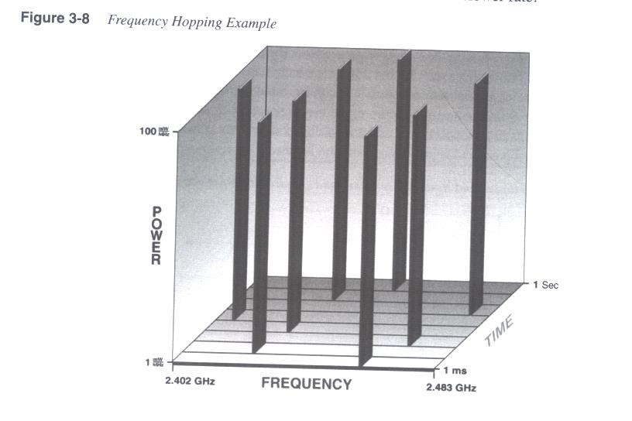
802.11 2.4 GHz FHSS
79 non overlapping channels 1MHz wide (USA and EU) 2.402 - 2.480 GHz
Hopping sequence: hop min rate 2.5 times/sec, minimum of 6 channels

Slide 12
802.11 2.4 GHz FHSS
FHSS PMD sublayer modulates the data stream by using
FSK
  PRO: simple system
  CONS: spectrally inefficient (no high data rates), interferences in the ISM band, NO mechanism to coordinate the hopping of adjacent APs (scalability)
f
f_{c}- f_{d}
f_{c}
f_{c}+ f_{d}
Hopping sequence

Slide 13
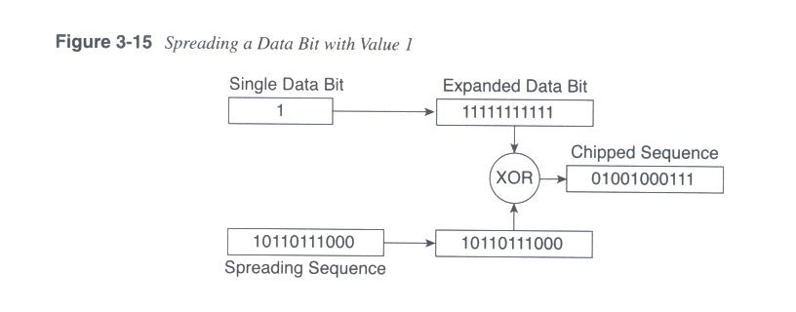
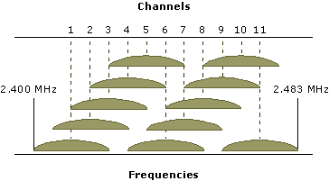
802.11 2.4 GHz
DSSS
22MHz channels, in 2.4 - 2.483 GHz → 3 non overlapping channels
1Mbps DBPSK (bit, phase)(0,0)(1,180)
2Mbps DQPSK (chip, phase)(00,0)(01,90)(11,180)(10,270)

Slide 14
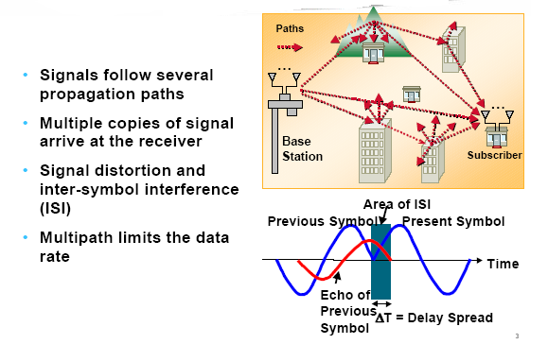
Multipath

Slide 15
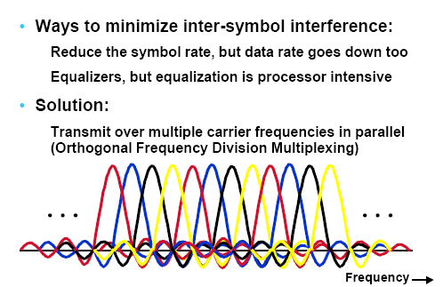
Diversity

Slide 16
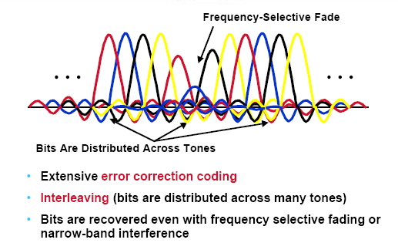

Slide 17
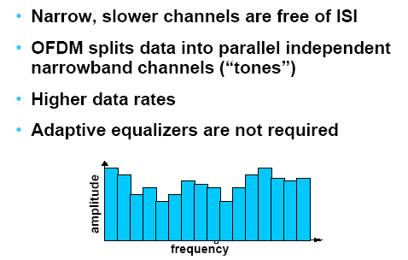
OFDM

Slide 18
