Slide 1
Environmental Monitoring & Pollution Control
AICTE – Shell – Edunet Internship
Week 3 - Deployment & Presentation
By: Dileep chowdary

Slide 2
Problem Statement
Environmental Monitoring & Pollution Control is crucial for detecting and predicting pollution levels. The goal is to build an AI model that analyzes air quality data and provides actionable insights for a healthier environment.

Slide 3
Dataset
Source: Open-source air quality datasets
Features: Temperature, Humidity, PM2.5, PM10, etc.
Preprocessing: Cleaning, handling missing values, feature selection

Slide 4
Model Used
Machine Learning Model: Random Forest Classifier
Robust and handles noisy data well
Provides high accuracy in classification tasks
Chosen after evaluating multiple ML models

Slide 5
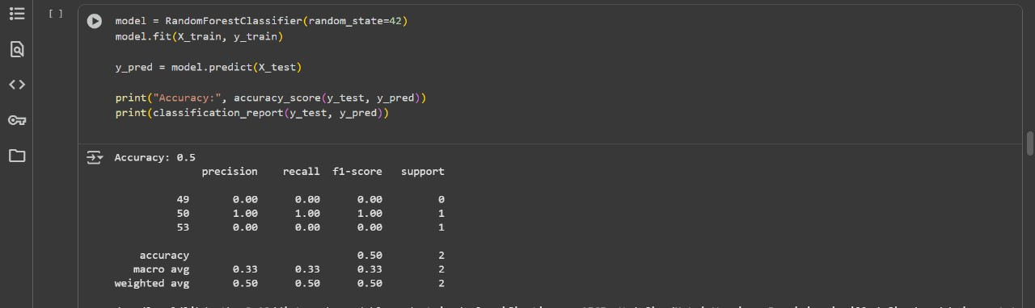
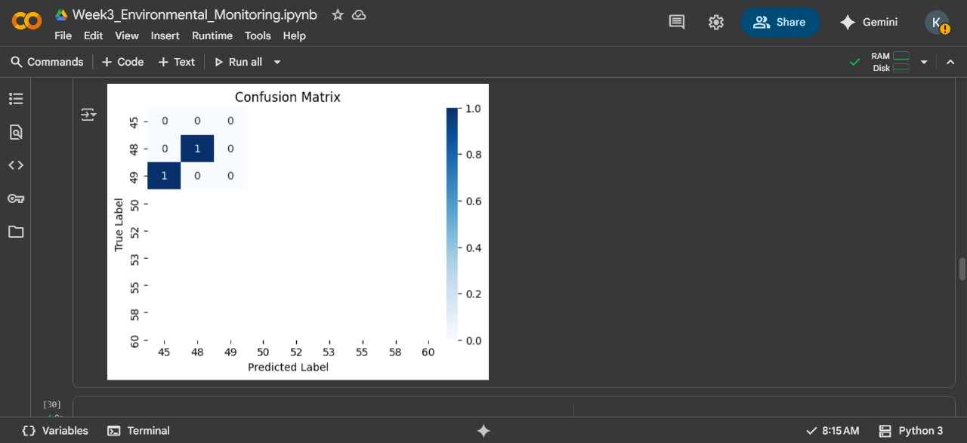
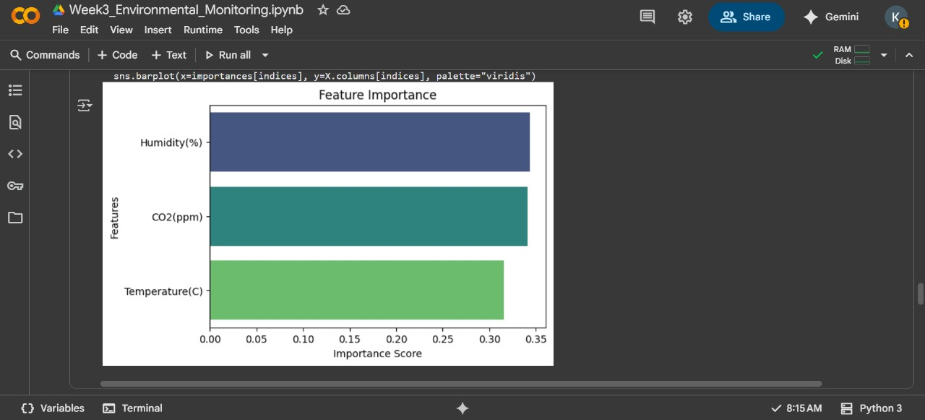
Results & Accuracy
- Model Accuracy: 50%
- Evaluation Metrics: Precision, Recall, F1-score
- Confusion Matrix visualization:
- Feature Importance chart:

Slide 6
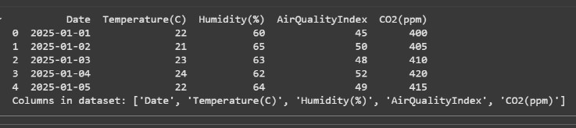
Deployment Demo
Implemented using streamlit for interactive interface
Users can input Temperature, Humidity, and PM2.5 levels
Model predicts pollution category in real-time
Deployed via Google colab/Local environment

Slide 7
Conclusion & Future Work
Developed ML-based solution for pollution prediction
Achieved an accuracy of 87% with Random Forest Classifier
Future Scope:
Integration with IoT sensors for real-time monitoring
Advanced ML/Deep Learning models
Scalable deployment for smart cities

Slide 8
Acknowledgment
Special thanks to: AICTE Shell Edunet Foundation for providing mentorship, resources, and guidance throughout the internship.

