Slide 1


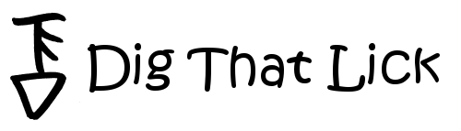
Computers in Systematic Musicology
Klaus Frieler
Institut für Musikwissenschaft, Weimar-Jena
SysMus 2019
HdPK Berlin
Sep 12, 2019

Slide 2
Computational Musicology

Slide 3
Computational Musicology
Complements and enhances existing and provides new analysis methods.
Pioneered by corpus-based sub-fields of musicology (e.g., ethnomusicology, old music research).
Boost since the early 2000s driven by Music Information Retrieval and by pervasion of computers and the internet („Music Google“).
Very active research field.
Connections to many different subfields of musicology.
Computational ≠ digital musicology!

Slide 4
Computational Musicology
Advantages:
Facilitates collection and curation of big data sets (improved reliability).
Necessary to analyse big musical data sets.
Acceleration of research processes.
Development, test and simulation of models.
Enables analysis pathways that are otherwise hard to obtain (e.g., timbre, intensity, intonation).

Slide 5
Computational Musicology
Issues:
Focus on quantitative methods.
Often simplified and specific definitions of concepts are needed to suit them for computer-use (can also be an advantage!).
High entry threshold (extra knowledge in maths, computer science, stats, machine learning, signal procession etc. required).
„Proving the obvious“ (but: „hindsight bias“).
Fear of “trivializing” the music and the musician.

Slide 6
Computational Musicology
Transcriptions
Audio
Metadata
Score
Sound Analysis
Music Analysis
Statistics
Results

Slide 7
Excursion: Features
Features are numerical or categorial properties of entities, here: of melodies.
Mostly based on some transformation of the melodical surface.
External metadata also considered features.
Possibility space for feature is virtually infinite (modular construction system: „feature machine“).
Currently, over 600 pre-defined features in the MeloSpyGUI.

Slide 8
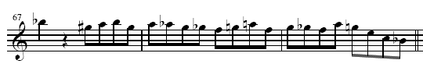

Excursion: Transformations
Excerpt from Bob Berg’s solo on „Angles“
pc: 10 8 9 10 8 9 8 7 6 5 6 9 5 7 6 5 9 7 4 0 10
cpc : 7 5 6 7 5 6 5 4 3 2 4 6 2 4 3 2 6 4 1 9 7
cdpc: 5 4 T 5 4 T 4 3 B 2 3 T 2 3 B 2 T 3 2 6 5
int: -2 1 1 -2 1 -1 -1 -1 -1 2 2 -4 2 -1 -1 4 -2 -3 -4-2

Slide 9
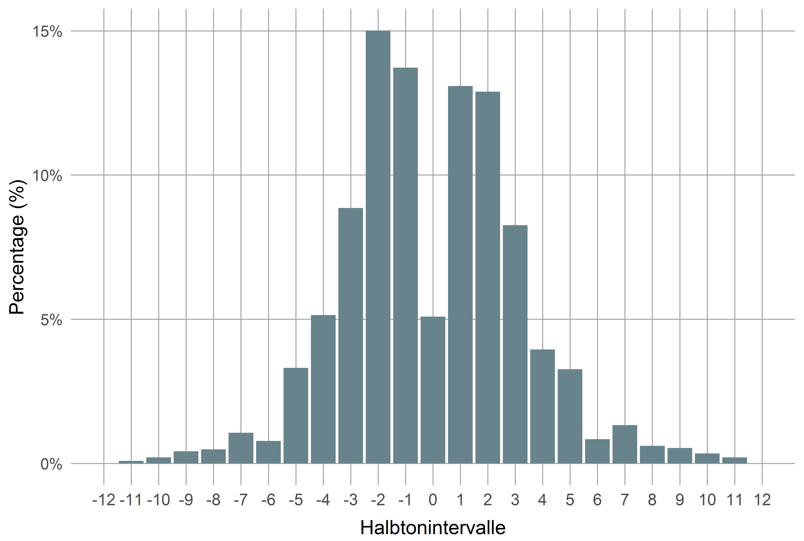
Example: Interval Distribution

Slide 10
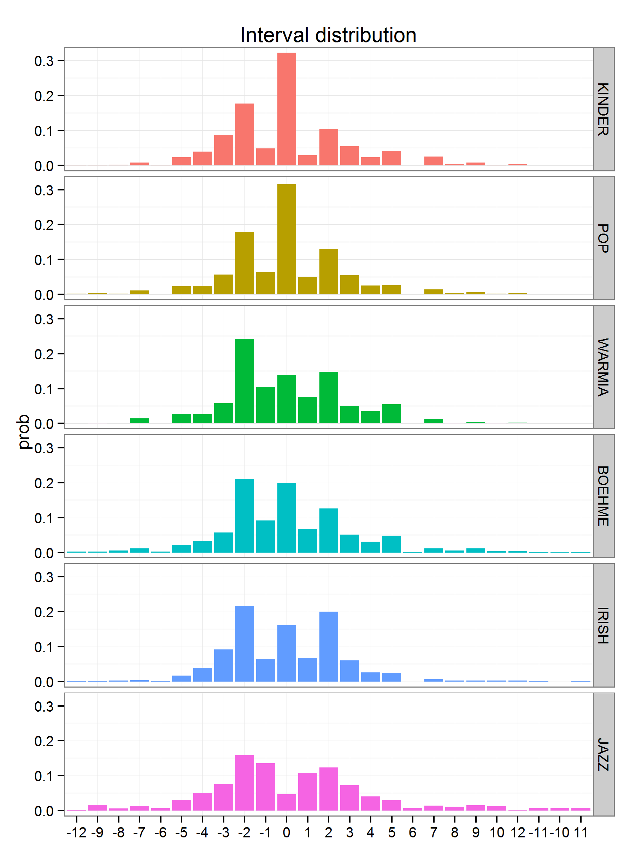
intervallverteilung

Slide 11
Hands-on for everyone

Slide 12
JRP/DTL Web Tools
Tools to be used
Feature History Explorer
Pattern History Explorer
Dig That Lick Pattern Search
Dig That Lick Similarity Search
Links: https://jazzomat.hfm-weimar.de/interactive.html

Slide 13
Feature History Explorer
Visualizes development of solo features in the WJD over time.
x-axis: recording year (or decade).
y-axis: selected feature.
Scatterplot with (polynomial) regression line.
Goodness-of-fit values: R², p value, AIC.
With or without aggregation.
Filtering, colouring, and presentations options.
Selecting area in plot displays data table for selected solos (only for unaggregated data).

Slide 14
Pattern History Explorer
Contains selection of 653 common interval patterns by eminent performers and its instances in the WJD.
See “Help” tab for further details
Listen & See: Shows pattern instances (score, audio, metadata)
Instances: More detailed info on instances
Stats: Stats for the pattern and its instances
Timeline: Distribution of instances over recording time and performers
General Stats: Stats of all patterns

Slide 15
Dig That Lick Pattern Search
Allows very flexible search for patterns in the WJD, the Essen Folk Song Collection and the Omnibook.
Entry via abstract notation or virtual keyboard.
Many different types of patterns. (“transformations”)
Secondary search (search in search results).
Metadata filter
Displays scores and audios + additional metadata.

Slide 16
Dig That Lick Similarity Search
Allows similarity search for patterns in the WJD,.
Entry via abstract notation or virtual keyboard.
Interval, fuzzy interval, pitch and CDPCX patterns.
Metadata filter.
Filter for extra conditions.
Displays audios + additional metadata.
Timeline and network visualizations.

Slide 17
Exercises
All questions and exercises (+ more) can be found here:
https://github.com/klausfrieler/digthatlick_lecture
Exercise are of different difficulty levels and mostly open ended.
Please choose freely exercises and tools you want to work on.
Group work highly recommended.
Ask me anything anytime.
Send me your results, if you want to have feedback.
You might want to start with the green ones.
Have fun!

Slide 18
Feature History Explorer
Questions & Tasks (select as you wish)
What das abs_int_range mean? Give an intuitive explanation.
What drives the trend in abs_int_range?
What does CDPCX mean?
Which CDPCX values show significant trends?
How do trends changes when you select “Mean” aggregation? Why?
Find a feature with a much better quadratic trend ( = larger R² and smaller AIC).
Which solo has the highest event density, which the lowest?
Which feature has the strongest aggregated trend?

Slide 19
Pattern History Explorer
Questions & Tasks (select as you wish)
Find the longest arpeggio patterns. Who owns it?
Find the longest “non-trivial” (non-trill, non-repetition) pattern. What can be said of its start pitch, harmonic context, accent pattern?
Find the most frequent pattern with the longest stretch of an ascending or descending whole tone scale. Who owns it? Who played it first (in the WJD)? Which are more common: ascending or descending?

Slide 20
Dig That Lick Pattern Search
Questions & Tasks (select as you wish)
Find “The Lick” in the WJD. Does it exist in the Essen Collection and the Omnibook? (Find the Lick on the internet).
Find the beginning of “Hänschen Klein” in the WJD. Which is the most similar instance, why? Why are other instances not similar at all?
Repeat one of the previous searches Lick with tone context of 2 or more tones before and after. How does it change the pattern impression? What are the most common pre/successions?
Find the longest ascending whole tone scale segment (within a single phrase) with only one search request.

Slide 21
Dig That Lick Similarity Search
Questions & Tasks (select as you wish)
How would you define pattern similarity? How did we define it?
Search for an interval pattern of choice with 5 elements. How many instances for similarity thresholds 1, .75, .5 and maximal length difference 0, 1, 2 do you get?
Search for “The Lick” with min sim = .8, max diff = 0. Then repeat: Start new similarity search (right click on the pattern) for the most frequent and most similar but not identical pattern. Does “The Lick” disappear from the result set? What happens? Why?
Find the most frequent 8-interval pattern by Chris Potter and play it at half speed. Who owns the pattern? How might it reflect influences? What is the most common start pitch? How does is mostly fit the chords? (Tip: Don’t forget the PHE).

