Slide 1



Computers in Systematic Musicology
Klaus Frieler
Institut für Musikwissenschaft, Weimar-Jena
SysMus 2019
HdPK Berlin
Sep 12, 2019

Slide 2
Agenda for today
Let’s talk
A little bit of input
Hands-on exercises for everyone

Slide 3
Well, so, let’s talk

Slide 4
Some questions
Which computer programs do you use and what for?
Would your current work be possible without computers?
Which computer programs would you like to learn/use?
Which tasks would you really like to with computers, which seems not possible yet (assuming Martian technology)?

Slide 5
Some more questions
Who has heard of the following tools/frameworks?
R
Python
Sonic Visualiser
PRAAT
Tony
Librosa
MIRToolBox
MIDIToolBox
Music 21
MeloSpyGUI
humdrum

Slide 6
Computers in Musicology
Experiments
Stimulus preparation (Audio tools, PD, MAX/MSP…)
Experimental control and presentation (Inquisit, MediaLab, DirectRT, E-Prime…,)
Device controller (fMRI, EEG, TMS, EMG, motion capture, eye tracking …)
Online surveys (Qualtrics, LimeSurvey, Mechanical Turk…)
Databases (WJazzD, EsAC, MuseScore, Million Song Dataset ….)
Data analysis
Statistics (SPSS, Excel, R, SAS…)
Computational analysis (humdrum, Praat, Sonic Visualiser, MeloSpyGUI…)
Communication & Presentation
Text-processing (Word, OpenOffice, LaTex…)
Presentation tools (Power Point, KeyNote, Prezi…)
Communication (E-mail, Skype, Twitter, Blogs, Journals…)
Online Search Tools (PsycNet…)

Slide 7
Computational Musicology

Slide 8
Computational Musicology
Complements and enhances existing and provides new analysis methods.
Pioneered by corpus-based sub-fields of musicology (e.g., ethnomusicology, Early Music research).
Boost since the early 2000s driven by Music Information Retrieval and by pervasion of computers and the internet („Music Google“).
Very active research field.
Connections to many different subfields of musicology.
Computational ≠ digital musicology!

Slide 9
Computational Musicology
Transcriptions
Audio
Metadata
Score
Sound Analysis
Music Analysis
Statistics
Results

Slide 10
Music Information Retrieval
Audio
User Behaviour
Sound Analysis
Machine Learning
Metadata

Slide 11
Digial Musicology
Metadata
Score
Archive

Slide 12
Computational Musicology
Advantages:
Facilitates collection and curation of big data sets (improved reliability).
Necessary to analyse big musical data sets.
Acceleration of research processes.
Development, test and simulation of models.
Enables analysis pathways that are otherwise hard to obtain (e.g., timbre, intensity, intonation).

Slide 13
Computational Musicology
Issues:
Focus on quantitative methods.
Often simplified and specific definitions of concepts are needed to suit them for computer-use (can also be an advantage!).
High entry threshold (extra knowledge in maths, computer science, stats, machine learning, signal procession etc. required).
„Proving the obvious“ (but: „hindsight bias“).
Fear of “trivializing” the music and the musician.

Slide 14
Features
Features are numerical or categorial properties of entities, here: of melodies (or music in general).
Mostly based on some transformation of the melodical surface.
External metadata also considered features.
Possibility space for feature is virtually infinite (modular construction system: „feature machine“).
Currently, over 600 pre-defined features in the MeloSpyGUI.
MIR uses mostly sound features derived directly from the audio.

Slide 15
Tonal transformations
Pitch (pitch):
Absolute pitch (MIDI encoding).
Extended chordal diatonic pitch class (cdpcx):
Root = 1, Thirds = 3, Fourth = 4 etc.,
Chromatics: #11: Tritone, #9: m3 over major chord, #10: M3 over minor chord, #7= M7 over minor chord, b7= m7 over maj7 chord, b13: m6 over major chord, b9 = flat ninth
Example: Lydian scale over major → 123[#11]567.
Intervals (int):
Difference of subsequent pitches as semitones.
Example: Major scale → +2 +2 +1 +2 +2 +2 +1.

Slide 16
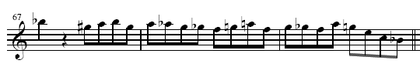

Transformations
Excerpt from Bob Berg’s solo on „Angles“
pc: 10 8 9 10 8 9 8 7 6 5 6 9 5 7 6 5 9 7 4 0 10
cpc : 7 5 6 7 5 6 5 4 3 2 4 6 2 4 3 2 6 4 1 9 7
cdpcx: 5 4 T 5 4 T 4 3 B 2 3 T 2 3 B 2 T 3 2 6 5
int: -2 1 1 -2 1 -1 -1 -1 -1 2 2 -4 2 -1 -1 4 -2 -3 -4-2

Slide 17
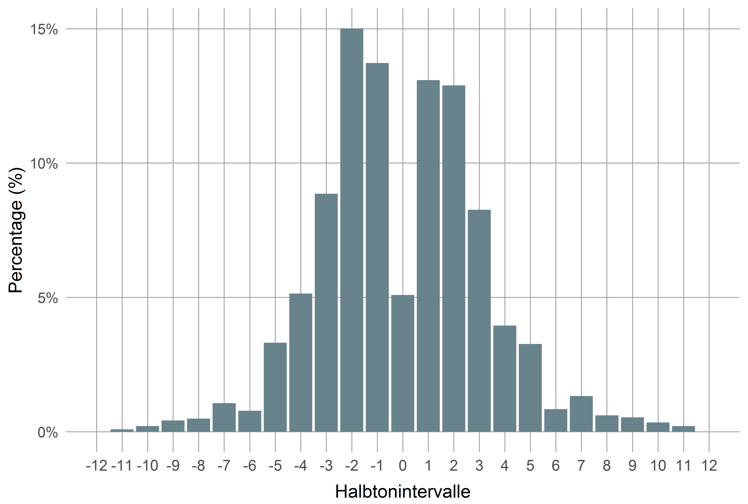
Example: Interval Distribution

Slide 18
Hands-on for everyone

Slide 19
JRP/DTL Web Tools
Tools to be used
Feature History Explorer
Pattern History Explorer
Dig That Lick Pattern Search
Dig That Lick Similarity Search
Links: https://jazzomat.hfm-weimar.de/interactive.html
Sonic Visualiser (https://www.sonicvisualiser.org/)
Tony (https://code.soundsoftware.ac.uk/projects/tony)

Slide 20
Feature History Explorer
Visualizes development of solo features in the WJD over time.
x-axis: recording year (or decade).
y-axis: selected feature.
Scatterplot with (polynomial) regression line.
Goodness-of-fit values: R², p value, AIC.
With or without aggregation.
Filtering, colouring, and presentations options.
Selecting area in plot displays data table for selected solos (only for unaggregated data).

Slide 21
Pattern History Explorer
Contains selection of 653 common interval patterns by eminent performers and its instances in the WJD.
See “Help” tab for further details
Listen & See: Shows pattern instances (score, audio, metadata)
Instances: More detailed info on instances
Stats: Stats for the pattern and its instances
Timeline: Distribution of instances over recording time and performers
General Stats: Stats of all patterns

Slide 22
Dig That Lick Pattern Search
Allows very flexible search for patterns in the WJD, the Essen Folk Song Collection and the Omnibook.
Entry via abstract notation or virtual keyboard.
Many different types of patterns. (“transformations”)
Secondary search (search in search results).
Metadata filter
Displays scores and audios + additional metadata.

Slide 23
Dig That Lick Similarity Search
Allows similarity search for patterns in the WJD.
Entry via abstract notation or virtual keyboard.
Interval, fuzzy interval, pitch and CDPCX patterns.
Metadata filter.
Filter for extra conditions.
Displays audios + additional metadata.
Timeline and network visualizations.

Slide 24
Exercises
All questions and exercises (+ more) can be found here:
https://github.com/klausfrieler/digthatlick_lecture
Exercise are of different difficulty levels and mostly open ended.
Please choose freely exercises and tools you want to work on.
Group work highly recommended.
Ask me anything anytime.
Send me your results by e-mail, if you want to have feedback.
Have fun!

Slide 25
Feature History Explorer
Questions & Tasks (select as you wish)
What does abs_int_range mean? Give an intuitive explanation.
What drives the trend in abs_int_range?
What does CDPCX mean?
Which CDPCX values show significant trends?
How do trends changes when you select “Mean” aggregation? Why?
Find a feature with a much better quadratic trend ( = larger R² and smaller AIC).
Which solo has the highest event density, which the lowest?
Which feature has the strongest aggregated trend?

Slide 26
Pattern History Explorer
Questions & Tasks (select as you wish)
Find the longest arpeggio patterns. Who owns it?
Find the longest “non-trivial” (non-trill, non-repetition) pattern. What can be said of its start pitch, harmonic context, accent pattern?
Find the most frequent pattern with the longest stretch of an ascending or descending whole tone scale. Who owns it? Who played it first (in the WJD)? Which are more common: ascending or descending?

Slide 27
Dig That Lick Pattern Search
Questions & Tasks (select as you wish)
Find “The Lick” in the WJD. Does it exist in the Essen Collection and the Omnibook? (Find the Lick on the internet).
Find the beginning of “Hänschen Klein” in the WJD. Which is the most similar instance, why? Why are other instances not similar at all?
Repeat one of the previous searches with tone context of 2 or more tones before and after. How does it change the pattern impression? What are the most common pre/successions?
Find the longest ascending whole tone scale segment (within a single phrase) with only one search request.

Slide 28
Dig That Lick Similarity Search
Questions & Tasks (select as you wish)
How would you define pattern similarity? How did we define it?
Search for an interval pattern of choice with 5 elements. How many instances for similarity thresholds 1, .75, .5 and maximal length difference 0, 1, 2 do you get?
Search for “The Lick” with min sim = .8, max diff = 0. Then repeat: Start new similarity search (right click on the pattern) for the most frequent and most similar but not identical pattern. Does “The Lick” disappear from the result set? What happens? Why?
Find the most frequent 8-interval pattern by Chris Potter and play it at half speed. Who owns the pattern? How might it reflect influences? What is the most common start pitch? How does is mostly fit the chords? (Tip: Don’t forget the PHE).

Slide 29
SV: Tatra Tempo Curve
Tools: Sonic Visualiser.
Background: Expressive timing is an important concept not only classical but also in folk music, e.g. music of the Gorales from the Tatra mountains in Poland.
Question: Is there a connection between different form parts and expressive timing/rubato? How do the players actually synchronize?
Task 1: Generate a tempo curve.
Task 2: Identify and annotate form parts
Task 3: Try an automatic beat tracker plugins and evaluate their performance.
Bonus task: How would you analyse scales, chords and overall tuning?

Slide 30
Tony: Hindewhu
Tools: Tony/Sonic Visualiser.
Background: Automated or semi-automatic transcription is one the main applications of MIR. The monophonic case is already satisfyingly solved – at least for pitches, onsets and durations. Further annotations (e.g., metrical) are still a problem.
Task 1: Create note track using Tony (recommended) or pYIN plugin for SV (or both). Analyse pitches (scale, tuning system, precision, accucary).
Task 2: Create a beat track, add metrical annotations by hand. Analyse rhythm statistically.
Task 3: Prepare a full transcription of an excerpt (or all of it).

