Slide 1
Drush performance vs PHP vs Rust
Klaus Purer
Drupal Austria Meetup April 12th 2023

Slide 2
Test case and goal
How fast can a command line script run?
Print the title of the 10 most recent job nodes on the command line.
Compare:
Drupal entity loads
Drupal direct MySQL query
PHP direct MySQL query
Rust direct MySQL query

Slide 3
Drupal entity load code
<?php
use Drupal\node\Entity\Node;
$job_nids = \Drupal::entityQuery('node')
->condition('type', 'job')
->condition('field_workflow_state', 'published')
->accessCheck(FALSE)
->range(0, 10)
->sort('changed', 'DESC')
->execute();
$jobs = Node::loadMultiple($job_nids);
foreach ($jobs as $job) {
print $job->getTitle() . "\n";
}

Slide 4
Drupal direct query code
<?php
$titles = \Drupal::database()->query("SELECT n.title FROM {node_field_data} n
JOIN {node__field_workflow_state} f ON n.nid = f.entity_id
WHERE f.field_workflow_state_value = 'published'
ORDER BY n.changed DESC
LIMIT 0,10
")->fetchCol();
foreach ($titles as $title) {
print "$title\n";
}

Slide 5
PHP direct query code
<?php
$conn = new mysqli('db', 'db', 'db', 'db');
$results = $conn->query("SELECT n.title FROM node_field_data n
JOIN node__field_workflow_state f ON n.nid = f.entity_id
WHERE f.field_workflow_state_value = 'published'
ORDER BY n.changed DESC
LIMIT 0,10")->fetch_all();
foreach ($results as $result) {
print $result[0] . "\n";
}

Slide 6
Rust direct query code
use mysql::*;
use mysql::prelude::*;
fn main() -> std::result::Result<(), Box<dyn std::error::Error>> {
let url = "mysql://db:db@db:3306/db";
let pool = Pool::new(url)?;
let mut conn = pool.get_conn()?;
let result: Vec<String> = conn
.query(
"SELECT n.title FROM node_field_data n
JOIN node__field_workflow_state f ON n.nid = f.entity_id
WHERE f.field_workflow_state_value = 'published'
ORDER BY n.changed DESC
LIMIT 0,10"
)?;
for title in result {
println!("{}", title);
}
Ok(())
}

Slide 7
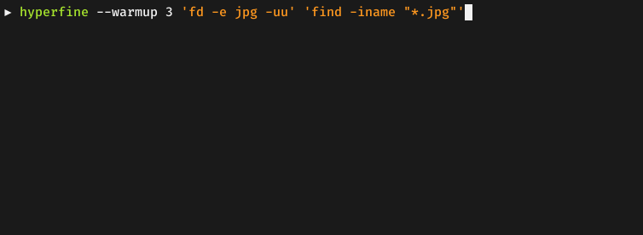
Script timing test with Hyperfine
https://github.com/sharkdp/hyperfine
A benchmarking tool with statistical analysis over multiple runs

Slide 8
Performance measurement results
Summary
'../droprabbit' ran
3.57 ± 0.90 times faster than 'php empty.php'
3.86 ± 0.98 times faster than 'php php_query.php'
13.24 ± 3.41 times faster than 'php -d opcache.file_cache=/tmp ../vendor/bin/drush scr drush_query.php'
14.33 ± 3.64 times faster than 'php -d opcache.file_cache=/tmp ../vendor/bin/drush scr load.php'
32.32 ± 8.13 times faster than 'drush scr drush_query.php'
35.42 ± 8.90 times faster than 'drush scr load.php'

Slide 9
Conclusion
Lots of Drupal/Drush bootstrap overhead in Drush scripts
Cheating in PHP gives you 1 order of magnitude better performance
Cheating in Rust gives you 2 orders of magnitude better performance
Downsides of cheating
  No Drupal APIs in Rust (reimplement everything)
  Potential security issues due to bypassing Drupal’s APIs
  Higher development effort (Rust learning curve, compile cycle)
  developers not trained in Rust
  Requires deployment setup to ship and run your Rust code

