Slide 1

Drupalcamp Vienna 2009
Development workflow and deployment at
Klaus Purer
2009-11-28
http://klausi.fsinf.at
http://identi.ca/klausi

Slide 2


Who am I?
Student at the Vienna University of Technology
  Software Engineering & Internet Computing
Software developer & server admin at
Google Summer of Code Student 2009
  Work for the Drupal Rules module
Passionate free & open source user/developer

Slide 3

Who are you?
You are Drupal developers
You want to know how others do their daily Drupal work
You want to organize development and deployment for your use case
You have basic knowledge about version control, databases, server administration

Slide 4
Who is Absolventen.at?
Job exchange platform in Austria
For school and university graduates
Drupal based
Highly distributed development team
ca. 7 developers
Incrementally evolving the code base

Slide 5





Absolventen.at software stack
+ custom Drupal themes
+ official Drupal modules
+ custom Drupal modules
+ custom server scripts
Notes:
* completely rely on free and open source software
* helper software: subversion, memcache

Slide 6
Goals in development
Preserve all code changes ever made
Rollback to any previous state possible
Seperate new features from bug fixes
Work in parallel on different parts
Avoid conflicts by editing the same code
Show features and tests to others

Slide 7

Version control with Subversion
Solves the code history problem
Allows working in parallel
Does not help separating bugs from features
Solution: devel branch and stable branch
  Requires Merging between them (not funny in Subversion < 1.5)
Problem: a commit must not break the code
Solution: big new features in feature branches
Does not avoid conflicts for you

Slide 8
Project management
Solves the edit conflict
We run an internal project management site (Drupal-based)
Includes an issue/bug tracker with developer assignments
Each module/functionality is assigned to one developer (maintains updates, ...)
Organizes the overall development process in milestones

Slide 9
Documentation
Implementation needs documentation references to spread the knowledge
Often a view pointers suffice to explain functionality
Custom patches need documentation
Development & Test guidelines
Design guidelines
OpenAtrium offers a good documentation and collaboration basis

Slide 10
Communication
Project web with issues, comments, blogs, docu pages etc.
Notifications via Email and RSS Feeds
Jabber/XMPP interaction (+ group chat)
Identi.ca private status updates (twitter-like)
Commit-Log with useful commit messages
Face to face meetings

Slide 11

Development work flow
Similar to Scrum
Time is sliced into one week sprints
Features and minor fixes are committed into the devel branch
More critical bug fixes are committed into the stable branch
  Production site is updated immediately
Every Monday development is merged and populated to the production site

Slide 12

Bloody Monday
Production database is dumped and provided to the developers
Subversion branches get merged
  Conflicts are reported to the developers
Simpletests get executed and verified
Stable branch is freshly cloned from the devel branch
Production site is updated
Caches are cleared

Slide 13
Bloody Monday (2)
Watchdog logs are examined
  File not found errors – are there any dead links on your site?
  PHP errors – did you check that array for null values?
Additional DB changes are deployed
Merge-log that summarizes all abnormalities as a report

Slide 14
Goals in deployment
Separate development environment from production environment
  Development server vs. production server
Provide a testing (staging) site that is an exact production clone
Provide a development site for each developer
Production site updates must be as fast as possible
Production site updates must be consistent

Slide 15
Deployed sites
Productive: the live site
Testing: clone of productive, experiments allowed
Devel: reflects current devel branch code
Devel X: dev site of developer X
Devel Y: dev site of developer Y
Devel Z: dev site of developer Z
...

Slide 16
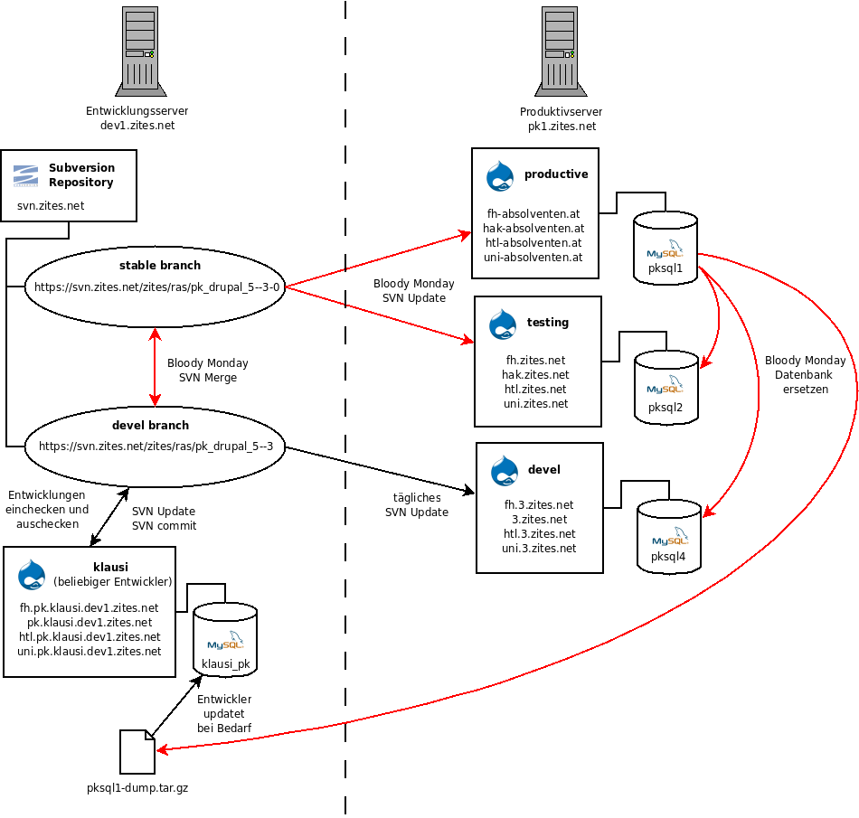

Slide 17
Deployment with Subversion
Drupal core + modules + settings are checked into the repository
All changes are committed to the repository and then checked out to production use
Never ever edit files directly in your production site!
  Inconsistencies can cause severe developer headache
Testing/Development sites are able to checkout an exact copy

Slide 18
Deploying database changes
Manually: do the changes on a testing site, do it again on the production site. Tedious :-(
Export: do the changes once and import them on the production site. Must be module-supported (e.g. Views, Rules, …)
Code: implement default hooks and commit them. Needs a developer.
Features: Similar to export, but allows you to commit Features-generated modules.

Slide 19
Test driven development
… we don't do that, actually
Test supported development
All mission critical features are covered by Simpletests
Mostly black box tests that execute tasks on testing (!) sites and report any failures
Developers are able to verify that their code does not break anything existing
Not all bugs are found via Simpletest, but many are avoided from the beginning

Slide 20
Drush
Drush = Drupal shell
Executes Drupal tasks from the command line
Automatically detects the Drupal site from the directory you execute it in
We use it to
  Run the Simpletests
  Add/Upgrade/Remove/Enable modules
  Run cron

Slide 21
Mysqldump speedup
Slow:
  mysqldump $DB_NAME > dump.sql
Faster (30%):
  mysqldump –-tab $TMPDIR $DB_NAME
  Import:
  cat $TMPDIR/*.sql | mysql $DB_NAME
  mysqlimport $DB_NAME $TMPDIR/*.txt

Slide 22
Subversion drawbacks
Subversion is not perfect for merging
Subversion is centralized, a feature must be working before you can commit it
Subversion wants to do CVS right
Linus Torvalds: “There is no way to do CVS right”
“If you like using cvs, you should be in some kind of mental institution or somewhere else.”

Slide 23
Version control future
Distributed version control systems
Merging is an integral part of the design
A commit is local
Changes are pushed to and pulled from arbitrary locations
Versioned development in an independent manner

Slide 24



Version control future (2)
And remember kids:
Die CVS, die!
The good guys:
CVS
Bazaar

Slide 25

Deployment Future
Drush – Drupal command line scripting
Aegir hosting system
  Easy deployment of a new site with a view clicks
  Management of many sites within a Drupal installation
Drush Make – resolves dependencies
Features module
  Bundle your CCK, Views, Rules etc. settings and save them as “features”

Slide 26
Discussion
Questions
Answers
Comments
Feedback

