Slide 1
SE 4XXX · UNDERGRADUATE COURSE
AI
Introduction to AI Application Development
AI Application Development
Week 1 · Introduction & Environment Setup
64 Contact Hours
16 Weeks × 4h
Junior · Software Engineering
International Students
W1
Lecturer: ____________ · School of Software Engineering

Slide 2

Contents
Module 1 · Week 1 · 180 min
01
Course Overview
Structure · assessment · 16-week calendar · academic integrity
5 Parts
02
What is AI
180 min in total
Technology hierarchy · three learning paradigms · waves and winters
Parts 1–4 cover theory and perspective,
part 5 is hands-on practice.
Domains & Careers
03
Four domains · landmark breakthroughs · career paths · ethics
04
Project Lifecycle
Theory ≈ 90 min · Lab ≈ 75 min · Quiz & wrap-up 15 min
Six stages · case walkthrough · the 80% rule · toolchain
05
Lab: Hands-on
Environment setup · Git · first ML program · deliverables
AI Application Development · Week 1
02 / 32

Slide 3
01
Course Overview
01
How this course works
4 Modules
Assessment
Policies
16 weeks · 64 hours
70% hands-on
What to expect

Slide 4
Course Structure & Assessment
Module 1 · Week 1
4 Modules · 16 Weeks · 64 Hours
Assessment
M1
AI & ML Foundations
Out of 100 · no written exam
W1–4 · 180 min weekly (lecture + lab)
Assignments ×3
30%
M2
Deep Learning & CV
Midterm Project
15%
W5–8 · 180 min weekly (lecture + lab)
Capstone Project
35%
M3
NLP & Large Language Models
W9–12 · 180 min weekly (lecture + lab)
Lab & Quizzes
20%
M4
AI Application Engineering
Projects & labs weigh 70% — this course is not "listened to", it is built.
W13–16 · 180 min weekly (lecture + lab)
Positioning: solid theory + balanced application — understand the principles first, then build.
AI Application Development · Week 1
04 / 32

Slide 5
Course Calendar
16 Weeks · 180 min / week
M1
AI & ML Foundations
M2
Deep Learning & CV
M3
NLP & LLMs
M4
AI App Engineering
W1–4 · 180 min weekly
W5–8 · 180 min weekly
W9–12 · 180 min weekly
W13–16 · 180 min weekly
W1
Intro & Environment Setup
W5
Neural Networks
W9
NLP Fundamentals
W13
GenAI & Agents
Overview · First ML program
Backprop basics
Tokenization · Tasks
Agents · Tool use
W2
Data Handling
W6
PyTorch Training
W10
Embeddings & Seq Models
A3 out
W14
Model Deployment
NumPy · Pandas · EDA
Tensors · Training loop
FastAPI · Docker
Word2Vec · RNN / LSTM
W3
ML Fundamentals
W7
CNN & Transfer Learning
A2 out
W11
Transformer & BERT
W15
MLOps
scikit-learn pipeline
Attention · Fine-tuning
Monitoring · CI/CD
Convnets · Fine-tuning
W4
Evaluation & Tuning
A1 out
W8
CV Apps · Midterm
Midterm
W12
LLM · Prompting · RAG
W16
Capstone Showcase
Capstone
Metrics · Validation
Midterm presentations
Prompt patterns · RAG
Final presentations
Key Dates
W4
Assignment 1 released
W7
Assignment 2 released
W8
Midterm presentations
W10
Assignment 3 released
W16
Capstone showcase
AI Application Development · Week 1
05 / 32

Slide 6
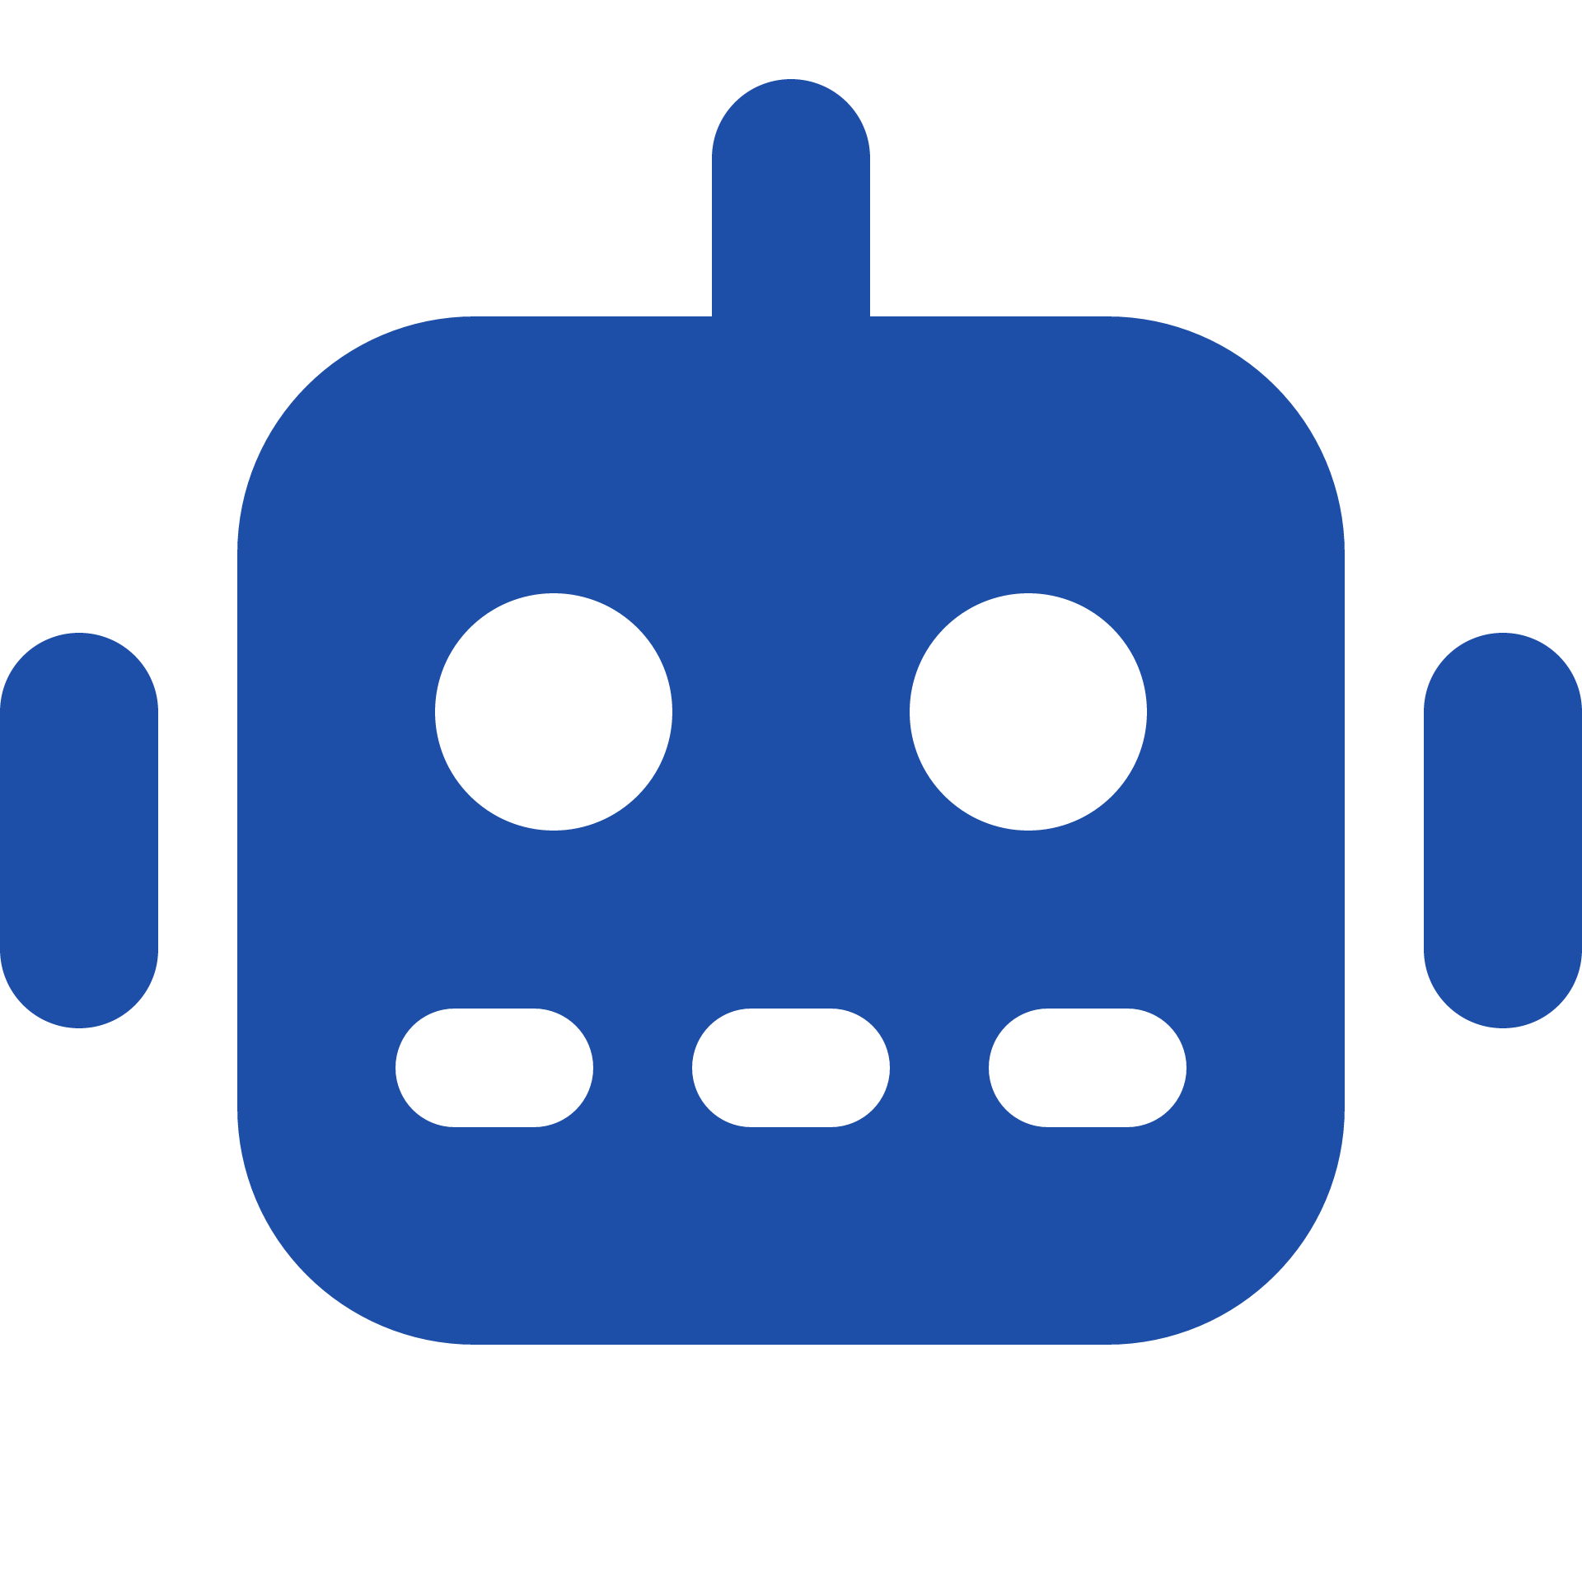



Grading Details & Integrity
Module 1 · Week 1
How Each Point Is Earned
Academic Integrity
Assignments ×3
30%
10% each: code + short report + reproducible run
AI tools allowed — but declared
State which parts were AI-assisted when you submit. Undeclared use = a violation.
Midterm Project
15%
Team of 2–3 · 5-min live demo + code
You must be able to explain every line you submit
Random spot-checks: if you can’t explain it, that part scores zero.
Capstone Project
35%
Plagiarism or ghost-writing = zero for that item
Proposal 5% + demo 15% + report 15%
Includes copying classmates or submitting ready-made answers found online.
Lab & Quizzes
20%
Team projects: state the division of work
Attendance & participation 10% + in-class quizzes 10%
Each member’s responsibility and contribution must be clear in the report.
Late policy: −10% per 24 h late; not accepted after 72 h.
AI Application Development · Week 1
06 / 32

Slide 7
02
What is AI?
02
The technology landscape
The Hierarchy
Three Waves
Why SE Students
AI / ML / DL / GenAI
1950s → today
Your entry window

Slide 8
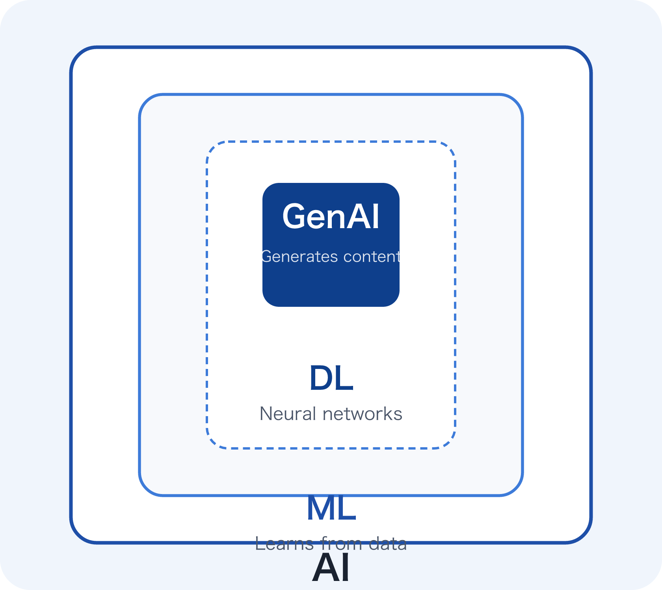
AI ⊃ ML ⊃ DL ⊃ GenAI · The Hierarchy
Module 1 · Week 1
Each level is a subset of the one above
AI simulates intelligence; ML learns from data;DL uses multi-layer neural networks; GenAI generates new content.
How to classify · 3 Questions
1
Does it learn from data?
→ ML or higher
2
Does it use neural networks?
→ DL or higher
3
Does it generate new content?
→ GenAI
Examples: ChatGPT = GenAI; face unlock = DL; spam filtering = ML (beyond rules).
AI Application Development · Week 1
08 / 32

Slide 9




Three Learning Paradigms
What is AI · Part 02
Supervised Learning
Unsupervised Learning
Reinforcement Learning
Given answers, learn the rules
No answers, find the structure
Given rewards, learn a policy
Train on labeled data: every input comes with a ground-truth answer.
Data has no labels; the algorithm discovers hidden structure on its own.
An agent interacts with an environment, maximizing cumulative reward through trial and error.
Typical tasks: Classification · Regression
Typical tasks: Clustering · Dimensionality Reduction
Real examples: Spam detection · house-price prediction · image classification
Typical tasks: Policy · Reward · Exploration vs. Exploitation
Real examples: Customer segmentation · anomaly detection · topic discovery
Real examples: Game AI · robot control · recommendation strategies
Focus of this course
Used in later modules
Used in later modules
Think: “Cluster users by purchasing behavior” — which paradigm? No labels, looking for structure → unsupervised (clustering).
AI Application Development · Week 1
09 / 32

Slide 10
Three Waves of AI
Module 1 · Week 1
Timeline
1950s–1970s
1980s–2000s
2012 – Today
Symbolic Era
Statistical ML
Deep Learning & GenAI
Turing Test; the Dartmouth Conference coins "AI"; expert systems. Limited by compute and data → the first AI winter.
Backpropagation revives neural networks; SVM and random forests mature; the internet brings massive data, making statistical learning mainstream.
AlexNet wins ImageNet; the Transformer (2017) leads to GPT and BERT; large language models and generative AI explode.
Takeaway: we are in the "application-engineering" era — model capabilities are commoditized, and the entry window for software engineers is open.
AI Application Development · Week 1
10 / 32

Slide 11
Two AI Winters
What is AI · Part 02
Winter I
1974 – 1980
Winter II
1987 – 1993
The First Winter
The Second Winter
What happened
What happened
Perceptron limitations proven (Minsky & Papert, 1969); symbolic systems fell far short of expectations
Expert systems cost far more to maintain than they earned; the Lisp machine market collapsed
Trigger
Trigger
The UK Lighthill Report (1973) + drastic funding cuts in the UK and US
Dedicated hardware replaced by commodity PCs; commercial investment walked away
The promise then
“Machines will do everything humans can within a generation.”
The promise then
“Expert systems will enter every company.”
1. Expectation bubbles: when promises outrun capability, capital retreats
2. Data and compute are the foundation: without them, capability is castles in the air
3. Stay sober today: AI is not magic — it is engineering
Three Lessons
AI Application Development · Week 1
11 / 32

Slide 12


Why Should SE Students Learn AI?
Module 1 · Week 1
Role Shift
From Training to Product
Feature → Data Engineering
With model capability built in, value shifts to data quality and pipelines — get the data right and the model follows.
Rules → Systems
Not "if-then" business rules, but the design of complete systems: data + model + evaluation + iteration.
Apps → Agents
LLMs create new paradigms — agents, RAG, multimodal — each a fresh set of engineering problems.
Frameworks and APIs have commoditized model capability — an engineer's value now lies in turning models into products.
Conclusion: an SE's edge is not "training better models" — it is delivering models as reliable software systems.
AI Application Development · Week 1
12 / 32

Slide 13
03
Domains & Careers
03
Where AI is applied
4 Domains
Career Roles
SE Leverage
CV · NLP · Multimodal · RecSys
4 paths
AI App Eng / MLOps

Slide 14




Application Domains
Module 1 · Week 1
Computer Vision
NLP
Perceive
Understand
Generate
Decide
CV
Natural Language Processing
Image classification, object detection, face recognition, defect inspection, autonomous-driving perception.
Machine translation, sentiment analysis, text summarization, question answering, intelligent customer service.
The four verbs behind every AI product
Speech & Multimodal
Recommendation & Decision
Audio · Vision · Text
RecSys
Speech recognition/synthesis, text-to-image, video understanding, multimodal assistants.
Recommender systems, risk control and fraud detection, supply-chain forecasting, pricing optimization.
All four domains converge: every AI application completes a loop from input to judgment/output. In the coming labs you will build this loop yourself.
AI Application Development · Week 1
14 / 32

Slide 15
Six Breakthroughs That Changed Everything
Domains & Careers · Part 03
2012
2016
2017
2020
2022
2023+
AlexNet
AlphaGo
Transformer
GPT-3
ChatGPT
Multimodal
Deep learning ignition
RL beats world champion
Foundation of all LLMs
Scale brings emergence
GenAI goes mainstream
Multimodal era
The deep-learning ignition point: ImageNet error dropped 10 points; GPU training became standard.
RL beat Lee Sedol; “intuitive” moves stunned the world and ignited a global AI boom.
“Attention Is All You Need”: attention became the foundation of every large model today.
175B parameters, few-shot learning: scale brought emergent capability for the first time.
100M users in two months; conversational AI entered daily life — the year of GenAI.
GPT-4V / Gemini: unified understanding and generation of text, image, audio, and video.
How to Read This Timeline
The pace is accelerating
Paradigms are converging
The barrier is falling
AlexNet to ChatGPT took 10 years; since then, every year is a milestone.
Different tasks (CV / NLP / speech) all converged on the unified Transformer architecture.
Paper-to-product time shrank from years to months — that is the application engineer’s window.
AI Application Development · Week 1
15 / 32

Slide 16
Career Paths
Module 1 · Week 1
4 Roles
1
ML Engineer
M1–2, M4
Train, evaluate, deploy, and monitor models; build ML pipelines
2
AI Application Engineer
M3–4
Build applications on LLMs/APIs: RAG, agents, product integration
3
Data Scientist
M1
Model business problems, analyze data, design experiments, derive insights
4
MLOps Engineer
M4
You don't need to become an algorithm researcher — engineering skill is your differentiator.
CI/CD, model serving, monitoring, and reliability engineering
Highest leverage for SE students: AI Application Engineer & MLOps — Modules 3–4 target these directly.
AI Application Development · Week 1
16 / 32

Slide 17




Ethics & Responsibility
Domains & Careers · Part 03
Bias & Fairness
Privacy & Data
Hallucination & Misuse
Accountability
Training data carries historical bias; models learn it and amplify it.
Models can “memorize” and leak personal information from training data.
Generative models fabricate facts with a straight face; diffusion models enable deepfakes.
When an AI system fails, who is responsible — the developer, the deployer, or the user?
Case
Amazon’s recruiting tool penalized women’s résumés (scrapped in 2018)
Case
Case
Case
A chatbot reciting phone numbers from its training set
AI-cited papers that do not exist; deepfake fraud
The liability chain in an autonomous-driving accident
Our stance
In every AI application you ship, bias, privacy, and hallucination are not “someone else's problem” — they are questions your code must answer. Every assignment in this course is graded with an “Ethics” line: even two sentences answering “who could this system hurt?”
The Builder's Responsibility
AI Application Development · Week 1
17 / 32

Slide 18
04
The AI Project Lifecycle
04
From idea to operations
6 Stages
The 80% Rule
Capstone Roadmap
Define → Monitor
Data & engineering
Your final project

Slide 19

The 6-Stage Lifecycle
Module 1 · Week 1
1
2
3
4
5
6
Define
Process
Goal · metrics · constraints
Collect
Clean · transform · features
Model
Deploy
Monitor
Data · EDA · feasibility
Baseline · train · iterate
API · Docker · product
Drift · retrain · optimize
Capstone = the full journey
Your final project runs from problem definition to Docker deployment — this six-stage chain is your roadmap.
AI Application Development · Week 1
19 / 32

Slide 20
Case Walkthrough: Canteen Queue Prediction
Project Lifecycle · Part 04
One running example through all six stages — “predict canteen queue time”.
1
Problem Definition
Predict each counter’s queue time for the next 15 minutes, within ±5 min error
Output: binary (crowded / not) or regression (minutes)? → Regression
POS transaction logs (dish, time) + camera-based foot-traffic counts + academic calendar (exam weeks spike)
Pitfall: camera footage must be de-identified first — never store faces
2
Data Collection
Feature Engineering
Time of day, weekday, weather, menu popularity, foot traffic in the ±15-minute window
Common-sense features often beat fancy models
3
Modeling & Training
Run a mean baseline first, then gradient-boosted trees (GBDT); compare errors
Remember: shipping without a baseline = flying blind
4
Wrap the model as a REST API with FastAPI; the mini-program polls predictions every 5 minutes
The model is not the product — API + UI is
5
Deployment
6
Monitoring & Iteration
Weekly error reports; a new canteen opening = data drift → triggers retraining
Launch day is when the project really begins
AI Application Development · Week 1
20 / 32

Slide 21
80%
Training the model is only ~20%
In real industry, about 80% of AI project time goes to data processing and engineering (stages 2–3 and 5–6), and only about 20% to "training the model".
Data & engineering 80%
Training 20%
of project time goes to
Two implications:① this course allocates heavy lab time to data handling and deployment — because that is where the real work happens; ② your employability comes precisely from the engineering delivery others are least good at.
data & engineering
AI Application Development · Week 1
21 / 32

Slide 22

Course Toolchain
Project Lifecycle · Part 04
M1 · W1–4
M2 · W5–8
M3 · W9–12
M4 · W13–16
Foundations
Deep Learning
NLP & LLMs
Engineering
Python 3.11 + Conda
PyTorch
Hugging Face Transformers
FastAPI
Language & virtual environments
The main framework of this course
The second most important library
Serving models as APIs
JupyterLab / Colab
torchvision
Datasets · Tokenizers
Docker
Interactive development
Vision models & datasets
Data & tokenization
Environment packaging & delivery
Git + GitHub
Colab GPU
Ollama
Streamlit
Version control & collaboration
Free compute
Run open LLMs locally
Rapid app interfaces
NumPy · Pandas · scikit-learn
Matplotlib
LangChain
MLflow
Data processing & classic ML
Training-curve visualization
Application orchestration framework
Experiment tracking
Everything above is free: the open-source Anaconda distribution plus free Colab quota covers every assignment — the only account you need is GitHub.
AI Application Development · Week 1
22 / 32

Slide 23

05
Lab: Hands-on Practice
05
Environment & Your First ML Program
Environment Setup
Jupyter & Git
Your First Model
Conda · Packages
Notebooks · Version Control
Iris + scikit-learn
Next ~75 minutes: follow along step by step and raise your hand whenever you get stuck — everyone leaves with a working model today.

Slide 24

Lab 0 · Overview & Checklist
Lab · Part 05
Today's Four Steps
Exit Checklist
All four checked = Lab complete
1
Install Miniconda and create the ai-app env
All dependencies isolated in one environment, nothing pollutes your system
conda activate ai-app succeeds with no errors
2
Get JupyterLab (or Colab) running
JupyterLab opens and runs a cell
Interactive coding — the main workbench for the rest of the course
3
Initialize Git and push to GitHub
GitHub repo created, at least 1 commit + push
Every assignment starts by cloning your repo
Iris model accuracy ≥ 0.9 printed on screen
4
Train your first model: Iris classification
Ten lines of code, the full ML pipeline end to end
Stuck? Raise your hand — don't grind alone. TAs are patrolling the front rows.
Your Stack at a Glance
OS
Package Manager
Isolated Env
Core Packages
Editor
Remote
macOS / Windows / Linux
Miniconda
conda env: ai-app
numpy pandas sklearn jupyter
VS Code / JupyterLab
GitHub + Colab
AI Application Development · Week 1
24 / 32

Slide 25



Lab 1 · Environment Setup
Lab · Part 05
Follow Along
Top 3 Errors
# 1. Download and install Miniconda (official site or a mirror)
https://docs.conda.io/en/latest/miniconda.html
conda: command not found
# 2. Create and enter the course environment
Terminal not reopened after install. Close it and open a new one; on Windows use “Anaconda Prompt”; if conda is still missing, add it to PATH.
conda create -n ai-app python=3.11 -y
conda activate ai-app
# 3. Install the core packages for this semester
conda install numpy pandas matplotlib \
Slow downloads / SSL errors
On a restricted network, switch to a mirror (TUNA / Aliyun) or use a phone hotspot — the big downloads are one-time only.
scikit-learn jupyter -y
# 4. Verify the installation
python -c "import sklearn; print(sklearn.__version__)"
PackageNotFoundError
# 5. Export the environment (for the deliverable)
Nine times out of ten you forgot conda activate ai-app and are running in base. Check whether your prompt shows the (ai-app) prefix.
conda env export > environment.yml
Why environments? Different courses and projects need different package versions — isolated environments keep them from clashing. Build this engineering habit on day one.
TAs are circulating — raise your hand if you are stuck for more than 5 minutes.
AI Application Development · Week 1
25 / 32

Slide 26


Lab 2 · JupyterLab & Colab
Lab · Part 05
JupyterLab
Google Colab
Local
Cloud
Launch
Launch
After conda activate ai-app, run jupyter lab — the browser opens automatically
colab.research.google.com — sign in with a Google account, zero install
Key concepts
Key concepts
Cells (code / Markdown) + Kernel (the runtime)
Notebooks run on a cloud VM with a free GPU tier (T4)
Key operations
Key operations
Shift+Enter runs a cell · Esc then B inserts a cell · Kernel → Restart resets state
Runtime → Change runtime type → GPU · mount Google Drive on the left
Best for
Best for
Daily assignments, small data, offline development
Deep-learning training from W5 on, and experiments your laptop can’t handle
Which one?
Default to JupyterLab; the moment your code has import torch and needs training — move it to a Colab GPU.
AI Application Development · Week 1
26 / 32

Slide 27



Lab 3 · Git in 5 Minutes
Lab · Part 05
Today's Commands
# First-time config (use your GitHub username and email)
Why Git Matters Even More for AI
git config --global user.name "Your Name"
git config --global user.email "you@example.com"
Traceable experiments
# Initialize a repo in the project directory
“Which lines dropped accuracy by 3 points?” — your commit history is the experiment log.
git init
# Stage + commit
git add . && git commit -m "week1: env + iris model"
Roll back anytime
# Link GitHub and push
Broke something? git checkout takes you back to the last working version in a second.
git remote add origin <your-repo-url>
git push -u origin main
Assignments become a portfolio
By semester end your GitHub holds four complete projects — more convincing than any line on a résumé.
Reminder: create a .gitignore first and list data/ and *.ipynb_checkpoints/ — keep data and caches out of the repo.
Write commit messages that say what you did: “week1: add iris knn baseline”, not “update”.
AI Application Development · Week 1
27 / 32

Slide 28
Lab 4 · Your First ML Program
Lab · Part 05
Iris Classification · Fully Runnable
from sklearn.datasets import load_iris
from sklearn.model_selection import train_test_split
The 5-Step Pattern
from sklearn.neighbors import KNeighborsClassifier
1
Load
Where data comes from: built-in datasets / CSV / APIs
# 1. Load data: 150 flowers · 4 features · 3 species
X, y = load_iris(return_X_y=True)
2
Split
Train set learns the rules, test set proves them — never mix the two
# 2. Split: 80% train / 20% test
X_train, X_test, y_train, y_test = train_test_split(
3
Train
fit(): the model “looks at” training data and adjusts parameters
X, y, test_size=0.2, random_state=42)
# 3. Train: K-nearest neighbors classifier
4
Evaluate
score(): an exam on data the model has never seen
model = KNeighborsClassifier(n_neighbors=3)
model.fit(X_train, y_train)
5
Predict
predict(): serving real, new samples
# 4. Evaluate + predict a new flower
These five lines are the semester's main theme — only the model changes (KNN → neural nets → Transformer); the skeleton stays.
print("accuracy:", model.score(X_test, y_test))
print(model.predict([[5.1, 3.5, 1.4, 0.2]]))
AI Application Development · Week 1
28 / 32

Slide 29






Deliverables & Rubric
Lab · Part 05
What to Submit (100 pts)
Deadline
Next Monday 23:59
environment.yml
20
Exported with conda env export — lets TAs reproduce your environment in one command
Submit on the course platform: upload a link to your repo (including environment.yml and the notebook).
week1_lab.ipynb
30
Notebook with Markdown notes: environment checks + the full Iris pipeline
Three Tips from Your Instructor
GitHub repo
20
1.
Get it running first, optimize later — tonight has one goal: accuracy printed on screen
≥ 3 meaningful commits + a one-line README
Model comparison
20
2.
Commit early, commit often — never one big upload at the end
Try KNN n_neighbors = 1 / 3 / 10, report and explain the accuracy changes
Reflection
10
3.
AI assistants are allowed — declare it in the notebook and be ready to explain every line
If accuracy were only 0.4, what would you check first? Three sentences
Broken env and can't submit? Hand in “error screenshots + your debugging process” for half credit — showing how you debug is worth more than the result.
AI Application Development · Week 1
29 / 32

Slide 30
Quick Quiz (counts 10% of Lab)
Module 1 · Week 1
No notes, 60 seconds each · vote by raising your hand — wrong answers are good: mistakes stick best.
Q1
“Deep learning is not machine learning — it is an independent technical line.” True or false?
True — DL stands alone
False — DL ⊂ ML ⊂ AI
Answer: B — DL is a subset of ML, using multi-layer neural networks to learn features automatically.
Q2
Grouping 100,000 users into 5 clusters by purchase behavior, with no labels at all — which paradigm?
Supervised learning
Unsupervised (clustering)
Reinforcement learning
Answer: B — no labels, find structure → unsupervised clustering (K-Means etc.; hands-on in W3).
Q3
In a typical AI project, roughly how much of an engineer’s time goes to “training the model” itself?
~80%
~50%
~20%
Answer: C — 80% goes to data and engineering (the 80% rule); training takes only about a fifth.
AI Application Development · Week 1
30 / 32

Slide 31




Summary
Module 1 · Week 1
5 Key Takeaways
Lab Recap · What you did today
AI ⊃ ML ⊃ DL ⊃ GenAI — nested subsets; classify with 3 questions
Environment
conda ai-app · install dependencies
Three waves: symbolic → statistical ML → deep & generative
Jupyter + Colab
Run locally + verify Colab GPU
We are in the application-engineering era; SE leverage is turning models into products
Git setup
init → commit → push to GitHub
First model
Six lifecycle stages: Define → Data → Features → Model → Deploy → Monitor
scikit-learn Iris classifier
Deliverables: environment.yml + notebook + GitHub link · due next Monday 23:59
80% of time goes to data & engineering; only 20% to training
AI Application Development · Week 1
31 / 32

Slide 32
W1
"AI won't replace engineers.
Engineers using AI will."
AI
The best way to predict the future is to build it.
Thank You
Next week: Data Handling Fundamentals for AI — NumPy, Pandas & Visualization
AI Application Development · Week 1 Lecture · 32 / 32

