Slide 1
SE 4XXX · UNDERGRADUATE COURSE
02
AI Application Development
Data Handling Fundamentals
Week 2 · NumPy · Pandas · Visualization · EDA
Module 1 · W2–4
180 min · Lecture + Lab + Quiz
Python · NumPy · Pandas
International Students
W2
Lecturer: ____________ · School of Software Engineering

Slide 2

Contents
Module 1 · Week 2
01
Why Data
5 Parts
Role · types & sources · 6 quality dimensions · bad-data cases
Today's Lecture
02
Core Tools
Arrays vs tables · vectorization · indexing & slicing · cheat sheet
Before models, master data —
your first hands-on data week.Before models, master data.
03
Visualization & EDA
Chart selection · 5-step routine · Titanic walkthrough
04
Data Cleaning
Theory ~90 min · Lab ~75 min · Quiz & Summary 15 min
6-step workflow · missing-value decisions · 3 outlier methods · GIGO
05
Hands-On Lab
Warm-up → explore → visualize → clean → submit · quiz included
AI Application Development · Week 2
02 / 32

Slide 3
01
Why Data Matters
01
The Role & Quality of Data
Data is Fuel
6 Quality Dimensions
Flaws Amplify
No data, no learning
How to judge a dataset
Errors propagate to predictions

Slide 4


Week 1 Review & This Week's Roadmap
Module 1 · Week 2
Week 1 · Key Takeaways
Module 1 · The Four Weeks
AI ⊃ ML ⊃ DL ⊃ GenAI
How to classify: learns from data? neural nets? generates content?
W1
Intro & environment
W2
Data handling (today)
NOW
Six-phase AI project lifecycle
Define → Data → Model → Evaluate → Deploy → Monitor
W3
Machine learning with scikit-learn
The 80% rule
W4
Model evaluation & tuning
Most effort goes into data & engineering, not model training
Environment ready
Today's Three Goals
conda ai-app · Jupyter/Colab · Git push
1
Manipulate data with NumPy / Pandas
First ML program
2
Plot charts and run the 5-step EDA
Iris classifier: fit → predict → evaluate
3
Clean missing values, outliers & duplicates
AI Application Development · Week 2
04 / 32

Slide 5






The Role & Quality of Data
Module 1 · Week 2
Models learn everything from data
6 Dimensions of Data Quality
Without good data, even the most advanced algorithm can only learn bias and noise. Data sets the ceiling of model performance; algorithms only approach that ceiling.
Accuracy
Completeness
Values match the real world
No systematic missingness
Consistency
Timeliness
The AI data workflow: raw data clean features train evaluate deploy — flaws can creep in at every step.
Same definitions across sources
Reflects the current state
Relevance
Volume & Bias
Key insight: data flaws never disappear — they get amplified and locked into every prediction the model makes.
Features relate to the target
Enough data, unbiased sampling
AI Application Development · Week 2
05 / 32

Slide 6



Data Types & Sources
Module 1 · Week 2
Structured Data
Semi-structured Data
Unstructured Data
Structured
Semi-structured
Unstructured
Neat rows and columns; fixed types per column — ready for a DataFrame.
Has labels but no fixed schema — parse first, then tabulate.
Free-form content — the battleground of Modules 2 & 3.
Examples
Examples
Examples
Database tables · CSV · Excel reports
JSON API responses · Log files · XML
Images · Text · Audio · Video
Where data comes from: Internal business databases / open datasets (Kaggle · UCI · government data) / scrapers & logs / sensors & user-behavior tracking.
Caution: sources set the quality ceiling — cleaning cannot recover fields lost at collection time.
AI Application Development · Week 2
06 / 32

Slide 7



When Data Goes Wrong
Module 1 · Week 2
Real case: bias in an AI hiring tool
A model trained on 10 years of resumes to auto-score new applications.
Quick poll: diagnose with 6 dimensions
Context
Problem
Historical hiring data already favored one group — the model learned that bias in full.
Which dimension does "40% of phone numbers are empty" violate?
Completeness
Impact
The model learned to penalize resumes with certain keywords; the project was shut down.
Which dimension does "Same customer, different ages in two systems" violate?
Lesson
Data shows how things were done, not how they should be done.
Consistency
Verdict: data flaws are not "statistical noise" — they are structural problems the model systematically amplifies.
Which dimension does "Using 2015 house prices to forecast the 2026 market" violate?
Timeliness
Which dimension does "Only daytime traffic data, yet modeling all day" violate?
Representation
Vote first, then reveal
AI Application Development · Week 2
07 / 32

Slide 8
02
The Two Core Tools
02
NumPy & Pandas
NumPy Arrays
Pandas DataFrames
Vectorization
Homogeneous numeric grids
Labeled heterogeneous tables
10–100× faster code

Slide 9
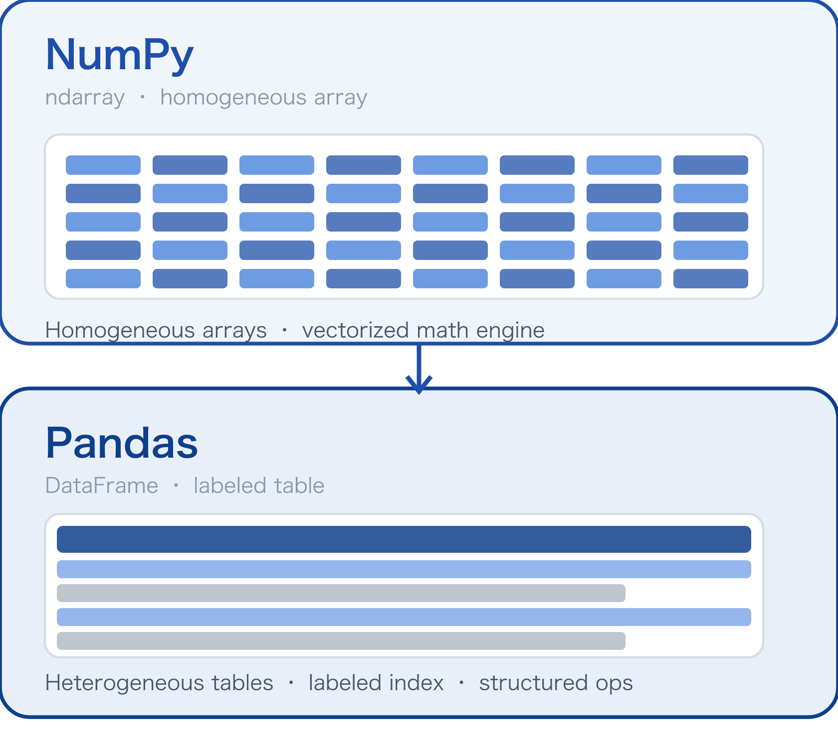
NumPy × Pandas · Division of Labor
Module 1 · Week 2
Pandas is built on NumPy
NumPy handles "grids of numbers" — one dtype, built for speed;Pandas handles "real tables" — mixed column types, with row/column labels. Pandas is the high-level table API on top of NumPy arrays.
When to Use Which
1
Numeric matrices / image tensors / math
→ NumPy
2
CSV / database tables / mixed columns
→ Pandas
3
Take a table column, do math on it
→ Both together
Examples: image pixels = NumPy; the Titanic passenger table = Pandas.
AI Application Development · Week 2
09 / 32

Slide 10



NumPy: Vectorization
Module 1 · Week 2
Two Ways to Write It
Why is vectorization faster?
# Python loop · slow
result = []
for x in data:
result.append(x * 2 + 1)
Runs in C
Loops execute inside compiled C code, bypassing the Python interpreter line by line.
# NumPy vectorized · fast
Contiguous memory
An ndarray is one contiguous memory block — far better CPU cache behavior than Python lists.
result = data * 2 + 1
# one line, 10–100× faster
SIMD parallelism
Broadcasting: arrays of different shapes align automatically, (100,1) + (1,3) → (100,3), with no data copying.
One instruction processes multiple data elements — free hardware-level parallelism.
Key insight: "vectorize instead of looping" is habit #1 for AI engineering code — every tensor operation from Week 5 onward builds on this.
AI Application Development · Week 2
10 / 32

Slide 11

Indexing, Slicing & Broadcasting
Module 1 · Week 2
# index & slice
a = np.arange(12).reshape(3, 4)
a[0, 1] # row 0, col 1 → 1
a[:, 2] # column 2 (all rows)
a[1:, ::-1] # from row 1, columns reversed
Broadcasting Rules
Align from the trailing dimension: if shapes are equal, or one is 1, broadcasting expands.
# common aggregations
a.sum(axis=0) # sum over columns
a.mean(axis=1) # mean over rows
a.argmax() # index of the max
(3, 4) + (4,)
trailing dims 4 = 4 ✓ → expands across rows
(3, 4) + (3,)
4 ≠ 3 ✗ → Shape Error
(3, 1) + (1, 4)
one 1 each ✓ → result (3, 4)
Slicing returns a view, not a copy: b = a[:, 0] — modifying b changes a too; use .copy() for an independent copy.
Why learn this now: every weight update in a Week 5 neural network is slicing + broadcasting — this is the foundation of tensor math.
AI Application Development · Week 2
11 / 32

Slide 12

Pandas: The Manipulation Chain
Module 1 · Week 2
1
2
3
4
5
Select
Load
Inspect
loc / iloc / boolean masks
Transform
Aggregate
read_csv / read_sql
head / info / describe
assign / apply / map
groupby / pivot_table
# Titanic: one chain, one question
(df[df.age > 18]
.groupby('sex')['survived']
.mean())
Key insight: one DataFrame flows through the entire pipeline — 80% of data preparation in AI projects is just recombining these five steps.
AI Application Development · Week 2
12 / 32

Slide 13
Pandas Cheat Sheet
Module 1 · Week 2
① Select
② Transform
③ Group & Merge
df.loc[df['age'] > 30, 'fare']
df['fare'] = df['fare'].fillna(0)
df.groupby('class')['fare'].agg(['mean', 'count'])
Condition + label-based column pick
New column from old (chainable)
Aggregate with multiple stats
df.iloc[0:5, [0, 3]]
df['is_child'] = df['age'] < 12
First 5 rows by position
Boolean column in one step
pd.merge(df1, df2, on='id', how='left')
Left join keeps the main table
df[df['sex'].isin(['male'])]
df['name'].str.lower()
Filter by a list of values
Vectorized text cleaning
pd.pivot_table(df, index='sex', values='survived')
Pivot table in one line
# classic trap: chained indexing
These 9 lines cover ~90% of Lab operations — screenshot them and keep them by your keyboard.Print this and keep it next to your keyboard.
df[df['age'] > 30]['fare'] = 0 # ✗ may silently fail
df.loc[df['age'] > 30, 'fare'] = 0 # ✓ correct way
AI Application Development · Week 2
13 / 32

Slide 14
03
Visualization & EDA
03
Exploratory Data Analysis
Right Chart
EDA 5 Steps
Look First
Match chart to question
A repeatable routine
Before modeling anything

Slide 15
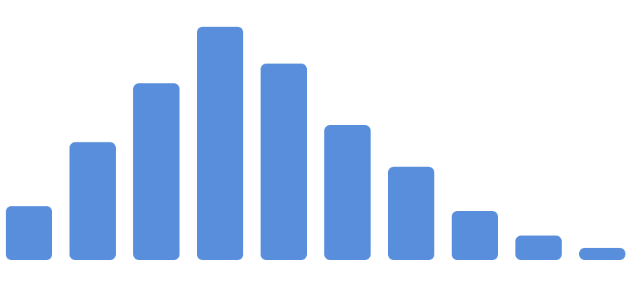


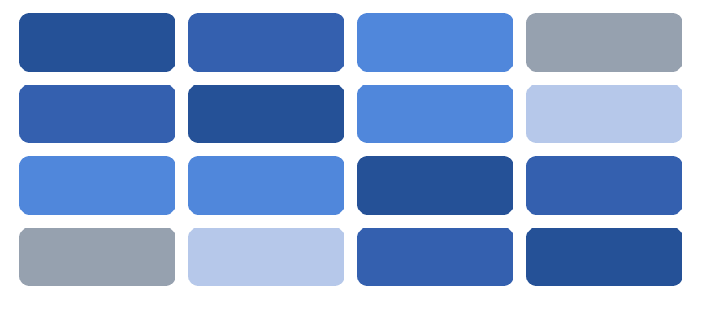
4 Chart Types × 4 Questions
Module 1 · Week 2
What's the distribution?
How do two variables relate?
Which group is bigger?
Which features correlate?
Histogram
Bar Chart
Heatmap
Scatter Plot
Shape of one variable: skew, modes, truncation.
Correlation, non-linearity, clusters at a glance.
Aggregate values across categories; add error bars.
Pairwise correlation matrix — the gateway to feature selection.
df[col].plot.hist()
df.plot.scatter(x,y)
df.groupby().mean().plot.bar()
sns.heatmap(df.corr())
Key insight: decide what question you're answering first, then pick the chart — doing it the other way around ("draw first, explain later") is where data storytelling turns into data fabrication.
AI Application Development · Week 2
15 / 32

Slide 16
The 5-Step EDA Routine
Module 1 · Week 2
EDA is reconnaissance
1
Overview
Training a model without EDA means fighting blind: you won't know if the data is poisoned, whether features need transforms, or whether your evaluation can be trusted.
shape / info / describe — how many rows and columns? What types? Any missing values?
2
Univariate
Histograms / value_counts — each variable's own distribution and outliers.
3
Bivariate
Scatter plots / grouped aggregates — how do features relate to the target?
# overview in three lines
df.shape
df.info()
df.describe()
4
Anomalies
Extreme values, missingness patterns — data-entry errors or real phenomena?
5
Hypotheses
Iron rule: write every finding into the notebook — your future self (and your teammates) will thank you.
Write them down — which features might have predictive power? What transforms are needed?
AI Application Development · Week 2
16 / 32

Slide 17
EDA Walkthrough: Titanic
Module 1 · Week 2
1
2
3
4
5
Overview
Univariate
Bivariate
Anomalies
Hypotheses
df.shape → (891, 12)
df["age"].plot.hist()
df.groupby("sex")["survived"].mean()
df["fare"].describe()
Write in the notebook
Hypothesis: sex + class + age predict survival; cabin is too sparse — consider dropping it.
Found: age missing 177, cabin missing 687, embarked missing 2.
Found: age is right-skewed, clustered at 20–40; fare has a heavy tail (max 512).
Found: female survival 74% vs male 19% — sex is a strong feature.
Found: 15 tickets with fare 0 — staff tickets or data-entry errors?
One dataset, five steps, actionable insights — that is the value of EDA: the feature list takes shape before any modeling.
Today's Lab follows exactly these five steps. Your findings do not have to match — same data, different angles.
AI Application Development · Week 2
17 / 32

Slide 18
04
Data Cleaning
04
From Raw to Usable
6-Step Workflow
Document Everything
Garbage In, Garbage Out
A repeatable procedure
Every step, a reason
The governing principle

Slide 19
The 6-Step Cleaning Workflow
Module 1 · Week 2
1
2
3
4
5
6
Audit
Missing
Outliers
Duplicates
Types
Validate
whitespace / case / unit chaos
drop / impute / flag
IQR rule / domain rules
duplicated → drop
dates / categories / numbers
re-run EDA to verify
Lab 2 does exactly this
Missing ages, outlier fares, duplicate rows in the Titanic data — you will handle all of them by hand in today's lab.Add a Markdown note for every step explaining "what you did and why". Every cleaning step needs a documented reason.
AI Application Development · Week 2
19 / 32

Slide 20
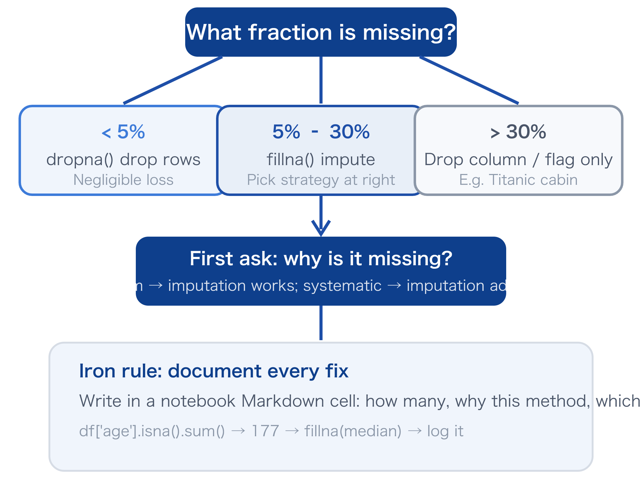



Missing Values: A Decision Guide
Module 1 · Week 2
Decision Path
Imputation
Numeric · approx. normal
mean
E.g. temperature, exam scores
Numeric · skewed / with outliers
median
E.g. income, fare (Titanic age)
Categorical
mode or "Unknown"
E.g. embarked, 2 missing → mode
Time series
forward / backward fill
Fill a sensor gap with the last reading
AI Application Development · Week 2
20 / 32

Slide 21


Three Ways to Spot Outliers
Module 1 · Week 2
IQR Method
Z-score Method
Domain Rules
Interquartile Range
Standard Deviations
Expert-defined Bounds
Flag values below Q1−1.5·IQR or above Q3+1.5·IQR. No distribution assumed — best for skewed data.
Flag |z| &gt; 3. Only valid for roughly normal data; heavy tails flag too many normal points.
Hard-code bounds from domain knowledge: age ∈ [0, 120], fare ≥ 0, blood pressure ∈ [40, 300].
q1, q3 = s.quantile([.25,.75])
z = (s - s.mean()) / s.std()
df = df[df['age'].between(0, 120)]
After detection, three options: drop (confirmed errors) ·clip (winsorize to bounds) ·keep (the anomaly is what you predict, e.g. fraud).
Judge first, then act: is a value an error or extreme-but-real — deleting real extremes can discard your most valuable samples.
AI Application Development · Week 2
21 / 32

Slide 22
Data quality is the model ceiling
A model has no "common sense" to correct bad input — it faithfully learns every bias, gap, and noise in the data, then amplifies them into every prediction.
GIGO
Bad data + great algorithm
Good data + simple model
No model swap will save you — metrics stay mysteriously stuck.
On clean data, logistic regression often beats deep networks.
Garbage In,
Garbage Out
Data quality sets the ceiling; algorithms only control how fast you approach it — which is why this week's cleaning skills are worth more than any tuning trick you'll learn next week.
AI Application Development · Week 2
22 / 32

Slide 23
05
Lab · Titanic Hands-On
05
Hands-On: The Titanic Dataset
Four Missions
Leave a Paper Trail
Quick Quiz
4 Missions · 75 min
Document Every Step
Quiz at the End

Slide 24





Lab Overview · Four Missions in 75 min
Module 1 · Week 2
A
10 min
B
25 min
C
20 min
D
15 min
E
5 min
Pandas Exploration
Visualization
NumPy Warm-Up
Load titanic.csv, run the 5-step EDA
Three charts answer three questions
Cleaning
Wrap-Up & Submit
Create · slice · broadcast drills
Missing · outliers · duplicates
Checklist · Git push
Environment & Data
Lab Rules
conda activate ai-app (created last week) · titanic.csv is on the course platform · create a new notebook lab02_eda.ipynb
1.
Stuck? Read the last error line first, then ask a neighbor, then raise your hand
2.
Give each task a Markdown heading
3.
No single right answer — reasoning beats answers
AI Application Development · Week 2
24 / 32

Slide 25
Lab A · NumPy Warm-Up (10 min)
Module 1 · Week 2
Task 1
Create & Inspect
# skeleton — try first, peek only if stuck
Make a 4×4 matrix of 0–15; print its shape, dtype, and sum.
import numpy as np a = np.arange(16).reshape(4, 4)
print(a.shape, a.dtype)
print(a.sum()) row2 = a[1] # row 2
block = a[2:, 2:] # bottom-right 2x2 b = a + np.array([0, 1, 2, 3])
# row i of b = row i of a + i
# that is broadcasting: (..,4) + (4,)
Task 2
Slicing Practice
Take row 2, column 3, and the bottom-right 2×2 block (remember: views!).
Task 3
Broadcast Arithmetic
Add [0, 1, 2, 3] to each row — one line of code.
Checkpoint: all three tasks green (no errors, expected results) before moving to Lab B.
AI Application Development · Week 2
25 / 32

Slide 26
Lab B · Pandas Exploration (25 min)
Module 1 · Week 2
# your starting point
import pandas as pd df = pd.read_csv('titanic.csv')
df.shape # (891, 12)
df.head() # first 5 rows
df.info() # types + missing
df.describe() # numeric stats
Answer with Code
Q1 · Which columns have missing values, and how many?
Hint: df.isna().sum()
Q2 · What is the mean fare for each of the three classes?
Hint: df.groupby('class')['fare'].mean()
Q3 · What is the survival rate of male passengers over 30?
Hint: df[(df['age']>30) & (df['sex']=='male')]['survived'].mean()
Tip: in the info() output, any column with a non-null count below 891 has missing values — note them in Markdown first.
Q4 · How much higher is female survival than male?
Hint: df.groupby('sex')['survived'].mean()
Under each answer, write a sentence starting with "I found that..." — that is raw material for EDA step 5.
AI Application Development · Week 2
26 / 32

Slide 27
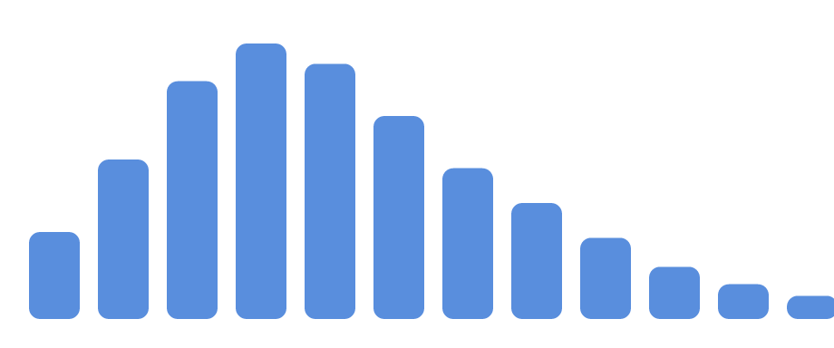


Lab C · Three Charts, Three Questions (20 min)
Module 1 · Week 2
Chart 1 · Histogram
Chart 2 · Bar chart
Chart 3 · Scatter plot
What does passenger age look like?
Which class has the highest survival rate?
How do age and fare relate?
df.groupby('class')['survived'].mean().plot.bar()
df["age"].plot.hist(bins=30)
df.plot.scatter(x='age', y='fare')
Look for: Right-skewed? Clustered where? Any suspicious zeros?
Look for: Does survival drop monotonically from first to third class?
Look for: Any ceiling effect (the 512 fare)? Where do cheap tickets cluster?
Requirement: add 1–2 sentences of Markdown interpretation per chart — a chart without a caption was not drawn.A chart without a caption is not analysis.
Stuck interpreting a chart? Revisit your Q1–Q4 answers for clues.
AI Application Development · Week 2
27 / 32

Slide 28
Lab D · Cleaning Practice (15 min)
Module 1 · Week 2
Cleaning checklist — follow in order
# skeleton
1
age missing: 177
# 1. age: median fill + flag
med = df['age'].median()
df['age_missing'] = df['age'].isna()
df['age'] = df['age'].fillna(med) # 2. embarked: mode fill
mode = df['embarked'].mode()[0]
df['embarked'] = df['embarked'].fillna(mode) # 3. fare: clip to IQR
q1, q3 = df['fare'].quantile([.25, .75])
iqr = q3 - q1
df['fare'] = df['fare'].clip(q1 - 1.5*iqr,
q3 + 1.5*iqr)
Skewed distribution → fill with the median and add an age_missing flag column.
2
embarked missing: 2
Categorical with very few gaps → fill with the mode.
3
fare outliers (0 and 512)
Clip to IQR bounds; do not drop — those 0-fare tickets may tell a story.
4
Check for duplicates
df.duplicated().sum(); if any, drop_duplicates().
5
Re-check after cleaning
Re-run df.info() + describe() and compare before vs after.
Before each step, write a ## why heading — that is what the rubric rewards.
AI Application Development · Week 2
28 / 32

Slide 29




Deliverables & Rubric
Module 1 · Week 2
What to Submit
Rubric (100 points)
Runnable code, clear logic
30 pts
lab02_eda.ipynb
Complete notebook from load to cleaning, with Markdown notes
Complete 5-step EDA, findings documented
30 pts
Three charts + captions
Sensible, documented cleaning choices (the why)
20 pts
Histogram / bar / scatter, each with 1–2 sentences
Correct chart choice + solid interpretation
10 pts
Hypothesis list (≥3)
Quality hypotheses (testable, evidence-based)
10 pts
Format: "I think ... because the charts show ..."
This Lab counts toward "Lab participation" (20%). The end-of-class quiz adds 10% to the Lab score.Late policy: -10% per 24h late.
Git push
Commit message: feat: complete lab02 EDA
Due: Monday 23:59 · submit via the course platform + a GitHub repo link
AI Application Development · Week 2
29 / 32

Slide 30
Quick Quiz (Show of Hands)
Module 1 · Week 2
Q1 · Single choice
Q2 · Single choice
Q3 · True or False
NumPy vectorization is 10–100× faster than a for loop. The main reason is:
The age column is ~20% missing and right-skewed. The most sensible first step is:
"A scatter plot is the right chart to show the distribution of a single variable."
A. Python 3 itself got faster
A. Drop the whole column
✗ False — that is the job of a histogram; scatter plots answer questions about the relationship between two variables.
B. Loop runs in C + contiguous memory + SIMD
B. Fill everything with 0
C. Fill with the median and keep a missing-flag column
C. NumPy secretly calls the GPU
Chart-choosing rule: question first, chart second
Vote first, then review
Each question: the class votes (A / B / C), then we reveal the answer and one student explains the reasoning. Getting all 3 right adds +0.5 to your final "Lab participation".Vote first, reveal second — explain the why.
AI Application Development · Week 2
30 / 32

Slide 31

Summary
Module 1 · Week 2
5 Key Takeaways
TODO: After Class
Six data quality dimensions set the model ceiling — flaws get amplified
Finish the Lab
notebook + 3 charts + hypothesis list · due Monday 23:59
NumPy for array math, Pandas for tables — the latter is built on the former
Push to Git
commit: feat: complete lab02 EDA
Vectorize instead of looping: 10–100× faster, habit #1 for AI code
Preview Chapter 3
install scikit-learn and build your first model
Four chart types answer four questions: distribution / relationship / comparison / correlation
Next week: Machine Learning with scikit-learn — train your first full model on today's cleaned data
EDA 5 steps + cleaning 6 steps: scout first, document every step
AI Application Development · Week 2
31 / 32

Slide 32
W2
"The quality of your data caps your model
before you write a single line of code."
02
Thank you
Next week: Machine Learning with scikit-learn — your first complete model
AI Application Development · Week 2 Lecture · 32 / 32

