Slide 1
Generation of Migratory Species Fact Sheets
Generate JPGs of distribution maps
Procedure:
1. Export all distribution maps from ArcView shapefile format into jpg images
(use a batch export ArcView script)
2. Generate an image, which contains the legend, the country file, the blue background
color, the scale bar and the map source information.
3. Generate and run a batch file (Linux shell script) that
a) performs an overlay of the distribution map and the legend image and
b) generates a scaled down copy of the output image, which is needed for the print
version.
Generate HTML text files
Procedure:
1. Generate two prototype html text files for the species fact sheets (normal version and
print version)
2. Design and carry out GROMS query that provides information for every species
3. Construct a form letter out of GROMS query, using the html prototypes
4. Split apart the query output, which contains the html code for all species, stringed
together in a single text file. Each species gets an individual html text file. The
splitting procedure is carried out by a C program.

Slide 2
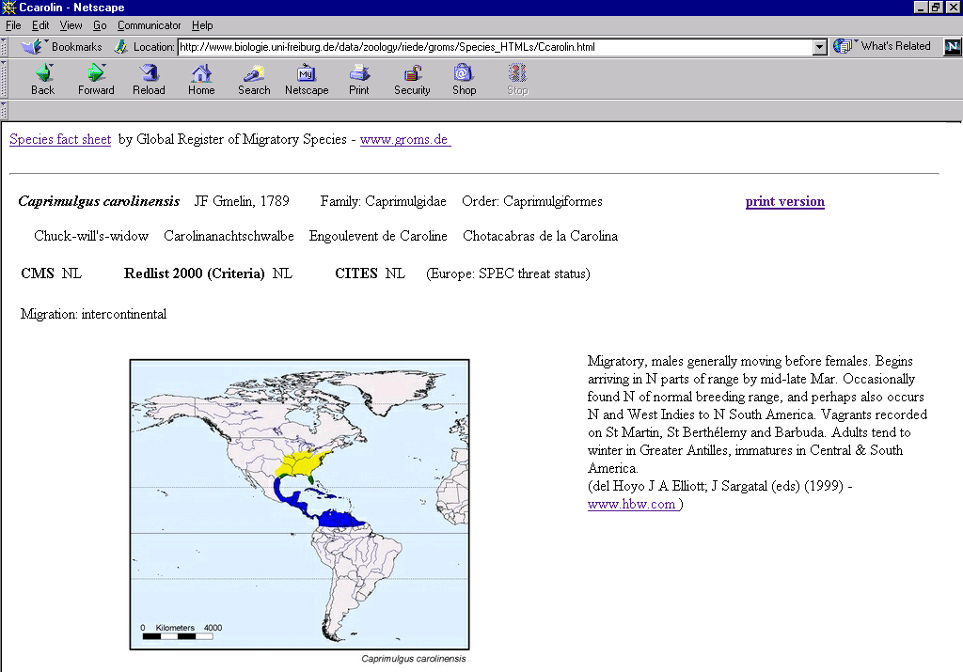
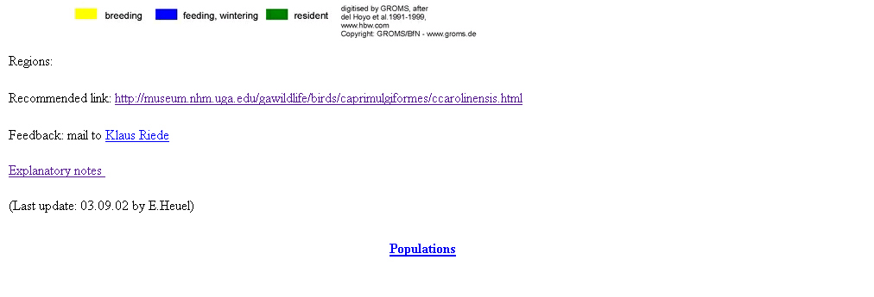
Example for a species fact sheet

