Slide 1

Pizza vs Pasta Classification Using Machine Learning
Detailed Analysis with Code, Models, and Results
Yun Zhu

Slide 2
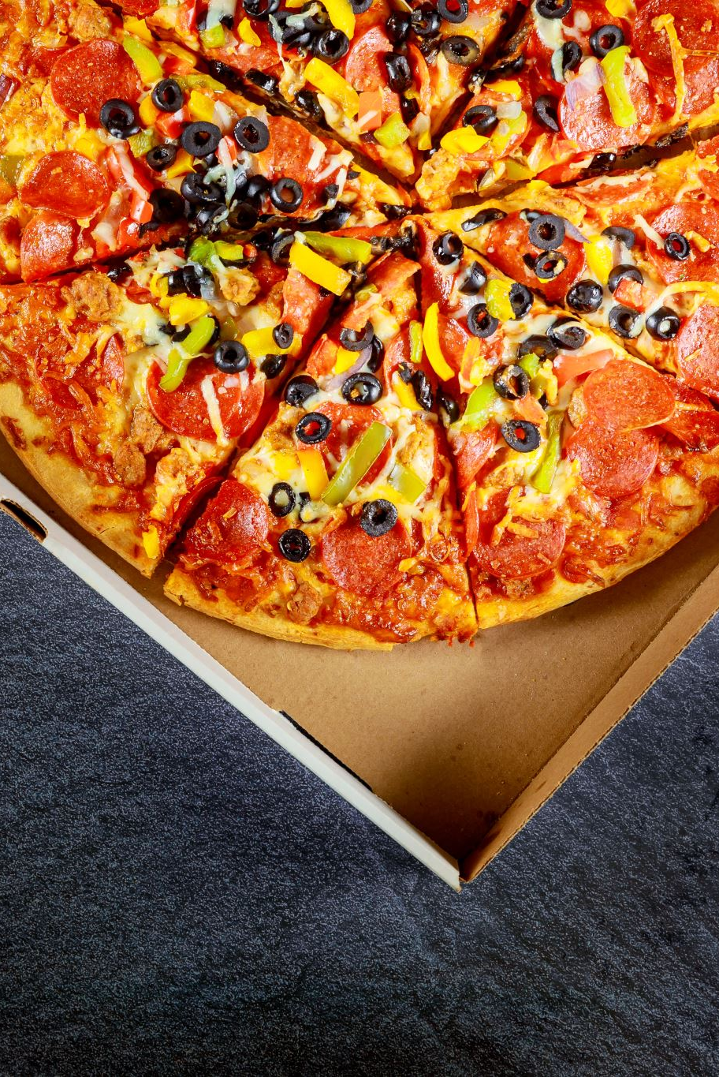
Project Overview
Objective:
- Classify images of pizza and pasta using Machine Learning models: CNN, MLP, and SVM.
Significance:
- Improve image classification tasks with food recognition applications in AI.

Slide 3
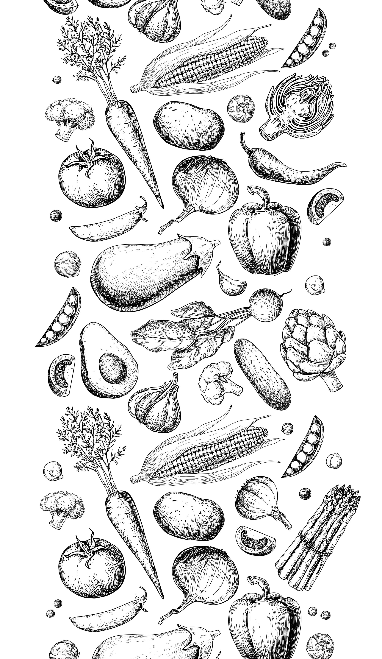
Dataset Overview
Dataset Details:
- 1000 Images (Pizza: 500, Pasta: 500).
- Grayscale, Resized to 128x128.
Sources:
- Labeled directories for image collection.

Slide 4
Data Loading Process
Code Sample:
```
# Load image file paths and labels
pizza_files = glob.glob('data/pizza/*.jpg')
pasta_files = glob.glob('data/pasta/*.jpg')
labels = [0]*len(pizza_files) + [1]*len(pasta_files)
filepaths = pizza_files + pasta_files
```

Slide 5
Data Preprocessing Steps
Preprocessing Steps:
- Convert to grayscale.
- Resize to 128x128 pixels.
- Normalize pixel values (0 to 1).
Code Example:
```
def process_image(file):
img = Image.open(file).convert('L').resize((128, 128))
return np.array(img) / 255.0
```

Slide 6
Train-Test Split
Dataset Split:
- Train: 80% (800 images)
- Test: 20% (200 images)
Code Example:
```
x_train, x_test, y_train, y_test = train_test_split(
filepaths, labels, test_size=0.2, random_state=42)
```

Slide 7
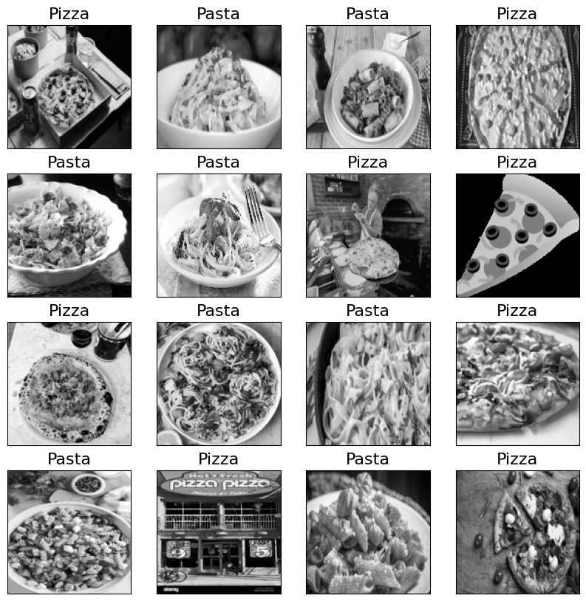
Image Visualization
Sample Images:
- Visualizing sample images of pizza and pasta from the dataset.

Slide 8
Convolutional Neural Network (CNN) Architecture
Model Overview:
- Convolutional layers, Max Pooling, Dense layers.
Code Example:
```
model = Sequential([
Conv2D(32, (3,3), activation='relu', input_shape=(128, 128, 1)),
MaxPooling2D((2,2)),
Flatten(),
Dense(64, activation='relu'),
Dense(1, activation='sigmoid')
])
```

Slide 9
CNN Training Process
Training Configuration:
- Learning Rate Scheduler
- Early Stopping for Overfitting Prevention.
Code Sample:
```
model.compile(optimizer='adam', loss='binary_crossentropy', metrics=['accuracy'])
model.fit(x_train, y_train, epochs=20, validation_data=(x_test, y_test))
```

Slide 10
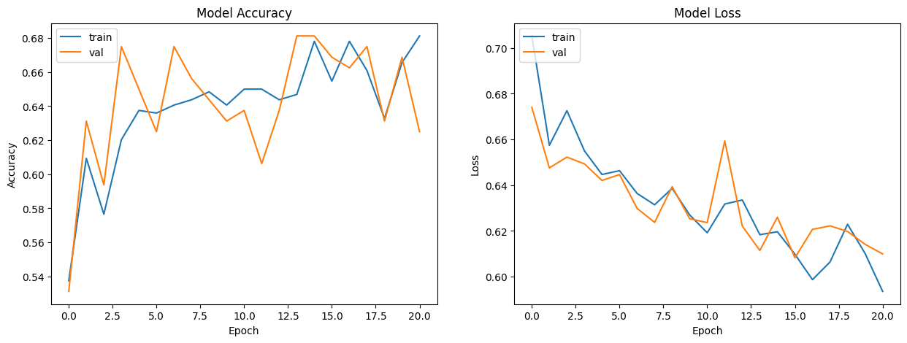
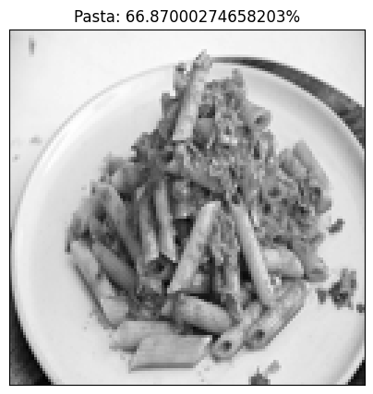
CNN Results
Training vs Validation Accuracy/Loss Curves.
Display Plots for Training Accuracy and Loss.

Slide 11
Multilayer Perceptron (MLP) Overview
Model Details:
- 3 Hidden Layers, Dropout for Regularization.
Code Example:
```
model = Sequential([
Dense(256, activation='relu', input_shape=(128*128,)),
Dropout(0.3),
Dense(128, activation='relu'),
Dropout(0.3),
Dense(1, activation='sigmoid')
])
```

Slide 12
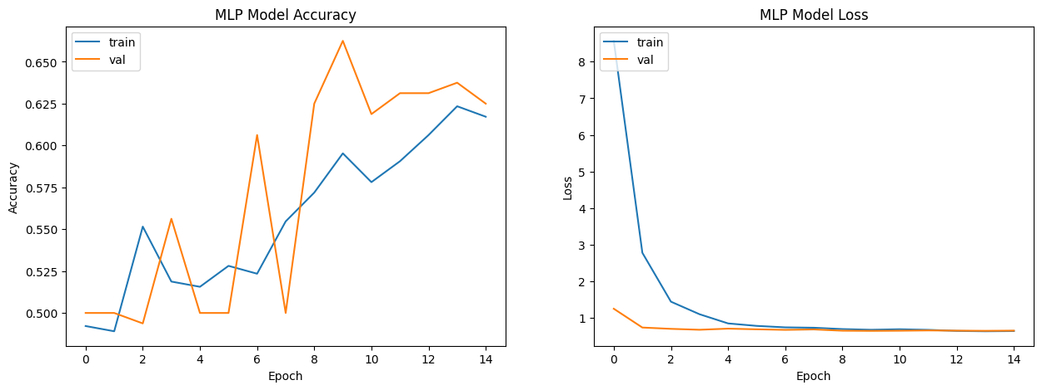

MLP Training and Results
Training Process and Results:
- Learning Rate Scheduler
- Early Stopping.
Code Example:
```
model.compile(optimizer='adam', loss='binary_crossentropy', metrics=['accuracy'])
model.fit(x_train, y_train, epochs=20, validation_data=(x_test, y_test))
```

Slide 13
Support Vector Machine (SVM) Configuration
Model Setup:
- SVM with Linear and RBF Kernels.
Code Example:
```
from sklearn.svm import SVC
model = SVC(kernel='rbf', C=1, gamma='scale')
model.fit(x_train, y_train)
```

Slide 14
SVM Evaluation Metrics
Evaluation Metrics:
- Accuracy, Precision, Recall, F1-Score, Confusion Matrix.
SVM Classification Report:
precision recall f1-score support
0.0 0.74 0.67 0.70 96
1.0 0.72 0.79 0.75 104
accuracy 0.73 200
macro avg 0.73 0.73 0.73 200
weighted avg 0.73 0.73 0.73 200
Confusion Matrix: [[64 32]
[22 82]]

Slide 15
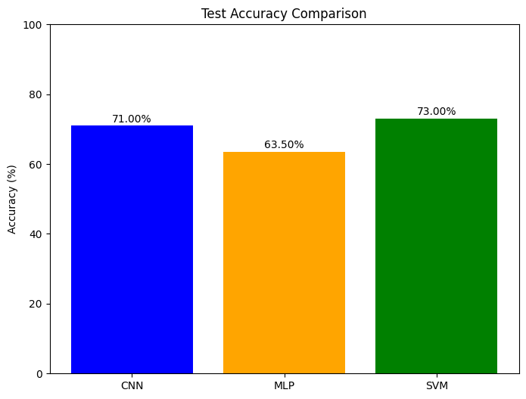
Model Comparison Table
Model Comparison:
- CNN: 71% Accuracy (Spatial Features).
- MLP: 63.5% Accuracy (Basic Neural Network).
- SVM: 73% Accuracy (Best Performance).

Slide 16
Challenges Encountered
Challenges:
- Overfitting in CNN.
- Limited Dataset Size.
- Need for Advanced Architectures.

Slide 17

Insights Gained
Insights:
- CNN is best for spatial data.
- MLP has limitations for image data.
- SVM performed best with optimized hyperparameters.

Slide 18
Applications
Applications:
- Automated Food Recognition.
- Restaurant Menu Digitization.
- Visual Search in Food Apps.

Slide 19
Future Improvements
Future Steps:
- Use Advanced Architectures (ResNet, EfficientNet).
- Expand Dataset.
- Add More Food Categories.

Slide 20
Conclusion
Summary:
- Successful Image Classification Achieved.
- Key Takeaways from Model Comparison.
- Thank You!

