Slide 1
SportThinking
Elimination day presentation

Slide 2
Problem
The user wishes to see which sporting events are available near their location
No easy way to get such information
Also no knowledge of sporting events abroad
The user normally only knows about the sports they are actively following and are interested in
No available information about other sports that might interest them

Slide 3
Solution
An application that recommends sporting events based on location
Navigates the user to the event
Enables buying tickets
Enables searching for the event on a map or a list based on the distance between the user and the event
Enables selecting sport preferences (filters)
Ease of use and an enjoyable user experience

Slide 4
Product
Native Android application (for now)
Map based on current location
List of nearby events (notifications)
Personalization, a personal user account to save preferences and have them available everywhere
Search (events by sport/location)
Event detail information (event highlights, statistics, rankings, sport information)
Option to buy tickets for each event (where available)

Slide 5
User base
The application is intended for sports fans that wish to visit certain sporting events but basically just do not know where to find information about them
Also very useful for people that travel a lot, since they have even less knowledge about sites or apps that show local events

Slide 6
Advertising
One option is to create two separate apps, a free version and a premium version
The second is to make an app that show ads pertaining to a specific company, i.e. affiliate marketing
We would connect with a small local company, as they are always looking for recognition
Banner ads or fullscreen ads
Main source of income

Slide 7
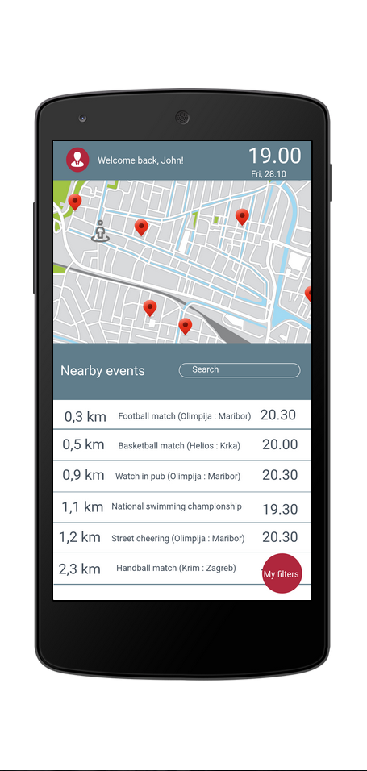
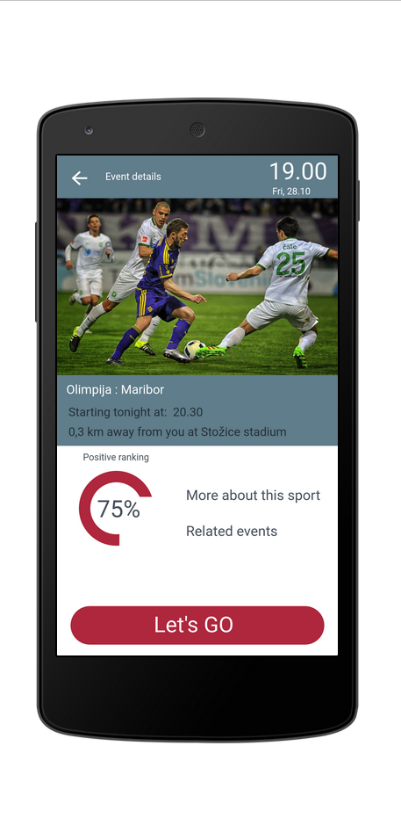
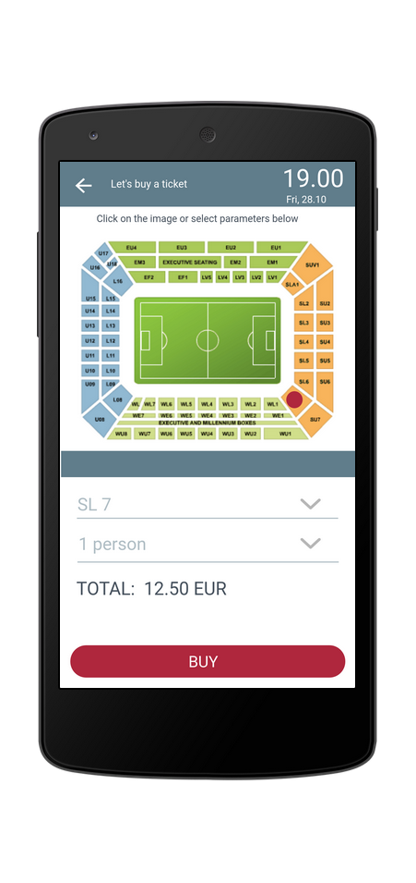
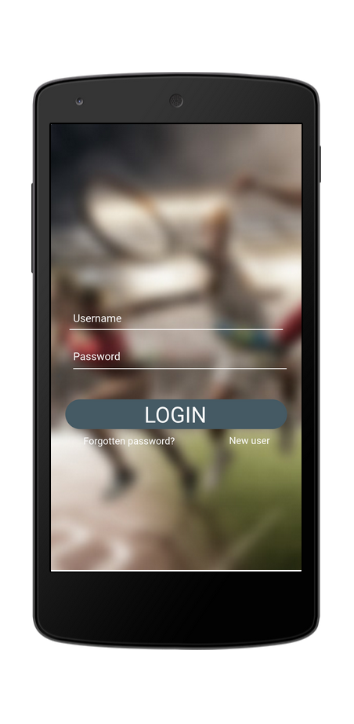
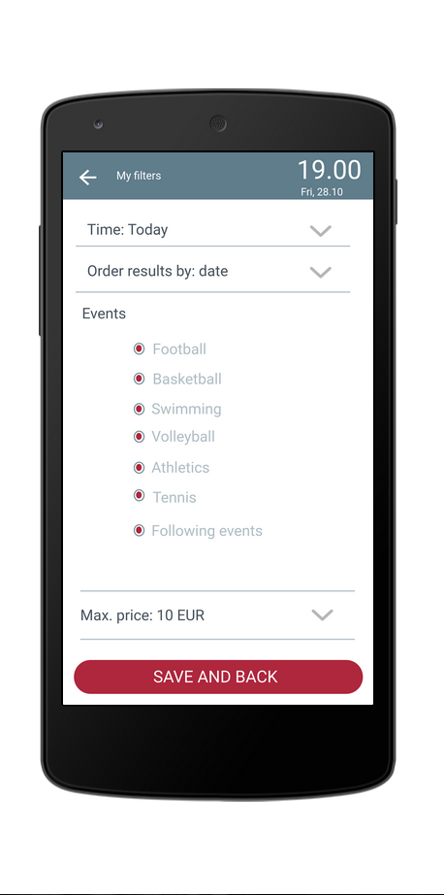
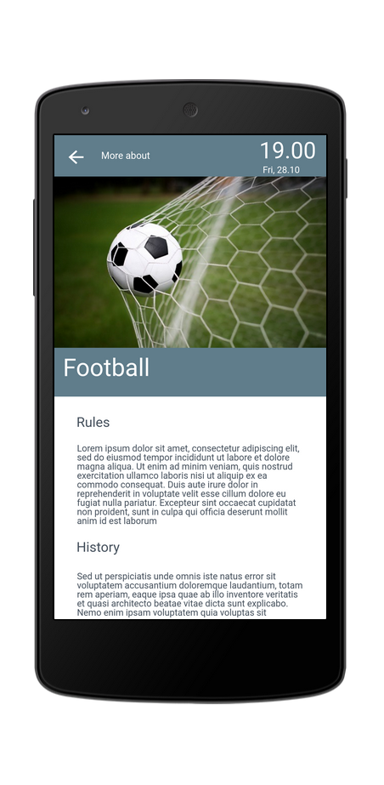
Mockup
https://marvelapp.com/239dfig/screen/16273959

Slide 16
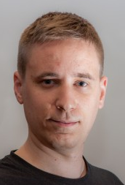
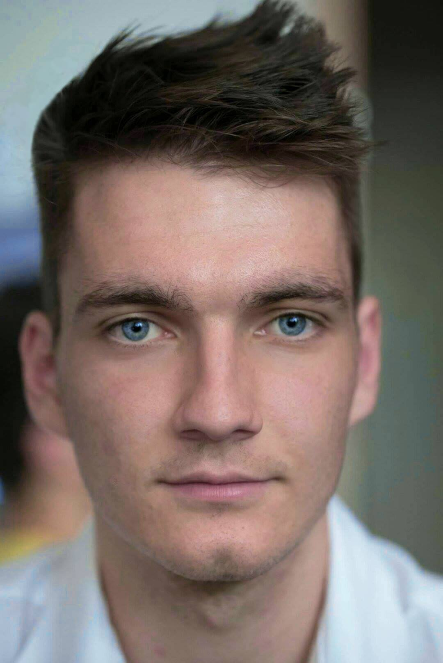
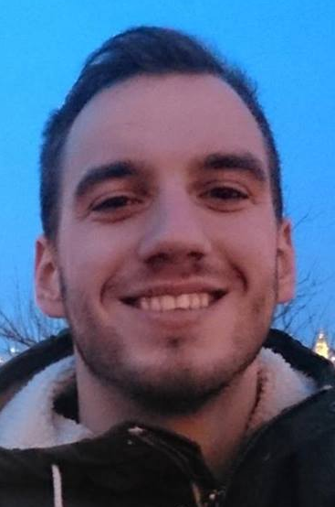
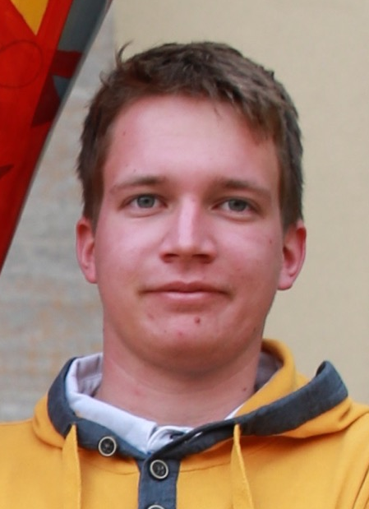
Team
Jan Vidic
Telecommunications
Team worker, Business enthusiast
Klavdij Starman
Mobile and web development
communicative geek with a passion for sports
Nejc Povšič
Developer
Hard working, never gives up, works well in a team
Luka Bezovšek
Software engineering
Determinism, persistence, team player

Slide 17
SportThinking
Jan Vidic, jan@Vidic.me,
Klavdij Starman, klavdij.starman1@gmail.com,
Luka Bezovšek, luka.bezovsek@gmail.com,
Nejc Povšič, npovsic@gmail.com

