Slide 1
EE 447
Control Systems Analysis
Fall 2007
Instructor: Eric Klavins
TAs: Steve Safarik and Mona Meisami-Azad

Slide 2
The UG Controls Sequence
447 (Autumn) = Introduction to the Mathematics of Control Systems
448 (Winter) = Control Systems Laboratory (Make stuff go)
449 (Spring) = Capstone control system design course

Slide 3
449 Project Example
Sam Burden, Stephen Day, Brian Wolfe

Slide 4
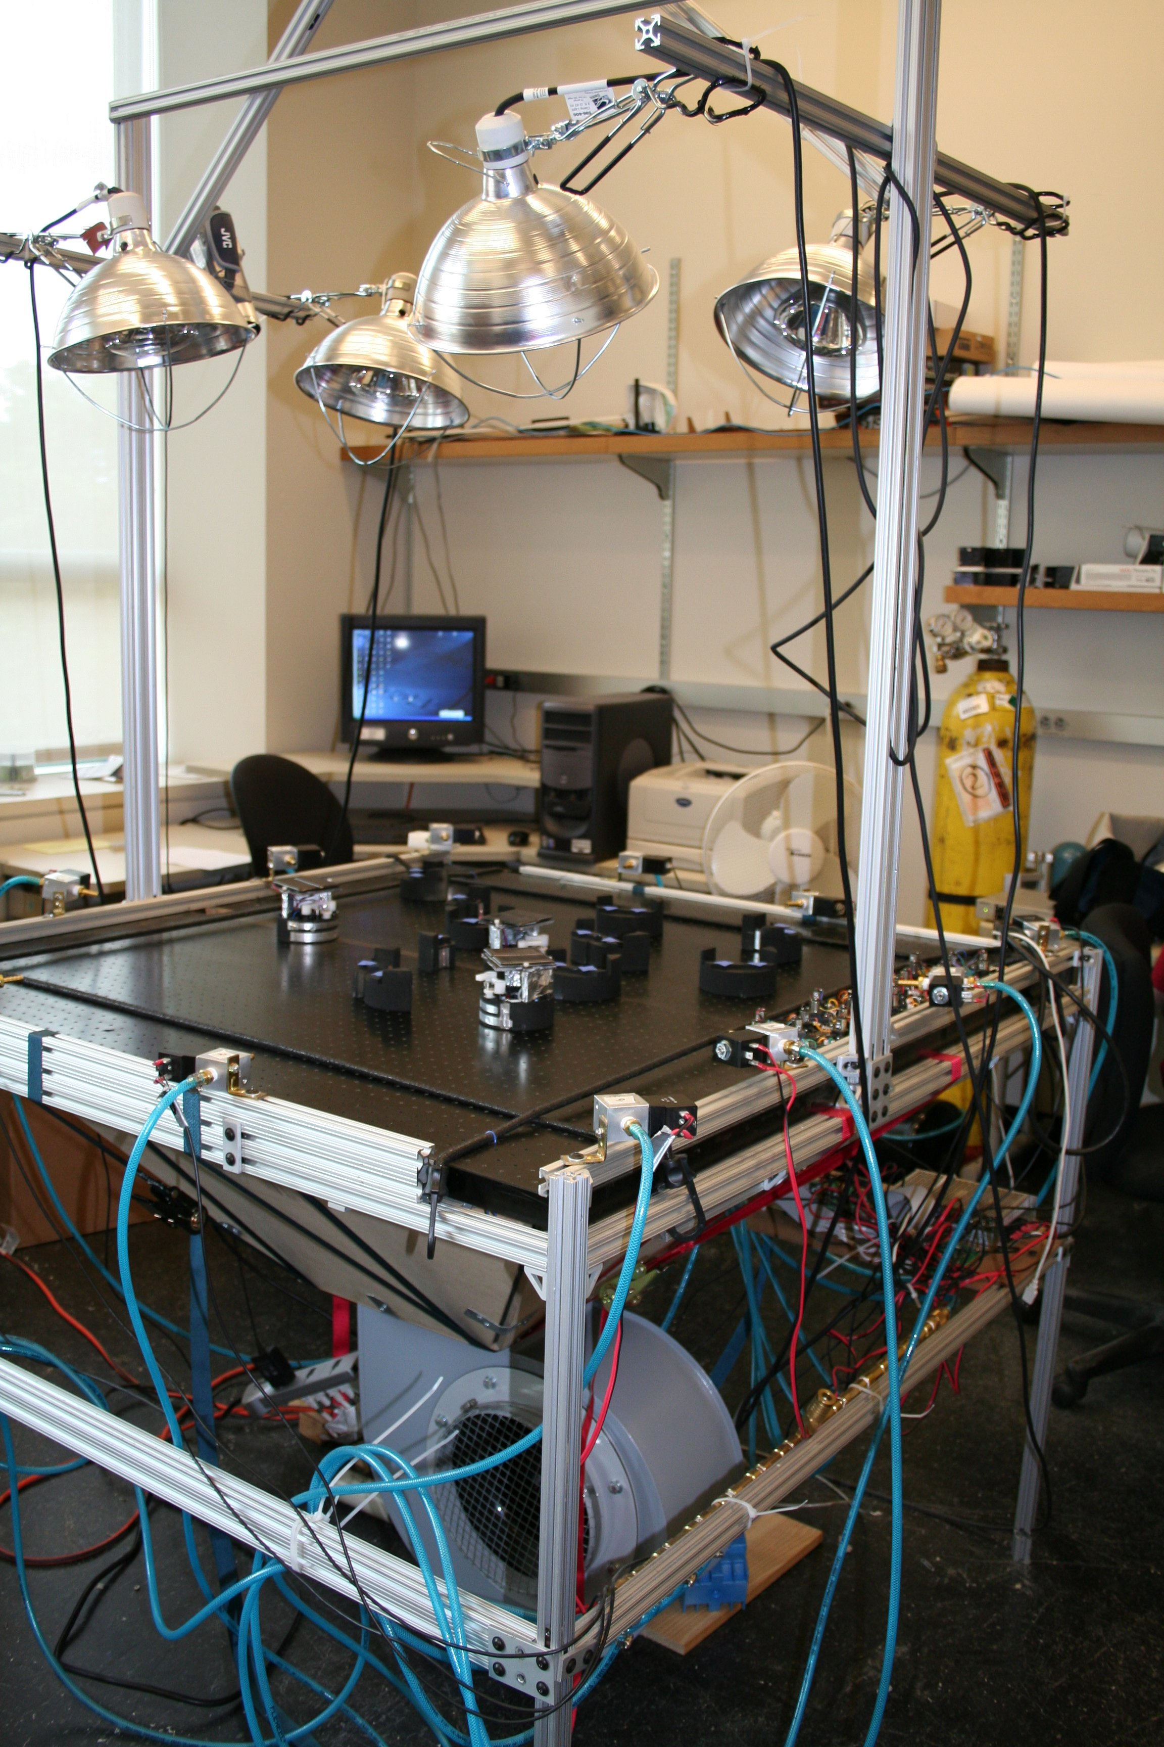
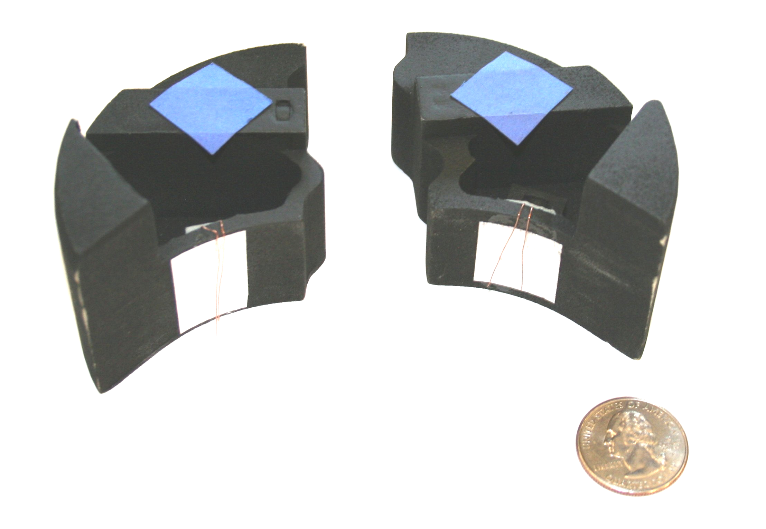
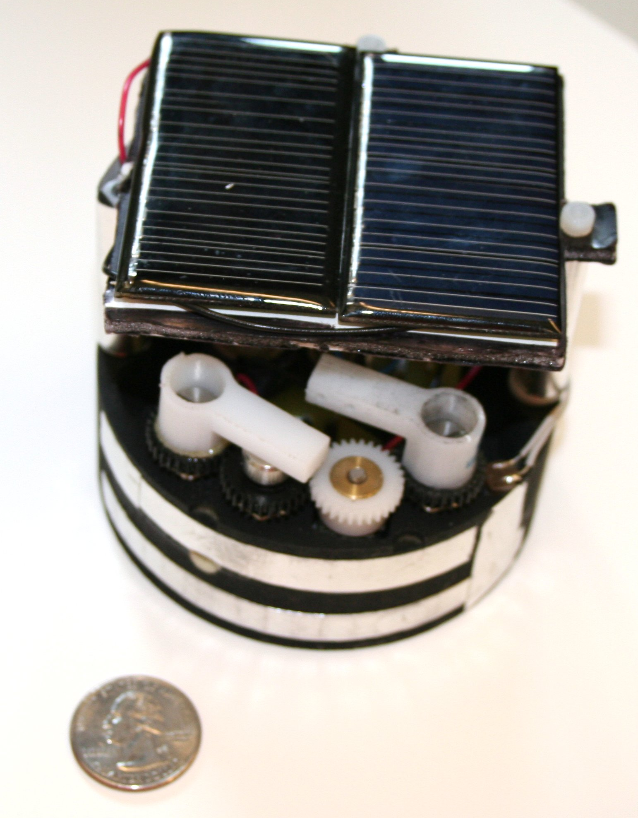
449 Project Example
Sheldon Rucker, Mike McCourt, Yi-Wei Luy (and Sam Burden)

Slide 5
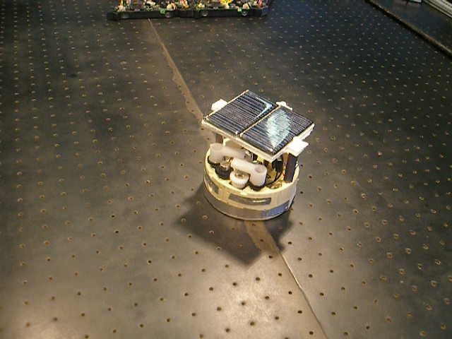
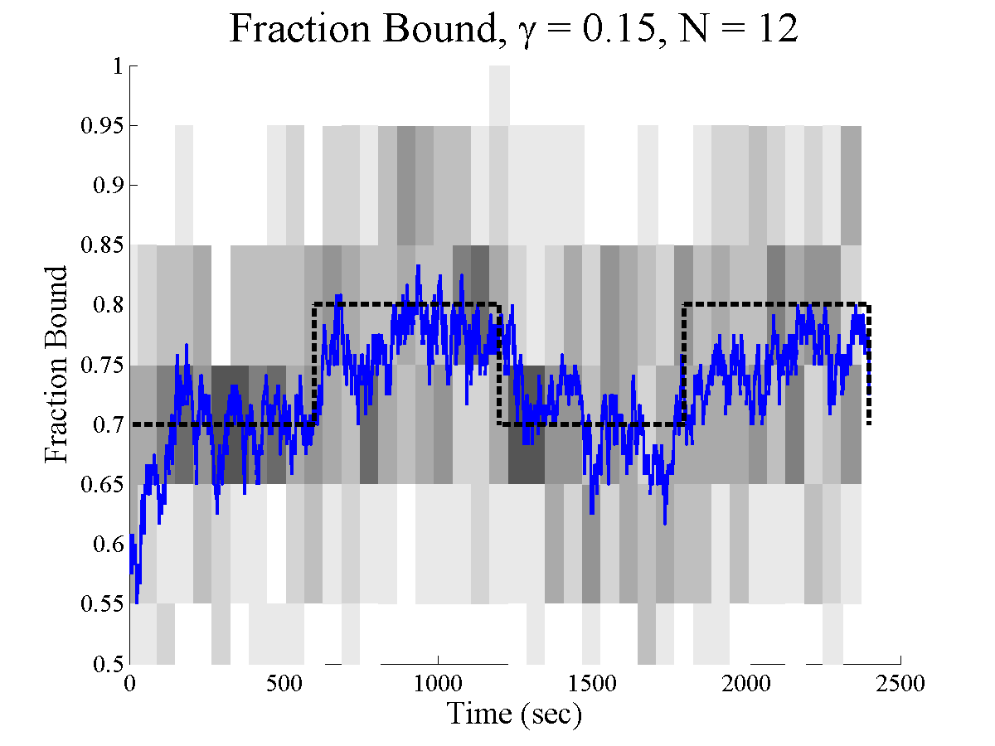
k₁
P₁ + P₂ P₁ P₂
P₁ P₂ + A P₁ + P₂ + A’
A’ A
k₋₁
k₂
u
y = #P₁ P₂

Slide 6
Academic Context of the Course
core graduate courses
optional
graduate courses
Linear Systems
Nonlinear Systems
Robust Control
System Identification
Optimal Control
Stochastic Control
Geometric Control
Digital Control
SISO (447-448-449)
Hybrid Systems
Cooperative Control
Discrete Event Systems
Quantum Control
Networked Systems
Power System Control
Control of Turbulence
Feedback in Genetics
special topics
Neural Interfaces
Active research

Slide 7
Course Structure (See Syllabus)
  Will change to wiki once we recover from our server crash
Open book, open notes.
No computational devices.

Slide 8
Today
What is feedback and control?
Examples
Course outline
Dynamical systems
First
hour
Second
hour

Slide 9
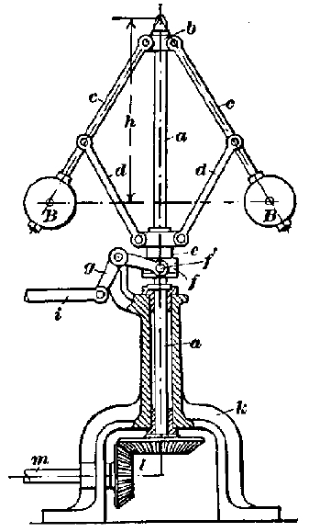
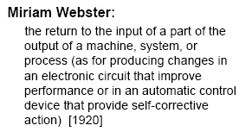
What is Feedback?
Balls fly out as speed increases
Steam
Engine
Flyball
Governor
Valve closes, slowing engine
The centrifugal governor (1788)

Slide 10
Feedback In Biology
A human polymorphonuclear leukocyte (neutrophil) on a blood film, crawling among red blood cells, notable for their dark color and principally spherical shape.The neutrophil is "chasing" Staphylococcus aureus microorganisms, added to the film.
Sensing? Actuation? Control Algorithm?

Slide 11
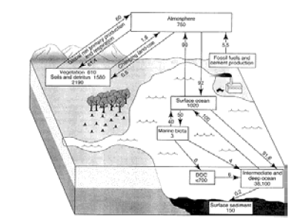
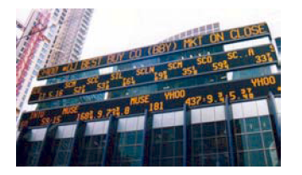
Other Examples
Environment
  Global Carbon Cycle
  Ecosystems...
Finance
  Supply and Demand
  Inflation/Interest Rates

Slide 12
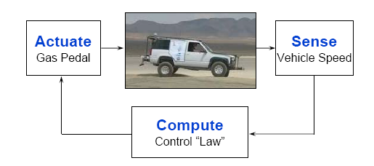
What is Control?
Sensing + Computation + Actuation
in a feedback loop
Stability
Performance
Robustness
WANT:

Slide 13
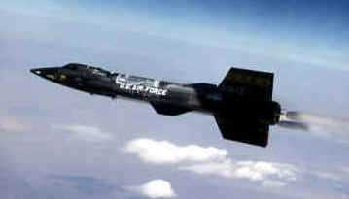
Why Stability and
Robustness are Good
... an electrical disturbance ... slightly degraded the control of the aircraft.
The X-15 Rocket Plane (1967)
The Honeywell adaptive flight control system began a limit-cycle oscillation just as the plane came out of the spin, preventing the system's gain changer from reducing pitch as dynamic pressure increased. The X-15 began a rapid pitching motion of increasing severity. All the while, the plane shot downward at 160,000 feet per minute, dynamic pressure increasing intolerably.

Slide 14
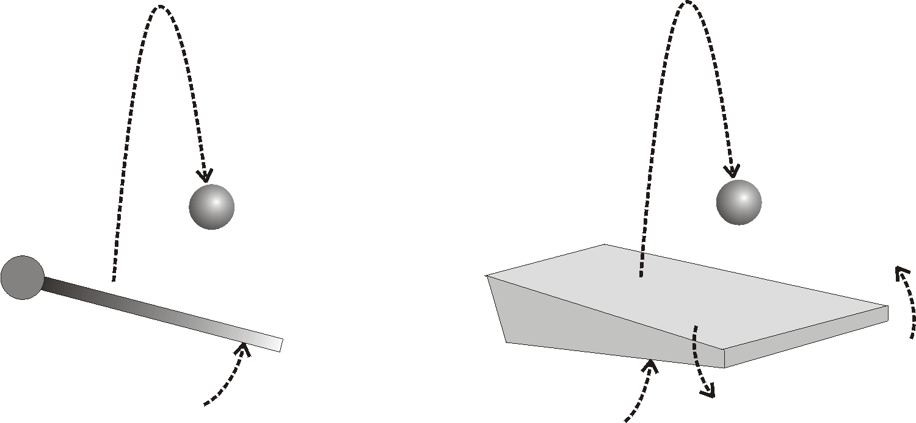
Control in Robotics
Pixmaps at 30Hz
Torque commands to motors
What does stability mean?
What performance guarantees?
What kinds robustness problems could occur?

Slide 15
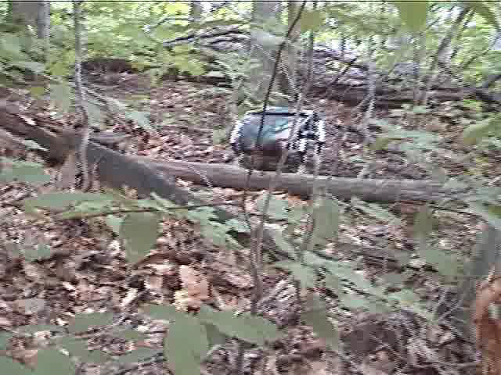
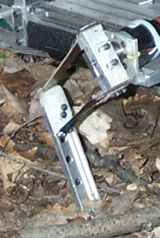
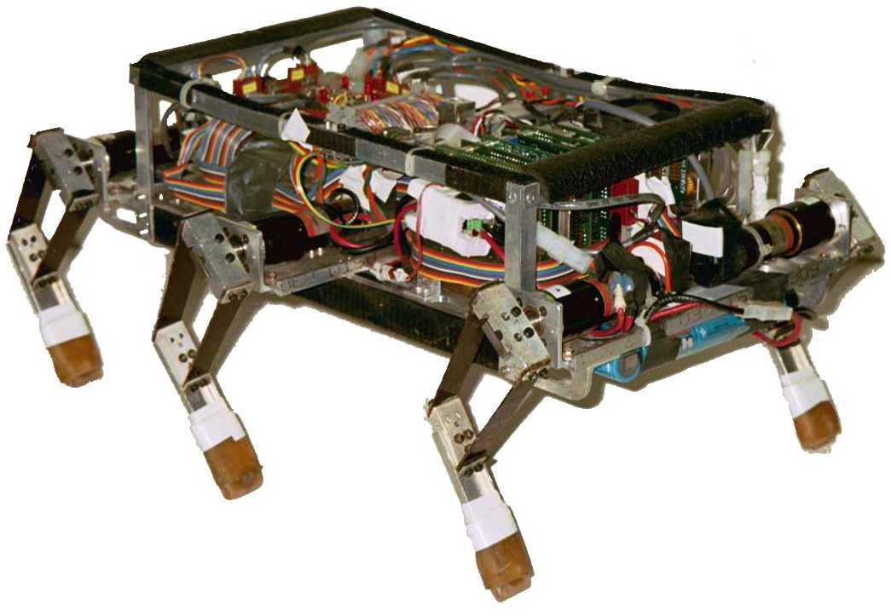
Control of the Bug Robot
Proportional-Derivative Control of Leg position.

Slide 16
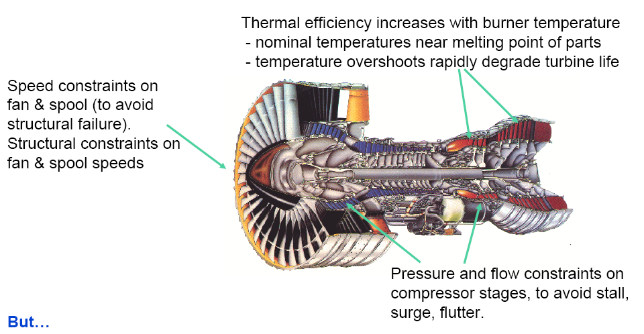
Jet Engine Control
Sensors
  Temperatures
  Pressures
  Spool Speed
Actuators
  Fuel flow
  Nozzle Area
  Vane angles

Slide 17
Internet Congestion Control
source
local
network
router (limited
throughput)
Sensors
  Number of dropped packets
Actuators
  Rate at which messages are sent
size of buffer

Slide 18
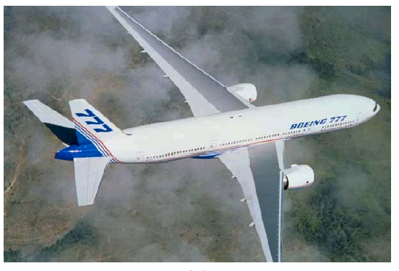
Control is Everywhere!
Problem: Identify the control systems and subsystems found in a modern passenger jet.

Slide 19
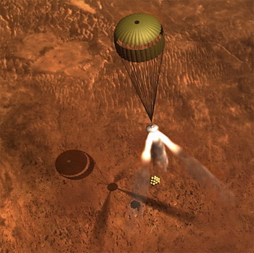
Professional Context
Control systems are used in the following industries (among others)
  Aerospace
  Automotive
  Military
  Oil
  Robotics
  Computers and devices
  Chemical Engineering
  Biotechnology

Slide 20
Summary
Feedback: Use the output of a system to adjust the input.
Control: Sense+Compute+Act
Issues: Stability+Performance+Robustness

Slide 21
Controls Lab: Sieg 428!
TA Office Hours
All 447 students will have access
MATLAB installed on about 10 workstations

