Slide 1

Kevin Lawson

Slide 2


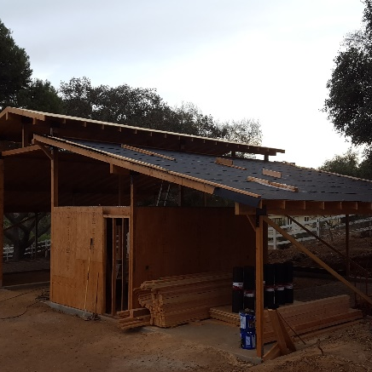
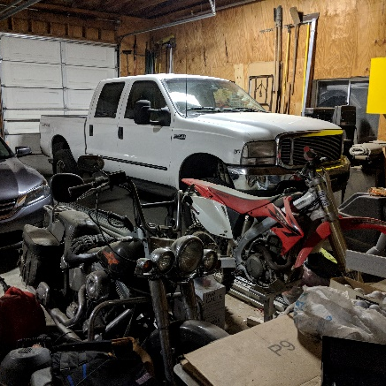

Balanced life

Slide 3
Solve the problem
Minimalist
Design for failure
Service
The urgent can often overtake the important
Big fan of keeping it simple whenever possible
Specifically design/build/maintain with a focus on no single point of failure
If you’re not helping the customer you should be helping someone who is

