Slide 1
Data Science Boot Camp Spring 2023 Machine Learning Integration
Project 4 – Room 4

Slide 2


Project 4 Room 4 Team
Debbie McNulty Kelly L Doyle Elizabeth Veltre Nema Aragones
Paul Arias
 | Professor | Professor
Jonathan Caro
 |  | Assistant

Slide 3
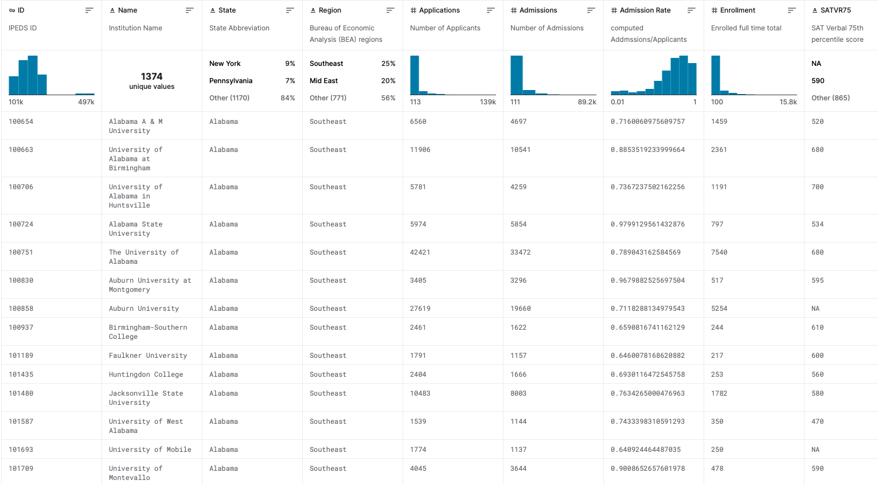
Project Dataset
US College & University Admissions 2020-2021
Admission Rates, SAT and ACT scores
IPEDS (Integrated Postsecondary Education Data System) is an annual data collection distributed by the Postsecondary Branch of the National Center for Education Statistics (NCES), a non-partisan center of the Institute of Education Sciences under the U.S. Department of Education. NCES is the primary federal entity for collecting and analyzing data related to education in the U.S. and other nations.
Of the 6,289 institutions, listed with IPEDS, institutions which offer a four-year program conferring an undergraduate degree were included (n=2,556). Dataset was limited to institutions reporting numbers for both number of applicants and admissions, and enrolment size greater than 100 (n=1,386)

Slide 4

THE WAY TO GET STARTED IS TO QUIT TALKING AND BEGIN DOING.
-Walt Disney

Slide 5

Process / Tools / Models
K-Means
Tensorflow
Automatic Hyperparameter Optimization with Keras Tuner
Manual Hyperparameter Optimization with Keras Tuner
Linear Regression
Artificial Neural Network
Scaled SAT & ACT score
Read CSV into Pandas Dataframe & exported to SQL/SQLite
Utilized Google Colab & VSCode for modeling & training
Used seaborn pairplot library to show relationships between every feature

Slide 6
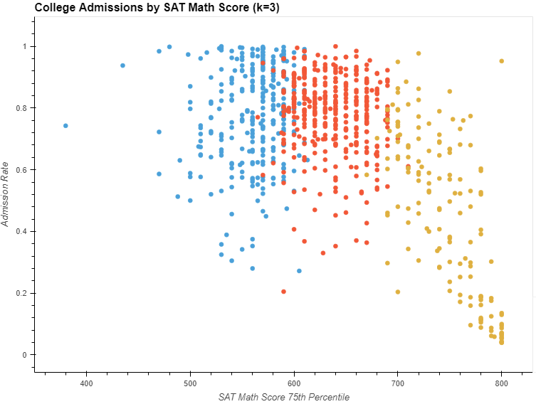
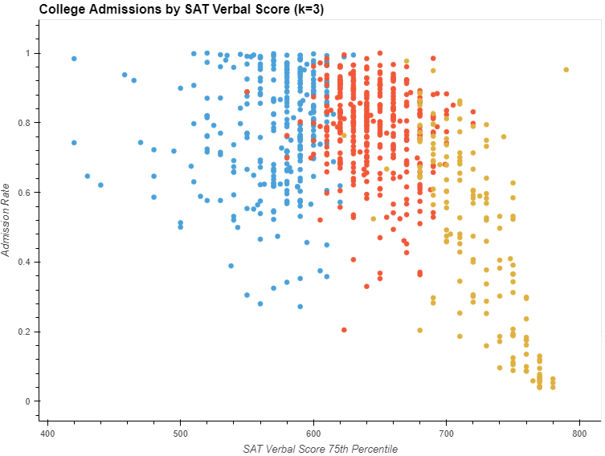
SAT Math vs Verbal Score
Analysis shows there is little to no variation between verbal and math scores and an inverse relationship between both SAT scores and Admission Rate

Slide 7
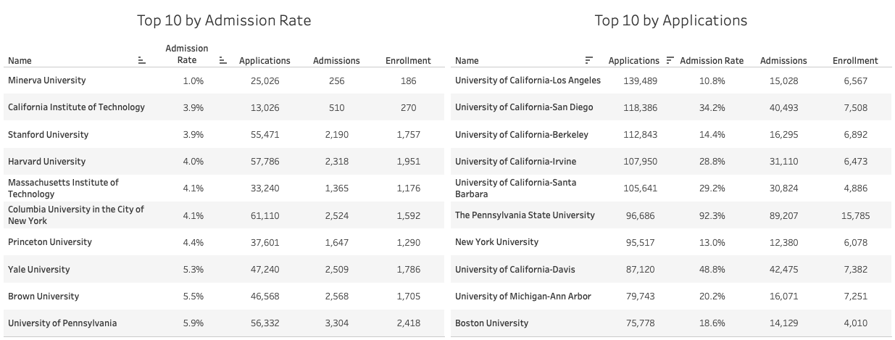
Admission Rate vs Applications Submitted
Schools with lower admission rates tended to have higher SAT scores
Admission rates and SAT scores varied with total number of applications submitted

Slide 8
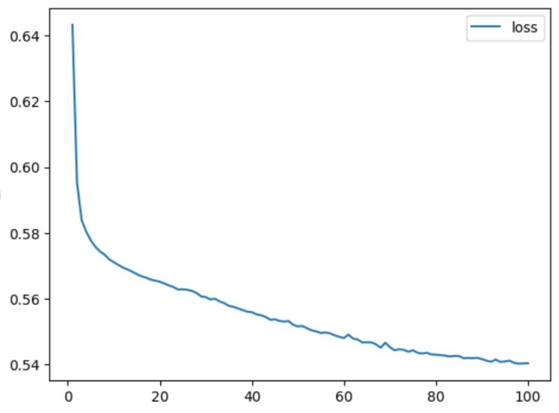
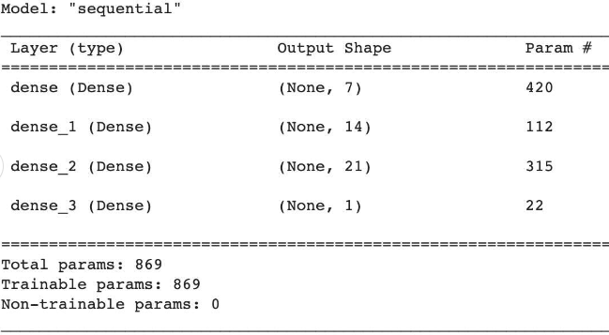
SAT Test Score Training
Loss: 0.5672
Accuracy: 0.0029
25ms/epoch - 2ms/step

Slide 9
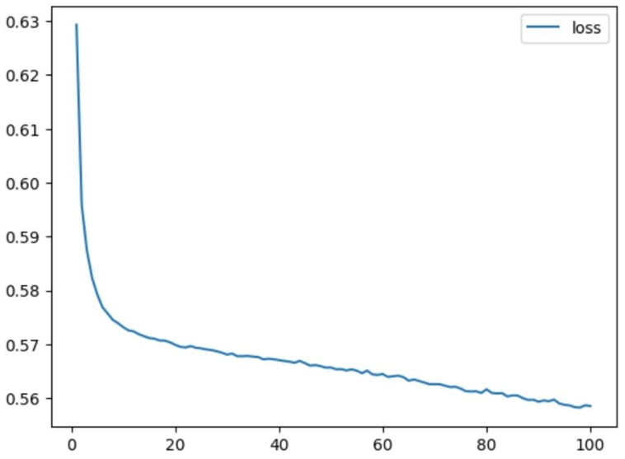
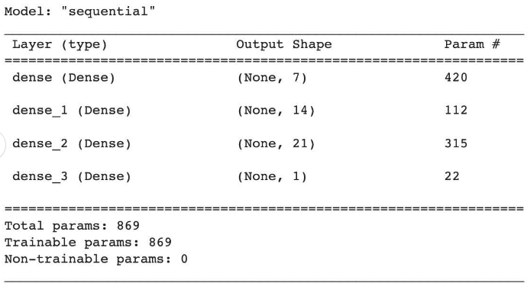
ACT Test Score Training
Loss: 0.5815
Accuracy: 0.0029
37ms/epoch - 3ms/step

Slide 10
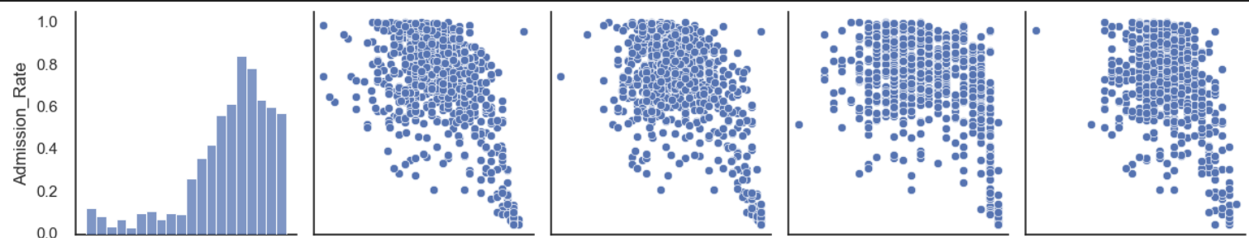
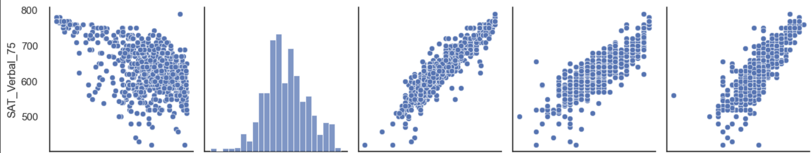
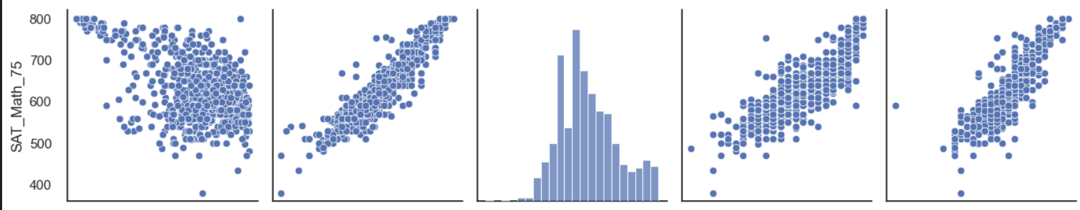
SAT Pairplot feature comparison

Slide 11
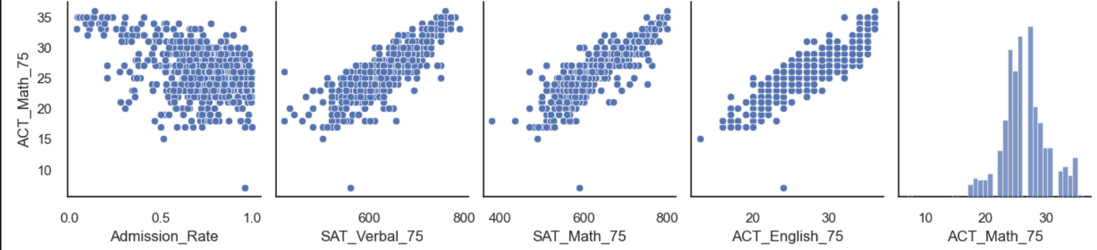
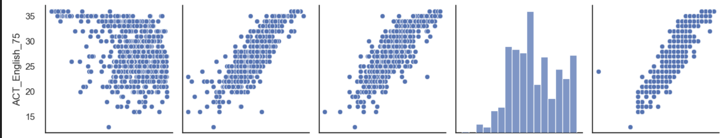
ACT Pairplot feature comparison

Slide 12
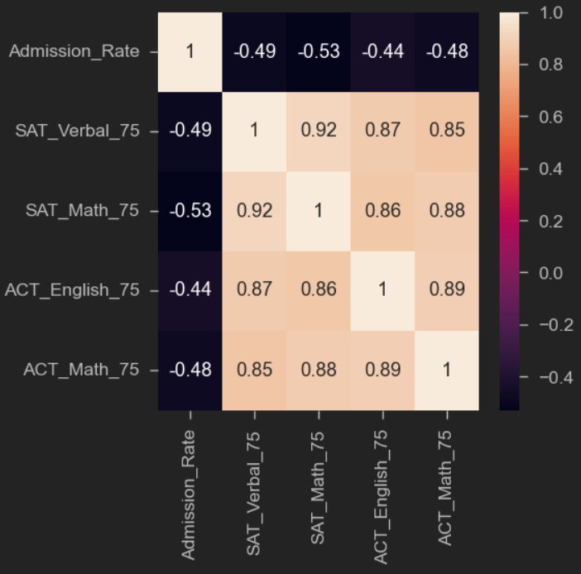
Correlation Heatmap

Slide 13
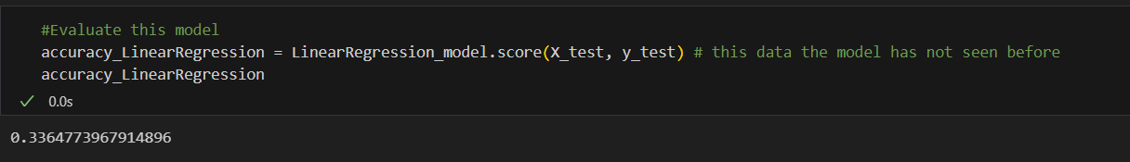
Training & Testing the Dataset
Features / Inputs (X) - 4 Features used ('SAT_Verbal_75, SAT_Math_75, ACT_English_75, ACT_Math_75)
- Target / output variable (y) - Admission_Rate
15% of data allocated to testing group, allocate the rest(85%) for training
Built a Machine Learning Linear Regression Model and achieve an accuracy of 33.6%

Slide 14
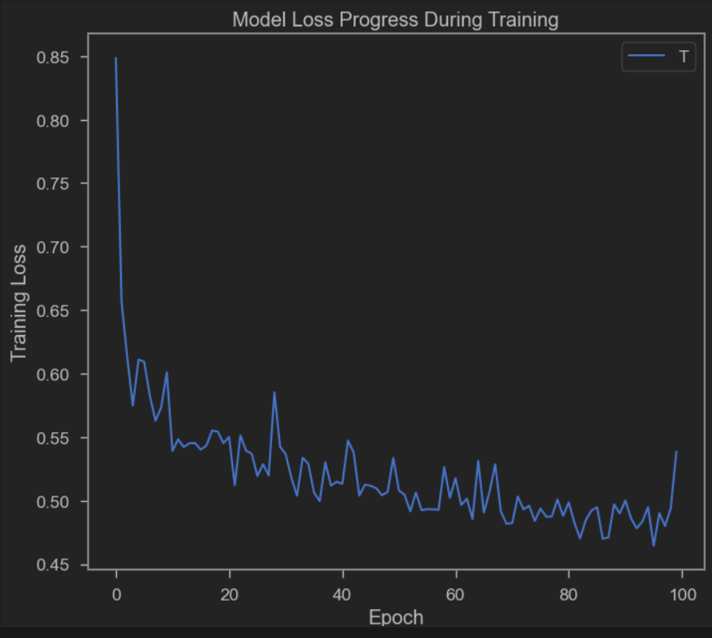
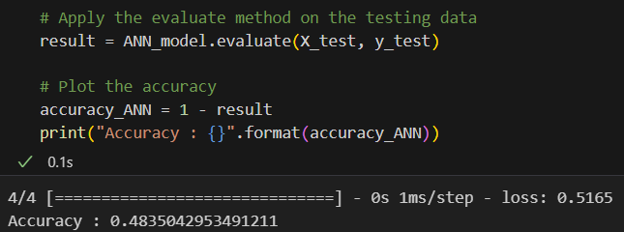
Artificial Neural Network
Used Dense to build artificial neural network with accuracy rate of 48.3%

Slide 15
Retrospective
Challenges
Lessons Learned
Changing NA to 0 created outliers that negatively impacted the modeling
Highest classification accuracy of 49% was obtained using Tensorflow
Google Colab issues with modeling and plotting due to versioning
More robust data set with additional features would increase predictability

Slide 16



Retrospective
Challenges
Changing NA to 0 created outliers that negatively impacted the modeling
Highest classification accuracy of 49% was obtained using Tensorflow
Google Colab issues with modeling and plotting due to versioning
Lessons Learned
More robust data set with additional features would increase predictability

Slide 17


THANK YOU
Project 4 Room 4
Debbie McNulty
Kelly L Doyle
Elizabeth Veltre
Nema Aragones

