Slide 1
Homework 2
Kody Davis - 5375

Slide 2
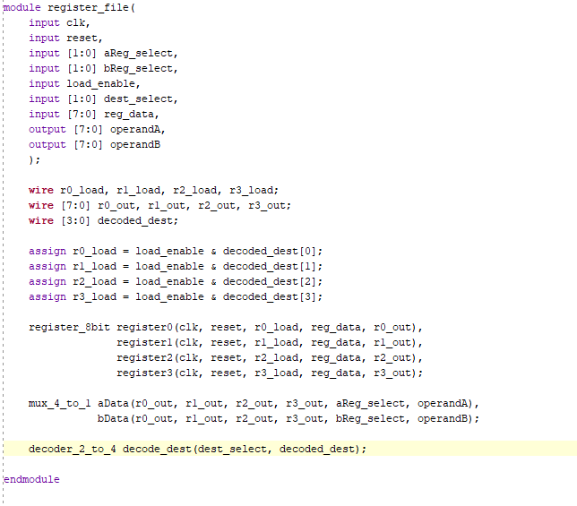
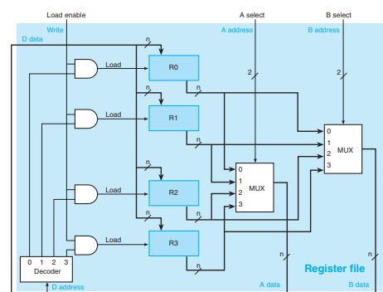
Register File Module
Each block of code corresponds to a unit in the blueprint
Load Gates
Registers
4-to-1 Mux
2-to-4 Decoder

Slide 3
Register File Module
The outputs of the module are the outputs of the two 4-to-1 mux modules
The inputs to the module are:
clk – clock signal (not pictured, only for registers)
reset – reset signal (not pictured, only for registers)
aReg_select – mux select signal for operandA
bReg_select – mux select signal for operandB
load_enable – load enable signal
dest_select – decoder signal
reg_data – data to be placed in a register

Slide 4
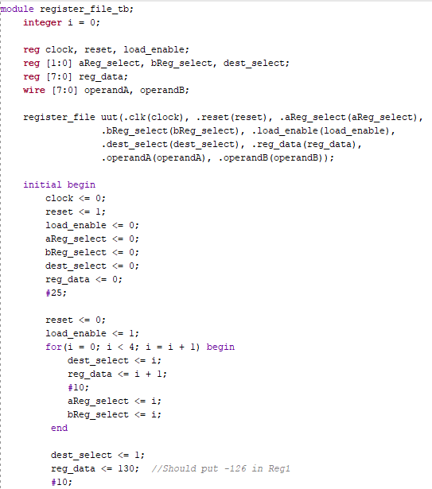
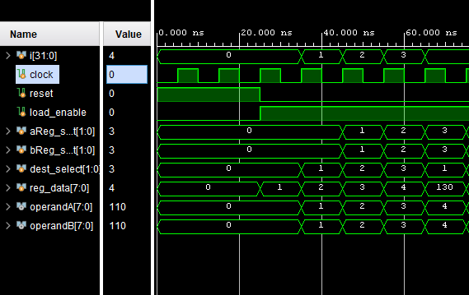
Testbench
Make assignments on the positive edge of the clock signal
If the assignments were made in the middle of the clock cycle, the signals “aReg_select” and “bReg_select” would cause the output of the MUXs to change in the middle of the cycle, causing problems if an adder unit was attached.
The clock signal is blocking (=), while the assignment signals are non-blocking (<=). This means the clock tick happens first (capturing “reg_data” in Register “dest_select”) and then the new assignments happen.
Initially, set everything to 0 and set reset to 1
Then, set reset to 0 and load_enable to 1
The for-loop places values 1-4 in Registers 0-3, respectively. It also sets the MUX signals to output the value of the register that was just given a value (“operandA” and operand”).

Slide 5
Testbench
Clock tick happens
reset is set to 0
load_enable is set to 1
dest_select stays 0 (data will be put in reg0)
reg_data is set to 1
aReg_select and bReg_select are set to 0 so,
operandA and operandB output 0
Clock tick happens
Previous “reg_data”(1) is captured in previous register “dest_select” (0)
“dest_select” is set to new destination register(1)
“reg_data” is set to new value to be captured at next clock tick
“aReg_select” and “bReg_select” are set to 0 so,
“operandA” and “operandB” output 1 (value in reg0)
Clock tick happens
Previous “reg_data”(2) is captured in previous register “dest_select” (1)
“dest_select” is set to new destination register(2)
“reg_data” is set to new value to be captured at next clock tick
“aReg_select” and “bReg_select” are set to 1 so,
“operandA” and “operandB” output 2 (value in reg1)
Etc…

Slide 6
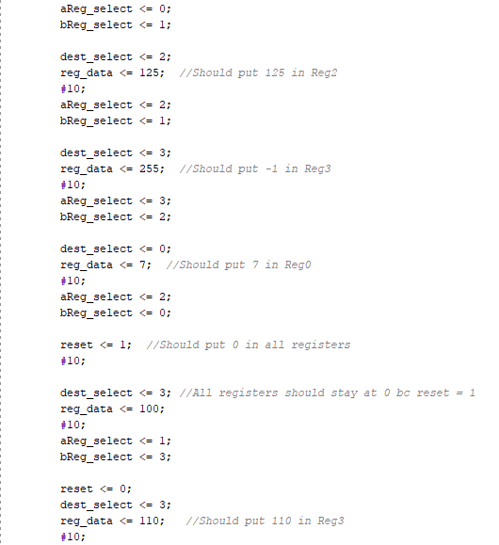
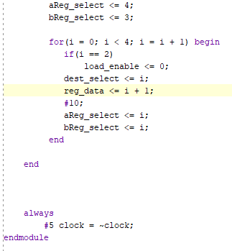
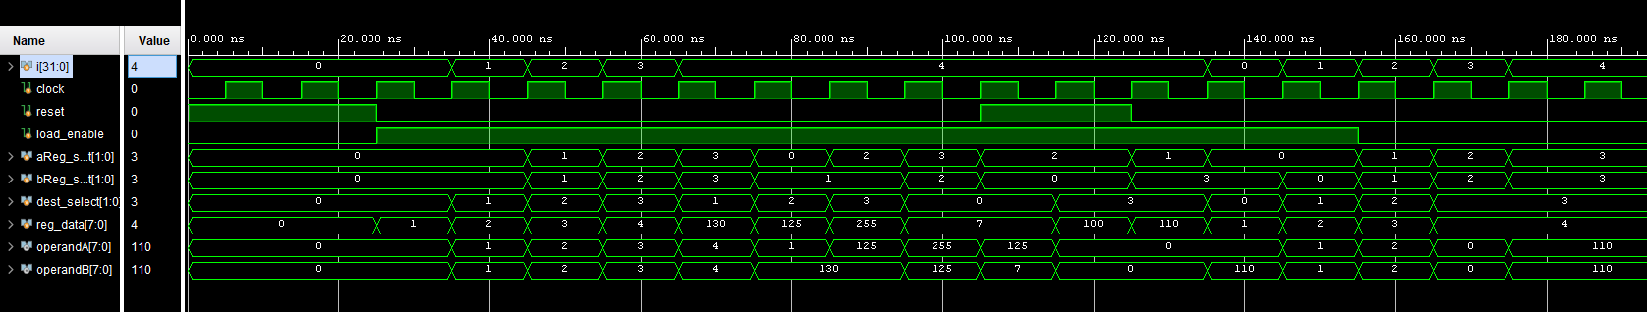
Testbench and Simulation

