Slide 1
Homework 3
Kody Davis - 5375

Slide 2
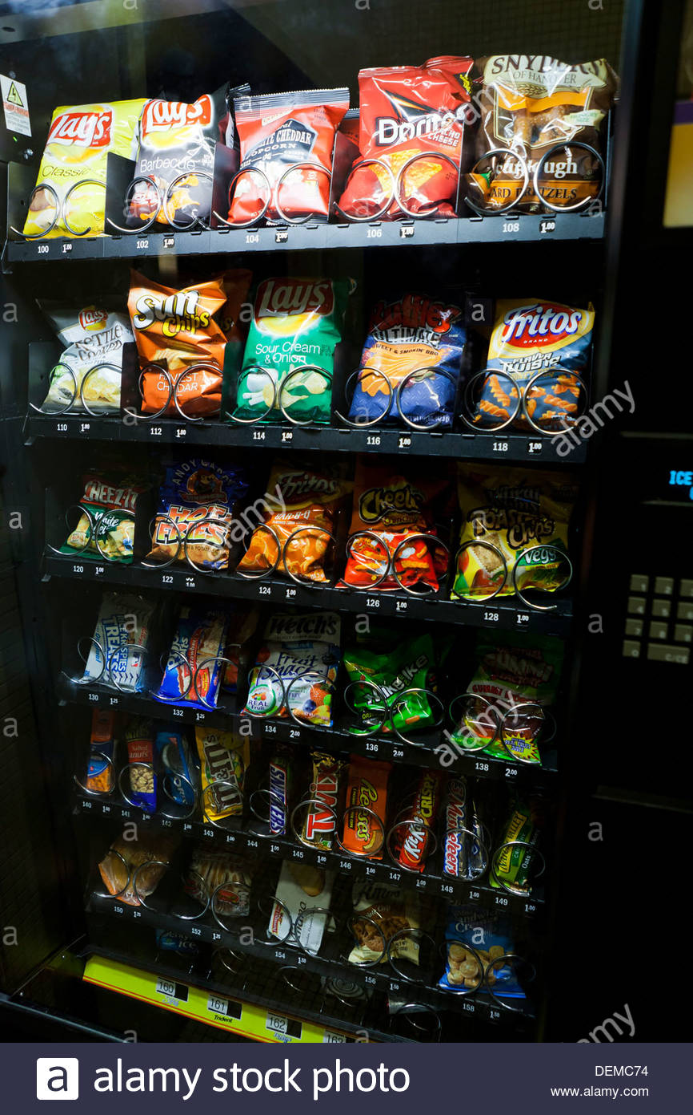
Modeled Machine
I found a stock photo and modeled my machine after it.
It has multiple rows and columns and many different prices. The bottom row is cut off, so I improvised some of the prices for that row.
100 $1.00 | 102 $1.00 | 104 $1.00 | 106 $1.00 | 108 $1.00
110 $1.00 | 112 $1.00 | 114 $1.00 | 116 $1.00 | 118 $1.00
120 $1.00 | 122 $1.00 | 124 $1.00 | 126 $1.00 | 128 $1.00
130 $1.25 | 132 $1.25 | 134 $2.00 | 136 $2.00 | 138 $2.00
140 $1.00 | 141 $1.00 | 142 $1.00 | 143 $1.00 | 144 $1.00 | 145 $1.00 | 146 $1.00 | 147 $1.00 | 148 $1.00 | 149 $1.00
150 $1.25 | 152 $1.25 | 154 $1.50 | 156 $1.50 | 158 $1.50
160 $0.50 | 161 $0.50 | 162 $0.75 | 163 $0.60 | 164 $0.25
As you may notice, the keypad contains number 0-9, but the machine contains far fewer items than the number that can be entered. This is accounted for in the Verilog code.

Slide 3
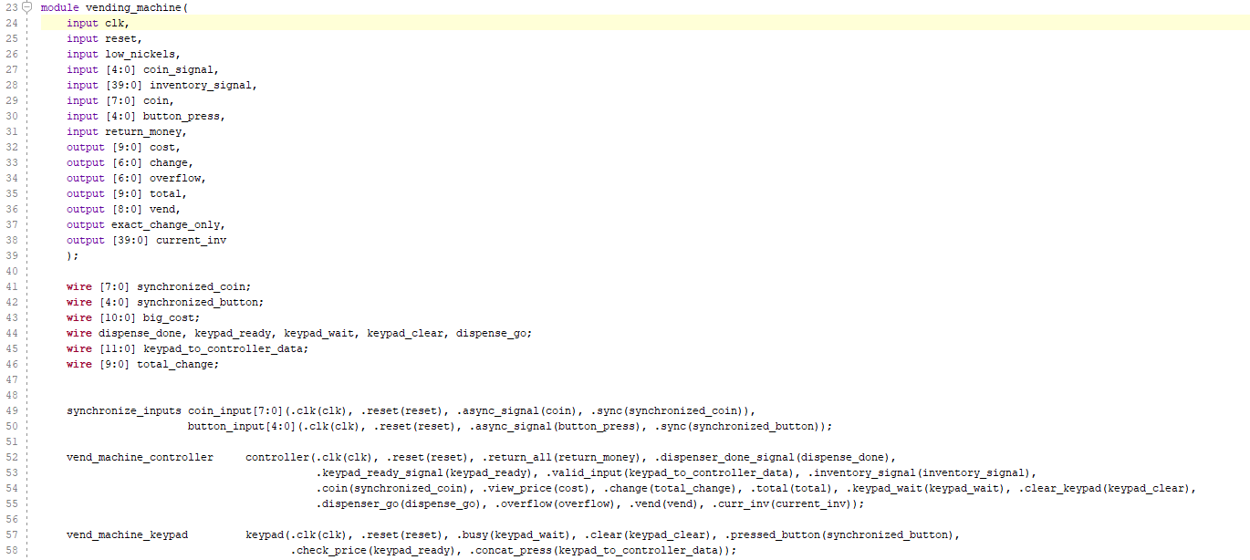
Vending Machine Module
The main Vending Machine module connects all of the pieces together:
The synchronizers for the buttons and the coins
The Vending Machine “controller”
The Vending Machine keypad
The Change Dispenser

Slide 4
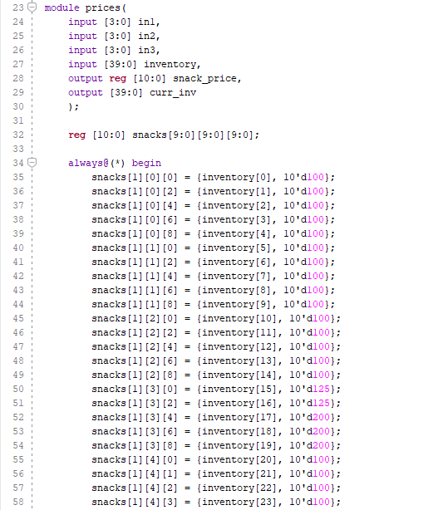
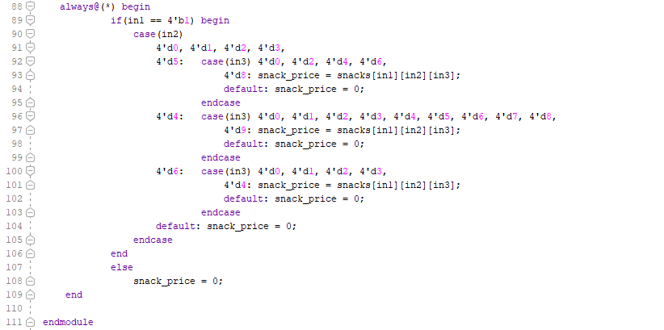
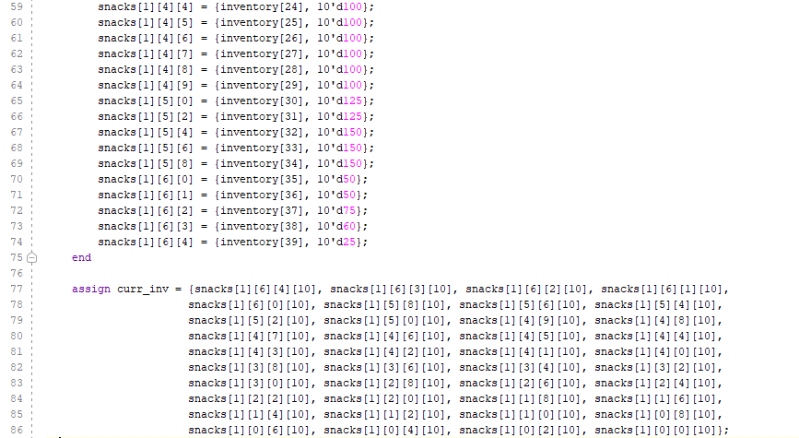
Price Memory and Inventory Information
This module remembers all the price and inventory data.
When the inventory data changes (the machine runs out of an item), this module updates the memory. The inventory data of an item is returned with the price of the item when the controller requests it.
The inputs “in1”, “in2”, and “in3” correspond to the index of the requested item. If the inputs are invalid, a price of $0.00 and an inventory signal of 0 is returned.
The “curr_inv” variable represents wires that are attached to the “out of stock” lights.

Slide 5
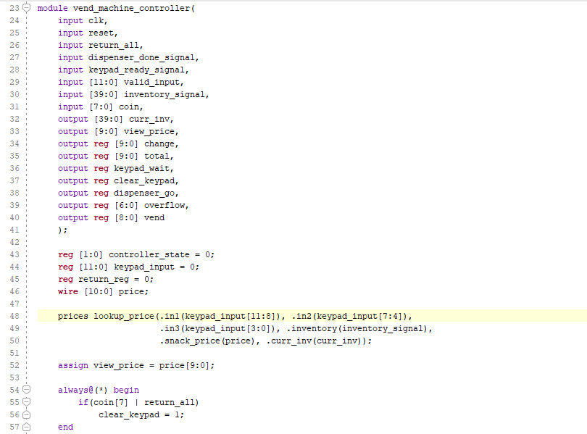
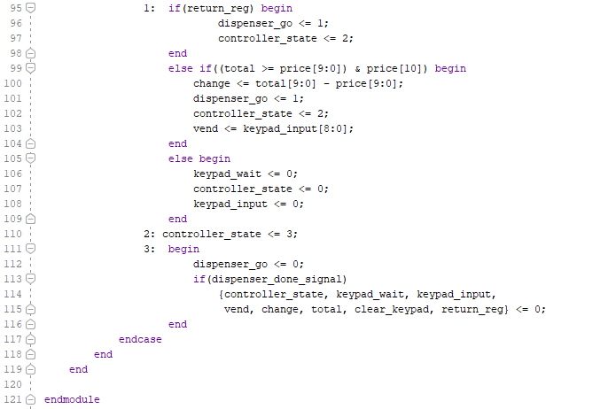
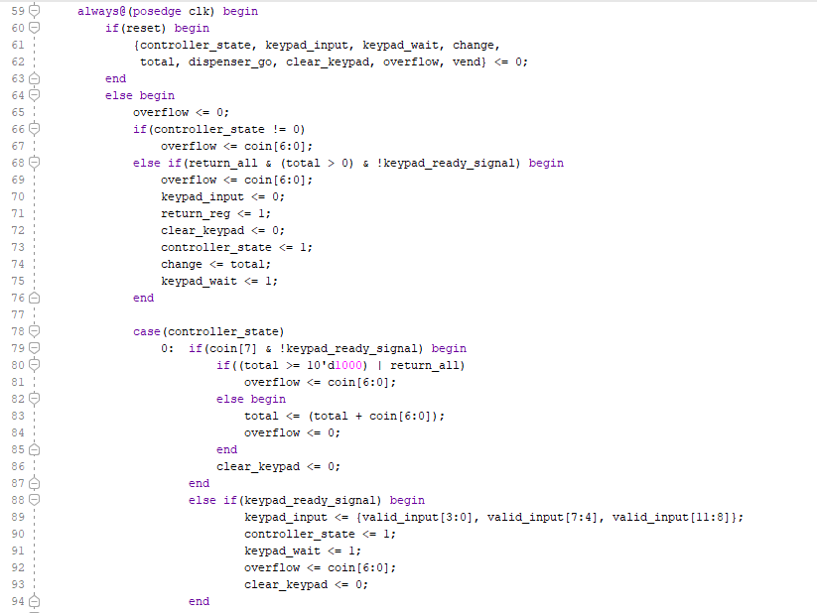
Controller Module
The Controller module counts the coins and keeps track of the total balance.
The controller sends a signal to the keypad to clear all inputs when a coin is received or the “return change” signal is given by the customer.
If the current balance is $10 or more, the keypad signal is being received, the “return change” input has been pressed, or the controller is not in state 0 (it is vending, calculating price, or waiting for the dispenser), the controller will route any inserted change to “overflow”.
The controller has three states:
In state 0, it is waiting for coins to be inserted and adds them to the total balance when they are received. It is also waiting for the keypad to send a signal indicating that three consecutive inputs have been given. It will send the keypad a “busy” signal upon receiving a “ready” signal from the keypad. This prevents the keypad from accepting any more inputs. It will turn the signal off after the dispenser is finished, or after checking the price of the requested item.
In state 1, it will confirm that enough money has been inserted to make the transaction, that the keypad input is valid, and that the item is in stock. If one of these is not true, it will output the price of the item ($0.00 if the input is invalid) and revert to state 0. If all are true, it will calculate the change, which is sent to the dispenser, and it will vend the item.
In state 2, it is waiting for the dispenser to send a “done” signal. When the signal is received, the controller sets everything to 0 and then changes to state 0.

Slide 6
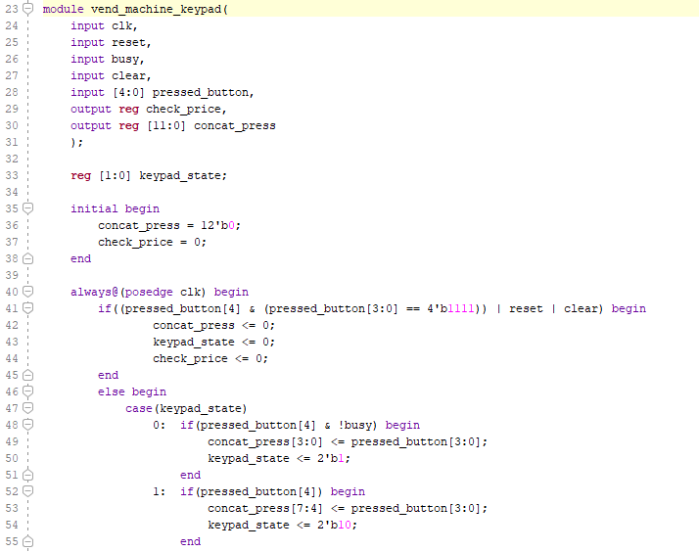
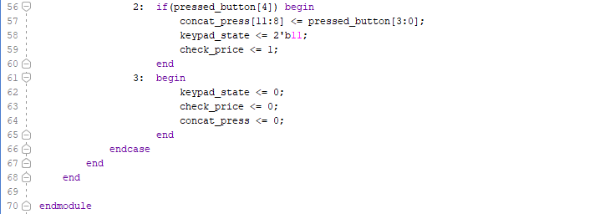
Keypad Module
The Keypad module keeps track of which buttons have been pressed.
If the “clear” button is pressed, the reset signal is received, or the clear signal is received from the controller (occurs when a coin is inserted), the keypad wipes any previously entered information.
The keypad has four states:
In state 0, it is waiting for the first button to be pressed and for the busy signal to be 0 (sent by the controller when items are being vended are change is being dispensed).
In state 1, it is waiting for the second button to be pressed.
In state 2, it is waiting for the third button to be pressed. After receiving three consecutive inputs in a row, the “check_price” signal is set to 1. This tells the controller that an input has been given and should be dispensed, if possible.
In state 3, it wipes all of the previously entered inputs and sets the “check_price” signal back to 0.

Slide 7
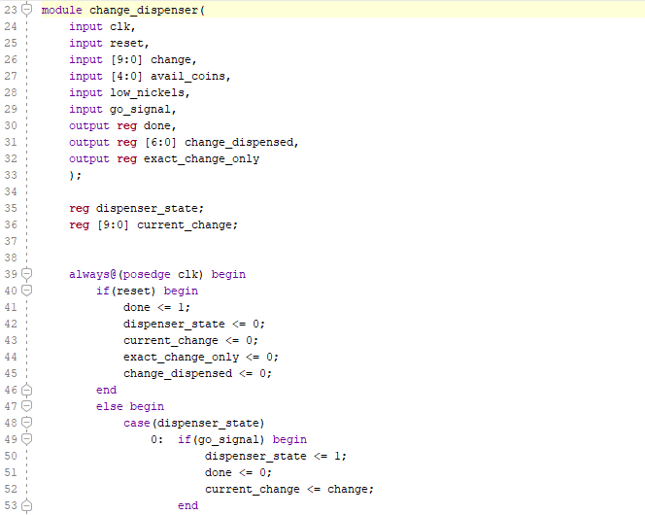
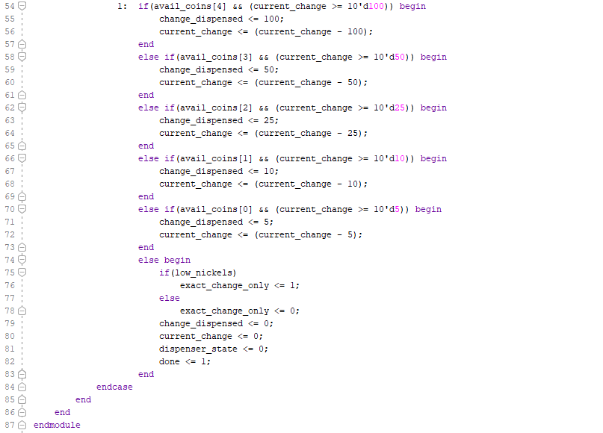
Dispenser Module
The Dispenser module keeps track of the coin inventory data and dispenses change when signaled by the controller.
Each time the dispenser finishes, it checks to see if the nickel balance is low and sets the “exact_change_only” signal accordingly.
The dispenser waits for a “go_signal” from the controller before starting. It sets a done signal when finished.
The dispenser has two states:
In state 0, it is waiting for the controller to send a “go” signal. When the signal is received, the dispenser sets the “done” signal to 0 and gets the amount of change to be dispensed.
In state 1, it dispenses a coin each clock tick. The dispenser goes through a series of statements each tick, checking to see if the current value of change to be dispensed is greater than or equal to a certain amount. If so, it checks to see if that coin is available or in stock and dispenses it, subtracting that coin from the amount left to dispense. If not, it moves on to the next lowest coin amount and tries again.

Slide 8
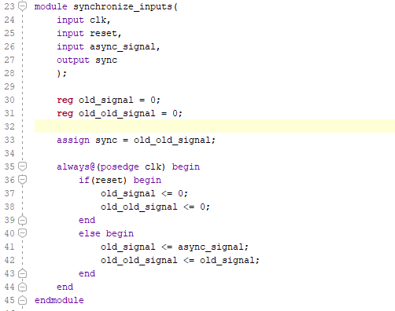
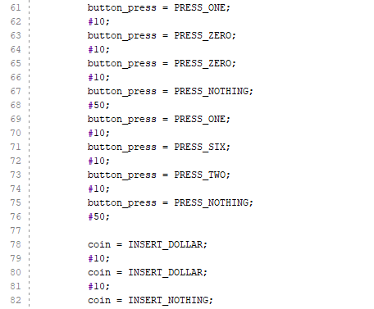
Synchronize Inputs Module and Testbench Explanation
This module synchronizes the button presses and the inserted coins to the clock signal.
Instead of using a module to detect rising and falling edges of inputs, I coded my machine so that each inserted coin signal and each pushed button signal comes with an extra bit as the MSB. The extra bit is set to 1 if the button was actually pushed or the coin was actually inserted. Otherwise, the extra bit is set to 0.
It was set up this way so that buttons do not have to be “pushed” for a tick and then “released” for a tick in the testbench. Instead, you can push buttons consecutively, one after the other, with only one tick separating them. The same reasoning applies to coin insertion. After coins are no longer being inserted, it must be indicated that you are inserting nothing. When buttons are done being pushed, it must be indicated that you are pushing nothing.

Slide 9
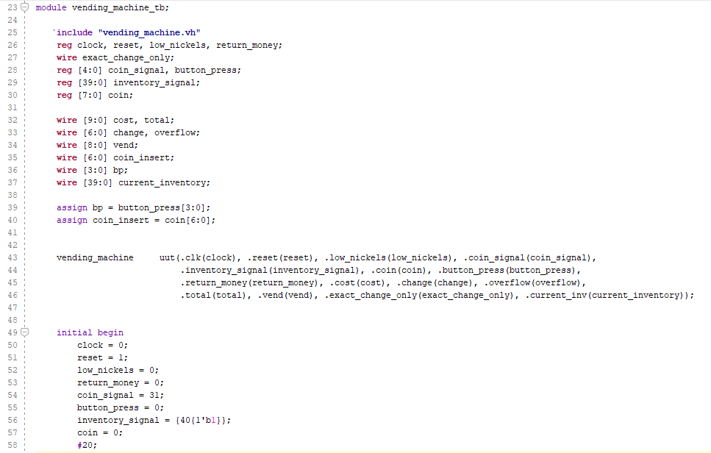
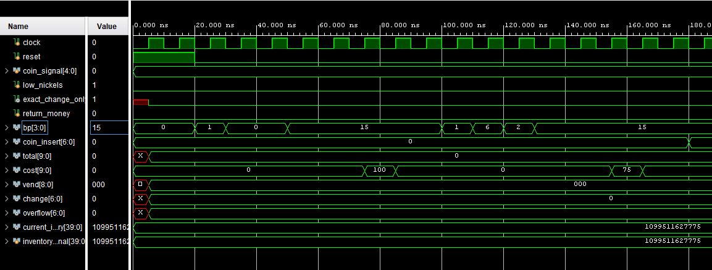
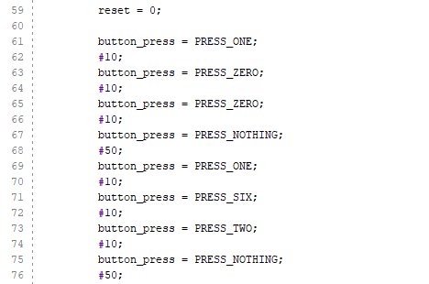
Testbench and Waveform
Signals:
coin_signal – 5 bits that indicate whether the machine has a certain coin, order is descending (dollar, … , nickel)
low_nickels – 1 bit that indicates less than 20 nickels remain in the machine (“exact_change_only” will be set)
return_money – 1 bit that tells the machine to return all inserted money
bp – indicates which button was pressed (0-9 or “clear” button)
coin_insert – the value of the inserted coin
total – the total of all the coins currently inserted
cost – the cost of the item indicated by which buttons were pressed ($0.00 if the input was invalid)
vend – the index of the item that is vending (only changes value when an item is actually being vended)
change – the value of the coin that is currently being dispensed
overflow – the value of an overflowed coin (only changes when coins are inserted after three buttons have been pressed or the machine is vending an item)
current_inventory/inventory_signal – signal is input from testbench, current is output, indicates if item is in stock

Slide 10
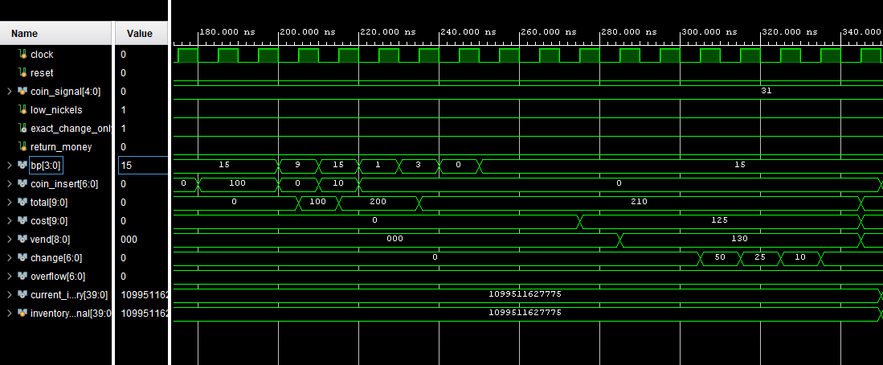
Testbench and Waveform
There is a delay between when the inputs are given and when they are registered as valid by the machine due to synchronization.
When no buttons are being pressed, the “bp” signal is set to 15 (otherwise it would be difficult to tell if 0 is actually being pressed or not).
In the first picture, the input 100 is given. After a few cycles, the cost is shown, but no item is vended because no money has been inserted. Then, the input 162 is given. After a few cycles, the cost is shown, but again, no item is vended.
In the second picture, two dollars are inserted. Then button 9 is pressed. Then a dime is inserted. This was to test the keypad wipe when a coin is inserted.
Total begins to update with the current amount of money that has been inserted.
The input 130 is given and the cost is shown. The vend signal changes to 130 since there was enough money inserted to vend the item. $2.10 has been inserted(total) and the item costs $1.25(cost), so 85 cents of change is dispensed(change).

Slide 11
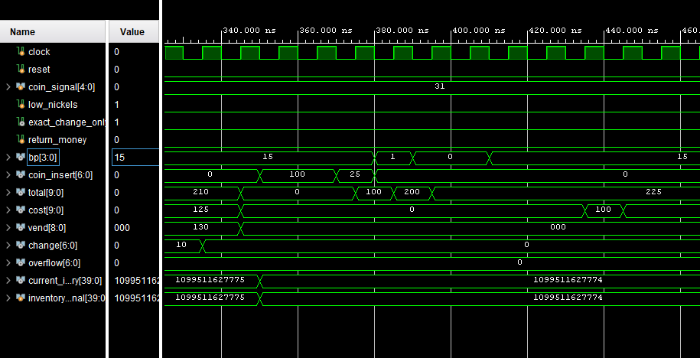
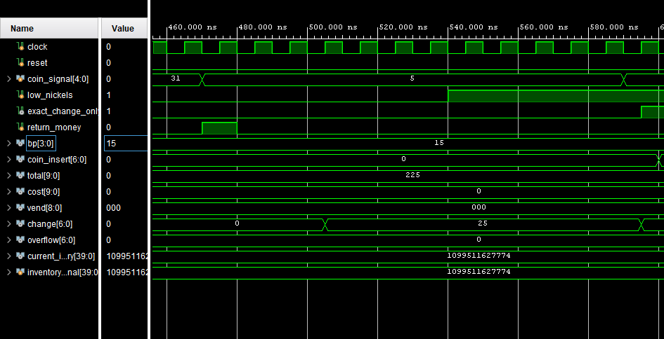
Testbench and Waveform
In the top picture, two dollars and a quarter are inserted. The inventory signal is changed (the item at index 100 is out of stock) and so the “current inventory” changes accordingly.
The buttons 1-0-0 are pressed. Since that item is out of stock, the price is shown, but no item is vended. No change is dispensed, and total remains the same.
In the bottom picture, the total is still $2.25 and the “return money” button has been pressed. The “coin signal” has also been changed to 5 (this means the machine has only quarters and nickels).
The machine does not have any dollars or half-dollars, so it gives quarters as change until $2.25 has been dispensed.
The “low nickels” signal is sent, so as the change is finished being dispensed, the “exact change only” signal comes on.

Slide 12
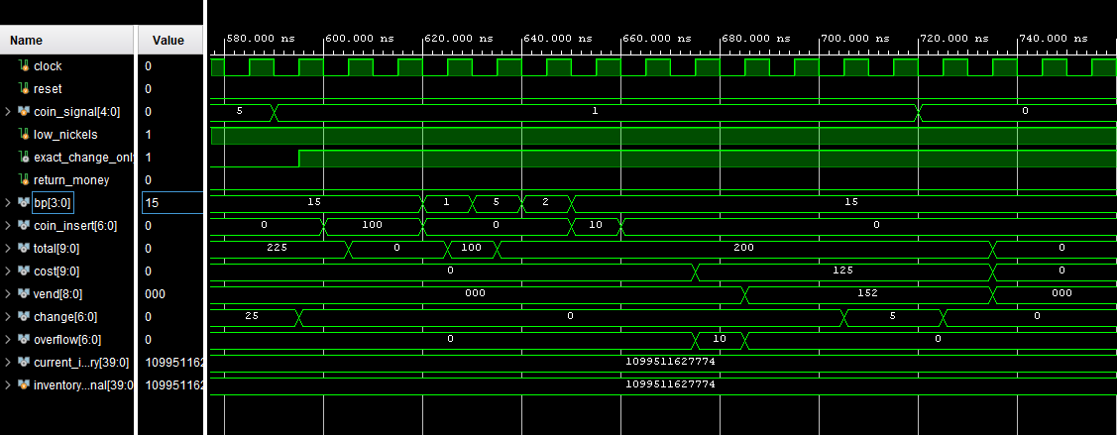
Testbench and Waveform
In this picture, two dollars are inserted and the buttons 1-5-2 are pressed.
A dime is inserted after the buttons have been pressed to test the “overflow” functionality.
Total is updated and the cost of the item is shown. The “vend” signal comes on and the item is vended. The dime that was inserted overflows and is given back to the customer.
Two nickels are given before the machine runs out of change (the “coin signal” is changed to 0 meaning the machine has no more coins).

Slide 13
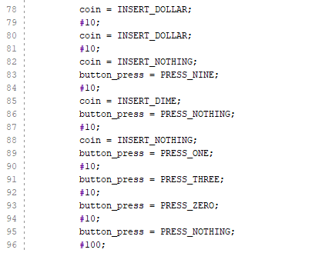
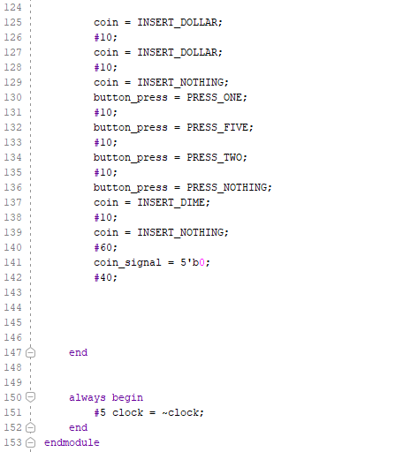
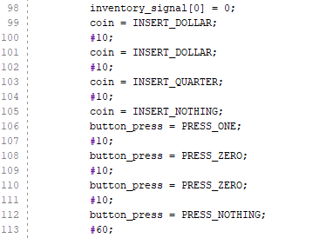
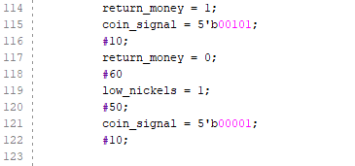
Full Testbench

