Slide 1
Homework 4
Kody Davis - 5375

Slide 2
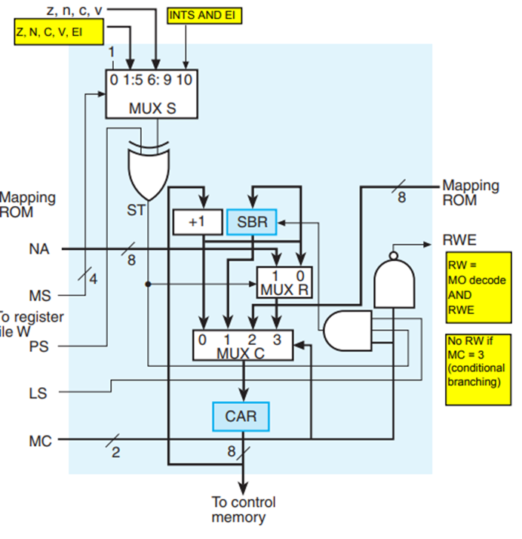
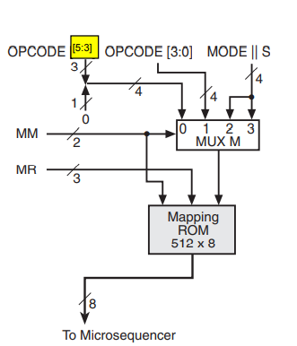
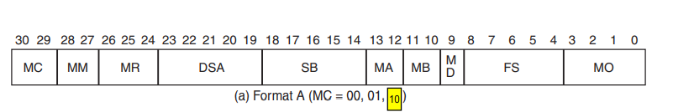
1OF IDI
CAR needs to get its new value from Mapping ROM. Since MO = 0 (NOP) and MC = 2, RW(register write) is enabled. Therefore, all other values should be 0 so that the value 0 is written to register 0.
No asterisk(*), meaning this operation does NOT prevent write to register file.
(101)
CAR ← ROM[ 10001 || MODE || X ]
MC MM MR DSA SB MA MB MD FS MO
2 2 1 00 00 0 0 0 00 0

Slide 3
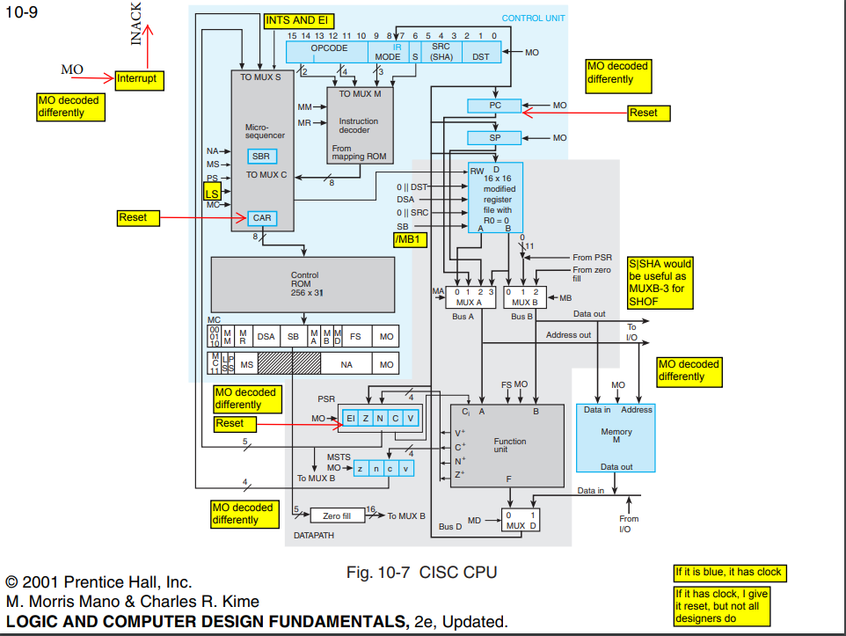
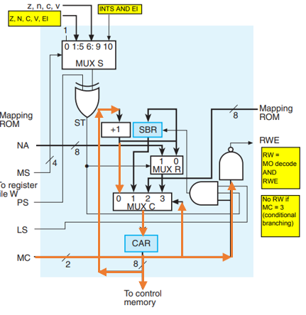
Use DA for temp storage since we will be referencing an address later.
DA gets the value located at the memory address PC.
Increment the PC counter. (MO = 5)
DA ← M[ PC ], PC ← PC + 1
MC MM MR DSA SB MA MB MD FS MO
0 X X 0E XX 1 X 1 XX 5

Slide 4
Use DA for temp storage since we will be referencing an address later.
DA gets the current value of DA plus the value of the register DST.
DA ← DA + R[ DST ]
MC MM MR DSA SB MA MB MD FS MO
0 X X 0E 10XXX 0 0 0 02 0

Slide 5
Use DA for temp storage since we will be referencing an address later.
DA gets the value located at the memory address DA.
DA ← M[ DA ]
MC MM MR DSA SB MA MB MD FS MO
0 X X 0E 00 0 X 1 XX 0

Slide 6
Use DD for temp storage since we will be executing the rest of the instruction before writing back to a register.
DD gets the value located at the memory address DA.
CAR changes to the proper execution(EX) state for the current operation. This is accomplished by loading the appropriate value from the Mapping ROM.
DD ← M[ DA ], CAR ← 1EX(ROM)
MC MM MR DSA SB MA MB MD FS MO
2 0 1 0F 0E 3 X 1 XX 0
5 ticks

Slide 7
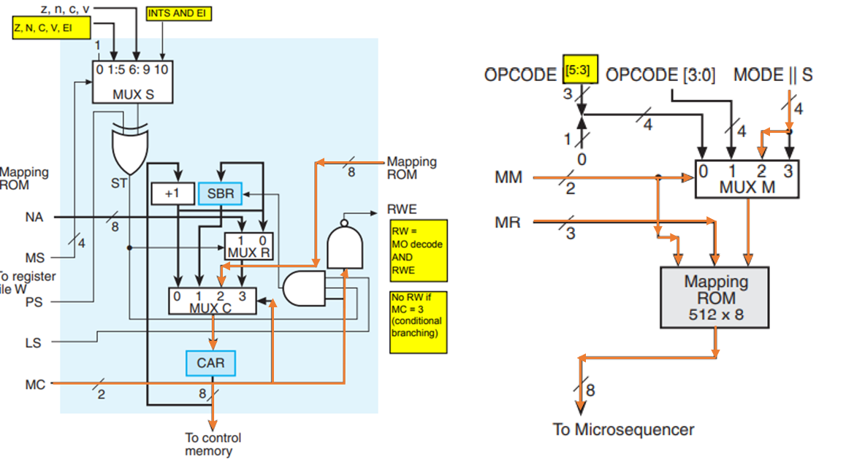
2OF IDI (S = 0)
CAR needs to get its new value from Mapping ROM. Since MO = 0 (NOP) and MC = 2, RW(register write) is enabled. Therefore, all other values should be 0 so that the value 0 is written to register 0.
No asterisk(*), meaning this operation does NOT prevent write to register file.
(101)
CAR ← ROM[ 10010 || MODE || 0 ]
MC MM MR DSA SB MA MB MD FS MO
2 2 2 00 00 0 0 0 00 0

Slide 8

Use SA for temp storage since we will be referencing an address later.
SA gets the value located at the memory address PC.
Increment the PC counter. (MO = 5)
SA ← M[ PC ], PC ← PC + 1
MC MM MR DSA SB MA MB MD FS MO
0 X X 0C XX 1 X 1 XX 5

Slide 9

Use SA for temp storage since we will be referencing an address later.
SA gets the current value of SA plus the value of the register SRC.
SA ← SA + R[ SRC ]
MC MM MR DSA SB MA MB MD FS MO
0 X X 0C 11XXX 0 0 0 02 0

Slide 10

Use SA for temp storage since we will be referencing an address later.
SA gets the value located at the memory address SA.
SA ← M[ SA ]
MC MM MR DSA SB MA MB MD FS MO
0 X X 0C 00 0 X 1 XX 0

Slide 11

Use SD for temp storage since we will be executing the rest of the instruction before writing back to a register.
SD gets the value located at the memory address SA.
SD ← M[ SA ]
MC MM MR DSA SB MA MB MD FS MO
0 X X 0D 0C 3 X 1 XX 0

Slide 12

Use DD for temp storage since we will be executing the rest of the instruction before writing back to a register.
DD gets the value located at the register DST.
CAR changes to the proper execution(EX) state for the current operation. This is accomplished by loading the appropriate value from the Mapping ROM.
DD ← R[ DST ], CAR ← 1/2EX(ROM)
MC MM MR DSA SB MA MB MD FS MO
2 0 2 0F 10XXX 3 0 0 00 0
6 ticks

Slide 13
2OF IDI (S = 1)
CAR needs to get its new value from Mapping ROM. Since MO = 0 (NOP) and MC = 2, RW(register write) is enabled. Therefore, all other values should be 0 so that the value 0 is written to register 0.
No asterisk(*), meaning this operation does NOT prevent write to register file.
(101)
CAR ← ROM[ 10010 || MODE || 1 ]
MC MM MR DSA SB MA MB MD FS MO
2 2 2 00 00 0 0 0 00 0

Slide 14
Use DA for temp storage since we will be referencing an address later.
DA gets the value located at the memory address PC.
Increment the PC counter. (MO = 5)
DA ← M[ PC ], PC ← PC + 1
MC MM MR DSA SB MA MB MD FS MO
0 X X 0E XX 1 X 1 XX 5

Slide 15
Use DA for temp storage since we will be referencing an address later.
DA gets the current value of DA plus the value of the register DST.
DA ← DA + R[ DST ]
MC MM MR DSA SB MA MB MD FS MO
0 X X 0E 10XXX 0 0 0 02 0

Slide 16
Use DA for temp storage since we will be referencing an address later.
DA gets the value located at the memory address DA.
DA ← M[ DA ]
MC MM MR DSA SB MA MB MD FS MO
0 X X 0E 00 0 X 1 XX 0

Slide 17

Use DD for temp storage since we will be executing the rest of the instruction before writing back to a register.
DD gets the value located at the memory address DA.
DD ← M[ DA ]
MC MM MR DSA SB MA MB MD FS MO
0 X X 0F 0E 3 X 1 XX 0

Slide 18

Use SD for temp storage since we will be executing the rest of the instruction before writing back to a register.
SD gets the value located at the register SRC.
CAR changes to the proper execution(EX) state for the current operation. This is accomplished by loading the appropriate value from the Mapping ROM.
SD ← R[ SRC ], CAR ← 1/2EX(ROM)
MC MM MR DSA SB MA MB MD FS MO
2 0 2 0D 11XXX 3 X 0 00 0
6 ticks

Slide 19
BAF IDI
CAR needs to get its new value from Mapping ROM. Since MO = 0 (NOP) and MC = 2, RW(register write) is enabled. Therefore, all other values should be 0 so that the value 0 is written to register 0.
No asterisk(*), meaning this operation does NOT prevent write to register file.
(101)
CAR ← ROM[ 10011 || MODE || X ]
MC MM MR DSA SB MA MB MD FS MO
2 2 3 00 00 0 0 0 00 0

Slide 20
Use DA for temp storage since we will be referencing an address later.
DA gets the value located at the memory address PC.
Increment the PC counter. (MO = 5)
DA ← M[ PC ], PC ← PC + 1
MC MM MR DSA SB MA MB MD FS MO
0 X X 0E XX 1 X 1 XX 5

Slide 21
Use DA for temp storage since we will be referencing an address later.
DA gets the current value of DA plus the value of the register DST.
DA ← DA + R[ DST ]
MC MM MR DSA SB MA MB MD FS MO
0 X X 0E 10XXX 0 0 0 02 0

Slide 22
Use DA for temp storage since we will be referencing an address later.
DA gets the value located at the memory address DA.
DA ← M[ DA ]
MC MM MR DSA SB MA MB MD FS MO
0 X X 0E 00 0 X 1 XX 0

Slide 23
Use DA for temp storage since we will be executing the rest of the instruction.
DA gets the value located at the memory address DA.
CAR changes to the proper execution(EX) state for the current operation. This is accomplished by loading the appropriate value from the Mapping ROM.
DA ← M[ DA ], CAR ← BEX(ROM)
MC MM MR DSA SB MA MB MD FS MO
2 0 3 0E XX 0 X 1 XX 0
5 ticks

