Slide 1
Homework 5
Kody Davis - 5375

Slide 2
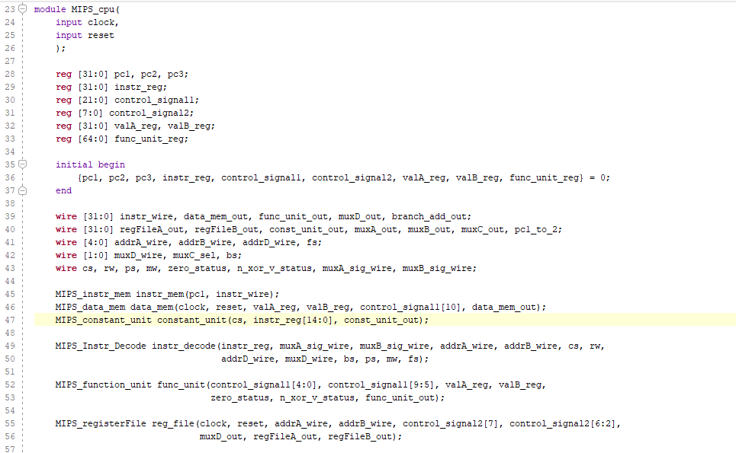
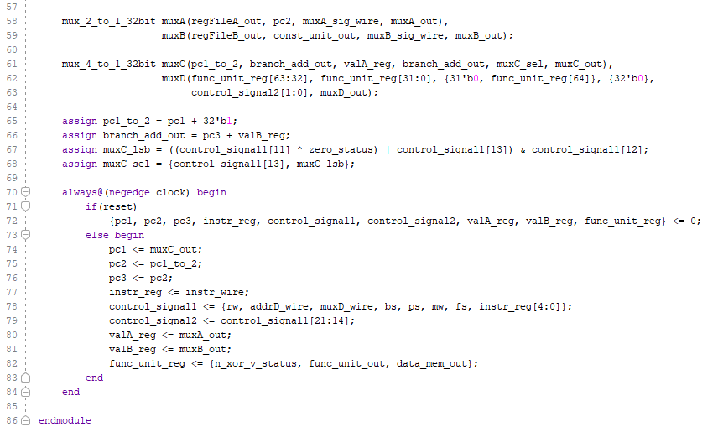
CPU Module
The CPU Module instantiates the sub-components of the MIPS processor and connects the components appropriately.
The instantiated sub-components are:
Instruction Memory
Data Memory
Constant Sign Extender
Instruction Decoder
Function Unit
Register File
Multiplexors A-D
The CPU Module also creates the intermediate registers and connects them to the appropriate ports of the sub-components.
The register names are listed at the top of the module. The expansive list of wires shown beneath the registers and Initial block are used to connect all of the components.

Slide 3
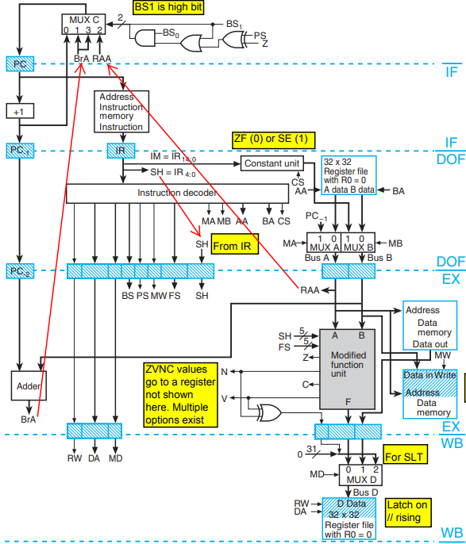
CPU Module
Most of the registers in this CPU latch on the falling edge of the clock. On reset, the value of every register is set to 0. When reset is turned off, each of the registers latch the value that is driving them the moment the clock signal flips from 1 to 0.
There are two register components that do not latch on the falling edge of the clock and instead latch on the rising edge. These two components are the Data Memory and the Register File.
While data is written to these two components only on the rising edge of the clock signal, data can be read asynchronously at any point during the clock cycle.

Slide 4
CPU Module
The components shown here make up the remainder of the CPU Module. The only other pieces of this module are the wires that connect everything and a few small addition and logic gate components.
The adder in the bottom left of the diagram as well as the “+1” adder in the top left can be implemented using assign statements. I did not see a point in writing them their own modules because they are so simplistic.
The Branch Select gates in the top middle of the diagram can also be easily implemented using assign statements.

Slide 5
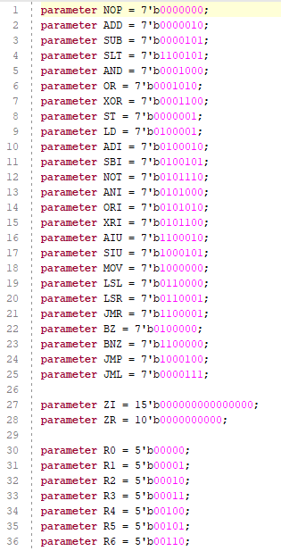
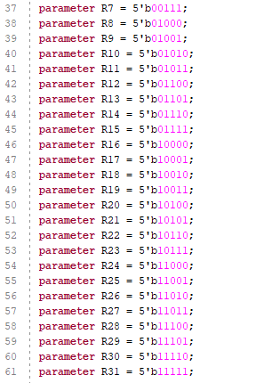
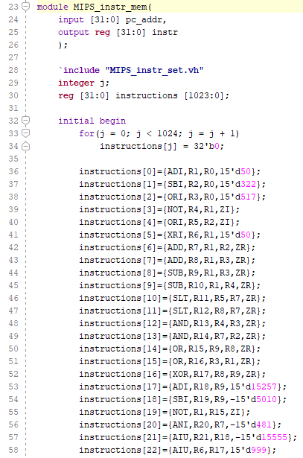
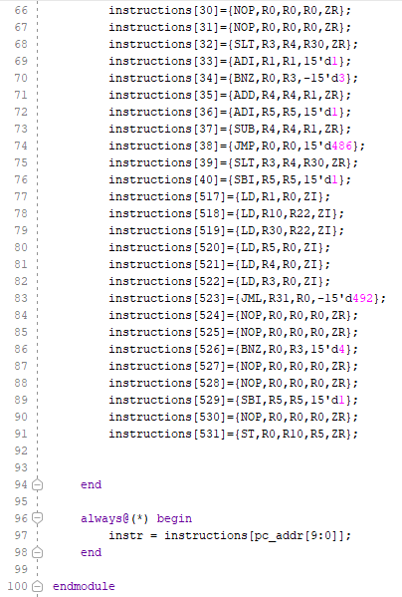
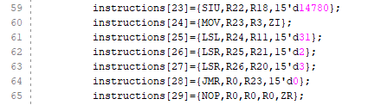
Instruction Memory & Parameters
The Instruction Memory module only takes one input, the PC, and only produces one output, the instruction at the memory address given by PC. The Instruction Memory is read only at runtime and must be programmed with the desired instructions beforehand. Initially, a for-loop sets every value to 0. Then, specific instructions at the desired addresses can be hard-coded into the memory. Memory/Instruction retrieval is asynchronous.
The pictures on the right are of a set of parameters that make it much easier to convey the instructions in a format very similar to Assembly code. The parameters include opcodes, registers, and ZI (zero-immediate) and ZR (zero-register). These last two parameters make it easier to fill in empty instruction space that is not always used.

Slide 6
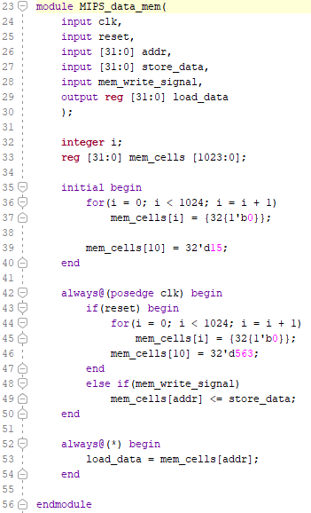
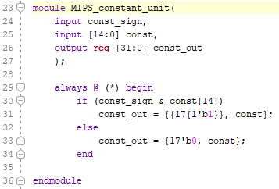
Data Memory
Constant Unit
The image on the left is the Data Memory module. Since data is stored on the rising edge of the clock signal and must be cleared when the CPU is reset, the module takes a clock signal and reset signal as two of its inputs.
The other inputs are:
The address at which data is going to be stored or retrieved
The value of the data to be stored
The “memory write” signal
Since data will always be available on the memory’s data input line, whether or not the data is actually stored will be controlled by the memory write signal.
Initially, a for-loop is used to set every memory value to 0. The extra values that are hard-coded were used to test the module’s functionality.
Notice, data is stored synchronously, but retrieved asynchronously. The only output is the retrieval data.
The image on the right is the Constant Unit. It is used to zero-pad or sign-extend the value of a constant when using an “Immediate” instruction. This is done asynchronously.
The module takes two inputs, the constant specified in the “Immediate” instruction and one other bit that indicates whether the constant should be sign-extended or zero-padded.
The output is a 32-bit binary number that can be used for arithmetic or as a branch or jump offset.

Slide 7
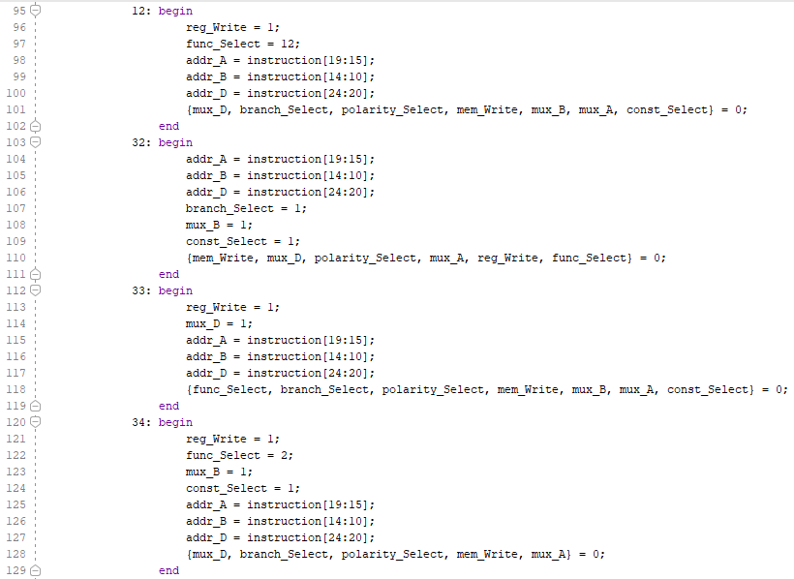
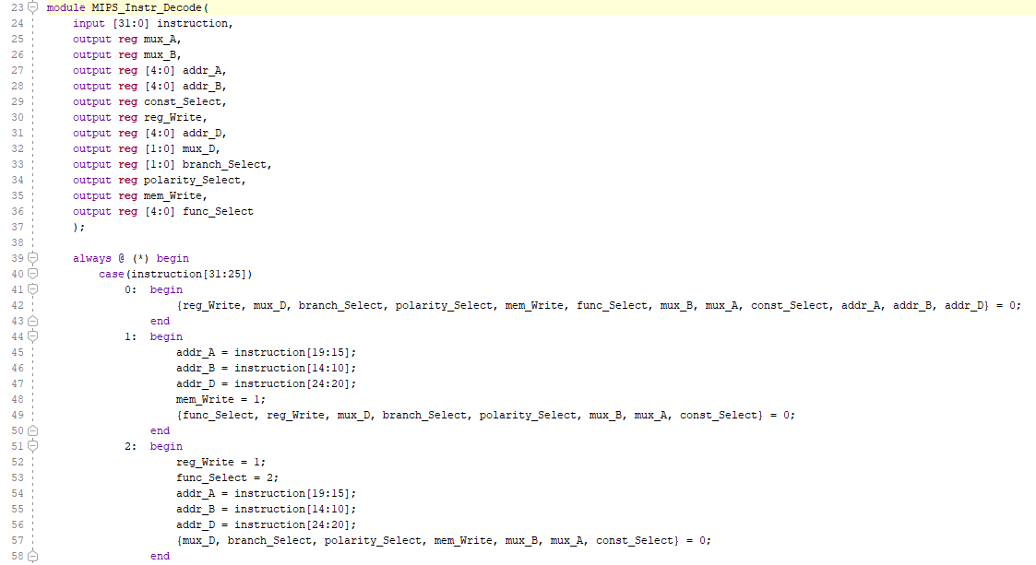
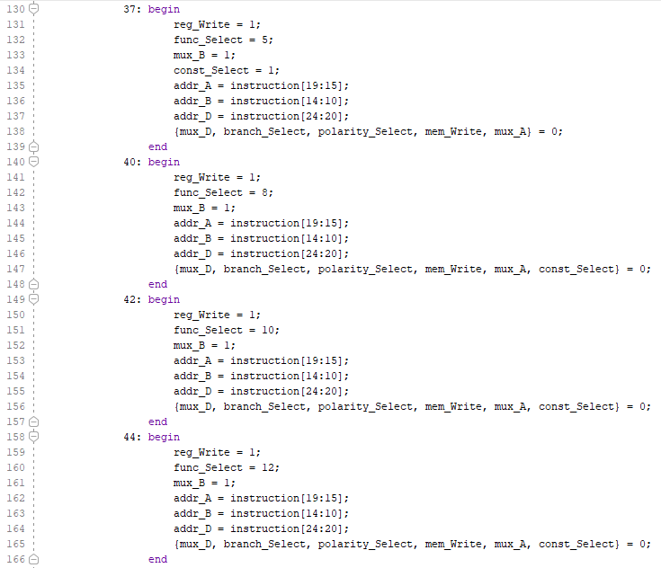
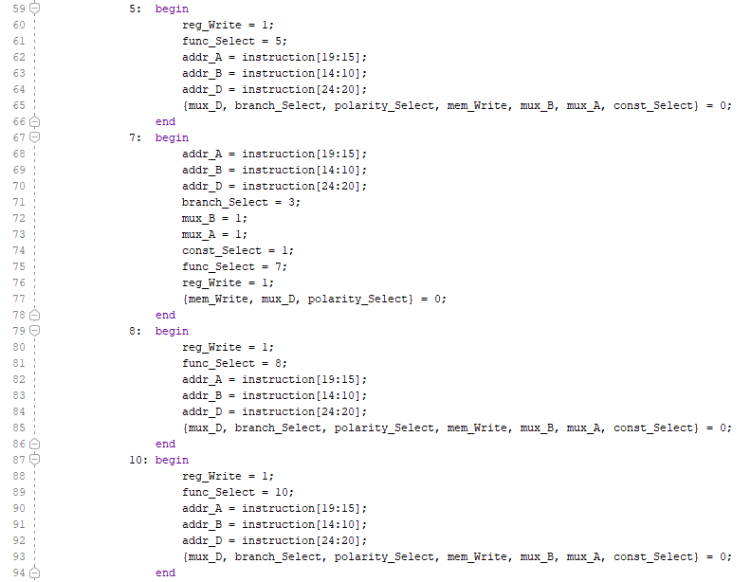
Instruction Decoder

Slide 8
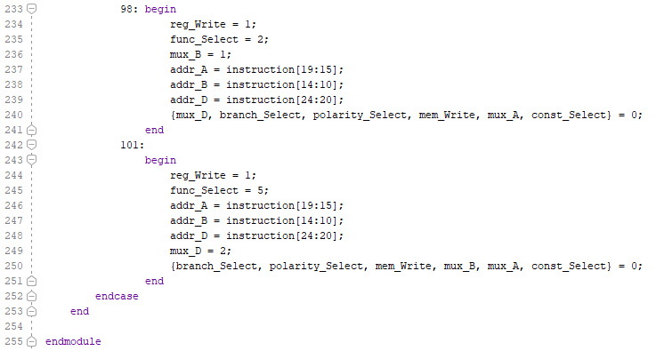
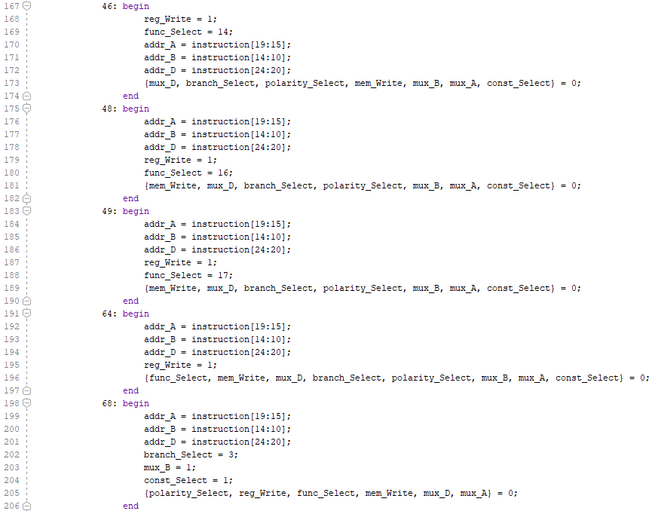
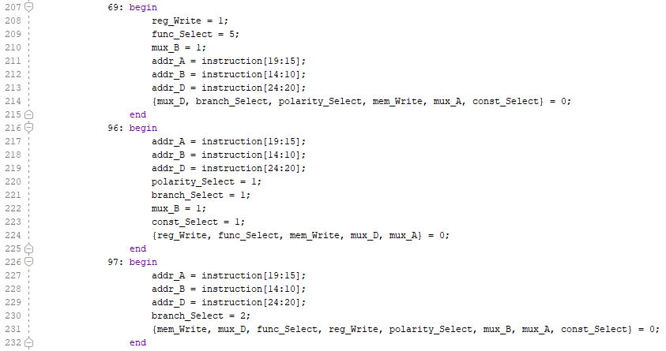
Instruction Decoder
The Instruction Decoder is one of the largest modules in my MIPS CPU implementation. It functions, as the name would imply, by looking at the opcode of the current instruction using a case statement and then setting the correct control signals for the desired functionality. This lookup is done asynchronously and only requires the instruction as an input.
The output consists of many control signals, some of which are used immediately during the current clock cycle. Other signals are saved and passed down through the pipeline along with the data for that instruction so that they may control how the data is manipulated and stored in later pipeline stages.
(In hindsight, the length of this module could have been shortened by always assigning addresses A, B and D before the case statement since they always come from the same bit slices in the instruction)

Slide 9
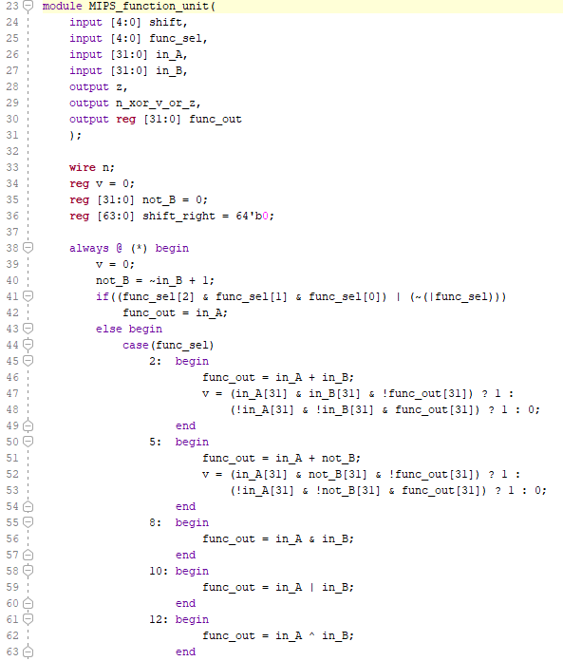
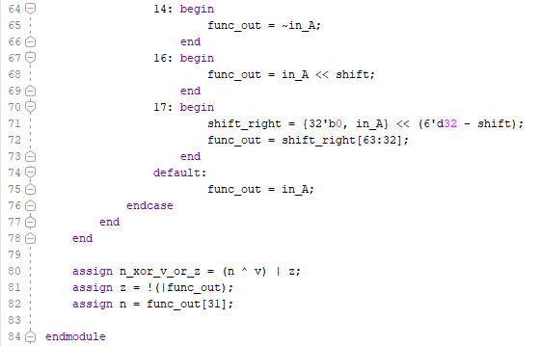
Function Unit
The Function Unit is used to do most of the arithmetic in the processor. The calculation done on inputs A and B is determined by the “function select” control signal, which itself is determined by the opcode that is decoded by the Instruction Decoder.
The inputs to the module are:
The shift amount (only used if doing a bit-shift of the input)
The function select signal
The operands A and B
The outputs of the module are:
The zero-status bit used for branch determinations
The “n xor v” status bit used to indicate whether A < B (modified slightly to include A <= B)
The result of the arithmetic operation
I have created a variable, denoted “not_B”, to always calculate the two’s complement of input B. I implemented this variable because it is often necessary to have the two’s complement of input B for subtraction operations as well as for overflow calculations.
The shifter is implemented such that both left shifts and right shifts are ultimately calculated using left shifts. This is accomplished by subtracting the shift amount from 32 when a shift to the right is requested and shifting left by that amount into a 64-bit, zero-padded number. Then, the upper 32-bits of that 64-bit number are taken as the final result.
In the “n xor v” signal, I have added an “or” with the zero-status bit. This is so that when computing a “set-less-than” instruction, the result will also be 1 when the two numbers are equal. This implementation was needed for the correct operation of part of my testbench.

Slide 10
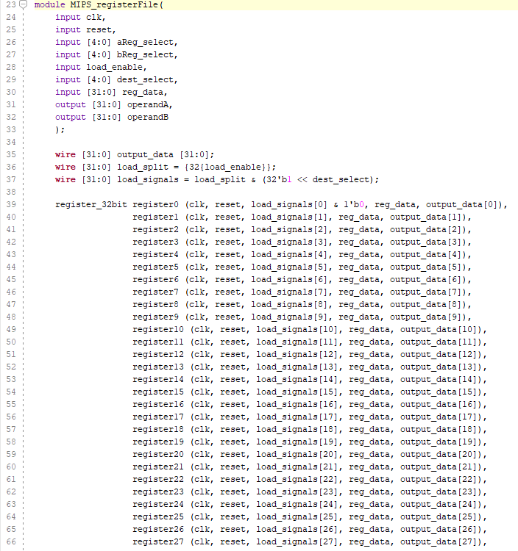
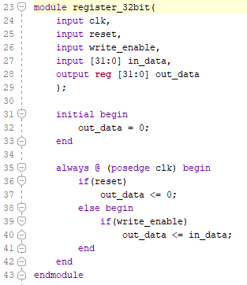
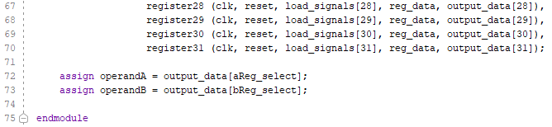
Register File
The Register File is implemented using an array of size 32 with each bit-vector in the array consisting of 32-bits. A control signal denoted by “load_enable” is split into 32 separate wires, each carrying the same control signal value. The 32 load-enable bits are then bitwise “anded” with a 32-bit number that has only one bit set to 1. Which bit is set to 1 is determined by the “dest_select” variable by shifting the 1 to the correct position such that only the desired register is able to be written to.
The outputs of the module are then obtained by accessing the desired element of the array for both output A and B.
All registers are given a clock signal and a reset signal so that each register can be written to synchronously and set to a value of 0 when the reset signal is given. While the registers are written synchronously, they can be read from asynchronously.

Slide 11
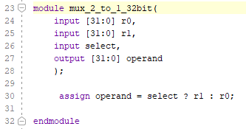
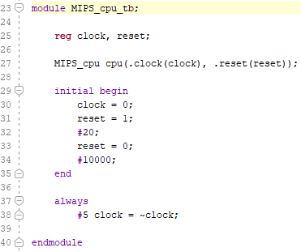
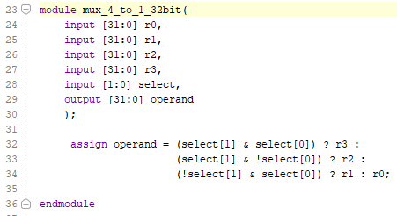
Multiplexors & Testbench
The multiplexors take multiple 32-bit inputs and output a single output as determined by the select bit/s. A single “assign” statement is used in both the 2-to-1 and 4-to-1 multiplexors.
The testbench is very short and has very few inputs and no outputs. This is because the program is hard-coded in advance in the instruction memory. Since any waveform from any of the modules can be easily viewed in the simulation, there is no real need to run all the outputs up to the testbench module.

Slide 12
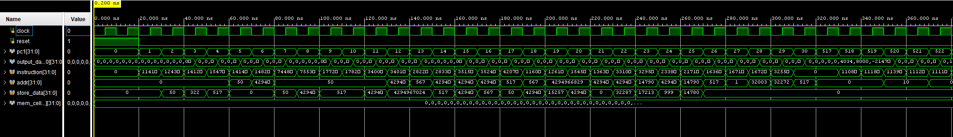
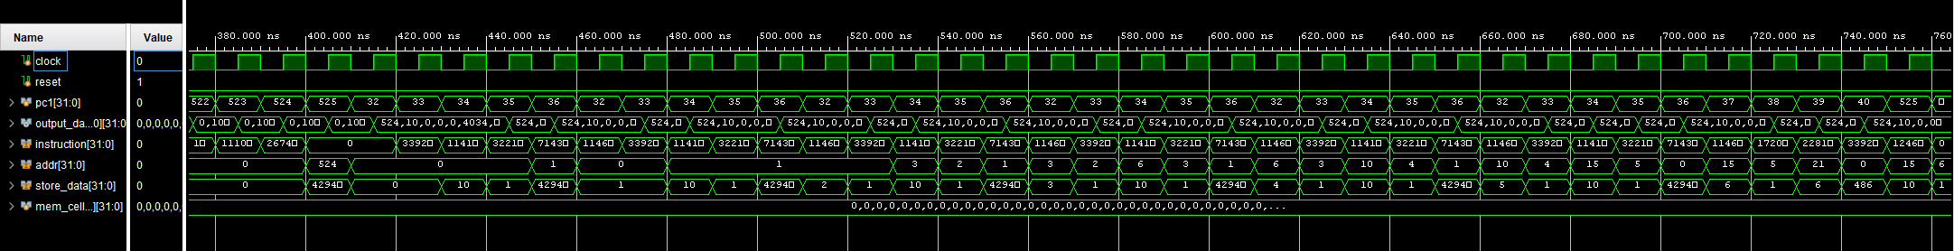
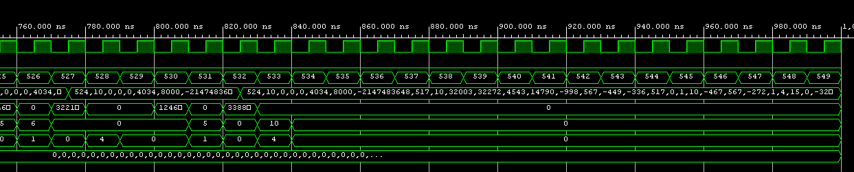
Waveform Output and Results

Slide 13
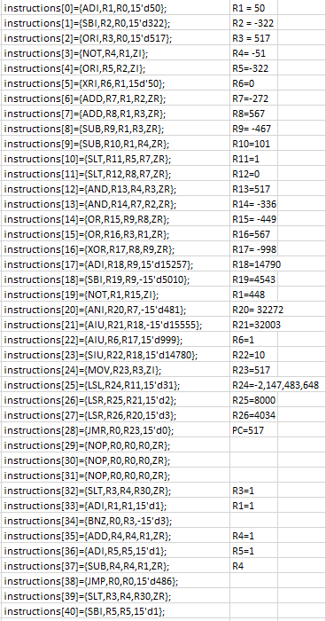
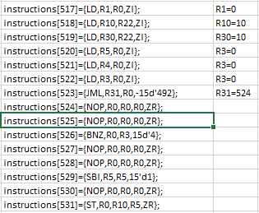
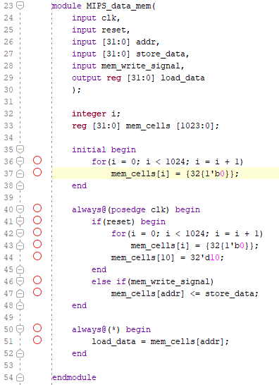
Waveform Output and Results
In the next slides, you can see that the values of the registers follow the values I calculated while putting the program together in Excel.
The first part tests all the different functions with different values. That is shown in the next two slides.
The second part is a short program I created that loads a value from the data memory and then loops until it finds the highest number that it can sum with all of the previous numbers all the way down to 1 without going over the target number that was loaded in from memory. It then stores that highest number in the data memory at the target number’s memory address.
So in this first example, I have stored the number 10 at memory location 10. That means 10 is the target number. The program will find the highest number that when summed with all previous integers from “1 – highest number”, it is less than or equal to the target number. In this example the answer is 4 since
“4+3+2+1 = 10”.
If I gave it 11 as the target instead of 10, the answer would still be 4 since, “5+4+3+2+1 = 15”.
15 is over the target number, so 4 is the highest it can go. If I gave it 15 or 16 or 17… etc, then it would store 5.
I will show some examples after the next two slides.

Slide 14
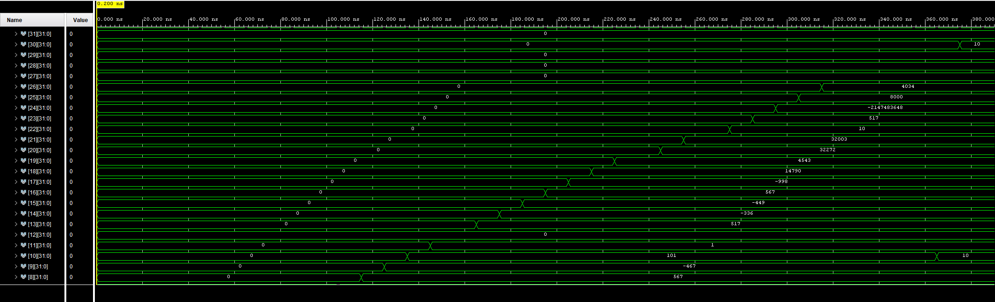
Waveform Output and Results

Slide 15
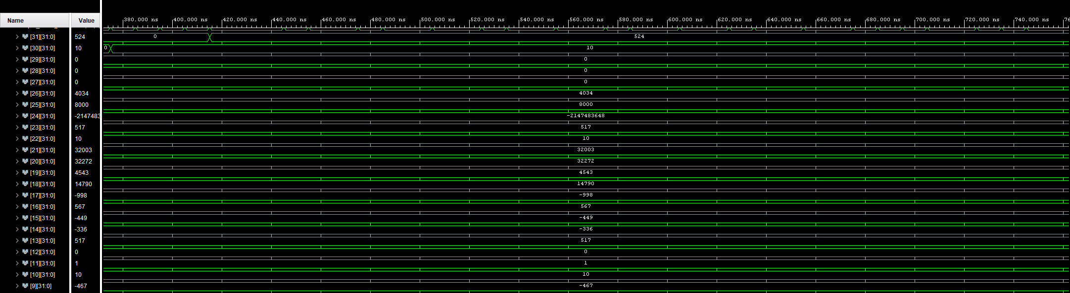
Waveform Output and Results

Slide 16
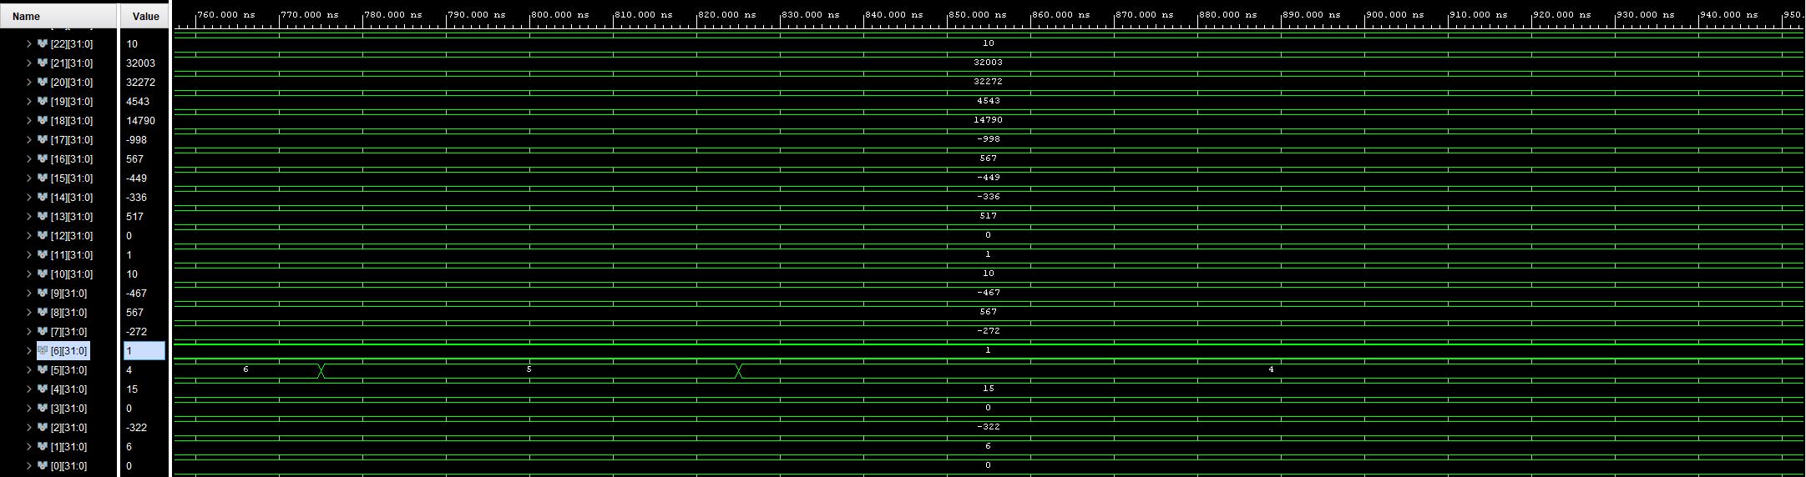
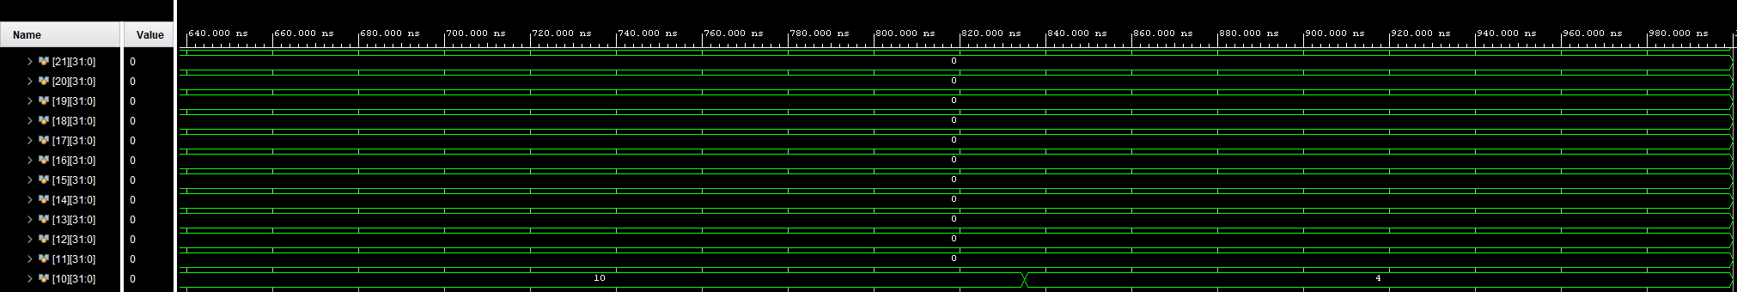
Waveform Output and Results
Stored at the memory address indicated by the target number (Mem[targetNum] ← highestNumber)

Slide 17
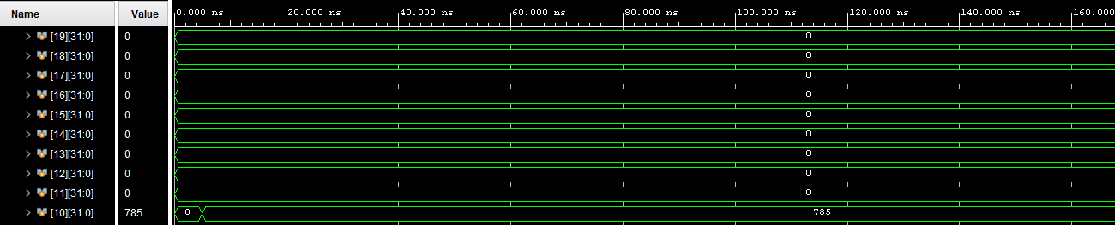
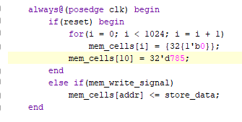
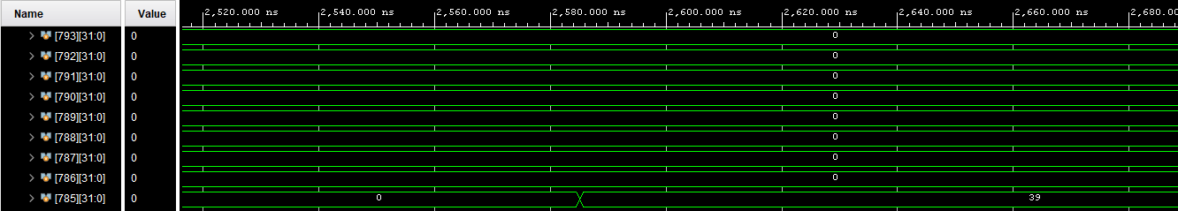

Waveform Output and Results
It took much longer finding 785 than it did for 10 but that is to be expected. You can see 785 is stored at Mem[10] as soon as the program starts and when it finally finds the highest number it stores it at Mem[target_number]. In this case the highest it could go was 39 since
$\sum_{0}^{38}{(39−n)}$ = 780. Or to do it the easy way (n(n+1)/2) = (39(40)/2) = 780.

