Slide 1
Homework 6
Kody Davis - 5375

Slide 2
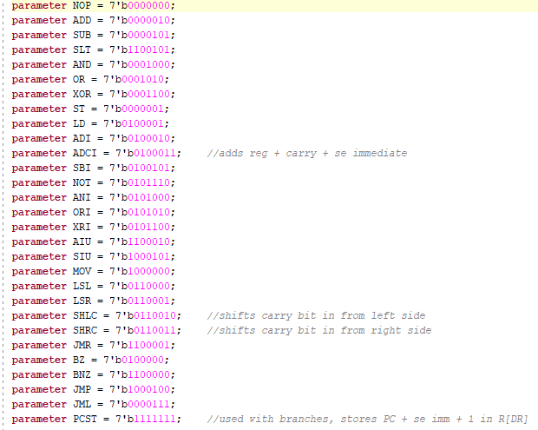
New Instructions
In total, only 3 new instructions were needed to give my CPU the functionality needed to do a 64-bit division.
The ADCI instruction function the same as an unsigned immediate add, but also adds the carry bit from the previous instruction which can be a 1 or a 0.
The SHLC and SHRC instructions shift by 1 bit to the left or right, respectively. They also shift in the carry bit from the previous instruction allowing high and low bits to be shifted out of one register and into another.
The PCST instruction was not necessary, in hindsight, but can still be useful in specific situations. This instruction is meant to be used to store “PC + 1 + sign extended” immediate in the specified register. It can be used with the JMR instruction to return from a function. This is especially useful when calling the same function from different areas in the program. It allows re-use of the same function code if you first put the value to be used by the function in a specific register.

Slide 3
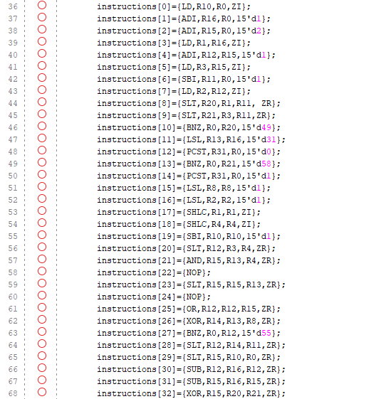
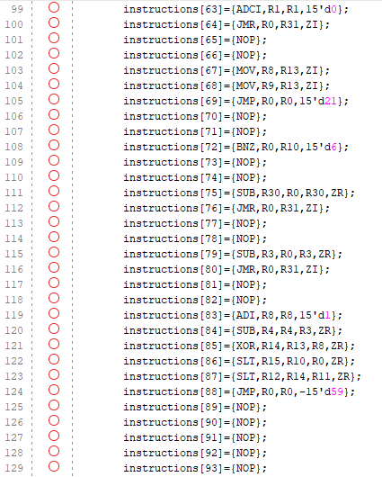
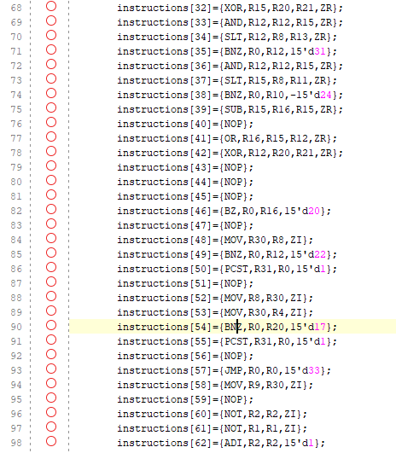
Assembly Code & Registers
The program only uses around 90 lines in total and probably could have been further reduced and optimized with a bit more time.
I initially typed up the code in Microsoft Excel and used Excel’s functions to keep track of jump and branch distances, after which the code can easily be copied and pasted into the instruction memory in verilog.
I also manually kept track of what information should be stored in each register. They are as follows:
R1 – top bits of 64-bit number
R2 – bottom bits of 64-bit number
R3 – divisor
R4 – holds shifts from R1
R11 – used to hold the value “-1”
R10 – used to hold the counter (always starts at 64)
R8 – used to hold the quotient
R9 – used to hold the remainder
R20 – holds the sign of the dividend
R21 – holds the sign of the divisor
R13 – holds the maximum negative value (-2^31)
R31 – holds the return PC value (PCST)
R30 – holds the value to be operated on by function
R16 – holds the value “1”

Slide 4
Overall Code Functionality
The assembly code works by first checking for negative values for the divisor and dividend. If one or both are found to be negative, they are complemented and made positive before beginning the division.
The core of the code works by shifting the top bit of the bottom 32-bits of the dividend into the bottom of the top 32-bit of the dividend. The top bit of the dividend is shifted into the “comparison register” (R4). Each loop through the program, a 0 is shifted into the result register (R8). The value in R4 is then compared with the divisor (R4) to see if R3 <= R4.
If the value in R3 is less than the value in R4, the 0 that was shifted into the result register is changed to a 1 and the divisor is subtracted from the comparison register. This process continues until the result register overflows or the loop has been executed 64 times.
If the result overflows, the maximum negative value is moved into the result and remainder registers and the program finishes early.
At the end of the division, the correct signs are given to the remainder and the result.

Slide 5
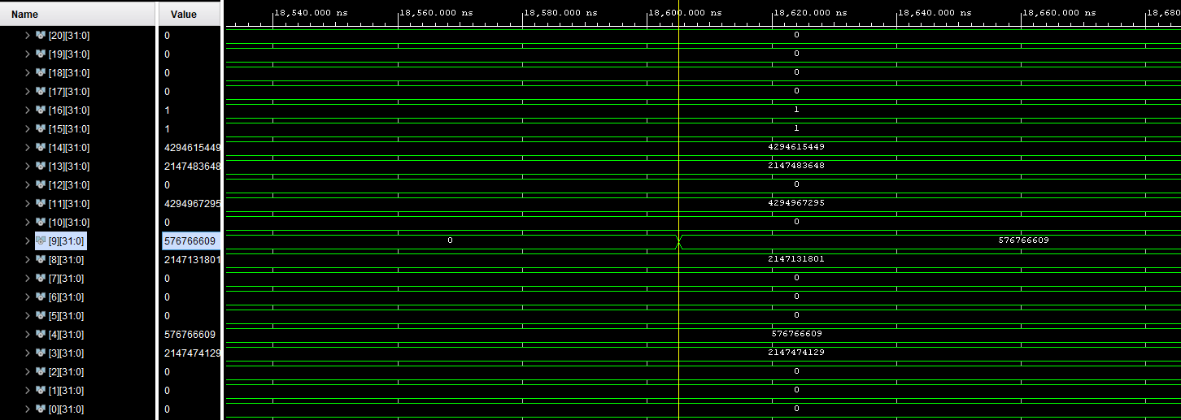

Examples and Results
In this example, the dividend is positive, and the divisor is positive. This yields a result that is positive and a remainder that is positive.

Slide 6
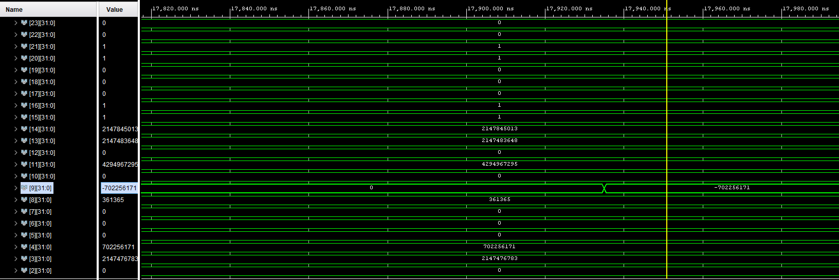

Examples and Results
In this example, the dividend is negative, and the divisor is negative. This yields a result that is positive and a remainder that is negative.

Slide 7
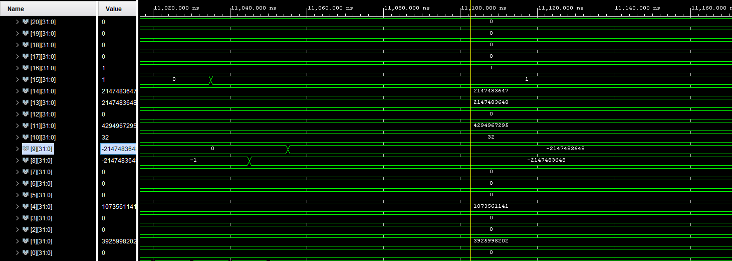

Examples and Results
In this example, the dividend is positive, and the divisor is zero. This yields an overflow result and an overflow remainder.

Slide 8
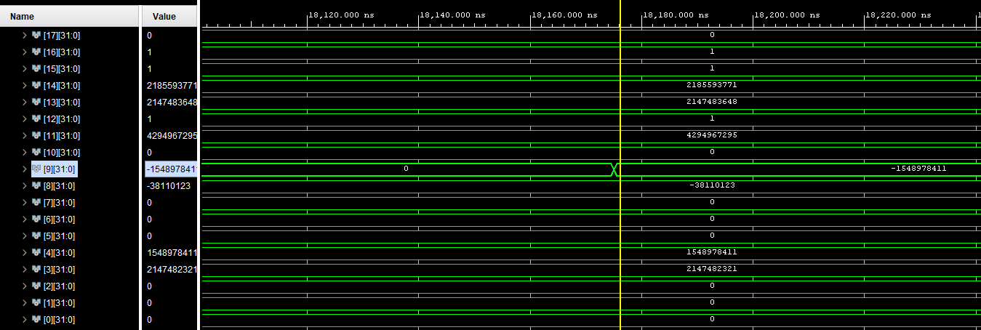

Examples and Results
In this example, the dividend is negative, and the divisor is positive. This yields a result that is negative and a remainder that is negative.

Slide 9
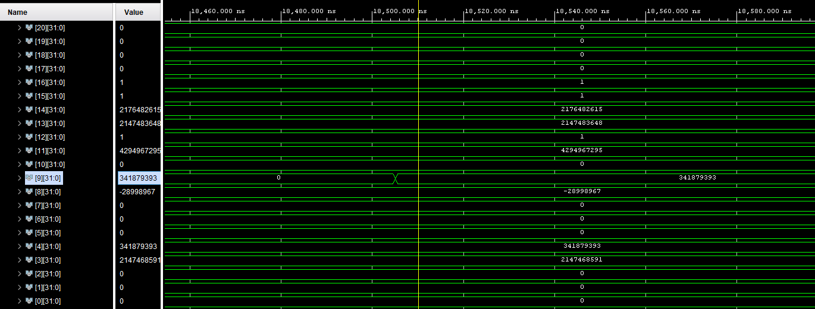

Examples and Results
In this example, the dividend is positive, and the divisor is negative. This yields a result that is negative and a remainder that is positive.

Slide 10
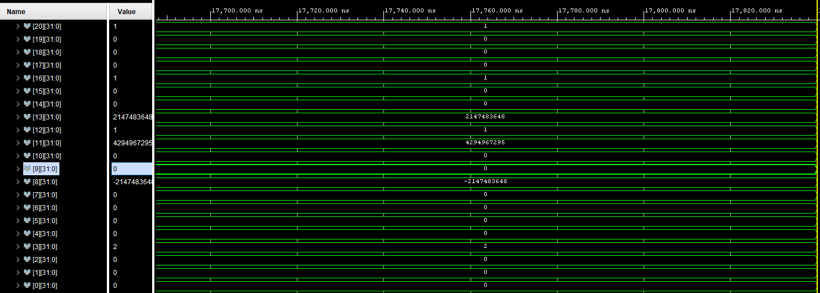

Examples and Results
In this example, the values of the dividend and divisor are such that the result should be the maximum negative value able to be held in a 32-bit register. There is no remainder, and the result is necessarily negative.

Slide 11
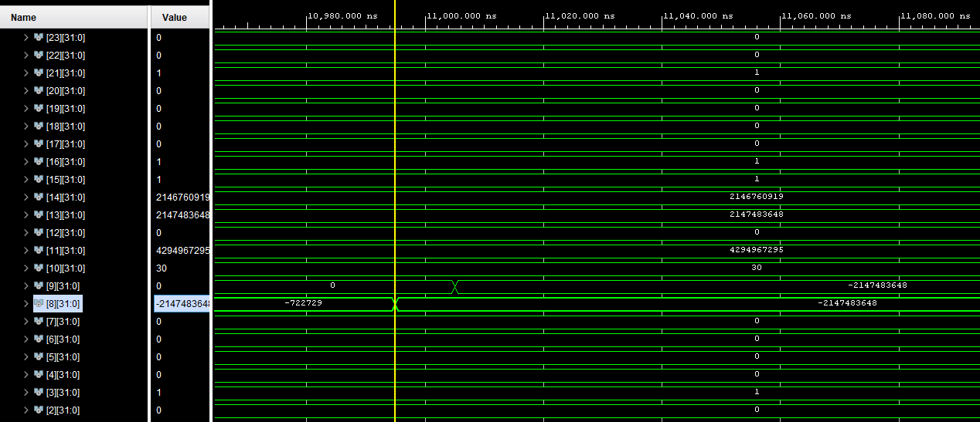

Examples and Results
In this example, the divisor is “-1” and the dividend is a large positive number. The result in an overflow value in the remainder and in the result.

