Slide 1
Homework 7 The STM32F070CB/RB/C6/F6 MCU
Kody Davis - 5375

Slide 2
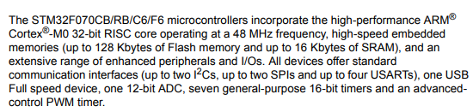
Overview
The STM32F070CB/RB/C6/F6 are a group of microcontrollers developed by STMicroelectronics.
For this presentation, we will specifically focus on the STM32F070F6 since it is the least complicated model out of the group.

Slide 3
STM32F070F6
Coming in the TSSOP20 package, it is the smallest MCU in the group with only 20 pins. The C6 and CB have 48 pins and the RB has 64 pins
Also has the lowest price point of the group, priced at only $1.57, with the C6 at $1.78, the CB at $2.32, and the RB at $2.55.
It is tied with the C6 for the smallest amount of Flash Memory and SRAM, both have only 32KB and 6KB, respectively. The CB and RB are tied for the largest amount, having 128KB and 16KB, respectively.

Slide 4
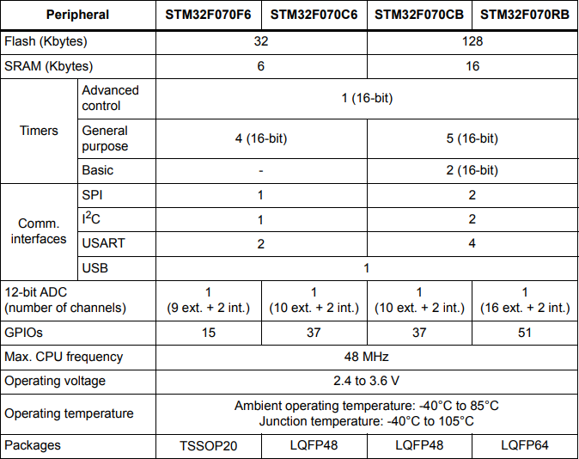
Peripherals/GPIOs
From the table, we can see the F6 contains:
1 Advanced control timer (16-bit)
4 General purpose timers (16-bit)
1 SPI (Serial Peripheral Interface)
1 I²C (Inter-integrated circuit interface)
2 USART (Universal Sync/Async Receive/Transfer)
1 USB (Universal Serial Bus)
1 12-bit ADC channel
15 GPIOs
It also contains:
Direct Memory Access Controller (DMA)
Real Time Clock (RTC)
Temperature sensor

Slide 5
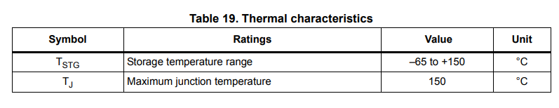
Power Consumption and Maximum Temperature
The datasheet states that the maximum current consumption while the MCU is in “Run” mode, supplied from a 3.6V source, at a temperature of 85°C with all peripherals enabled, and using the 48MHz(max) clock speed is 27.6mA. This would give a power consumption of around 99.4mW.
When under those same voltage and temperature conditions, but put in “Standby” mode with only absolutely necessary components still powered on, the datasheet states that the current consumption is 1.5μA. This would give a power consumption of around 5.4μW.

Slide 6
Programming and Debugging
Programming the device can be done through a number of IDEs:
Ac6 System Workbench is specifically for STM32 MCUs.
ARM Development Studio 5 can be used for ARM products more generally.
Debugging is made easier through the Cortex –M0s integrated on-chip debug support consisting of:
A pin specifically for debugging (SW-DP)
A break point unit that allows the programmer to set break-points at specific instructions in the code
Data watchpoint capability allowing the programmer to set break-points not only at specific instructions, but on specific memory accesses.

Slide 7
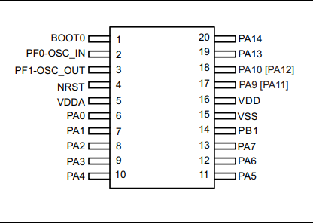
GPIO Pins and Functionality
1 – Boot memory selection
2 – External Oscillator Input / I2C1_SDA
3 – External Oscillator Output / I2C1_SCL
4 – Device reset input / internal reset output (active low)
5 – Analog Power Supply
6 – USART2_CTS
7 – EVENTOUT / USART2_RTS
8 – USART2_TX
9 – USART2_RX
10 – SPI1_NSS / USART2_CK / USB_NOE / TIM14_CH1
11 – SPI1_SCK
12 – SPI1_MISO / TIM3_CH1 / TIM1_BKIN / TIM16_CH1 / EVENTOUT
13 – SPI1_MOSI / TIM3_CH2 / TIM1_CH1N / TIM14_CH1 / TIM17_CH1 / EVENTOUT
14 – TIM14_CH1 / TIM3_CH4 / TIM1_CH3N
15 – Ground
16 – Digital power supply
17 – USART1_TX / TIM1_CH2 / I2C1_SCL / USART1_CTS / TIM1_CH4 / EVENTOUT
18 - TIM17_BKIN / USART1_RX / TIM1_CH3 / I2C1_SDA / USART1_RTS / TIM1_ETR / EVENTOUT
19 – SWDIO / IR_OUT / USB_NOE
20 – SWCLK / USART_TX

Slide 8
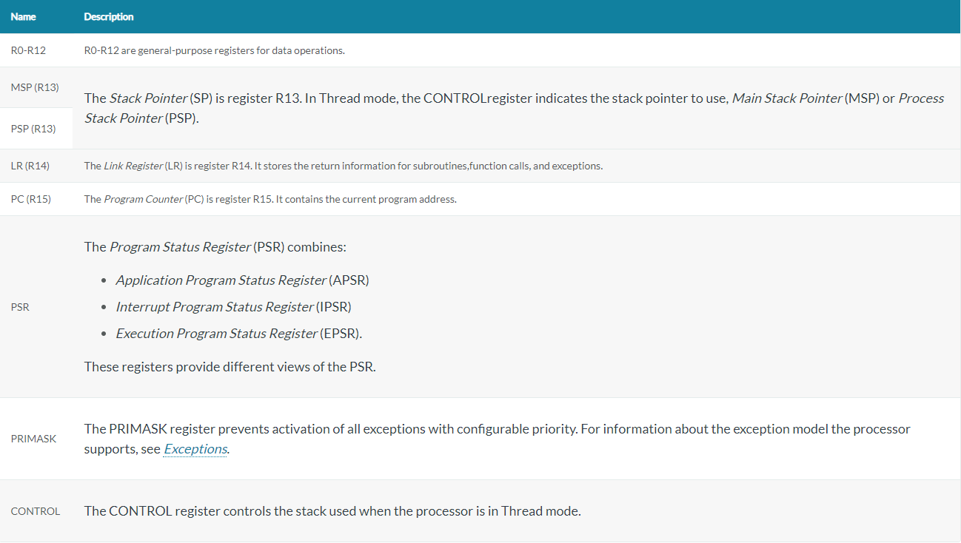
Cortex –M0 Core Registers
In total, there are 19 core registers that are all 32-bits wide.
Because the PSR, PRIMASK, and CONTROL registers are not reachable via standard methods with 16-bit instructions, two special instructions called MSR and MRS move a value from a register to the specified “special” register and vice versa.

Slide 9
Cortex –M0 Instruction Set
This processor is very interesting and complex in that it uses both 16-bit and 32-bit instructions. There are a total of 86 instructions, 6 of which are 32-bit instructions. The types of instructions include:
Branch instructions
Data-processing instructions
Status register access instructions
Load and store, and load and store multiple, instructions
Miscellaneous instructions
Most 16-bit instructions can only access registers R0-R7, but a few are able to access registers R8-R15. It appears that the instruction set only gives the programmer the ability to address load and store instructions in two ways. In the “immediate” addressing mode, an unsigned immediate is added to or subtracted from the value in a specified register including PC or SP. In the “register” addressing mode, the value in a register is added to or subtracted from the value in another register.
The instruction set allows for multiple registers to be loaded or stored in a single instruction. The stack and SP are used for the values and initial address when POP multiple is used. The registers are specified as a list such that the bottom value of the stack goes into the first register listed. This list can include the PC register such that this load acts as an unconditional branch. When a regular load multiple or store multiple is used, a register containing the address of the first value is specified instead of using the SP.
The instruction set does include one multiply instruction and it seems to be implemented in hardware. It is a 32x32 bit multiply that results in a 32-bit number being written to the destination.

Slide 10
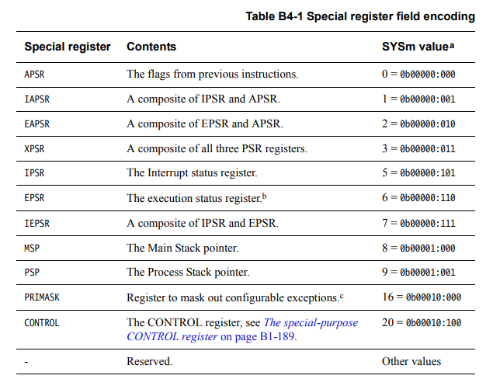
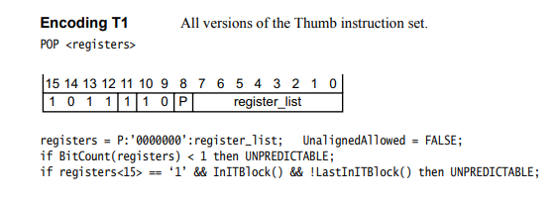
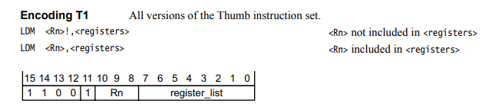
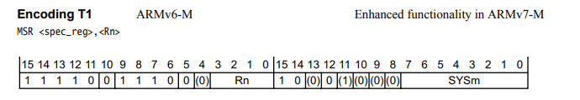
Cortex –M0 Instruction Examples
Register Table
used with
POP MSR
LDM
MSR

Slide 11
Instruction Set, Stack, and Interrupts
Because some instructions are 32-bits and some are only 16-bits, the NOP instruction is very useful. The NOP instruction’s binary value is “1011-1111-0000-0000”. Notice that it is only 16-bits. The assembler uses this instruction to keep the program aligned in memory.
The Branch instruction can be encoded in two ways. The first uses an 8-bit signed integer and is conditional. The second uses an 11-bit signed integer and is unconditional. In the first encoding, the condition to be branched on is set using a bit mask in bits 11-8 of the instruction. The condition flags are held in the ASPR region of the PSR.
The SP and the stack itself begin at a value set by the programmer. Asserting reset will cause the processor to abandon the current Execution state without saving it. When reset is de-asserted, all registers that have a defined reset value will contain that value. All others will have unknown values.
The ARMv6-M architecture used in the Cortex –M0 uses a full-descending stack. This means when pushing context onto the stack after interrupts or exceptions, the hardware decrements the SP to the end of the new stack frame before storing data onto the stack. When popping context, the hardware reads the data from the stack frame and then increments the SP.
Exceptions within code can cause interrupts as well as “events” that occur from external sources, so long as the system is configured to receive and process that event. Various interrupts can be enabled and disabled using the interrupt mask register. Interrupts can be assigned a priority such that interrupts with a higher priority are serviced first.

Slide 12
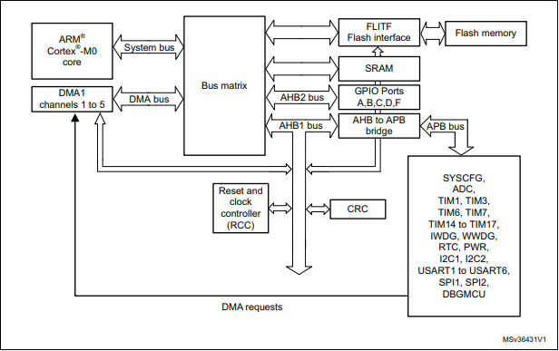
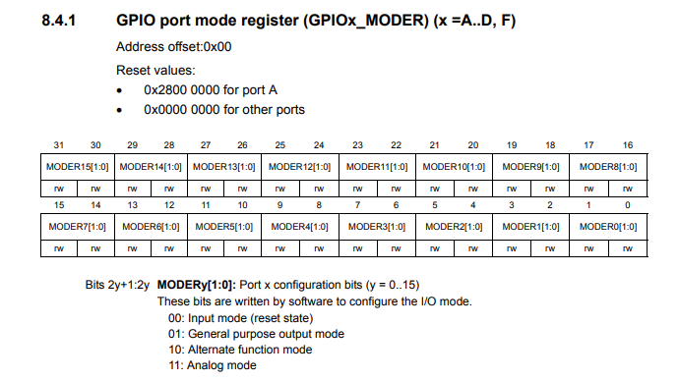
Pipeline, Memory Architecture and MCU Layout
The Cortex –M0 uses a 3-stage pipeline.
Loads and stores take 2 cycles, while basic arithmetic operations take only 1 cycle.
The memory utilizes a von Neumann architecture in which data and program memory share the same bus.
The function of GPIO pins is changed by changing the values at specific memory addresses through software, as are many other control bits.

