Slide 1

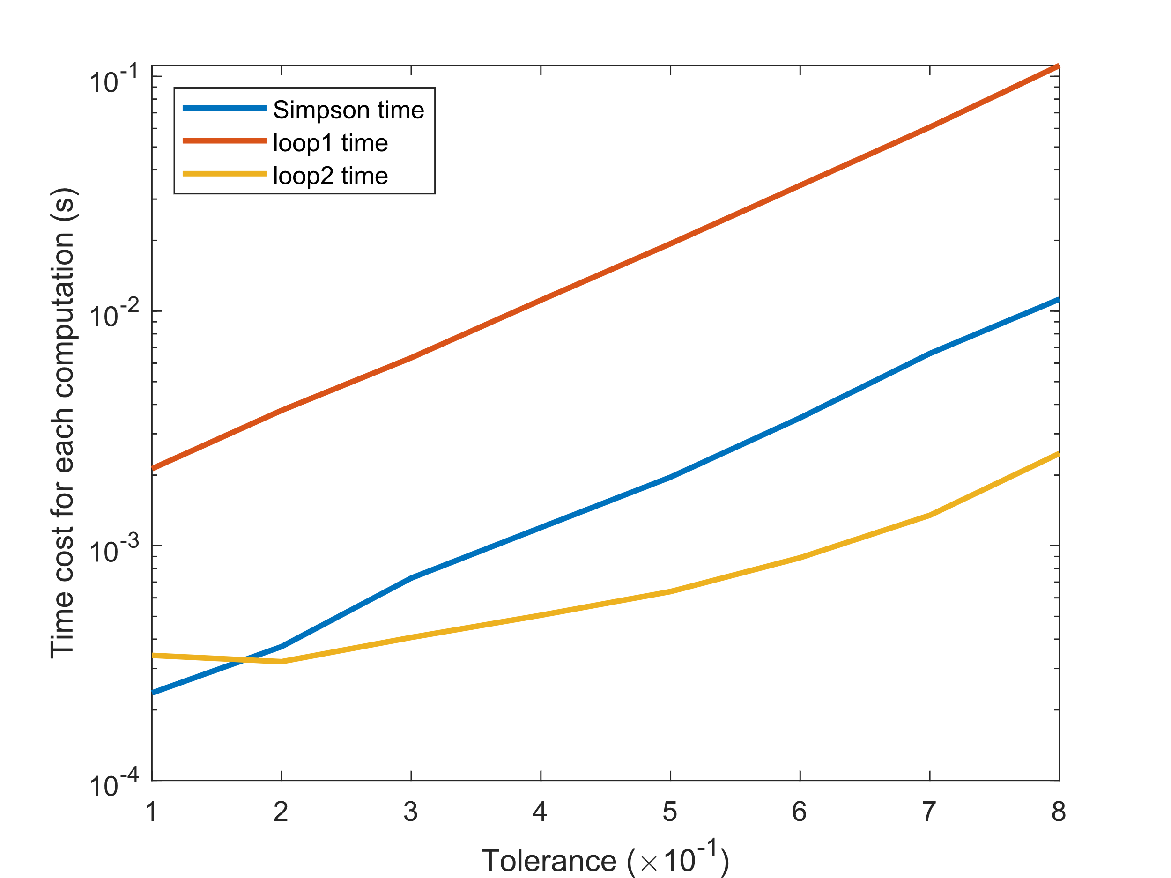


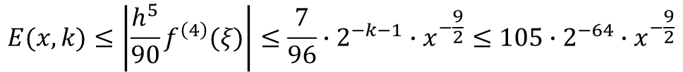

Id number
2023/7/31
Adaptive Simpson
Zhenpeng.Liu20, Wanqian.Chen20
Hui Zhang, Jiaotong-Liverpool University
Abstract
Improved implementations
The quadrature problem for a given function f(x) is to estimate the value of
$$If= \int_{0}^{1}{f\left(x\right)dx}$$
Traditional quadrature formulas give estimates of the form:
$$Q_{N}f= \sum_{i=1}^{N}{w_{i}f(x_{i})}$$
Adaptive quadrature is a numerical integration method that approximates the integral of a function f(x) using refined subintervals. It is efficient for both "well behaved" and "badly behaved" integrands, unlike traditional algorithms that may fail with the latter.
We have made slight improvements to the implementation of the algorithm in MATLAB and attempted to discuss its bounded characteristics.
Raw implementation
Fit calculated and measured results
Obtaining the most suitable model
Comparison
Example
Consider the integration:
$$f\left(x\right)=x^{−0.5}, w\left(x\right)=x,k=16,α=−0.5,p=4$$
$$\int_{eps}^{1}{\frac{1}{\sqrt{x}}dx}$$
$$f^{\left(4\right)}\left(x\right)=\frac{105}{16}x^{−\frac{9}{2}}≤16x^{−0.5−4}=10x^{−\frac{9}{2}}$$
It follow the assumption 1 and 2 ^{[1]} by :
$$E(x,k)≤\left|\frac{h^{5}}{90}f^{\left(4\right)}(ξ)\right|≤\frac{7}{96}∙2^{−k−1}∙x^{−\frac{9}{2}}≤105∙2^{−64}∙x^{−\frac{9}{2}}$$
Conclusion
for enough large K
Decreasing
Bounded limitation
Acknowledgements
References: 1. John R. Rice. 1975. A Metalgorithm for Adaptive Quadrature. J. ACM 22, 1 (Jan. 1975), 61–82. https://doi.org/10.1145/321864.321870.
2. Agarwal, S., Povolotskyi, M., Kubis, T. et al. Adaptive quadrature for sharply spiked integrands. J Comput Electron 9, 252–255 (2010). https://doi.org/10.1007/s10825-010-0338-3.

