Slide 1

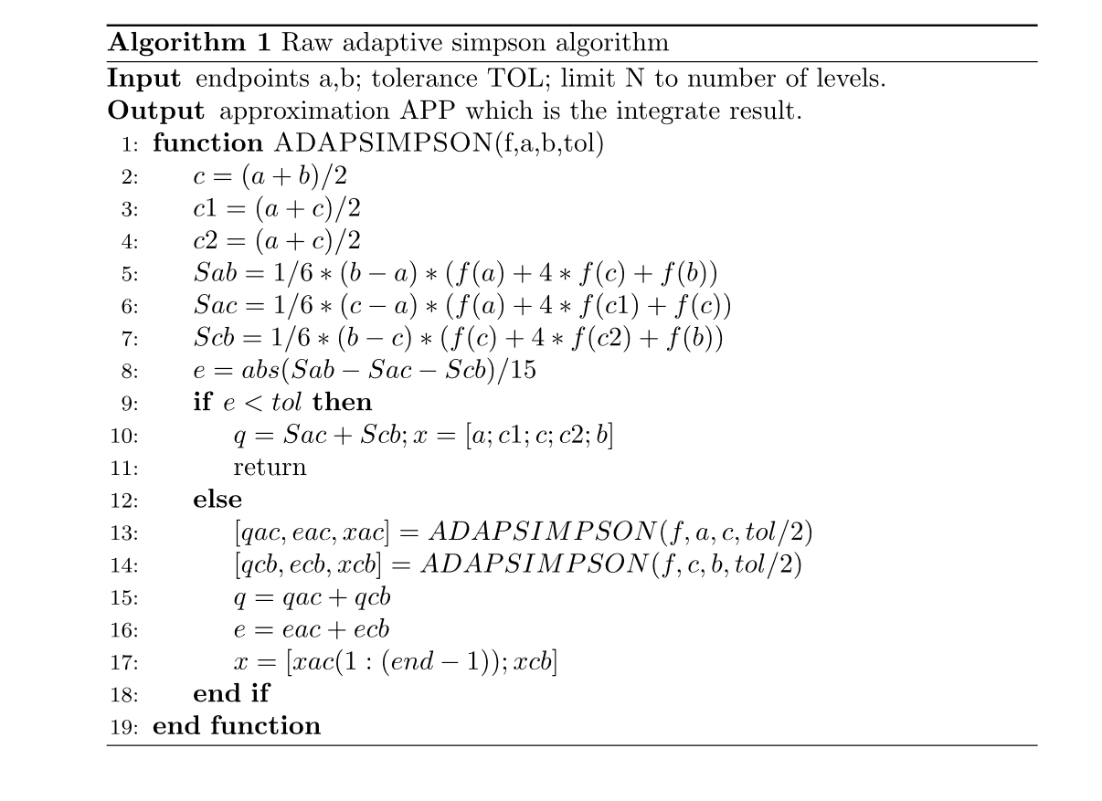
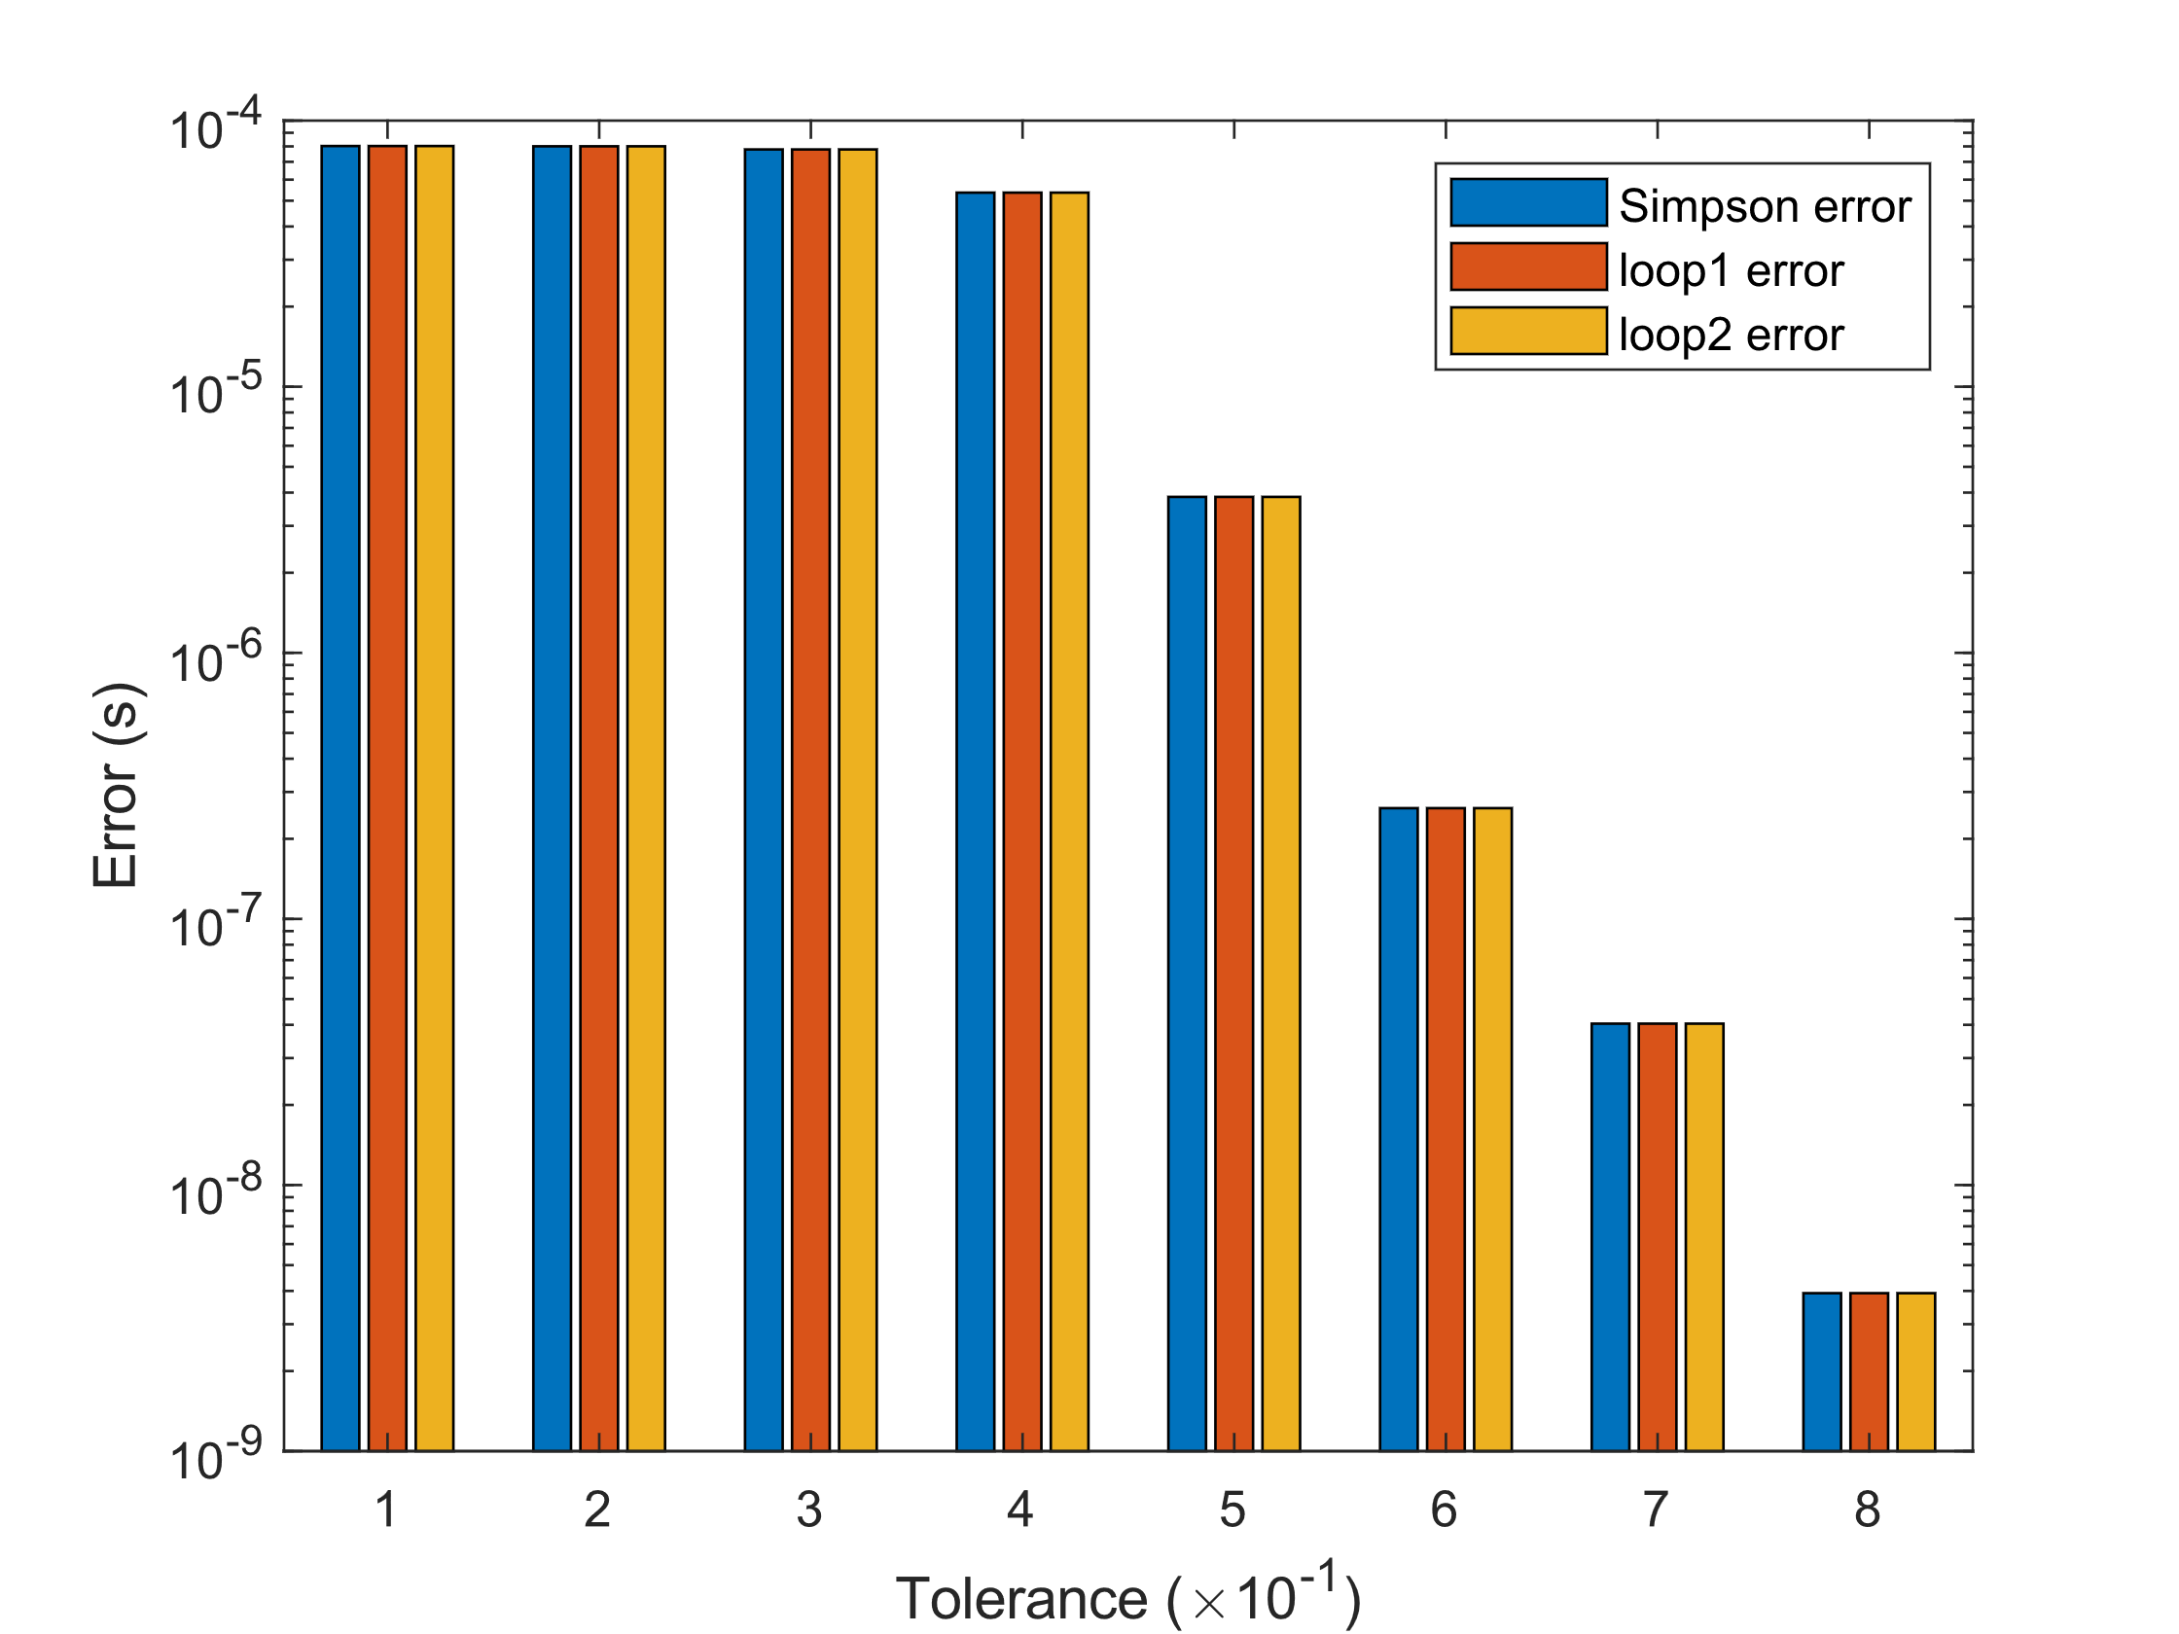
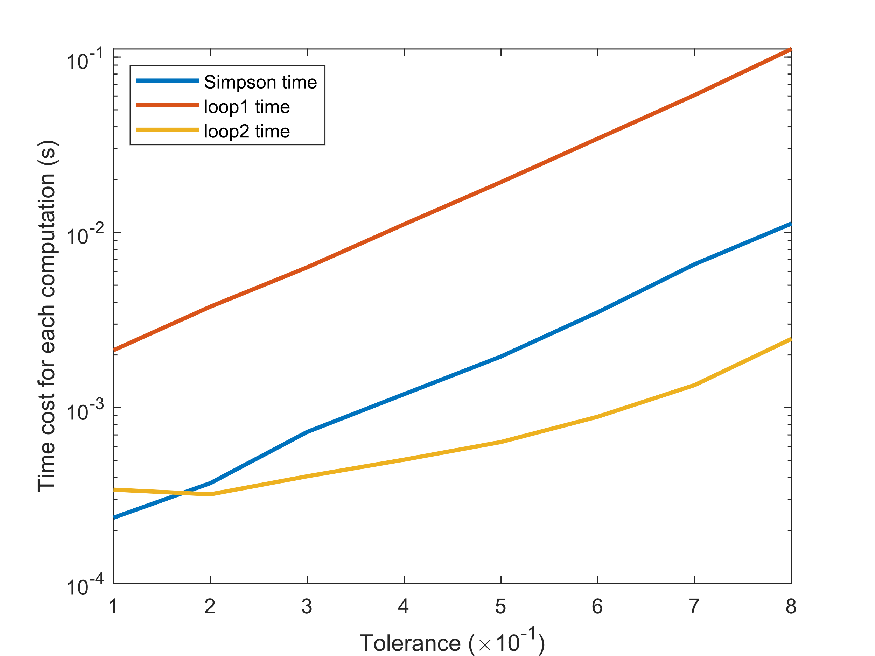

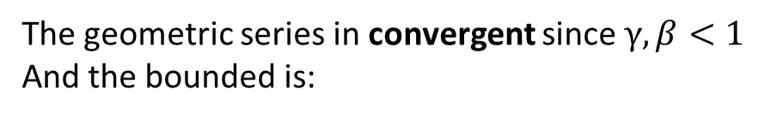

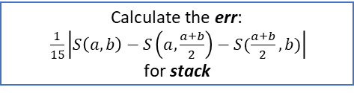
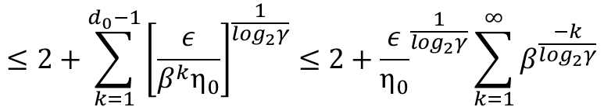
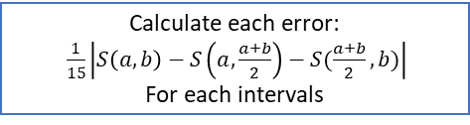


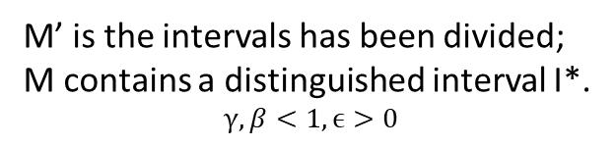
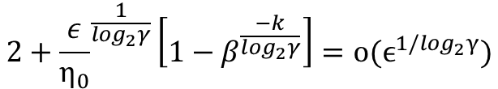
Id number: SURF-2023-0041
2023/7/31
Adaptive Numerical Algorithms: Convergence and Efficiency
Hui Zhang, Jiaotong-Liverpool University
Zhenpeng.Liu20, Wanqian.Chen20
Abstract
Improved implementations
The quadrature problem for a given function f(x) is to estimate the value of
$$If= \int_{0}^{1}{f\left(x\right)dx}$$
Traditional quadrature formulas give estimates of the form:
$$Q_{N}f= \sum_{i=1}^{N}{w_{i}f(x_{i})}$$
Adaptive quadrature is a numerical integration method that approximates the integral of a function f(x) using refined subintervals. It is efficient for both "well behaved" and "badly behaved" integrands, unlike traditional algorithms that may fail with the latter.
loop1
loop2
Input (f, a, b, tol)
Input (f, a, b, tol)
Initial beta to 0; Q to 0; err = tol+1; ini = [f, a, b, tol]; arr = [ini];
Initial I with the interval [a,b]
Arr is not empty
N
Subdivide the intervals three times in equal proportions
Y
Calculate each error:
$\frac{1}{15}\left|S\left(a,b\right)−S\left(a,\frac{a+b}{2}\right)−S(\frac{a+b}{2},b)\right|$
For each intervals
Choose the last element of arr called stack
Calculate the err:
$\frac{1}{15}\left|S\left(a,b\right)−S\left(a,\frac{a+b}{2}\right)−S(\frac{a+b}{2},b)\right|$
for stack
Select the intervals whose errors are less than tol, put it in to the set finished, leave the remaining part I
We have made slight improvements to the implementation of the algorithm in MATLAB and attempted to discuss its bounded characteristics.
Y
stack.err < stack.tol
I is empty or count > n
N
N
Y
Split stack into two terms, extend arr and put them into arr(end) and arr(end+1)
One term is[f, a, (a+b)/2, 0.5*tol];
Another is [f, (a+b)/2, 0.5*tol];
Integrate function f using the Simpson's integration method over intervals partitioned by finished.
Raw implementation
Delete stack from arr
Add stack to finished
Program completed
Integrate function f using the Simpson's integration method over intervals partitioned by finished.
Note: The biggest difference between loop1 and loop2 is that loop2 can be almost fully vectorized in supported languages (e.g., MATLAB), whereas loop1 is more difficult to vectorize.
Note: This implementation is based on iteration and may not provide the highest computational efficiency.
Program completed
Comparison
The calculation for the example: $\int_{eps}^{1}{\frac{1}{\sqrt{x}}dx}$
Example
Consider the integration:
$$\int_{eps}^{1}{\frac{1}{\sqrt{x}}dx}$$
It follow the assumption 1 and 2 ^{[1]} by :
$$f\left(x\right)=x^{−0.5}, w\left(x\right)=x,k=16,α=−0.5,p=4$$
$f^{\left(4\right)}\left(x\right)=\frac{105}{16}x^{− \frac{9}{2}}≤16x^{−0.5−4}=10x^{− \frac{9}{2}}$
$E(x,k)≤\left|\frac{h^{5}}{90}f^{\left(4\right)}(ξ)\right|≤\frac{7}{96}∙2^{−k−1}∙x^{− \frac{9}{2}}≤105∙2^{−64}∙x^{− \frac{9}{2}}$
It is obvious they will have the same error because of the same algorithm. But the time taken for the same content varies. While their time complexity seems to be equivalent, loop2 is significantly faster.
for enough large K
Finite iteration
length
M’ is the intervals has been divided; M contains a distinguished interval I*.
$$γ,β<1, ϵ>0$$
Conclusion
n
L
🔍 Theoretical Insights and Convergence 🧠
Delving deep into numerical algorithms, our study meticulously examines the convergence rate, subsequently delving into the exploration of convergence termination criteria. Through theoretical analysis, we present pragmatic solutions for real-world computational challenges.
📊 Empirical Validation and Exemplification 📊
We substantiate our findings through concrete examples, demonstrating the efficacy of our proposed methodologies. These instances not only comprise theoretical analysis but also encompass tangible solutions to real-world problems, establishing the versatility and robustness of our approaches.
⚙️ Innovations in Adaptive Simpson's Algorithm ⚙️
Propelling beyond conventional boundaries, we have two enhancements to the traditional implement of adaptive Simpson's algorithm. By applying our innovations to real-world scenarios, we not only drastically amplify computational speed though uphold the algorithm's original time complexity.
1
L/2
$$2+\sum_{k=1}^{d_{0}−1}{2^{d_{k}}}≤2+\sum_{k=1}^{d_{0}−1}{2^{\left[\frac{\log_{2}\frac{ϵ}{β^{k}η_{0}}}{\log_{2}γ}\right]}}$$
2
L/4
$$≤2+\sum_{k=1}^{d_{0}−1}{{\left[\frac{ε}{β^{k}η_{0}}\right]}^{\frac{1}{\log_{2}γ}}}≤2+{\frac{ε}{η_{0}}}^{\frac{1}{\log_{2}γ}}\sum_{k=1}^{∞}{β^{\frac{−k}{\log_{2}γ}}}$$
3
4
L/8
The geometric series in convergent since $γ,β<1$
And the bounded is:
n
L/2^{n}
$$2+{\frac{ε}{η_{0}}}^{\frac{1}{\log_{2}γ}}\left[1−β^{\frac{−k}{\log_{2}γ}}\right]=\text{o}\text{(}ϵ^{1/\log_{2}γ})$$
Further research
Using parallel calculation to increase the integration speed.
Find a smaller bound for adaptive Simpson. And calculate its convergence rate.
Our research propels numerical algorithms towards greater horizons!
We sincerely appreciate your thoughtful engagement!
References: 1. John R. Rice. 1975. A Metalgorithm for Adaptive Quadrature. J. ACM 22, 1 (Jan. 1975), 61–82. https://doi.org/10.1145/321864.321870.
2. Agarwal, S., Povolotskyi, M., Kubis, T. et al. Adaptive quadrature for sharply spiked integrands. J Comput Electron 9, 252–255 (2010). https://doi.org/10.1007/s10825-010-0338-3.

