Slide 1
Predicting new location for new shopping mall

Slide 2
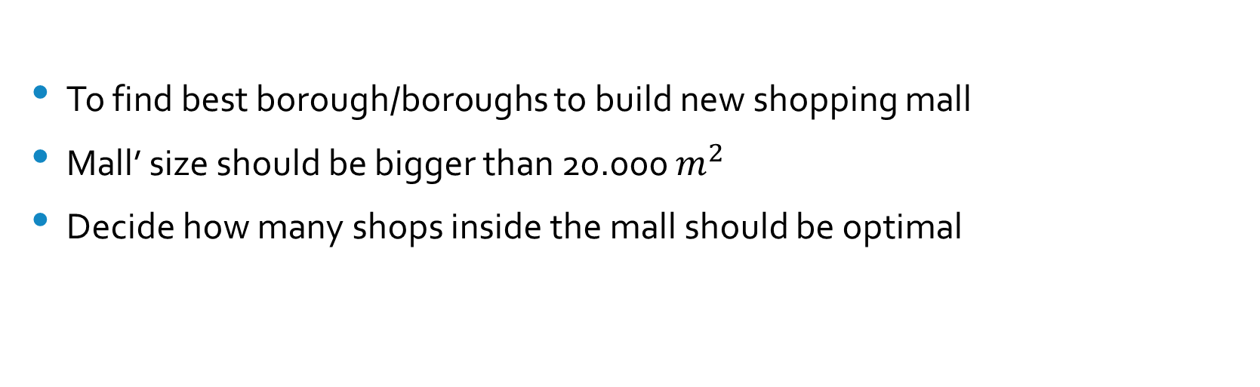
Stakeholders business problem:
To find best borough/boroughs to build new shopping mall
Mall’ size should be bigger than 20.000 $m^{2}$
Decide how many shops inside the mall should be optimal

Slide 3
Data acquisition and cleaning
Main malls currently in Vilnius: data scraped from Wikipedia
Smaller shop/chains in the Vilnius: data scraped from https://www.1551.lt/
Other type of shops: data scraped from Foursquare API
Boroughs data scraped from Wikipedia
Available land deals to buy: scraped from https://www.ober-haus.lt/
Total 580 rows and 14 features
Duplicate data was dropped

Slide 4
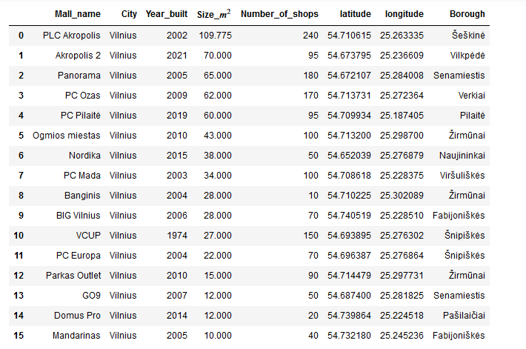
Our main shopping mall list in Vilnius
As we see malls size and regions/boroughs do vary

Slide 5
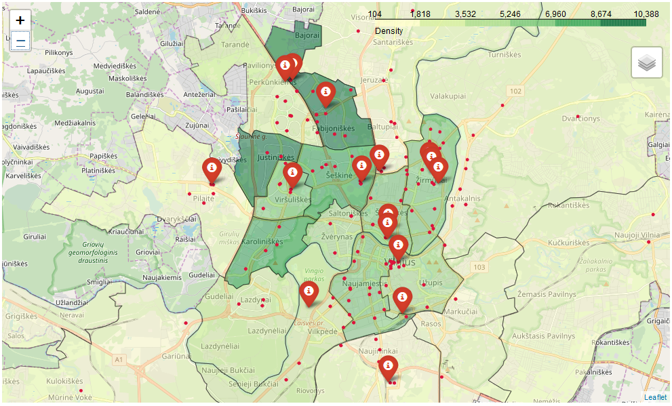
Distribution on the map(smaller shops included)
As we see the concentration of the mall and the shops is seen very clearly

Slide 6
Our prime locations:
After data format we find 5 best boroughs based on these criteria :
No malls in the borough
People density is highest
And smaller amount other shops/chains

Slide 7
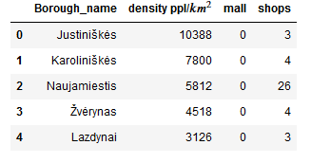
Our prime locations(part II):
We drop the ‘Naujamiestis’ due to high shop number compared to other locations

Slide 8
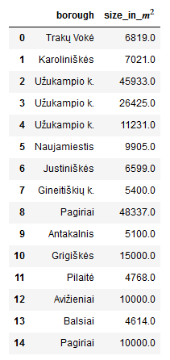
Our best deals currently on the market for sale:

Slide 9

The best locations for our new mall are:

Slide 10
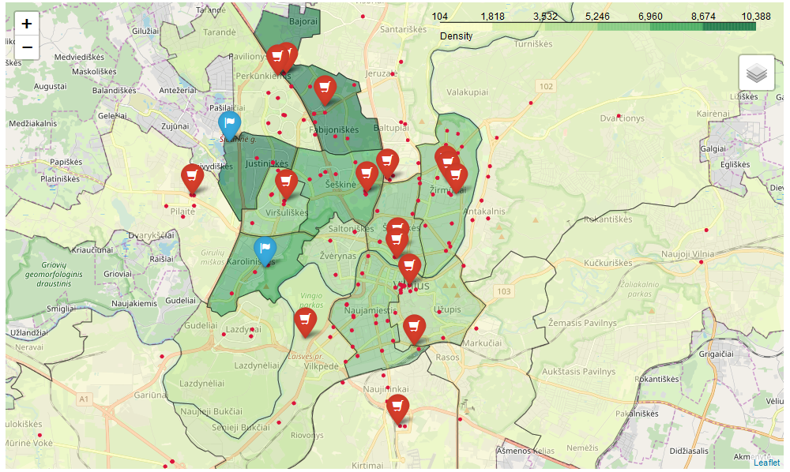
Our target’s locations on the map :

Slide 11
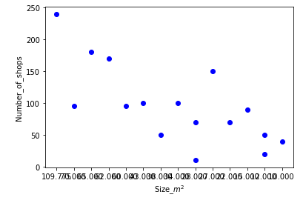
Regression model
As we can see our data widely distributes around axis so regression models (Linear and Polynomial) were
always overfitting or very inaccurate , so we decided to stich with averages
And average number of shops through the malls are +/- 100

Slide 12
Conclusion
Found the best places where the mall could be built
Found the best available deals (current moment)
After all analysis provided 2 possible best locations and suggested number of shops.

