Slide 1



Fundamentals of ETL: data extraction, transformation and loading. Read data
Applied Mathematical Modeling in Banking
+

Slide 2
Table of contents
What is ETL?
Data Quality
Data Profiling

Slide 3

R packages
Source: https://roelverbelen.netlify.app/resources/r/packages/
Notes:
R functions is a set of packages developed by researchers all over the world

Slide 4




R packages
.xlsx
jsonlite
.json
xlsx
.gsheet
httr
.txt
.html
.csv
XML
.xml
utils
methods

Slide 5
CSV
Comma Separated Values
Id,Name,Sales,Salary
1,Ivan Petrov,1542,10445.45
2,Stepan Ivanov,1240,7587.2
…

Slide 6
CSV
data <- read.csv(file = “file_path)
data <- read.csv(file = “file_path”, na.strings = c(“NULL”, “NA”, “”, “DbNull”)))
data <- read.csv2(file = “file_path”, sep =“,”, dec = “.”)
#install.packages(“readr”)
library(readr)
data <- read_csv(file = “file_path”, …
data <- read_csv2(file = “file_path”, … )
packages:
utils
readr

Slide 7
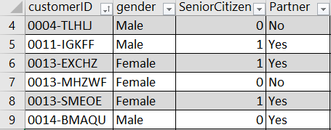
XLSX
Microsoft Excel Open XML Format for Spreadsheets
packages:
xlsx
openxlsx

Slide 8
XML
eXtensible Markup Language
packages:
XML
methods
<RECORDS>
<EMPLOYEE>
<ID>1</ID>
<NAME>Rick</NAME>
<SALARY>623.3</SALARY>
<STARTDATE>1/1/2012</STARTDATE>
<DEPT>IT</DEPT>
</EMPLOYEE>
...
</RECORDS>

Slide 9
ETL
Extract Transform Load
A properly designed ETL system extracts data from the source systems, enforces data quality and consistency standards, conforms data
Delivers data in a presentation-ready format so that application developers can build applications and end users can make decisions.

Slide 10
References
Unit 4 ETL (Extract Transform Load). Url: https://slideplayer.com/slide/6386658/
The Data Warehouse ETL Toolkit by Ralph Kimball
ETL (Extract, Transform, and Load) Process in Data Warehouse Url: https://www.guru99.com/etl-extract-load-process.html
What is Extract, Transform, Load? Definition, Process, and Tools. Url: https://www.talend.com/resources/what-is-etl/

