Slide 1



Fundamentals of ETL: data extraction, transformation and loading
Applied Mathematical Modeling in Banking
+

Slide 2
Table of contents
What is ETL?
Data Quality
Data Profiling

Slide 3
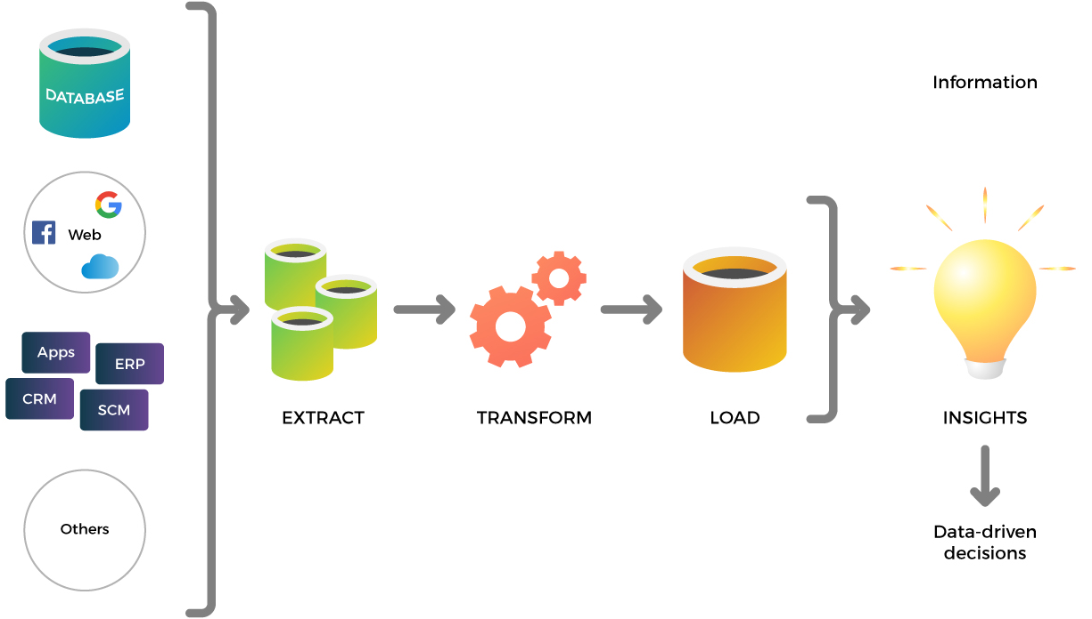
ETL

Slide 4
ETL
Extract Transform Load
A properly designed ETL system extracts data from the source systems, enforces data quality and consistency standards, conforms data
Delivers data in a presentation-ready format so that application developers can build applications and end users can make decisions.

Slide 5
ETL
Removes mistakes and corrects missing data
Provides documented measures of conﬁdence in data
Captures the ﬂow of transactional data for safekeeping
Adjusts data from multiple sources to be used together
Structures data to be usable by end-user tools
Notes:
Building the ETL system is a back room activity that is not very visible to end users, it easily consumes 70 percent of the resources needed for implementation and maintenance of a typical data warehouse.

Slide 6
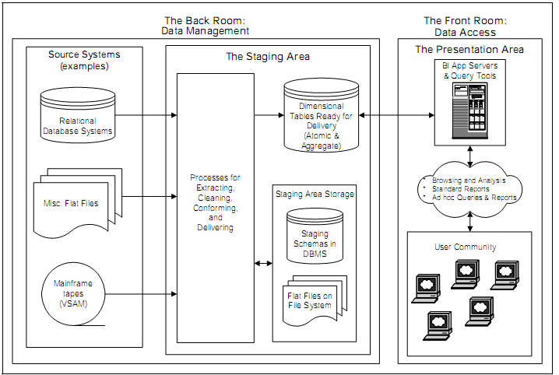
ETL
Notes:
Building the ETL system is a back room activity that is not very visible to end users, it easily consumes 70 percent of the resources needed for implementation and maintenance of a typical data warehouse.

Slide 7
What is Data Quality?
World of heterogeneity.
Different technologies.
Different platforms.
Large amount of data being generated everyday in all sorts of organizations and Enterprises.
Problems with data.
Notes:
Building the ETL system is a back room activity that is not very visible to end users, it easily consumes 70 percent of the resources needed for implementation and maintenance of a typical data warehouse.

Slide 8
Data Quality: Problems
Duplicated, inconsistent, ambiguous, incomplete.
Need to collect data in one place and clean up the data.

Slide 9
Data Quality: Motivation
What have you missed?
When things go wrong.
Making confident decisions.
Notes:
Why data quality matters?
Good data is your most valuable asset, and bad data can seriously harm your
business and credibility…

Slide 10
Data Quality: Definition
Data quality is a perception or an assessment of data’s fitness to serve its purpose in a given context.
Notes:
So, what is data quality?

Slide 11
Data Quality: Dimensions
Correctness / Accuracy : Accuracy of data is the degree to which the captured data correctly describes the real world entity.
Consistency: This is about the single version of truth. Consistency means data throughout the enterprise should be sync with each other.
Completeness: It is the extent to which the expected attributes of data are provided.
Timeliness: Right data to the right person at the right time is important for business.
Metadata: Data about data.

Slide 12
Data Quality: Example
Inconsistent data: cleaning up
Bill ID | Customer | SecurityNumber
1140114 | Mr. Joe | SN11475
1254478 | Mr. Joe Dou | SN11475
2134545 | Mr. Dou Joe | SN11475
1234875 | Mr. Jou Dou | SN11475

Slide 13
Data Quality: Example
Inconsistent data: cleaning up
Bill ID | Customer | SecurityNumber
1140114 | Mr. Joe Dou | SN11475
1254478 | Mr. Joe Dou | SN11475
2134545 | Mr. Joe Dou | SN11475
1234875 | Mr. Joe Dou | SN11475

Slide 14
Data Profiling: Problem
Several data inconsistencies in source, like missing records or NULL values.
Column you chose to be the primary key column is not unique throughout the table.
Schema design is not coherent to the end user requirement.
Any other concern with the data, that must have been fixed right at the beginning.

Slide 15
Data Profiling: what is?
It is the process of statistically examining and analyzing the content in a data source, and hence collecting information about the data.
It consists of techniques used to analyze the data we have for accuracy and completeness.

Slide 16
Data Profiling: Motivation
Data profiling helps us make a thorough assessment of data quality.
It assists the discovery of anomalies in data.
It helps us understand content, structure, relationships, etc. about the data in the data source we are analyzing.
It helps us know whether the existing data can be applied to other areas or purposes.
It helps us understand the various issues/challenges we may face in a database project much before the actual work begins. This enables us to make early decisions and act accordingly.
It is also used to assess and validate metadata.

Slide 17
Data Profiling: Plan
Writing SQL queries on sample data extracts put into a database.
Using data profiling tools.
P.S. You can use R for data profiling

Slide 18
Data Profiling: Methods
Data quality: Analyze the quality of data at the data source.
NULL values: Look out for the number of NULL values in an attribute.
Candidate keys: Analysis of the extent to which certain columns are distinct will give developer useful information w. r. t. selection of candidate keys.
Primary key selection: To check whether the candidate key column does not violate the basic requirements of not having NULL values or duplicate values.
Notes:
Data profiling involves statistical analysis of the data at source and the data being loaded, as well as analysis of metadata.
These statistics may be used for various analysis purposes.: on slide

Slide 19
Data Profiling: Methods
Empty string values: A string column may contain NULL or even empty sting values that may create problems later.
String length: An analysis of largest and shortest possible length as well as the average string length of a sting-type column can help us decide what data type would be most suitable for the said column.
Identification of cardinality: The cardinality relationships are important for inner and outer join considerations with regard to several BI tools.
Data format: Sometimes, the format in which certain data is written in some columns may or may not be user-friendly.

Slide 20
Data Profiling: Conclusion
Elimination of some input fields completely
Flagging of missing data and generation of special surrogate keys
Best-guess automatic replacement of corrupted values
Human intervention at the record level
Development of a full-blown normalized representation of the data

Slide 21
Data Profiling: what is?
Several data inconsistencies in source, like missing records or NULL values.
Column you chose to be the primary key column is not unique throughout the table.
Schema design is not coherent to the end user requirement.
Any other concern with the data, that must have been fixed right at the beginning.

Slide 22
References
Unit 4 ETL (Extract Transform Load). Url: https://slideplayer.com/slide/6386658/
The Data Warehouse ETL Toolkit by Ralph Kimball
ETL (Extract, Transform, and Load) Process in Data Warehouse Url: https://www.guru99.com/etl-extract-load-process.html
What is Extract, Transform, Load? Definition, Process, and Tools. Url: https://www.talend.com/resources/what-is-etl/

