Slide 1

Trees based algorithms: Decision Tree, Random Forest, Gradient Boosting
Course
Applied Mathematical Modeling in Banking

Slide 2
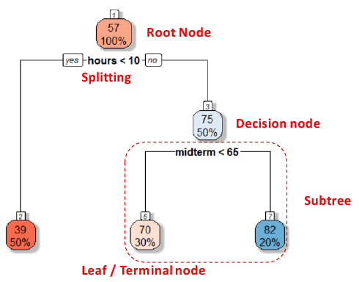
Definition
A decision tree is a decision support tool that uses a tree-like model of decisions and their possible consequences, including chance event outcomes, resource costs, and utility. It is one way to display an algorithm that only contains conditional control statements.

Slide 3
Types
Regression Tree
For continuous quantitative target variable.
Eg. Predicting rainfall, predicting revenue, predicting marks etc.
Classification Tree
For discrete categorical target variables
Eg. Predicting High or Low, Win or Loss, Healthy or Unhealthy etc

Slide 4
CART
Decision tree algorithms
ID3
C5(4.5)
CART

Slide 5
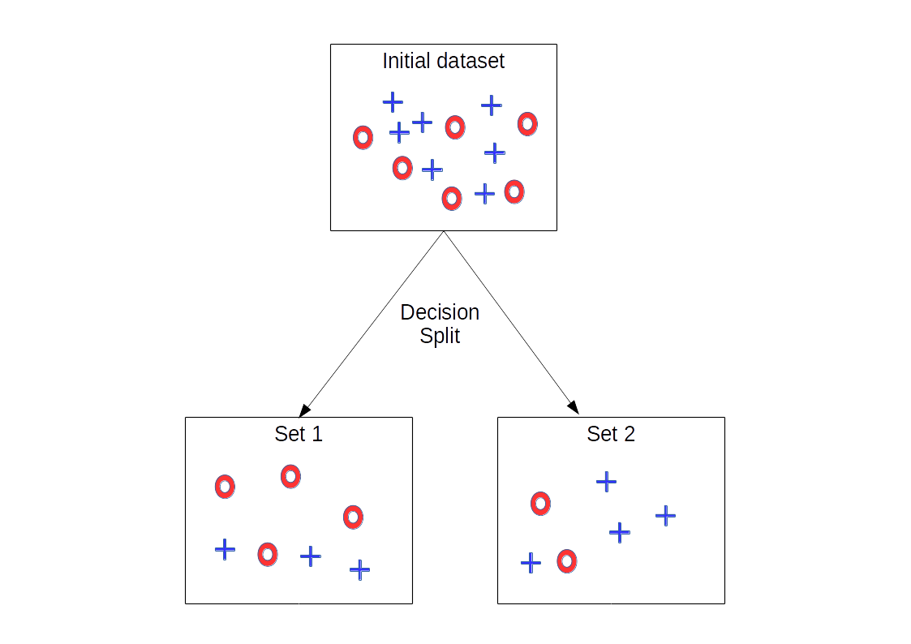
Entropy (ID3, C5)
Entropy is an indicator of how messy your data is.

Slide 6
CART
CART
Classification Trees
Regression Trees

Slide 7

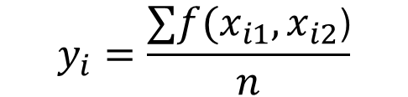
RERESSION
x2 > 15
No
Yes
x1 > 100
x1 < 80
No
Yes
No
Yes
x2 > 25
$y=f(x_{1},x_{2}$)
No
Yes
X1
78
1,5
78
1,5
100
80
$$y_{i}=\frac{∑f(x_{i1},x_{i2}\text{)}}{n}$$
11
11
0,5
5,2
0,5
5,2
15
25
X2
Notes:
Значення обчислюється як середнє з блоку.

Slide 8
CLASSIFICATION
x1 > 75
No
Yes
x2 <10
x2 > 8
No
Yes
No
Yes
x1 > 45
No
Yes
X1
75
45
8
10
X2
Notes:
Значення обчислюється як середнє з блоку.

