Slide 1



Neural Networks
Course
Applied Mathematical Modeling in Banking
Клебан Ю.В.
м. Київ, 2018
+

Slide 2
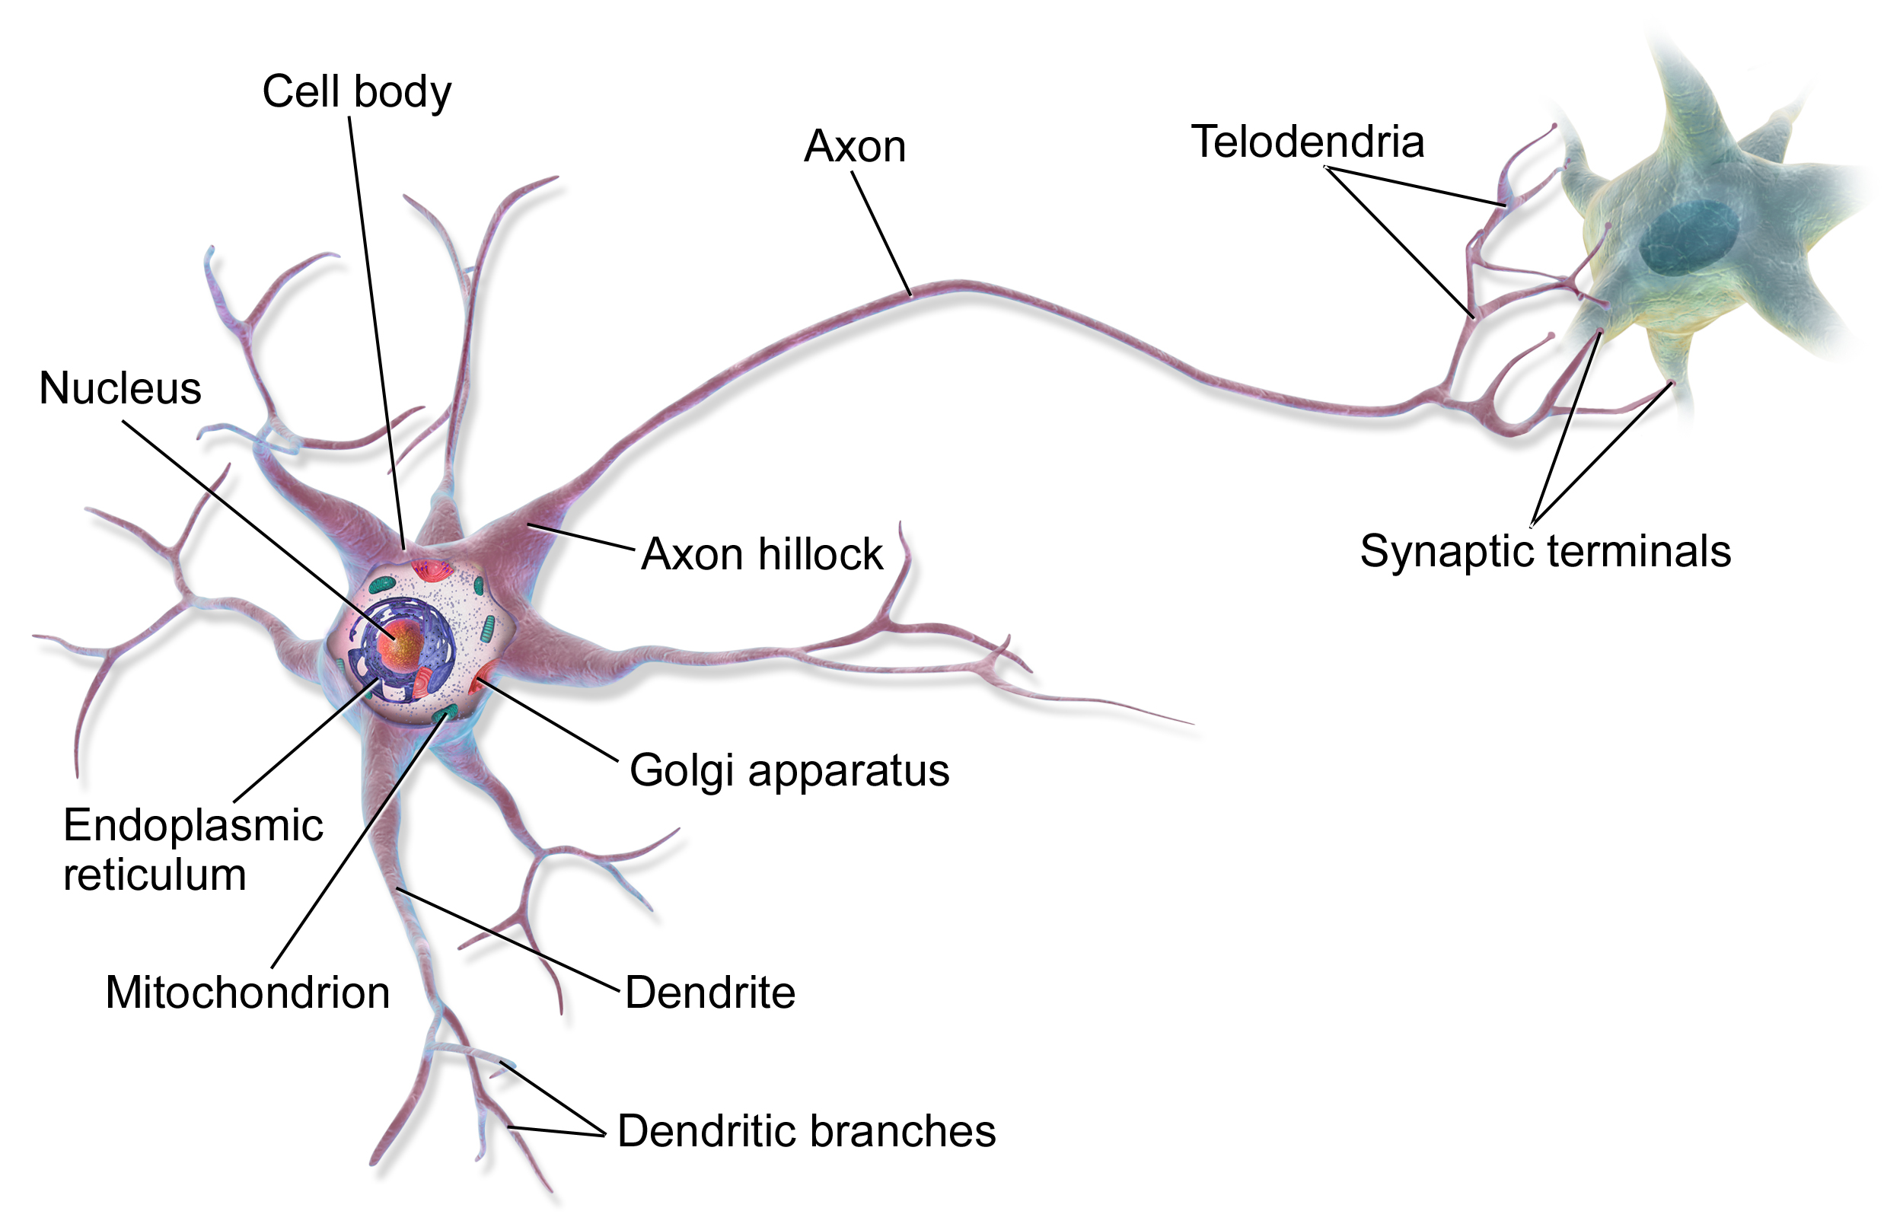
Biological Neuron
Notes:
Людський мозок складається зі з'єднаних нейронів з дендридами, що отримують дані на вхід і далі на основі цих даних створюють електричний сигнал, що подається через аксон до інших нейронів.

Slide 3
General Cases
Neural networks are algorithms based on a biological neuron that involve learning models similar to the approach used by humans.
Neural Network Cases:
Image recognition
Time-series prediction
Anomaly Detection
Clusterization
Classification

Slide 4
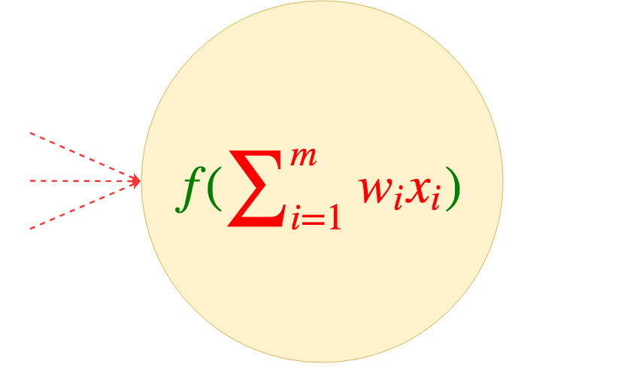
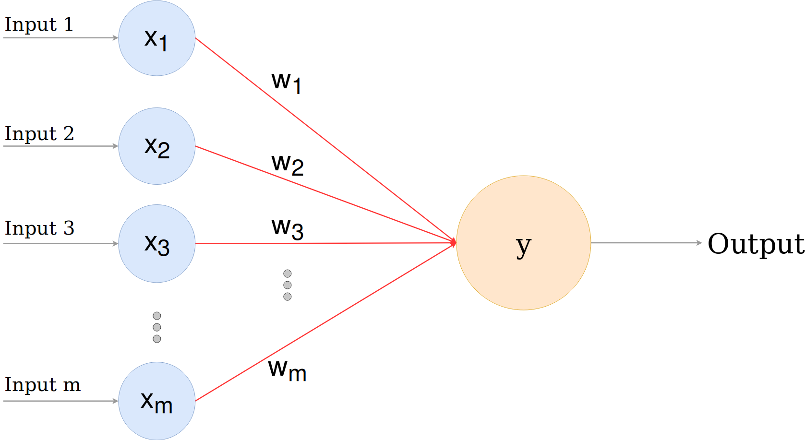
Perceptron
A perceptron is a single layer neural network
Notes:
Input nodes are connected to the output with synapses. Each synapse has a weight.
the scores are calculated and the prediction is made in the output unit based on the inputs and weights.
to make a prediction from this calculated score, we have to use an activation function (sygmoid)

Slide 5
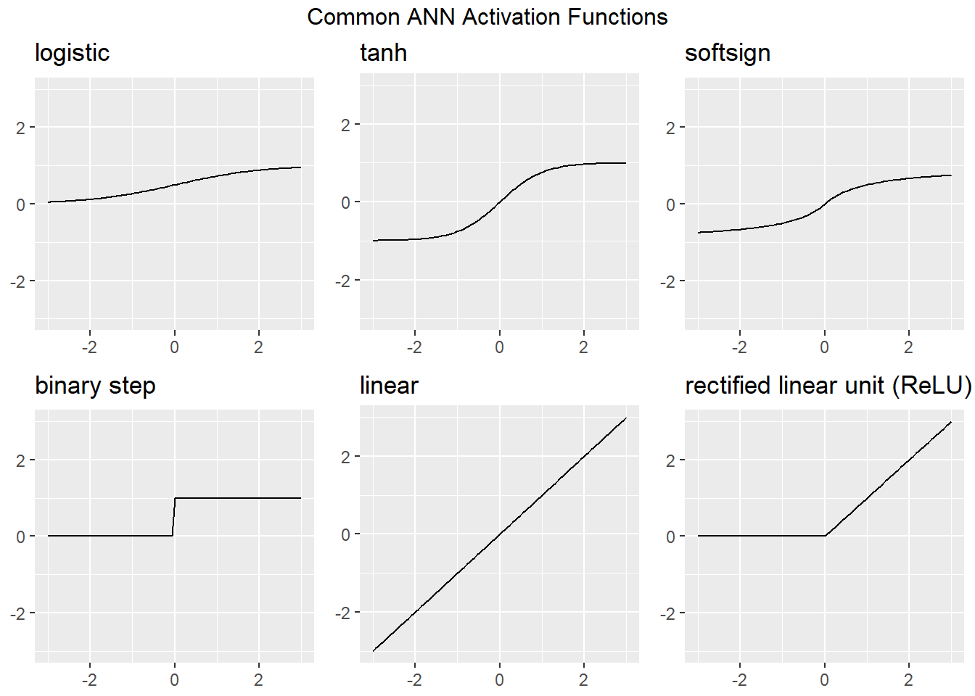
Activation Functions

Slide 6
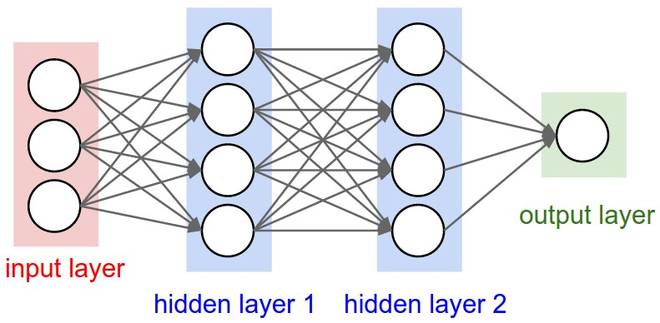
НЕЙРОННА МЕРЕЖА
Neural network - a set of interconnected perceptrons with input, output and hidden layers.
Outputs are not visible on the hidden layers

Slide 7
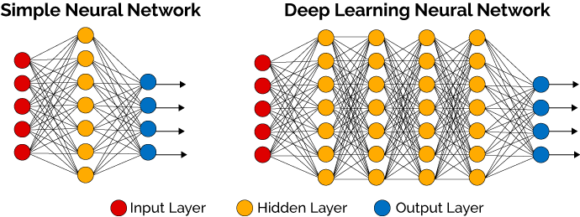
DEEP LEARNING

Slide 8
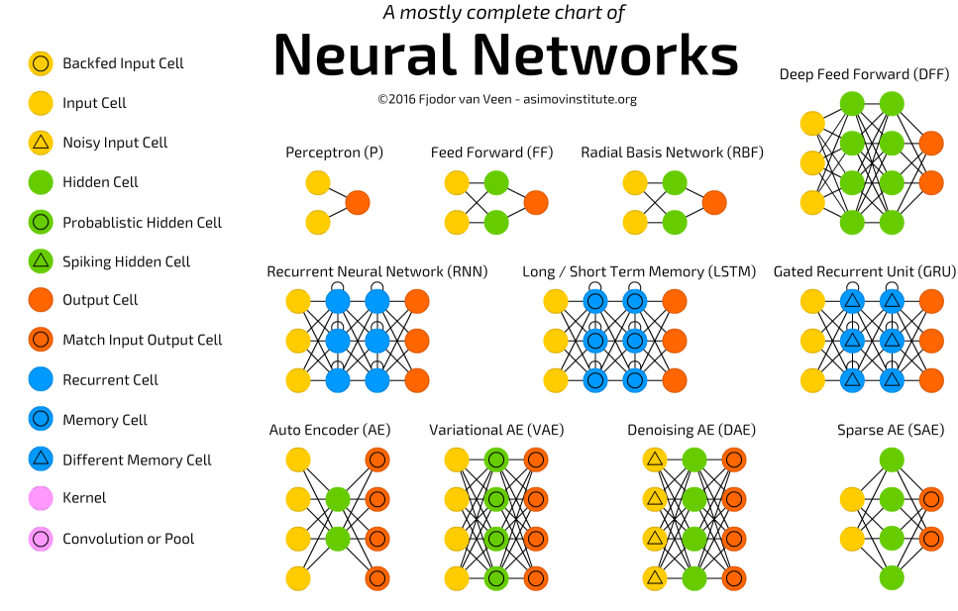
Types of Neural Networks

Slide 9
R packages
R Package | Description
nnet | Software for feed-forward neural networks with a single hidden layer, and for multinomial log-linear models.
neuralnet | Training of neural networks using backpropagation
h2o | R scripting functionality for H2O
RSNNS | Interface to the Stuttgart Neural Network Simulator (SNNS)
tensorflow | Interface to TensorFlow
deepnet | Deep learning toolkit in R
darch | Package for Deep Architectures and Restricted Boltzmann Machines
rnn | Package to implement Recurrent Neural Networks (RRNs)
FCNN4R | Interface to the FCNN library that allows user-extensible ANNs
rcppDL | Implementation of basic machine learning methods with many layers (deep learning), including dA (Denoising Autoencoder), SdA (Stacked Denoising Autoencoder), RBM (Restricted Boltzmann machine) and DBN (Deep Belief Nets)
deepr | Package to streamline the training, fine-tuning and predicting processes for deep learning based on darch and deepnet
MXNetR | Package that brings flexible and efficient GPU computing and state-of-art deep learning to R

