Slide 1

Feature Engineering
Course
Applied Mathematical Modeling in Banking

Slide 2
Contents
Feature Scaling
  Normalization
  Standardization
Feature Transformation
Feature Construction
  Binning
  Label Encoding
  One-hot Encoding

Slide 3
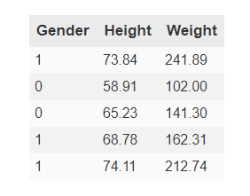
Feature Scaling
Notes:
Feature Scaling Is An Important Data Pre-Processing Step Before Going Ahead With Building A Machine Learning Model. In Most Cases, The Performance Of A Machine Learning Model Varies Significantly Depending Upon Whether The Data Has Been Scaled Or Not. The Objective Of Feature Scaling Is To Enclose All Features In A Common Boundary Without Losing Information.
So By Default, A Machine Learning Model Will Assume That The Height Feature Will Have More Significance Than Gender Based On Its Magnitude. In Such Cases, It Is Necessary To Bring All Features To The Same Level.

Slide 4
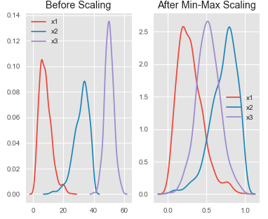
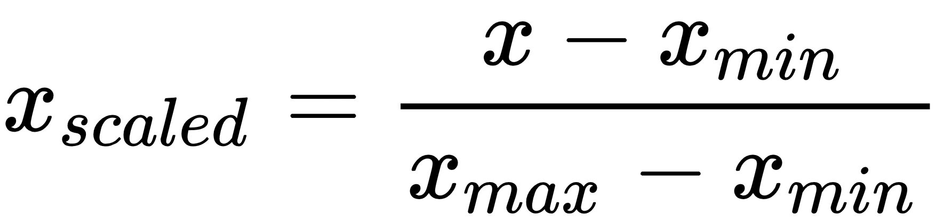
Feature Scaling - Normalization
Notes:
Normalization is a scaling technique in which values are shifted and rescaled so that they end up ranging between 0 and 1. It is also known as Min-Max scaling.

Slide 5
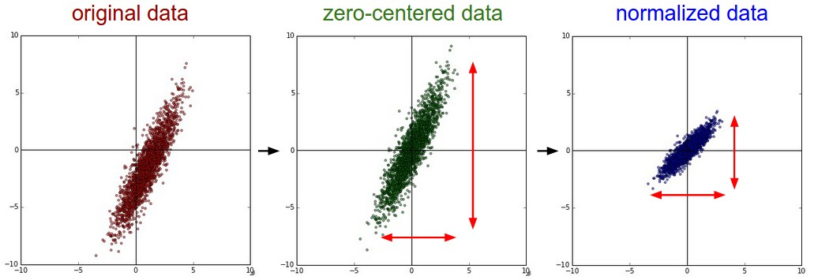
Feature Scaling - Standardization

Slide 6
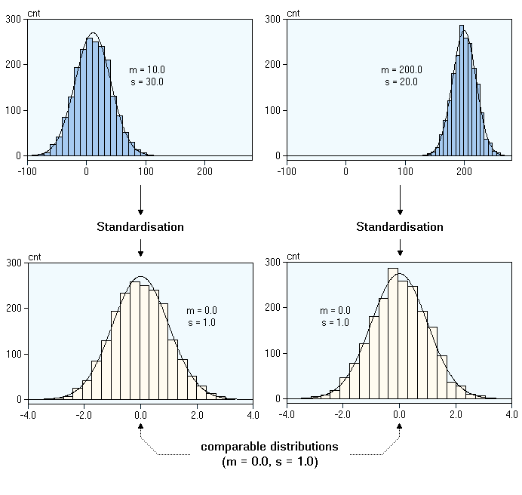

Feature Scaling - Standardization
Notes:
Standardization is another scaling technique where the values are centered around the mean with a unit standard deviation. This means that the mean of the attribute becomes zero and the resultant distribution has a unit standard deviation.

Slide 7
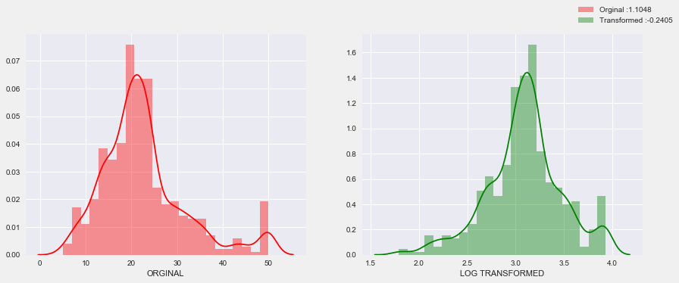
Feature Transformation
Notes:
various types of transformations of data to better fit for normal distribution (Gaussian Distribution).

Slide 8
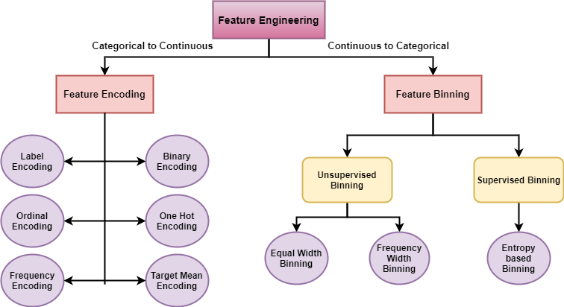
Feature Construction
Notes:
Binning is the term used in scoring modeling for what is also known in Machine Learning as Discretization, the process of transforming a continuous characteristic into a finite number of intervals (the bins), which allows for a better understanding of its distribution and its relationship with a binary variable.

Slide 9
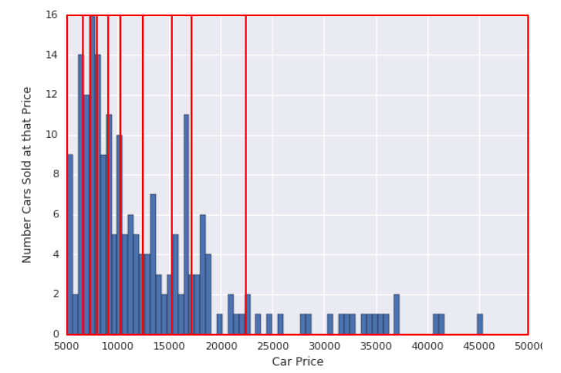
Feature Construction - Binning

Slide 10
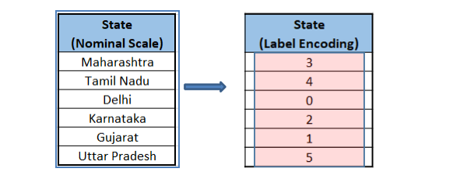
Feature Construction – Label Encoding
Notes:
Encoding is the process in which numerical variables or features are created from categorical variables. It is a widely used method in the industry and in every model building process. It is of two types: Label Encoding and One-hot Encoding.
Label Encoding involves assigning each label a unique integer or value based on alphabetical ordering. It is the most popular and widely used encoding.

Slide 11
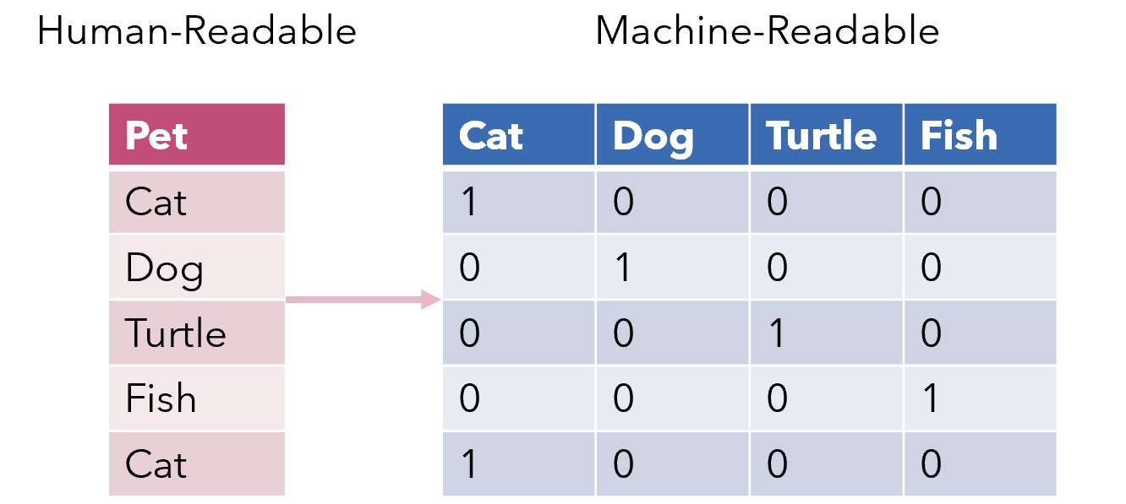
Feature Construction – One Hot Encoding
Notes:
One-hot Encoding involves creating additional features or variables on the basis of unique values in categorical variables i.e. every unique value in the
category will be added as a new feature.

