Slide 1

Machine Learning and AI in Risk Management
Course
Applied Mathematical Modeling in Banking

Slide 2
Typical tasks
Data science approach
Basic approaches
Supervised Learning
Unsupervised Learning
Prediction
Classification
Clusterization
Tasks
Multiple
Binary
Notes:
The main distinction between the two approaches is the use of labeled datasets.
While supervised learning models tend to be more accurate than unsupervised learning models, they require upfront human intervention to label the data appropriately.
Unsupervised learning models, in contrast, work on their own to discover the inherent structure of unlabeled data

Slide 3
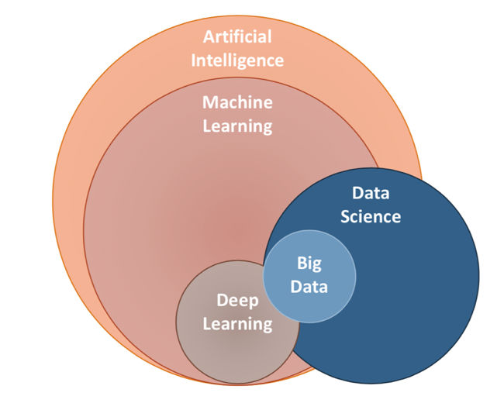
AI – ML - DS
Notes:
AI is different from Machine Learning, because it is working to create an intelligent system which can perform various complex tasks, whereas ML is working to create machines that can perform only those specific tasks for which they are trained.
Data science is about using data to provide value (money, growth, reputation, etc.) to an organization.
Machine learning is about using data to make optimized predictions.

Slide 4
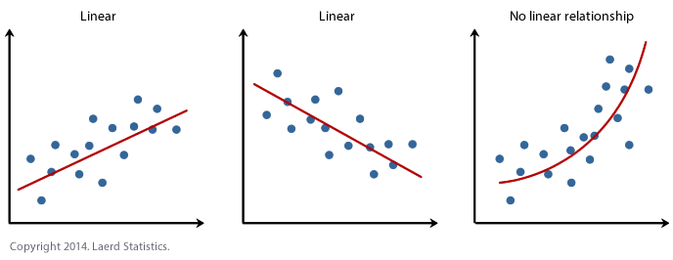
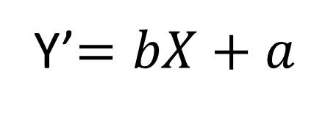
Linear Regression
Y’$=bX+a$

Slide 5
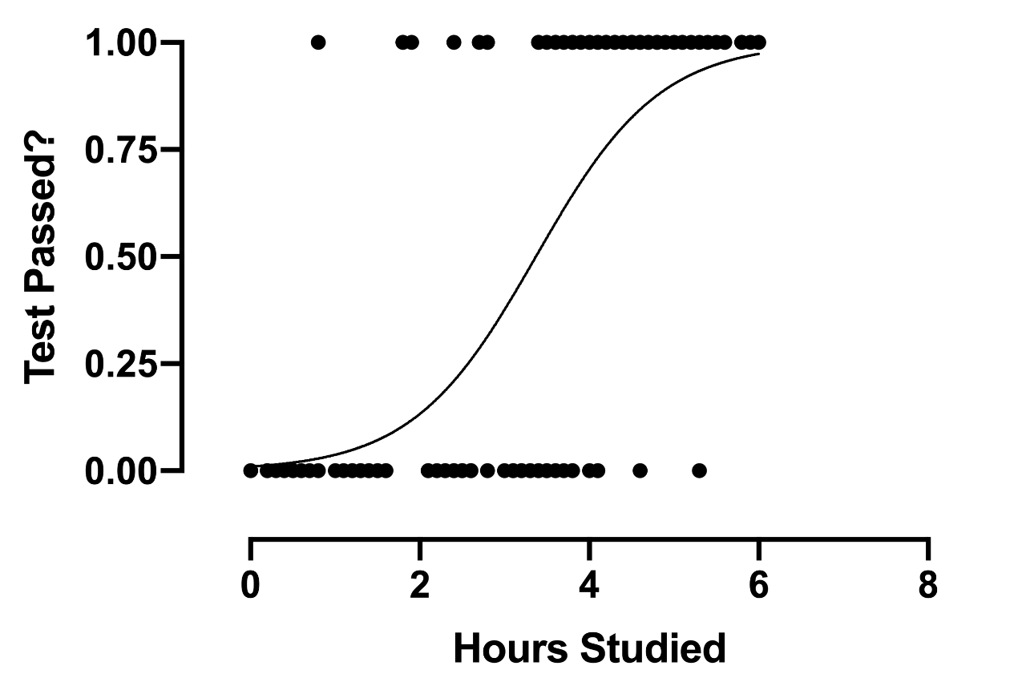
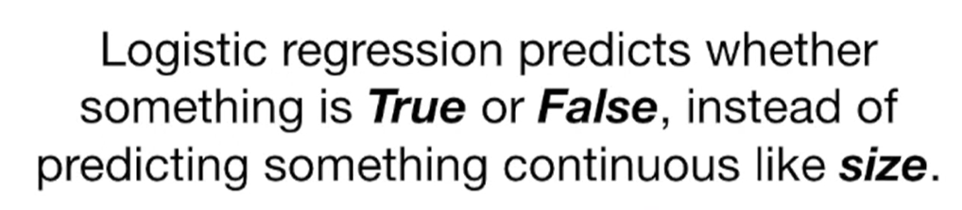
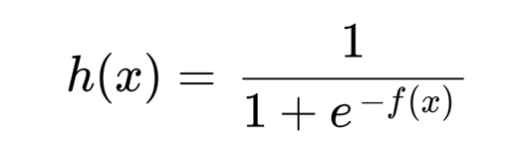
Logistic Regression

Slide 6
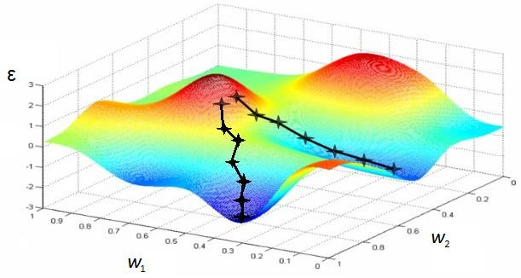
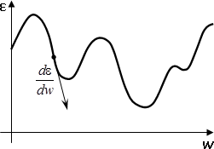
Parameter optimization
Notes:
Gradient descent is an algorithm that numerically estimates where a function outputs its lowest values.

Slide 7
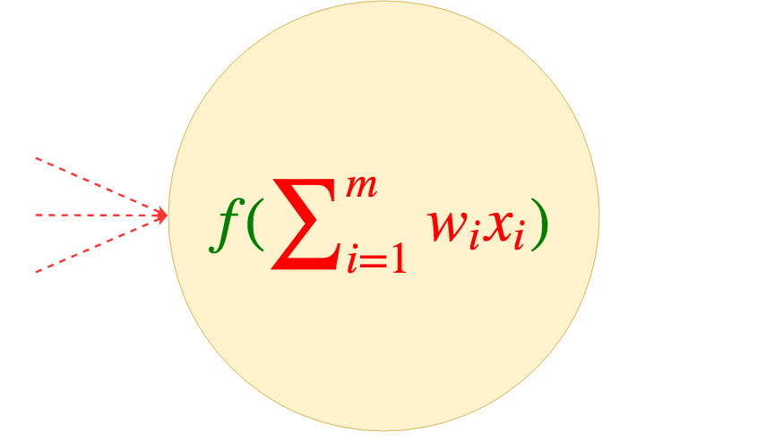
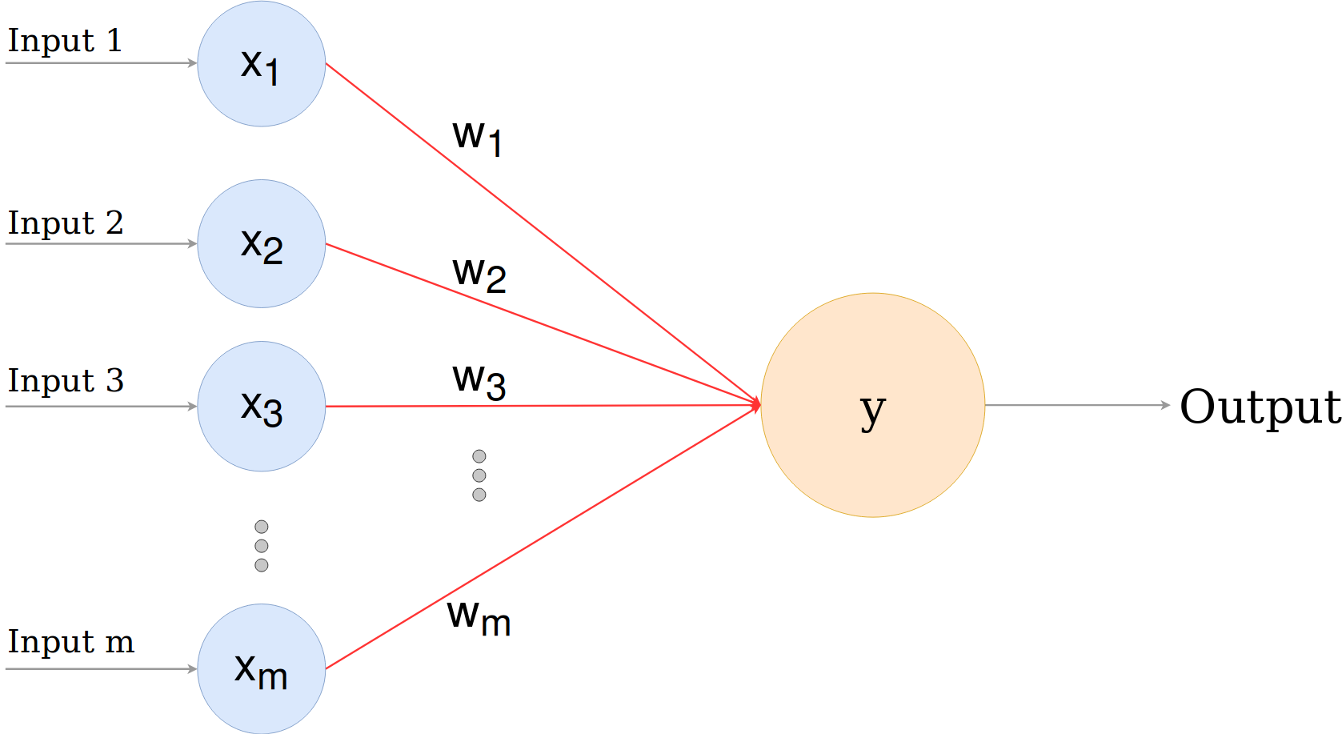
Neural Network Perceptron
A perceptron is a single layer neural network
Notes:
Input nodes are connected to the output with synapses. Each synapse has a weight.
the scores are calculated and the prediction is made in the output unit based on the inputs and weights.
to make a prediction from this calculated score, we have to use an activation function (sygmoid)

Slide 8
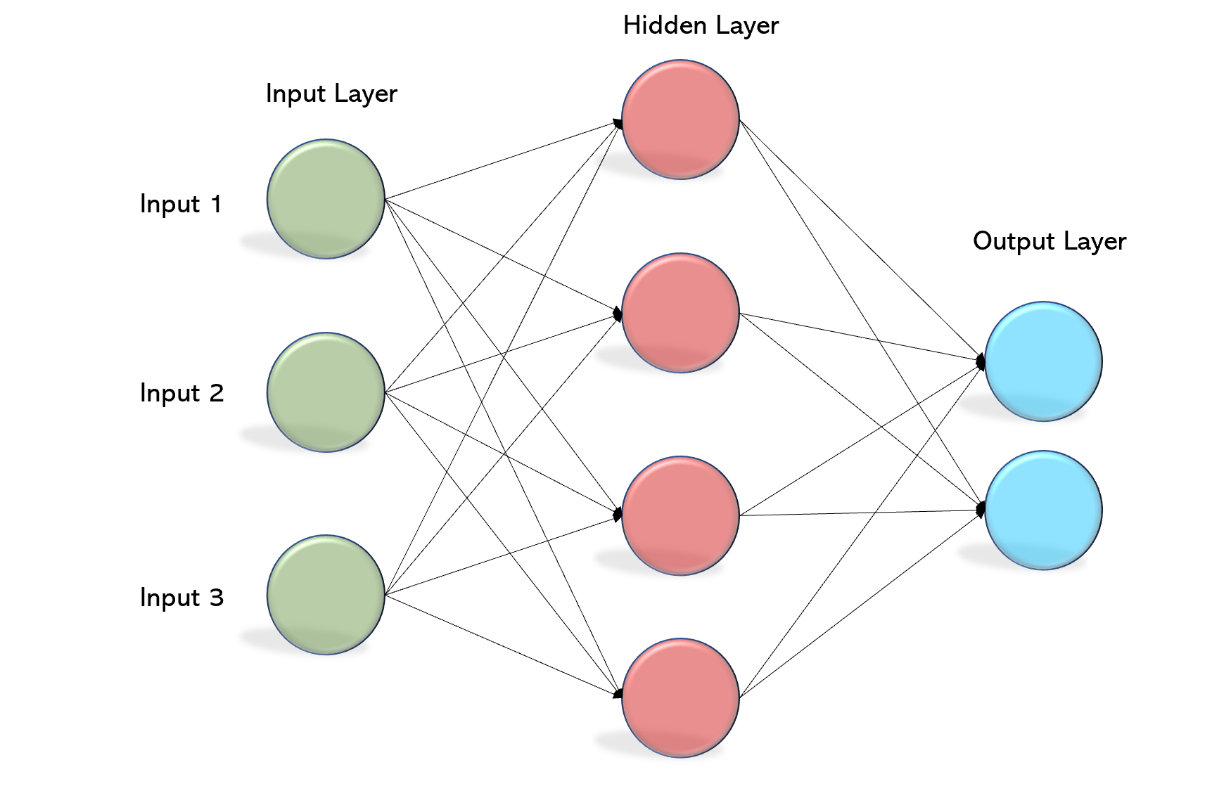
Multi layer Perceptron (MLP)
Notes:
MLP consists of at least three layers of nodes: an input layer, a hidden layer and an output layer.
each node is a neuron that uses a nonlinear activation function

Slide 9
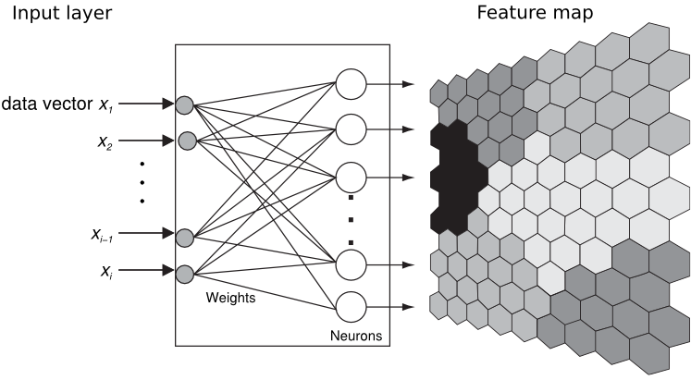
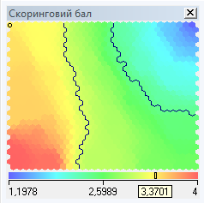



Self-Organizing Maps
x_{i}

Slide 10
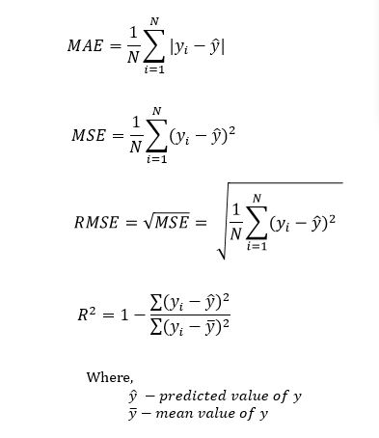
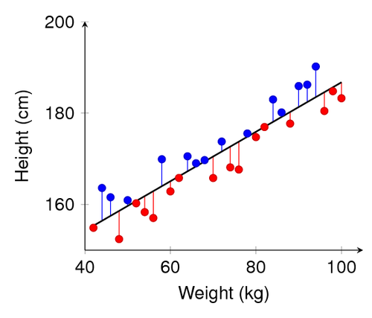
Regression Model Accuracy
Notes:
Evaluating the model accuracy is an essential part of the process in creating machine learning models to describe how well the model is performing in its predictions.
The errors represent how much the model is making mistakes in its prediction. The basic concept of accuracy evaluation is to compare the original target with the predicted one according to certain metrics.
R-squared (Coefficient of determination) represents the coefficient of how well the values fit compared to the original values. The value from 0 to 1 interpreted as percentages. The higher the value is, the better the model is.
Mean Squared Error,
Mean Absolute Error

Slide 11
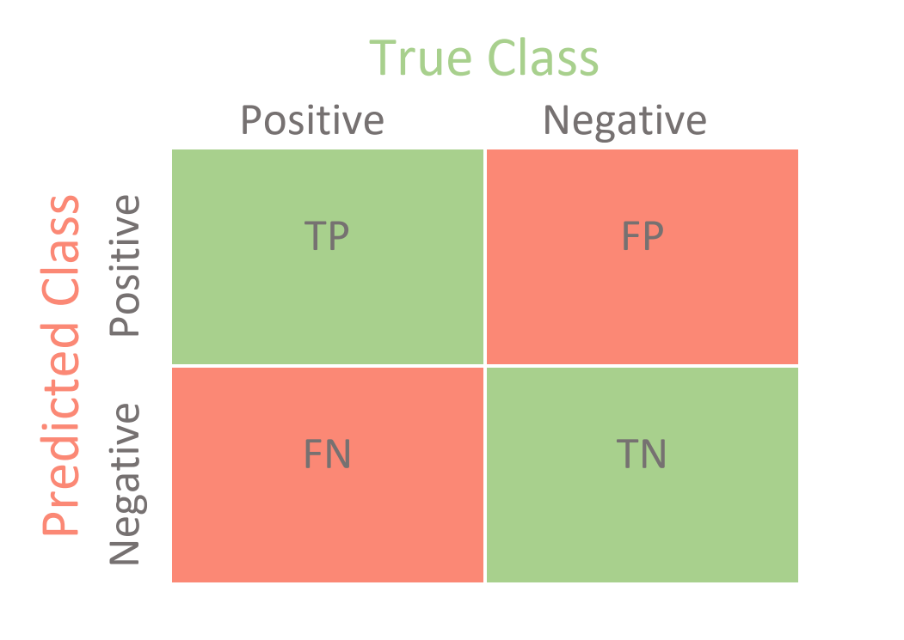
Classification Model Accuracy
Confusion Matrix for Binary Classification
TP - correctly predicts the positive class as positive
TN - correctly predicts the negative class as negative
FP - incorrectly predicts the negative class as positive
FN - incorrectly predicts the positive class as negative
Notes:
Here are some of the most common performance measures you can use from the confusion matrix.
Accuracy: overall accuracy of the model,
Misclassification Rate: It tells you what fraction of predictions were incorrect
Precision: It tells you what fraction of predictions as a positive class were actually positive
Recall: It tells you what fraction of all positive samples were correctly predicted as positive by the classifier
F1-score: It combines precision and recall into a single measure.

Slide 12
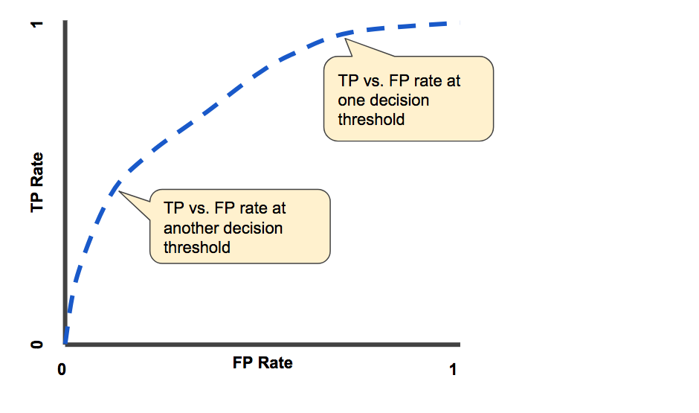
ROC curve
Notes:
An ROC curve (receiver operating characteristic curve) is a graph showing the performance of a classification model at all classification thresholds.
Our goal with the ROC is for our blue line in the graph below to be as close as possible to upper-left portion of the figure.
On the other hand, the closer it is to the linear line, the worst our model performance.

Slide 13
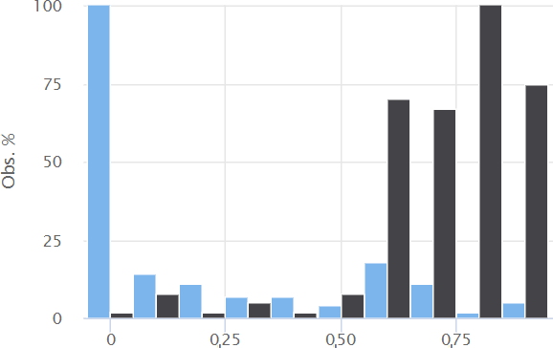
Percentile distribution

Slide 14
Classification efficiency
OVERDRAFT
COMPLIANCE
Probability range | Bad clients |  |  |  | Good clients
0-10% |  |  | 7% |  | 63%
10-20% |  | 4% |  |  |  | 4%
20-30% | 2% |  |  |  |  | 4%
30-40% |  |  | 7% |  |  |  | 7%
40-50% | 0% |  |  |  |  | 2%
50-60% | 0% |  |  |  | 0%
60-70% |  |  | 7% |  |  | 2%
70-80% |  |  | 7% |  | 0%
80-90% |  |  |  | 11% |  |  | 7%
90-100% | 57% |  |  |  |  |  | 9%
Probability range | Denied |  |  |  |  |  | Approved
0-10% |  | 3% |  |  |  |  | 33%
10-20% |  |  |  | 11% |  |  |  |  |  |  |  |  | 17%
20-30% |  | 3% |  |  |  |  | 0%
30-40% |  |  | 6% |  |  |  |  |  |  |  | 11%
40-50% |  |  | 6% |  |  |  |  |  |  | 8%
50-60% |  |  |  | 11% |  |  |  |  |  |  |  | 14%
60-70% | 17% |  |  |  |  |  |  | 3%
70-80% |  |  |  | 11% |  |  |  |  |  | 8%
80-90% |  |  |  |  | 14% |  |  |  | 6%
90-100% | 19% |  |  |  |  |  | 0%
№
№
1
2
3
4
5
6
7
8
9
10
1
2
3
4
5
6
7
8
9
10

