Slide 1
Karolina Lęcznar
Automation Engineer with Python

Slide 2
About me
Diversely skilled Engineer with hands-on experience in API integration, application development, database technologies, and AI-powered solutions. Passionate about building practical software tools, automating repetitive tasks, continuously expanding programming skills to build scalable solutions.

Slide 3
Portfolio samples

Slide 4
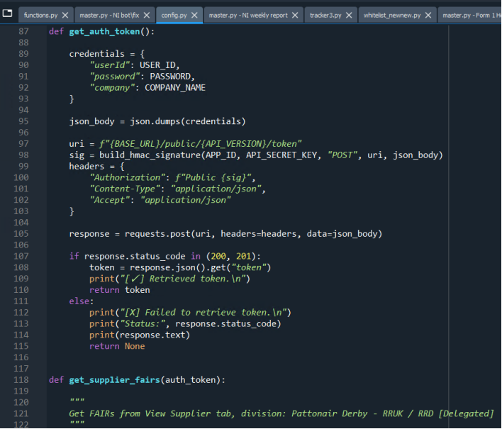
SHELL FAIR API bot
(API integration with Python)
Connect to the Net-Inspect API server and create Shell FAIRs for Delegated suppliers for customer Rolls-Royce automatically
GET: find FAIRs that don’t have a Shell FAIR yet and extract data
POST: create a Shell FAIR (Incora Form 1) + fill out required data
PUT: amend data if needed

Slide 5
Automated bot for Shell FAIR creation powered with Net Inspect API, originally implemented using web scraping techniques (originally done manually by the Quality department), now refactored to leverage NI API for improved reliability and performance.
The project initially relied on HTML parsing and browser automation to extract data and perform actions. This approach was later replaced with direct API integration, significantly enhancing speed, stability, and maintainability while reducing susceptibility to UI changes and anti-scraping mechanisms.
Key features include real-time data retrieval, automated Shell FAIR creation based on configurable criteria, and efficient request handling with rate limiting and error management. The bot supports scalable architecture, allowing easy extension for additional endpoints or automation workflows.

Slide 6
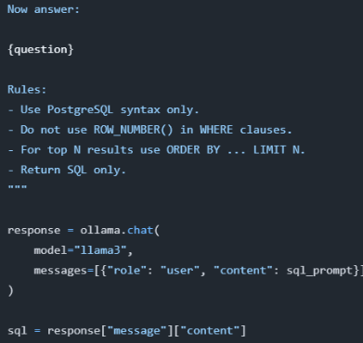
AI-driven workflow automation
(AI + Python)
Developed an AI-driven workflow automation solution leveraging a locally hosted Llama 3 model via Ollama. Integrated Excel data processing with PostgreSQL and SQLAlchemy to enable natural-language querying, automated data analysis, AI-generated responses with dynamic chart generation using Matplotlib.

Slide 7
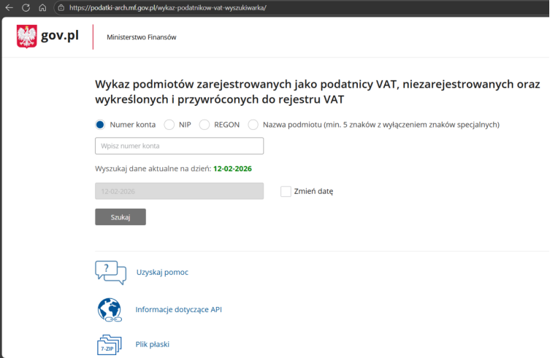
WHITELIST PROJECT
(web scraping)
Developed an app, which verifies whether companies, for which payments are to be released, are active taxpayers on Wykaz podatników VAT - wyszukiwarka - podatki.gov.pl, and subsequently saving confirmation reports in designated folders, previously handled manually by AP clerks. The tool has potential for further development and replication in other Incora's divisions - time/cost saving up to ~120h annually.

Slide 8
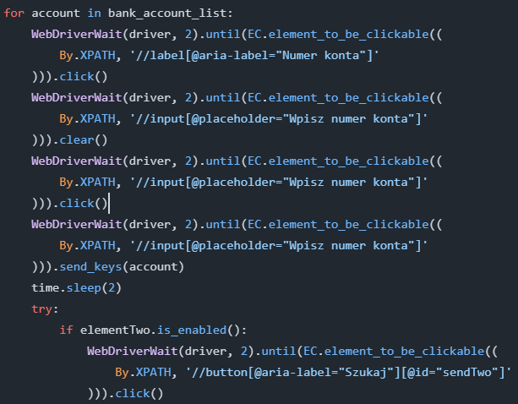
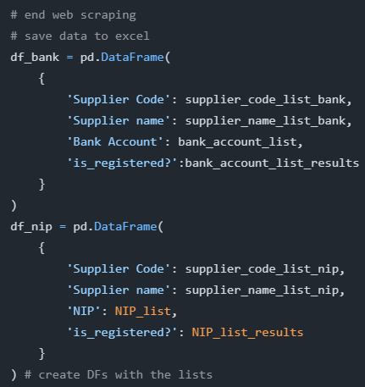

Slide 9
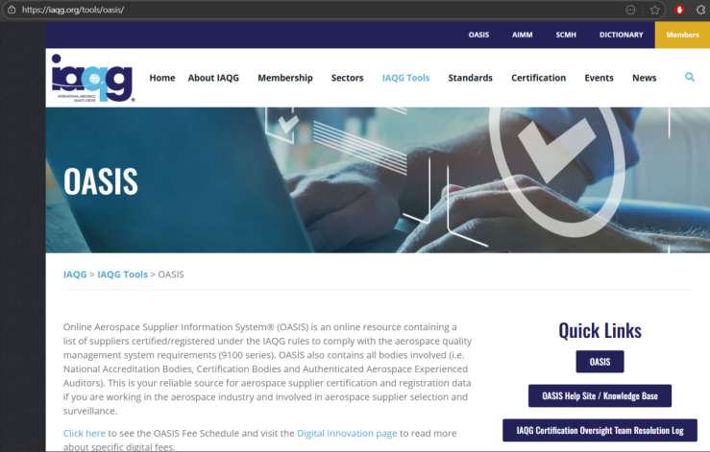
WATCHLIST PROJECT (web scraping)
Developed an app, which verifies suppliers' AS/ISO certificates on OASIS website, downloads certificates into designated directory, creates reports, done once a month, previously handled manually by the Quality department - time/cost saving up to ~540h annually

Slide 10
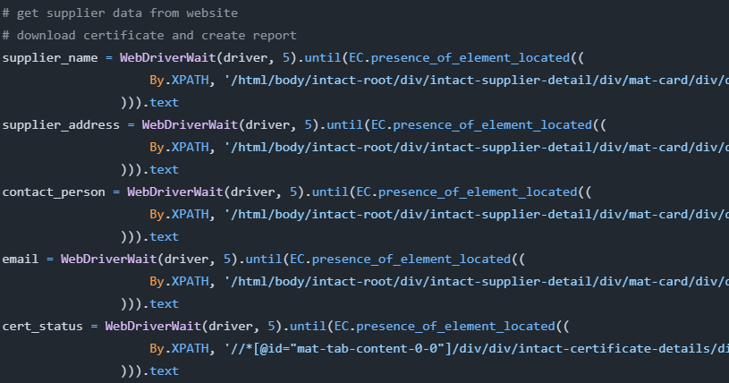
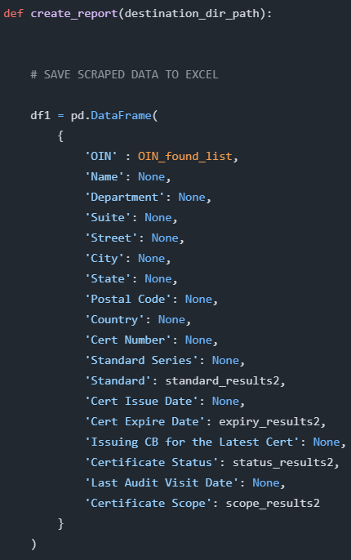
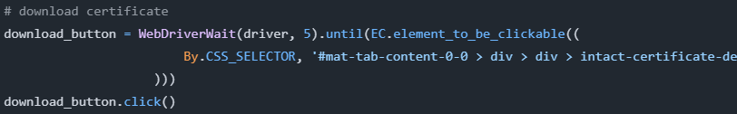

Slide 11
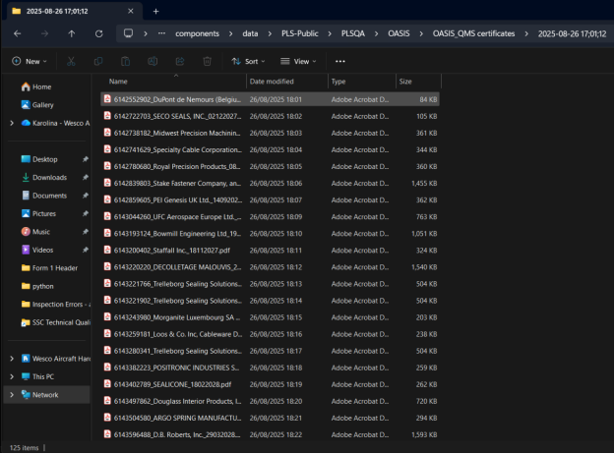
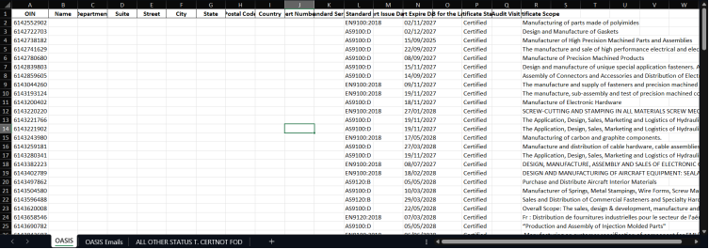

Slide 12
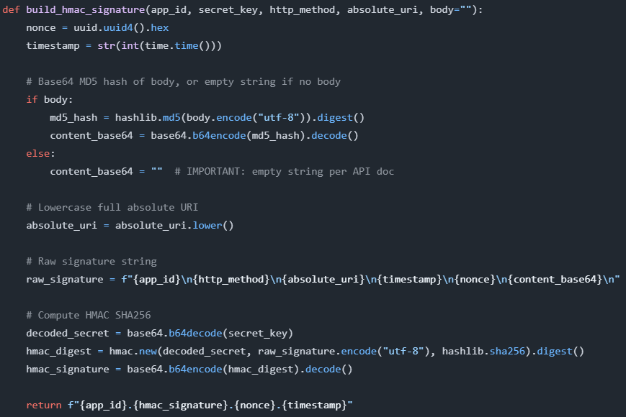
WEEKLY REMINDER TO SUPPLIERS
(Python + API + Power Automate)
Built a python script to look up all disapproved FAIRs on Net-Inspect and chase suppliers who have not taken any action in over 7 days through a Power Automate flow.

Slide 13
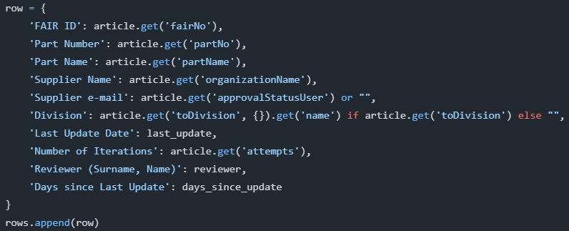
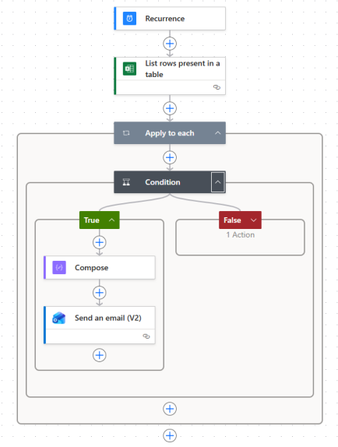
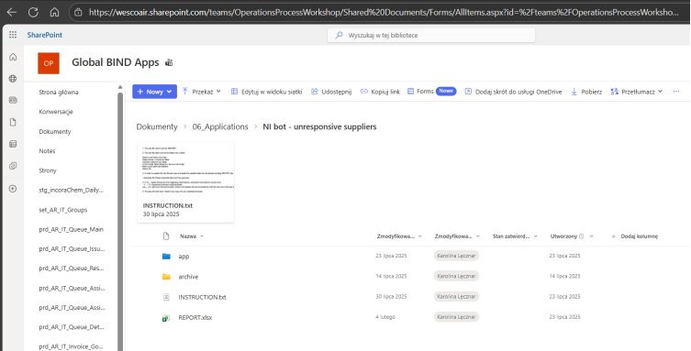

Slide 14
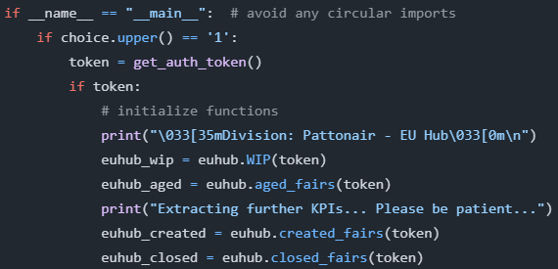
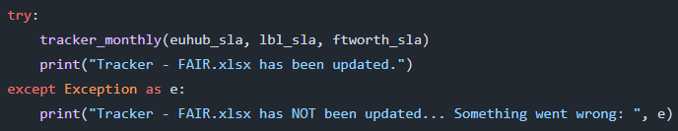
Net Inspect KPIs
(Python + API)
Developed an app, which connects to the Net Inspect API, calculates weekly and monthly KPIs for various locations and pastes data to Tracker in Sharepoint for the Quality department in SSC, Poland.

Slide 15
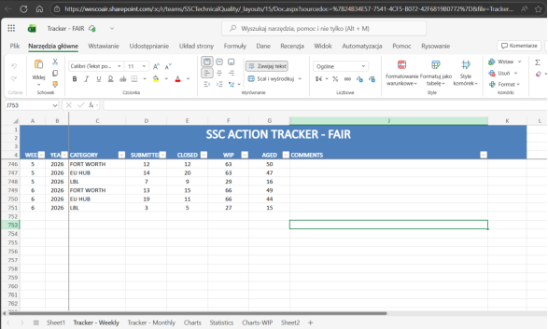

Slide 16
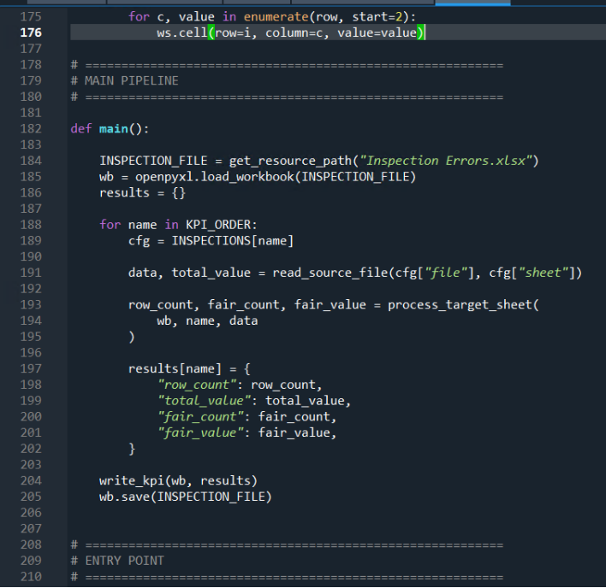
INSPECTION ERRORS KPIs
(Python + API + Power Automate)
Developed an app, which moves xlsx files from Outlook via Power Automate flow to Sharepoint folder, analyses them in python, calculates KPIs and pastes data to Tracker in Sharepoint for the Quality department in SSC, Poland.

Slide 17
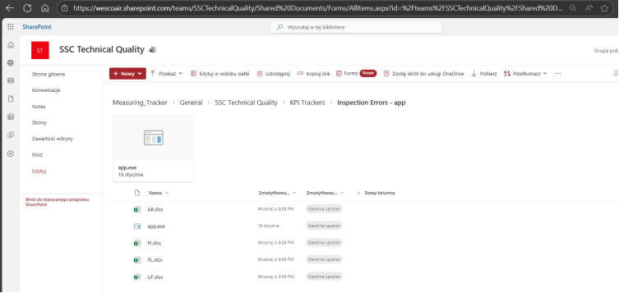
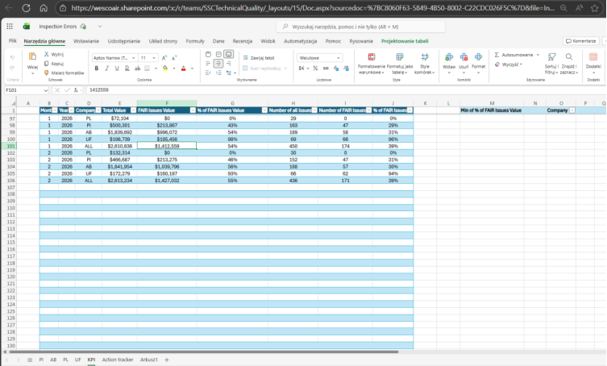

Slide 18
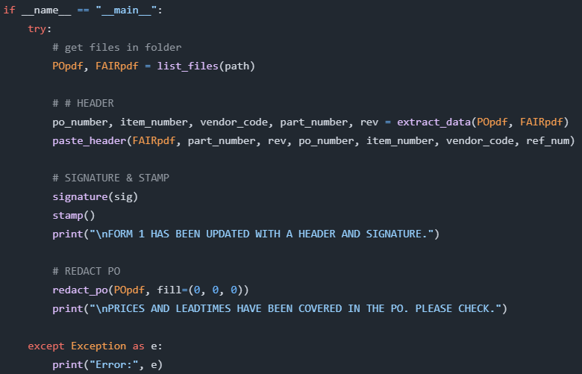
FORM 1 HEADER & PRICE REDACTION TOOL
(Python: pypdf, fitz, ocr)
Built a python exe tool which adds a header to Form 1 with Incora’s information, adds inspector’s stamp and redacts any sensitive data (price, leadtime, etc.) in Purchase Order for the Quality dept in SSC, Poland.

Slide 19
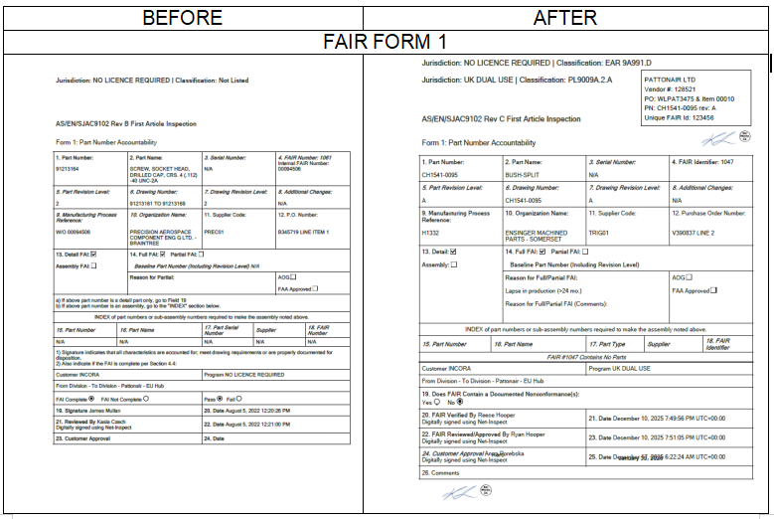

Slide 20
