Slide 1
An analysis of weather type associated with coronavirus rate by latitude
GEOG 832
Kun-Yuan Lee

Slide 2
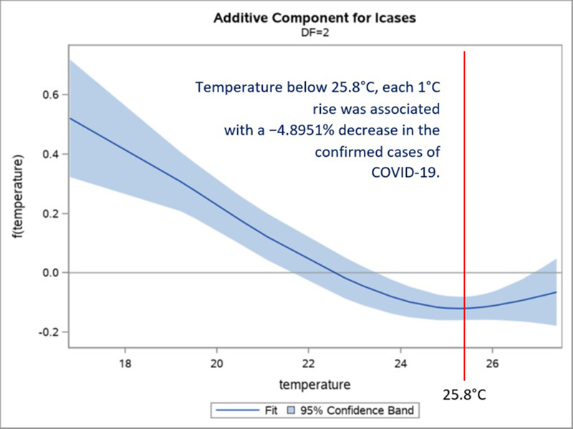
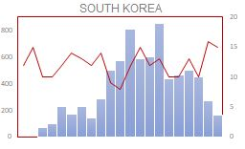
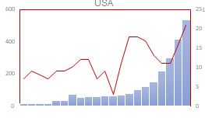

Background/motivation
COVID-19 impacts our life/become part of our social routine
Even with vaccine on going, only 70% society recovery compared to pre-pandemic period
Virus can last several hours to a day in aerosol and on the surface
Study showed the temperature can be a factor in transmitting the virus
Question …
Is the COVID-19 rate are more influence by the weather type or the temperature ? (broader objective)
Are there any latitudinal variation?
Prata et al. 2020
Courtesy Windy.com

Slide 3
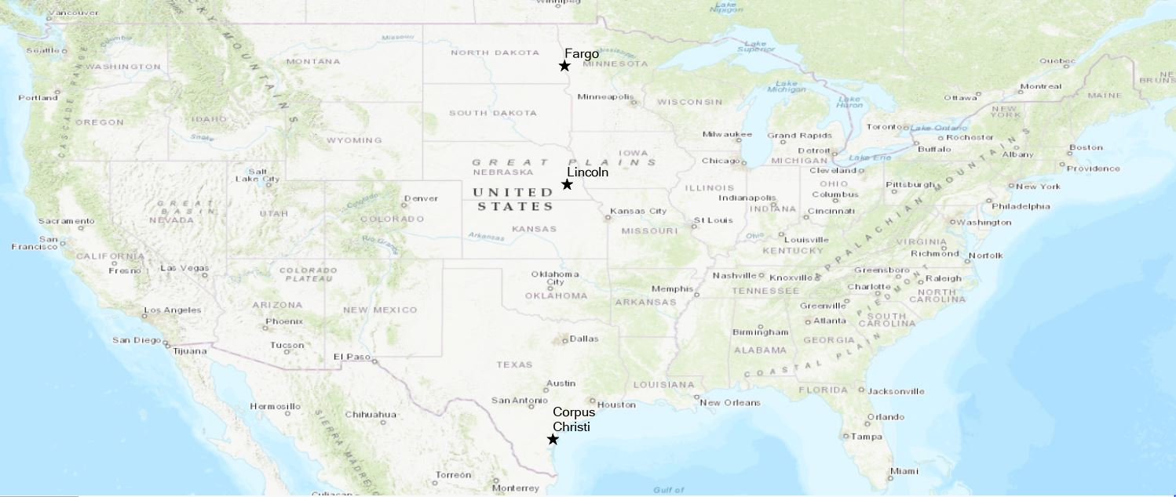
Study area

Slide 4
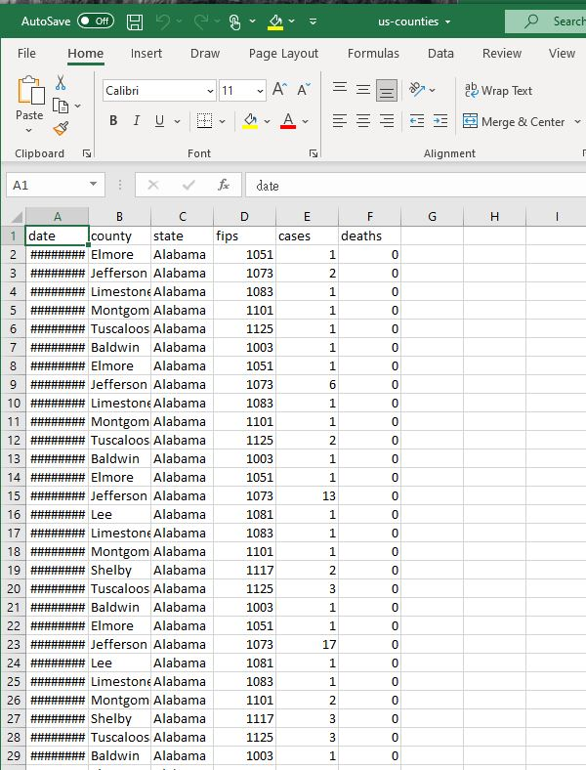
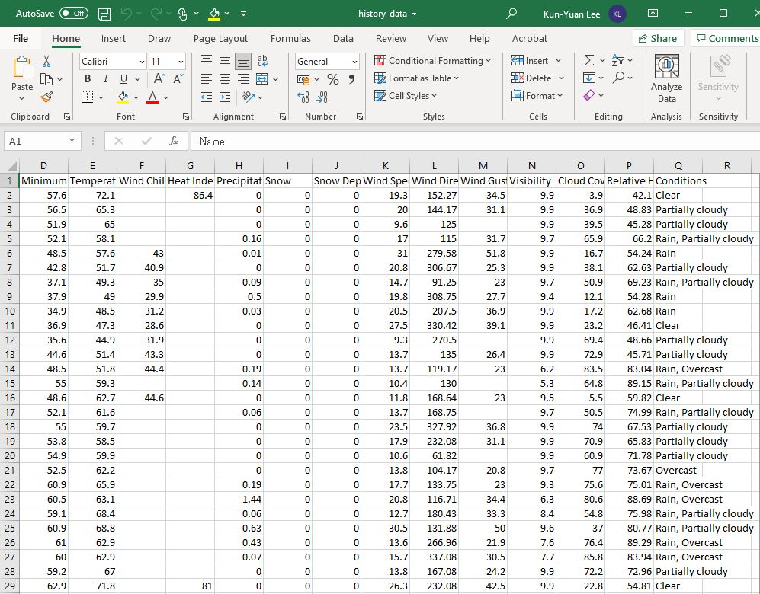
Dataset / Research area
COVID-19 data
New York Time
Date, County, State, Fips, Case, Death
Weather & Temperature data
Name, Date/ Time, Maximum T, Minimum T, Temperature, Cloud cover, Relative Humidity, Condition

Slide 5
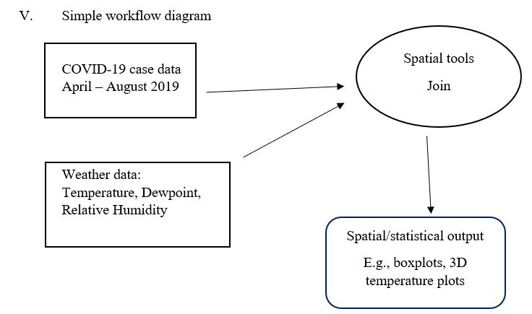

Slide 6


Challenges
Other factors (political, company policy..
mask mandate)
Temporal lag?
Can not eliminate uncontrolled influences ( Traveler… seasonal flu.. Local event… etc.)
Ongoing:
Sorting the data – Join the temperature, weather and COVID-case data

