Slide 1

An Analysis of latitudinal COVID-19 cases associated with weather condition
GEOG432-832.001 12.18
Kun-Yuan Lee

Slide 2


Objective
COVID-19 impacts our life/become part of our social routine
Variants Alpha, Delta, Omicron…
Study showed the temperature can be a factor in transmitting the virus
Question would like to know:
How does the temperature affect the COVID-19 cases?
Does it vary between latitudinally ?
Does it vary monthly
Does it influence by temperature or the weather condtiton?

Slide 3
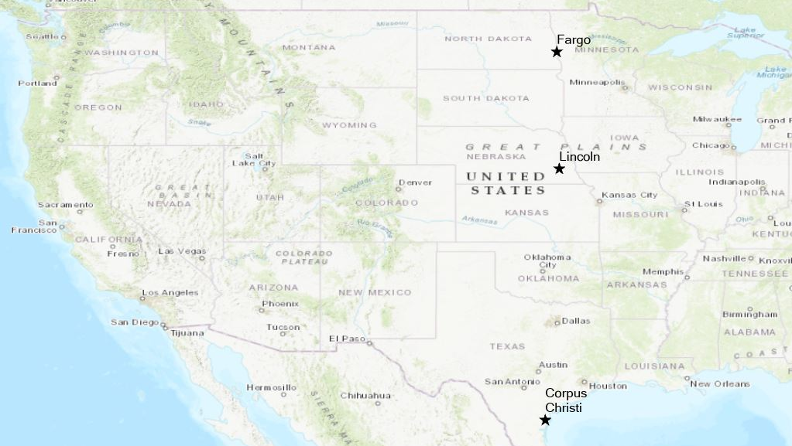
Background/Assumption
How does COVID-19 Spread?
COVID-19 spreads when an infected person breathes out droplets and very small particles that contain the virus.
In door or People who are closer than 6 feet from the infected person are most likely to get infected.
This project.. [ Candidate cities: Fargo, ND, Lincoln, NE, and Corpus Christi, TX]
Date Periods : May 01, 2021 – October 31, 2021
Account for similar COVID-19 city measurements (Mask-Mandated, In door restrain)
Account for similar populations and within the similar longitude
Does not account the for the traveler
Does not account the incubation Period (3-10 days)

Slide 4
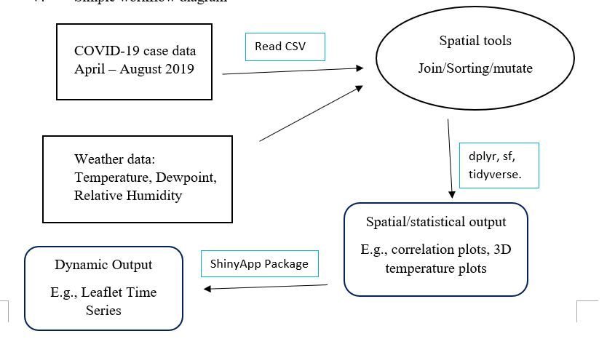
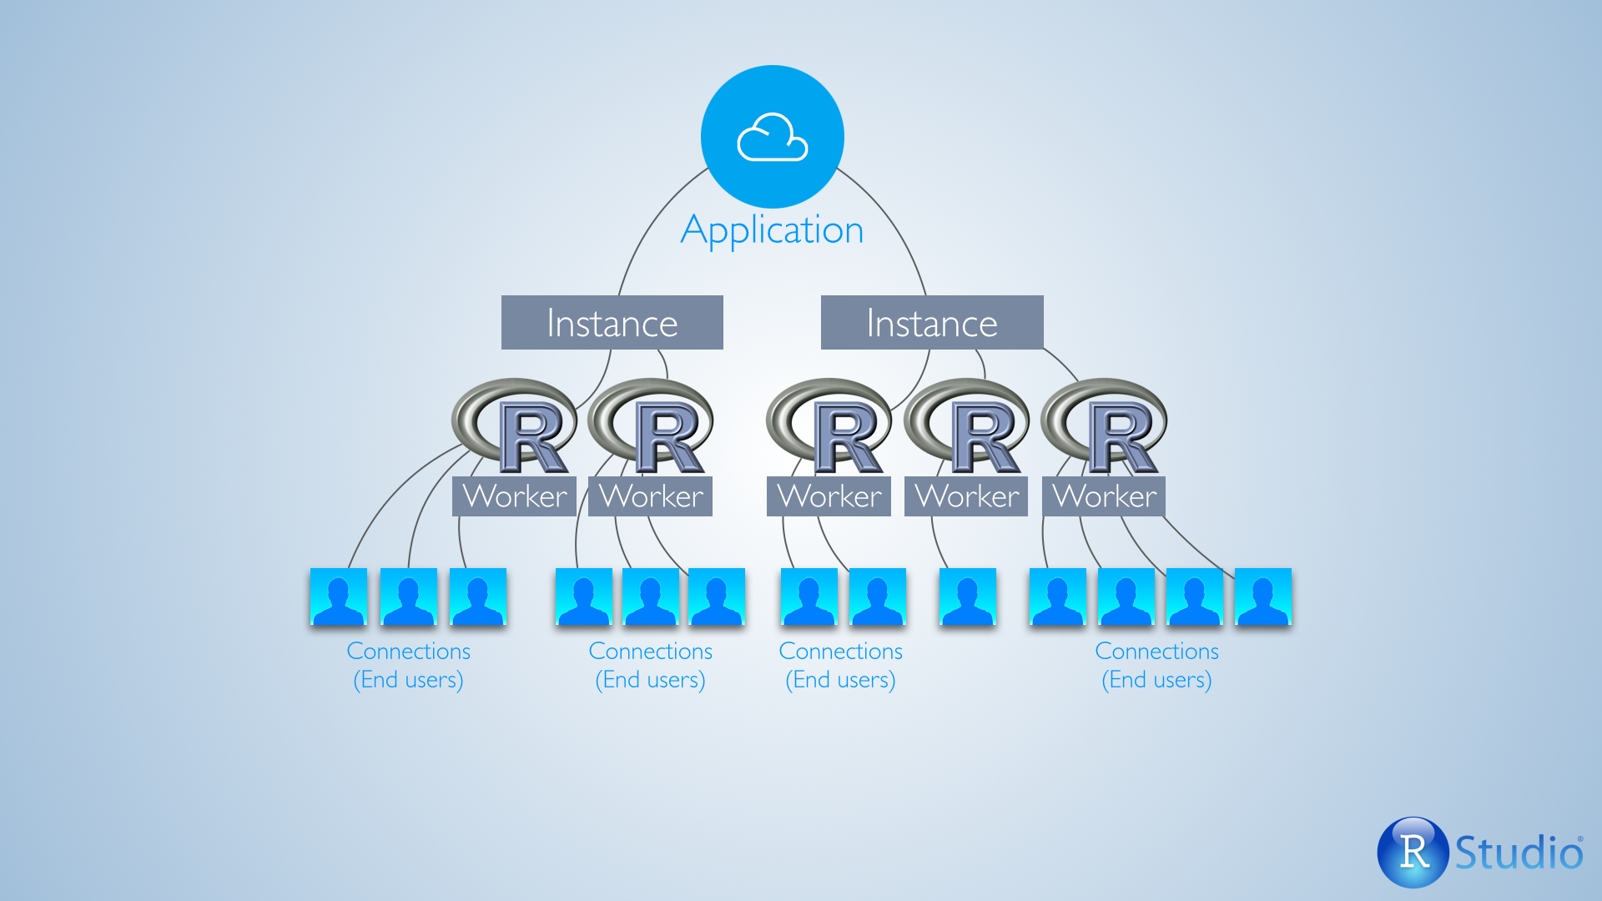
Method/Workflow/Packages
Functions: readcsv, dplyr, sf, tidyverse
Packages: Leaflet, ShinyApp
Advantage: store everything on the server and control access for the designated user

Slide 5


Obstacle/Limitation/Challenge
Time-series data formation
5/20/2021 vs. 05/20/2021 vs. 05-20-2021
Color scale in reverse-order
Temperature color
Time slide representation (not allow for non-character display)
Does not have case subregion for detail investigation
Does not allow multiple interactive time slide options -> TBE

Slide 6
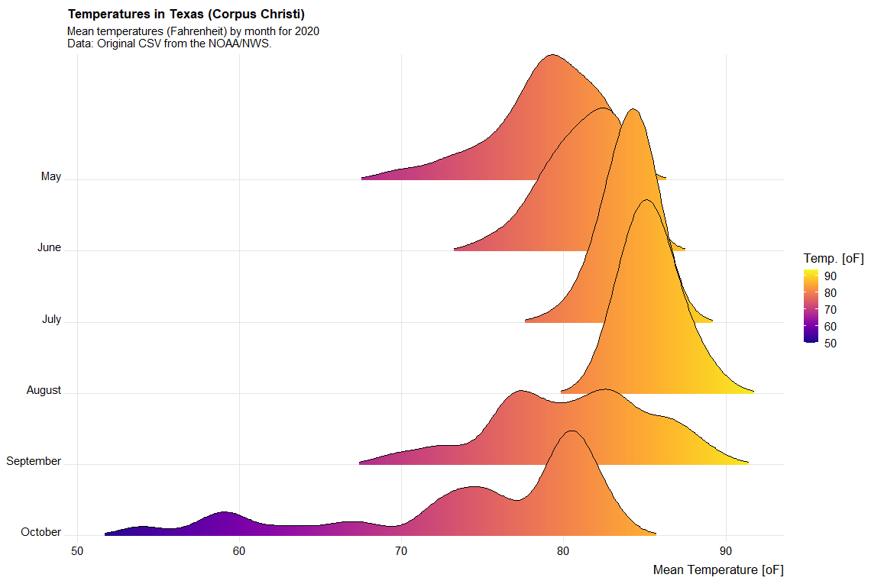
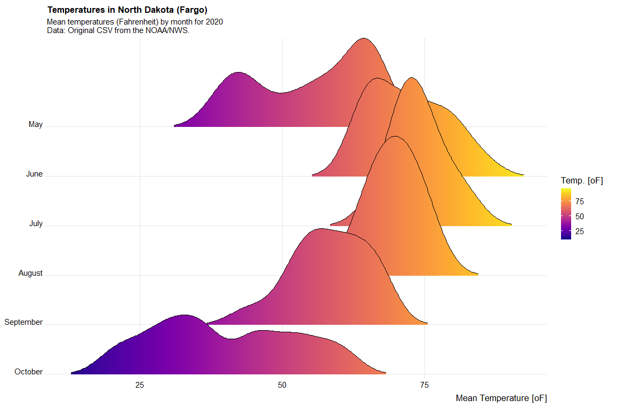
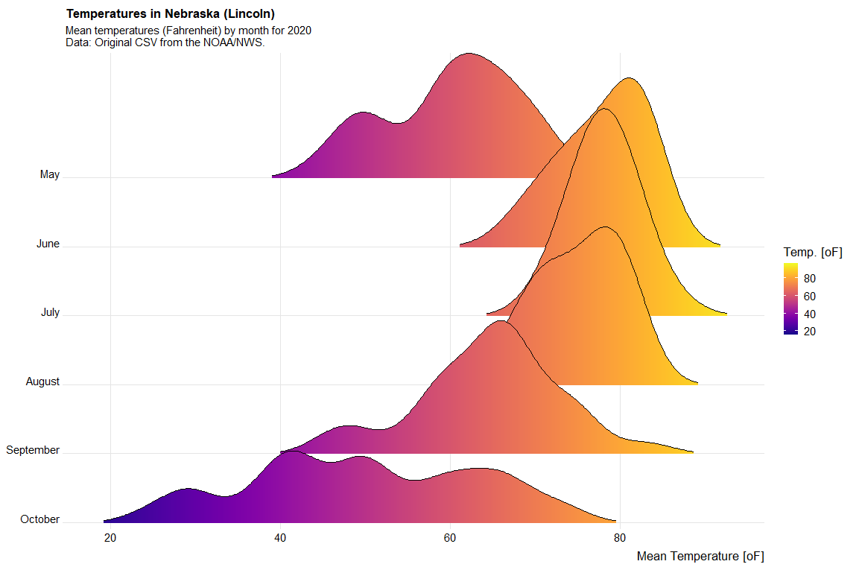
Temperature glance

Slide 7
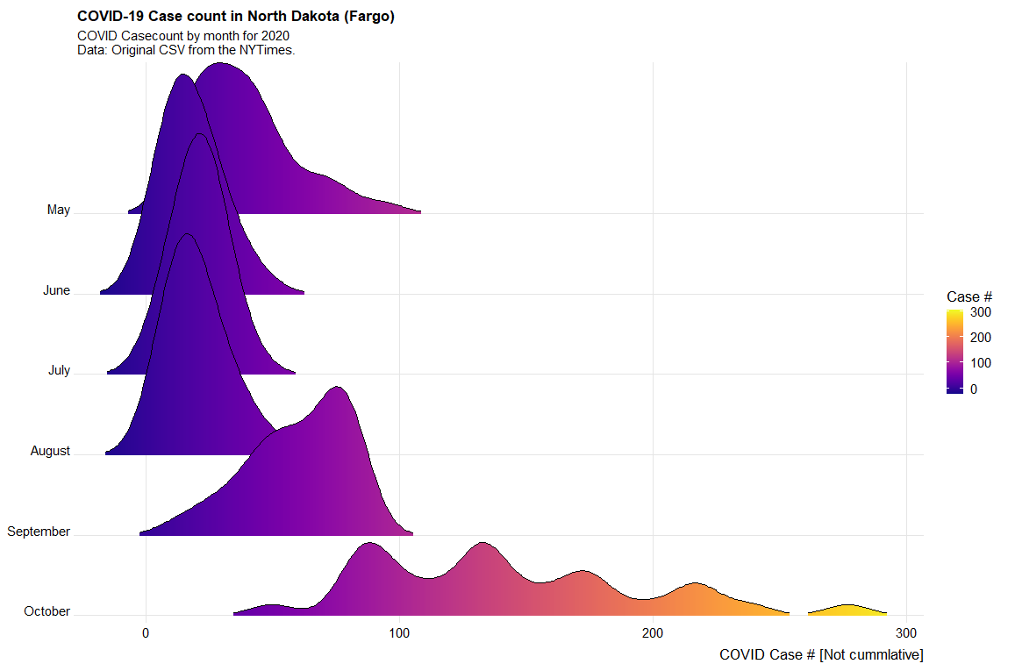
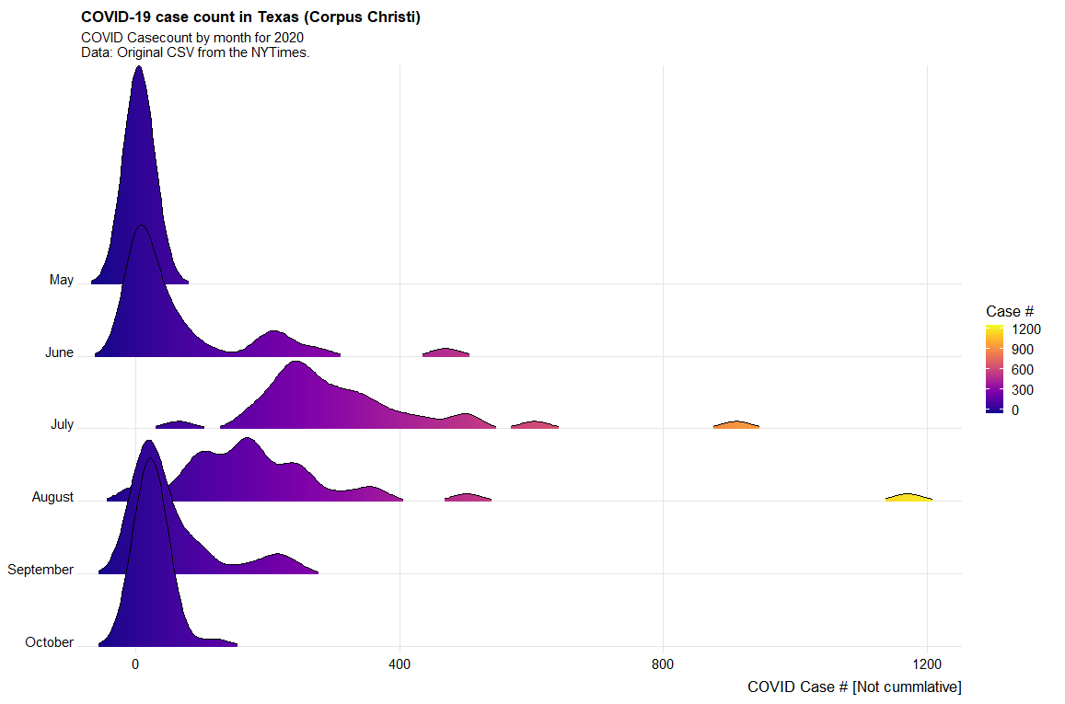
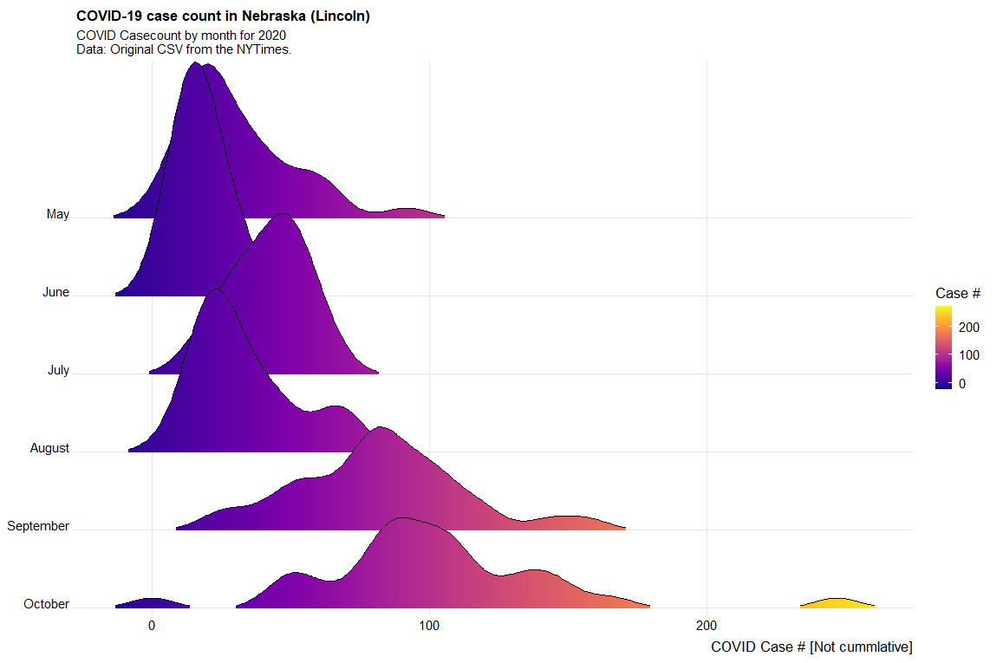

Slide 8
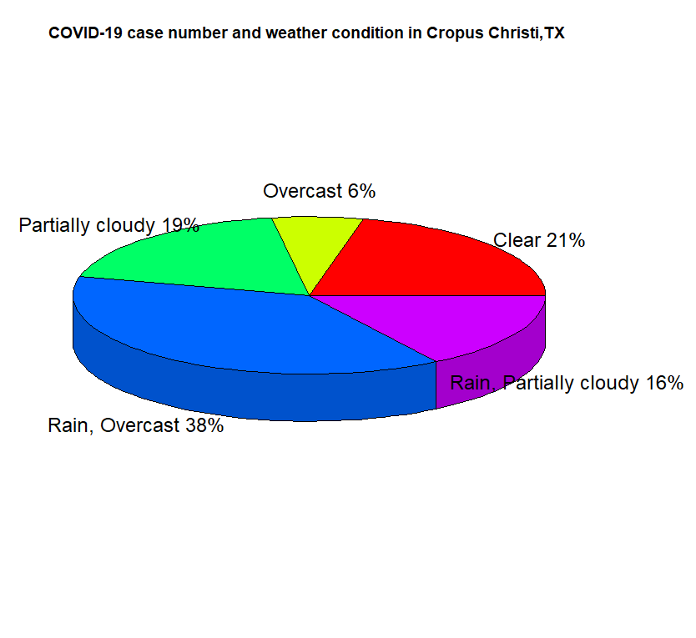
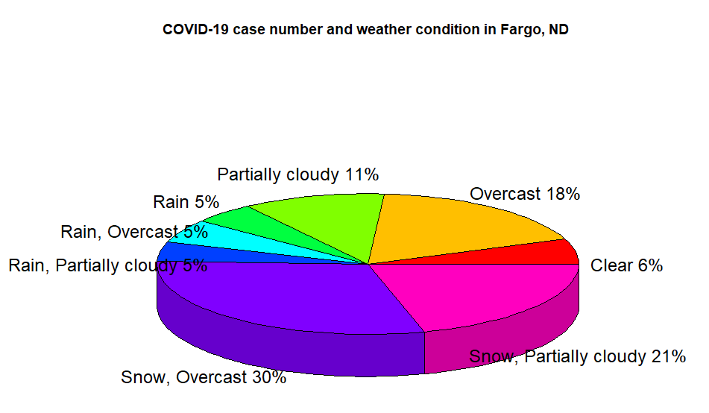
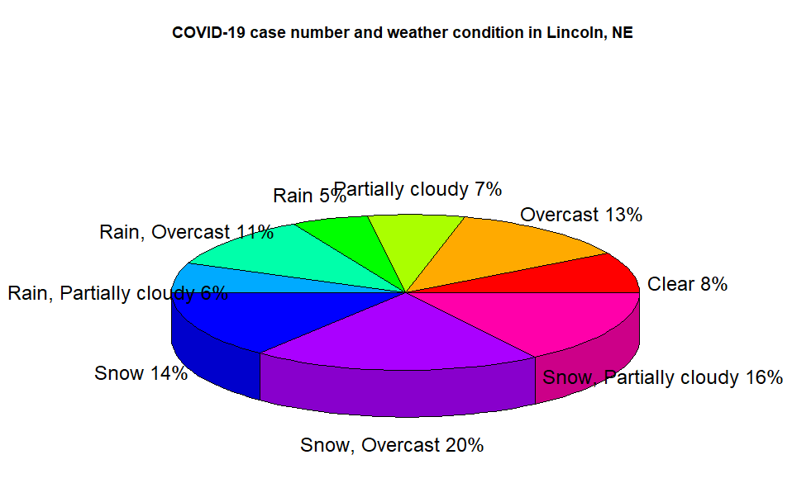
Result ( Weather condition)

Slide 9
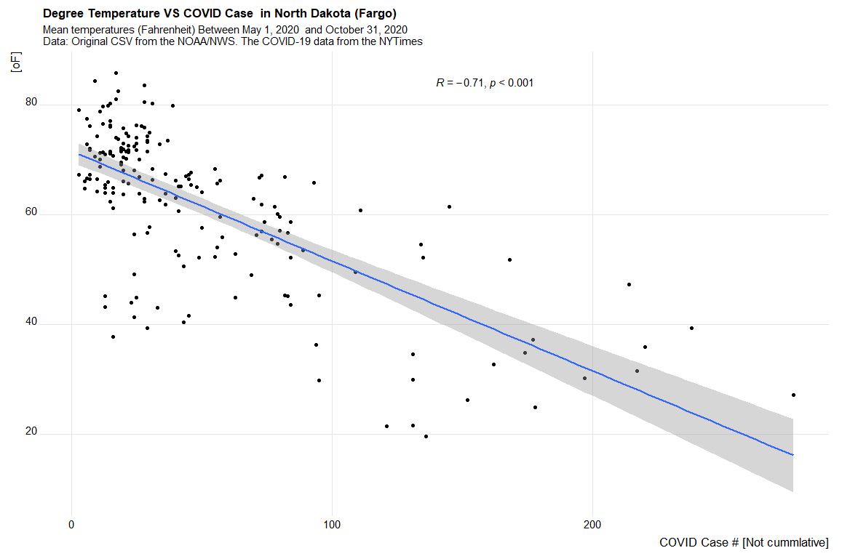
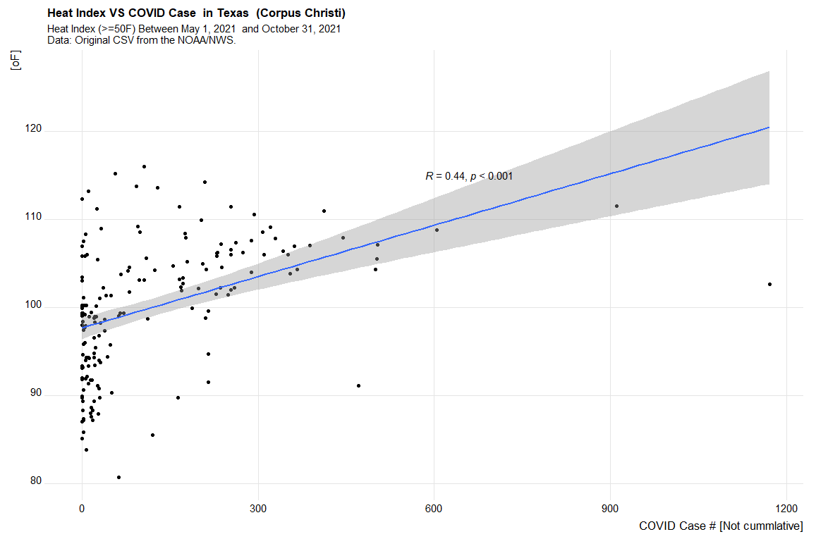
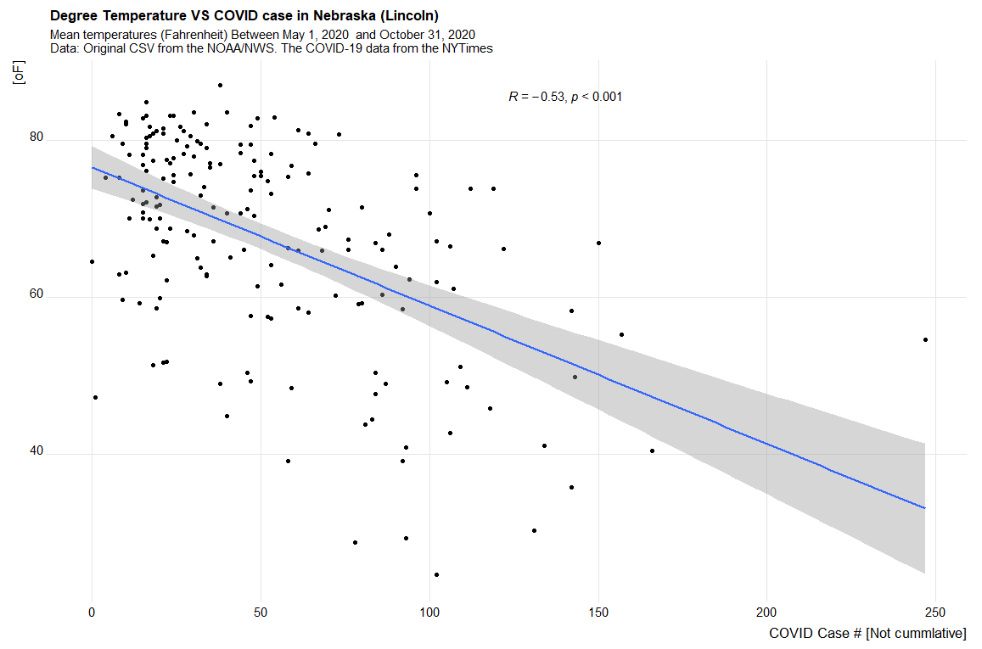
Result (Temperature VS COVID-19 case

Slide 10
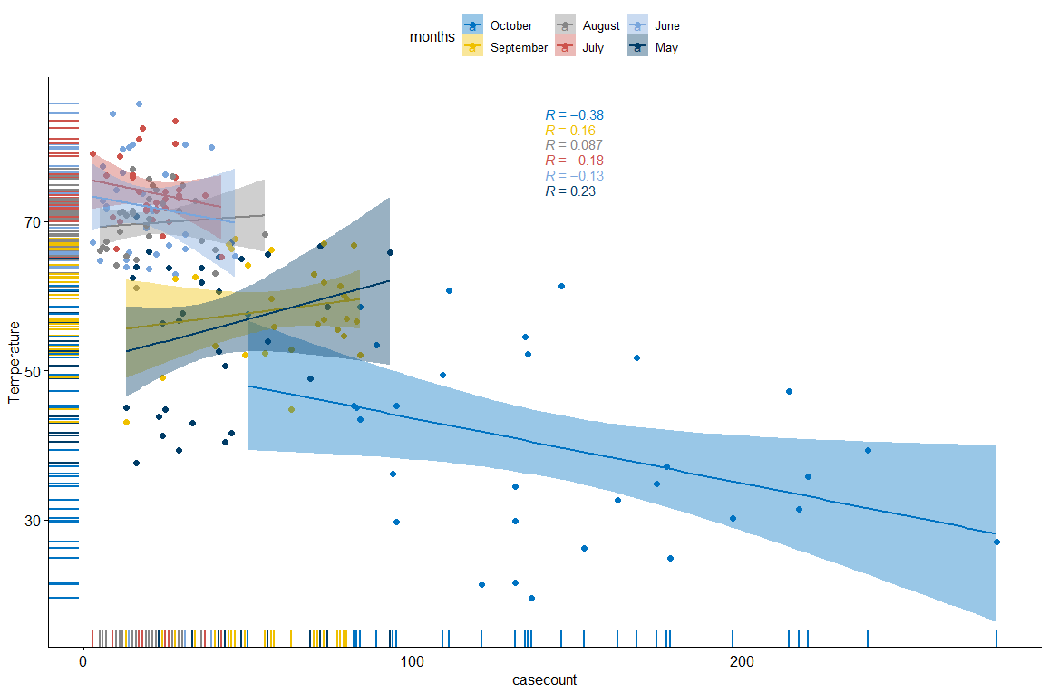
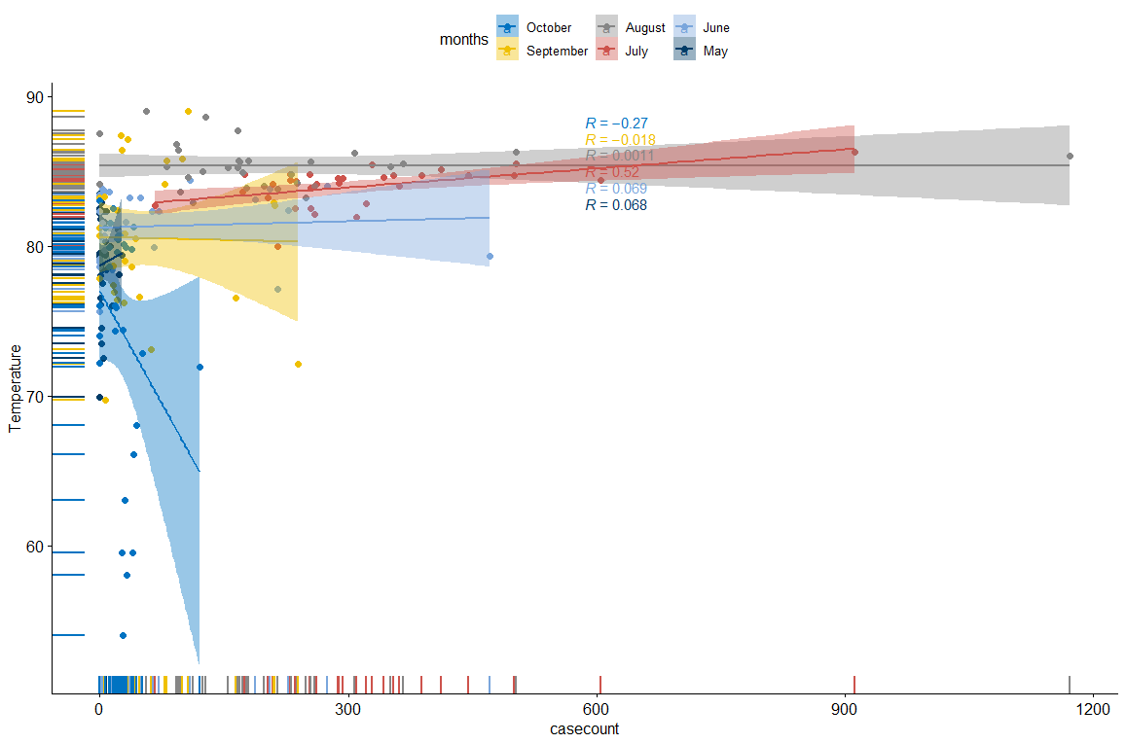
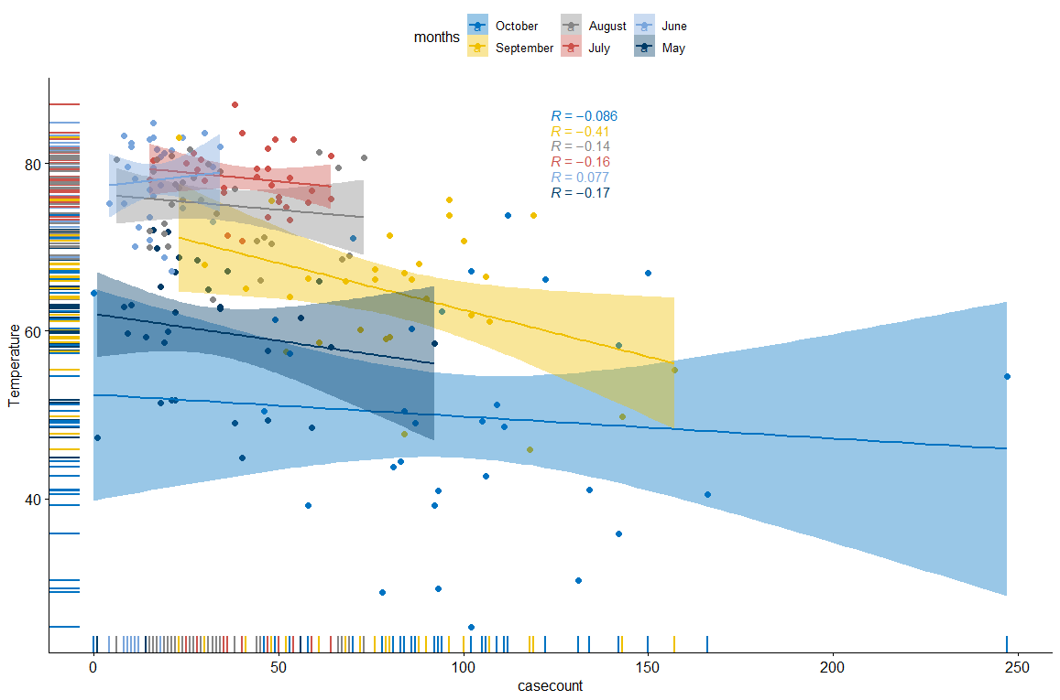
Result – Differentiate by month

Slide 11
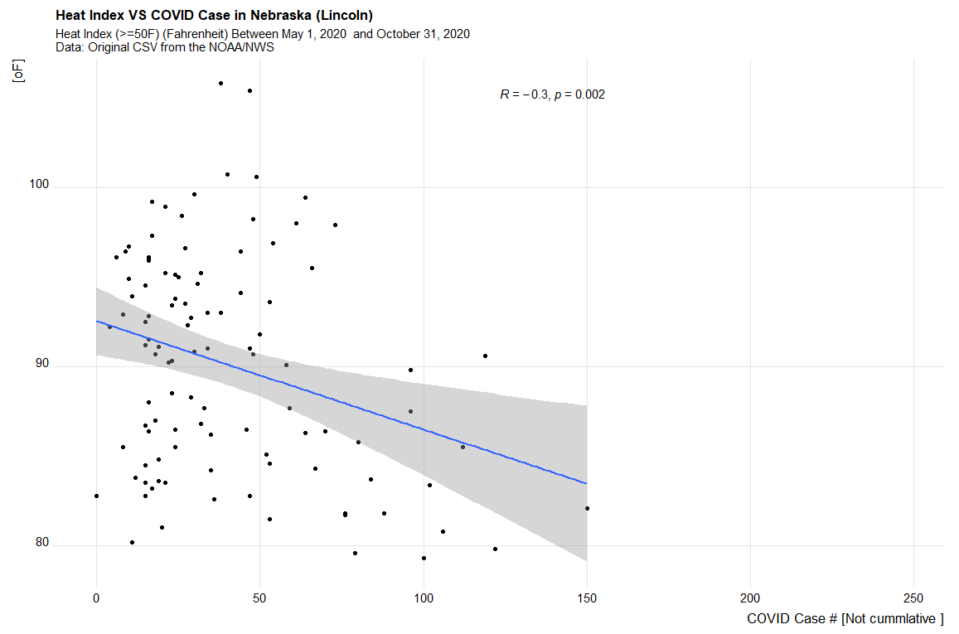
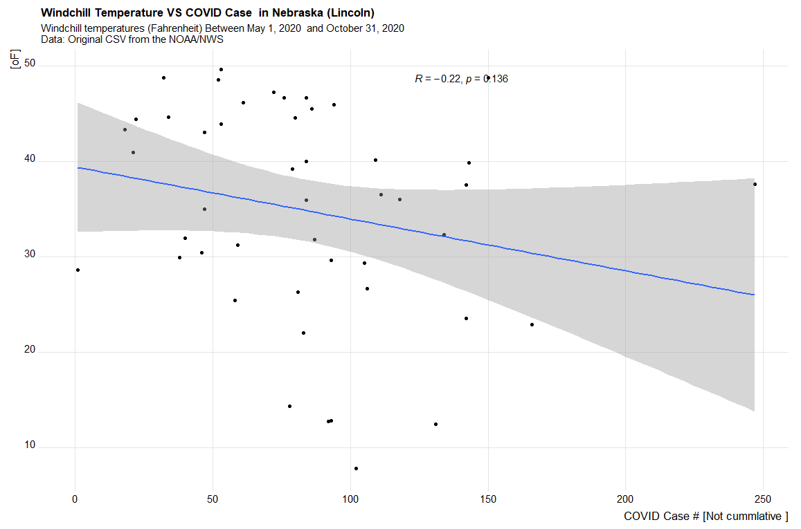
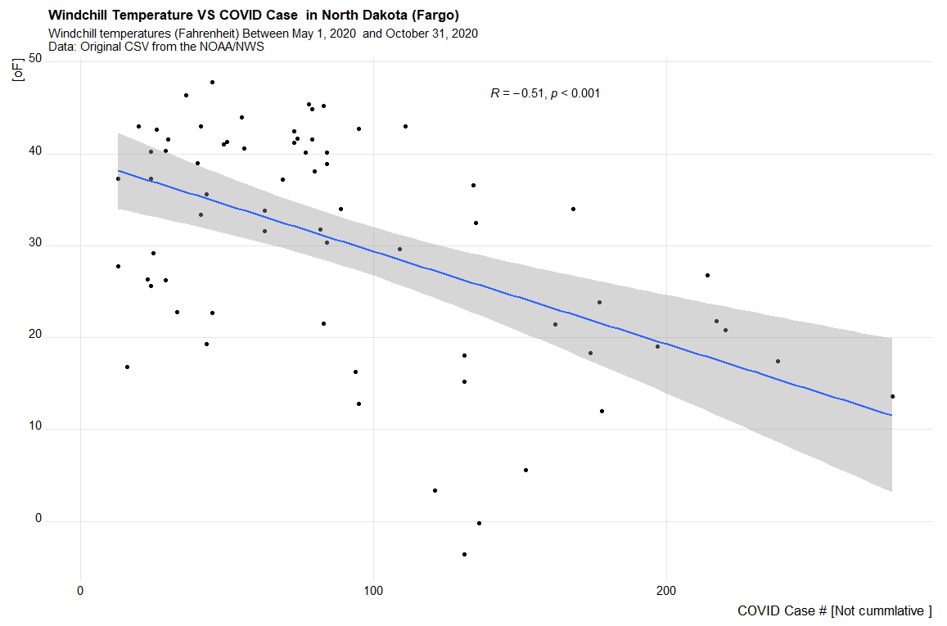
Results (Windchill/Heat Index)
Windchill 50 F or less
Heat Index 80 F or more

Slide 12

Leaflet/Time-series by ShinyApp
Day 1 – 184 (May 01, 2021 – October 31, 2021)
Ratio between Temperature and COVID-19 case in three cities
Option for multiple slot of time
http://lee471.shinyapps.io/Project

Slide 13
Implication
Temperature do play a role for and apparent trend for the COVID-19 cases (at large glance [longer period studies])
In the North state -> colder temperature day associated more COVID-19 cases
In the South state -> warmer temperature day associated more COVID-19 cases
In Nebraska, Lincoln -> neither colder/warmer temperature (weak correlation).
COVID-19 varies not only seasonal, but also vary monthly
The Fargo, ND, and Corpus Christi, TX has more significant trend
People live in ND have higher COVID-19 case in Snow,(overcast) and Snow,(partly cloud) condition.
People live in TX have higher COVID-19 case in Rain,(overcast) and Rain,(partly cloud) condition
People live in NE have most even COVID-19 case in two-more categories weather conditions

Slide 14

Future Improvement
Expand the time-series plots/visualization
Possible to located the subregion data
Working on publish everything on server to accommodate potential large dataset

Slide 15
Reference
Reference
Chen, S., Prettner, K., Kuhn, M. et al. Climate and the spread of COVID-19. Sci Rep 11, 9042 (2021). https://doi.org/10.1038/s41598-021-87692-z
Riddell, S., Goldie, S., Hill, A. et al. The effect of temperature on persistence of SARS-CoV-2 on common surfaces. Virol J 17, 145 (2020). https://doi.org/10.1186/s12985-020-01418-7
Singhal T. A Review of Coronavirus Disease-2019 (COVID-19). Indian J Pediatr. 2020 Apr;87(4):281-286. doi: 10.1007/s12098-020-03263-6. Epub 2020 Mar 13. PMID: 32166607; PMCID: PMC7090728.
Covid case data: nytimes/covid-19-data: An ongoing repository of data on coronavirus cases and deaths in the U.S. (github.com)
Weather information data : https://www.ncdc.noaa.gov/cdo-web/

