Slide 1
小專題報告
鄭植諺
2018/04/25

Slide 2
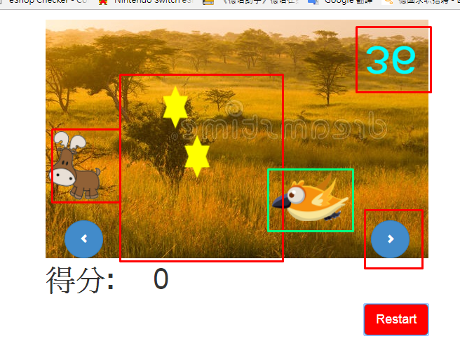
Layout

Slide 3
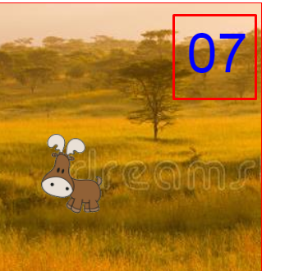
Display two digits
timeChar = (gameTime+1000).toString().substr(2,2);

Slide 4
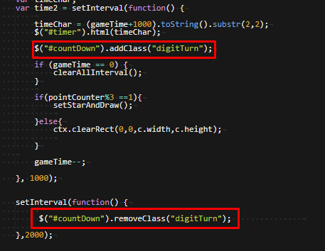
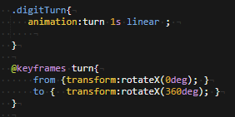
Digits Turn Animation
Add and remove with different setInterval()
https://www.youtube.com/watch?v=9bOlAFoFy0A

Slide 5
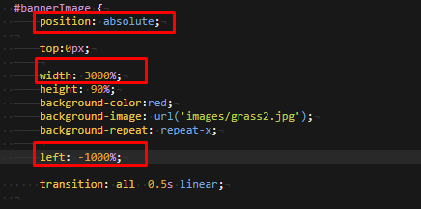
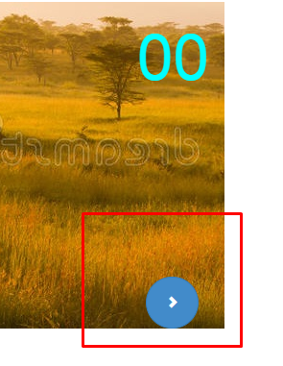
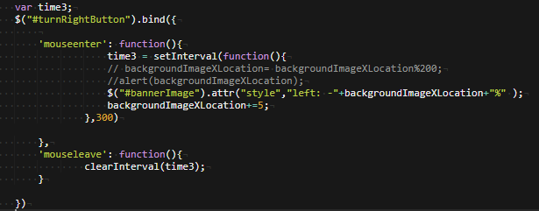
Background image Button

Slide 6
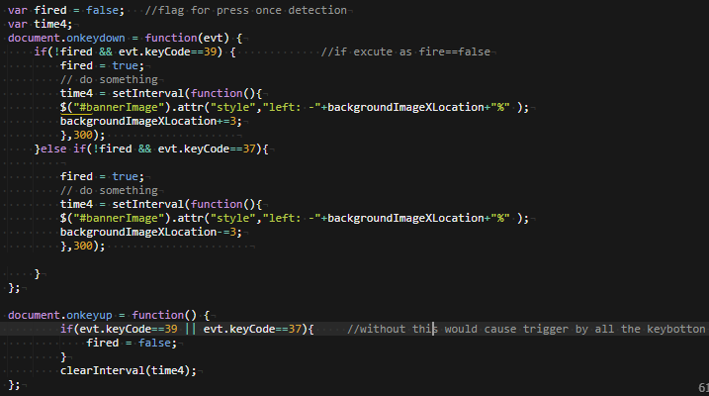
Direction detection for once
Otherwise, accumulation speeding-> use fire flag(only reset as keyup)
Notes:
Code 是累加五，用單純的keydown會一直累加，加速過頭。利用fire flag

Slide 7
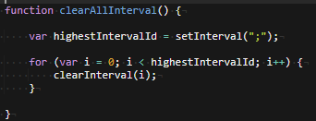
clear all the setInterval()

Slide 8
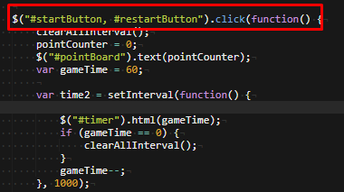
Selector with MultiSelector

Slide 9
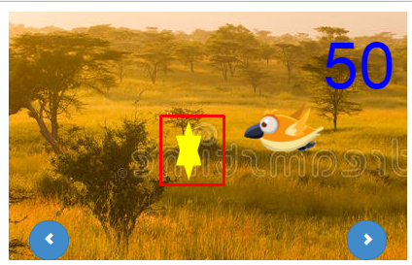
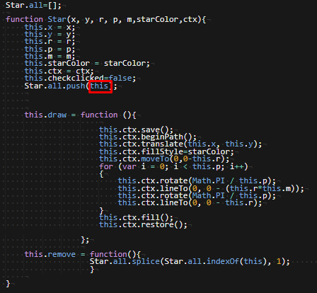
Class function Star(){}

Slide 10
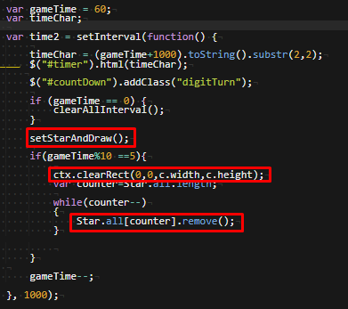
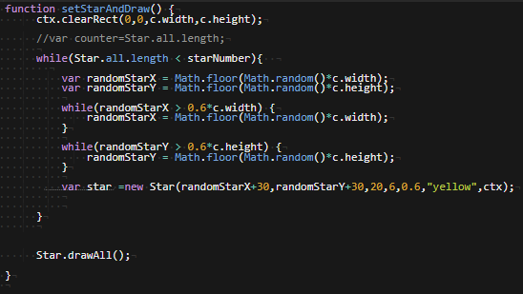
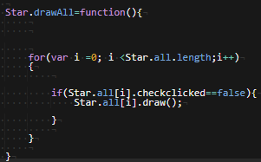
Star Draw
Call the function every sec. and update every ten sec.
Notes:
利用timer 之便，每5的倍數+1分的時候，印出加分star。starClickFlag= false才印

Slide 11
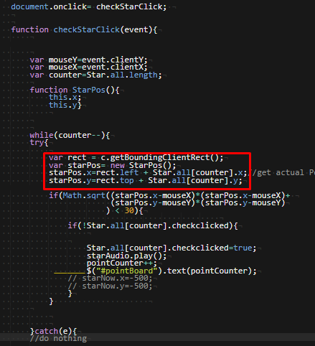
Star Click Event Detection
Notes:
getStarMousePos 回傳真實的滑鼠位置，利用回傳canvas左上角點，再利用checkStarClick去檢查flag要不要設為true，如果是true就不印出來(直接remove)

Slide 12
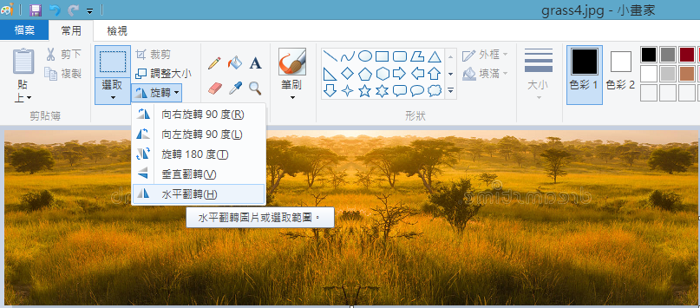
Background image
http://www.dreamstime.com/royalty-free-stock-photography-african-savannah-misty-morning-light-serengeti-national-park-tanzania-image67663867

Slide 13

音效
來源
http://tw.yisell.com/(槍聲)
http://forums.wasabistudio.ca/viewtopic.php?f=70&t=35276(馬利)
剪輯 https://mp3cut.net/tw/
Note: 用.mp3有時候只會撥一次，後來用.ogg(https://www.online-convert.com/)

Slide 14

圖檔來源
http://bpic.588ku.com/element_origin_min_pic/17/11/30/0c098cf1f0efb94bcec9e03298ee0b6d.jpg
http://588ku.com/sucai/7522351.html
https://cn.dreamstime.com/%E5%BA%93%E5%AD%98%E7%85%A7%E7%89%87-%E5%9C%A8%E6%9C%89%E8%96%84%E9%9B%BE%E7%9A%84%E6%97%A9%E6%99%A8%E5%85%89%E7%9A%84%E9%9D%9E-%E5%A4%A7%E8%8D%89%E5%8E%9F-image67663867

Slide 15
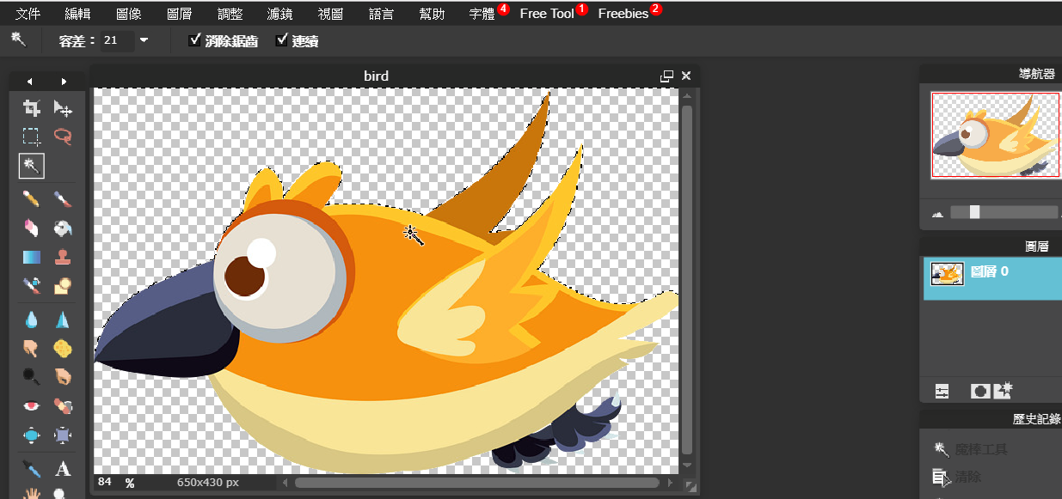
線上去背
https://pixlr.com/editor/

Slide 16
Q&A

Slide 17
謝 謝 大 家

Slide 18
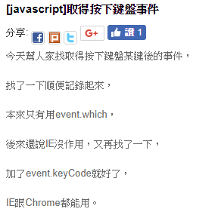
http://sheep0222.pixnet.net/blog/post/55814811-%5Bjavascript%5D%E5%8F%96%E5%BE%97%E6%8C%89%E4%B8%8B%E9%8D%B5%E7%9B%A4%E4%BA%8B%E4%BB%B6

Slide 19
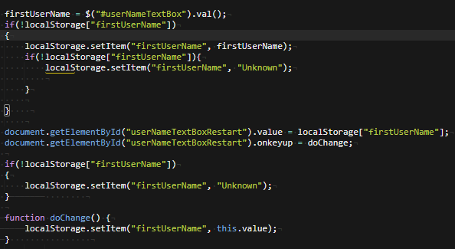
LocalStorage for Username

