Slide 1
Psycholinguistics Class 2: Speech perception

Slide 2
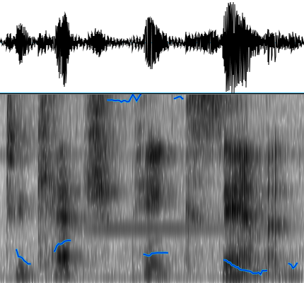
What is speech
air pressure
“sound wave”
spectrogram
frequency
“to catch pink salmon”

Slide 3
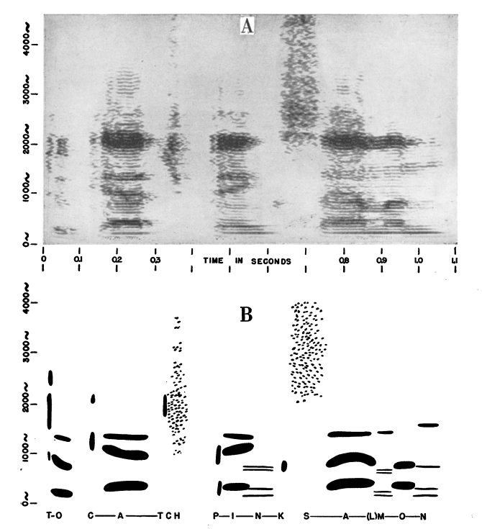

Slide 4
Classic findings
Categorical perception
Lack of invariance
phonetic context/coarticulation
talker variability

Slide 5
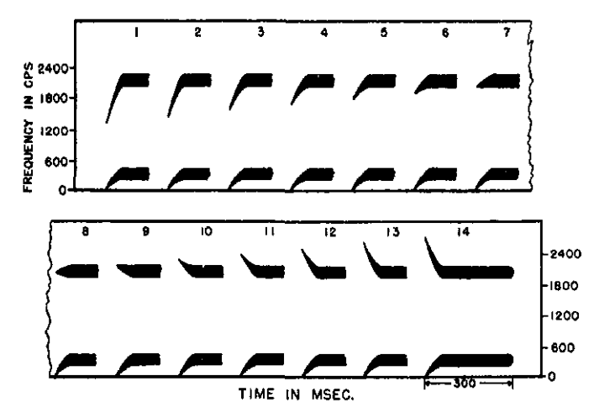
Categorical perception
Liberman et al. (1957)

Slide 6
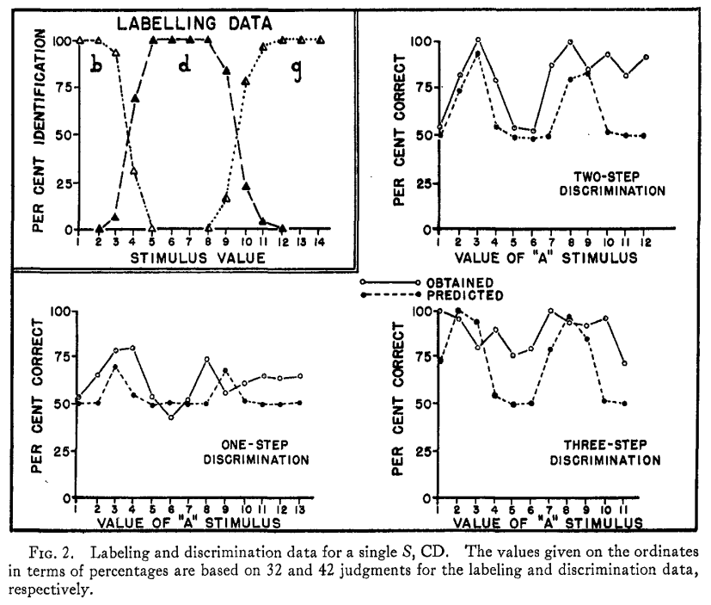

Slide 7
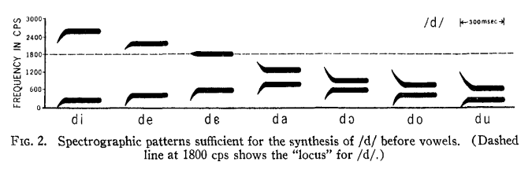
Lack of invariance
Liberman et al. (1967; from 1955)

Slide 8
Lack of invariance
[Newman, Clouse, and Burnham, 2001]

Slide 9
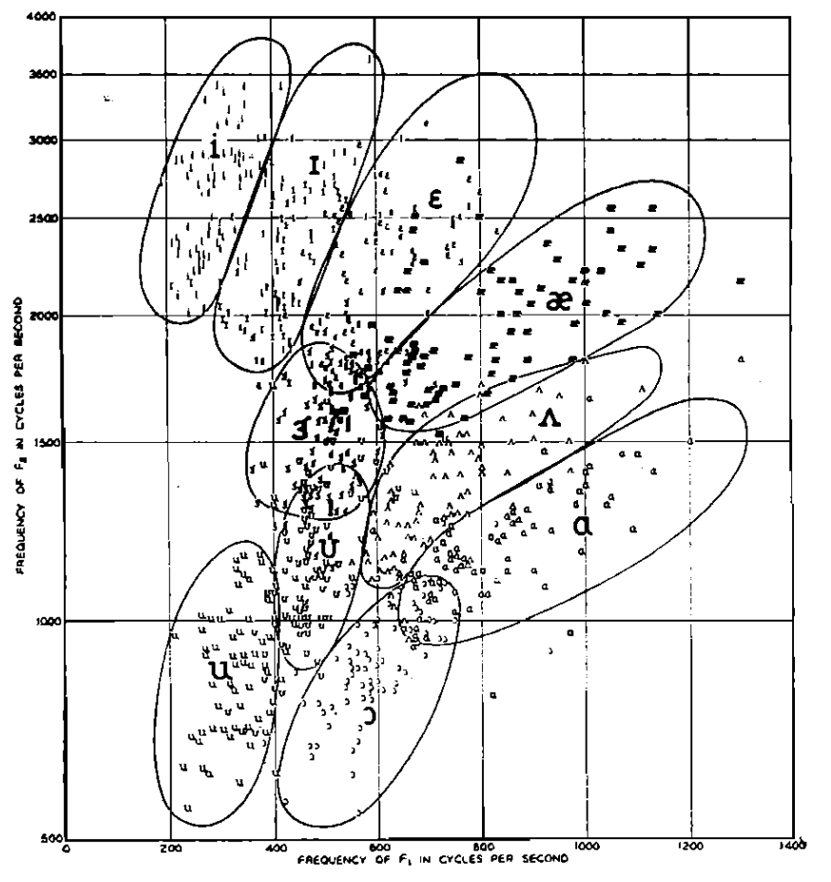
Lack of invariance
Peterson & Barney (1952)

Slide 10
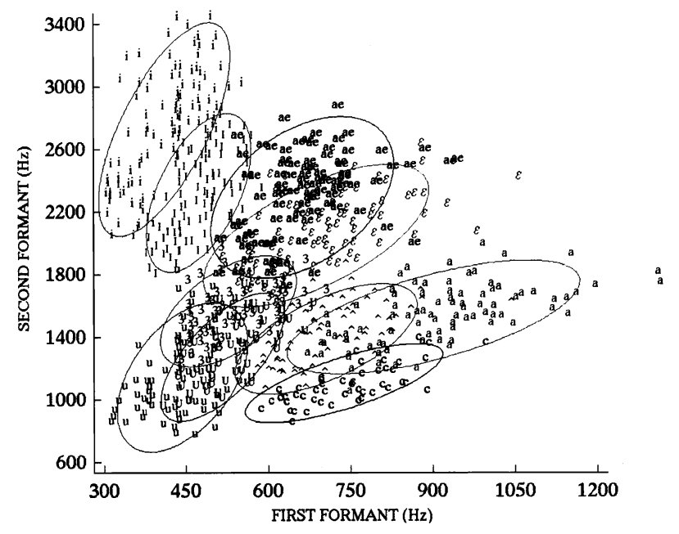
Lack of invariance
Hillenbrand et al. (1995)

Slide 11
Models
“Traditional” (abstractionist)
Connectionist
Exemplar

Slide 12
Traditional model
Template for each (allo)phone(me)
Compare templates to spectrogram to classify
Output is string of (allo)phone(me)s
Look up in mental dictionary (lexicon) to find words
Requires normalization

Slide 13
Connectionist models
Different families:
Interactive activation and competition (IAC)
Localist vs. distributed
Engineered vs. learned
Statistical (implicit vs. explicit)

Slide 14
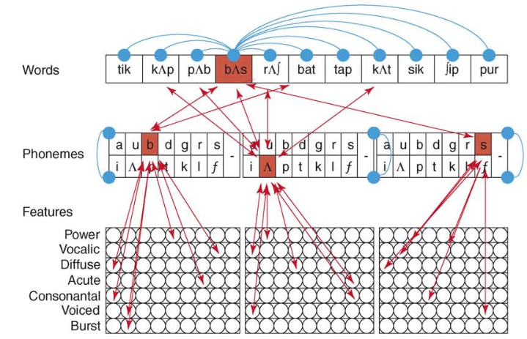
TRACE: classic IAC model

Slide 15
TRACE
Is a localist model (each node is a word/phoneme etc.)
It’s built, not trained (connection weights are set by hand)
It uses idealized input (phonological features), not actual sound

Slide 16
Exemplar models
Remember detailed acoustic traces of individual words
Don’t try to analyze into phonemes or smaller segments
Phonological abstraction emerges
Similarity-based retrieval: compare new sounds with stored traces and let them vote

Slide 17
Exemplar models
Trained not built (at least mostly)
Learns from recent experience (because stored exemplars are re-used)
Uses (more) low-level sound as input

Slide 18
The evidence
What is the evidence in favor of exemplars?
What is the evidence in favor of abstractions?

Slide 19
Marr levels
What Marr level do these models target?
IAC (TRACE)
Backprop-trained neural network
Exemplar model

Slide 20
Strawpeople
Is the traditional model a “strawman”? Why would anyone believe that kind of model?

Slide 21
Abstraction
What makes an representation “abstract”?
Are phonological features more or less abstract than phonemes?
What is the benefit of using a small number of abstract codes vs. a large number of more specific codes?

Slide 22
Context, signal, and noise
Variation due to talker and coarticulation are often thought of as “noise”...are they?

