Slide 1
Adaptation I Ideal observers, Bayesian belief update, and the plasticity of adult language
LSA Summer Institute 2011, Computational Psycholinguistics, Lecture 7
Florian Jaeger, Human Language Processing Lab http://www.hlp.rochester.edu/
Notes:
Ling inquiry late seventies (wanna contraction, postal & pullum)

Slide 2
Readings
Required:
Kleinschmidt and Jaeger (2011) – 8pp
Kraljic, Samuel, and Brennan (2008) – 8pp
Kording, Tenenbaum, and Shadmehr (2007) – 8pp
Suggested: Eisner and McQueen (2006); Farmer, Fine, and Jaeger (2011); Fine and Jaeger (2011); Kraljic and Samuel, 2006a,b; Kraljic, Brennan, and Samuel (2008); Maye, Aslin, Tanenhaus, 2003; Pado and Remez (2006); Pierrehumbert, 2001; Pouget and Knill (2004); Wei and Kording (2008)
Technical reading: Jacobs;
For R:
Lynch (2010): Introduction to Applied Bayesian Statistics and Estimation for Social Scientists
Albert (2008): Bayesian Computation in R

Slide 3
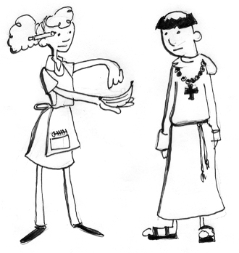

Slide 4


Slide 5
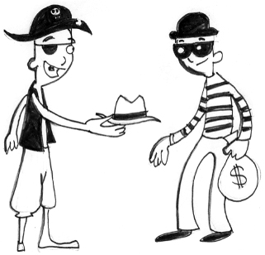

Slide 6
The pictures on the previous three slides were generously provided by Bob Slevc

Slide 7
Efficient Language Processing
Much evidence over the last decades that comprehension involves access to probabilistic cues to the incremental parse (interpretation) [Garnsey et al 97; Hare et al 03; Kamide et al 99, 03; MacDonald et al 93; StaubClifton06; Tanenhaus et al 95; Trueswell et al 93, 94]
Variety of accounts, but they share the functional motivation that probabilistic cues help to process noisy input efficiently [e.g. Bicknell et al 09; Hale 01; Levy 08; Smith and Levy 09]

Slide 8
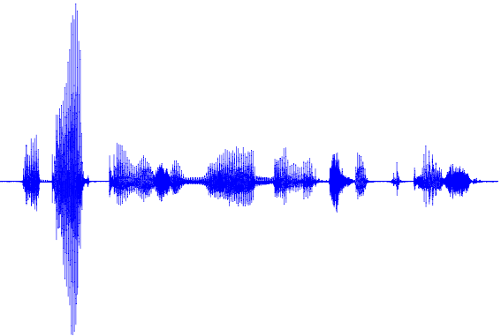
Inference over a noisy channel
Syntax
form 1
form 2
form k
Lexicon
Context
Inference over a noisy channel
Intended meaning
Prosody
Other meaning
Other meaning
Other meaning
Other meaning
Other meaning
Other meaning
Social
World knowledge

Slide 9
The (hidden) Assumption
Reliance on probabilistic knowledge about language to process language (e.g. for anticipatory eye-movements; resource allocation) will only be efficient if the listener’s model of the underlying conditional distributions resemble the speaker’s distributions sufficiently closely.
But these distributions might differ between speakers (this is most obvious for acoustics-to-phoneme mappings)

Slide 10
Questions
Do listeners adapt to the specific statistics of different speakers/situations/topics? This would facilitate efficient language comprehension.
Specifically, do we implicitly learn over everything we process (‘Processing is learning’, cf. Chang et al 06 and many other connectionist architectures; ‘Incremental Bayesian belief update)?
If so, what are the mechanisms that enable this plasticity?

Slide 11
Plan
Adaptation – What’s known?
Phonetic perception [Bradlow and Bent, 2003, 2008; Kraljic and Samuel, 2005, 2006a,b, 2007, 2008; Norris et al., 2003; Vroomen et al., 2004, 2007]
Syntactic processing [Fine et al., 2010; Fine and Jaeger, 2011; Farmer et al., 2011]
Lack of invariance revisited
Adaptation as rational behavior: Phonetic perception as Bayesian belief update [Kleinschmidt and Jaeger, 2011; XXX-VISION]
Linking computation to mechanisms:
What type of learning mechanisms are involved in adaptation? [Fine and Jaeger, submitted; Kaschak and Glenberg, 2004; Snider and Jaeger, submitted]
Where will this lead us? Acquisition and adaptation
Notes:
The last bullet refers to a full blown model of adaptation

Slide 12
A priori considerations
We know that we generally have the ability to learn statistical patterns
E.g. learning new languages with structure and statistical dependencies between them [GomezGerken 99; Marcus et al 99; Saffran et al 96, 97; Wonnacut et al 08; Fedzechkina et al 11]
E.g. learning new structures for known languages [e.g. Kaschak and Glenberg 04]
But today let’s focus on the question as to whether we adapt to situation-specific statistics even when we already have acquired structures (or are we ‘done’ learning at some point?)

Slide 13
Part 1 Perceptual adaptation

Slide 14
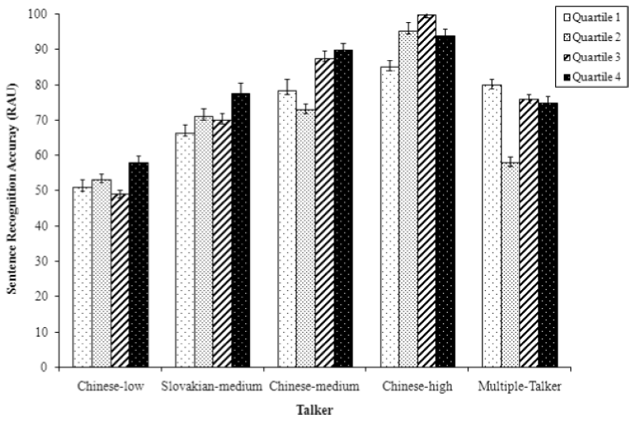

Evidence for Plasticity in Adults
Most is known about the mapping from acoustics-to-phonology:
Adaptation to foreign accents after exposure [BradlowBent08]
… including generalization across speakers (→ formation of non-speaker specific representation)
[Figure 1 from Bradlow and Bent 2008]

Slide 15
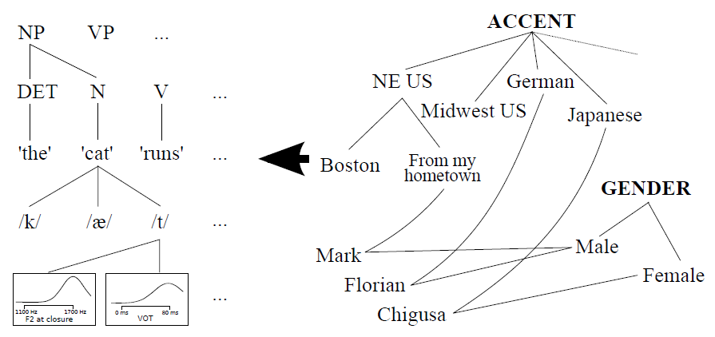
Adaptation shows hallmarks of rational learning under uncertainty
[Figure from Kleinschmidt and Jaeger, in prep]

Slide 16
Evidence for Plasticity in Adults
Most is known about the mapping from acoustics-to-phonology:
Adaptation to foreign accents after exposure [BradlowBent08]
… including generalization across speakers (→ formation of non-speaker specific representation)

Slide 17
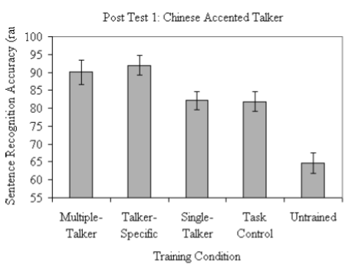
Generalizing across speakers
[Figure 3 from Bradlow and Bent 2008]

Slide 18
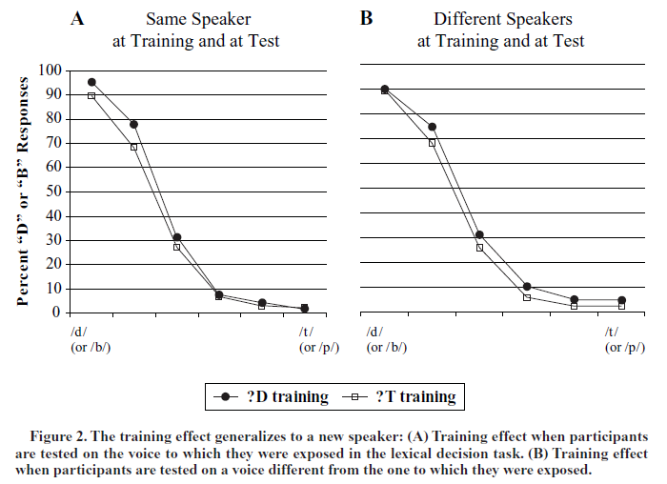
[Figure 2 from Kraljic and Samuel, 2006]

Slide 19
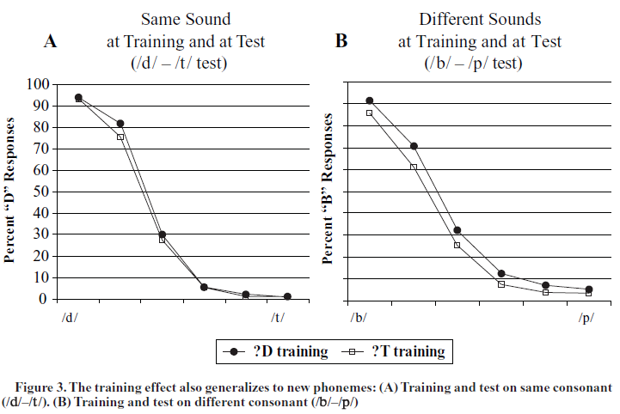
And across sounds
[Figure 3 from Kraljic and Samuel, 2006]
Notes:
Different sound test was always presented before same sound test. As kraljic and samuel point out, the smaller effect for the same training and test sound might be due to decay of the adaptation effects by that time.

Slide 20
When do listeners generalize?
No cross-speaker generalization for
f/s training [Eisner and McQueen, 2005]
s/sh training [Kraljic and Samuel, 2006b]
Cross-speaker generalization for
d/t training [Kraljic and Samuel, 2006a,b]
(also learner were not able to maintain representations of adapted d/t based on previous exposure to same speaker)
Cross-phoneme generalization for d/t training (→ to b/p) [Kraljic and Samuel, 2006a]
Notes:
Kraljic and Samuel 06b: Perceptual adjustments to multiple speakers
pronunciations in stop consonants generalize to new speakers, while adjustments to fricatives are often speaker-specific (e.g., Eisner & McQueen, 2005; Kraljic & Samuel, 2005, 2006).
When the critical sound varies along a temporal-voicing dimension (Experiment 1’s stop consonants), hearing a new voice appears to serve as a ‘resetting’ cue, to return to the standard representation in preparation for adapting to the current speaker. The result is that categorization of the ambiguous sound will be consistent with the most recent speaker heard, as a priming account predicts (Dell & Brown, 1991; Pickering & Garrod, 2004). But when the critical soundvaries along a spectral-place dimension (Experiment 2’s fricatives), the system appears able to maintain multiple representations simultaneously, each for the appropriate speaker.

Slide 21
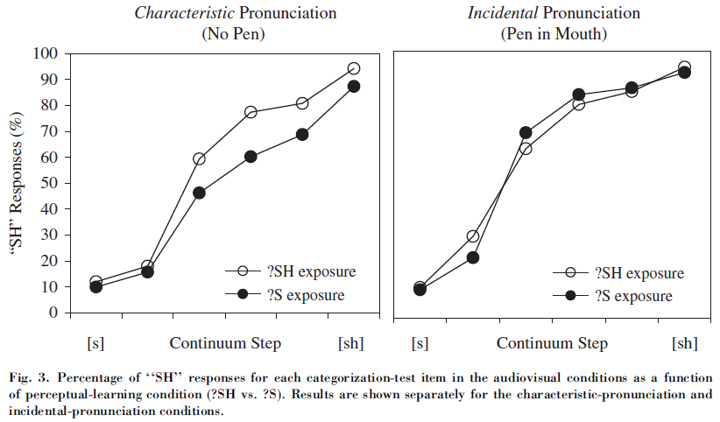
Causal attribution
[Figure 3 from Kraljic, Samuel, and Brennan, 2008]

Slide 22
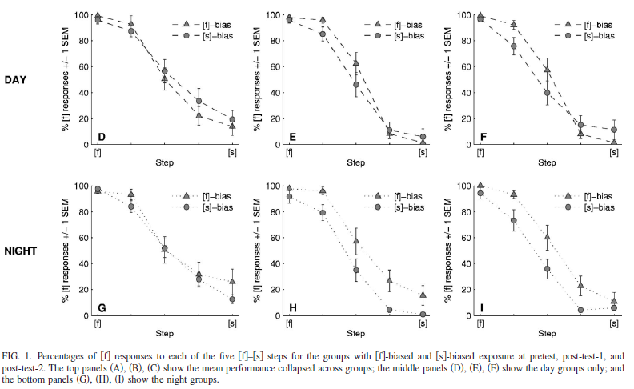
Long lasting [Eisner and McQueen, 2006; Kraljic and Samuel, 2005]
[Figure 1 from Eisner and McQueen, 2006]
Notes:
From their paper: Immediately after exposure, there was a first categorization post-test, and after a delay of 12 h, a second
post-test. For 30 participants, the pretest started at 9 am, and posttest-2 was at 9 pm on the same day “day group”. For a further 30 subjects, the first session began at 9 pm, while post-test–2 took place at 9 am the following morning “night
group”.

Slide 23
Evidence for Plasticity in Adults
Most is known about the mapping from acoustics-to-phonology:
Adaptation to foreign accents after exposure [BradlowBent08]
… including generalization across speakers (→ formation of non-speaker specific representation)
Mappings can also change with relatively little exposure to just slightly shifted native speaker representations (idiolects) [KraljicSamuel05; PardoRemez06; VroomenETAL07; ClayardsTanenhausAslin08]
… including generalization across phonemes and across speakers, based on phonetic acoustic properties. [KraljicSamuel06a,b,07]
These adjustments in mappings can persists at least beyond the short term [KraljicSamuel05]

Slide 24
Part 2 Is there Syntactic Adaptation in Adults?

Slide 25
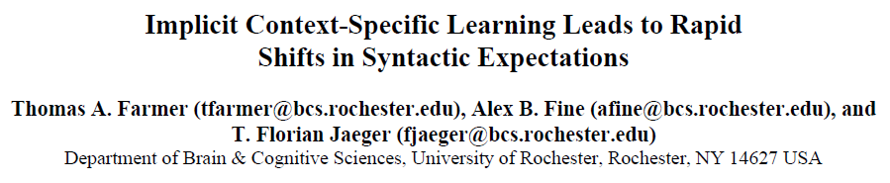

Experiment 2: Learning to expect the different
Farmer, Fine & Jaeger (2011-CogSci)

Slide 26
Syntactic Adaptation
While it is well-known that the mapping from acoustic percepts to phonetic categories is highly variable from speaker to speaker, this is less clear for syntax.
The fact that individual differences in sentence production experiments on alternations are typically high suggests that syntax exhibits similarly high inter-speaker variability.
Additionally, subcategorization probabilities can differ based on register, genre, etc.

Slide 27
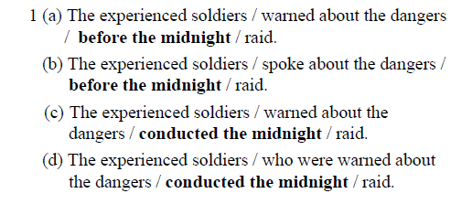
Experiment 1
Elicits ambiguity effect (‘garden path’) at disambiguation region

Slide 28
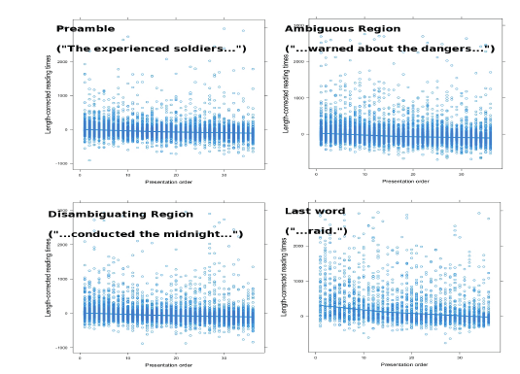
[Figure from Farmer, Fine, and Jaeger, 2011 presentation]

Slide 29
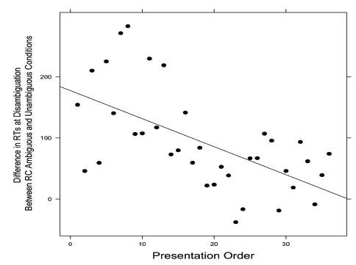
Change of ambiguity effect
[Figure from Farmer, Fine, and Jaeger, 2011]

Slide 30
Summary
Evidence that syntactic beliefs are continuously updated as the distribution of observed structures deviates from those typically expected.
Replicated on other different structure with temporary ambiguity (Fine, Qian, Jaeger, and Jacobs, 2010-CMCL/ACL)

Slide 31
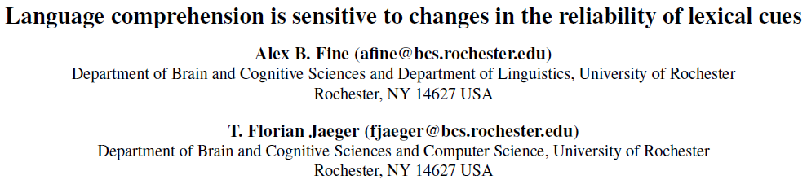
Experiment 3: Learning to expect the different
Fine & Jaeger (2011-CogSci)

Slide 32
Materials
Complement clauses with temporary ambiguity (garden-path, Garnsey et al., 1997):
DO-biased verbs: The talented photographer accepted the money could not be spent yet.
EQ-biased verbs: The ticket agent admitted the mistake had been careless and stupid.
SC-biased verbs: The proud mother announced the wedding would be a big event.
Unambiguous variant contains that (3 x 2 design)
Temporary NP always was a plausible object to the verb. Always two words until disambiguation

Slide 33
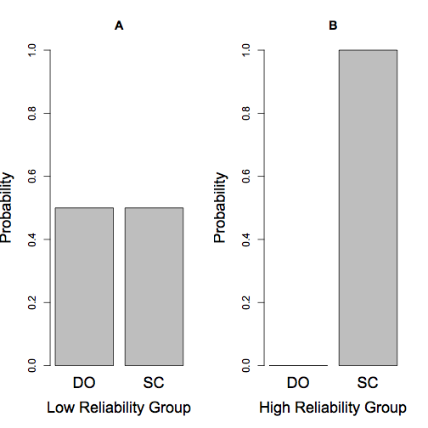
Manipulating cue reliability of verb between subjects
The judge acknowledged …
[Figure 1 from Fine and Jaeger, 2011]
Verb is a relatively bad cue to
syntactic structure for this group
Verb is a relatively good cue to
syntactic structure for this group

Slide 34
Visit 1: Self-paced reading
Visits 2-4: Exposure
Period.
64 DO/SC items each visit
1/2 of all SCs
occur with that
(No EQ items)
Low Reliability Group
High Reliability Group
50% SCs
100% SCs
[at least two days pass]
50% SCs
100% SCs
[at least two days pass]
50% SCs
100% SCs
[at least two days pass]
Visit 5: Self-paced reading
[cf. paradigm used in Wells et al., 2009]
[based on Figure 2 from Fine and Jaeger, 2011]

Slide 35
Pre-exposure
General replication of Garnsey et al (1997) results: Slow down at disambiguation point is less severe the more the verb is biased towards the intended SC parse.

Slide 36
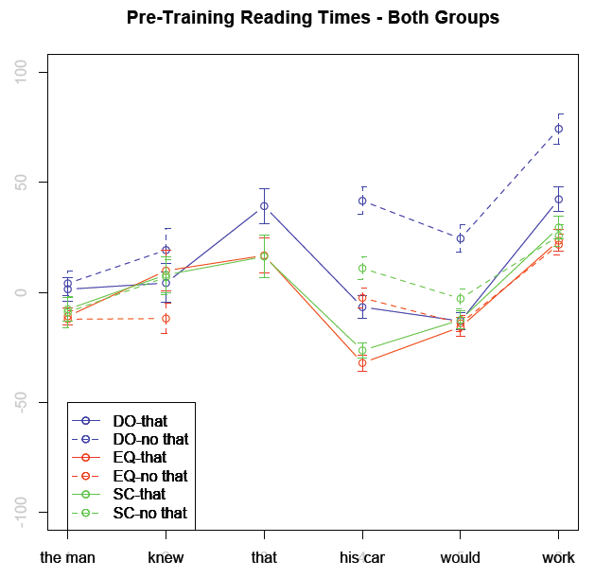
[Figure based on data from Fine and Jaeger, 2011]

Slide 37
Predictions
As the verb becomes a less informative cue (for the low reliability group), participants in the low reliability group (compared to the high reliability group) should come to rely MORE on the complementizer as a cue to syntactic structure.
Notes:
Group 1: previously observed processing cost for SCs occurring after a DO-biased verb should be attenuated;
Advantage for SC-bias verbs should similarly be attenuated.
Group 2: previously observed processing cost for SCs occurring after a DO-biased verb should be strongly
Attenuated, and processing advantage for SC-biased verbs should be strengthened.

Slide 38
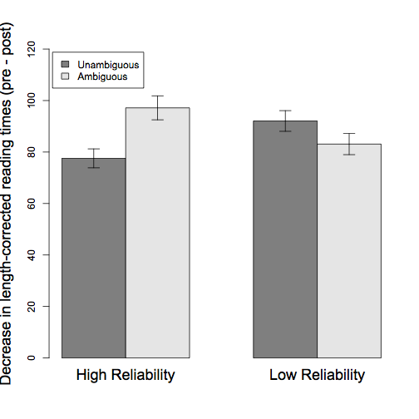
Larger decrease in RTs given that for low reliability group
[Figure 3 from Fine and Jaeger, 2011]

Slide 39
Larger decrease in RTs
for high reliability group in
ambiguous sentences
(reflects greater certainty
about presence of SC)
[Figure 3 from Fine and Jaeger, 2011]

Slide 40
Summary
Recent experienced syntactic distributions can change expectations over syntactic structures [Wells et al., 2009]
Additional evidence suggests that this effect is lexically specific (some verbs in the test did not occur in training)
The fact that this persists over days argues against short-term activation accounts.
Comprehenders use their knowledge of the reliability of cues to syntactic structure in order to exploit these cues in an efficient, or rational, manner

Slide 41
Part 3 What Mechanism underlie Rapid Syntactic Adaptation?

Slide 42
Error-driven Implicit Learning?
We explored the potential role of error-driven implicit learning (as opposed to lingering activation or unsupervised learning), which has been shown to play an important role in human skill acquisition on language processing in adults. [Chang et al., 2000, 2006; see also Plunkett Juola99 on language acquisition; BotvinickPlaut04 on motor skill acquisition]
Prime strength ∝ expectation-violation (surprisal of prime, e.g. given its properties).

Slide 43
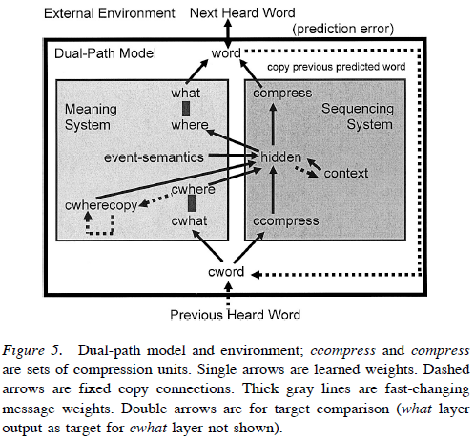
Connectionist models of language production [Chang et al., 2000, 2006]
[Figure 2 from Chang, Dell, and Bock, 2006]

Slide 45
Experiment 4: Error-driven Syntactic Priming in Comprehension
Fine*⁺ and Jaeger* (submitted)
⁺ Linguistics, University of Rochester
*Brain and Cognitive Sciences, U. of Rochester

Slide 46
Meta-Analysis
Thanks!
Thothathiri & Snedeker (2008) found syntactic priming in comprehension using eye-tracking in a visual world paradigm:
24 participants
16 ditransitive items
Short dialogue:
2 primes (both PO or both DO)
Target (PO/DO)

Slide 47
Context
John’s 2-year-old daughter’s birthday was coming up soon. His secretary went to the bookstore to look for children’s books.
[1st Prime, DO/PO] There a nice bookstore clerk sold the secretary a book/sold a book to the secretary.
[2nd Prime, DO/PO] That night, John read his daughter a story/read a story to his daughter.

Slide 48
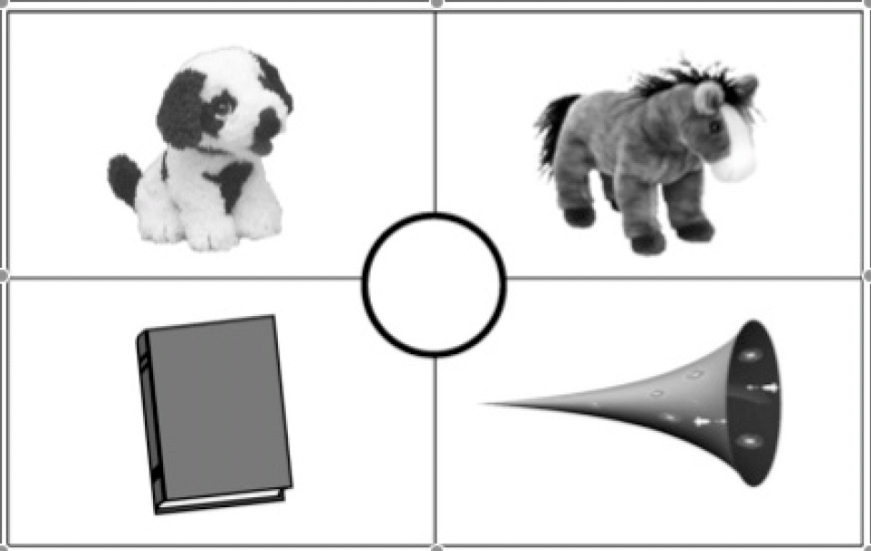
Target
Now, you can give the horse the book/take the horn to the dog.
hor…se
hor...n
[Figure 1 from Thothathiri and Snedeker, 2008]

Slide 49
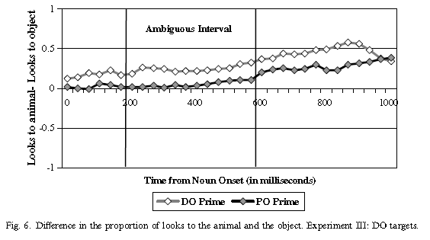
Thothathiri & Snedeker’s Result
[Figure 6 from Thothathiri and Snedeker, 2008]

Slide 50
Estimating Surprisal
Norms elicited via sentence completion experiment:
John’s 2-year-old daughter’s birthday was coming up soon. His secretary went to the bookstore to look for children’s books.
There a nice bookstore clerk sold …
That night, John read ...
Both primes were of each context were completed 100 times (over Mechanical Turk).
Surprisal: -log p(prime structure | completion norms)

Slide 51
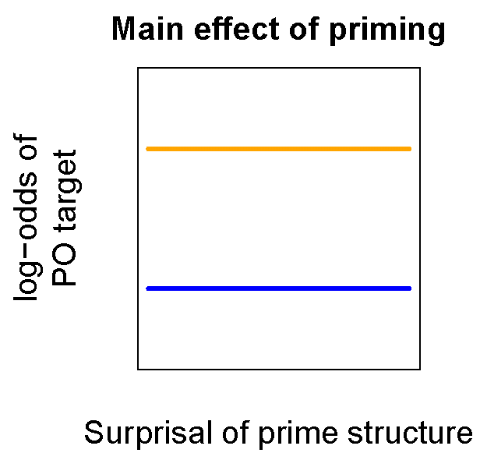
Prediction
… sold/showed a book to the secretary.
… sold/showed the secretary a book.
No error-driven syntactic priming
Error-driven syntactic priming
[Figures from Snider and Jaeger, in prep]

Slide 52
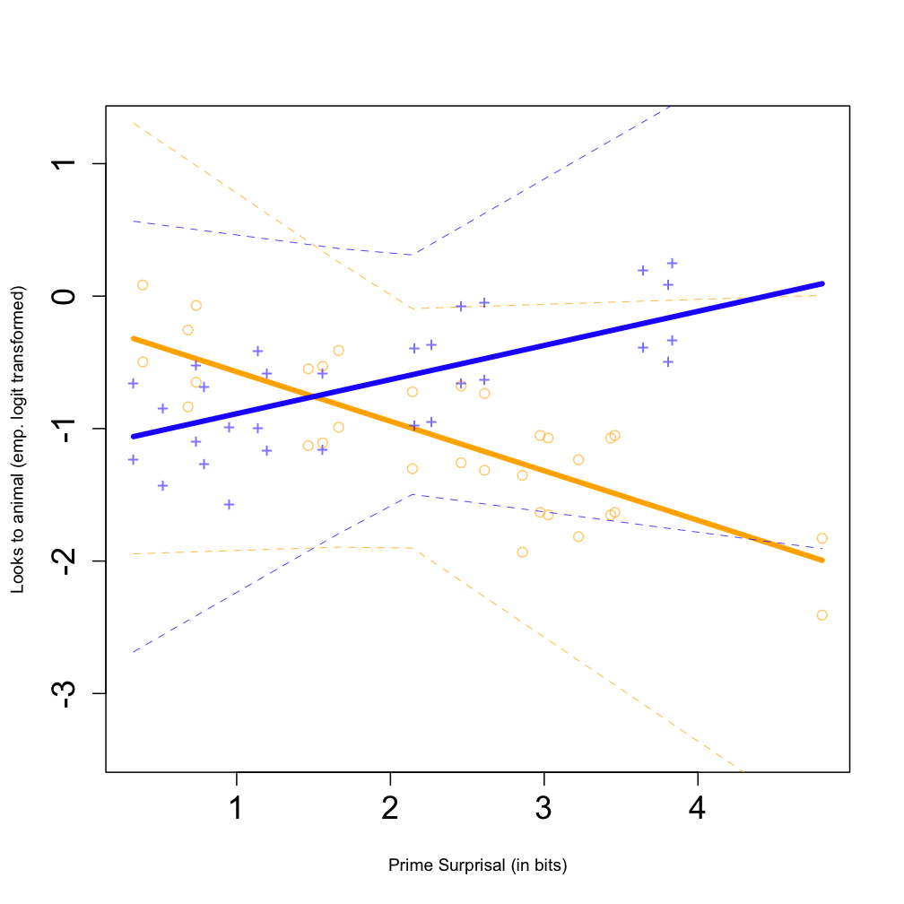
Results
Prime structure: p < .05
Surprisal: p > .4
Surprisal x Prime structure: p < .01
Empirical log-odds of looks to RECIPIENT
[Figure based on Fine and Jaeger, submitted]
Prime surprisal (in bits)

Slide 53
Summary
Prediction-error (surprisal) affects priming, consistence with the hypothesis that this process is involved in
→ error-driven implicit learning (also predicted, but not tested by Chang et al., 2000, 2006)
Would argue against unsupervised or base learning accounts of syntactic priming (Malhotra, 2009; Reitter et al., 2011)

Slide 54
Unsupervised vs. Supervised Learning
Reitter et al 2010 propose an unsupervised learning algorithm to account for the inverse frequency effect (‘base level learning’ mechanism within ACT-R).
This itself does not predict our results. But could it be that the joint frequency of verb and structure explains our results? (i.e. stronger priming due to lower base level activation for more common verb-structure pairs).
For all studies presented here, error-driven implicit learning always comes out on top of unsupervised implicit learning

Slide 55
Next
If error-driven implicit learning to change language throughout adult life, we would expect it to also operate during production
Also, we were curious to see whether such learning would be sensitive to recent experience beyond what would be expected from cumulative activation: Do the relative distributions of POs/DOs in recent experience affect how strongly each of the primes primes?

Slide 56
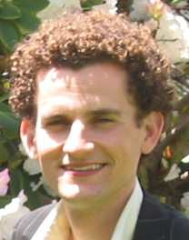
Experiment 5: Error-driven Implicit Learning in Production
Snider⁺ & Jaeger* (submitted); Jaeger & Snider (2007-URWP, 2008-CogSci); Snider (2008-thesis)
⁺ Nuance Communications, Inc.
*Brain and Cognitive Sciences, U. of Rochester

Slide 57
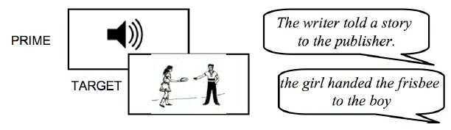
Procedure
trials
[Figure from Snider and Jaeger, in prep; based on picture materials generously provided by Kathryn Bock]

Slide 58
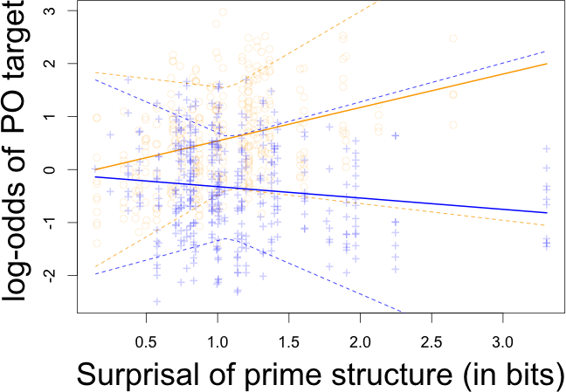
Result
Prime structure: p < .01
Surprisal: p > .6
Surprisal x Prime structure: p < .05
[Figure from Snider and Jaeger, in prep]

Slide 59
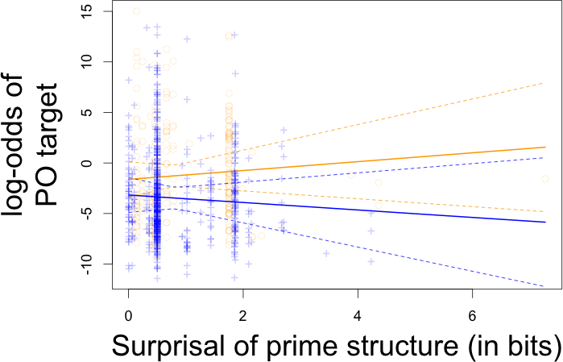
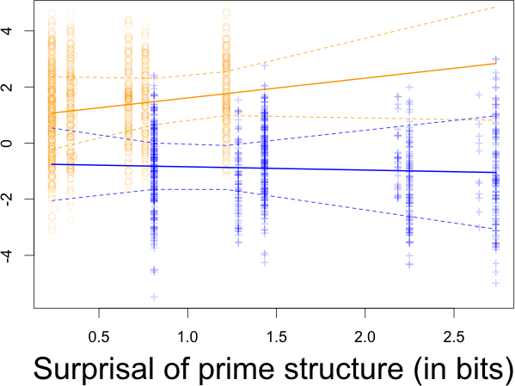
Replications
Thanks
Unscripted speech (corpus)
Meta-study (Kaschak et al)
Prime structure: p < .1
Surprisal: p > .6
Surprisal x Prime structure: p < .05
Prime structure: p < .01
Surprisal: p > .4
Surprisal x Prime structure: p < .05
[Figures from Snider and Jaeger, in prep]

Slide 60
Summary
Prediction-error (surprisal) affects priming, consistence with the hypothesis that this process is involved in
→ error-driven implicit learning (also predicted, but not tested by Chang et al., 2000, 2006)
Recent replication for Dutch by Bernolet and Hartsuiker (2010).

Slide 61
Experiment
… also contained between-participant block manipulation:
[Figure from Snider and Jaeger, in prep]

Slide 62
Prime surprisal based on Experience within Experiment
Very high surprisal
Expected surprisal of prime structure based on previous trials
Item Order
[Figure from Snider and Jaeger, in prep]

Slide 63
Result
Prime structure: p < .01
Surprisal: p > .6
Surprisal x Prime structure: p < .05
Cumulative priming: p< .01
Adapted surprisal: p > .1
Adapted surprisal x Prime structure: p < .05
[Figure from Snider and Jaeger, in prep]

Slide 64
Summary: Priming & Learning
Syntactic priming is sensitive to expectation-violation and hence error-driven, as would be expected if priming is learning rather than short term activation bursts (as proposed in Chang et al., 2000, 2006).
Strength of syntactic priming is sensitive to recent experience.
This may be taken to argue that priming is reflecting continuous implicit learning of linguistic distributions.

Slide 65
Readings
Required:
Fine and Jaeger (submitted)
Suggested: Bock and Griffin (2000); Chang et al. (2000, 2006); Jaeger and Snider (2008); Kaschak and Glenberg (2004); Reitter et al. (2011); Snider and Jaeger (submitted)
Technical reading:
For R:
Lynch (2010): Introduction to Applied Bayesian Statistics and Estimation for Social Scientists
Albert (2008): Bayesian Computation in R

