Slide 1
Language Production:
From message to articulation
BCS 501, Fall 2009

Slide 2
Traditions in Production
Product Tradition:
  How is a message translated into an utterance?
  Planning
Action Tradition:
  How do we do things with language?
  Communication of intentions

Slide 3
Topics
Product tradition
  Accessibility: Availability vs. Alignment
  Incrementality
  Competition or not?
  Ambiguity Avoidance
Incrementality at the message level?
From word to sentence production?
Action Tradition

Slide 4
Product Tradition

Slide 5
Producing Utterances
Translation of non-verbal thought into articulation via a lexically and syntactically specified utterance
  Speakers sequentially produce word forms to construct utterances with the intended conceptual meanings
Questions:
  What are the subprocesses/stages?
  Modularity/Interfaces/Information flow: What information is available to what process when?
  Incrementality: How far ahead to we plan?

Slide 6
Production Stages
Conceptualization
Decide What to Say
Formulation
Decide How to Say It
Articulation
Say It
Notes:
How to make it a psychological model? Put boxes around it?

Slide 7
small greyish mammal…
NK123
message
Rabbit concept
grammatical component
Structure
Assignment
term denoting concept NK123;
(noun, count)
Direct object
Lexical
selection
verb
subject
ver
Morpheme
Retrieval
Constituent
Assembly
N
(raebet) _{stem}
spec
N
/r//ae//b/e//t/
phonological component

Slide 8
Availability
Availability: in case of choice, continue with whatever becomes available first (Bock & Warren, 1985; Ferreira & Dell, 2000)
  Maybe because of keeping the ground or because of efficiency, etc.
More accessible material should be ordered first

Slide 9
‘Choices’ at many levels in production
  Utterance level: Move the triangle to the left.
  Select the triangle. Move it to the left.
  Phrasal level: She gave {him the key/the key to him}
  She already ate (dinner)
  She stabbed him (with a knife).
  Word level: I read a book (that) she wrote.
  Morphological level: I’ve\have gone there.
  Phonological level: t/d-deletion; final cluster reduction; vowel weakening
  Phonetic level: formant energies, F1/F2 ratio, speech rate

Slide 10
Optionality in Utterance Formulation
Word order:
  Actives/Passive
  Double object/Prep-dative
  Heavy NP shift
  Particle shift
  Scrambling
Reduction
  Optional phrases, Optional words
  Morphosyntactic reduction, phonetic reduction
  Etc.
Substitution (lexical choice, syntactic choice)?

Slide 11
Effects related to Availability
[for overviews, see Branigan et al., 2008; Jaeger and Norcliffe, 2009]
Ease of lexical selection (concept → L-level/Lemma)
  Imageability [Bock & Warren, 1985]
  Animacy
  [Prat-Sala & Branigan, 2000; Tanaka et al., 2011; Nice & Dietrich, 2003]
  Givenness, semantic priming
  [Bock & Irwin, 1980; Ferreira and Yoshita, 2003; MacWhinney & Bates, 1978]
  Concreteness
  Individual differences in working memory [Slevc, upcoming?]
Ease of phonological encoding
  Word form repetition (beyond referent repetition)
  Phonological priming
  [Bock, 1987; Jaeger, Furth, & Hilliard, in prep]
  Predictability

Slide 12
Effects that could be related to Availability
Unclear:
  Frequency (lemma or wordform?)
Ease of syntactic plan?
  Syntactic priming
  [Reitter et al., 2006; Jaeger et al., in prep]
  Predictability of constituent structure?
  [Jaeger, 2006, 2010; Wasow et al., 2011]

Slide 13
Methods to Study Choice in Production
Recall (retelling)
Post to NYT (paraphrasing)
Question-answer
Picture description
Map-task (or other task oriented dialogues)
Corpora
Priming

Slide 14
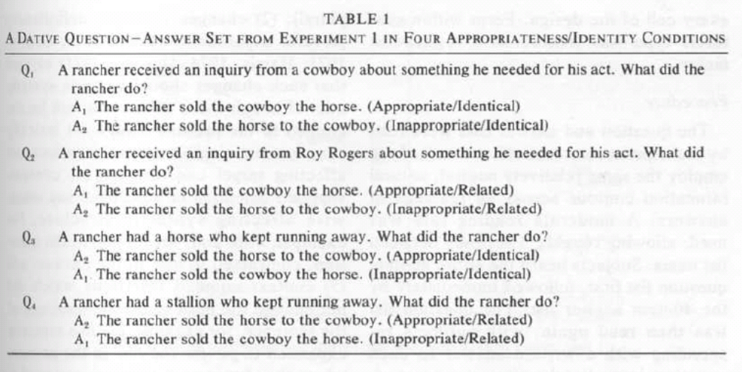
An early result: Bock & Irwin (1980)
RECALL PARADIGM (see p. 469)

Slide 15
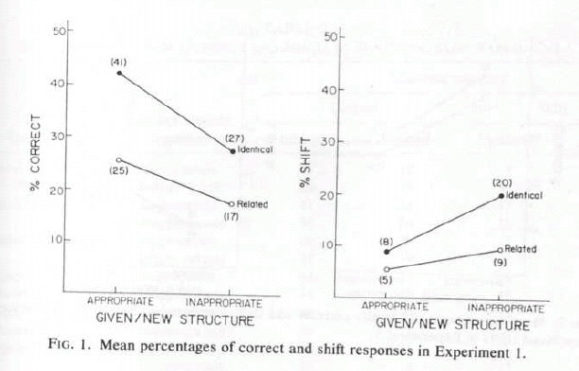
An early result: Bock & Irwin (1980)
RECALL PARADIGM (see p. 469)
old < new
new < old
old < new
new < old

Slide 16
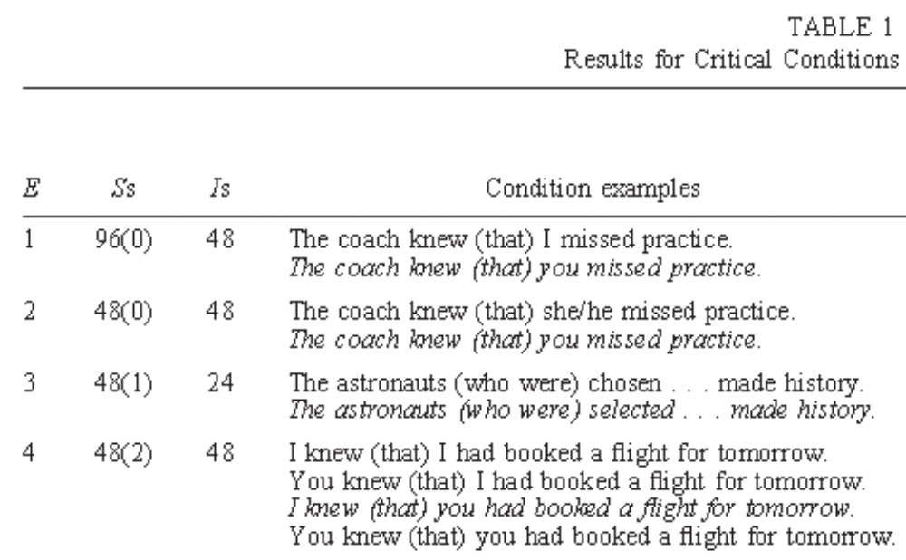
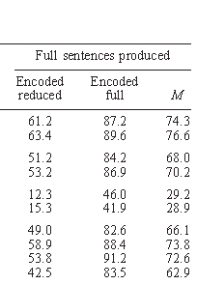
Beyond word order: Ferreira & Dell (2000)
More that-mentioning before less accessible complement clause subjects

Slide 17
Alignment vs. Availability
Are phrases with accessible referents ordered first because they are easy to produce (availability) or because they are aligned with the subject (alignment)?

Slide 18
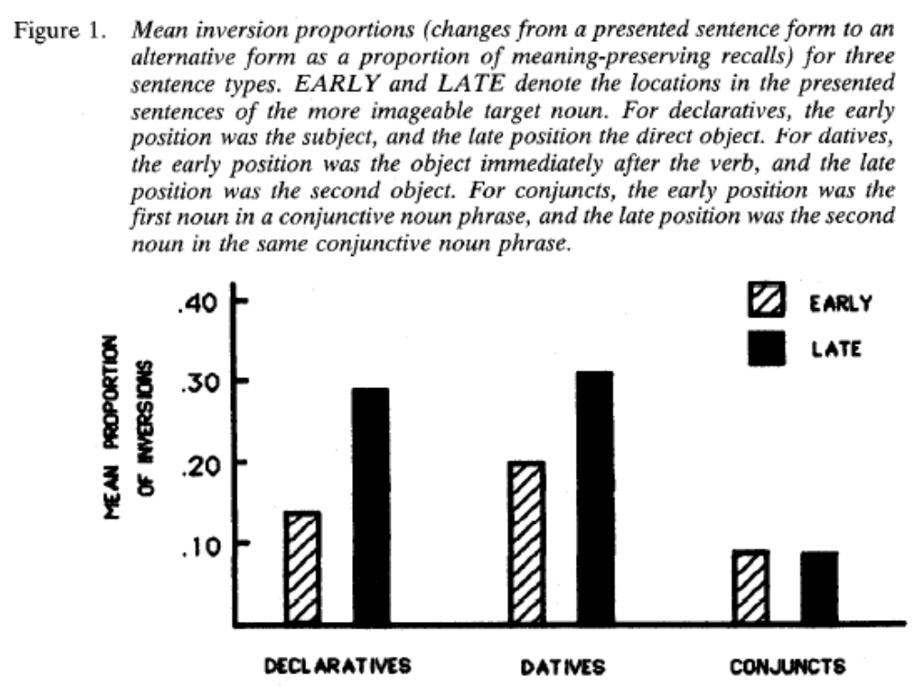
Bock & Warren (1985)
Tests in English limited to (lack of effect in) one structure (conjunction)
Evidence for alignment?

Slide 19
The problem of English-centric research
GF-assignment and word order confounded in English (cf. Prat-Sala & Branigan, 2000).

Slide 20
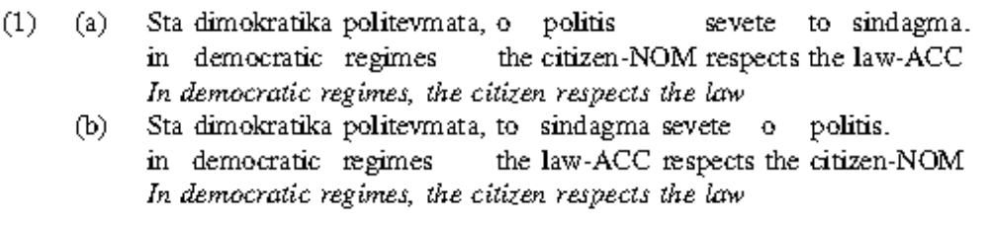
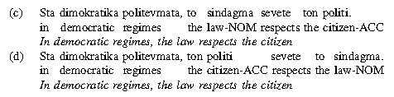
Branigan et al. (2007)
What about languages where GF-assignment and word order are not confounded? Greek, Japanese, German, …

Slide 21
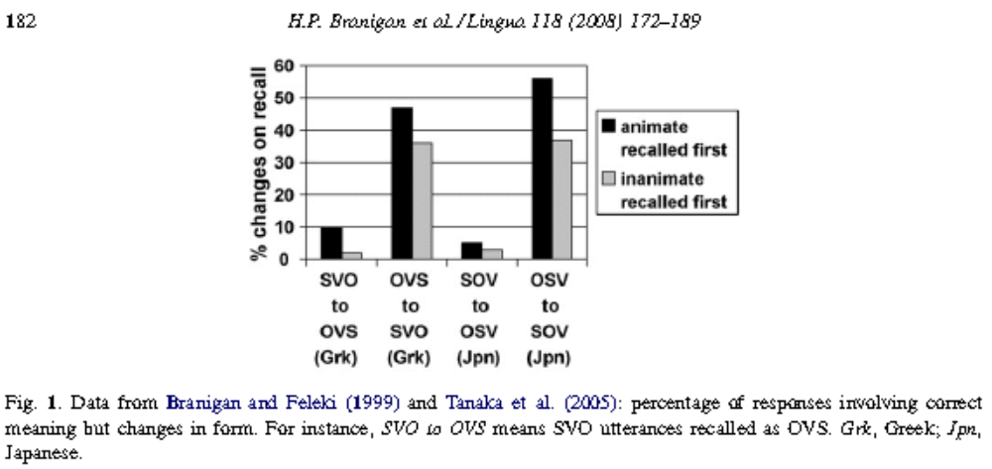
Results

Slide 22
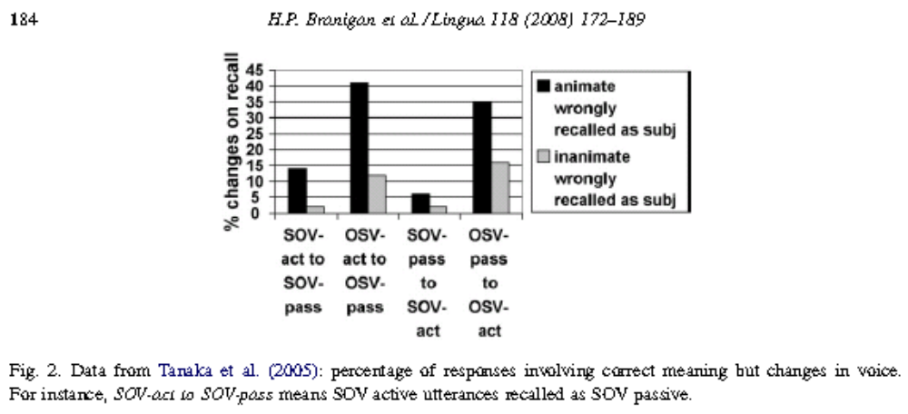
But also …

Slide 23
Ways to rethink Availability
Related or not?
  Aboutness, rather than givenness?
  [Prat-Sala & Branigan, 2000; Ferreira & Yoshita, 2003]
  Visual salience → aboutness or perceptual accessibility? [Gleitman et al., 2007; Krutchinsky et al., 2011; Myachykov et al., 2007]

Slide 24
Incrementality
Sentence production is incremental → we don’t plan entire sentences before we start talking
Evidence:
  Availability effects (see previous slides)
  Gaze patterns in production
  Cross-linguistics differences

Slide 25
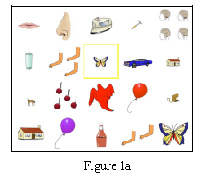
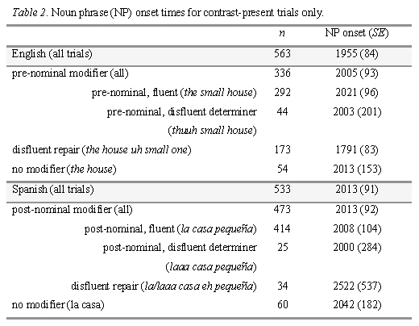
Brown-Schmidt & Konopka (2009)

Slide 26
But note:
Some look ahead:
  Order preferences based on ratio of constituent complexity
  Seen in initial pitch height
  Some preliminary evidence that fluency is affected by upcoming phrases (not just current phrase; Gomez Gallo & Jaeger, 2008-CUNY; Gomez Gallo, 2009)
  Inverse word-length effect, etc. (Griffin, 2003; Lindsay, 1975, 1976; van Nice & Dietrichs, 2003; Smith & Wheeldon, 1999; etc.)

Slide 27
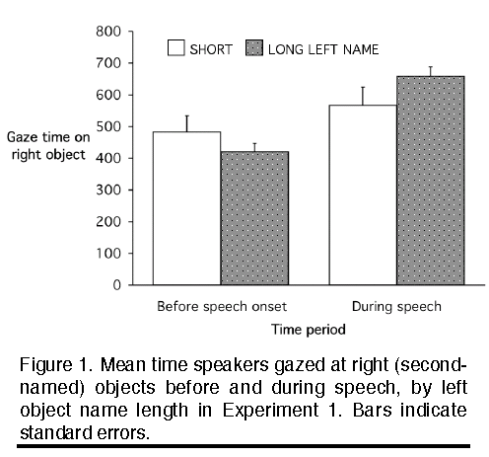
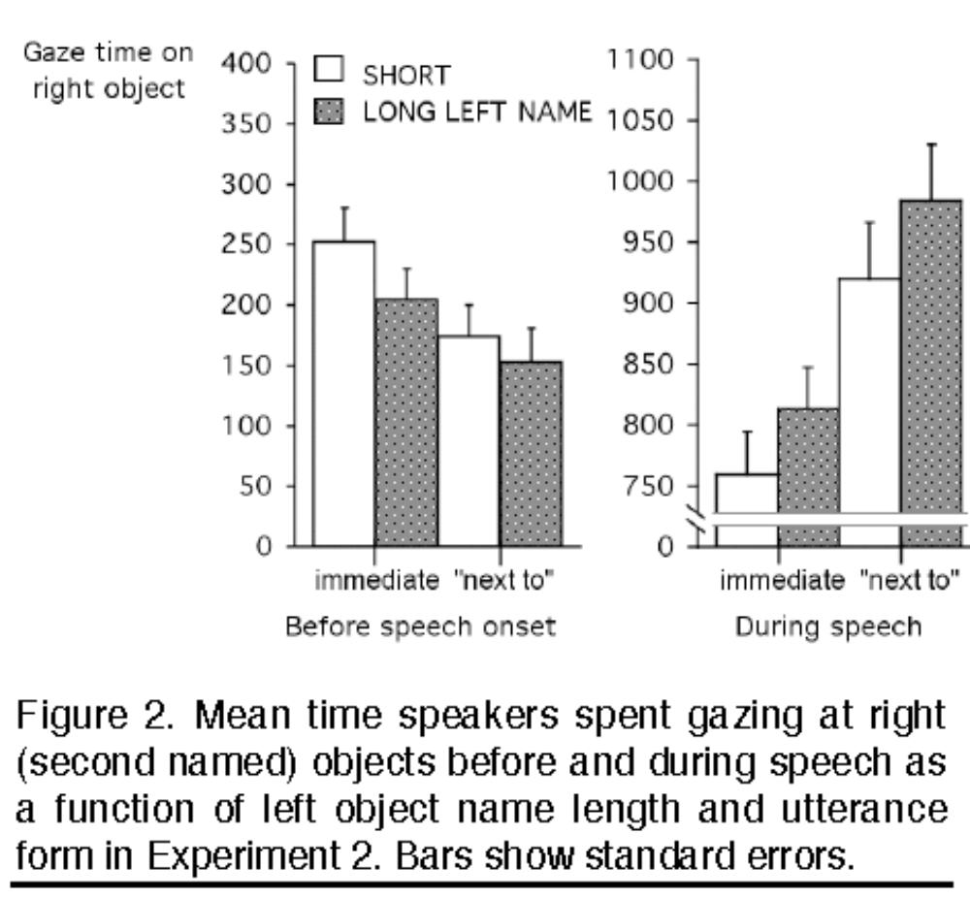
Griffin (2003) – EXP 1 & 2

Slide 28
Learning to produce sequences of words in (a correct) order

Slide 29
Dell et al. (2008)

Slide 30
Competition or Not?

Slide 31
Ferreira (1996)
Contrasts competition and ‘incrementality’ account (really, ‘syntactic flexibility’).
Alternating (give) vs. non-alternating verbs (donate)
x
Order constrained by task (“to” preposition had to be produced) vs. unconstrained
DV: latency and error rate

Slide 32
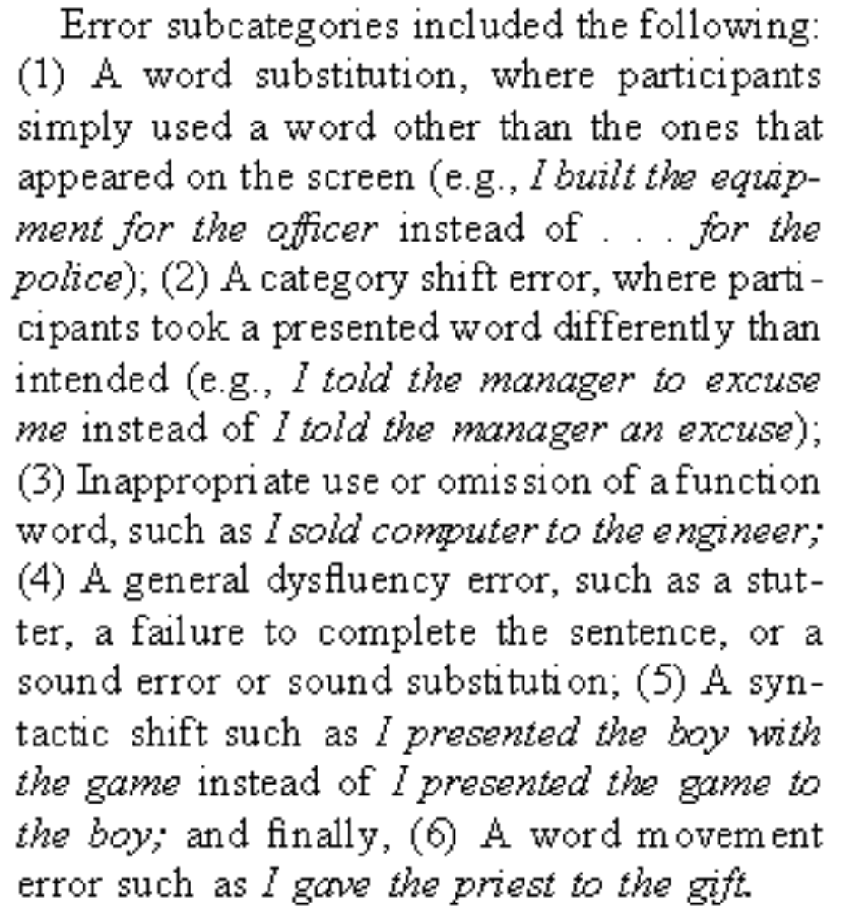
What counts as error?
Not just disfluencies (problems with formulating intended message), but also problems with task

Slide 33
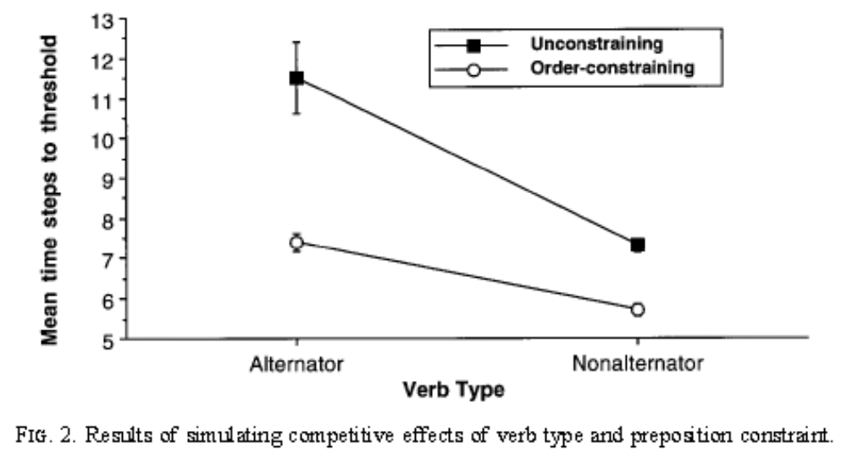
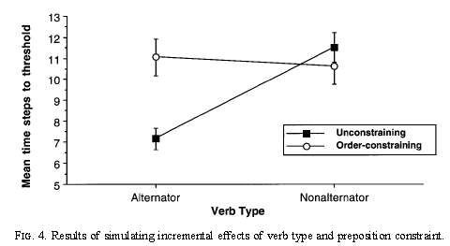
Competition
account
‘Incrementality’
account
Notes:
predictions

Slide 34
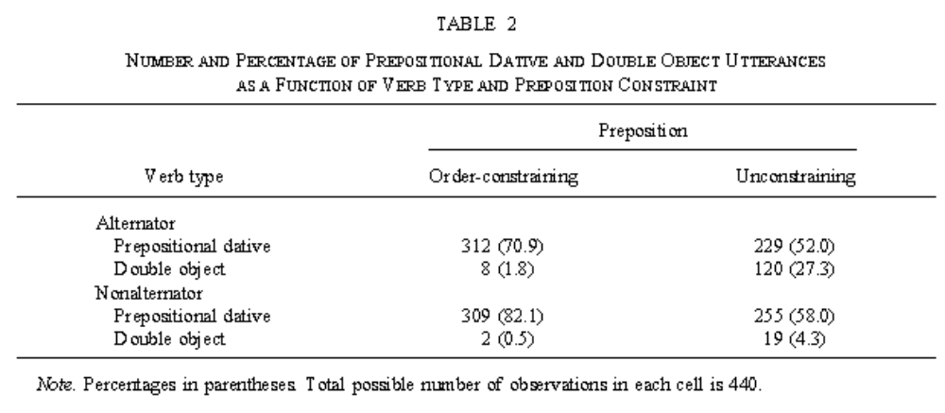
Results (EXP1) – Produced Structure
Notes:
red

Slide 35
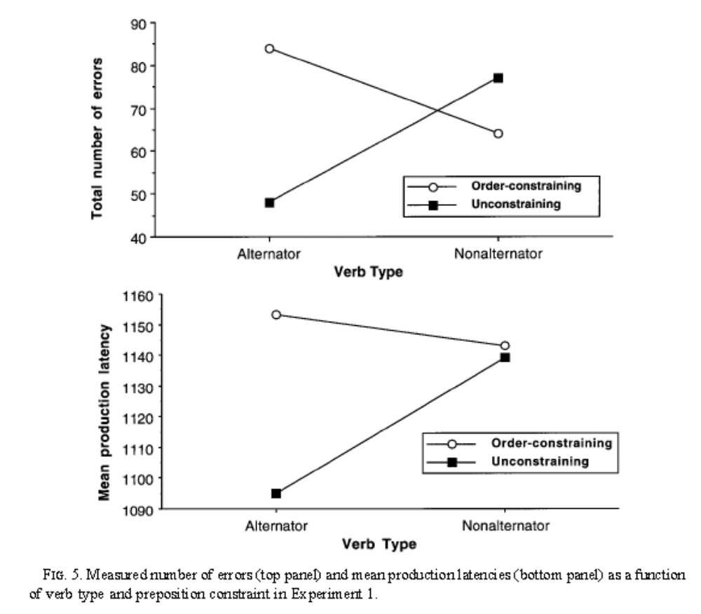
Results (EXP1) – Latency and Disfluency

Slide 36
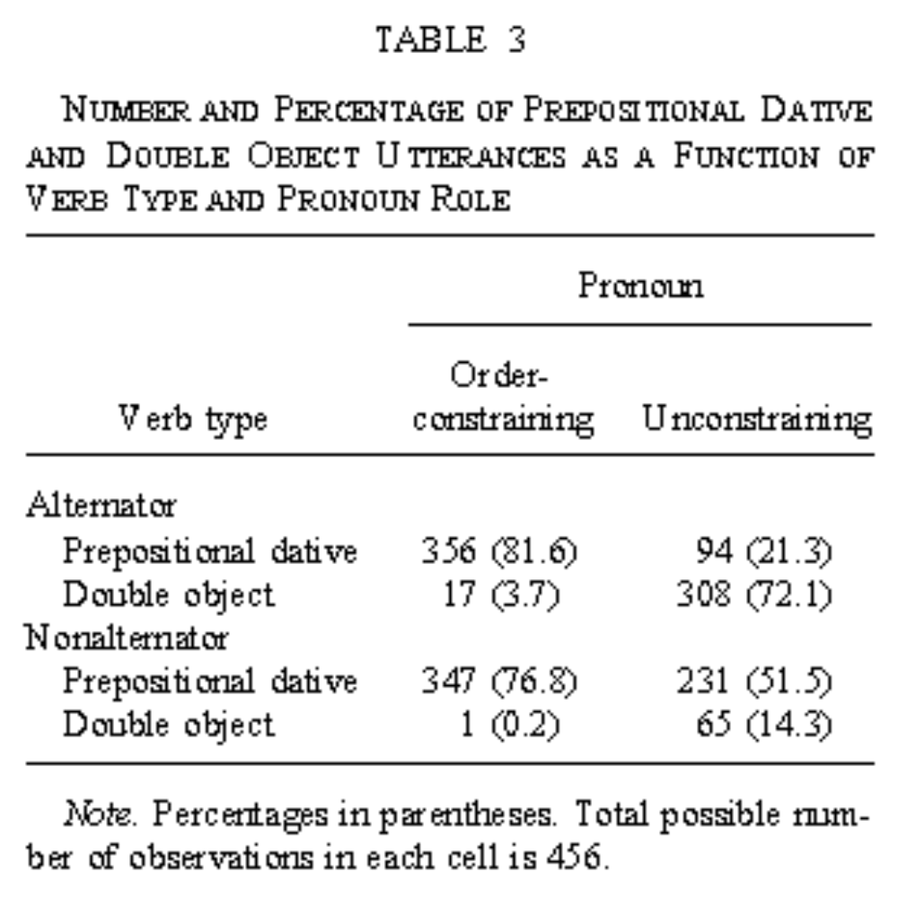
EXP2
Use unstressed pronoun to constrain order, rather than forcing people to produce “to” when constraining order

Slide 37
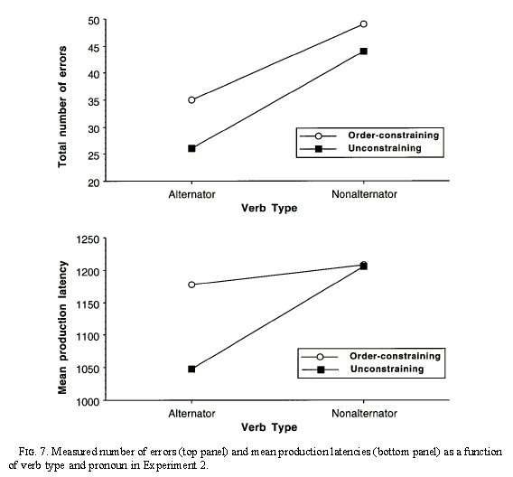
Results (EXP2) – Latency and Disfluency

Slide 38
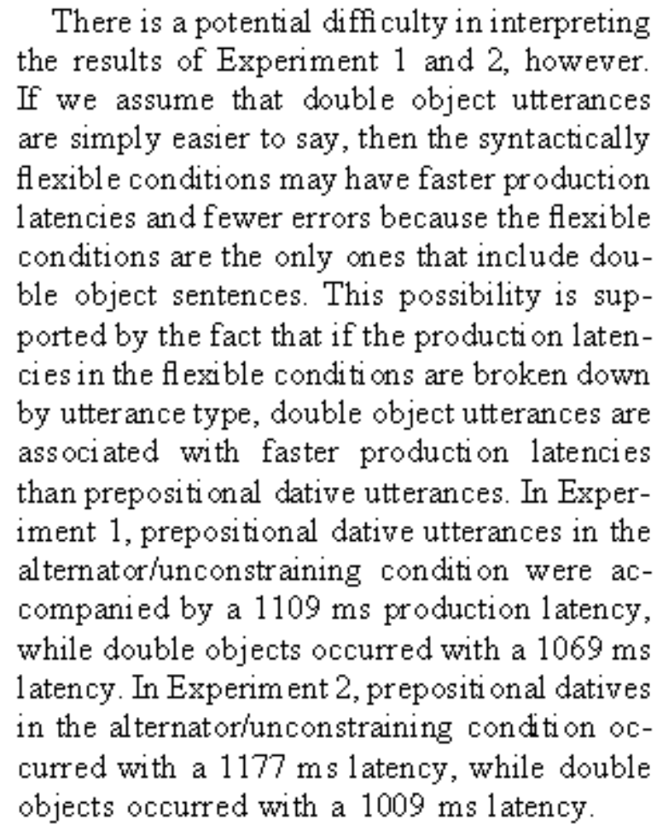
Can you think of an alternative interpretation?
Ferreira could (p. 743):

Slide 39
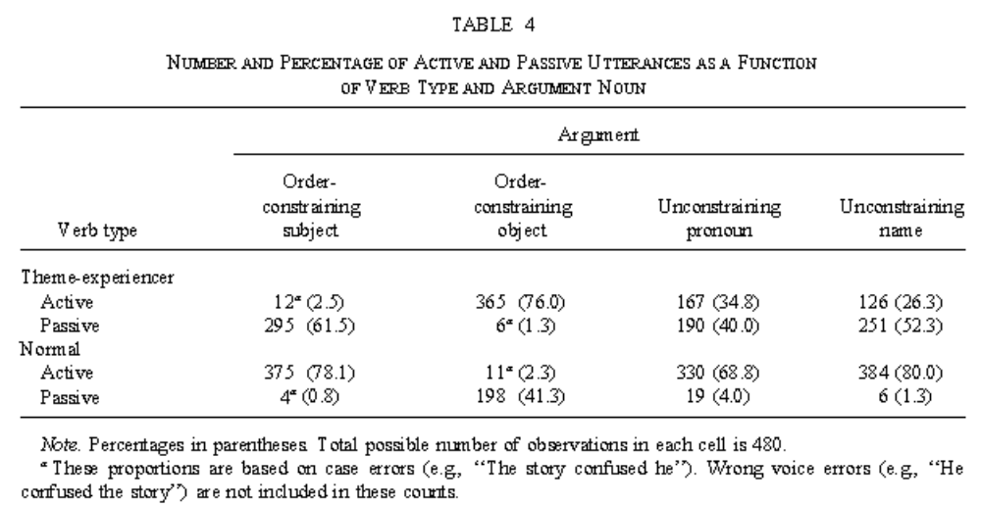
Active vs. Passive
Idea to address this problem: use active vs. passive choice and constrain order using case-marked pronouns (in recall-like task)

Slide 40
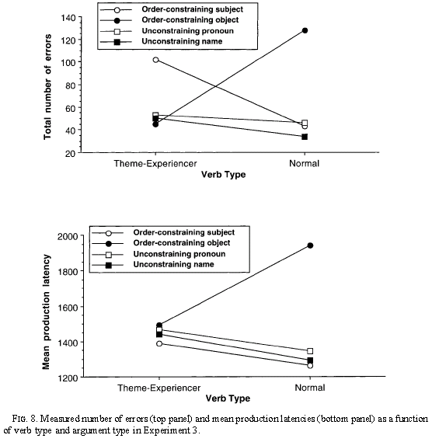
Results (EXP3) – Latency and Disfluency

Slide 41
But…
Does this really address the problem (as Ferreira, p. 750) claims?

Slide 42
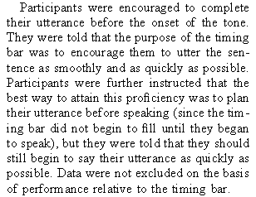
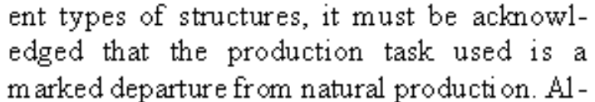
Some questions
Method and scoring: What do you think?
  ‘I gave’ … ‘toys/to/children’, ‘toys//children’ (p. 731)
  Also:
Theoretical:
  Does competition account really have to be non-incremental?
  Is there any evidence that the activation of the non-chosen structure matters?

Slide 43
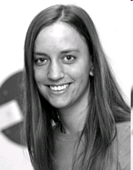
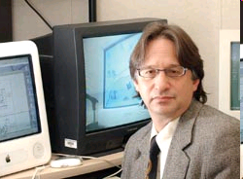
Producing less preferred structure
Wagner Cook*, Jaeger⁺, & Tanenhaus⁺ (2009)
*Psychology, University of Iowa
⁺ Brain and Cognitive Sciences, University of Rochester

Slide 44
Production of less preferred structure
What happens when speakers choose a less preferred structure (i.e. an unexpected and hence high information content structure)?
Competition-account: More production difficulty with less preferred structures
  Disfluencies (Shriberg 1996)
  Gestures (Gerwing & Bavelas, 2005; Rauscher, Krauss & Chen, 1996; Goldin-Meadow et al., 2001, Wagner et al., 2003)
‘Incremental account (Ferreira, 1996): no prediction

Slide 45
Method
Controlled elicitation of spontaneous descriptions using 3D animated videos
PO Simon is handing [the backpack] to [the girl].
DO Simon is handing [the girl] [the backpack].
Use distribution of structures in those descriptions to assess which structure (given the properties of the message) is preferred (a.k.a. probable → low in information content)

Slide 46
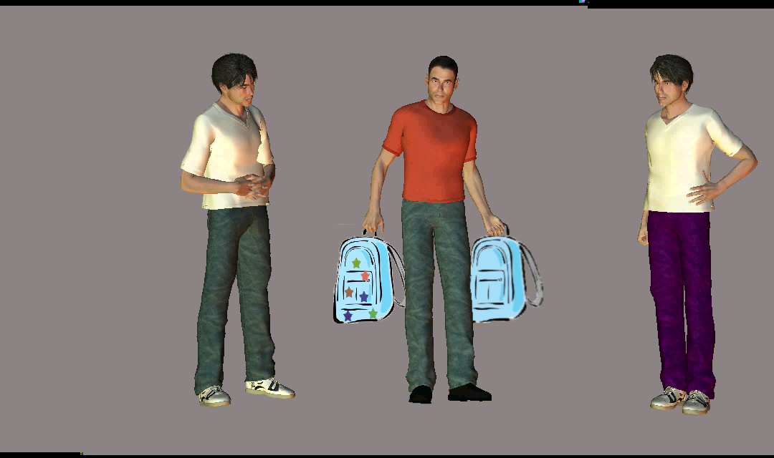
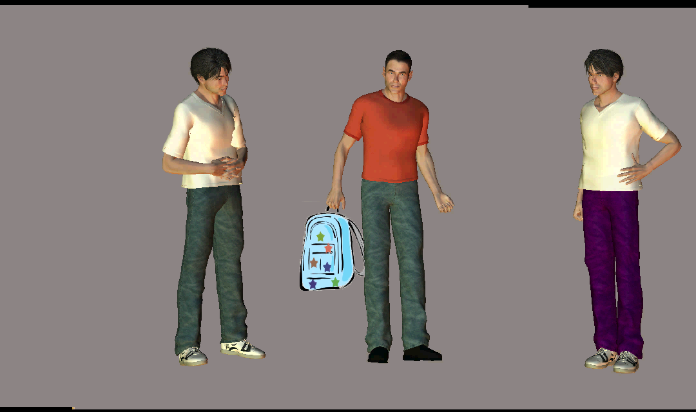
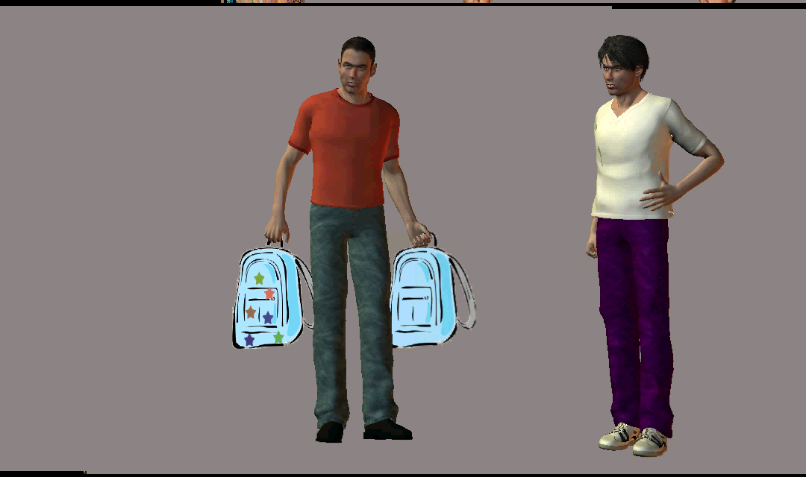
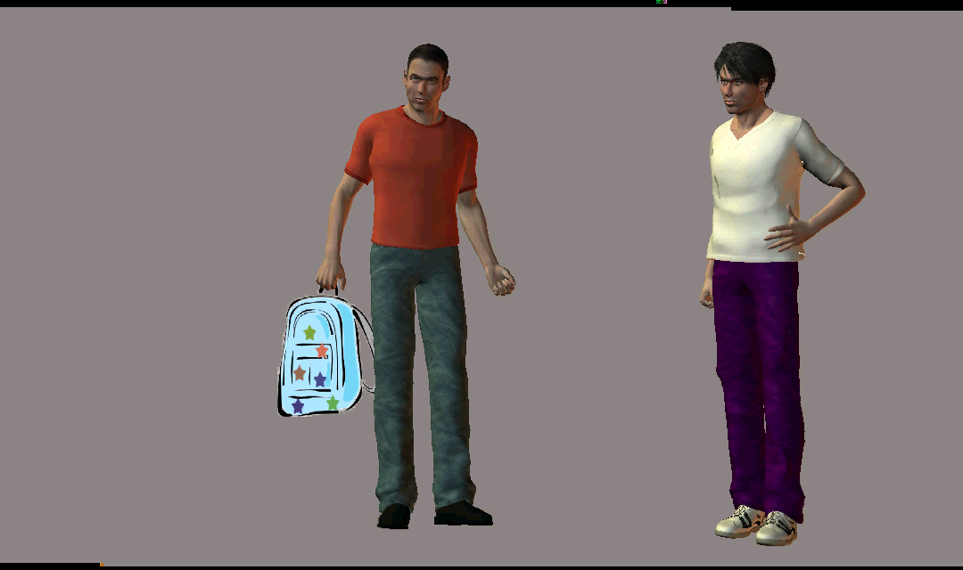
Method

Slide 47
Design
Use contrasts (→ modification → length of arguments) and verb bias to create items with widely differing associated structural preferences.
Verb bias
Less PP
More PP
Show
Give
Offer
Throw
Hand
Take
Contrast
Less PP
theme
both, neither
More PP
recipient

Slide 48
Information density of structures
Multilevel logit model to predict the probability of a DO vs. PO structure, based on
  Recipient NP: pronominality & modification (length)
  Theme NP: pronominality & modification (length)
  Syntactic prime
  Verb bias
  Speaker and video (as random effects)
Notes:
How much new information does u contain?
How surprising is u?
How (non-)redundant is u?

Slide 49
Analyses
Multilevel logit analysis to analyze when speakers’ produce disfluent utterances and when speakers produce gestures depending on preference for structure
Simultaneously controlling for:
  Length of sentence
  Random effects for individual differences between subjects and items

Slide 50
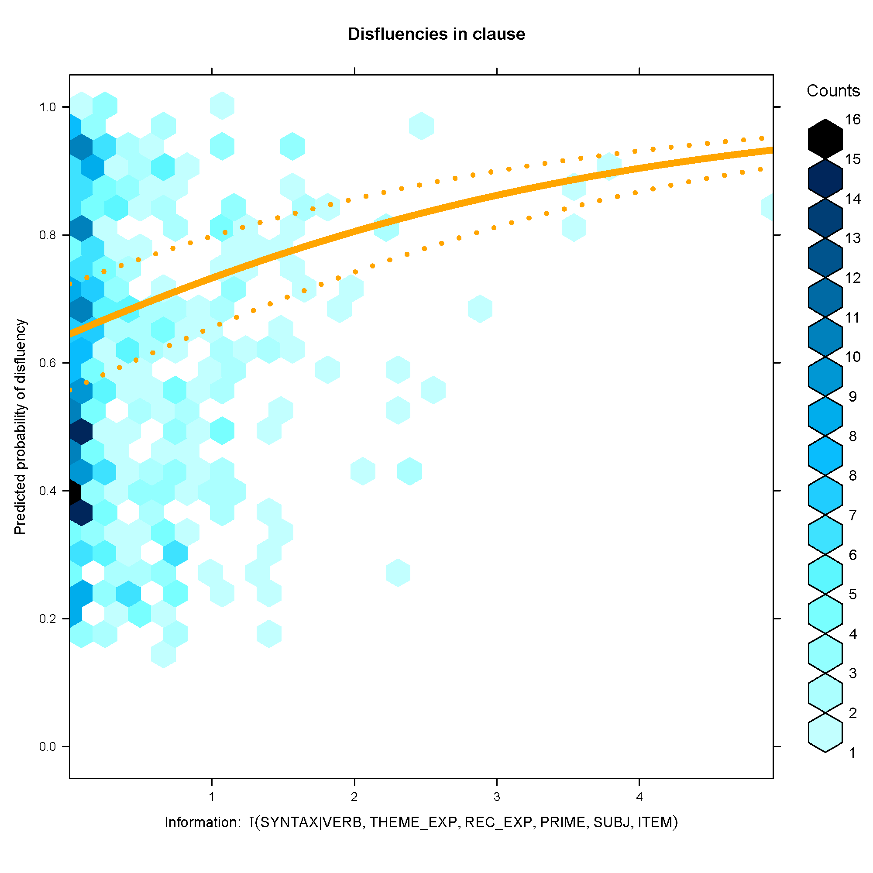
Less preferred structure

Slide 51
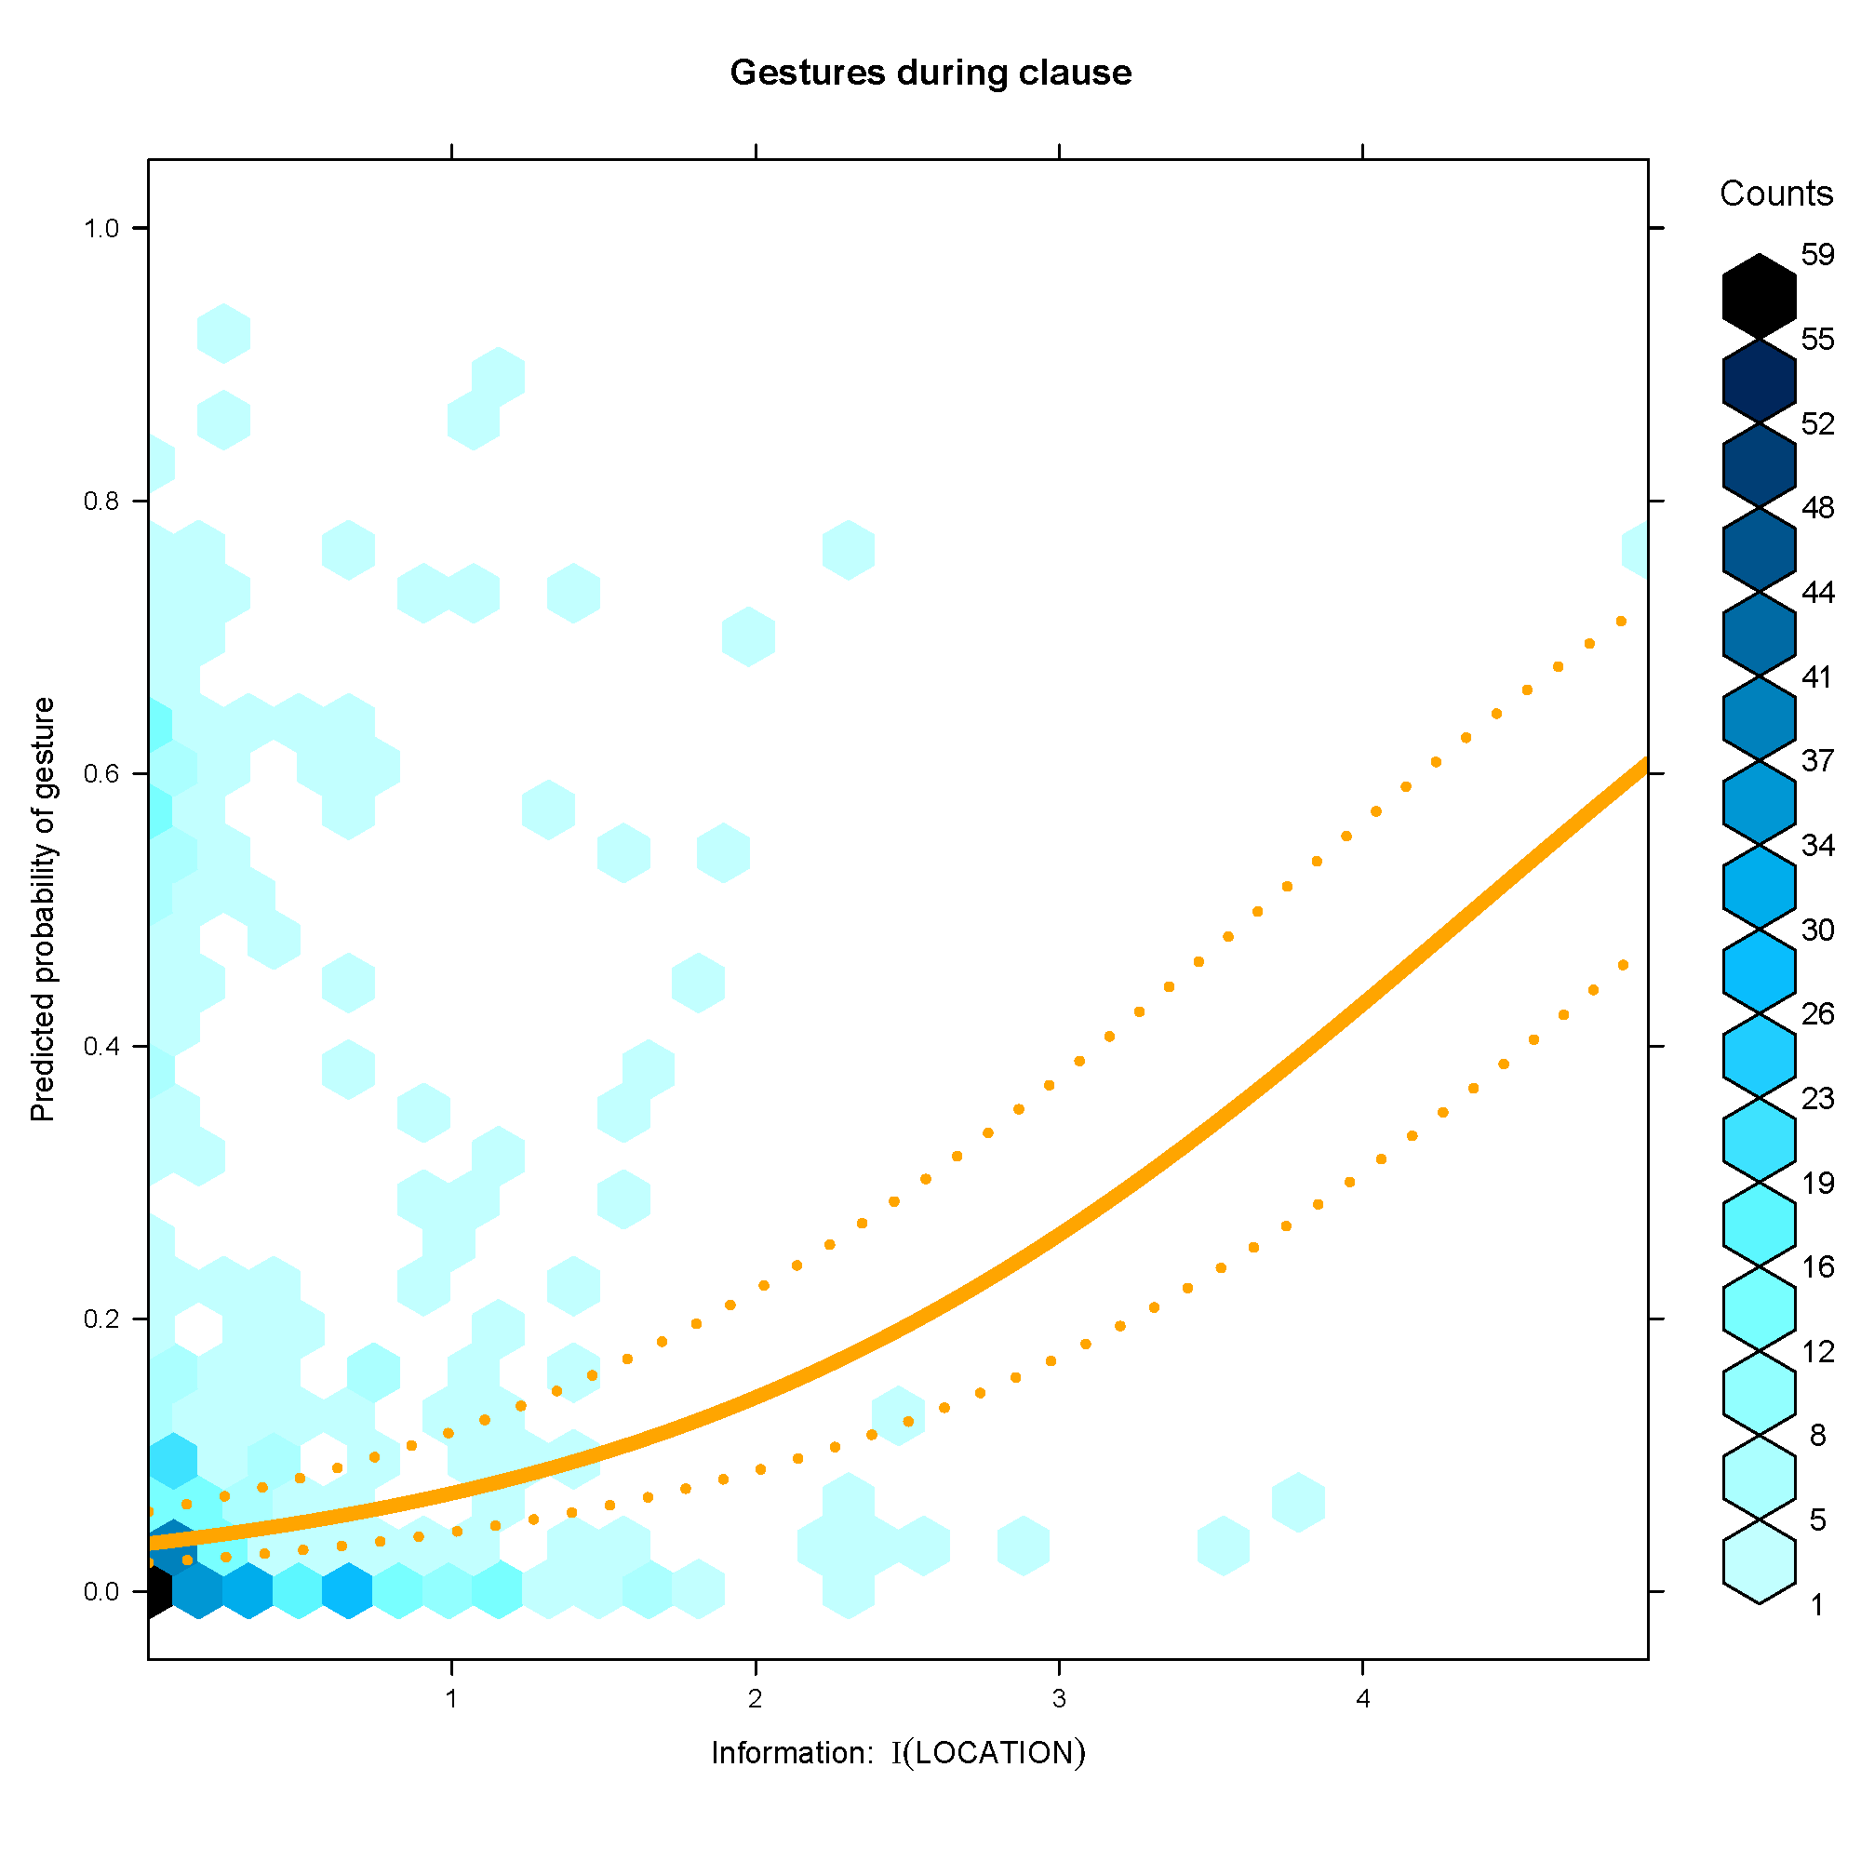
Less preferred structure

Slide 52
Summary
Speakers uttering a less preferred structure produce …
    … more disfluencies (see also Tily et al., 2007-CUNY)
    … more gestures
Predicted by competition accounts (and UID), but not by ‘incrementality’ accounts (Ferreira 1996)

Slide 53
Beyond the clause
Incrementality at the message level?

Slide 54

Information Density & Inter-clausal Planning
Gómez Gallo*, Jaeger⁺, & Smyth° (2008-LREC, 2008-CUNY, 2008-CogSci); Gómez Gallo* & Jaeger⁺ (in prep)
*CS & LIN, University of Rochester
*BCS & CS, University of Rochester
° LIN, University of Toronto

Slide 55
Inter-clausal planning
Given an intended message, what determines how speakers distribute the message across clauses?
Mono-clausal
  Put a tomato inside Central Park.
Bi-clausal
  Take a tomato. Put it inside Central Park.
→ accessibility-based theories make no predictions
Expression in same position and with same GF!

Slide 56
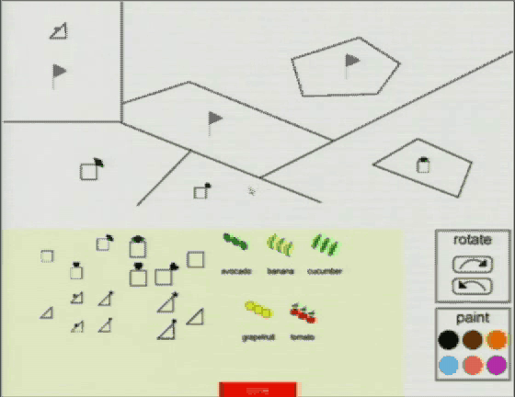
Data
Spontaneous elicitation of utterances in task-oriented dialogue (Fruit carts corpus, Gómez Gallo et al., 2007)
“Take a tomato. Put it inside Central Park.”

Slide 57
Manipulating early complexity
  Put an apple inside the Central Park.
THEME
THEME either easy had short label (tomato, banana, …) or required complex description (the triangle with the heart at the corner)

Slide 58
Natural production → many variants
Mono-clausal MOVE
  Put an apple inside Central Park.
  The apple is inside Central Park.
  …
Bi-clausal MOVE
  Take an apple. Put it inside Central Park.
  Take an apple and now put it inside Central Park.
  …
Left-dislocation
  The apple, put it inside Central Park.
Current study:
limited to V-initial

Slide 59
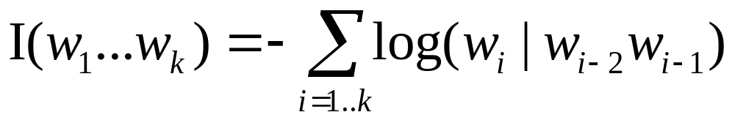
Estimating information of clause
We approximate information of clause by information content of argument expressions:
Mono-clausal: Put an apple inside Central Park.
Bi-clausal: Take an apple. Put it inside Central Park.
Shannon information of theme:
  Sum of information content of words
  Word information content estimated via trigram (w/ back-off & smoothing)
Notes:
How much new information does u contain?
How surprising is u?
How (non-)redundant is u?

Slide 60
Analysis
Multilevel logit analysis to analyze when speakers’ choose bi-clausal over mono-clausal utterances depending on information density of theme.
Simultaneously controlling for:
  Length, fluency, and givenness of theme
  Length, information density, and fluency of location
  Random effects for individual differences between subjects and elicitation sessions

Slide 61
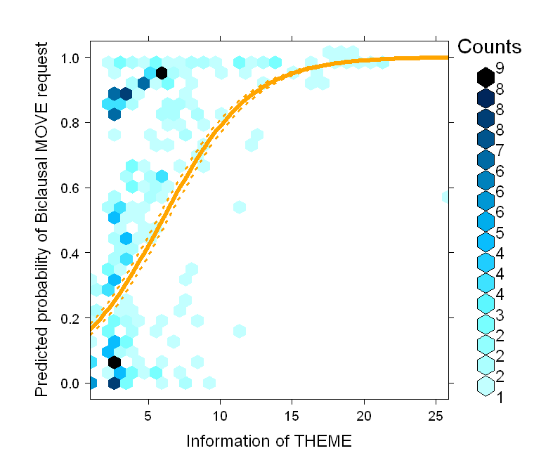
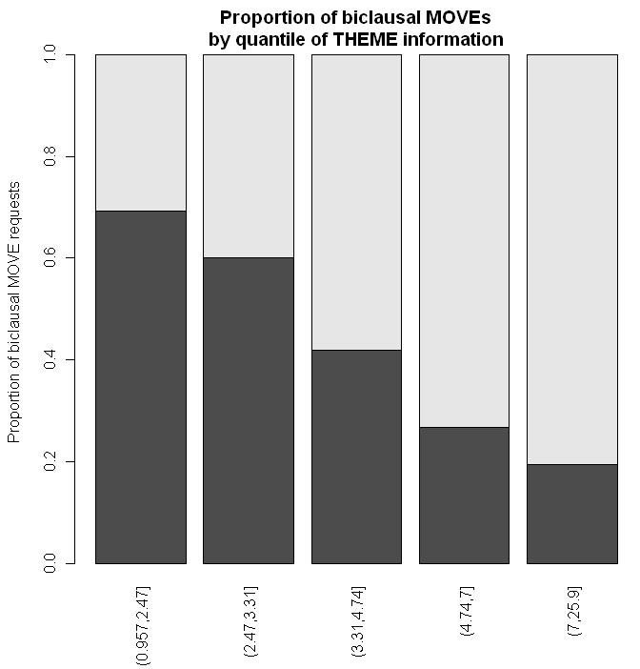

Slide 62
Time course of clausal planning
When is the choice for a mono/bi-clausal structure made? Can we be sure this is really a choice about clausal planning?
The verb already expresses a commitment to the structure and the verb is the first word in the sentence
Verb | Mono-clausal | Bi-clausal
take | 0% | 73%
move | 28% | 0%
put | 27% | 1%
be | 43% | 7%

Slide 63
Summary
Effect cannot be captured by accessibility-based theories
Early verb-choice would suggest that this is really a priori planning on how to distribute information across clauses

Slide 64
Ambiguity Avoidance
The last account of speakers’ choices to be discussed today builds on ideas from Audience Design (Brennan & Williams, 1995; Clark & Murphy, 1982; Clark, 1992; Lockridge & Brennan, 2002)
Speaker may avoid ambiguity, or –more specifically, so called garden paths for comprehenders (Bolinger, 1972; Hawkins, 2004; Snedecker & Trueswell, 2003; Temperley, 2003)

Slide 65
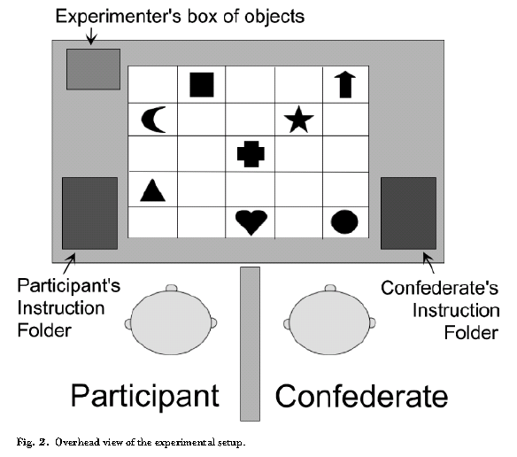
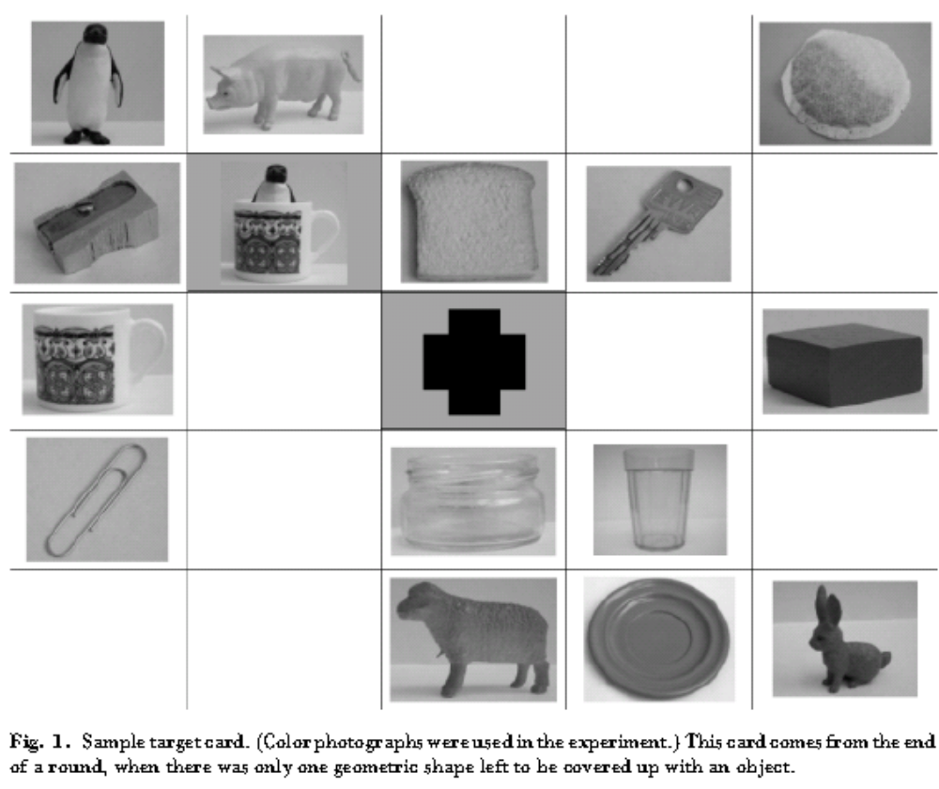
Evidence from PP attachment
(Haywood et al., 2005)
Put the penguin in the cup …
helpful or not

Slide 66
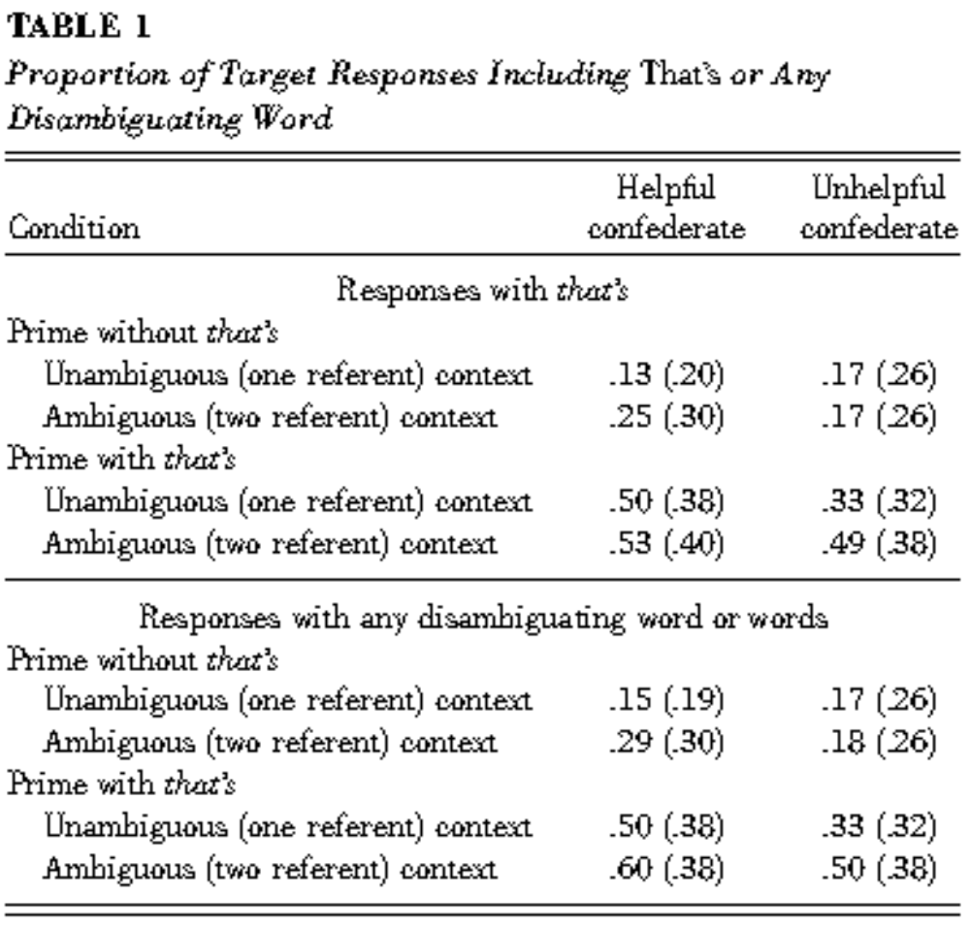
cnt'd
Proportions analyzed with ANOVA → has to be interpreted with caution

Slide 67
But …
… other studies –many of which contained better controls than previous studies– did not find ambiguity avoidance effects (Arnold et al., 2004; Ferreira & Dell, 2000; Jaeger, 2006; Kraljic & Brennan, 2005; Roland et al., 2005; Schafer et al., 2000)
… and others found only very weak evidence (Jaeger, 2010, 2011)

Slide 68
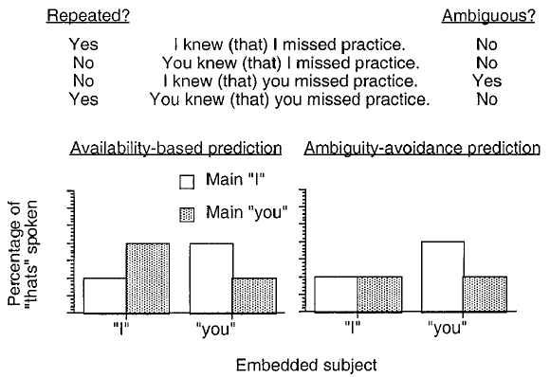
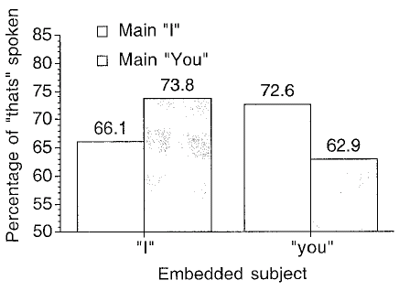
No sign of ambiguity avoidance
(Ferreira & Dell, 2000:316-318)

Slide 69
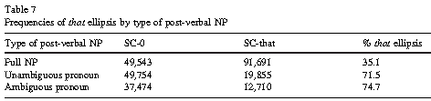
Replicated in corpus study
(Roland et al., 2005:25)
that-mentioning in complement clauses in British English: no sign of ambiguity avoidance

Slide 70
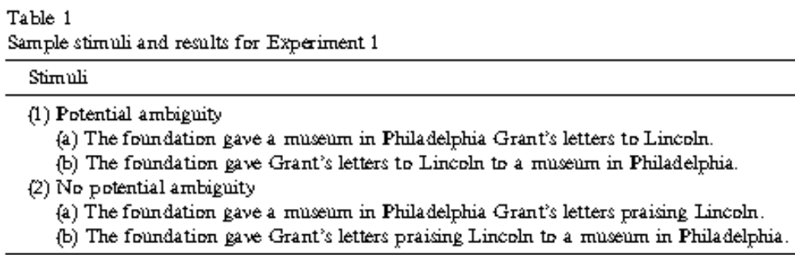
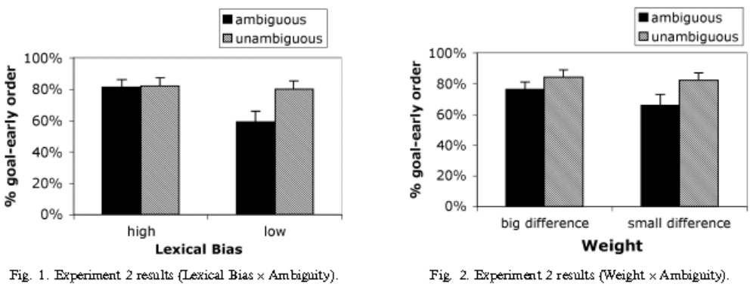
No PP-attachment avoidance
(Arnold et al., 2004:Experiments 2 & 3)

Slide 71
Garden-path avoidance vs. Ambiguity Avoidance
There is some evidence that speakers avoid long-lasting ambiguities where contextual biases would mislead comprehenders into garden-paths (Jaeger, 2006, submitted, in prep)

Slide 72
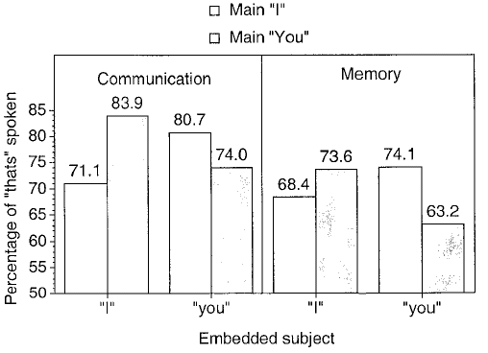
A different type of Audience Design? (Ferreira & Dell, 2000:324)
[…] speakers (the communication group) looked at and spoke to their addressees when they produced the sentence. Addressees rated the clarity of speakers’ productions with pen and paper on a 7-point scale. […] The group of speakers not paired with addressees (the memory group) performed the identical task, except that they did not speak to an addressee and no instructions about maximizing clarity were given.
More complementizers when audience present.

Slide 73
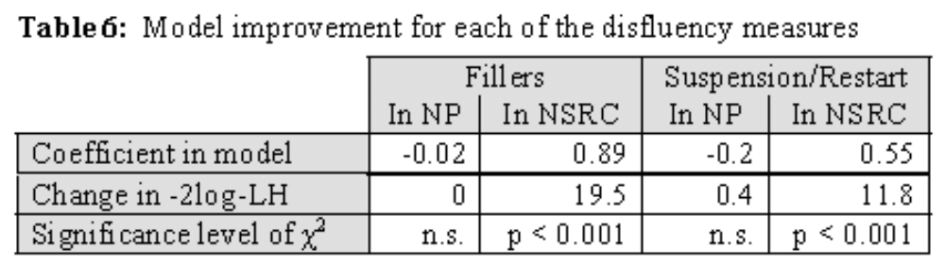
Different types of Audience Design
Maybe speakers do design their utterances to their audience, but they do not bother to avoid ambiguity, or at least not most:
  Real ambiguities, as in cases that can create serious garden paths, are rare (cf. Jaeger, 2006, submitted; see also pragmatic ambiguity, Wasow, 2002)
Collateral signals (Jaeger, 2005): that in complement and relative clauses could signal production difficulty (Clark & Fox-Tree, 2002)

Slide 74
Action vs. Product Tradition

Slide 75
Action Tradition
Speaker (primary) vs. utterance meaning:
Traveler:
  "Can you tell me what track the 3:00 train to London leaves from?"
Information desk:
  "The 3:15 express to Windsor stops at London and arrives earlier?"
→Speaker's plan is being recognized and responded to, not literal meaning

Slide 76
Action Tradition
Roots in Oxford school philosophers (Austin, Grice, Searl)
Grice's Cooperative Principle: Follows communicative Maxims:
      Quality (Be truthful)
      Quantity (Be informative)
      Relation (Be relevant)
      Manner (Be clear)

Slide 77
Cooperativeness
Participants in a conversation are cooperating
→ audience design

Slide 78
Current debate
Speakers design utterances for addressees
  Clark, Brennan, and colleagues
Speakers (and listeners) are egocentric:
  Keysar, Barr, Bard, Ferreira, and others
Empirical domains:
  Disfluency
  Ambiguity avoidance
  Collaborative terms (addressee knowledge)
  Choice of Referential expressions

Slide 79
Disfluencies
e.g. Thee uh, pauses
  Action Tradition: Collateral signals
    Inform hearer of state of production system
    Enable additional inference on audience’s side
  Product tradition: epiphenomena of production difficulty

Slide 80
Questions
Why different type of disfluencies in different contexts?
  Clark & Fox-Tree (2002) on uh/um: different choice signals severity of upcoming production difficulty
Why not just silence?
  Action Tradition: Clark (2004): collateral signal helps comprehenders (Arnold et al., 2003, 2007)
  Production Tradition: ??? (FJ’s favorite metaphor: don’t stop an old car once it’s running)
Even if disfluencies help comprehension, are they intended for that purpose?

Slide 81
Collateral signals
Also:
  Phonetic shortening of words, articulatory detail
  Reduction at other linguistic levels

Slide 82
Optional that
English complementizer [a] and relativizer [b] that can be omitted (in certain environments):
When and why do speakers use optional that?
[a] Some believe [_{CC} (that) optional that does not help speakers to prevent disfluencies].
[b] I present [_{NP} evidence [_{NSRC} (that) I collected from the Switchboard corpus]].

Slide 83
Overview - Method and data
3,701 NSRCs from the Switchboard corpus
  16% contained a disfluency
  1.3% were part of a disfluency
793 disfluencies overall
  44% were fillers/editing terms, predominantly uh/um (61%) and you know (32%).
  56% suspension & restarts (almost all suspensions are followed by a restart)

Slide 84
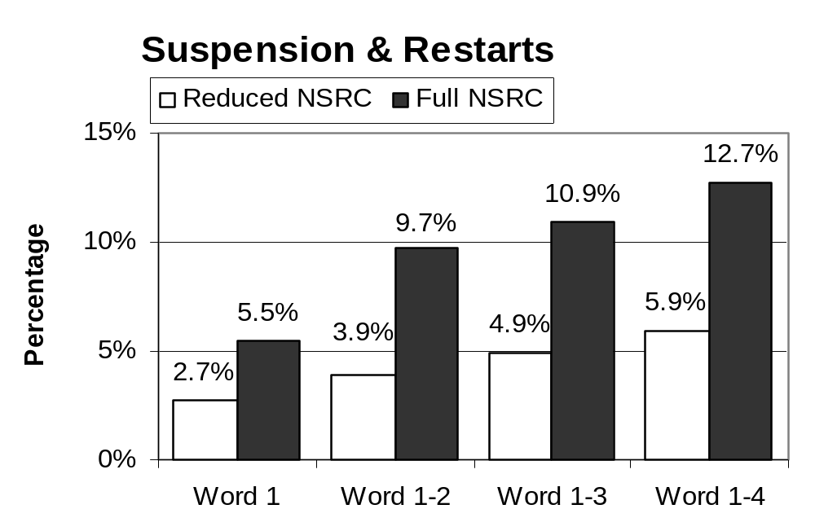
Early suspension & restarts
**
**
**
**

Slide 85
Is this yet evidence for a collateral signal account?
What if, optional that does not always but only sometimes buy sufficient time to completely alleviate production difficulty (and in other cases the encountered problem is too big, so that the time of uttering that does not suffice)?
Cases of incomplete alleviation would not lead to prevention of disfluency.

Slide 86
Alleviation Hypothesis
Let’s assume
(a) the success rate of optional that is less than 100% (i.e. sometimes it does not completely alleviate encountered production problems).
(b) for reasons that do not matter here optional that is also associated with more complex sentences.
(Race & MacDonald, 2003i; Jaeger et al., 2005; Jaeger & Wasow, 2005)
So, even though optional that alleviates production difficulty, there are still more disfluencies in full NSRCs than reduced NSRCs.

Slide 87
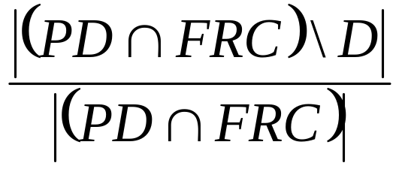
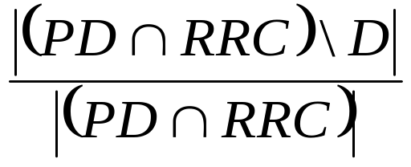
What it really means to test the Alleviation Hypothesis
The proportion of completely alleviated production difficulties in full NSRCs should be higher than the proportion of completely alleviated difficulties in reduced NSRCs.
But as PD is unknown, these proportions, cannot be calculated.
Reduced NSRCs (RRC)
Full NSRCs (FRC)
Disfluency (D)
Production difficulty (PD)

Slide 88
Great. So, what to do then?
One can, however, try to control for all kinds of factors that are known to make an NSRC complex (i.e. a member of PD).

Slide 89
Pronoun subject are easier to comprehend and presumably also easier to produce
Dep. Variable | Normalized disfluency rate in NSRC
Fixed effects [categorical] | Relativizer presence
 | Grammatical function of modified NP
 | Is the NSRC subject a pronoun?
[continuous] | Rate of speech before NSRC
 | Rate of speech in NSRC
 | Length of modified NP (in words)
 | Length of RC (in words)
 | Normalized rates of fillers in NP
 | Normalized rate of suspension/restarts in NP
Random effects | Speaker
Rate of speech usually correlates with disfluency rate
Words that are part of a disfluency per word
Length of NP and RC as an estimate of the grammatic weight/complexity
This may be indicators that production pressure is already high before the NSRC
To capture inter-speaker variation in the overall frequency of optional that
Other factors were tested but not included in the design since they did not contribute to the model at all.

Slide 90

Contrary to Alleviation Hypothesis
Relativizer presence (still) correlates with significantly higher disfluency rates in the NSRC.
  For fillers: F1(1, 652)=6.3, p<0.02
  For suspensions/restarts: F1(1, 989)=6.1, p<0.02
**
**

Slide 91
Signal Hypothesis
Signal Hypothesis Mentioning optional that is a collateral signal to addressees that the speaker is anticipating production difficulty in the NSRC.
With regard to the distribution of disfluencies, the Signal Hypothesis predicts that full NSRCs should contain significantly more disfluencies than reduced NSRCs.
The evidence seen so far is consistent with the Signal Hypothesis.

Slide 92
Three necessary conditions for (collateral) signals
In order for something to be a signal three conditions must be full-filled (Brennan & Williams, 1995):
  The cue must be produced reliably and spontaneously by speakers in dialog.
  It must vary depending on speakers intentions in the situation or toward addressees
  It must be interpretable by addressees.
☑
(☑)
?

Slide 93
Next step
Does optional that carry information about the state of the speaker’s production system (e.g. the likelihood of upcoming production difficulties) at the point when it’s uttered.
To avoid confounds, this has to be shown after controlling for other factors known to convey such information.

Slide 94
Design
Dep. variable | Normalized disfluency rate in NSRC
Fixed effects [categorical] | Relativizer presence
 | Grammatical function of modified NP
 | Existence of a pause before the NSRC
[continuous] | Rate of speech before NSRC
 | Length of modified NP (in words)
 | Normalized rates of fillers in NP
 | Normalized rate of suspension/restarts in NP
 | Standardized log-duration of optional that
Random effects | Speaker

Slide 95
Results
As predicted by the Signal Hypothesis, optional that is a significant predictor of a higher rate of suspensions and restarts (F1(1, 734)=20.4, p<0.001)
  as expected given e.g. Clark & Fox-Tree (2002), lengthening also was a significant predictor F1(1, 2854)=20.2, p<0.001
  Dito for pauses immediately preceding the NSRC F1(1, 2854)= 9.4, p<0.001
  Similar results were obtained for the rate of fillers.
Thus addressees could use presence of optional that as a collateral signal that the speaker is likely to run into production difficulties.

Slide 96
Referential expressions
Sensitivity to common ground: Speakers design their utterances to make adding to common ground easy.

Slide 97
Common ground
Participants work together against a background of common knowledge or common ground (what each participant can mutually believe)
In conversation, common ground is accumulated. The common ground forms the context for interpreting the speaker's meaning and the context for the speaker’s plans.

Slide 98
Factors important for common ground
Anything that helps to constraint the relevant domain for inferences:
  physical co-presence
  linguistic co-presence
  cultural co-presence
  shared previous experience

Slide 99
Examples
"Consider the stallion".
  Possible referents of stallion:
    horse (pasture context)
    test tube contents (vets)
    painting
Meaning and reference constructed from lexical, world, and contextual knowledge:
"I'm hot"
    Get me the ball. (Basketball)
    I wouldn't bet if I were you. (Poker game)

Slide 100
Grounding
Establish common ground through grounding.
Establishing reference
    A: Do you know the guy next door?
    B: Derek?
    A: Yeah. Well, he just got a great job in Alaska for the summer.
    A: Do you know the guy next door?
    B: Uh-huh
    A: Well, he just got a great job in Alaska for
    the summer?
Grounded utterances contribute to mutual belief. (I know, you know, we know)

Slide 101
Grounding, continued
Claim: Speakers design their utterances to make adding to common ground easy.
  Given-New contract: Utterances divided into Given (what we know) and New (additional information)
  Given information comes first unless explicitly marked
    Where did John go? John went to the store.
    Who went to the store?

Slide 102
Tangram
    Then number 12 is.. looks like uh uh dancer or something really weird. Um, and has a square head and um, there's like, there's uh thee kinda this um
1
4
11
12
matcher
director

Slide 103
Tangram
Director (D); Matcher (M); Overhearer (O):
    D: Then number 12 is.. looks like a, a dancer or something really weird. Um, and has a square head and um, there's like, there's uh the kinda this um
    M: Which way is the head tilted?
    D The head is eh- towards the left, and then th- an arm could be like up towards the right?
    M: Mm-hm,
    D*And, Its
    M:*an a big* fat leg? *You know that one?*
    D: Yeah, a big* fat leg.
    M: and a little leg.
    D. Right
    M Okay
    D Okay
    M: Yeah
Afterwards: Dancer with the fat leg

Slide 104
Results
Common knowledge is appealed to and created.
References become shorter over discourse
Overhearers have difficulty.
Evidence for collaborative effort
But (says the Product Tradition): how do we know that this is done for comprehension?

