Slide 1







Spoken word recognition
The problem:
Spoken words unfold as a series of transient acoustic events extending over a few hundred ms, without reliable cues to word boundaries.
Imagine reading this page through a two-letter aperture, the text scrolling past without spaces separating the words, at a variable rate one could not control, with the visual features for each letter arriving asynchronously.
Segmentation problem
Recognition problem

Slide 2
Outline
Early results (M-W-mid 1970s)
Early recognition and context
Cohort model (parallelism and uniqueness)
TRACE (interactive activation)
Competitors (NAM)
Feedback (lexical-phonemic)
Sentence context
Sub-phonetic detail (it’s the stimulus stupid)
subcategorical mismatch
syllable duration
within-category variation
perceptual learning
Exemplar models
indexical information
What’s next?

Slide 3
Outline
Early results (M-W-mid 1970s)
Early recognition and context
Cohort model (parallelism and uniqueness)
TRACE (interactive activation)
Competitors (NAM)
Feedback (lexical-phonemic)
Sentence context
Sub-phonetic detail (it’s the stimulus stupid)
subcategorical mismatch
syllable duration
within-category variation
perceptual learning
Exemplar models
indexical information
What’s next?

Slide 4
Marslen-Wilson’s early results
Monitoring (1975)
  (category, rhyme, identity)
Close shadowing (1973)
  Error patterns
  Restoration (M-W & Welsh, 1975)
    shigarette study

Slide 5
Outline
Early results (M-W-mid 1970s)
Early recognition and context
Cohort model (parallelism and uniqueness)
TRACE (interactive activation)
Competitors (Nam)
Feedback (lexical-phonemic)
Sentence context
Sub-phonetic detail (it’s the stimulus stupid)
subcategorical mismatch
syllable duration
within-category variation
Perceptual learning
Exemplar models
indexical information
Ideal observer(Bayesian models)

Slide 6
Cohort Model
Mapping against multiple lexical representations aligned at onset
Finesses Segmentation
  Elephant
elephant
elevator
elegant
E
L
E

Slide 7
Evidence for parallelism/cohorts
The cohort
    elephant (elegant, eloquent, element, elevator)
  Phoneme monitoring
    (point where lexical effects emerge)
  Gating
    recognition at point where word becomes unique
  X-modal priming
      bank
        ^1 ^2
        1. priming to both money and river
        2. priming to only money
      kapitain
      ^1 ^ 2
        1. priming to lift and trunk
        2. priming only to trunk
The nervous double agent was certain there was a bug^ hidden^ in his room
spy

Slide 8
Outline
Early results (M-W-mid 1970s)
Early recognition and context
Cohort model (parallelism and uniqueness)
TRACE (interactive activation)
Competitors
Feedback (lexical-phonemic)
Sentence context
Sub-phonetic detail (it’s the stimulus stupid)
subcategorical mismatch
syllable duration
within-category variation
Perceptual learning
Exemplar models
indexical information
What’s next?

Slide 9
TRACE (McClelland & Elman, 1986) interactive activation:continuous mapping
words
beaker
speaker
phonemes
/b/
features
quasi-spectral input

Slide 10
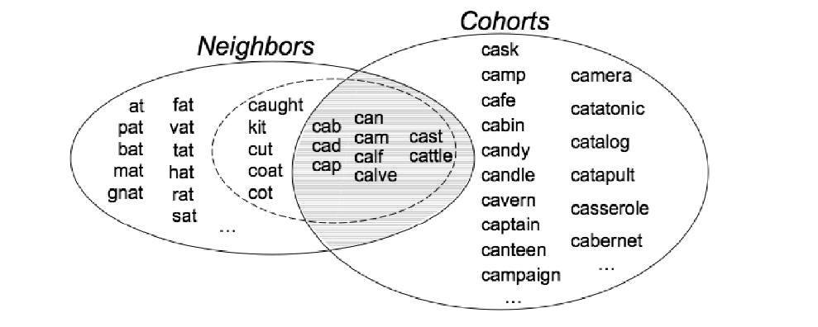
Competitors
Which words compete?
Neighborhood Activation Model (Luce & Pisoni, NAM)
Recognition time related to frequency-weighted neighborhood probability: word’s frequency/sum of its own frequency and frequencies of its neighbors.
Evidence:
shadowing
words in noise
lexical decision

Slide 11
TRACE activation functions for target, cohort, rhyme and unrelated competitors

Slide 12
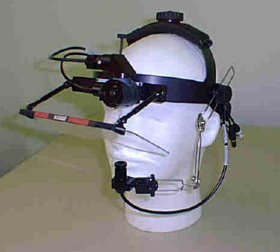
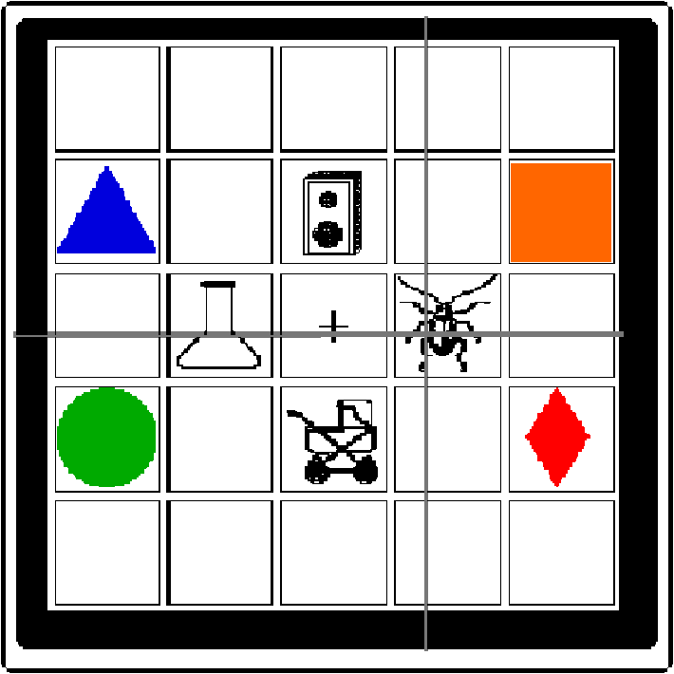
Allopenna, Magnuson & Tanenhaus (1998)
Eye
Eye camera
tracking
computer
Scene camera
‘Pick up the beaker’

Slide 13
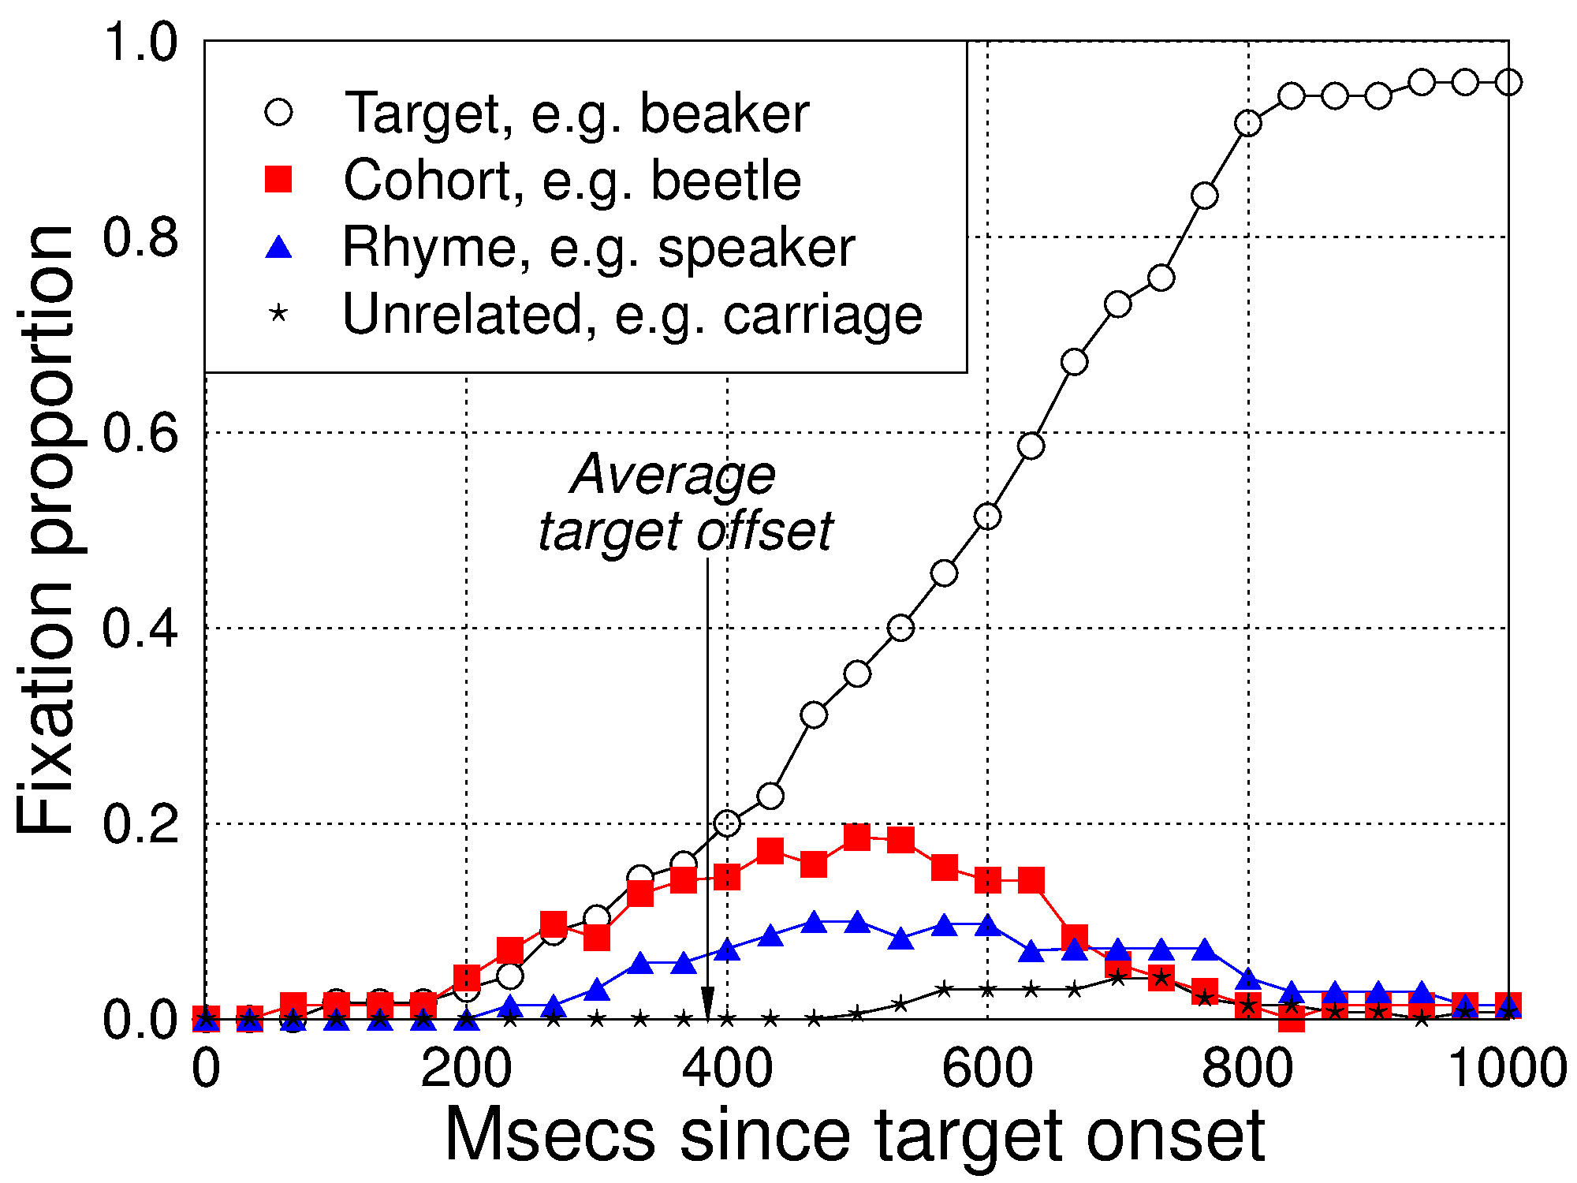
Allopenna et al. Results

Slide 14
Linking hypothesis:
•Activations converted to probabilities using the Luce (1959) choice rule
S_{i} = e ^{kai}
  S: response strength for each item
  a: activation
  k: free parameter, determines amount of separation between activation levels (set to 7)
L_{i} = S_{i} / ∑ S_{i}
Choice rule assumes each alternative is equally probable given no information; when initial instruction is “look at the cross” or look at picture X, we scale the response probabilities to be proportional to the amount of activation at each time step:
d_{i} = max_act_{i} / max_act_overall
R_{i} = d_{i} L_{i}
Referent (e.g., "beaker")
Cohort (e.g., "beetle")
Rhyme (e.g., "speaker")
Unrelated
Average target offset
0
200
400
600
800
1000
Time since target onset (msec)

Slide 15
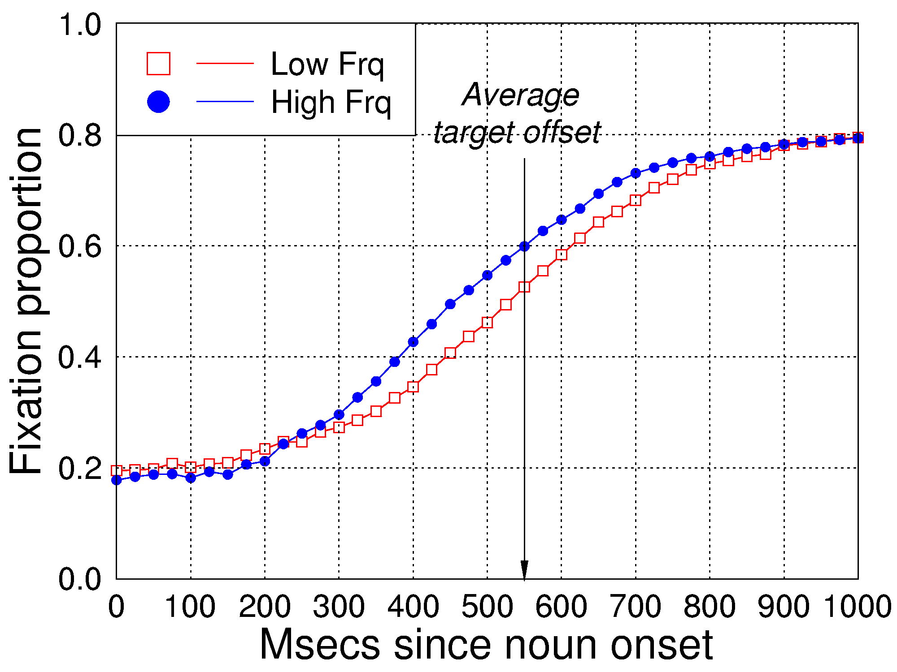
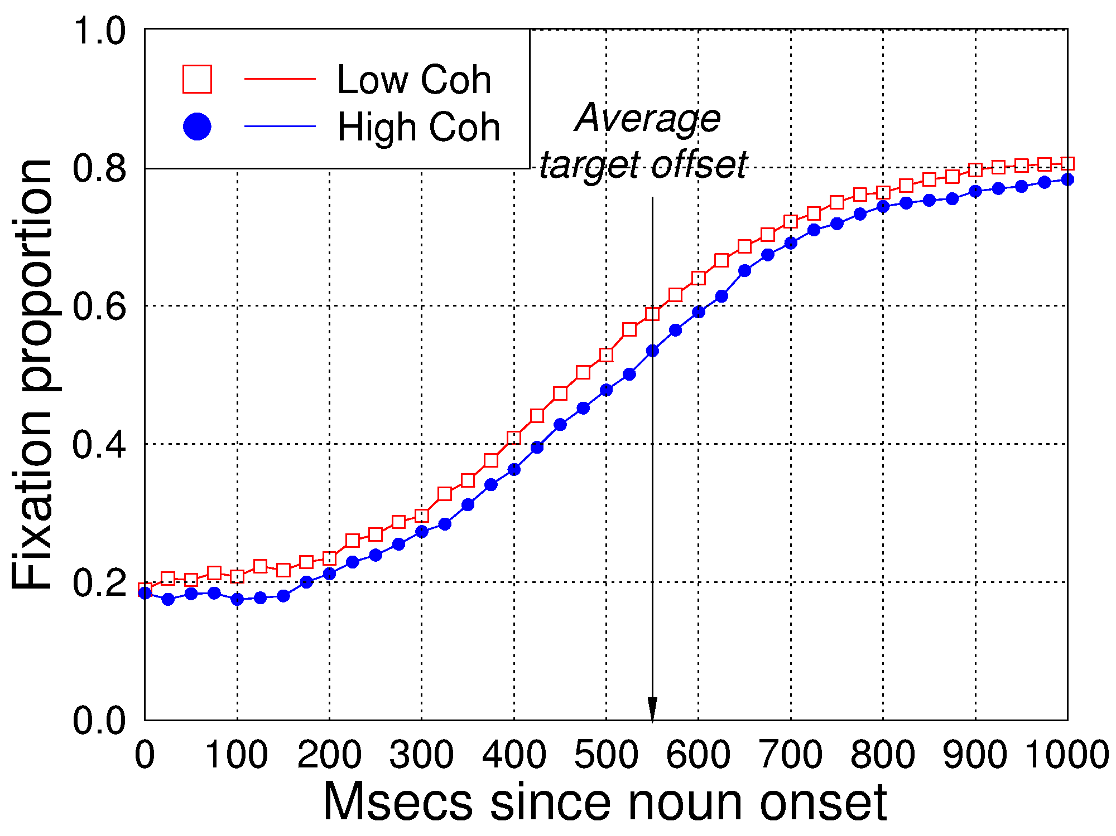
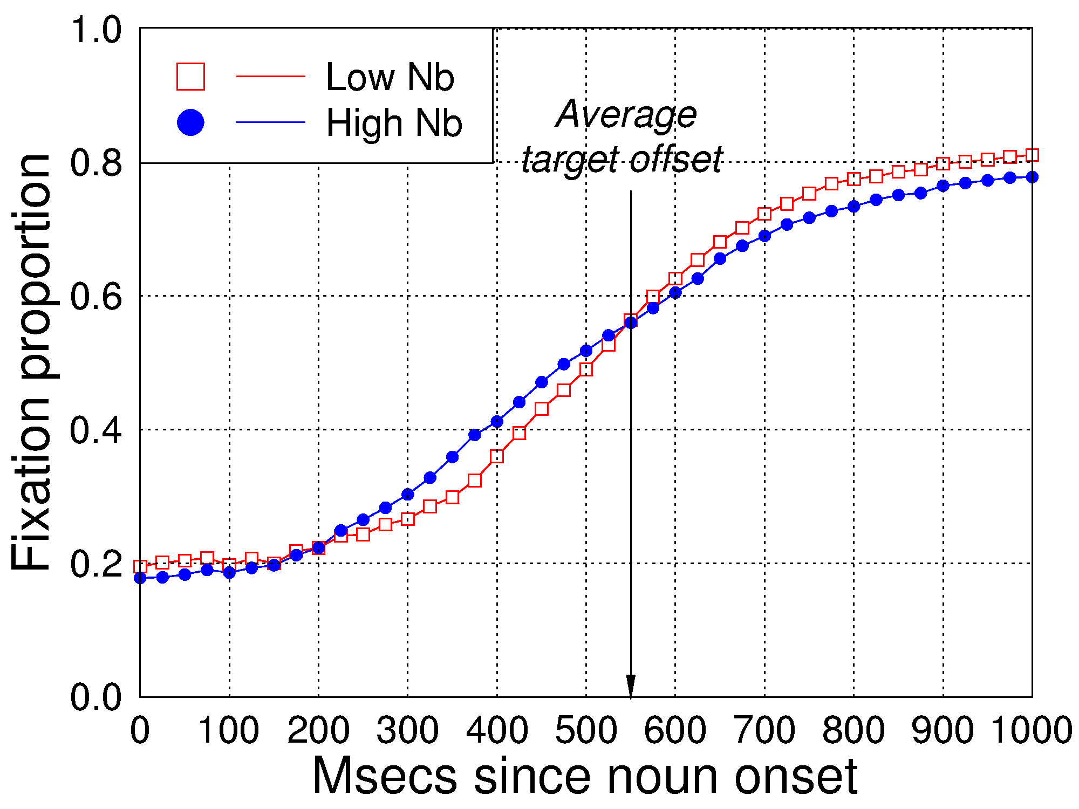
Magnuson et al. (Cognitive Science, 2007)

Slide 16



Salverda, Dahan & McQueen (Cognition, 2003)
Ze dacht dat die hamster verdwenen was
Ze dacht dat die hamster verdwenen was
Ze dacht dat die ham

Slide 17


Salverda et al., 2007
Put the cap next to the circle
Now click on the cap

Slide 18
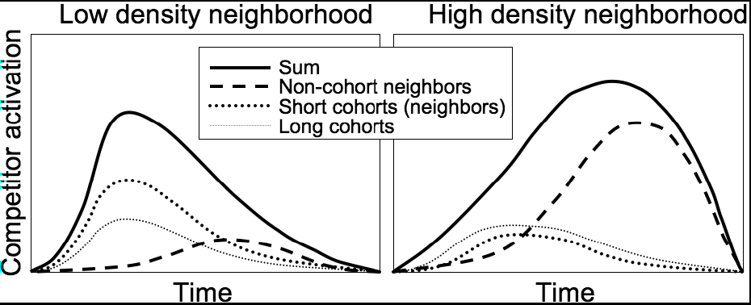
Syllable duration and neighborhoods

Slide 19
Adding new words
Gaskell & colleagues
cathedruk
Initially facilitates lexical decision to cathedral, then after time it interferes

Slide 20
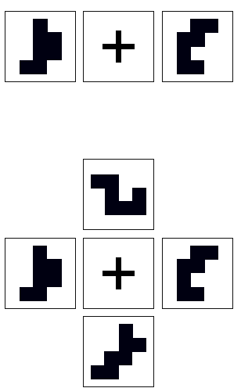
Artificial lexicon paradigm
Magnuson, Tanenhaus, Aslin & Dahan (2003) JEP:Gen
15 participants learned a 16-word lexicon
Words refer to shapes →
  7 contiguous cells randomly filled in a 5x5 grid
  Random word → picture mapping for each subject
Four sets like:
  pibo pibu dibo dibu
Allows high- and low-frequency (HF vs. LF) items with HF or LF neighbors

Slide 21
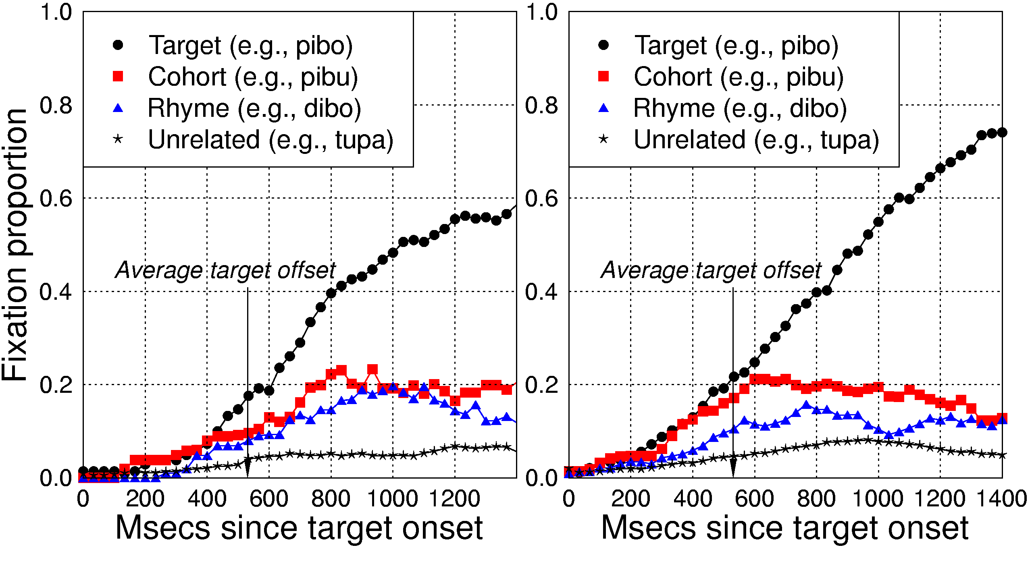
Cohort and rhyme effects

Slide 22
Artificial lexicon language studies
Lexical learning
Creel et al., (stress, indexical effects, cons/vowels); Shatzman & McQueen (prosody in lexical learning and representation)
Context effects (create well-defined contingencies, well-controlled neighborhoods)
(Pirog Revill, Tanenhaus & Aslin, 2008; Magnuson, Tanenhaus & Aslin, 2008)
Does word recognition automatically activate perceptual/motor areas of cortex? (Pirog Revill, Aslin, Tanenhaus & Bevalier, 2008))

Slide 23
Feedback
TRACE versus Shortlist/Merge
words
beaker
speaker
beetle
phonemes
/b/
features
quasi-spectral input

Slide 24
Lexical Phonemic Feedback
Phoneme restoration: (Samuel 1996 LCP for a review in Special issue on paradigms in spoken word recognition)
Warren (1970) Science
Warren & Warren
http://www.acsu.buffalo.edu/~bmb/Courses/Old-Courses/PSY341-Fa2003/Exercises/Phon-rest/phon-rest.html
Samuel (1980) Combined restoration with signal detection analysis
-d’ between noise added and noise replaced greater for words than nonwords
selective adaptation
Ganong effect (Ganong, 1980)

Slide 25
Lexically -based category boundary shifts
“Ganong effect”
(word~nonword)
more /d/ responses if real word begins with /d/ (dash—tash)
nonword-word: dask-task
word-nonword: dash-tash
100
% /d/
50
0
short VOT (d) long VOT (t)
  Ganong (1980) J. Exp. Psych: HPP 6, 110-125

Slide 26
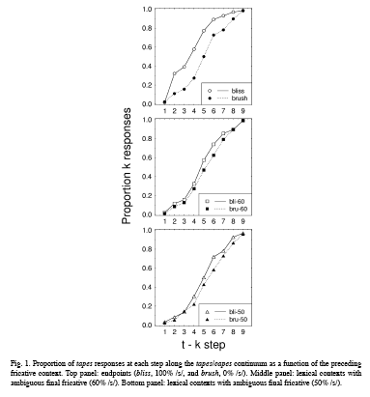
Elman & McClelland
Lexically-based compensation for coarticulation
    T/K boundary diff following /s/ and /esh/
Combined with Ganong (X is ambiguous)
    ChristmaX
    fooliX
Lexical context shifted boundary
Ongoing debate
Mirman, Holt &McClelland (JML, TICS)
Norris, McQueen & Cutler (BBS)
transitional probabilities
perceptual learning explanation

Slide 27
Outline
Early results (M-W-mid 1970s)
Early recognition and context
Cohort model (parallelism and uniqueness)
TRACE (interactive activation)
Competitors
Feedback (lexical-phonemic)
Sentence context
Sub-phonetic detail (It’s the input stupid!)
subcategorical mismatch
syllable duration
within-category variation
perceptual learning
Exemplar models
indexical information
What’s next?

Slide 28
Cross-modal priming
Early studies suggested that context was used as a late filter:
Probe right after ambiguous word:
equal priming to related and unrelated meanings
Probe delayed 200 ms or so:
priming only to contextually related meaning
The nervous double agent was certain there was a bug^ hidden^ in his room
spy
insect
spy
Zwitserlood (Cognition, 1989) Same result with gated fragments

Slide 29
Traditional view of meaning access and integration with context in spoken word recognition
Integration
elephant
Selection
Access
elephant
elevator
input
elephant

Slide 30
Traditional view of meaning access and integration with context in spoken word recognition
Integration
Reasons to reconsider:
1) Lexical ambiguity
more constraining contexts
2) Verb-based thematic constraints
Rochester: wh work
McRae and colleagues
3) Recent ERP work:
N400 effects at point where plausible cohort is ruled out
Selection
Access
input
Alternative: Continuous mapping, continuous sensitivity to the input

Slide 31


Nog nooit is een bo^{k}k ….
vs.
Nog nooit is een bo^{t}k ….

Slide 32
Dahan & Tanenhaus, 2004
Nog nooit klom een bo^{k}k ….
vs.
Nog nooit klom een bo^{t}k ….

Slide 33
Outline
Early results (M-W-mid 1970s)
Early recognition and context
Cohort model (parallelism and uniqueness)
TRACE (interactive activation)
Competitors
Feedback (lexical-phonemic)
Sentence context
Sub-phonetic detail (it’s the stimulus stupid)
subcategorical mismatch
syllable duration
within-consonant variation
perceptual learning
Exemplar models
indexical information
What’s next?
Notes:
Sucat mismatch:
Cross-splicing fromwords and non-words:
Debate about whether there are phonemes and can TRACE sim.
net
ne(k)t
ne(p)t
TRACE: bigger mismatch effects for X-spliced words than non- words but don’t see with lexical decision, but do with eye-tracking.
Syllable duration:
frequency modulates duration in corpora

Slide 34
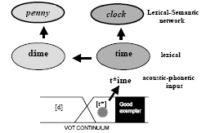
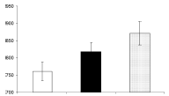
Sub-phonetic detail
Andruski, Blumstein & Burton Cognition (1994).
Mediated Priming in lexical decision task
A /t/ with a short VOT primes unrelated words via rhymes that have /d/ instead of /t/
Related Modified Neutral dime t*ime clock
or time
t*ime primes penny via dime
Notes:
Figure 2 Misiurski et al. (2005, Brain and Language 93: 64-78): poor exemplars of a word partially activate the meaning of competing words. Misiurski et al. manipulated VOT in a time—dime continuum, to create:
a good exemplar of time with long VOT
a poor exemplar of time with short VOT (t*ime), but still long enough to be identified as time
a good exemplar of dime
In a lexical decision task, dime primed the related word penny. The poor exemplar t*ime also primed penny (through dime) but the good exemplar of time did not.
(Priming is facilitation of a response due to prior experience, e.g. people are quicker to say that penny is a real word if they have recently heard its semantic relative dime.)

Slide 35
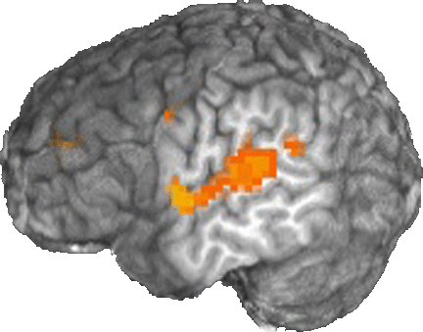
Brain activation for category boundaries
Many studies: Superior Temporal Gyrus (STG) is active when phonetic decisions are made
(+ many other areas)
STG activation does not differ when the decisions are hard (other areas do
e.g. frontal regions)
Binder et al. (2004) Nat.Neurosci. 7, 295-301
Blumstein et al. (2005) J. Cog. Neuroscience 17, 1353-1366

Slide 36
Brain activation for category boundaries: Ganong effect
STG is sensitive to change in category boundary due to lexical status: gift-kift; giss-kiss
Conclusion: lexical knowledge influences basic phonetic categorization processes
Lateral view of left brain hemisphere
Myers & Blumstein (CNS 2005)

Slide 37


Competitor looks as function of VOT
Response=
Response=
0.08
0.07
Looks to
0.06
Fixation proportion
0.05
Looks to
0.04
Category
Boundary
0.03
0.02
0
5
10
15
20
25
30
35
40
VOT (ms)

Slide 38
Is sub-categorical detail short-lived?
X
McMurray, Tanenhaus & Aslin, 2008

Slide 39
Look-contingent analysis
A
Time to fixate the target after the point of disambiguation as a function of distance from the prototype (in VOT) for voiced and voiceless targets.
Trace will not simulate with phoneme-level inhibition.
Results amenable to Bayesian approaches to cue-integration and learning

Slide 40
“Assimilation”
Gaskell & M-Wilson
  A quick run/m picks you up
    (underspecification account; complex data)
Gow
  Natural assimilation contains acoustic cues
Gow and McMurray
  Both forward and backward assimilation

Slide 41
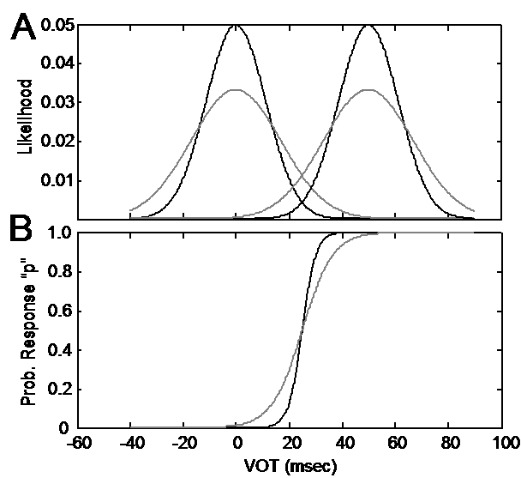
Perceptual Learning: sensitivity to distributions
If listener’s are storing probabilistic detail like this, should be continuous sensitivity to distributions--continuous perceptual learning (Bayesian mechanism)
(Clayards, Tanenhaus, Aslin & Jacobs, 2008):
Exposed people to VOTs from wide or narrow distributions

Slide 42
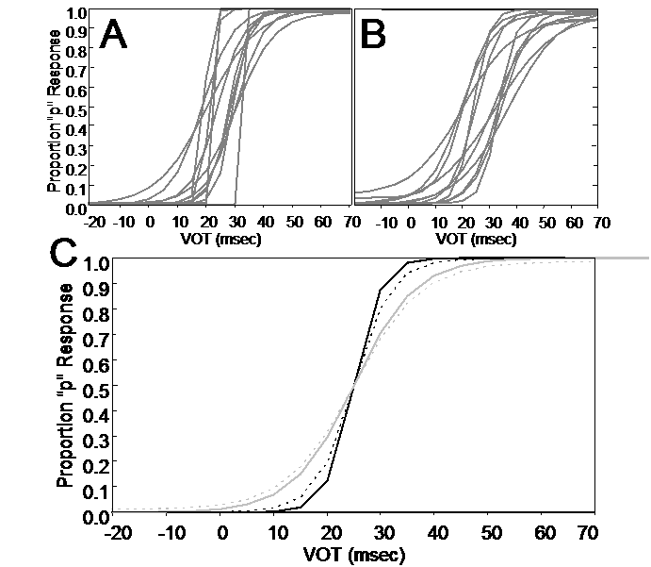
Identification functions for (A) narrow and B (wide subjects
Predicted and actual group identification functions

Slide 43
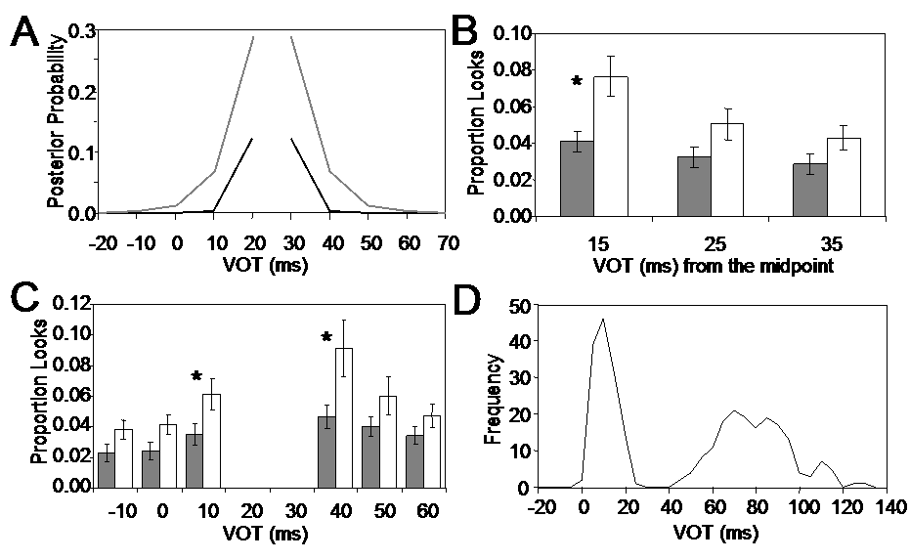
Bigger effect on “p”-side reflects effect of priors-- “p” s are more narrowly distributed than Ps in natural language stimuli.

Slide 44
Perceptual learning, shifting category boundaries
Norris, McQueen & Cutler (Cog Psychology)
lexical decision/shifted fricatives boundaries (f/s) (speaker/word specific)
Kraljik & Samuel (stops)
generalized to new speakers, new sounds sharing same feature
slow return to baseline.
Maye, Aslin & Tanenhaus (vowel e.g., wekud wetch)
generalized to new words
Kaljik, Brennan & Samuel ( (f/s)
no perceptual learning when variation attributable to other source--pencil in mouth.

Slide 45
Outline
Early results (M-W-mid 1970s)
Early recognition and context
Cohort model (parallelism and uniqueness)
TRACE (interactive activation)
Competitors
Feedback (lexical-phonemic)
Sentence context
Sub-phonetic detail (it’s the stimulus stupid)
subcategorical mismatch
vowel duration
within-category variation
perceptual learning
Exemplar models
indexical information
What’s next?

Slide 46
Initial contact
1. Phonemes vs finer-grained input.
Coarticulation
vowel-based
consonant-based (s/esh t/k)
Sub-phonetic variation:
Consonants
Blumstein & colleagues
McMurray and colleagues
Vowels (embedded words):
Salverda and colleagues
Abstract representations vs episodes.

Slide 47
Exemplar effects
Cross-speaker facilitation and inhibition
    Hear words from diff speakers
    Make lexical decisions
  Results: faster responses to same speaker
Goldinger and others (Johnson, Pierrehumbert) argue for exemplar models
Debate about time course and generality of effects
  McLennan and Luce
    (effects are late: show up for longer and low frequency words in lex decision and shadowing)
  Creel, Aslin & Tanenhaus
    Early effects with eye-tracking

Slide 48
Outline
Early results (M-W-mid 1970s)
Early recognition and context
Cohort model (parallelism and uniqueness)
TRACE (interactive activation)
Competitors
Feedback (lexical-phonemic)
Sentence context
Sub-phonetic detail (it’s the stimulus stupid)
subcategorical mismatch
syllable duration
within-category variation
Exemplar models
indexical information
What’s next?

Slide 49
What’s next?
Ideal observer models (Bayesian)
  Mechanism neutral
    Questions about units
      (lexical/sublexical)
      abstract/episodic
    Cue integration/Perceptual learning
    Coordinating with context
      Especially important for speech
    The role of noise
What information is accessed?
    Combinatory information
    Perceptual/conceptual/motor information
Sorting out where we are in the computational/algorithmic cycle

