Slide 1
Overview
Why do people study reading?
Why the focus on words?
eye movements in reading
Word recognition as reading
reading and pedagogy
sound and reading
Some basic facts about visual word recognition & acquired dyslexia
Early Models:
logogen, search, M&R
PDP and the DRC
Deep dyslexia
Role of sound in learning
Where are we now?

Slide 2
Visual word recognition and reading
People study for the following reasons:
1. reading, its development and pedagogy
2. front end of language processing system
3. testing-ground for models of attention, memory, information processing.
Recent years:
Domain for highly influential computational models, especially PDP, with concomitant debates (rules versus patterns in quasi-regular domains. e.g., language)
Early and continuing application of cognitive neuropsychology (feedback loop between acquired and developmental dyslexia and models of “normal” processes; brain-imaging studies)

Slide 3
Why the focus on words: eye movements and reading?
As we read, we shift our local attention throughout the text in word size units. (video example)
We make a saccadic eye movement to fixate each word, rarely skipping a word, except for short function words, and occasionally making multiple fixations within a word.
“Windowing” the text so that we only see word units does not dramatically interfere with reading.
With a window of 20 characters (cognitive scientists) reading is nearly as efficient as with unrestricted text.
“Preview’ effects are limited
We fixate on words because they are the central processing unit, NOT because they have spaces between them.

Slide 4
Fixation duration and patterns related to lexical variables
Frequency
Ambiguity
Contextual fit
Models of fixation patterns
1. Cognitive variables modulate fixations, affecting when we make the next saccade (Rayner and colleagues)
2. Saccade goes to next region of interest (based on low-level factors, unless there is an error signal (McConkie)
3. Rapid information estimation: compromise between two constraints: be fast and fixate long-enough

Slide 5
Distribution of fixations
225 ms
frequency
time

Slide 6
Distribution of fixations:
Expectation from standard model
low freq
high freq
225 ms
250 ms
frequency
time

Slide 7
McConkie’s results
Longest latency onset saccades cancelled
frequency
time

Slide 8
Review: Reading as Reading
Writing systems must make a trade-off between semantic transparency and expressiveness:
They ALL choose expressiveness by using an orthographic symbol, whether it be a “logograph”, a symbol for a syllable, or a symbol for a phoneme to represent a unit of sound
What role does sound play in reading?
Classic distinction:
direct access (visual to meaning)
mediated access (visual to phonological to meaning)
dual process (two routes, weighting shifts as skill increases)
What role should sound play in reading pedagogy?

Slide 9
Phonics versus “look-say”
Chall 1960s, phonics works
Meta-linguistic sound tasks correlated with early reading & reading readiness
(e.g., take the “k” out of monkey and what do you get?)
Phoneme is inaccessible linguistic unit of sound (depends on literacy, as do many other “sound judgments” (e.g. orthographic effects in rhyming)

Slide 10
Skilled reading:
Van Orden (1987), phonological effects on category decisions
Category: flower
rose (fast yes, few errors)
rows (slow no, many errors)
roze (slow no, many errors)
Masked priming:
towed/toad prime frog at short prime intervals

Slide 11
Other Basic results:
Tasks:
lexical decision (word or non-word)
naming (pronunciation aloud)
Variables: Results (naming):
frequency (piano versus viola) main effect
orth patterns (aisle versus caste) main effect
spelling-sound regularity: waste versus caste) interaction with freq***
lexicality (cave versus kave) main effect; nonwords pronounced consistently
concreteness (truck versus truth) interaction with freq
lexical neighborhoods: bone (done, one) interaction with freq,
hit (???) regularity; affects nonwords***

Slide 12
Frequency by regularity interaction in naming
irregular
regular
Naming Time
HF
LF

Slide 13
Acquired Dyslexia
Deep dyslexia (massive left hem damage):
  semantic errors:
    apple----> orange
    yacht----> boat
  visual errors:
    shoe------> shop
  mixed errors:
    sympathy-----> orchestra
Phonological dyslexia:
  Nonword naming is impaired
Surface dyslexia:
  Irregular words hard to name
    caste
  Nonwords and regular words are easy
    kave, haste

Slide 14
Early influential models
TOP
Logogen (Morton):
pattern detectors (precursor to localist connectionist models)
Search model (Forster)
(Murray and Forster, 2005)
house
scallop
turnip
the
and
but
Interactive activation
McClelland and Rumelhart
TOP
words
Word superiority:
Letter better detected in a word than a non word
T
letters
features

Slide 15
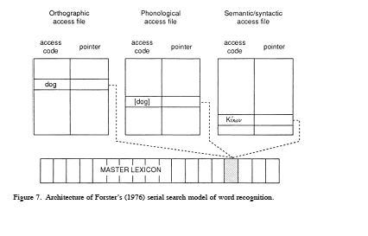

Slide 16
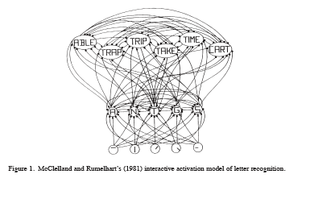

Slide 17
Pronunciation Models
Dual Route Model
Spelling-sound rules to assemble phonology
Direct access through orthography to retrieve "addressed phonology"
  Brain damage can result in lesions to either route (surface vs phonological dyslexia
  A child with phonological problems may have difficulty with the spelling-sound route.

Slide 18
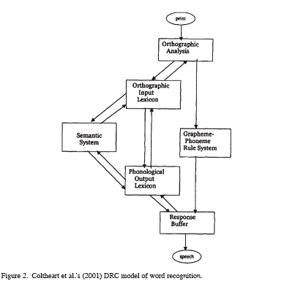

Slide 19
Neighborhood effects
Frequency effects
Orthographic lexicon
addressed phonology
phonology
Assembled phonology
Output
Visual processing
Spelling-sound rules
Freq by reg due to race
Non-word effects
input

Slide 20
Phonological dyslexia
Orthographic lexicon
addressed phonology
phonology
Assembled phonology
Output
Visual processing
Spelling-sound rules
input

Slide 21
Surface dyslexia
Orthographic lexicon
addressed phonology
phonology
Assembled phonology
Output
Visual processing
Spelling-sound rules
input

Slide 22
Problems:
What are the rules?
    “Neighborhood” effects for non words
    Why are phonological codes accessed in skilled reading?
    Why is there a correlation between phonological impairment and reading?
Orthographic lexicon
addressed phonology
phonology
Assembled phonology
Output
Visual processing
Spelling-sound rules
input

Slide 23
100
DRC model
Interactive activation
100
Orthographic lexicon
addressed phonology
phonology
Mapping rules: serial output:“whammies” Truth, Pruth
Assembled phonology
Output
Visual processing
Spelling-sound rules
Non-word effects
input

Slide 24
Seidenberg & McClelland Model:
“Triangle Model”
context
semantics
HU
HU
orthography
HU
phonology

Slide 25
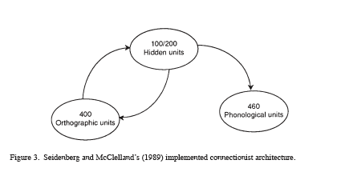
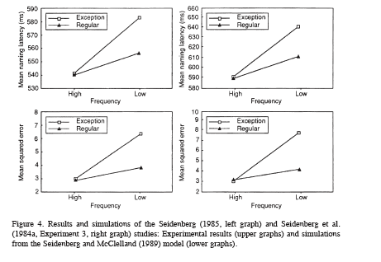

Slide 26
Neural Network learns mapping from spelling to sound:
distributed representation of phonemes
distributed representation of letters
    Simulates freq, freq by reg interaction, non-word reading with no rules (degree of learning)
    Too few hidden units lead to surface dyslexia.
    Performs badly on non words (poor representations)
    Degraded phonological representations make it like a phonological dyslexic

Slide 27
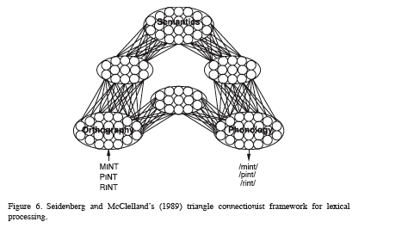

Slide 28
Deep Dyslexia:
(Hinton, Plaut & Shallice)
    semantic errors
      apple read as orange
    visual errors
      sympathy read as symphony
    mixed errors
      sympathy read as orchestra
    syntactic class effects
      nouns<verbs<adjectives<function words
    concreteness effects
    nonwords badly impaired

Slide 29
Hinton, Plaut & Shallice
semantics
HU
HU
orthography
HU
phonology

Slide 30
Hinton, Plaut & Shallice
semantics
hard to learn
HU
HU
orthography
HU
phonology
easy to learn

Slide 31
Hinton, Plaut & Shallice
Clean-up
semantics
hard to learn
HU
HU
orthography
HU
phonology
easy to learn

Slide 32
Representational space for semantic units
opera
orchestra
symphony
sympathy
house

Slide 33
Semantics and Division of Labor:
Harm & Seidenberg (2004)
semantics
orth-phon-sem
orth-sem
HU
HU
orthography
HU
phonology

Slide 34
Can one relate PDP models to the brain?
Two major circuits involved in normal reading.
Dorsal parietotemporal system (orth-phon-sem):
angular gyrus, supramarginal gyrus, posterior portions of the superior temporal gyrus.
Ventral occipitotemporal system (orth-sem):
Portions of middle temporal gyrus and middle-occipital gyrus.

Slide 35
Rules versus patterns
Dual route: exceptions are patterns, regulars learned/processed by rule
PDP approach: division of labor among multiple systems; no rule versus pattern distinction
Past-tense
pick/picked, lick/licked, hit/hit; goes/went
Pinker & colleagues (Marcus, Ullman)
two systems: rule and pattern association
frequency affects exceptions not regulars
Seidenberg and colleagues: same as spelling-sound regularity:
linguistic subsystems are “emergent properties”

