Slide 1
Dealing with people who will not learn
Dave Kleinschmidt
BST 413 // May 1, 2013

Slide 2
Background
How do task and training interact in learning?

Slide 3
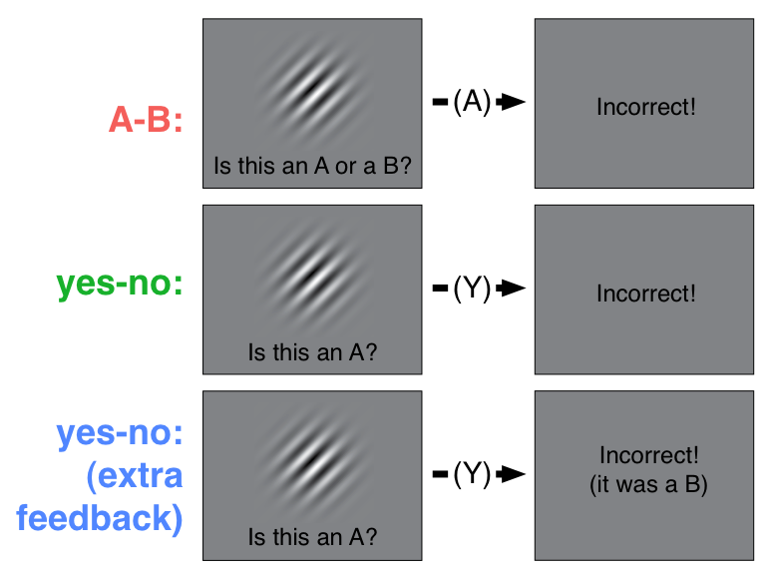
Training

Slide 4
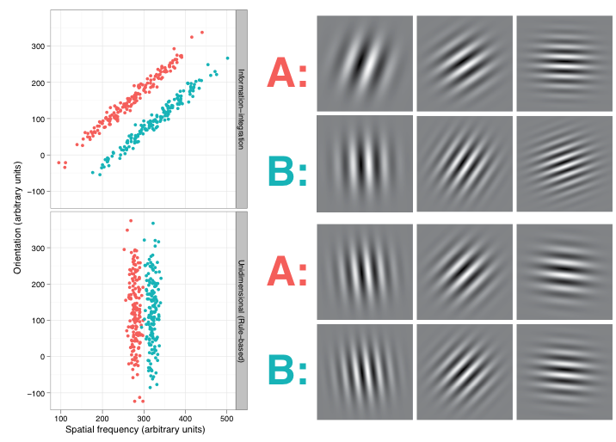
Tasks
II
RB

Slide 5
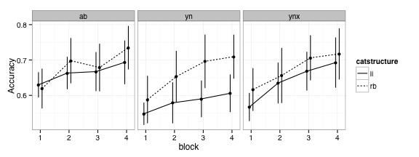
Data
Notes:
What we’re interested in is how well and how quickly people learn in these different conditions. In particular, we’d like to be able to say which of these combinations of conditions produce better learning, which is commonly done in this field using ANOVA or other regression-based techniques.

Slide 6
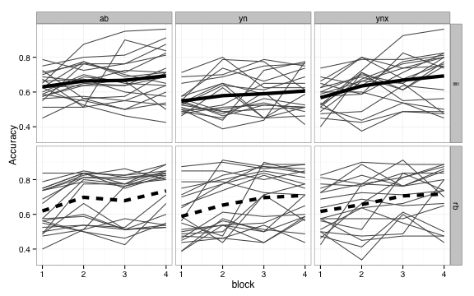
Notes:
Now typically, the standard ANOVA analysis assumes that the data are normally distributed, but clearly they are not normally distributed here. There seems to be a large number of subjects who simply to not show any learning, performing at chance accuracy throughout.

Slide 7
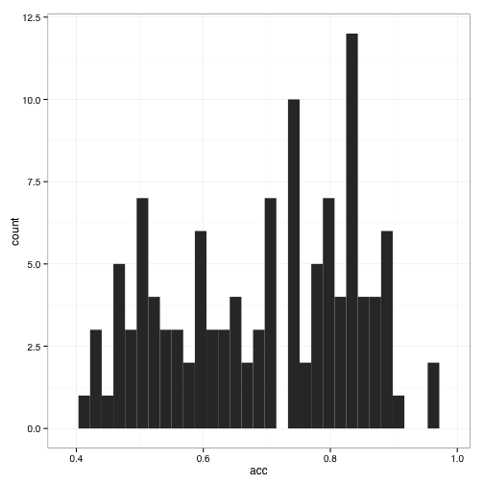
Notes:
If we look at the overall distribution of final-block accuracy, it’s highly bimodal.

Slide 8
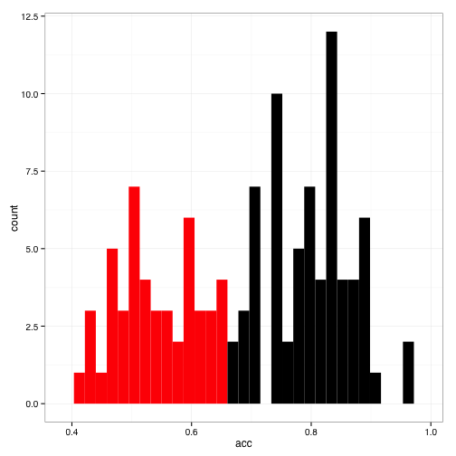
Notes:
Some people in this field have suggested throwing out data from subjects with accuracies below 65%. This pretty cleanly splits the two groups, but there are some problems.

Slide 9
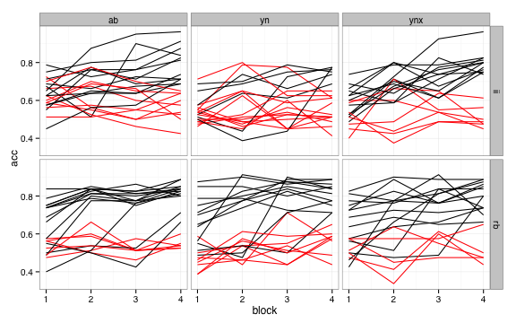
Notes:
Most notably, in some conditions, you’d be throwing out nearly all the subjects, and in many cases there isn’t a clear bimodality between learners and non-learners. Also, this approach ignores the fact that some conditions might produce more non-learners than others, which is as theoretically interesting as how well people learn when they catch on.

Slide 10
Questions
What are the effects of experimental conditions on who learns?
On how well/fast they learn?
Notes:
There’s uncertainty about both of these issues, given limited and noisy data, so a bayesian approach is well suited to this problem.

Slide 11
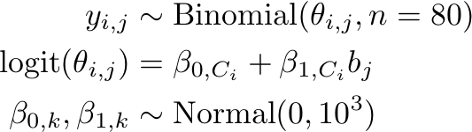
LEARNING CURVE MODEL: BAYESIAN LOGISTIC REGRESSION
Notes:
The second question is modeled using a straightforward logistic regression model, where the number of successful trials (out of 80) in block j for subject i are modeled as a…

Slide 12
FIT USING GIBBS SAMPLING (JAGS/BUGS)
model {
for (c in 1:Ncond) {
intercept[c] ~ dnorm(0, 1e-3)
slope[c] ~ dnorm(0, 1e-3)
for (block in 1:Nblock) {
logit(theta[block, c]) <- intercept[c] + slope[c] * (block - Nblock/2 - 0.5)
}
}
for (subj in 1:Nsubj) {
for (block in 1:Nblock) {
y[subj, block] ~ dbinom(theta[block, cond[subj]], n[subj, block])
}
}
}
Notes:
Using the JAGS package inference in this model is done very simply using Gibbs sampling. 3 chains, 1000 samples each, checked convergence via Rhat

Slide 13
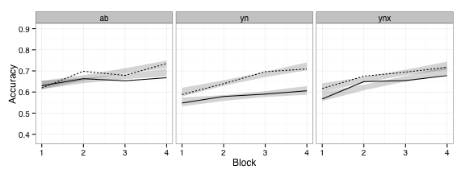
Logistic regression fits
Notes:
Here are the learning curves, with the 95% posterior predictive intervals from the logistic regression

Slide 14
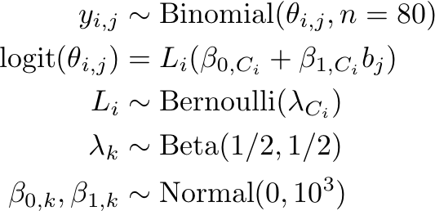
Modeling Non-learners
Notes:
How

Slide 15
FIT USING GIBBS SAMPLING (JAGS/BUGS)
model {
for (c in 1:Ncond) {
# regression parameters
intercept[c] ~ dnorm(0, 1e-3)
slope[c] ~ dnorm(0, 1e-3)
for (block in 1:Nblock) {
logit(theta[block, c]) <- intercept[c] + slope[c] * (block - Nblock/2 - 0.5)
}
# learner rate
learnerRate[c] ~ dbeta(0.5, 0.5)
}
for (subj in 1:Nsubj) {
# sample non-learner index
Learner[subj] ~ dbern(learnerRate[cond[subj]])
for (block in 1:Nblock) {
x[subj, block] ~ dbinom(theta[block, cond[subj]] * Learner[subj] +
0.5 * (1-Learner[subj]),
n[subj, block])
}
}
}

Slide 16
Logistic regression fits

Slide 17
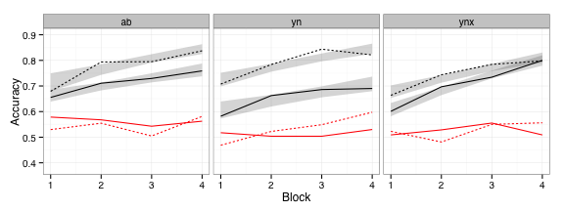
Logistic regression + non-learners fits

Slide 18
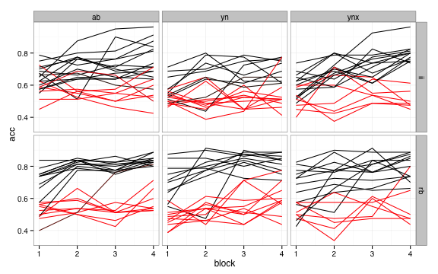
Notes:
Here are the individual subjects data, color coded according to the probability they are classified as a learner. Looks pretty similar to what we saw before with the 65% cutoff, with some important exceptions

Slide 19
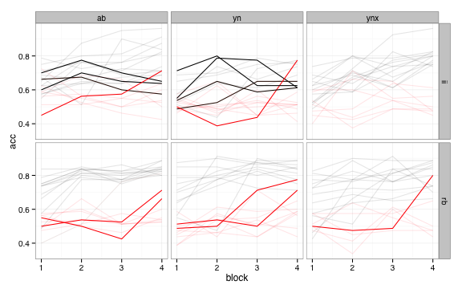
Notes:
Note that there are BOTH kinds of disagreements: subjects in conditions where learning is generally poor are classified as learners even though they have low final block accuracies. More problematically, subjects who have high final block accuracies but low otherwise are classified by this model as non-learners.

Slide 20
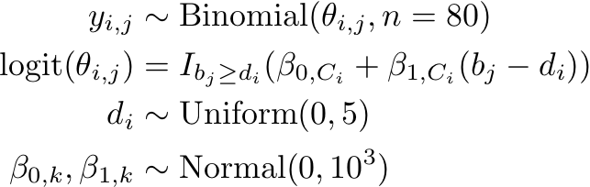
Modeling delayed learners
Notes:
Can refine the model by using a learning DELAY instead of a simple binary classification. The delay goes from 0 to 5; anything over 4 is the same as a non-learner in the last model

Slide 21
FIT USING GIBBS SAMPLING (JAGS/BUGS)
model {
for (c in 1:Ncond) {
# regression parameters
intercept[c] ~ dnorm(0, 1e-3)
slope[c] ~ dnorm(0, 1e-3)
}
for (subj in 1:Nsubj) {
delay[subj] ~ dunif(0, Nblock+1)
for (block in 1:Nblock) {
logit(theta[subj, block]) <- (intercept[cond[subj]] +
slope[cond[subj]] *
(block-Nblock/2-0.5-delay[subj])
) * (block > delay[subj])
# sample succeses
y[subj, block] ~ dbinom(theta[subj, block], n[subj, block])
}
}
}

Slide 22
Logistic regression + non-learners fits

Slide 23
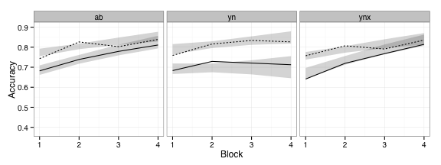
Logistic regression + Delayed learners fits
Notes:
Here’s the results from the delayed learner fits, plotted with data from people who were classified as starting learning in the first block. Note that the overall accuracy for learners goes up, and the slopes flatten out a bit. This suggests that what would have been interpreted as gradual learning might really be due to the fact that people jump from chance to relatively high accuracy rather abruptly.

Slide 24
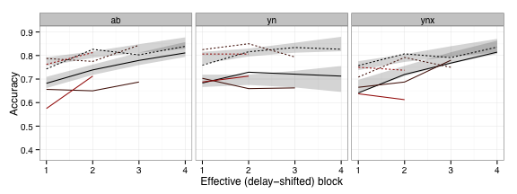
Logistic regression + Delayed learners fits
Notes:
Grouped by (rounded) delay and plotted with the shifted block (b_j – d_i)

Slide 25
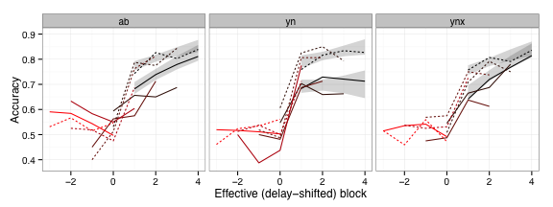
Logistic regression + Delayed learners fits
Notes:
And here’s the same plot showing the non-learning blocks, too. You can see that in most cases there’s a pretty sharp increase in accuracy once learning is said to begin by the model.

Slide 26
Conclusions
Bayesian data analysis provides flexible tools for understanding behavioral data
Capture effects of non-learners in a sensible way

