Slide 1
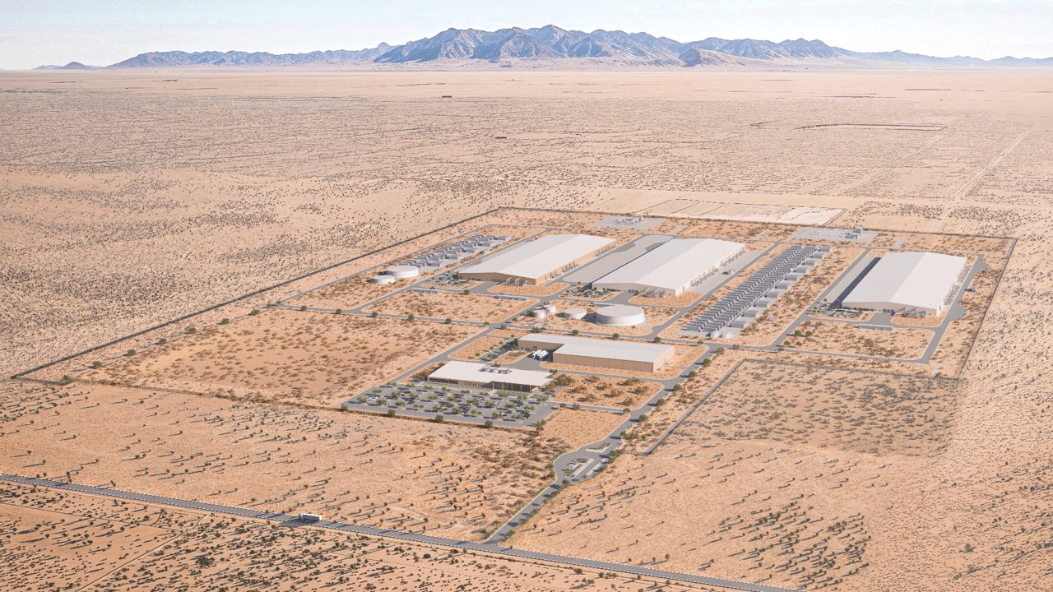
Critical Vibe Coding
Session 01 — Welcome & landscape
Meta El Paso data-center campus (press / Contentstack CDN) — teaching use; see ATTRIBUTION.md
Notes:
Part B classroom input after outdoor check-in.
Priority airtime: Block 2 (technical), Block 3 (visions/fears/regulation), Block 4 (bubble).
Q&A after each block. Source: course/lectures/01-welcome-landscape-lecture.md

Slide 2
Block 1 — Scope · ~4 min
Two tracks. Neither optional.
Technical — leave with a working personal agent setup
Critical / shared space — fears, hopes, authorship, labour, ecology
Third thread: the agent as interface (skills, tools, knowledge as material)
Notes:
Ask: Who came mostly for the install, who mostly for the politics?
Midpoint (s9): demo + short proposal. Final (s13): architecture + one use + reflection.
Neither track is optional.

Slide 3
Block 2 — What LLMs and agents are · ~12 min · high priority
Model ⊂ Product ⊂ Agent
Keep this vocabulary all semester
Model — trained network, tokens → tokens (weights on disk / GPU)
Product / chat — UI + safety + memory + billing around a model
Agent — loop that calls tools, reads/writes files, follows skills
Chat answers. An agent acts — with your permission and tools.
Notes:
Examples: Llama/Qwen/Claude model; ChatGPT/Claude.ai product; Hermes/Cursor Agent/Claude Code as agents.
Q: Where is authorship if the agent writes half the patch?

Slide 4

Training → inference
Fluent continuation is not truth
HPC data center — U.S. Department of Energy / public domain
Notes:
verified fact / teaching model (simplified):
1 Training — next-token prediction; parameters store regularities, not a fact database.
2 Inference — prompt tokenized; the model samples a continuation.
3 Context window — working memory of this call.
4 Hallucination — fluency ≠ truth; agents worsen this if they write files without verify.
Good at: draft, translate formalisms, summarize, structure, boilerplate.
Bad alone: ground truth, long-horizon accountability, unstated artistic intent.

Slide 5
Block 2 — Context
Context is finite
Longer context = more compute per turn = more € and watts
A 200-page vault does not fit in every call
Pattern: small schema + index + pull only relevant pages
That is the LLM Wiki habit (Karpathy gist) — Session 02 deepens it
Notes:
English ≈ 0.75 words/token; code denser.
Why agents need files: overflow forces drop or summarize.
Image alternative if wanted: sticky-notes overflow (03) — keep typographic for calm Scandinavian beat.

Slide 6
Block 2 — Preview (architecture = Session 02)
Tools · Skills · MCP · Harness
Filesystem tools — read/write a vault (enough for a wiki)
Skills — written procedures the agent should follow
MCP — protocol so an agent can call other apps as tool kitchens
Harness — everything that is not the model
Metaphor: waiter (host) / kitchen (MCP server) / dish (result)
Notes:
Point to what-is-mcp / what-is-harness. Deep architecture next class.
Q: Has anyone used an agent that edits files, not only chat?

Slide 7
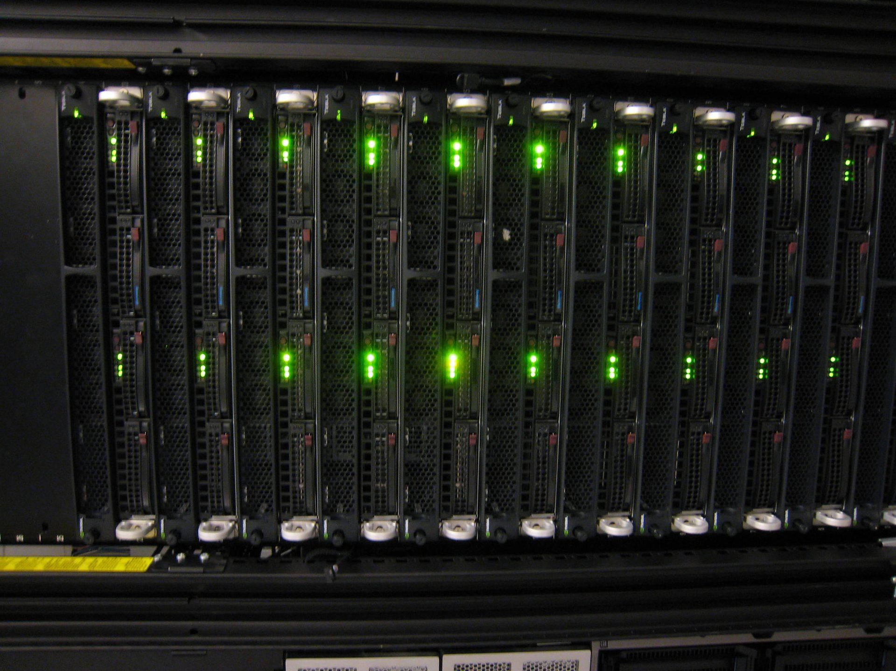
Local vs cloud
Privacy, lock-in, hardware cost — one slide
Tesla / NVIDIA GPU cluster — ChrisDag / CC BY 2.0
Notes:
Cloud API: strong models, little hardware — lock-in, logging, price, jurisdiction.
Local weights: privacy, offline, cost control, political choice — hardware €, ops, weaker unless you invest.
Deep dive: research/local-gpu-hardware-for-llms · sessions 3 + 10.

Slide 8
Block 3 — Drivers, visions, fears, regulation · 10–15 min · high priority
Why now?
CLAIM · political-economy frame
CLAIM — next growth platform after PC → internet → mobile
Data and compute were already ready; race incentives matter
Script: course/visions-fears-regulation — four beats only
Do not teach the EU AI Act here — point to eu-ai-act-and-datenschutz
Notes:
Primary script: course/visions-fears-regulation.
Beat 1 Drivers (Coxon): growth treadmill + data/compute + race — not “we asked for utopia.”
Technical scaling is real and parallel to the money story.

Slide 9
Block 3 — Two industry stories
Abundance rhetoric
Existential risk rhetoric
UBI / UHI talk, “age of abundance”
Real discourse — not delivered policy
Musk, Altman, Ismail responses
Loss of control, misuse, race under-funds safety
Same industry scene often carries both stories
Credibility problem if both are sold at once
Notes:
Lecture frames positive sci-fi futures vs doom futures as industry discourse — keep serious.
Utopia rhetoric (UBI/UHI, abundance) is real discourse, not a funded social contract.
Same scene also sells existential risk. Stewart: pick a lane / credibility problem.
This course spends more time on the social/institutional fear stack (labour, lock-in, ecology).
Clips (teacher): Coxon Daily Show; Stewart monologue — paths in visions-fears-regulation.

Slide 10
Block 3 — Amplifier vs power
Who owns the gain knob?
Ismail: AI as amplifier — useful language
Social science: not neutral; amplifies hierarchy; feedback loops
A tutor-bot for a student ≠ a hyperscaler with weights, cloud, and lobbying
“Depends how you use it” is incomplete for platforms that reorganise labour and grids
Notes:
Ismail amplifier / fire metaphor — then complicate with Crawford / Zajko.
Class line: Amplifier is useful if you always ask who owns the gain knob.

Slide 11
Block 3 (+6) — Regulation
Uses and data — not mathematics
OPEN QUESTION for the room
Regulation can constrain uses, liability, data, markets
It cannot put the maths back in the bottle
Watch credibility marketing: safety theatre + fundraising
Law orientation: course/eu-ai-act-and-datenschutz (not taught in this hour)
Notes:
Beat 4 from visions-fears-regulation. Folded from Block 6 per lecture.md.
Ask: what would a credible local rule look like for your studio practice?
GDPR stays in parallel with the AI Act — verified fact from DSB position in the law note.

Slide 12
Block 4 — Economic background · 10–12 min · high priority
Bubble does not mean useless technology
THESIS · research/ai-bubble-productivity-datacenter
1 Financial bubble — investors overpay / lose money
2 Productive investment boom — overbuild can leave usable infra (Perez…)
3 Technological dead end — infra ages into scrap
Open question: end-user demand once circular loops are stripped out?
Notes:
Core sentence: speculative finance, circular investment, and REAL infrastructure can coexist.
Q: If investors lose money but GPUs remain, who benefited?

Slide 13
Block 4 — Circularity · verified fact · BIS Bulletin 137 (1 Oct 2026)
28.7%
of AI firms’ investment deal value (2021–25) targeted other AI firms
55.2% incoming from other AI firms
46.4% of AI-to-AI deal value also had supplier–customer links
Interdependence is not proof that all demand is fake.
Notes:
Quote three BIS bullets; source aloud.
Tooze (Chartbook / Ones and Tooze Ep. 250 clipping): skeptical political-economy — concentrated capex, codependent hyperscalers.
Q: Where does your ChatGPT subscription sit in that circular diagram?

Slide 14
Block 4 — Productivity and ecosystems
Modest macro effect — contested timing
Acemoglu: nontrivial but modest macro GDP effect over ~10 years (~1% order) vs 7%+ consultancy headlines
Serious economists disagree on magnitude and timing — not “AI does nothing”
US hyperscalers — capex race, closed APIs, CUDA, private credit into data centres
Chinese open-ish weights — fast release, exportable weights
EU / academic — hosting jurisdiction; say clearly if students cannot use campus AI
Notes:
Update Austrian academic AI access sentence before class (academic-ai-austria).
Vault clipping: A new look at the economics of AI (Acemoglu / MIT Sloan).

Slide 15
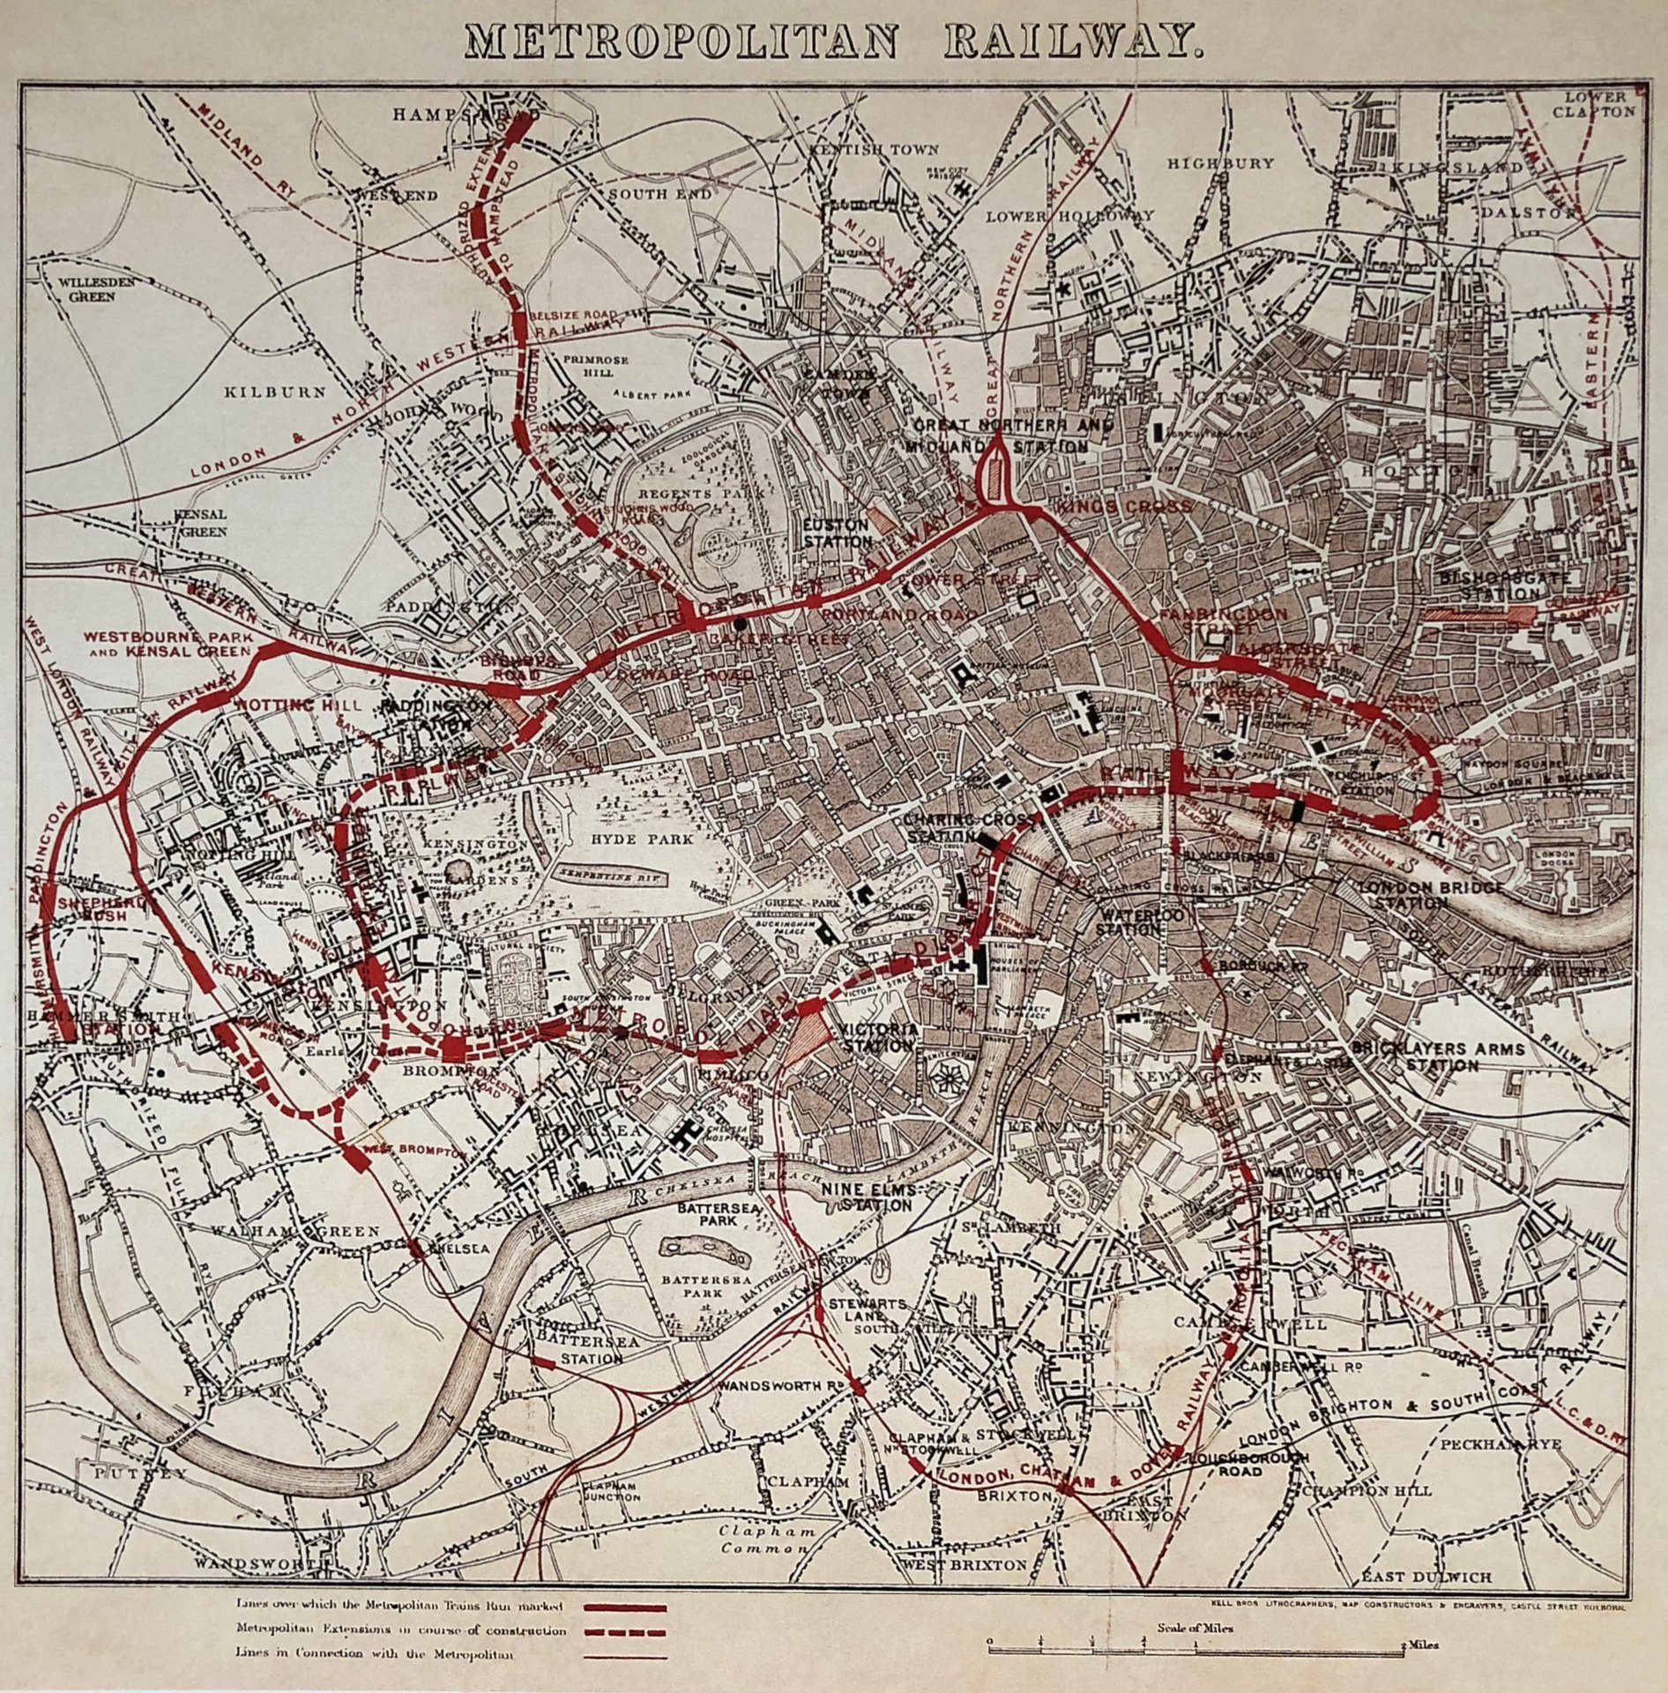
Productive bubbles leave tracks
Installation phases can outlive the speculation
Metropolitan Railway map, c. 1867 — public domain
Notes:
Perez / DeLong / Takshashila: overbuild can still leave usable infrastructure.
Contrast with technological dead end. Bridge to ecology / real build-out next.

Slide 16
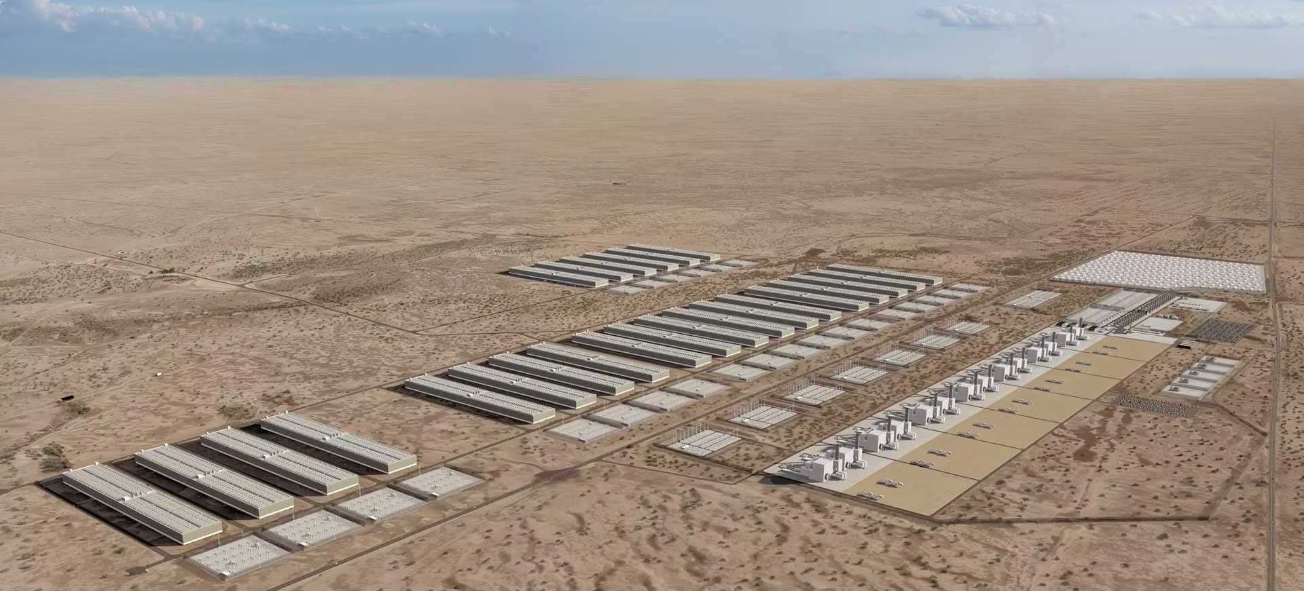
Real build-out at campus scale
Ecology seed · local grids, water, emissions, neighbours — deep dive Session 11
GW Ranch render — via heise online (Amazon / Pacifico Energy AI campus + gas generation, Texas) · ATTRIBUTION.md
Notes:
PROMINENT image (Sebastian). GW Ranch: off-grid gas generation planned for hyperscale AI — Heise reporting on Amazon/Pacifico plans in Texas.
Use as scale + ecology bridge: training vs inference; students mostly inference; still scales with tokens/video.
US ~45% of global DC electricity (IEA 2024). Name water/land/grid/who lives next door — no scopes 1–3 lecture here.
Space data centres: hype contrast only.
Research: data-centers-energy-ecology-economy · Session 11.

Slide 17
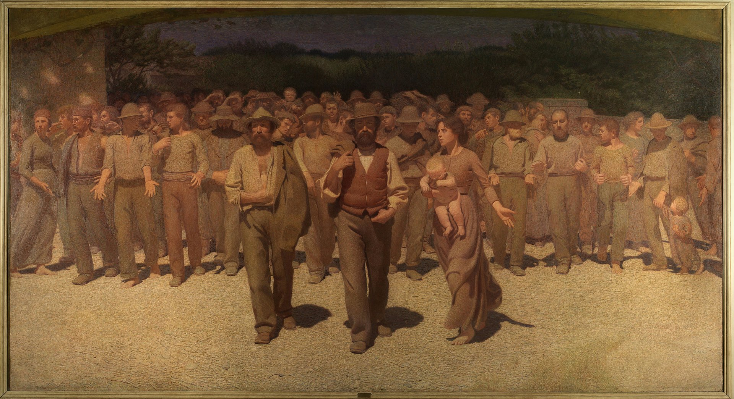
Who trains / who clicks / who owns?
Labour question — not a GDP headline
Pellizza da Volpedo, Il Quarto Stato (1901) — public domain
Notes:
Separate macro claims (IMF/McKinsey) from observed creative freelance shifts and student anxiety.
Ghost work: annotation, moderation, eval farms — Session 10.
Acemoglu: inequality/welfare can move differently from GDP.
Jobs seed only: rising tide + early-career canary — research/ai-jobs-rising-tide-productivity.

Slide 18
Block 7 — Media-art workflows · ~5 min
Speed · flattening · authorship · interface · refusal
More iterations — less sitting with a bad idea
Taste flattening — same generative look, same helpful prose voice
Authorship — who signed the work if the agent wrote the patch?
New interfaces — agent + wiki + MCP as the piece (Session 05)
Refusal — knowing when not to use AI is a skill (Session 11)
Notes:
Link outdoor Part A themes back. Prefer own installation photos when available.
Block 6 regulation already covered inside Block 3.

Slide 19
Block 8 — Default setup · ~5 min
Obsidian · Hermes · Wiki habits
1 Knowledge store with phone sync (default Obsidian; alternatives OK)
2 Hermes Agent pointed at that vault
3 Harness + LLM Wiki habits — next class
4 Models: whatever you already pay for / can access
Homework: note LLM access · optional Karpathy gist · course materials
Notes:
Repeat homework aloud. Student share pack, not whole vault.
howto-obsidian-setup-and-sync · howto-hermes-setup · llm-wiki-standard-files.
Next: harness after a student humanities input.

Slide 20
Close
What stays with you from Part A?
Bring one fear and one hope into the stack
Open questions feed later input nodes
11:55–12:00 — homework and close
Notes:
Collect open questions. Do not race leftover blocks — priorities were #2, #3, #4.

