Slide 1
Bad Coding Style
Sharer: Klen
Sharing Date: 30 June 2020

Slide 2
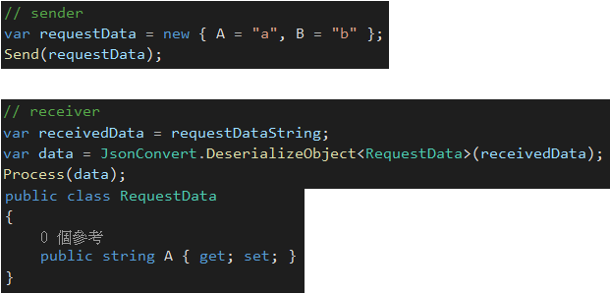
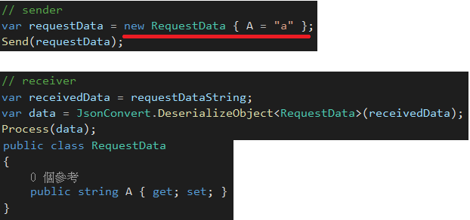
Inconsistent data structure
Bad
Good
Notes:
In our current projects, there were many application sent a request to the other api service. But they used different request data structure between both side. It will let project to be difficult to maintain and it's easy to be confused.
It's better to define a common structure for the request data.

Slide 3
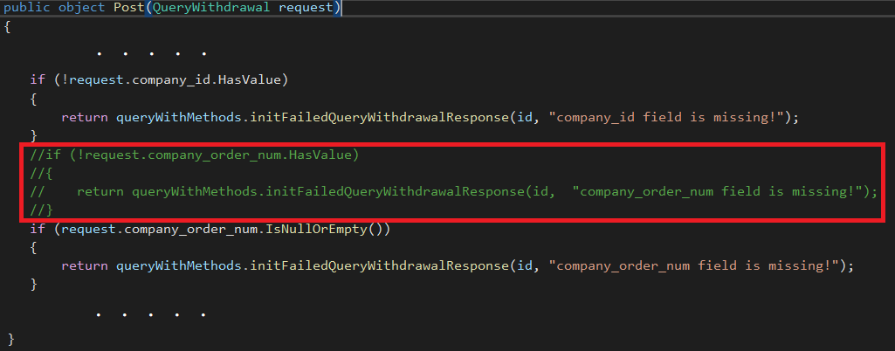
Useless code
Bad
Good
Just delete the useless code
Notes:
We can see many useless code that are remarked and kept in our projects.
It will cause the project to be very dirty.
We should use source control tool to keep every version of code, such as Git, SVN, TFS...etc.

Slide 4
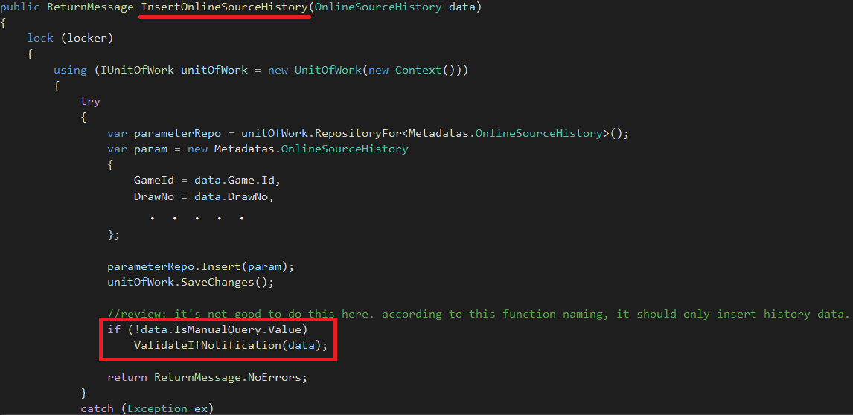

Violate SRP
Bad
Good
We should callback the validate function out of function to make every function have unique responsibility
Notes:
SRP: Single Responsibility Principle. It means object should only have one responsibility at the same time.

Slide 5
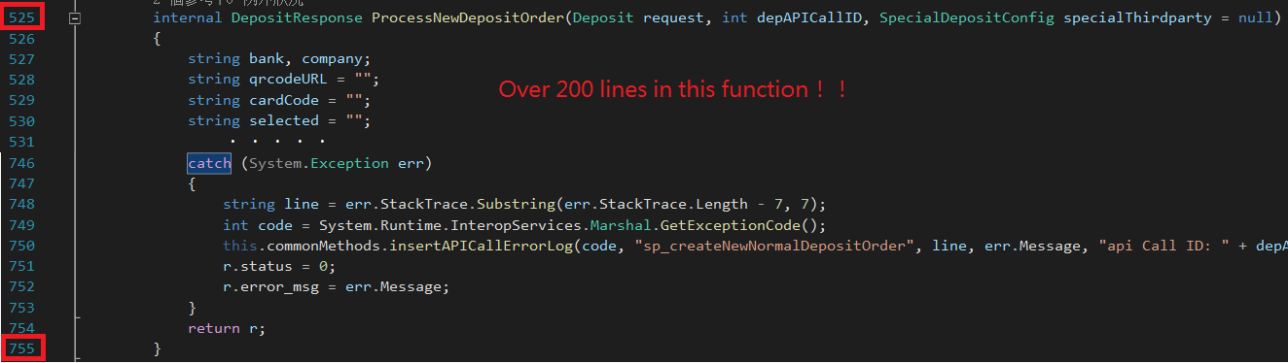
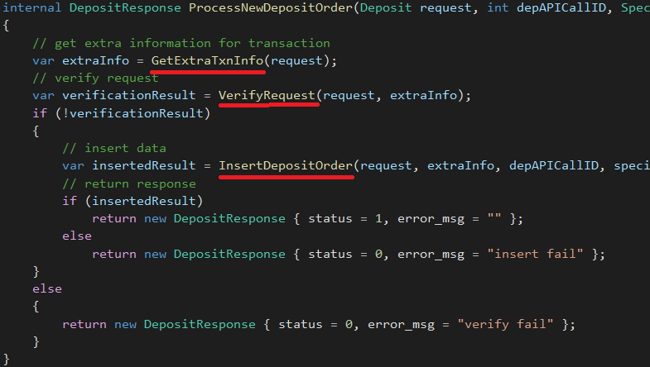
Lengthy function
Bad
Good
Break big function to small functions. Such as
Notes:
To separate to small functions will be easy to read the code.

Slide 6
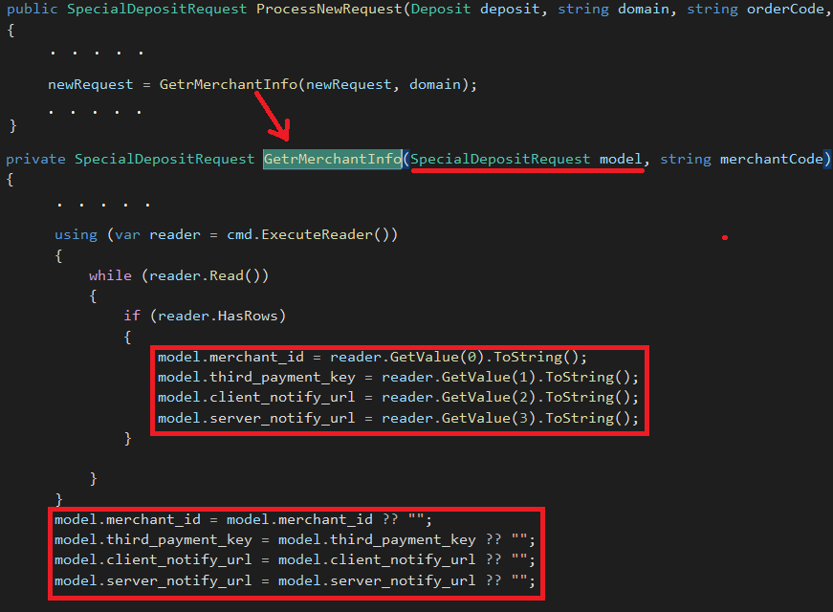
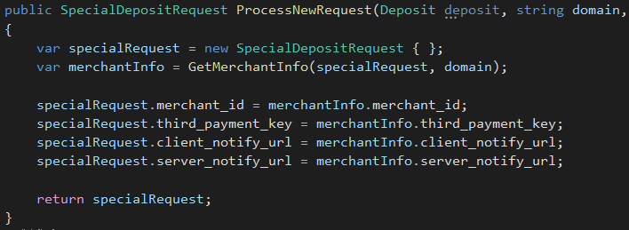
Modify property of input parameter
Bad
Good
Notes:
It's not good to modify properties value of reference type input parameter. If the function is provide to other developer and we only give them dll file. Then it's really hard to notice the property value already be changed after callback the function.
Because dll file cannot run the code step by step. So this is a bad coding style.

Slide 7
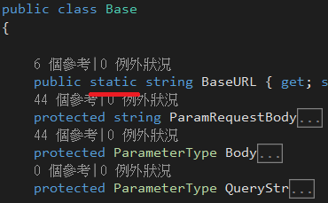
Abuse static keyword
Bad
Good
If the class is a common class and many functions may change the property value, such as BaseURL, this property should not be static. If it's static, it may cause one error is one function change the URL value while the other function is using this object.
Notes:
There is a terrible design in EC project. Static keyword was abused.
We should understand how static work and use it in right place.

Slide 8
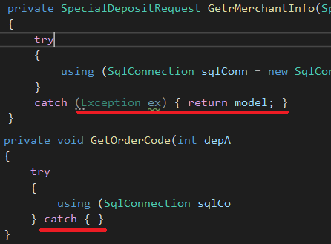
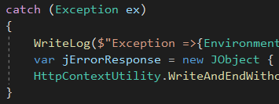
Exception handle
Bad
Good
Notes:
The exception should be recorded.

Slide 9
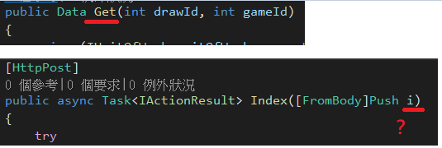
Bad naming
Bad
Good
Get what and i ?
Should use a meaningful naming
Notes:
Naming should be meaningful and easy to understand.

Slide 10
Naming rules - pascal, camel
Namespace – pascal
Class – pascal
Property – pascal
Method – pascal
Interface – Start with I and pascal
Enum – pascal
Field – camel
Local parameter – camel
Readonly and const field – pascal
Function input – camel
Delegate and Event – pascal
Notes:
Pascal => such as GetName
Camel => such as getName

Slide 11
End

